Slide 1


A Spectral Clustering Approach to Optimally Combining Numerical Vectors with a Modular Network
Motoki Shiga, Ichigaku Takigawa,
Hiroshi Mamitsuka
Bioinformatics Center, ICR, Kyoto University, Japan
KDD 2007, San Jose, California, USA, August 12-15 2007
1

Slide 2
Table of Contents
Motivation
Clustering for heterogeneous data
(numerical + network)
Proposed method
Spectral clustering (numerical vectors + a network)
Experiments
Synthetic data and real data
Summary
2

Slide 3
Heterogeneous Data Clustering
Heterogeneous data : various information related to an interest
Ex. Gene analysis : gene expression, metabolic pathway, …, etc.
Web page analysis : word frequency, hyperlink, …, etc.
Gene expression
Numerical
Vectors
k-means
SOM, etc.
#experiments = S
Gene
S-th value
1
3
To improve clustering accuracy, combine numerical vectors + network
2
…
1st expression value
metabolic
pathway
5
4
Network
Minimum edge cut
Ratio cut, etc.
6
7
M. Shiga, I. Takigawa and H. Mamitsuka, ISMB/ECCB 2007.
3

Slide 4
Related work : semi-supervised clustering
・Local property
Neighborhood relation
-must-link edge, cannot-link edge
・Hard constraint (K. Wagstaff and C. Cardie, 2000.)
・Soft constraint (S. Basu etc., 2004.)
- Probabilistic model (Hidden Markov random field)
Proposed method
・Global property (network modularity)
・Soft constraint
-Spectral clustering
4

Slide 5
Table of Contents
Motivation
Clustering for heterogeneous data
(numerical + network)
Proposed method
Spectral clustering (numerical vectors + a network)
Experiments
Synthetic data and real data
Summary
5

Slide 6
Spectral Clustering
L. Hagen, etc., IEEE TCAD, 1992., J. Shi and J. Malik, IEEE PAMI, 2000.
1. Compute affinity(dissimilarity) matrix M from data
2. To optimize cost
J(Z) = tr{Z^{T} M Z} subject to Z^{T}Z=I
where Z(i,k) is 1 when node i belong to cluster k, otherwise 0,
Trace optimization
compute eigen-values and -vectors of matrix M
by relaxing Z(i,k) to a real value
e₂
Each node is by one or more
computed eigenvectors
Eigen-vector e₁
3. Assign a cluster label to each node ( by k-means )
6

Slide 7

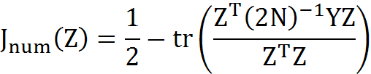
Cost combining numerical vectors with a network
Cost of numerical vector
network
cosine dissimilarity
What cost?
N : #nodes,
Y : inner product of normalized numerical vectors
To define a cost of a network,
use a property of complex networks
7

Slide 8
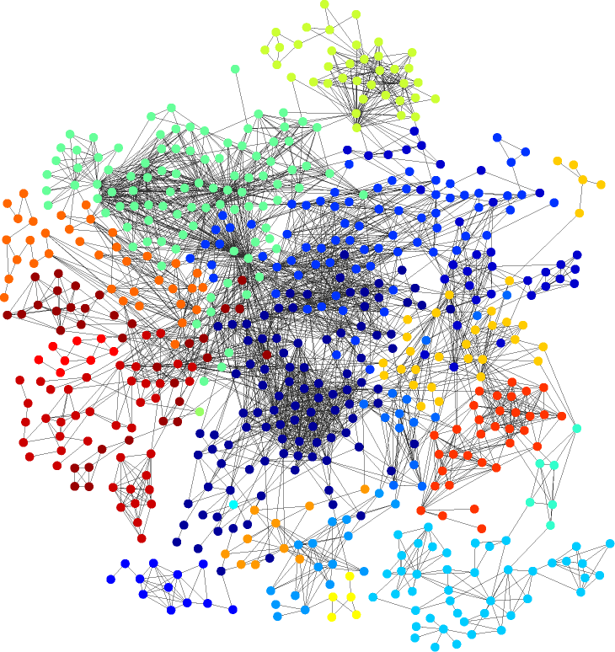
Complex Networks
Ex. Gene networks,
WWW,
Social networks, …, etc.
Property
Small world phenomena
Power law
Hierarchical structure
Network modularity
Ravasz, et al., Science, 2002.
Guimera, et al., Nature, 2005.
8

Slide 9
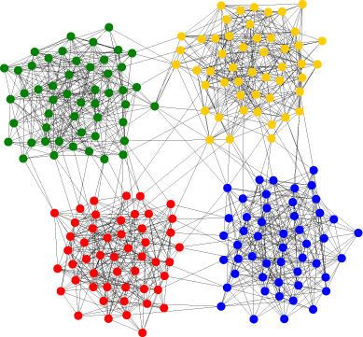
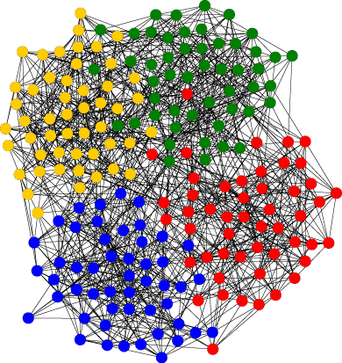
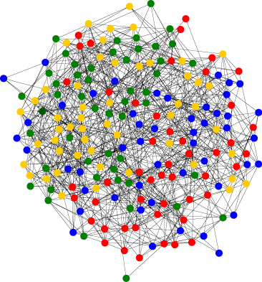
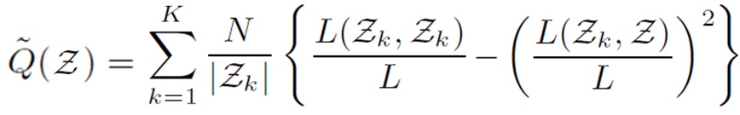
Normalized Network Modularity
= density of intra-cluster edges
High
Low
# intra-edges
# total edges
normalize by cluster size
Z : set of whole nodes
Z_{k} : set of nodes in cluster k
L(A,B) : #edges between A and B
Guimera, et al., Nature, 2005., Newman, et al., Phy. Rev. E, 2004.
9

Slide 10
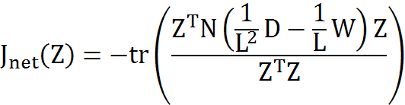


Cost Combining Numerical Vectors with a Network
Cost of numerical vector
network
Normalized modularity
(Negative)
cosine dissimilarity
M_{ω}
10

Slide 11



Our Proposed Spectral Clustering
for ω = 0…1
Compute matrix M_{ω}=
To optimize cost J(Z) = tr{Z^{T} M_{ω} Z} subjet to Z^{T}Z=I ,
compute eigen-values and -vectors of matrix M_{ω} by
relaxing elements of Z to a real value
Each node is represented by K-1 eigen-vectors
Assign a cluster label to each node by k-means.
(k-means outputs in spectral space.)
e₂
e₁
end
e₂
is sum of dissimilarity
(cluster center <-> data)
・Optimize weight ω
x
x
Eigen-vector e₁
11

Slide 12
Table of Contents
Motivation
Clustering for heterogeneous data
(numerical + network)
Proposed method
Spectral clustering (numerical vectors + a network)
Experiments
Synthetic data and real data
Summary
12

Slide 13
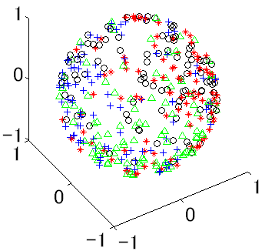
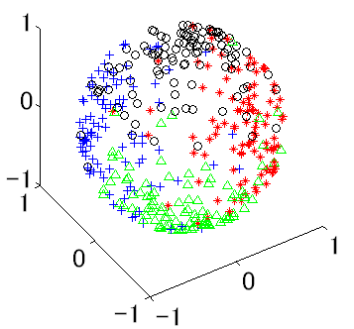
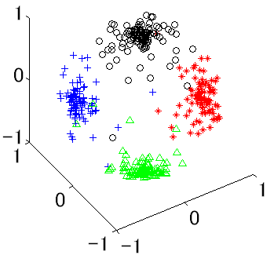
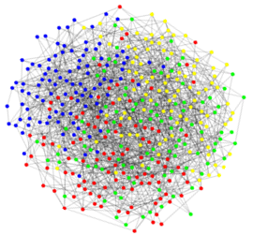
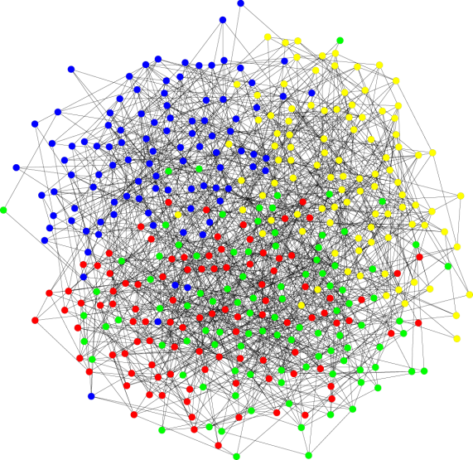
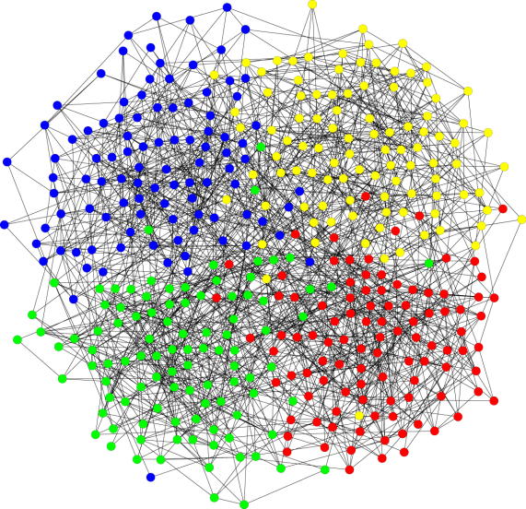
Synthetic Data
Numerical vectors (von Mises-Fisher distribution)
θ = 1
5
50
x₃
x₃
x₃
x₂
x₂
x₂
x₁
x₁
x₁
Network (Random graph) #nodes = 400, #edges = 1600
Modularity = 0.375
0.450
0.525
13

Slide 14
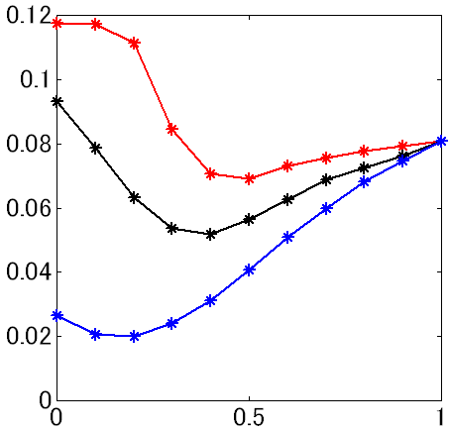
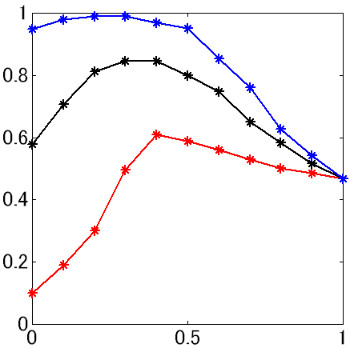
Results for Synthetic Data
Modularity = 0.375
Numerical vectors
θ = 1
5
50
θ = 1
x₃
x₃
x₃
Cost_{spectral}
θ = 5
θ = 50
x₂
x₂
x₂
x₁
x₁
x₁
Network
NMI
#nodes = 400, #edges = 1600
Modularity = 0.375
ω
Numerical vectors only
(k-means)
Network only
(maximum modularity)
・Best NMI (Normalized Mutual Information) is in 0 < ω < 1
・Can be optimized using Cost_{spectral}
14

Slide 15
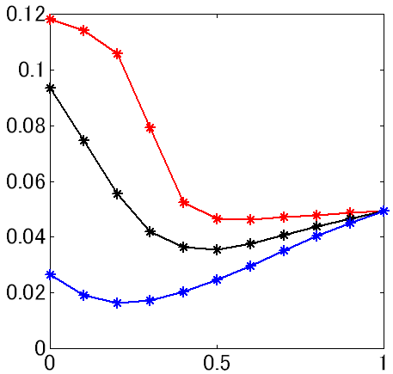
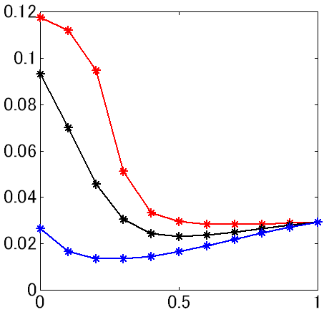
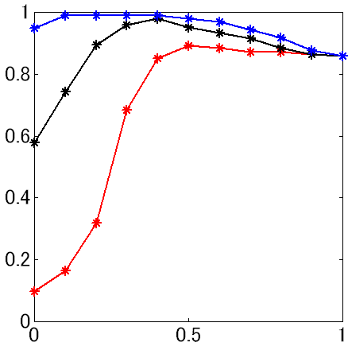
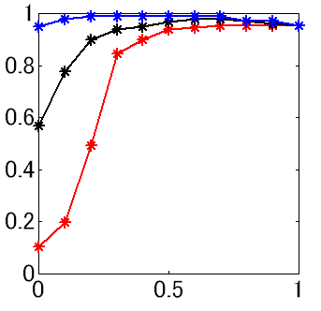
Results for Synthetic Data
Modularity = 0.375
0.450
0.525
θ = 1
Cost_{spectral}
θ = 5
θ = 50
NMI
ω
ω
ω
Numerical vectors only
(k-means)
Network only
(maximum modularity)
・Best NMI (Normalized Mutual Information) is in 0 < ω < 1
・Can be optimized using Cost_{spectral}
15

Slide 16
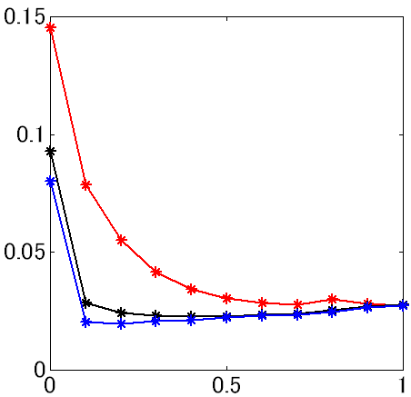
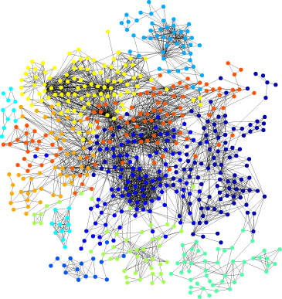
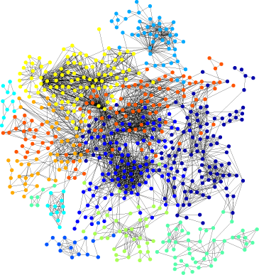
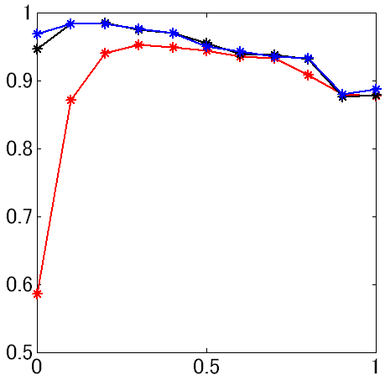
Synthetic Data (Numerical Vector)
+ Real Data (Gene Network)
True cluster
(#clusters = 10)
Resultant cluster
(ω=0.5, θ=10)
Cost_{spectral}
θ = 10
θ = 10²
θ = 10³
Gene network
by KEGG metabolic pathway
NMI
・Best NMI is in 0 < ω < 1
・Can be optimized using Cost_{spectral}
ω
16

Slide 17
Summary
New spectral clustering method proposed
combining numerical vectors with a network
・Global network property (normalized network modularity)
・Clustering can be optimized by the weight
Performance confirmed experimentally
・Better than numerical vectors only and a network only
・Optimizing the weight with synthetic dataset and
semi-real dataset
17

Slide 18
Thank you for your attention!
our poster #16

Slide 19
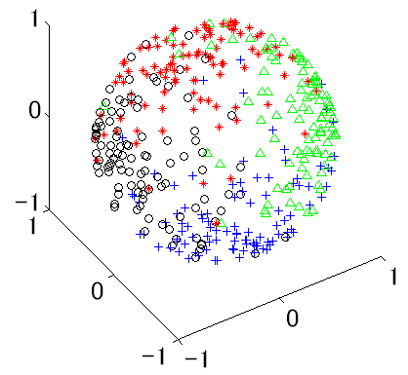
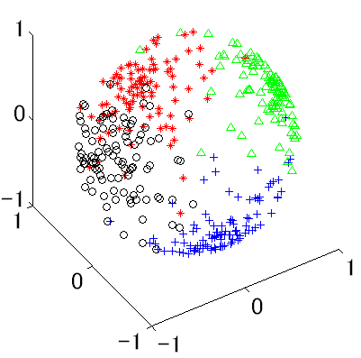
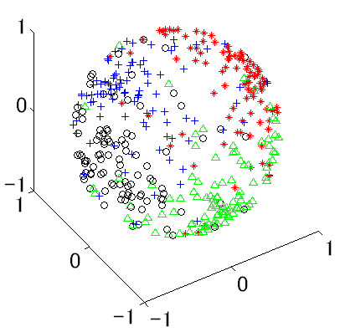
Spectral Representation of M_{ω}
(concentration θ = 5 , Modularity = 0.375)
ω = 0
ω = 0.3
ω = 1
e₃
e₃
e₃
e₂
e₂
e₂
e₁
e₁
e₁
Cost J_{ω} = 0.0932
0.0538
0.0809
Select ω by minimizing Cost_{spectral}
(clusters are divided most separately)

Slide 20
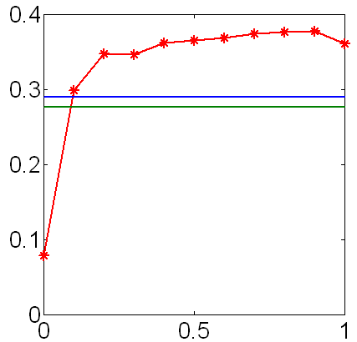
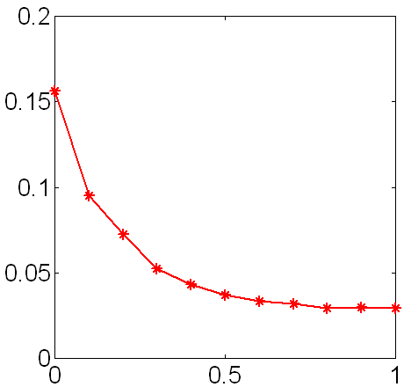
Result for Real Genomic Data
Numerical vectors : Hughes’ expression data (Hughes, et al., cell, 2000)
Gene network : Constructed using KEGG metabolic pathways
(M. Kanehisa, etc. NAR, 2006)
Our method
Normalized cut
Ratio cut
NMI
Cost_{spectral}
Our method
ω
ω

Slide 21
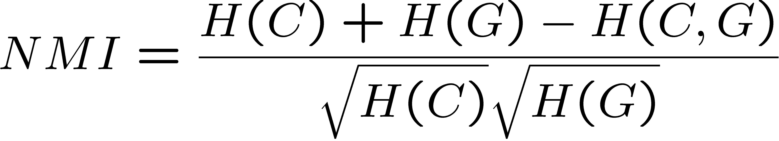
Evaluation Measure
Normalized Mutual Information (NMI)
between estimated cluster and the standard cluster
H(C) : Entropy of probability variable C,
C : Estimated clusters, G : Standard clusters
The more similar clusters
C and G are, the larger the NMI.
14

Slide 22
Web Page Clustering
Word | Frequency
A | n_{(A,1)}
B | n_{(B,1)}
… | …
Numerical
Vector
Word | Frequency
A | n_{(A,2)}
B | n_{(B,2)}
… | …
Frequency of word Z
…
Frequency of word A
To improve accuracy,
combine heterogynous data
1
2
3
4
5
Network
6
7

Slide 23

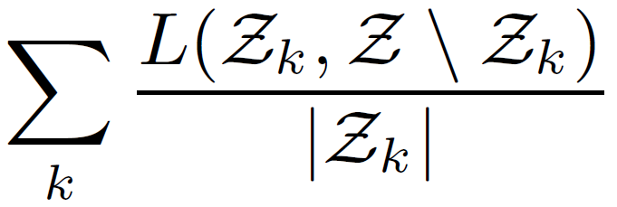

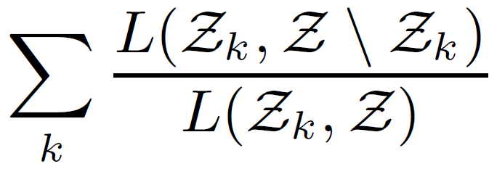

Spectral Clustering for Graph Partitioning
Ratio cut
Subject to
Normalized cut
Subject to
L. Hagen, etc., IEEE TCAD, 1992., J. Shi and J. Malik, IEEE PAMI, 2000.

