Slide 1

Cyc
Ground Facts, Rules and Probabilistic Inference
Michael Witbrock
Cycorp Europe
http://cycorp.eu
witbrock@cycorp.eu
September 8th, 2007
CYC
Notes:
This is an introduction to Cyc, the artificial intelligence technology under development at Cycorp.
The presentation begins with a brief overview of the Cyc technology. Then we examine a few of Cyc’s key capabilities, looking at examples of their use.

Slide 2
Overview
Representing Data
Using Cyc
Indexing and Search
Gathering Information
NLP
Probabilistic Reasoning
Using KB with classification
Large Vocabulary
Expressive Logic
Detailed Representations
Question Answering
Fact Acquisition
Using with Markov Logic (preliminary)

Slide 3
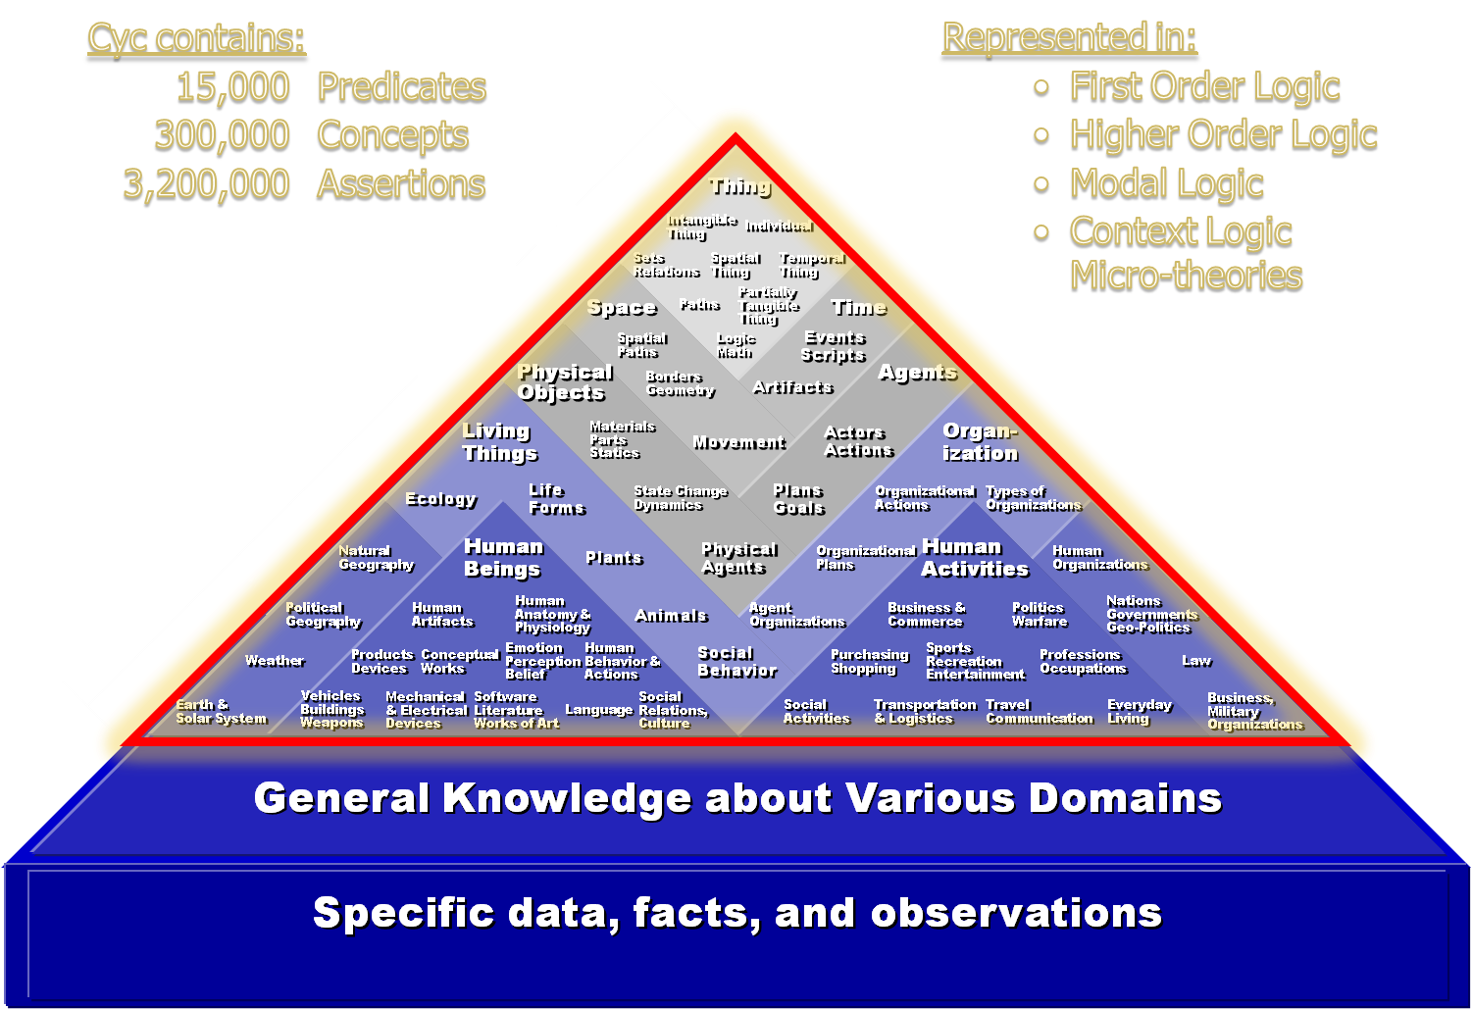
The Power of Deduction
Large Background KBs (like Cyc) are Necessary

Slide 4
Syntactic Power
First Order
With Context
Rule
(isa ASBFinancialCorp PubliclyHeldCorporation)
In Mt : FinancialTransactionMt
(relationAllExists performedBy RepurchaseProgram PubliclyHeldCorporation)
In Mt: FinancialTransactionMt
(forAll ?X (implies
(isa ?X RepurchaseProgram)
(thereExists ?Y (and (isa ?Y PubliclyHeldCorporation) (performedBy ?X ?Y)))))
(corporateOfficers ASBFinancialCorp GeraldRJenkins)

Slide 5
Syntactic Power
Second Order
(implies
(and (isa ?SET Set-Mathematical) (cardinality ?SET 1) (elementOf ?THING ?SET))
(equals ?SET (TheSet ?THING)))
i.e. If a set with a cardinality of 1 has X as a member, then that set is the singleton set containing X
Modal
(beliefs Israel (relationInstanceExists possesses Syria ClusterBomb))
Meta
(opaqueArgument beliefs 2)
i.e. If a relationship is opaque in an argument position N, then the substitution of co-referential terms does not necessarily preserve truth

Slide 6
For Inference:
Senses of ‘In’
Does part of the inner object
stick out of the container?
  None of it.
  #$in-ContCompletely
  Yes
  #$in-ContPartially
  No
  #$in-ContClosed
  If the container were turned around could the contained object fall out?
Yes
  #$in-ContOpen
Cycorp © 2007

Slide 7
Senses of ‘In’
Is it attached to the inside of the outer object?
  Yes
  #$connectedToInside
Can it be removed by pulling, if enough force is used, without damaging either object?
  No #$in-Snugly
  or #$screwedIn
  Does the inner object
  stick into the outer object?
  Yes
  #$sticksInto

Slide 8
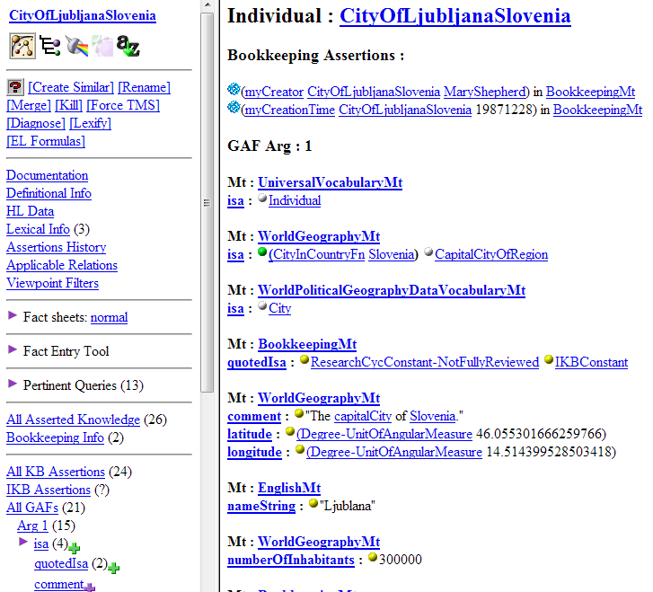
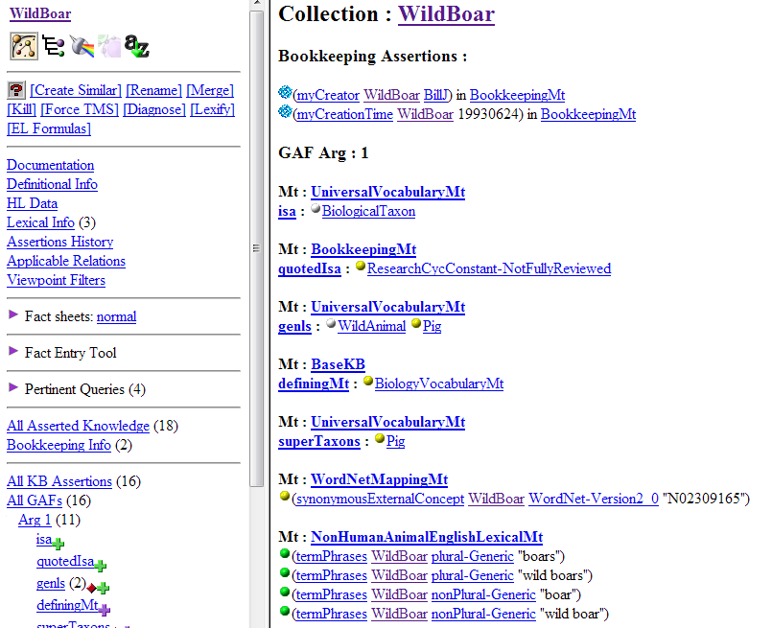
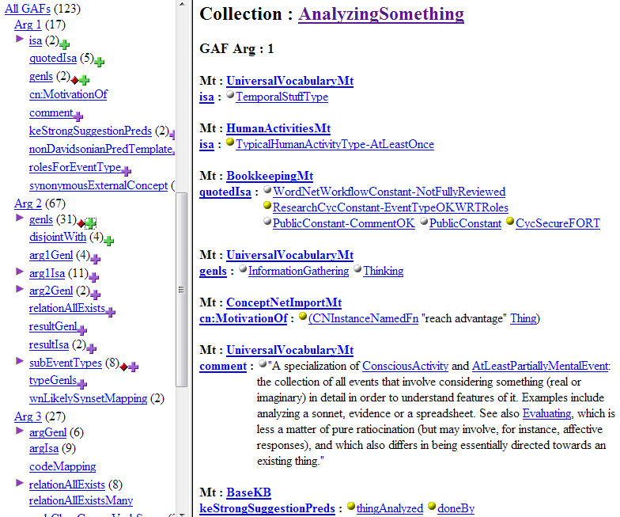
Existing Vocab.

Slide 9
Representing Probabilities
Law of Addition of Probabilities:
(implies
(and
(probability-Frequency ?SIT-TYPE ?A-TYPE ?A-PROB)
(probability-Frequency ?SIT-TYPE ?B-TYPE ?B-PROB)
(probability-Frequency ?SIT-TYPE
(CollectionIntersectionFn (TheSet ?A-TYPE ?B-TYPE)) ?AANDB-PROB)
(evaluate ?APLUSB-PROB (PlusFn ?A-PROB ?B-PROB))
(evaluate ?AORB-PROB (MinusFn ?APLUSB-PROB ?AANDB-PROB)))
(probability-Frequency ?SIT-TYPE
(CollectionUnionFn (TheSet ?A-TYPE ?B-TYPE)) ?AORB-PROB))
eventSet
conditionalProbabilitySet
conditionalProbabilityForAgent
NumericLikelihood
ProbabilityInterval
independentSentences
bayesParentSet
conditionalLikelihood
atLeastAsLikelyAs
likelihoodOfInsBeingIns
sentenceWeight
ProbabilityOfSetFn
BayesNet
moreLikelyThan
ConditionalProbabilitySetFn
probabilityForAgent
likelihood
mtSampleSpace
BayesVariable
probabilityOfSet
conditionalProbability
bayesParent
probabilityOfInsBeingIns
probability
sampleSpace
assertionWeight
NoteOnProbability
ProbabilityFn
ConditionalProbabilityFn
probabilisticallyCertain
conditionallyIndependent-GivenSet
moreLikelyThanGivenThat
ProbabilityDistributionFunction
moreLikelyThanNot-Conditional
BayesDiscreteOutcome
increasesLikelihood-PropProp
conditionallyIndependentSentences
BasicProbabilityTheoryMt
bayesNetOfMicrotheory
probabilityOfSetGivenSet
…
Indifference Principle:
(implies
(and
(partitionedInto ?SIT-COL ?COL-TYPE)
(isa ?COL-TYPE IndifferentPossibleOutcomePartition)
(isa ?OUTCOME-COL ?COL-TYPE)
(extentCardinality ?COL-TYPE ?N)
(evaluate ?PROB (QuotientFn 1 ?N)))
(probability-Frequency ?SIT-COL ?OUTCOME-COL ?PROB)).

Slide 10
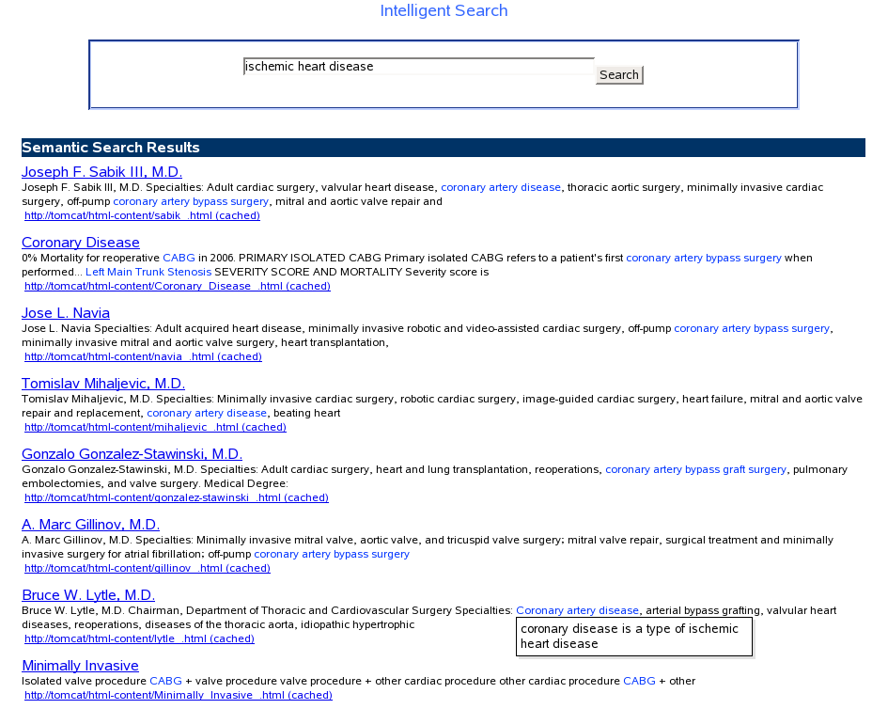
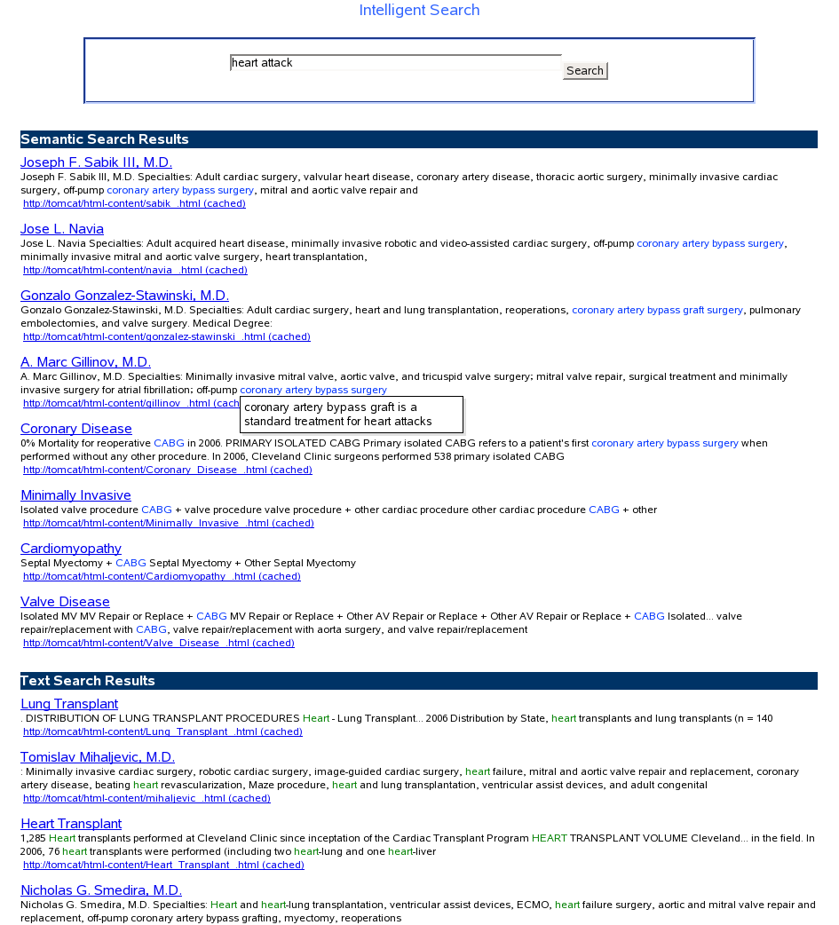
Semantic Search

Slide 11
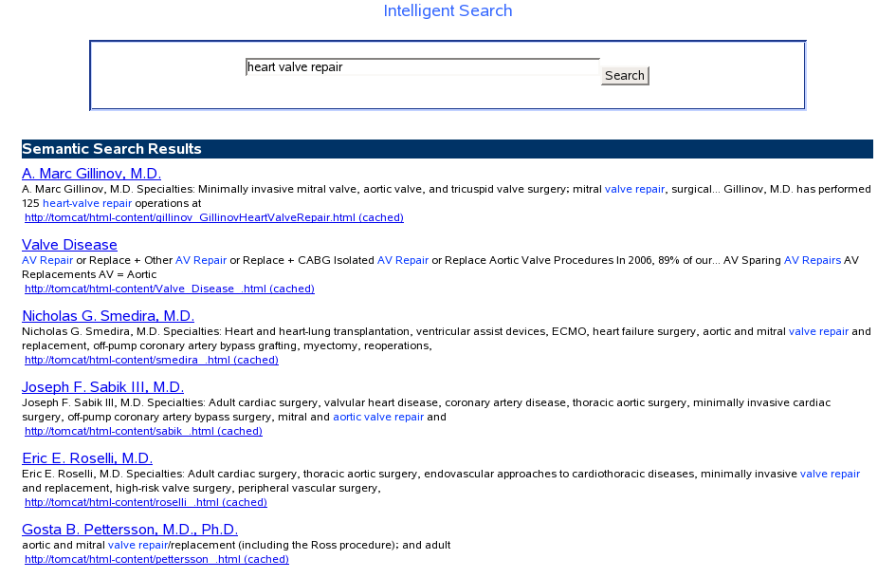
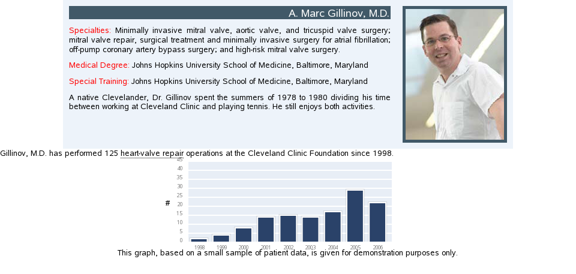
Contextual Content

Slide 12
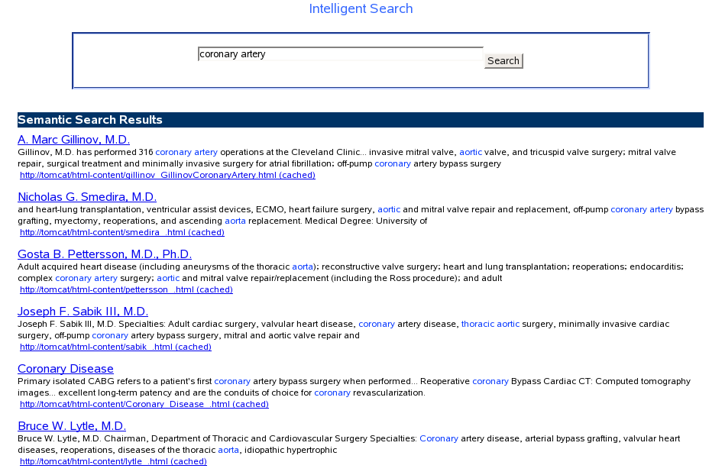
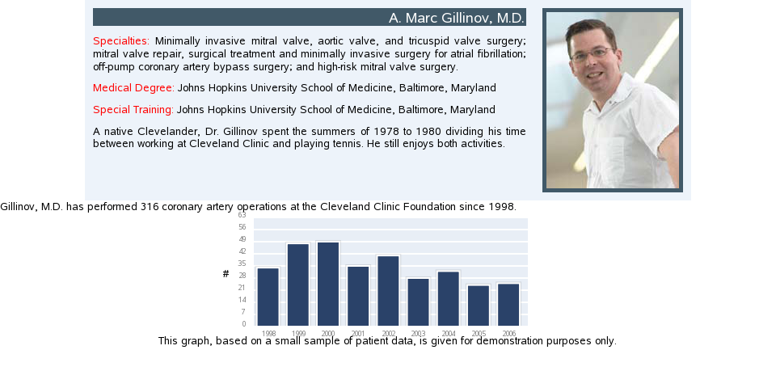

Slide 13
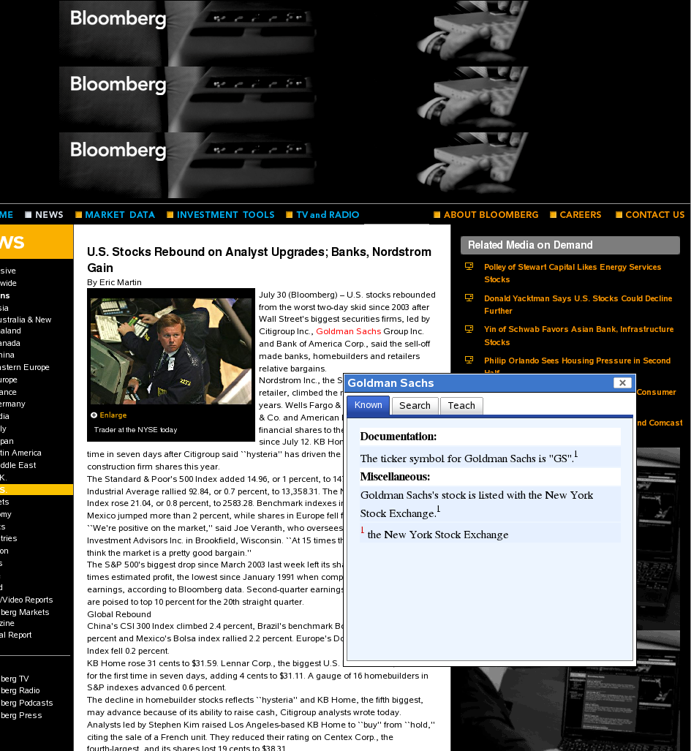
Contextual Information Access

Slide 14
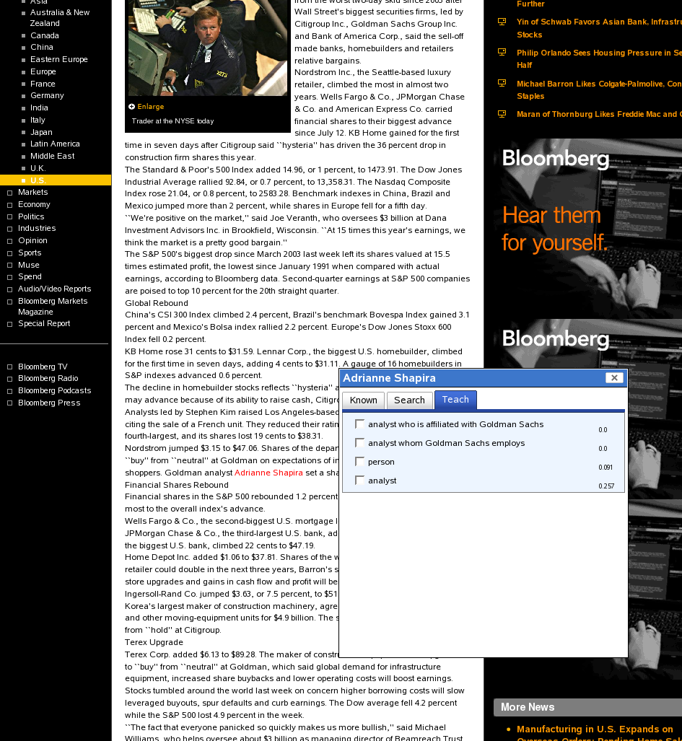

Contextual Learning

Slide 15
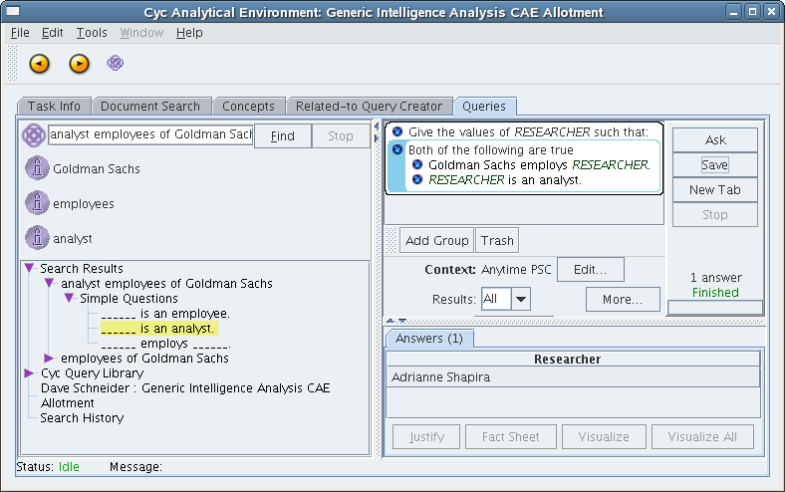
Using Learned Information

Slide 16
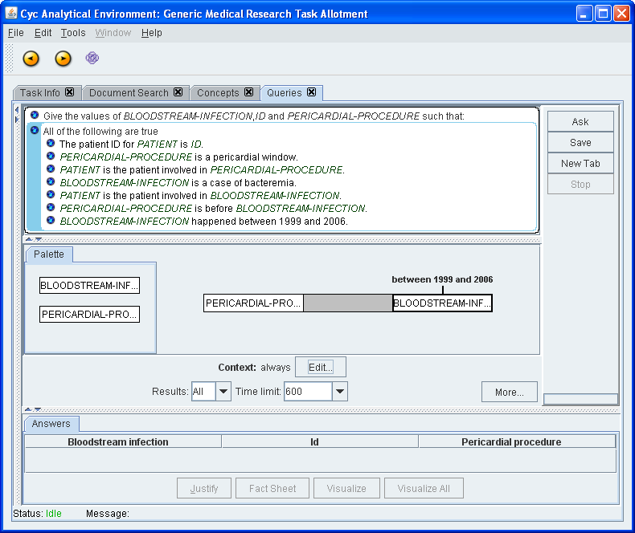
Notes:
When the answers come back we paraphrase the event and procedure nodes with information from the justification.

Slide 17
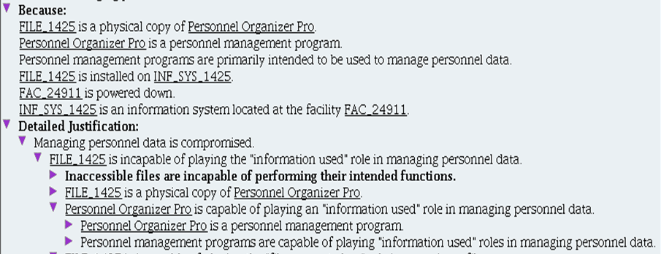
45th’s Space Wing Hurricane Preparedness

Slide 18
Cyc Analytical Environment
DEMO
Continue

Slide 19
The Cyc Analytic Environment
Simple English sentences are typed into the query search box
The system extracts entities, concepts, and relations from the text and instantiates them according to rules and constraints places on the concepts and relations

Slide 20
The Cyc Analytic Environment
The user selects the relevant query fragments
They then use a menu option to automatically combine the fragments into a single query

Slide 21
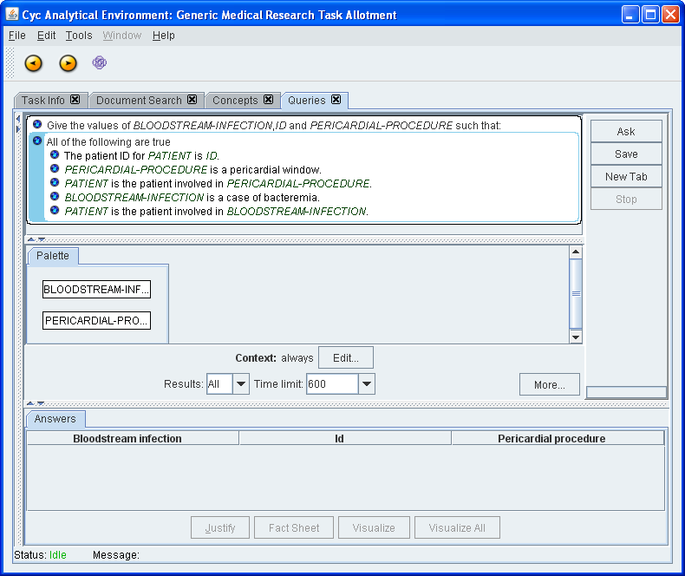
The full query appears in the query construction screen
Notes:
The system combines the fragments into a single query

Slide 22
Terms that can be temporally qualified are referenced here.
Notes:
The system combines the fragments into a single query

Slide 23
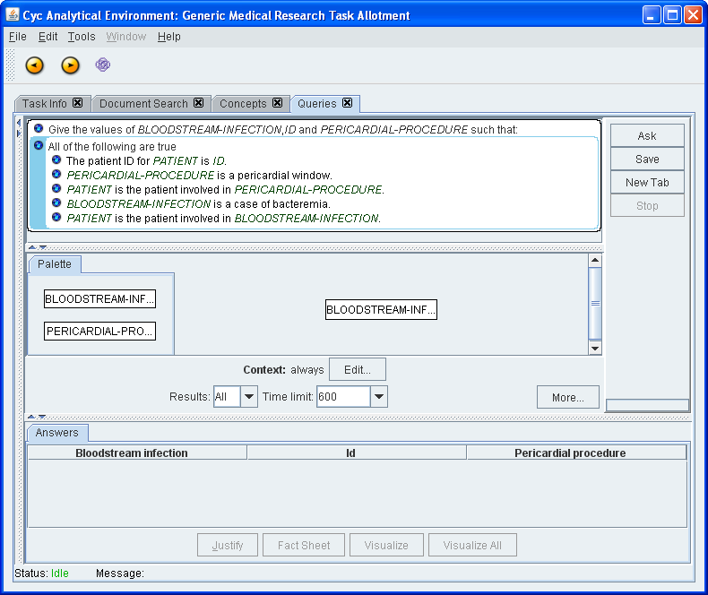
The user can drag and drop these to form sequences
Notes:
The user can drag and drop boxes representing various events to designate temporal ordering

Slide 24
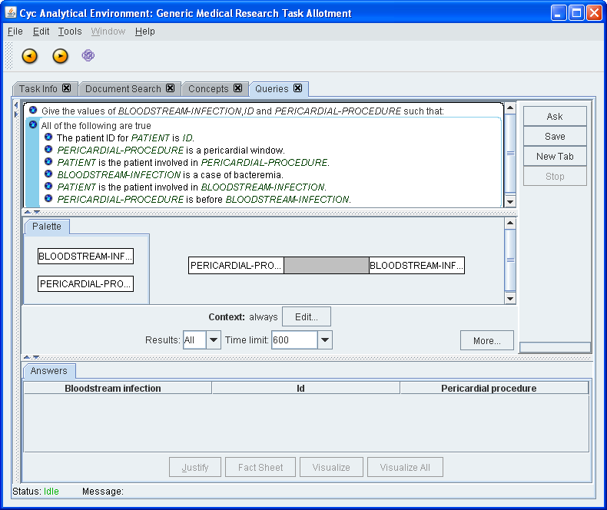
Here the user has specified that the pericardial procedure is before the infection
Notes:
Here the user has specified that the infection comes after the pericardial window procedure

Slide 25
At that point, the constraint is automatically added to the query
Notes:
Here the user has specified that the infection comes after the pericardial window procedure

Slide 26
The user can also specify a range of times that the condition or procedure must occur within.
Notes:
When the answers come back we paraphrase the event and procedure nodes with information from the justification.

Slide 27
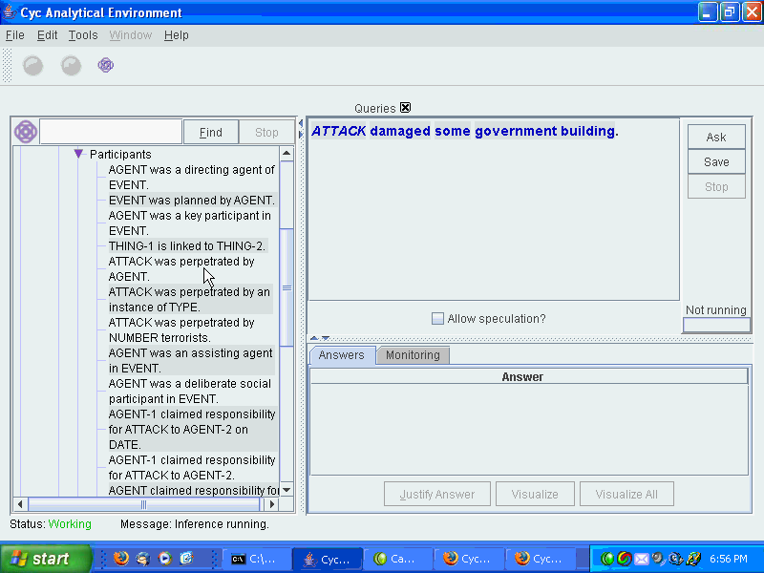
Cyc Analytical Environment
DEMO

Slide 28
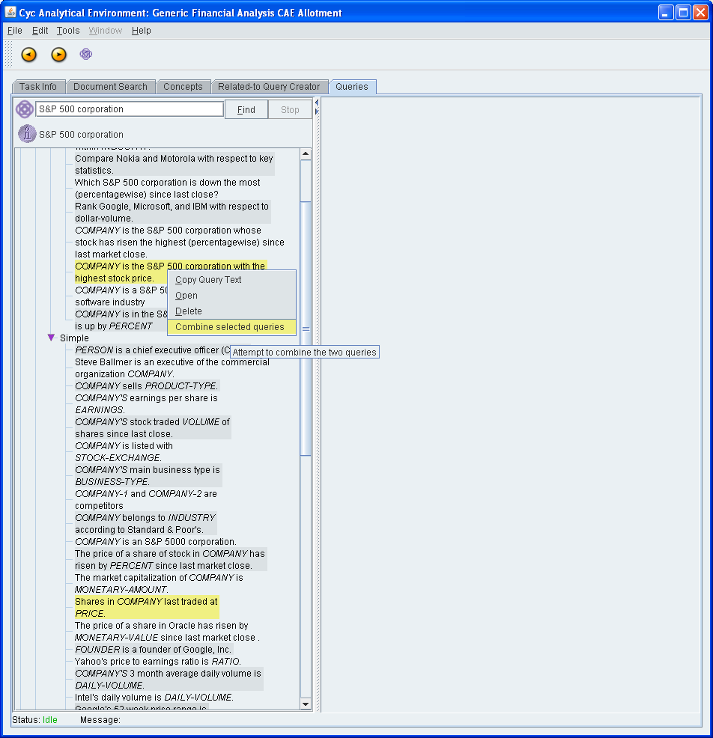
Application in Finance – Last trading price for highest share price S&P 500 company

Slide 29
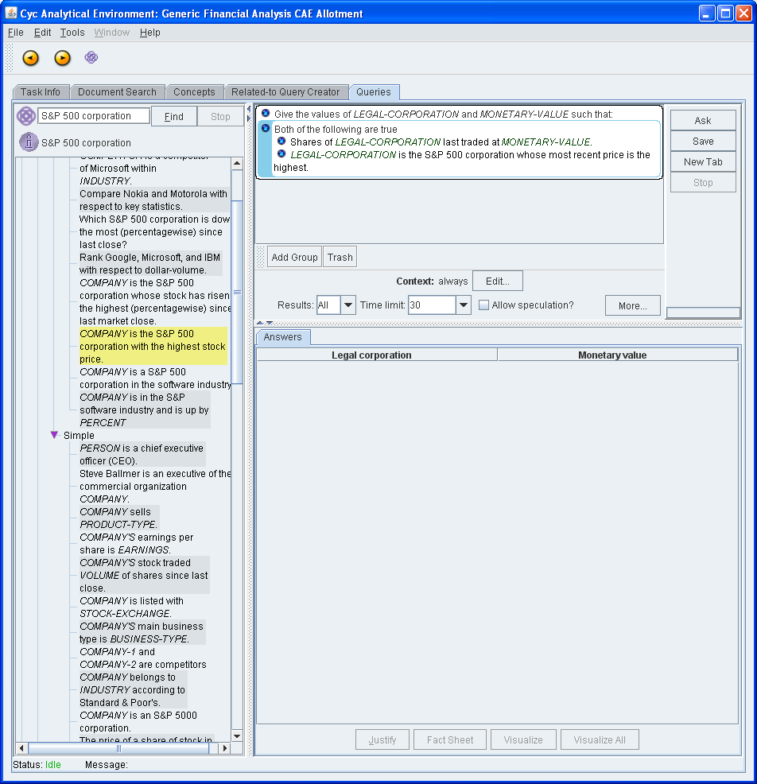

Slide 30
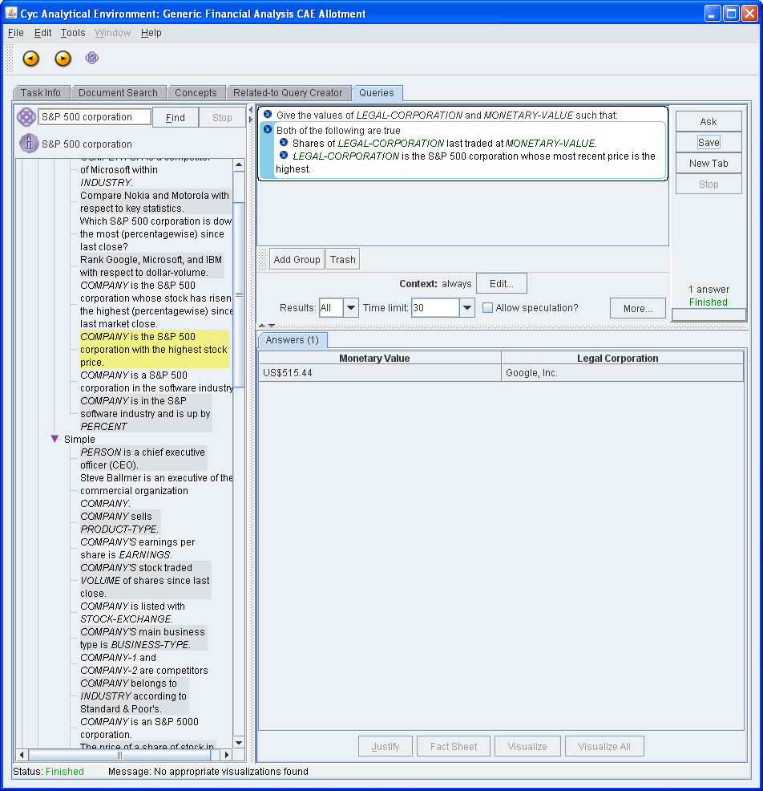

Slide 31
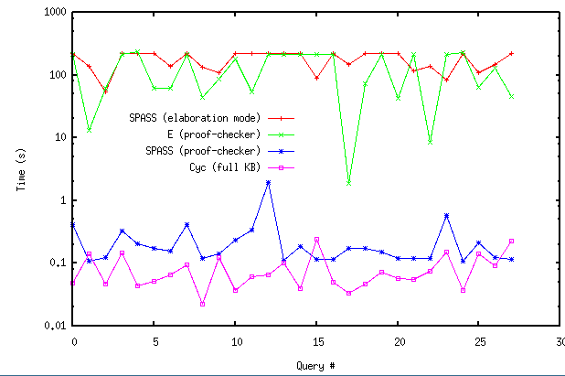
Performance:
Subtheory: disjointWith
e.g. (disjointWith Doctor-Medical HumanInfant)
Proof checker:
<100 relevant axioms
Elaboration Mode:
1600 relevant axioms
Cyc KB:
4 million axioms
relevant & irrelevant
Note: Otter times out

Slide 32
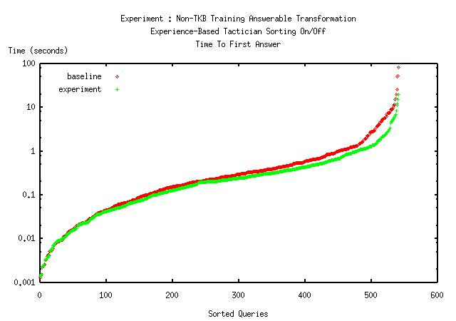
Inference is Fast & Trainable

Slide 33
Cycorp Corporate Mission
1984:
Increase human capabilities by building the first true Artificial Intelligence.
Revised:
Increase human capabilities by teaching the first true Artificial Intelligence to build itself.

Slide 34
Cyc NL Lexicon
English Words | 18,796
Syntactic Frame Links | 23,336
Single-word Denotation Mappings | 27,681
Multi-word Phrase Denotation Mappings | 44,298
Verbal Semantic Frame Links | 3,701
Noun Semantic Frame Links | 2,578
WordNet 2.0 Links | 11,322
Names (Includes chemical symbols, person/place/organization names, acronyms, etc.) | 100,811
Predicate-based Phrasal Links (genTemplates for paraphrase) | 9,637
Notes:
Stats from KB 7118
Syntactic frame links = #$subcatFrame

Slide 35
NL Lexicon: Eat
Constant: Eat-TheWord
isa: EnglishWord
Mt: EnglishMt
infinitive: “eat” pastTense: “ate”
perfect: “eaten” agentive-Sg: “eater”
(subcatFrame Eat-TheWord Verb 0 TransitiveNPCompFrame)
(verbSemTrans Eat-TheWord 0 TransitiveNPCompFrame
(and (isa :ACTION EatingEvent)
(performedBy :ACTION :SUBJECT)
(inputsDestroyed :ACTION :OBJECT)))

Slide 36
Noun Compounds
(SubcollectionOfWithRelationToFn
Artist activeDuringPeriod
TheRenaissance)
Renaissance Artists
(SubcollectionOfWithRelationToFn
Farmer activeDuringPeriod
TheBronzeAge)
Bronze Age Farmers
Kind of TimeInterval
Noun Form: not plural
Kind of Agent-Generic
Noun form: plural
Notes:
Reusable, flexible (20 billion+ two-word compounds), avoids caching

Slide 37
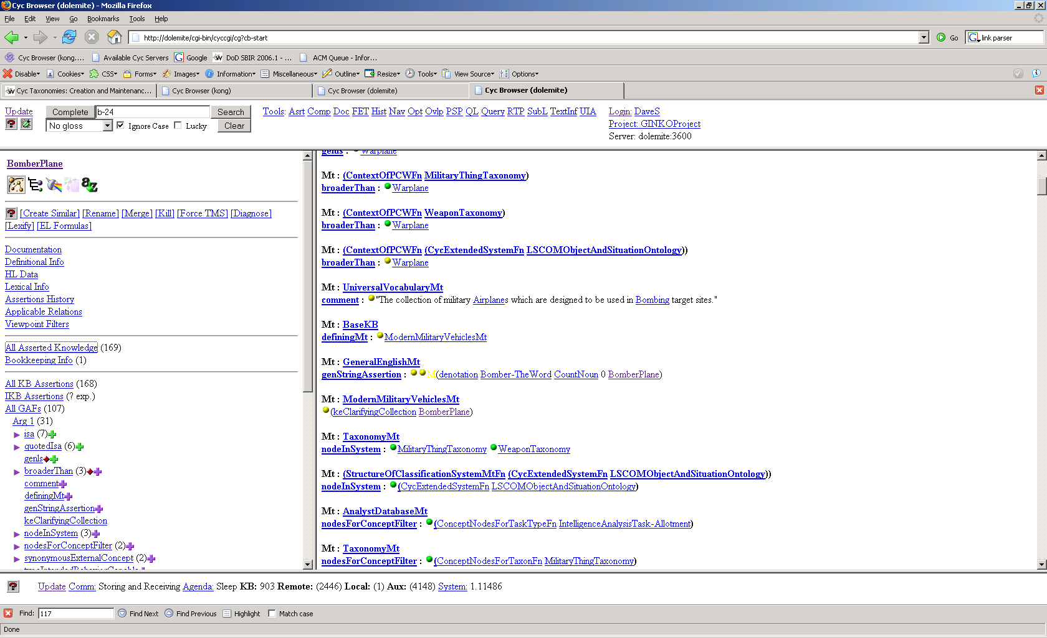
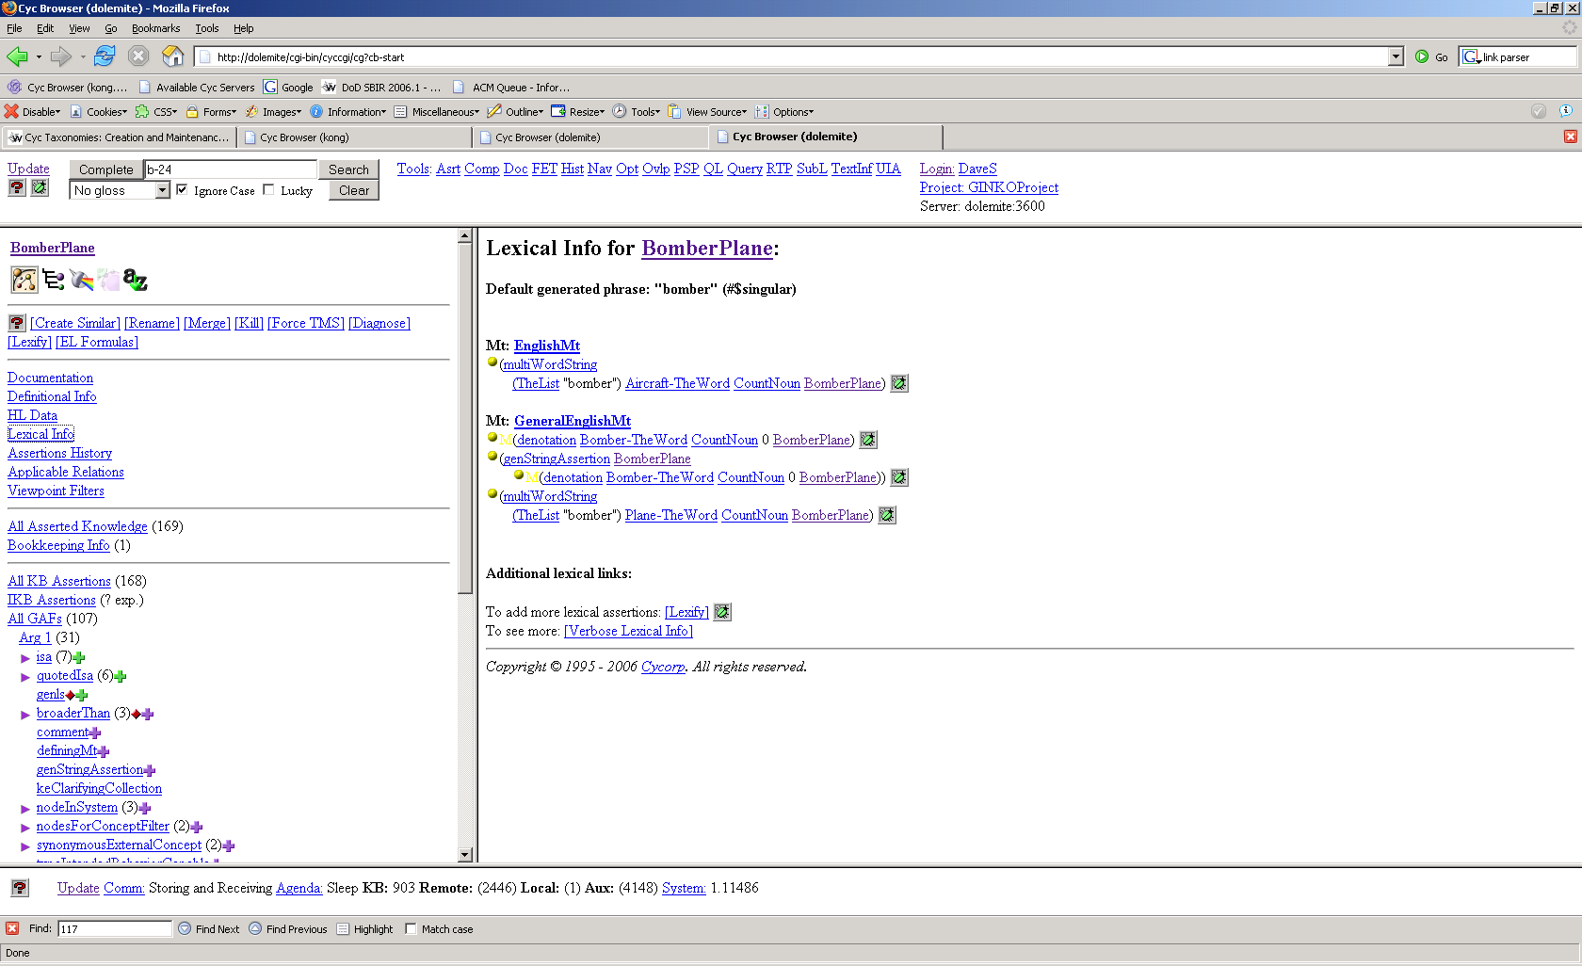
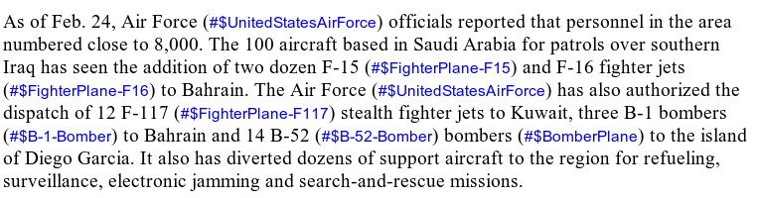
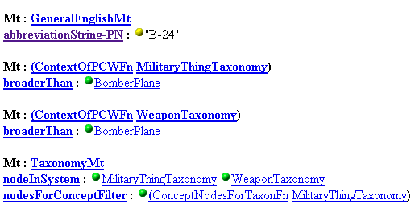
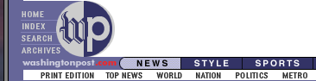
Military Taxonomy
  …
warplanes
  bombers (warplanes)
    B 24 bomber
    B-1 bombers
    B-2 stealth bombers
    B-29 Superfortress
    B-52 bombers
    …
  fighter planes
    A-5C fighter planes
    A10 fighter plane
    F-117 Nighthawks
    F-14 fighter plane
    F-15 eagles
    F-16 falcons
    …

Slide 38
Knowledge for Disambiguation
Simple Example: #$isa
“… natural resources, of which oil and diamonds are the most relevant.”
“oil”
#$Oil
#$Petroleum-CrudeOil
#$ArtistOilPaint
#$PetroleumProduct
#$isa licence
Looks for collections in the text of which a given object is an instance
“natural resources”
#$NaturalResourceType
“diamonds”
#$Diamond
#$Diamond-Gem
#$Diamonds-Suit
#$siblingsWRTType licence
Looks for collections in the text that share a type

Slide 39
Train
+-------------------------------------------Xp-------------------------------------------+
+------------Wd------------+ +--------------------MVp---------------------+ |
| +--------A--------+ | +------Jp-----+----Mp----+ | |
| | +--G--+--G-+--Ss--+---Os---+--Mp-+ +--Dmcn--+ +N Sa+ +-Js-+ |
| | | | | | | | | | | | | | |
LEFT Royal.a Dutch Shell Plc halted.v output.n of 455,000 barrels.n a day.p in Nigeria .
(#$and (#$isa (#$TheFn #$DecreaseEvent)
(#$DecreaseInValueReturnedByFn (#$ExportRateOfByFn #$Petroleum-CrudeOil) #$Nigeria))
(#$doneBy (#$TheFn #$DecreaseEvent) #$RoyalDutchShell)
(#$quantityChangeAmount (#$TheFn #$DecreaseEvent) (#$BarrelsPerDay 455000)))
Template
+-------------------------------------------Xp-------------------------------------------+
+------------Wd------------+ +--------------------MVp---------------------+ |
| + | +------Jp-----+ | |
| +-----------+--Ss--+---Os---+--Mp-+ + +-Js-+ |
| | | | | | | | |
LEFT [Agent] halted.v output.n of [Quantity] in [Locn] .
(#$and (#$isa (#$TheFn #$DecreaseEvent)
(#$DecreaseInValueReturnedByFn (#$ExportRateOfByFn #$Petroleum-CrudeOil) [Locn]))
(#$doneBy (#$TheFn #$DecreaseEvent) [Agent])
(#$quantityChangeAmount (#$TheFn #$DecreaseEvent) [Quantity]))
Use
Petróleos de Venezuela S.A. halted output of 760 000 barrels a week in Maracaibo.
(#$and (#$isa (#$TheFn #$DecreaseEvent)
(#$DecreaseInValueReturnedByFn (#$ExportRateOfByFn #$Petroleum-CrudeOil)
#$CityOfMaracaiboVenezuela))
(#$doneBy (#$TheFn #$DecreaseEvent) #$PetroleosdeVenezuelaSA
(#$quantityChangeAmount (#$TheFn #$DecreaseEvent) (#$BarrelsPerDay 760000)))
Notes:
Example-Based Machine Translation (EBMT) is an approach to building translation rules between two natural languages by providing a learning system with pairs of sentences in the two languages.
We can apply EBMT to the acquisition of IE rules by providing the system pairs in which the first element is a sentence in natural language, and the second element is an appropriate internal representation in CycL.
39

Slide 40

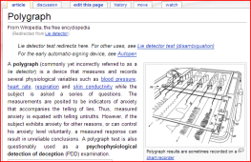


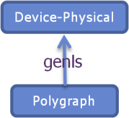
Automatically Adding to the Model
… Klingberg contacted the USSR for the first time in 1957, and soon after that he started his espionage activity. Israel's foreign and domestic intelligence agencies, Mossad and Shin Bet, started suspecting Klingberg of espionage, but shadowing brought no results. At one point, the scientist also successfully passed the polygraph test…
Unknown word
“polygraph”
Device-Physical
genls
Wikipedia
Page Download
Sentence Extractor
EBMT Parser
Semantic Checker
Success
Polygraph
(#$genls #$Polygraph #$Device-Physical)
CYC
No page found
Uninformative
sentence
Unable to parse
Hypothesis not
logically consistent

Slide 41

Learning Facts by Search
Query
“What are symptoms of Whooping Cough?”
→
(symptomOfAilment WhoopingCough ?SYMP )
NL Generation
Partial English sentences
“A symptom of whooping cough is ___”
“Whooping cough can cause ___”
“A symptom of Pertussis Bordetella is ___”
“Symptoms (such as ____) of whooping cough”

Slide 42
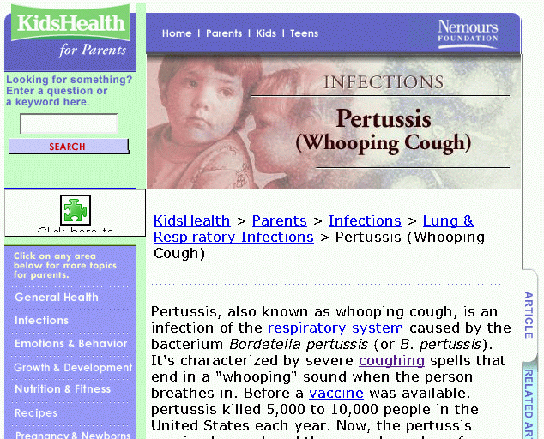
Parsing Results
Looking for something that matches the argument constraints on the predicate…
“… symptoms of pertussis such as fever and a dry cough …”
Parse back into
existing CycL concepts
(symptomOfAilment WhoopingCough Fever)
(symptomOfAilment WhoopingCough Coughing-AilmentCondition)
Parsing Results

Slide 43
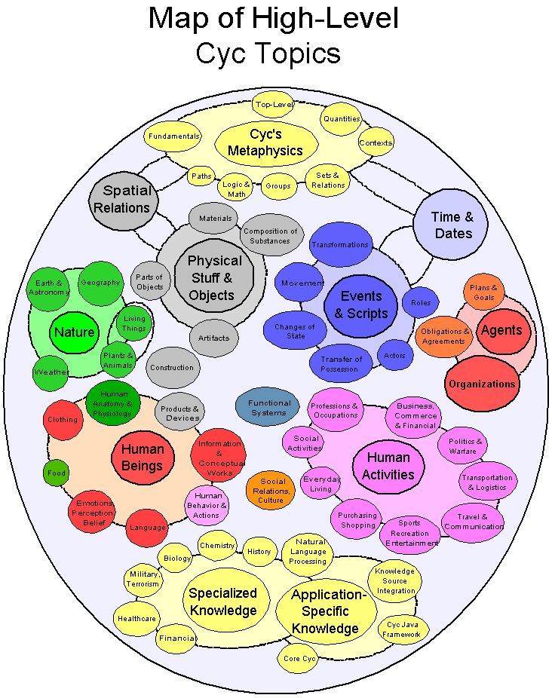
KB Consistency Check
Throw out provably wrong answers
Explicitly: perform one step of inference to throw out facts inconsistent with KB
Implicitly: don’t even look at things that don’t match argument constraints
Skip already known
(provably right) knowledge



Slide 44
Given a set of events that Cyc already knows about…
January
15, 2006
Group of
Pirates 2
Group of
Pirates 3
Group of
Pirates 1
February
18, 2006
perpetrator
Piracy
Event 1
dateOfEvent
perpetrator
Piracy
Event 3
perpetrator
dateOfEvent
dateOfEvent
January
20, 2006
Piracy
Event 2
eventOccursNear
eventOccursNear
Nigeria
deviceUsed
Somalia
intendedAttackTargets
eventOccursNear
intendedAttackTargets
Speed
Boat 1
MV Delta
Ranger
Philippines
MV Man
Chu Yi
…recognize new instances of that event type in text
Malacca Straits:
On 17 April 2006, a Malaysian fishing vessel was attacked by armed pirates at approximately nine nautical miles off Parit Haji Baki coast in the Malacca Straits at about 0200 Hrs LT. Six pirates armed with guns in a speedboat closed in rapidly and opened fire at the fishing vessel underway. Several shots hit the side of the vessel but the crew escaped injuries. The fishing vessel crew lodged a police report.
New
Piracy
Event
Probabilistic Event Extraction

Slide 45
…look at role fillers for known events…
January
15, 2006
Group of
Pirates 2
Group of
Pirates 3
Group of
Pirates 1
February
18, 2006
perpetrator
Piracy
Event 1
dateOfEvent
perpetrator
Piracy
Event 3
perpetrator
dateOfEvent
dateOfEvent
January
20, 2006
Piracy
Event 2
eventOccursNear
eventOccursNear
Nigeria
deviceUsed
Somalia
intendedAttackTargets
eventOccursNear
intendedAttackTargets
Speed
Boat 1
MV Delta
Ranger
Philippines
MV Man
Chu Yi
and find similar types of concepts mentioned in the text.
???
intendedAttackTargets
Malacca Straits:
On 17 April 2006, a Malaysian fishing vessel was attacked by armed pirates at approximately nine nautical miles off Parit Haji Baki coast in the Malacca Straits at about 0200 Hrs LT. Six pirates armed with guns in a speedboat closed in rapidly and opened fire at the fishing vessel underway. Several shots hit the side of the vessel but the crew escaped injuries. The fishing vessel crew lodged a police report.
New
Piracy
Event
perpetrator
???
dateOfEvent
???
eventOccursNear
???

Slide 46
Concepts in Cyc’s ontology are found in the text
Things
People
& Org.s
Places
Malacca
Straits
Dates
Vehicles
People
Pirates
Malaysia
Speed
Boats
Police
Parit Haji
Baki
April 17,
2006
Some
Pirate
Some
Speed
Boat
Some
Police
Officer
Malacca Straits:
On 17 April 2006, a Malaysian fishing vessel was attacked by armed pirates at approximately nine nautical miles off Parit Haji Baki coast in the Malacca Straits at about 0200 Hrs LT. Six pirates armed with guns in a speedboat closed in rapidly and opened fire at the fishing vessel underway. Several shots hit the side of the vessel but the crew escaped injuries. The fishing vessel crew lodged a police report.

Slide 47
Probabilities can be estimated for extracted concepts…
Things
People
& Org.s
Places
Malacca
Straits
Dates
Vehicles
People
Pirates
Org.s
Malaysia
Speed
Boats
Police
Parit Haji
Baki
April 17,
2006
Some
Pirate
Groups
of
Pirates
Some
Speed
Boat
Some
Police
Officer
to measure how well they fit the relation.
Parit Haji
Baki
eventOccursNear
p(Malacca Straits) = 1
p(Malaysia) = 1
p(Parit Haji Baki) = 1
p(April 17, 2006) = 0
p(Speed Boats) = 0
P(Some Speed Boat) = 0
…
New
Piracy
Event
eventOccursNear
Malacca
Straits
Malaysia

Slide 48
After repeating this process for every relation, choosing
relation/concept pairs with >0.5 probability, a potential
event has been extracted from the text.
Some
Speed
Boat
Parit Haji
Baki
New
Piracy
Event
intendedAttackTargets
eventOccursNear
Malacca
Straits
dateOfEvent
Malaysia
April 17,
2006
Malacca Straits:
On 17 April 2006, a Malaysian fishing vessel was attacked by armed pirates at approximately nine nautical miles off Parit Haji Baki coast in the Malacca Straits at about 0200 Hrs LT. Six pirates armed with guns in a speedboat closed in rapidly and opened fire at the fishing vessel underway. Several shots hit the side of the vessel but the crew escaped injuries. The fishing vessel crew lodged a police report.
Human Feedback:
In initial experiments, giving feedback on the 27 piracy paragraphs raised precision from .39 to .61 using 2-fold cross-validation

Slide 49
Markov Logic
Undirected Graphical Models
Formed from weighted first order logic statements
Tractible (if not fast) algorithms for learning the weights from ground cases
Tractible (if not fast) algorithms for computing the probabilities of various ways in which a formula might be satisfied
Matthew Richardson and Pedro Domingos, Markov Logic Networks, Machine Learning, 62, 107-136, 2006.

Slide 50
Integrating Markov Logic
pred2C_eventOccursAt_typeAttackOnObject_typeGeographicalRegion(act,+location)
⇒ pred2C_perpetrator_typeAttackOnObject_typeTerroristGroup(act,+group)
pred2C_damages_typeAttackOnObject_typeEmbassyBuilding(act,target)
⇒ pred2C_perpetrator_typeAttackOnObject_typeTerroristGroup(act,+group)
pred2C_intendedAttackTargets_typeAttackOnObject_typeEmbassyBuilding(act,target)
⇒ pred2C_perpetrator_typeAttackOnObject_typeTerroristGroup(act,+group)
pred2C_perpetrator_typeAttackOnObject_typeTerroristGroup(act,+group)
⇒ pred2C_eventOccursAt_typeAttackOnObject_typeGeographicalRegion(act,+location)
pred2C_perpetrator_typeAttackOnObject_typeTerroristGroup(act,+group)
^ pred2C_damages_typeAttackOnObject_typeEmbassyBuilding(act,damaged)
⇒ pred2C_eventOccursAt_typeAttackOnObject_typeGeographicalRegion(act,+location)
('suggests' (eventOccursAt ?ACT :LOCATION)
(perpetrator ?ACT :GROUP))
('suggests' (damages ?ACT ?TARGET)
(perpetrator ?ACT :GROUP))
('suggests' (intendedAttackTargets ?ACT ?TARGET)
(perpetrator ?ACT :GROUP))
('suggests' (perpetrator ?ACT :GROUP)
(eventOccursAt ?ACT :LOCATION))
('suggests' (and (perpetrator ?ACT :GROUP)
(damages ?ACT ?DAMAGED))
(eventOccursAt ?ACT :LOCATION))
sentenceWeight
assertionWeight
MarkovLogicNetwork
MarkovNetwork
ContentOfMarkovLogicNetworkFn
DiscriminativeWeightLearning
GenerativeWeightLearning
markovLogicNetworkDataFilePathname
markovLogicNetworkFilePathname
markovLogicNetworkGeneratedUsingCommandString
markovLogicNetworkGeneratedUsingLearningType
markovLogicNetworkRepresentedByMicrotheory
markovLogicNetworkRuleFilePathname
markovLogicNetworkTypeConstantDeclarationFilePathname

Slide 51
Early ML Experiments
Entities
Training Statements (GAFs)
AttackOnObject [369]
GeographicalRegion [152]
EmbassyBuilding [11]
TrerroristGroup [2]
pred2C_damages_typeAttackOnObject_typeEmbassyBuilding [5]
pred2C_eventOccursAt_typeAttackOnObject_typeGeographicalRegion [232]
pred2C_intendedAttackTargets_typeAttackOnObject_typeEmbassyBuilding [5]
pred2C_perpetrator_typeAttackOnObject_typeTerroristGroup [202]
Testing Statements (GAFs)
pred2C_damages_typeAttackOnObject_typeEmbassyBuilding [7]
pred2C_eventOccursAt_typeAttackOnObject_typeGeographicalRegion [229]
pred2C_intendedAttackTargets_typeAttackOnObject_typeEmbassyBuilding [3]
pred2C_perpetrator_typeAttackOnObject_typeTerroristGroup [201]
Perpetrator | Correct | Miss | False +ve | Total | Recall | Precision
Lebanese Hizballah | 166 | 3 | 19 | 169 | 0.98 | 0.897
Al Qaida | 13 | 19 | 3 | 32 | 0.41 | 0.813

Slide 52

Future
(perpetrators MurderFn(RHariri) ?X)
Inference is a search through proof space applying a large, extensible array of reasoning modules to perform deduction
Query
...
Goal!
(advocates RHariri ?WHAT)
Worker
  Performs all low-level inference work
Tactician (meta)
  Enforces a strategy
  Decides what work should be done
Strategist (meta-meta)
  Manages resources
  Decides overall strategy
> 1000 special purpose inference modules
!
.
.
.

Slide 53
Overview
Representing Data
Using Cyc
Indexing and Search
Gathering Information
NLP
Probabilistic Reasoning
Using KB with classification
Large Vocabulary
Expressive Logic
Detailed Representations
Question Answering
Fact Acquisition
Using with Markov Logic (preliminary)

