Slide 1
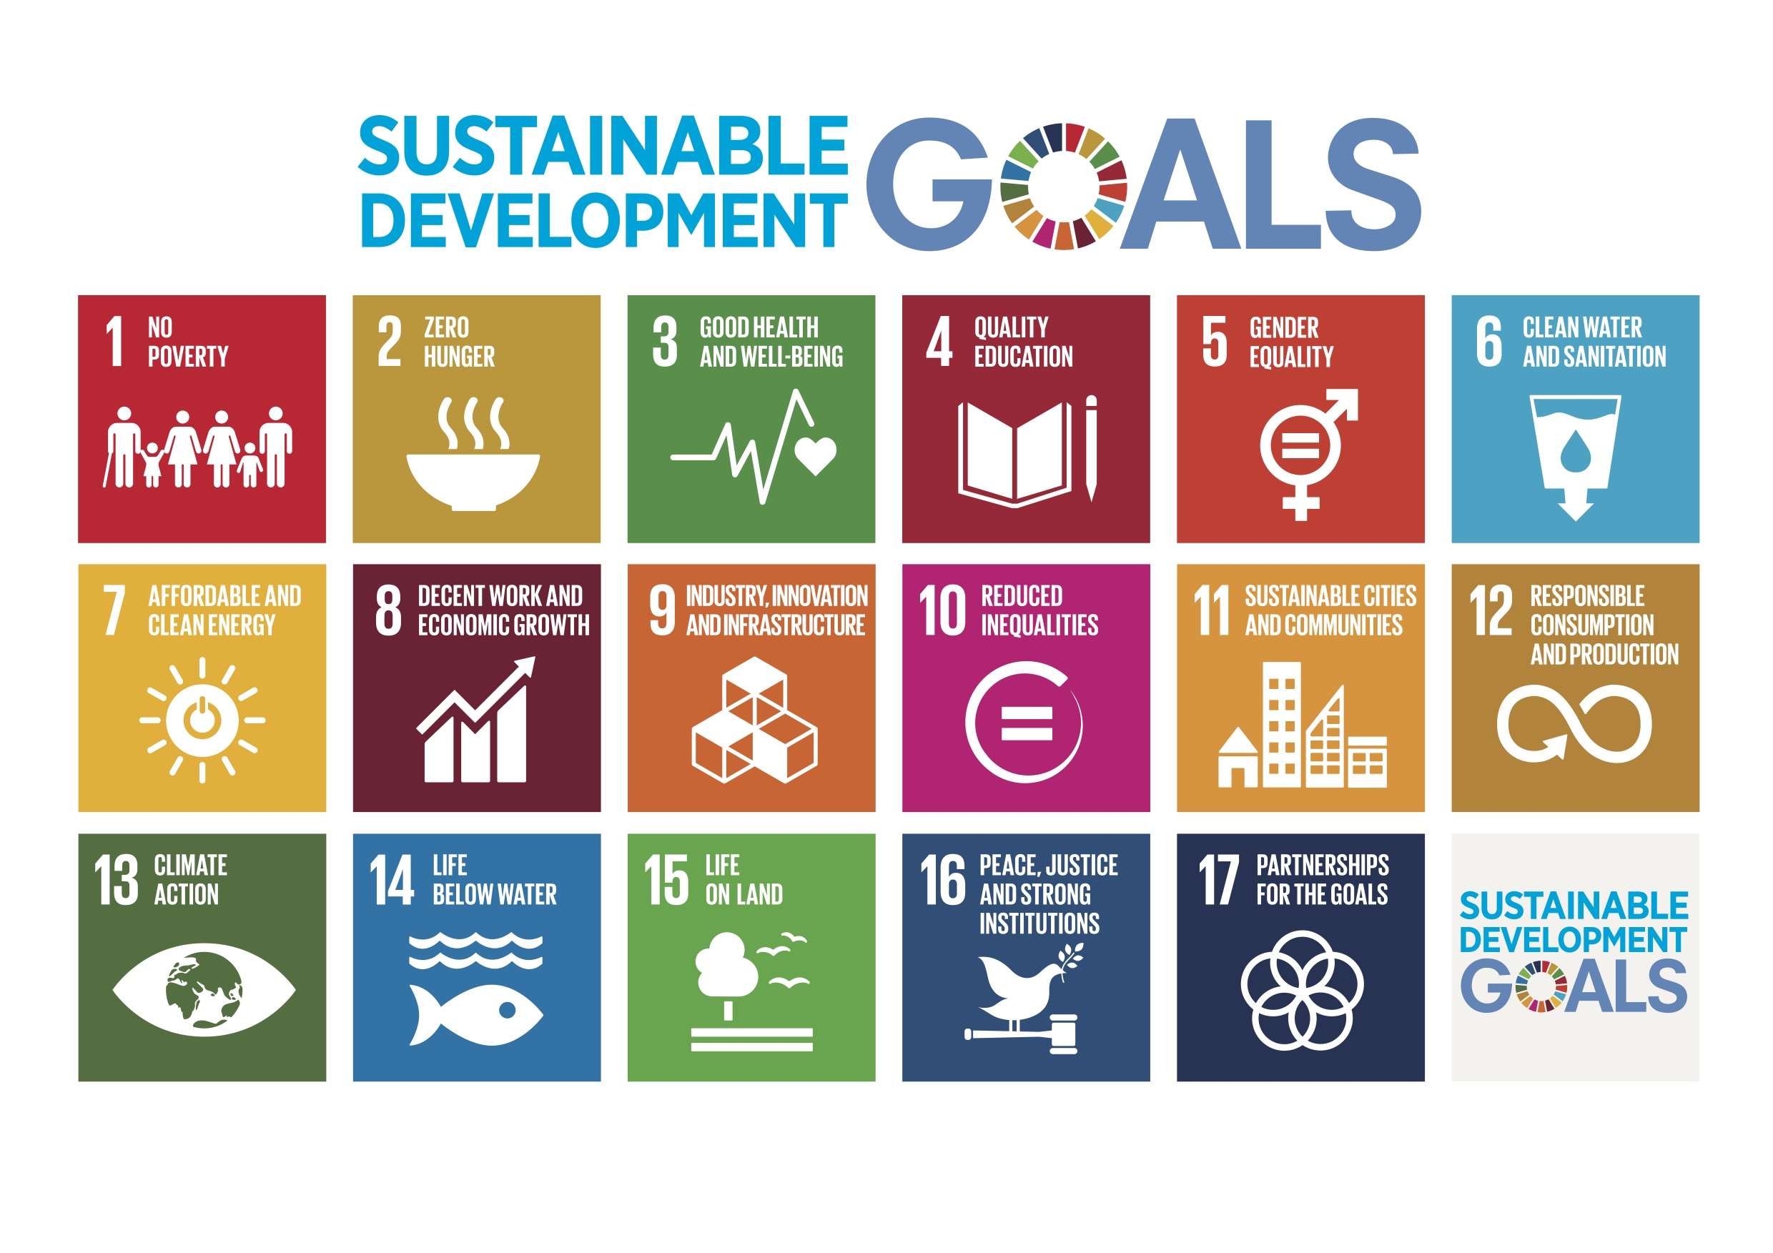
SDGs and Open Design: Inquiry Based Learning
Jenni Hayman, M.Ed, Doctoral Candidate
@jennihayman on Twitter
Email: jlhayman@asu.edu

Slide 2
Mentoring
Photo by G. Crescoli on Unsplash
Notes:
About me and about my mentors – eCampusOntario Program Managers, instructional designer (open learning designer), doctoral candidate, currently analyzing and writing final chapters
Dr. Rory McGreal, UNESCO/COL Chair for OER, Athabasca, Alberta, Canada
Dr. Pedro Mendoza Arana
Prof. dr. Pedro Mendoza Arana is Profesor Principal en Universidad Nacional Mayor de San Marcos. He is active promoter of open education in Peru. He is voting representative of UNMSM at the Open Education Consortium. He created three master degree courses in blended format in 2017 and one MD course in blended format in 2015. He has been creating two ongoing research projects on open education use and willingness to use in Peru. He has a PhD in Medicine and obtained Master of Science in Health Planning and Financing, at London School of Economics de la University of London.
Prof. dr. Rory McGreal is a Professor and Director of Technology Enhanced Knowledge Research Institute (TEKRI) at Athabasca University and UNESCO/Commonwealth of Learning/International Council for Open and Distance Education Chair in OER.

Slide 3
The Project
Public Domain by Jenni Hayman
Notes:
http://ld4oep.org/blog/courses/inquiry-based-learning-using-oer-and-sdgs-for-community-success/?tab=tab-curriculum
The purpose of this six-month project is to design a series of digital modules and learning resources that may be added to post-secondary in-person or online courses. Using the 17 Sustainable Development Goals (SDGs) as a foundation, mini-modules and resources will be developed using open educational resources (OER) with a focus on problem and project-based teaching. Examples, including modules in multiple disciplines, with a variety of activities and assessment suggestions will be included in the project. Several collaborative and individual-work activities will be designed to suit diverse learner needs. A foundational series of mini-modules on OER including discernment (how to find OER), adaptation (how to remix and revise OER), inclusive design (ensuring better accessibility through tools and user choice), and copyright (how to share OER using Creative Commons licenses) will be shared. Leveraging the opportunity of the Creative Commons Summit 2018 (April 12-14 in Toronto, Ontario), an open, collaborative workshop will be conducted to increase the number and diversity of resources available by July, 2018.

Slide 4
Purpose of IBL, SDGs, and OER
Learner engagement
Localized, contextual, culturally specific
Inclusive, flexible design
Continuous improvement assessment model
Connecting global learners and educators with each other
Contributing to global success for everyone
Notes:
Learner engagement as community researchers and co-creators of knowledge
Inclusive, flexible design (can be accomplished with low, medium, and high use of technology and resources)
Sustainable assessment model that can be extended beyond one course and one group of learners

Slide 5
Why IBL? (Inquiry Based Learning)
Photo by Emily Morter on Unsplash
Notes:
Benefits of inquiry based learning models…
Learner-led
Collaboration
Critical thinking
Critical review of learning resources and research materials
Academic research and writing skills
One group of findings can be built upon by a new group of learners
Connection with global peers

Slide 6
Definitions of IBL
Prince and Felder (2007) defined it as teaching that begins by ‘presenting students with a specific challenge, such as experimental data to interpret, a case study to analyze, or a complex real-world problem to solve’”
“Justice et al. (2007, 202)…IBL refers to ‘a range of instructional practices that promote student learning through student-driven and instructor-guided investigations of student-centred questions’”
“Spronken-Smith et al. (2007) proposed the following as core elements of IBL: it should be driven by questions or problems; based on seeking new knowledge and understanding; and student-centred and -directed, with teachers acting as facilitators”
(Aditomo, Goodyear, Bliuc, & Ellis, 2013)

Slide 7
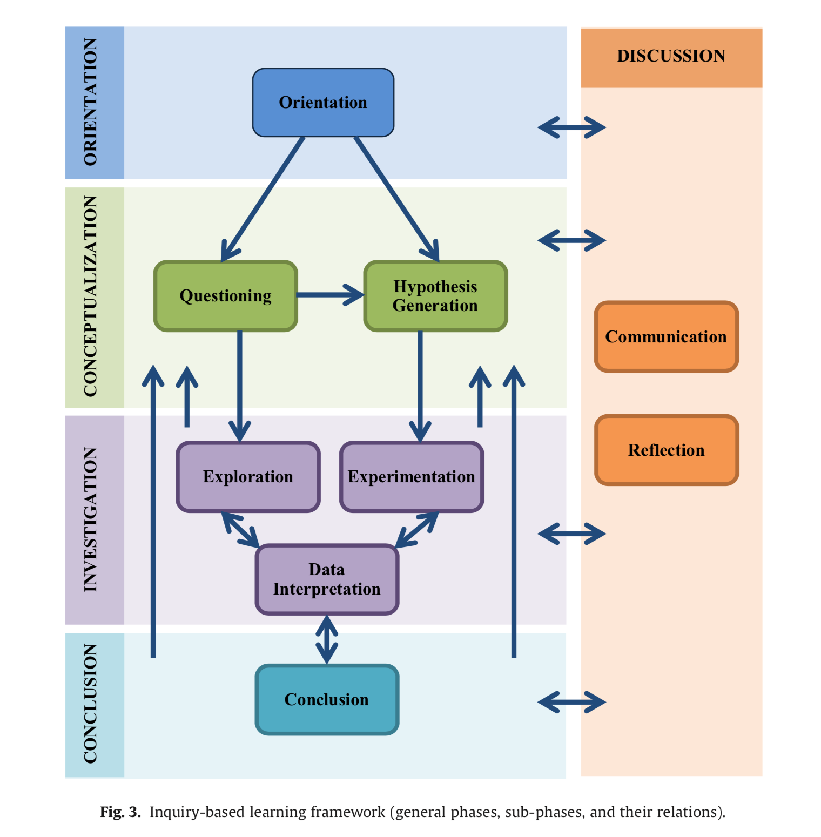
Phases of IBL
Orientation
Conceptualization
Investigation
Conclusion
Discussion
(Pedaste, Maeots, Siiman, de Jong, van Risen, Kamp, Manoli, Zacharia, & Tsourlidaki, 2015)
Notes:
IBL Model of

Slide 8
Why SDGs?
14.1 - TARGET
By 2025, prevent and significantly reduce marine pollution of all kinds, in particular from land-based activities, including marine debris and nutrient pollution
14.1.1 - INDICATOR
Index of coastal eutrophication and floating plastic debris density
14.2 - TARGET
By 2020, sustainably manage and protect marine and coastal ecosystems to avoid significant adverse impacts, including by strengthening their resilience, and take action for their restoration in order to achieve healthy and productive oceans
14.2.1 - INDICATOR
Proportion of national exclusive economic zones managed using ecosystem-based approaches
Notes:
For every one of the 16 SDGs, there are multiple targets and indicators. Targets present potential problems that might be of interest to learners (and groups of learners) as something to research in their local contexts. Indicators provide one idea for how to measure the success of any initiative related to the Target. These targets and indicators can be customized by learners to suit their contexts and interests.
Link to SDGs, Targets, and Indicators: https://sustainabledevelopment.un.org

Slide 9
Why OER?
Learner-led explorations of resources for their own learning – teach them to find and use OER
Learner portfolios and longitudinal work can be easily shared
Helps establish knowledge as a public good (both finding and sharing resources)

Slide 10
Open Design
WordPress
LearnPress
H5P – assessment and design elements
Google Docs
No sign-in, no password, downloadable, editable, openly licensed formats
Inclusive Design
Notes:
I use reclaim hosting to host my WordPress shared services account, I have installed LearnPress (a learning management system type plug-in for familiar organization), H5P, and use Google Docs as a communication backup. I’m currently learning and exploring Markdown as an option to have one content source that updates multiple iterations, otherwise I’m chasing two different sources when I update.

Slide 11
Exploring the Resources
LD4OEP.org/blog
(Learning Design for Open Educational Practices)
Open Courses
Notes:
http://ld4oep.org/blog/courses/inquiry-based-learning-using-oer-and-sdgs-for-community-success/?tab=tab-curriculum

Slide 12
Dialogue
Photo by Ian Schneider on Unsplash

Slide 13
References
Aditomo, A., Goodyear, P., Bliuc, A.-M., & Ellis, R. A. (2013). Inquiry-based learning in higher education: principal forms, educational objectives, and disciplinary variations. Studies in Higher Education, 38(9), 1239-1258. http://dx.doi.org/10.1080/03075079.2011.616584
Pedaste, M., Maeots, M., Siiman, L. A., de Jong, T., van Risen, S.A.N., Kamp, E. T., Manoli, C. C., Zacharia, Z., Tsourlidaki, E. (2015). Phases of inquiry-based learning: Definitions and the inquiry cycle. Educational Research Review, 14, 47-61.

