Slide 1
A Maximum Likelihood Approach to Multiple F0 Estimation From the Amplitude Spectrum Peaks
Zhiyao Duan, Changshui Zhang
Department of Automation
Tsinghua University, China
duanzhiyao00@mails.tsinghua.edu.cn
Music, Mind and Cognition workshop of NIPS07
Whistler, Canada, Dec. 7, 2007

Slide 2
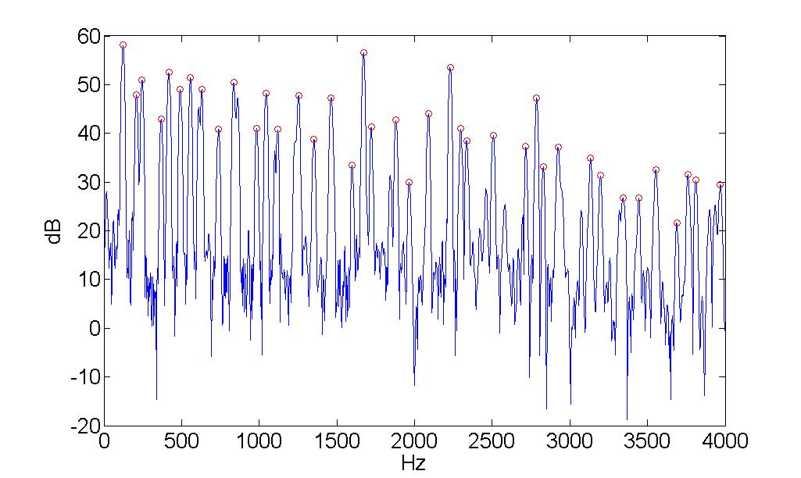
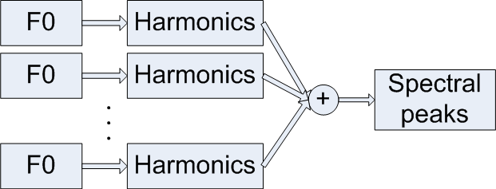
Problem Formulation
Parameters to be estimated
Number of F0s (polyphony): N
F0s:
Observation
frequencies and amplitudes of the peaks in the amplitude spectrum

Slide 3
Likelihood Function
A peak
“True”: : generated by a harmonic
“False”: : caused by detection errors

Slide 4
Likelihood Function (a peak)
Learn the parameters from the training data
Training data: the monophonic note samples
Easy to know whether a peak is “true” or “false”
= 0.964
“true” peak part
“false” peak part

Slide 5
True Peak Part
Assume that each “true” peak is generated by only one F0
50dB + 30dB = 50.8dB
amplitude
frequency

Slide 6
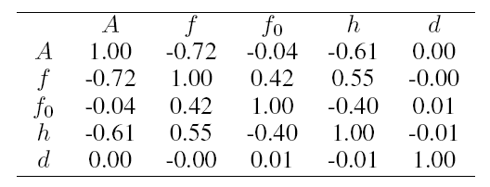
True Peak Part (amplitude)
Replace F0 with hi: harmonic number of the peak i
Estimate from the training data
A Parzen window (11*11*5)

Slide 7
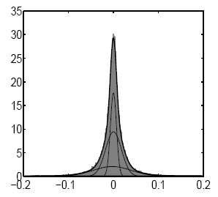
True Peak Part (frequency)
Convert the peak frequency into the frequency deviation of the peak from the nearest harmonic position of F0
Estimated from training data
Symmetric, long tailed, not spiky
A Gaussian Mixture Model (4 kernels)
MIDI number

Slide 8
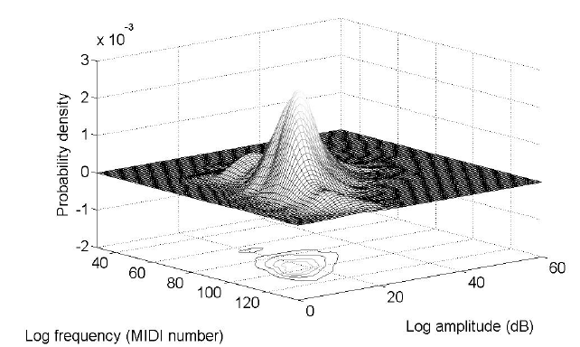
False Peak Part
Estimated from training data
A Gaussian distribution
Mean
covariance

Slide 9
Estimating the Polyphony
The likelihood will increase with the number of F0s (overfitting)
A weighted Bayesian Information Criteria (BIC)
K: number of peaks; N: polyphony
Search the F0s and the polyphony to maximize BIC
A combinational explosion problem
Greedy search: Start from N=1; add F0 one by one
Log likelihood
weight
BIC penalty

Slide 10
Experiments (1)
Acoustic materials: 1500 note samples from Iowa music database
18 wind and arco-string instruments
Pitch range: C2 (65Hz) – B6 (1976Hz)
Dynamic: mf, ff
Training data: 500 notes
Testing data: generated using the other 1000 notes
Mixed with equal mean square level and no duplication in pitch
1000 mixtures each for polyphony 1, 2, 3 and 4.

Slide 11
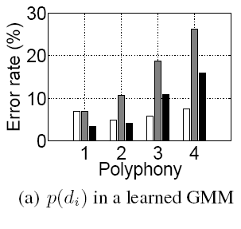
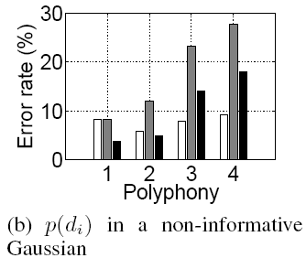
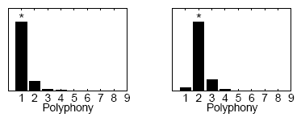
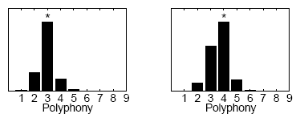
Experiments (2)
Frequency estimation
Polyphony estimation

Slide 12
Thank you! Welcome to my poster!

