Slide 1
An Experimental Comparison of Click Position-Bias Models
Nick Craswell Onno Zoeter
Michael Taylor Bill Ramsey
Microsoft Research

Slide 2
Position Bias
Top-ranked search results get more clicks
This position bias occurs because:
...users sometimes blindly click on early results?
...users are less likely to view lower ranks?
...users click the first relevant thing they see?
A model for position bias allows:
List data → Debiased evaluation of a result
Per-result data → Evaluate a list

Slide 3
Summary
Four alternate hypotheses for explaining position bias
Including a `cascade’ model
A large-scale data gathering effort
Evaluation: Which model best explains data?
Which models fail and how
Cascade model succeeds, at early ranks
Conclusions

Slide 4
A. Hypotheses

Slide 5
Hypothesis 1: No Bias
Our baseline
c_{di} is P( Click=True | Document=d, Position=i )
r_{d} is P( Click=True | Document=d )
Why this baseline?
We know that r_{d} is part of the explanation
Perhaps, for ranks 9 vs 10, it’s the main explanation
It is a bad explanation at rank 1 e.g. Eye tracking
Attractiveness of summary ~= Relevance of result

Slide 6
Hypothesis 2: Blind Clicks
There are two types of user/interaction
Click based on relevance
Click based on rank (blindly)
A.k.a. the OR model:
Clicks arise from relevance OR position
Notes:
>> x=[.3, .2, .1, .05, .02, .01, 0, 0, 0, 0]
x =
0.3000 0.2000 0.1000 0.0500 0.0200 0.0100 0 0 0 0
>> bar(x)
>> ylabel('b_i')
>> xlabel('i')

Slide 7
Hypothesis 3: Examination
Users are less likely to look at lower ranks, therefore less likely to click
This is the AND model
Clicks arise from relevance AND examination
Probability of examination does not depend on what else is in the list

Slide 8
Hypothesis 4: Cascade
Users examine the results in rank order
At each document d
Click with probability r_{d}
Or continue with probability (1-r_{d})

Slide 9
Cascade Model Example
This may seem different from the formulation on the previous slide, but is precisely equivalent
500 users typed a query
0 click on result A in rank 1
100 click on result B in rank 2
100 click on result C in rank 3
Cascade (with no smoothing) says:
0 of 500 clicked A ➔ r_{A} = 0
100 of 500 clicked B ➔ r_{B} = 0.2
100 of remaining 400 clicked C ➔ r_{C} = 0.25

Slide 10
B. Data collection

Slide 11
Flipping Adjacent Results
Do adjacent flips in the top 10
9 types of flip: 1-2, 2-3, ... , 9-10.
An “experiment”: query, URL A, URL B, rank m
A&B originate from m&m+1, though maybe not that order
Equally likely to show AB and BA
Controlled experiment: We only vary the position
108 thousand experiments with real users
Because it’s real users, adjacent flips
Our experiment requires flips, but our models do not

Slide 12
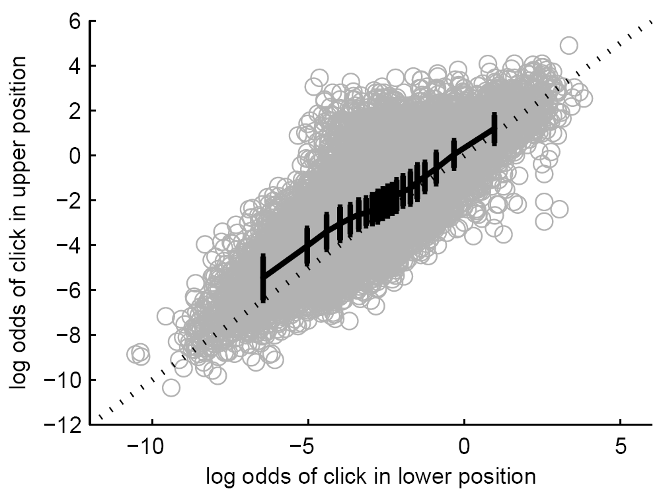
Our Dataset
logodds(p)=log(p/(1-p))

Slide 13
Blind-Click & Examination Hypotheses Are “Broken”
Blind-Click: Rank 1 might have 0 clicks
Examination: Rank 2 might have 100% clicks
Learn our parameters to stay within bounds:
Blind-Click: makes no adjustment
Examination: 2→1 is 3.5%, while 4→3 is 9.0%.
Something in rank 2 had c_{d2}=0.966
→ Need some other way to stay within bounds

Slide 14
Non-Hypothesis: “Logistic”
The shape of the data suggests a Logistic model
This is related to logistic regression

Slide 15
Measurement
Given click information for AB, predict clicks in order BA:
4 events : Click B, Click A, click both, click neither
10-fold cross validation

Slide 16
C. RESULTS

Slide 17
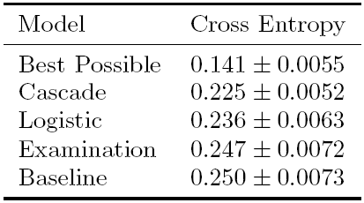
Main Results
Best possible: Given the true click counts for ordering BA

Slide 18
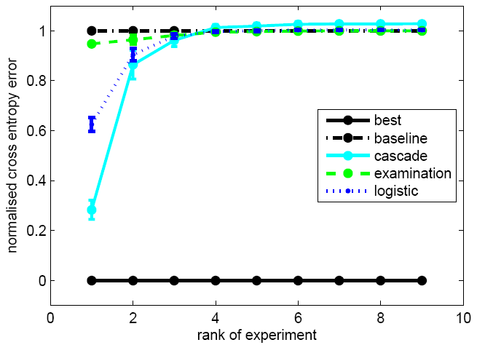
Results by Rank

Slide 20
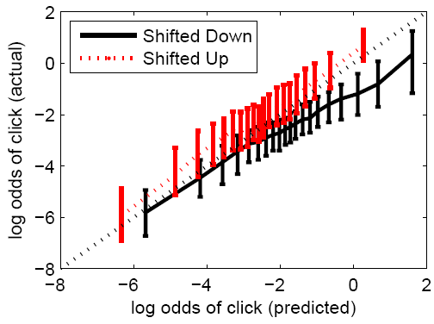
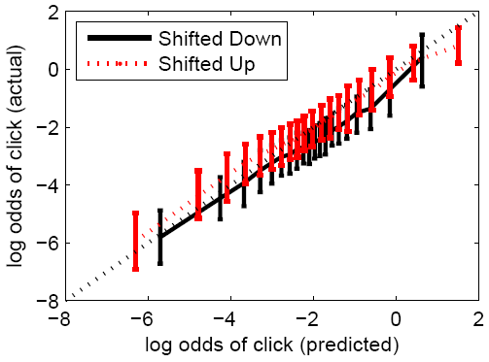
Cascade Errors
Predictions are closer to diagonal, with less spread
Not perfect

Slide 21
D. Conclusions + Future Work
Surprisingly, we reject the simple AND/OR
Users do not click randomly on rank 1
Users do not have a fixed examination curve
Cascade model works well
Particularly for 1-2 and 2-3 flips
Cascade model is basic. In future could model:
Users who click multiple results
Users who abandon their search
Different types of user or search?

Slide 22
Thank you

