Slide 1

A Scalable Pattern Mining Approach to
Web Graph Compression with Communities
Greg Buehrer and Kumar Chellapilla
Microsoft Live Labs

Slide 2
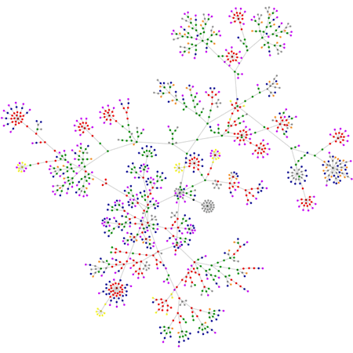
Motivation
+
=>
Who links to me?
How many hops is it from me to Kevin Bacon?
What is the growth/impact of social network X?
Are these web pages part of a link farm?

Slide 3
Web Graph Compression
Goal: Reduce the memory footprint of the graph
Existing Approaches [WWW04, DCC02, SHS]
  Sort by URL to improve similarity between near nodes
  Encode Id lists using a reference to a list in a near node, say within 5 nodes, called REFERENCE
  Sort outlinks to minimize gap, code gap instead of Id, using Huffman coding (or a similar flat code) – called GAP
  Zeta Codes – Flat codes to code the gap (no lookup table required) designed for power law distributions
Node | Outlinks
1 | 2,10,12,14,18
2 | 5,10,12,14,18
Node | Outlinks
1 | 2,10,12,14,18
2 | (-1) +5,-2
Node | Outlinks
1 | 8,2,2,2,4
2 | (-1) +5,-2

Slide 4
Our Approach
Mine for Dense Bipartite Graphs
20 Links
[CN99, KDD00]

Slide 5
Virtual Node Miner
Virtual
Node
9 Links (20/9) = 2.2x compression

Slide 6
Finding Bipartite Graphs
Cast adjacency list as a transactional data set
Use pattern mining to find frequent itemsets
Use an approximate mining strategy
Cust 1: milk bread cereal
Cust 2: milk bread eggs sugar
Cust 3: milk bread butter
Cust 4: eggs sugar
Node 1 Outlinks: 12,13,14,17
Node 2 Outlinks: 12,13,14,19
Node 3 Outlinks: 12,13,14,33
Node 4 Outlinks: 3,4,12,13,14
=>

Slide 7
Webgraph Compression via Probabilistic Itemset Mining
Perform mining in several steps
  Cluster/group similar nodes together using min-wise hashing
  Finds patterns in the correlated group
  Create virtual nodes
  Substitute VN into graph
  Iterate
Find Patterns
Remove Patterns
Add Virtual Node
Cluster

Slide 8
Step 1 – Clustering
Use K min hashes to reduce each outlink list from variable length to length K, obtaining an n*K matrix
Id | 1 | 2 | 3 | 4 | K
1 | hashA | hashF | hashW | hashC | hashB
2 | hashF | hashR | hashA | hashA | hashB
3 | hashA | hashE | hashA | hashF | hashC
n | hashG | hashR | hashE | hashG | hashG

Slide 9
Clustering (cont)
B. Sort the matrix
Id | 1 | 2 | 3 | 4 | K
3 | hashA | hashE | hashA | hashF | hashC
1 | hashA | hashF | hashW | hashC | hashB
2 | hashF | hashR | hashA | hashA | hashB
n | hashG | hashR | hashE | hashG | hashG
Id | 1 | 2 | 3 | 4 | K
1 | hashA | hashF | hashW | hashC | hashB
2 | hashF | hashR | hashA | hashA | hashB
3 | hashA | hashE | hashA | hashF | hashC
n | hashG | hashR | hashE | hashG | hashG

Slide 10
Clustering (cont)
Traverse the columns lexicographically, grouping nodes with the same hash value
  If we reach K or have a small set, mine it
Id | 1 | 2 | 3 | 4 | K
3 | hashA | hashE | hashA | hashF | hashC
1 | hashA | hashE | hashA | hashC | hashB
2 | hashA | hashE | hashW | hashA | hashB
n | hashA | hashR | hashE | hashG | hashG

Slide 11
Step 2 - Mining
Scan all node outlinks and record a histogram of outlink ID frequencies
Node Id | Outlinks
23 | 6,10,5,12,15, 1,2,3
102 | 1,2,3,20
55 | 2,3, 10,12,1,5,6,15
204 | 1,7,8,9,3
13 | 1,2,3,8
64 | 1,2,3,5,6,10,12,15
43 | 1,2,5,10,22,31,8,23,36,6
431 | 1,2,5,10,21,31,67,8,23,36,6
Id | 1 | 2 | 3 | 5 | 6 | 10 | 8 | 12 | 15 | 23 | 31 | 36 | 7 | 9 | 20 | 21 | 22 | 67
Count | 8 | 7 | 6 | 5 | 5 | 5 | 4 | 3 | 3 | 2 | 2 | 2 | 1 | 1 | 1 | 1 | 1 | 1

Slide 12

Mining (cont)
Reorder each node’s
outlink list based
on the histogram
(delete those
with count=1)
Node Id | Outlinks
23 | 6,10,5,12,15, 1,2,3
102 | 1,2,3,20
55 | 2,3,1,5
204 | 1,7,8,9,3
13 | 1,2,3,8
64 | 1,2,3,5,6,10,12,15
43 | 1,2,5,10,22,31,8,23,36,6
431 | 1,2,5,10,21,31,67,8,23,36,6
Node Id | Outlinks
23 | 1,2,3,5,6,10, 12,15
102 | 1,2,3
55 | 1,2,3,5,6,10,12,15
204 | 1,3,8
13 | 1,2,3,8
64 | 1,2,3,5,6,10,12,15
43 | 1,2,5,6,10,8,23,31,36
431 | 1,2,5,6,10,8,23,31,36
Id | 1 | 2 | 3 | 5 | 6 | 10 | 8 | 12 | 15 | 23 | 31 | 36 | 7 | 9 | 20 | 21 | 22 | 67
Count | 8 | 7 | 6 | 5 | 5 | 5 | 4 | 3 | 3 | 2 | 2 | 2 | 1 | 1 | 1 | 1 | 1 | 1

Slide 13
Mining (cont)
1: {13,23,43,55,64,102,204,431}
1: {23}
Build a trie of the node
outlink lists
1: {23,102}
2: {13,23,43,55,64,102,431}
2: {23}
2: {23,102}
3: {204}
5: {43,431}
3: {13,23,55,64,102}
3: {23}
Node Id | Outlinks
23 | 1,2,3,5,6,10, 12,15
102 | 1,2,3
55 | 1,2,3,5,6,10,12,15
204 | 1,3,8
13 | 1,2,3,8
64 | 1,2,3,5,6,10,12,15
43 | 1,2,5,6,10,8,23,31,36
431 | 1,2,5,6,10,8,23,31,36
3: {23,102}
8: {204}
6: {43,431}
5: {23,55,64}
5: {23}
5: {23}
8: {13}
10: {43,431}
6: {23,55,64}
6: {23}
8: {43,431}
10: {23,55,64}
10: {23}
23: {43,431}
12: {23,55,64}
12: {23}
31: {43,431}
15: {23,55,64}
15: {23}
36: {43,431}

Slide 14
Mining (cont)
1: {13,23,43,55,64,102,204,431}
1: {23}
1: {23,102}
Walk the trie and
add candidate
nodes to a list
$ = (L-1)*(F-1)
2: {13,23,43,55,64,102,431}
2: {23}
2: {23,102}
3: {204}
5: {43,431}
3: {13,23,55,64,102}
3: {23}
3: {23,102}
8: {204}
6: {43,431}
5: {23,55,64}
5: {23}
5: {23}
8: {13}
10: {43,431}
6: {23,55,64}
6: {23}
8: {43,431}
10: {23,55,64}
|P| | Node List | $
9 | 43,431 | 8
10: {23}
|P| | Node List | $
9 | 43,431 | 8
3 | 13,23,43,55,64,102,431 | 8
|P| | Node List | $
9 | 43,431 | 8
2 | 13,23,43,55,64,102,431 | 6
8 | 23,55,64 | 14
3 | 13,23,55,64,102 | 8
|P| | Node List | $
9 | 43,431 | 8
3 | 13,23,43,55,64,102,431 | 6
8 | 23,55,64 | 14
23: {43,431}
12: {23,55,64}
12: {23}
31: {43,431}
15: {23,55,64}
15: {23}
36: {43,431}

Slide 15
Mining Stage (cont)
Sort the list based on their $
  Including a Virtual Node for a pattern may rule out another pattern
|P| | Node List | $
9 | 43,431 | 8
8 | 23,55,64 | 14
3 | 13,23,55,64,102 | 8
2 | 13,23,43,55,64,102,431 | 6
|P| | Node List | $
8 | 23,55,64 | 14
9 | 43,431 | 8
3 | 13,23,55,64,102 | 8
2 | 13,23,43,55,64,102,431 | 6

Slide 16
Mining (cont)
Remove the top item in the list and make a virtual node of it (replacing outlink IDs along the way)
Node Id | Outlinks
23 | 6,10,5,12,15, 1,2,3
102 | 1,2,3,20
55 | 2,3, 10,12,1,5,6,15
204 | 1,7,8,9,3
13 | 1,2,3,8
64 | 1,2,3,5,6,10,12,15
43 | 1,2,5,10,22,31,8,23,36,6
431 | 1,2,5,10,21,31,67,8,23,36,6
Node Id | Outlinks
23 | V1
102 | V3,20
55 | V1
204 | 1,7,8,9,3
13 | V3,8
64 | V1
43 | V2,22
431 | V2,21,67
V1 | 1,2,5,6,10,8,23,31,36
V2 | 1,2
V3 | 1,2,3,5,6,10,12,15
|P| | Node List | $
8 | 23,55,64 | 14
9 | 43,431 | 8
3 | 13,23,55,64,102 | 8
2 | 13,23,43,55,64,102,431 | 6

Slide 17
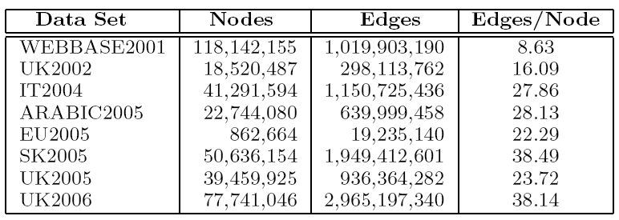
Empirical Evaluation
Goal: Evaluate along 3 axes
  Compression, Scalability, Patterns Discovered
  Implementation in C++
  Windows Server 2003, 16GB RAM, 2.8GHz core
Datasets from WebGraph data repository

Slide 18
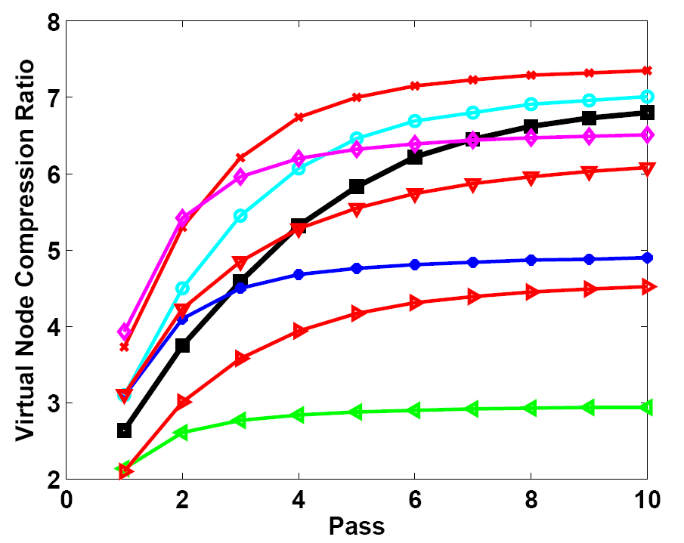
Compression Afforded by VNodes
Webbase2001 is old and only has 8 edges/node

Slide 19
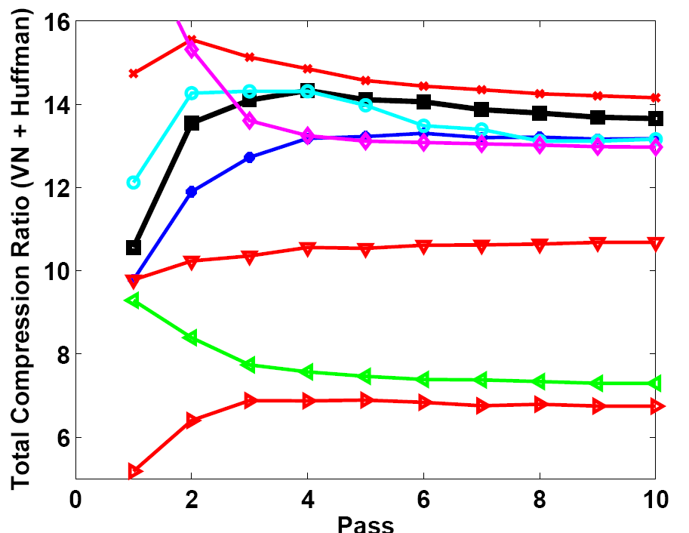
Total Compression

Slide 20
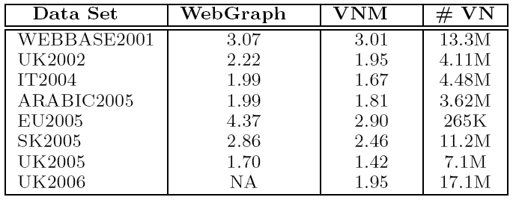
Compression Comparison
Bits per edge for Virtual Node Miner and WebGraph

Slide 21
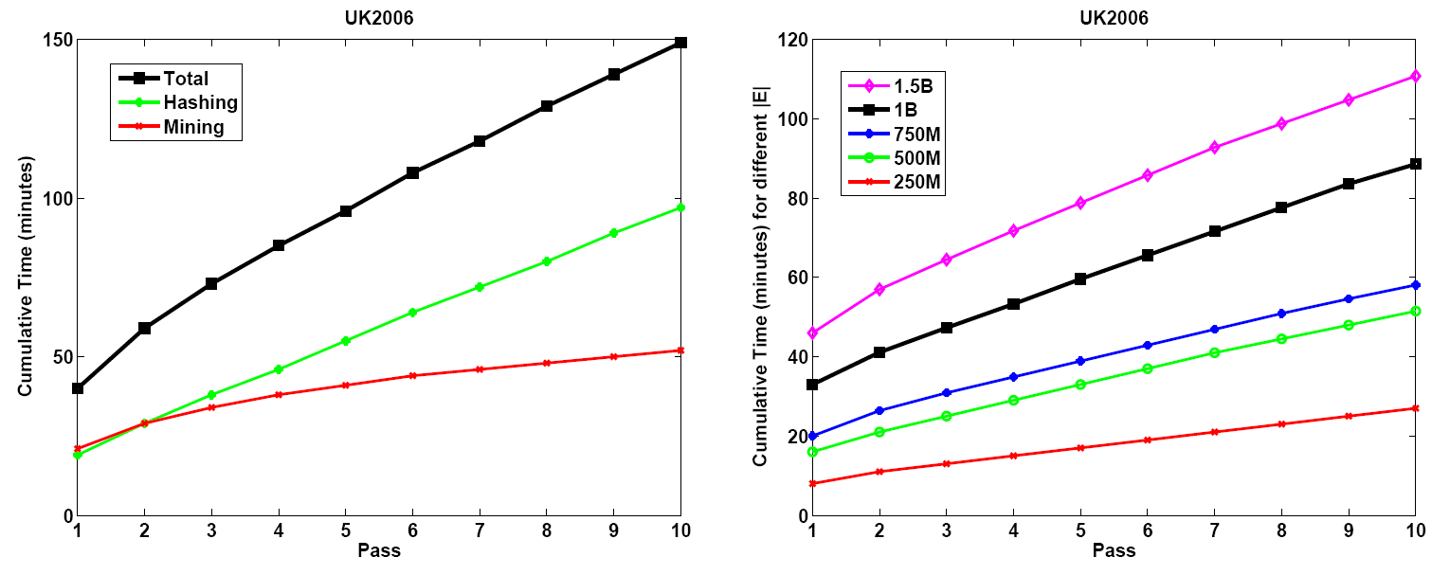
Scalability

Slide 22
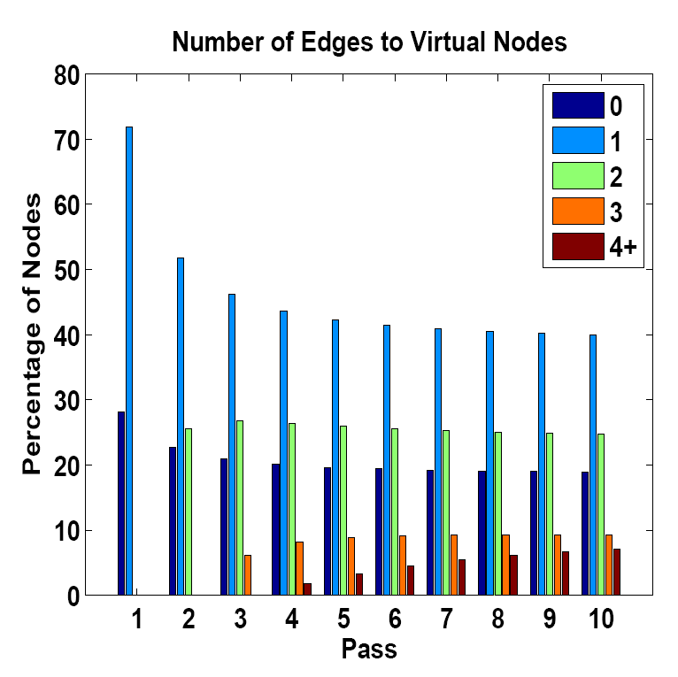
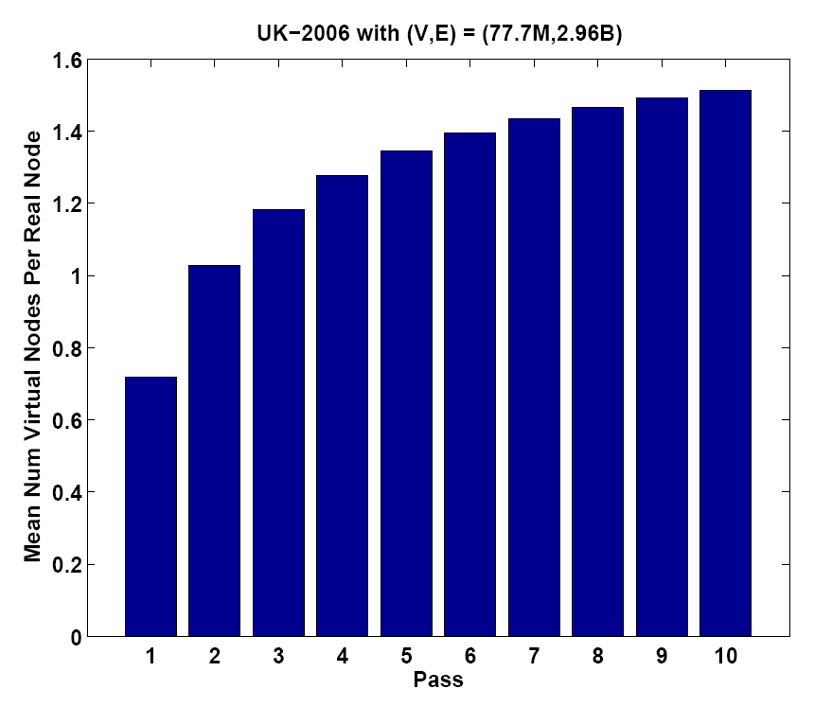
Virtual Node Properties

Slide 23
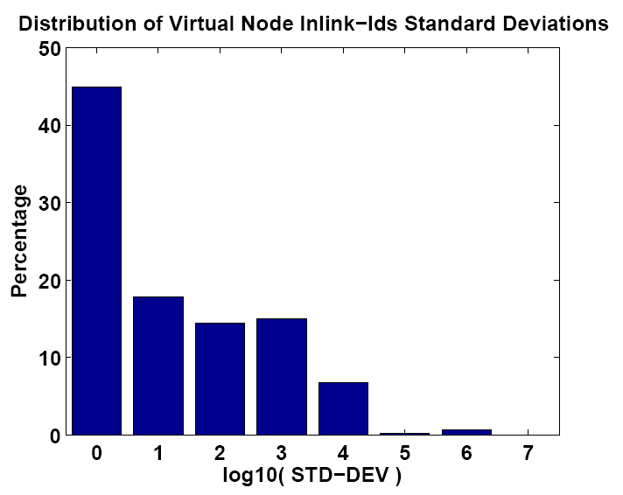
Communities are far apart
Reference schemes typically have a small window size

Slide 24
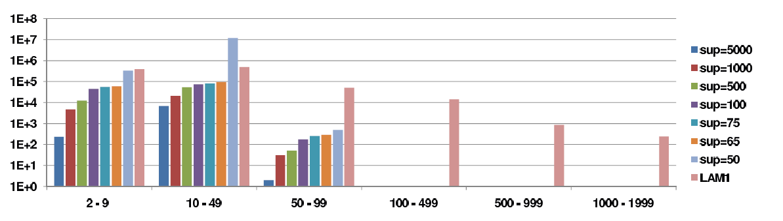
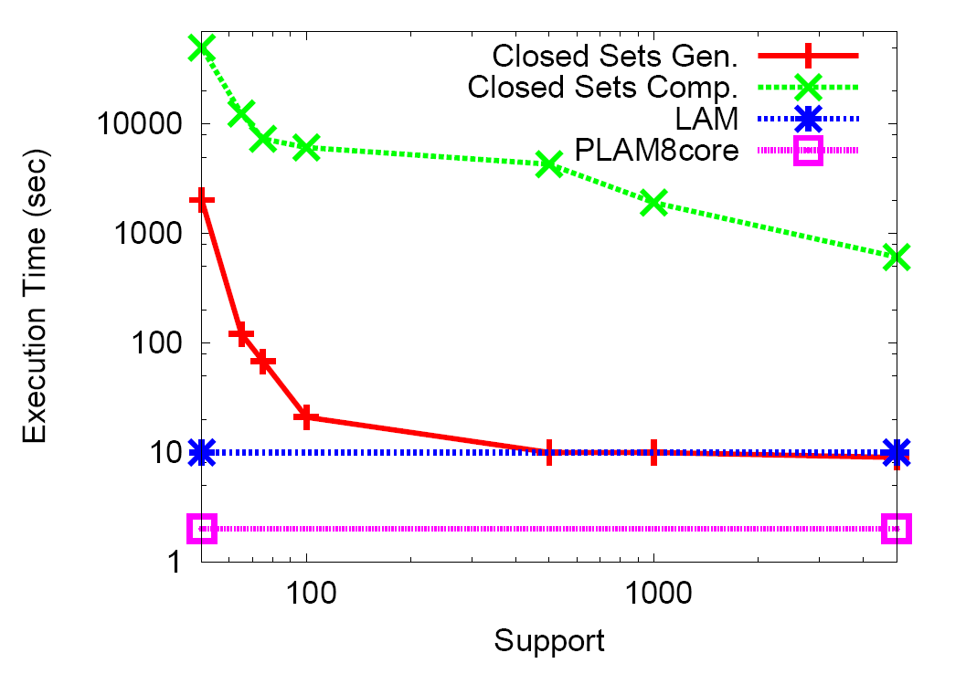
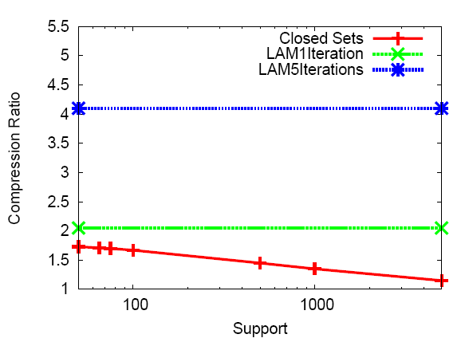
Vs Traditional Mining
σ=5000
σ=1000
σ=500
σ=100
σ=75
σ=65
σ=50
VNM
Closed Sets Gen.
Closed Sets
Closed Sets Comp.
VNM1Iteration
VNM
VNM5Iterations
VNM8core
EU-2005

Slide 25
Take Home Message
Web Graph Compression Contribution
  Supports any URL ordering, any labeling
  Supports any encoding scheme
  Seeds for community discovery
  High compression ratio
  Scales well
  Can be extended
Data Mining
  Log-linear itemset miner
  Interesting data sets for pattern mining

Slide 26
Ongoing Work
Computations on the compressed graph
Ease of importing/updating data
Compression for the full graph

Slide 27
Thanks!
External References
[JCSS98] A. Broder, M. Charikar, A. Frieze, M. Mitzenmache. Min-wise Independent Permutations. In Journal of Computer and System Sciences, 1998.
[CN99] R. Kumar, P. Raghavan, S. Rajagopalan and A. Tomkins. Trawling the Web for emerging cyber-communities. In CN 1999.
[KDD00] G. Flake, S. Lawrence and C. Giles. Efficient identification of web communities. In KDD 2000.
[SIG00] J. Han, J. Pei and Y. Yin. Mining frequent patterns without candidate generation. In SIGMOD 2000.
[DCC02] K. Randall, R. Stata, R. Wickremesinghe and J. Wiener. The Link database: Fast access to graphs of the web. In DCC 2002.
[WWW04] P. Boldi and S. Vigna. The webgraph framework i: Compression Techniques. In WWW 2004.
[VLDB05] D. Gibson, R. Kumar and A. Tomkins. Discovering large dense subgraphs in massive graphs. In VLDB 2005.

Slide 28
End of Talk

Slide 29
Extra slides for question support

Slide 30
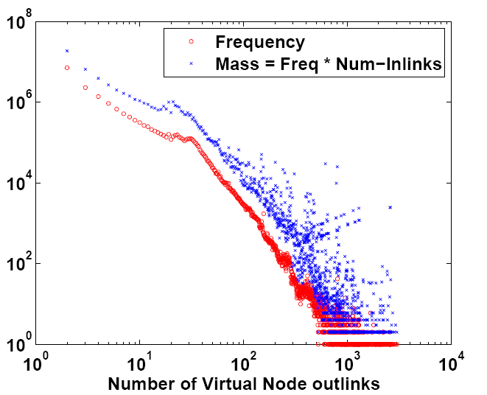
Length of Virtual Nodes

Slide 31
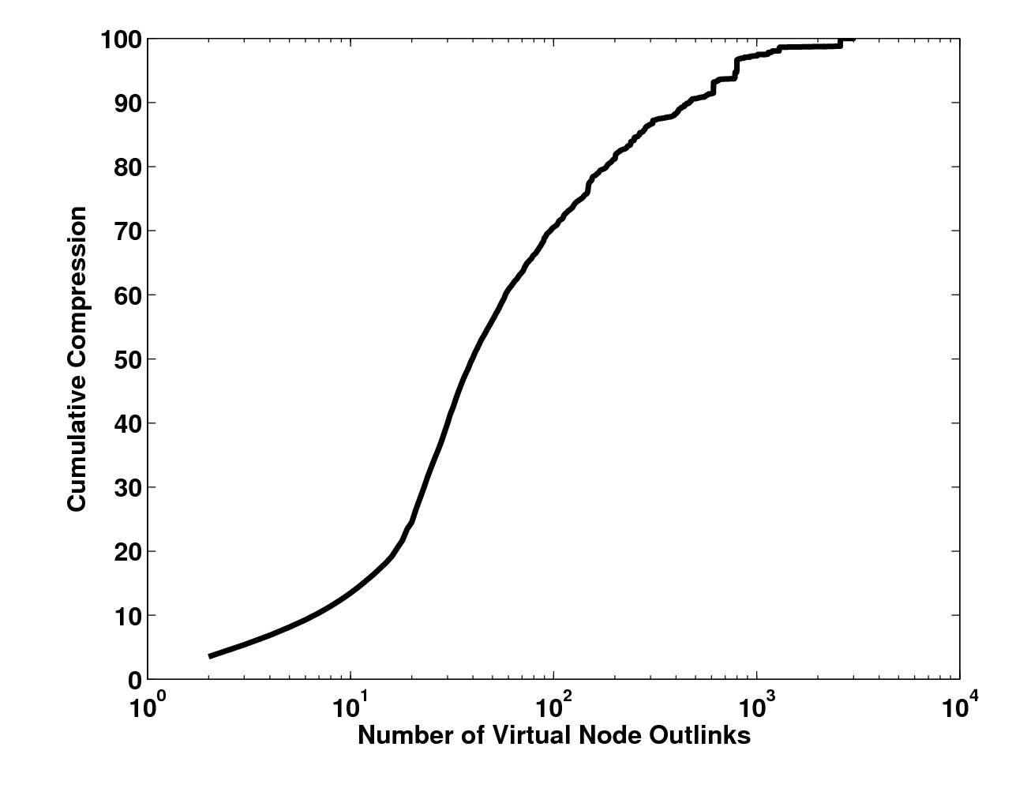
Compression as a
Function of Pattern Length

Slide 32
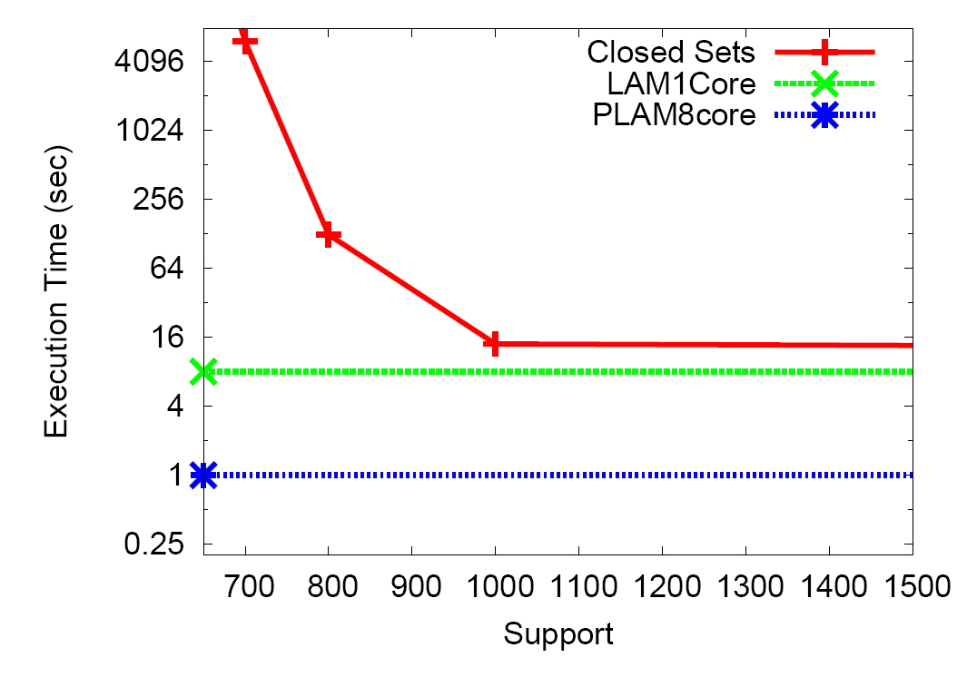
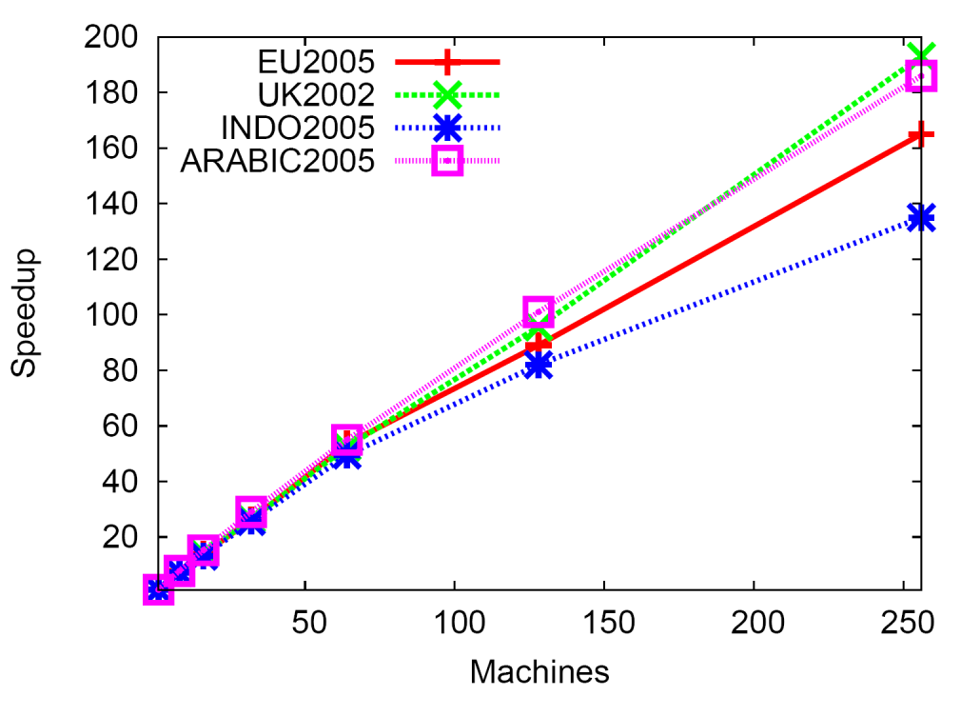
Empirical Evaluation
Scalability and Execution Time

Slide 33
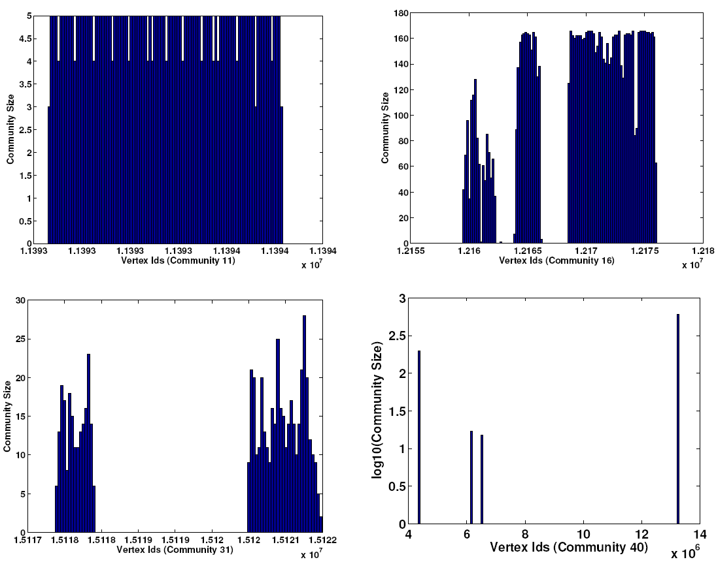
Semantics
Community 16:
Community 11:
A link farm for
http://loan69.co.uk/
inlinks 1000+
pattern 1000+
Community 40:
Community 31:
ringtones.mobilefun.co.uk

Slide 34
Optimality
What if we were given every itemset and its frequency for free?
1,2,4,5,9,10,12,13,14,18,23,34
Optimality is intractable
An approximate solution may prove useful

Slide 35
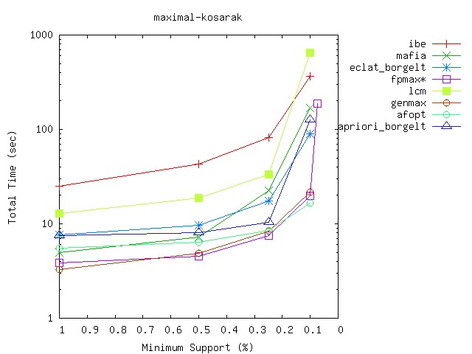
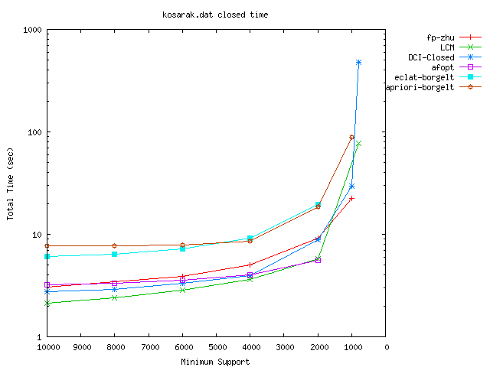
Existing Itemset Mining Algorithms
Existing solutions have worst case exponential runtimes [FIMI03]
  Our use case is worst case (support=2)
  Even streaming algorithms have worst case exponential runtime complexities
Other patterns besides itemsets, such as closed sets, maximal sets, and top-K sets also have exponential runtimes

Slide 36
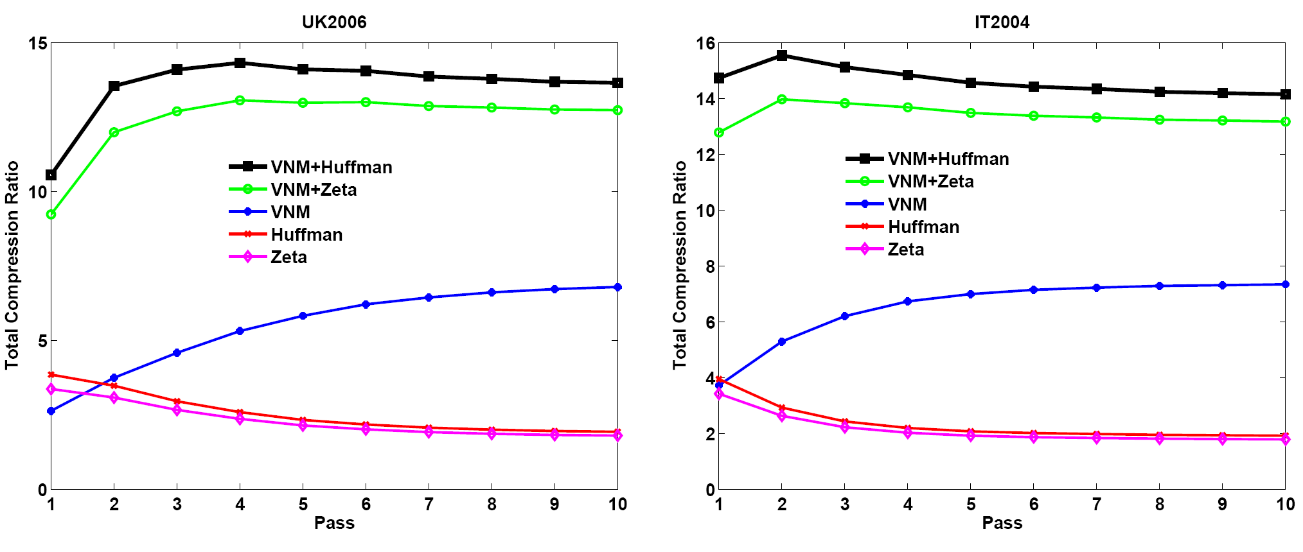
Compression Components
Huffman coding degrades as
VN compression increases

