Slide 1
Personal Name Classification in Web queries
Dou Shen*, Toby Walker*, Zijian Zheng*,
Qiang Yang**, Ying Li*
*Microsoft Corporation
** Hong Kong University of Science and Technology

Slide 2
Introduction
Goal:
To detect whether a Web query is a personal name, without referring to any other context information;
Motivation
2~4% of daily Web queries are personal names
~6% of jumping queries are personal names
Users tend to test a search engine by their names
Applications
Paid Search
“toby walker” → “Wheeled Walkers Sale $89.”
Query Suggestion
Show the profile-related information once a query is determined as a personal name
X

Slide 3
Related Work
Improve Personal Name Search
Dozier studied some specific strategies for personal name search [1]
Wan et al. studied a person resolution system to improve people search performance [2]
Personal Name Extraction/Recognition
As a special case of named entities, personal name extraction from document/webpage/emails has been widely studied recently [3, 4, 5]
Web Query Enrichment
Use click-trough data [6]
User Web Search [7]

Slide 4
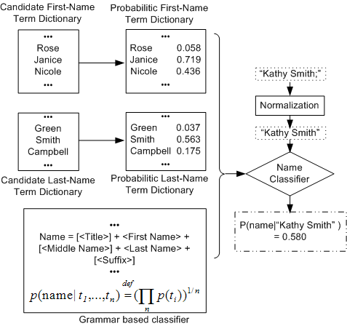
Overview of Our Solution
Offline Training
Online Classifier

Slide 5
Offline Training

Slide 6
Offline Training
Terminology
Candidate Dictionaries
Term Context: “…toby walker…”; “…city of walker…”
Name Term Context: “…toby walker…”
Name Context: “…Dr. Qiang Yang’s student…”
Probability Estimation Methods
Relative Frequency
Context Probability
Co-Occurrence in Search Snippets
Co-Occurrence in Bigrams

Slide 7
Probability Estimation Methods (1)
Relative Frequency
Get a set of names
Get the relative frequency of each term
Context Probability
Assumption: if a term is name term, its term contexts should be name contexts
Train a unigram model over some name contexts
Given a term, get its term contexts through search engines and calculate the probability of term contexts using the trained model

Slide 8
Probability Estimation Methods (2)
Co-Occurrence in Search Snippets (S-CoOcc)
Get term contexts through search engines
Identify name term contexts using some rules
followed by a last name term, such as “john smith”;
followed by a first name term and then a last name term, such as “John Maynard Smith”;
followed by a special kind of verbs such as “did, said, announced, claimed…” as in “John said”;
……
Estimate the term probability as the ratio between name term contexts and term contexts
Golden Dictionaries

Slide 9
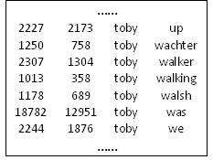
Probability Estimation Methods (3)
Co-Occurrence in Bigrams (B-coOcc)
Get term contexts from a bigram file
Estimate the term probability as in S-coOcc

Slide 10
Online Classifier (1)
Grammar matching
Geometric average
Tricks
p(title) = 1; p(suffix)=1
q = [t₁] t₂ [t₃] t₄ [t₅]
[<Title>] <First Name>[<Middle Name>]<Last Name>[<Suffix>]

Slide 11
Online Classifier (2)
Personal Name Grammars
<Personal Name> ::= [<Title>] <First Name>[<Middle Name>]<Last Name>[<Suffix>]
<Title> ::= dr | doctor | ms, …
<Suffix> ::= sr.| jr.| III …
<First Name> ::= <first name term>|
<first name term>-<first name term>;
<Middle Name>::= <First Name> | <Last Name>;
<Last Name> ::= <last name term>|
<last name term>-<last name term>;

Slide 12
Experiments
Data Sets
Dictionaries
Name Context:
Top 200, 000 personal names from WP
10,000,000 name contexts
Term Context
2,000,000 candidate terms
80,000,000 term contexts
Testing Data Sets
Validation dataset: 2,000 queries, 81 names
Test dataset: 10,000 queries, 232 names

Slide 13
Baselines
Dictionary Look-up
Supervised Methods
Classifiers
SVM, Logistic Regression
Features
f₁: the length of the query;
f₂: whether the query contains a title term;
f₃: whether the query contains a suffix term;
f₄: the probability of a term being a first name term
f₅: the probability of a term being generated by a character level bigram model trained on first-name terms;

Slide 14
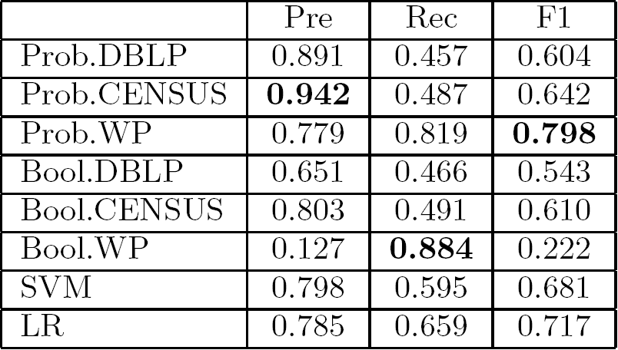
Experiment Results (1)
Comparison among our method and the baselines
Our Methods
Dictionary Look-up
Supervised Methods

Slide 15
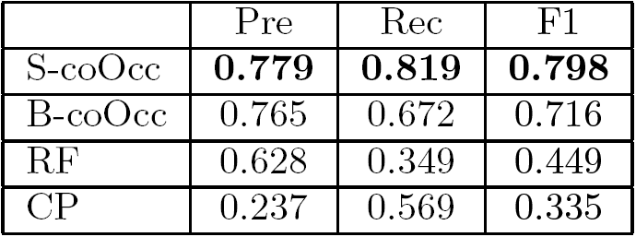
Experiment Results (2)
Comparison of different ways of constructing probabilistic dictionaries.
Candidate Dictionaries: WP
Golden Dictionaries: CENSUS

Slide 16
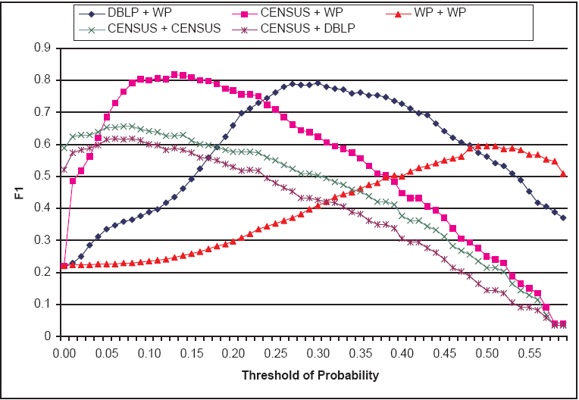
Experiment Results (3)
Effect of Golden Dictionaries and Candidate Dictionaries

Slide 17
Experiment Results (4)
Effect of Enlarging Golden Dictionaries
Golden dictionaries: CENSUS and its expansions
Candidate dictionaries: WP
S-coOcc

Slide 18
Experiment Results (5)
Effect of Enlarging Candidate Dictionaries
Gold dictionaries: CENSUS
Candidate dictionaries: CENSUS and its expansions
B-coOcc

Slide 19
Conclusion and Future Work
Conclusion
Put forward an easy but effective method for personal name classification in Web queries
Exploit the methods of enlarging golden dictionaries and candidate dictionaries.
Future work
Instead of using rules, try to define name term contexts using existing named entity recognition algorithms
Validate the contribution of personal name classification to Web Search and Advertising
Validate the classifier in non-US names

Slide 20
References
[1] C. Dozier. Assigning belief scores to names in queries. HLT '01.
[2] X. Wan, J. Gao, M. Li, and B. Ding. Person resolution in person search results: Webhawk. CIKM '05
[3] Z. Chen, L. Wenyin, and F. Zhang. A new statistical approach to personal name extraction. ICML '02:
[4] H. L. Chieu and H. T. Ng. Named entity recognition with a maximum entropy approach. HLT-NAACL ‘03
[5] V. Krishnan and C. D. Manning. An effective two-stage model for exploiting non-local dependencies in named entity recognition. ACL-COLLING ’06
[6] J.-R. Wen, J.-Y. Nie, and H.-J. Zhang. Clustering user queries of a search engine. WWW ‘01
[7] D. Shen, R. Pan, J.-T. Sun, J. J. Pan, K. Wu, J. Yin, and Q. Yang. Query enrichment for web-query classification. TOIS ‘06.

Slide 21
Thanks!

