Slide 1
Space Planning for Online Community
Danyel Fisher, Tammara Combs Turner, and Marc A. Smith
Microsoft Research, Microsoft Live Labs, and Microsoft Internet Services Research Center 1 Microsoft Way Redmond, Washington 98052 {danyelf, tcombs, marc.smith}@microsoft.com
Notes:
Engaged as internal consultants on community
Discussion about how communities are doing
Lots of experience (good/bad/ugly)

Slide 2
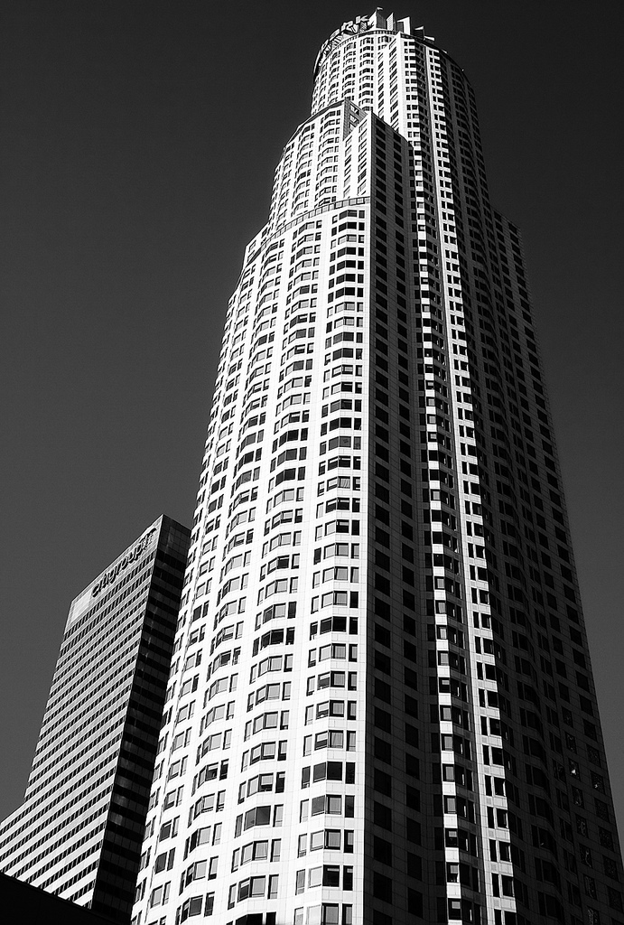
Notes:
social issues in running and organizing online communities from the perspective of a corporate or institutional host
these points are illustrated with brief examples that represent interactions with managers of online communities and other business partners.
Build a product or service related community
Maintain community products
Manage conflict
http://flickr.com/photos/funwithcameras/499980599/
http://flickr.com/photos/seraphimc/300380965

Slide 3
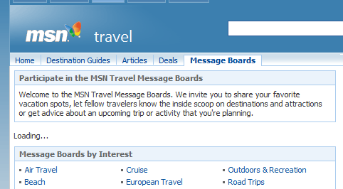
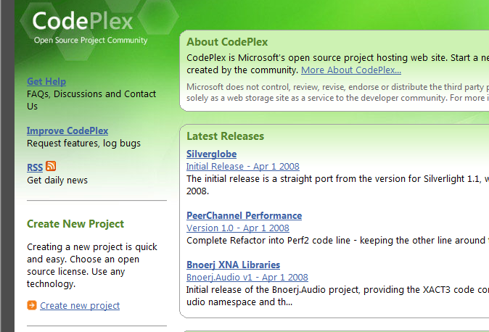
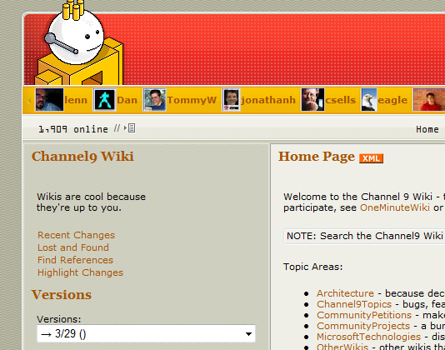
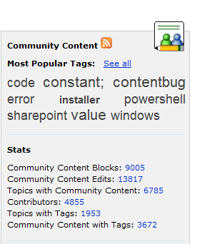

Slide 4
Location and Purpose
Monitor Social Activity
Provide Feedback
Organize and Maintain the Space
Know the space’s purpose
Reward Users
Encourage critical mass
Know what the space is doing
Embrace leaders
Build on existing community
Use positive reputation
Exert gentle control
Notes:
Windows Live Maps (3d)
http://flickr.com/photos/steve-n-leona/242286201/
http://flickr.com/photos/hopkinsii/163936283/

Slide 5
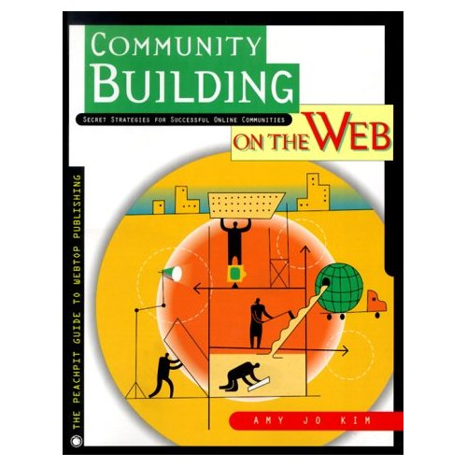
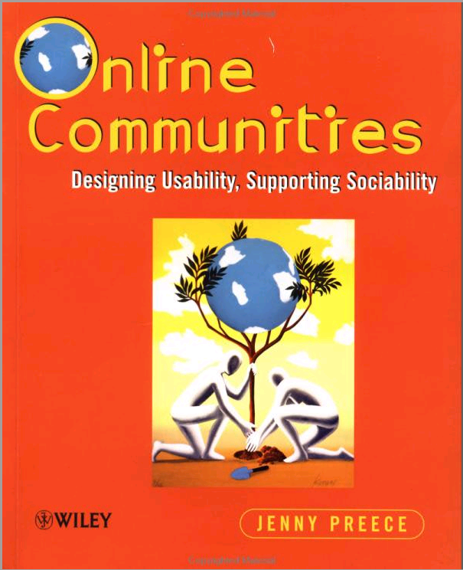
Notes:
mapping between existing research into online social spaces to the leading issues we have found in a large scale corporate online community environment.

Slide 6
1
Get that many good people in one place and great stuff must happen.
It‘s been six months now, and no one has shown up!

Slide 7
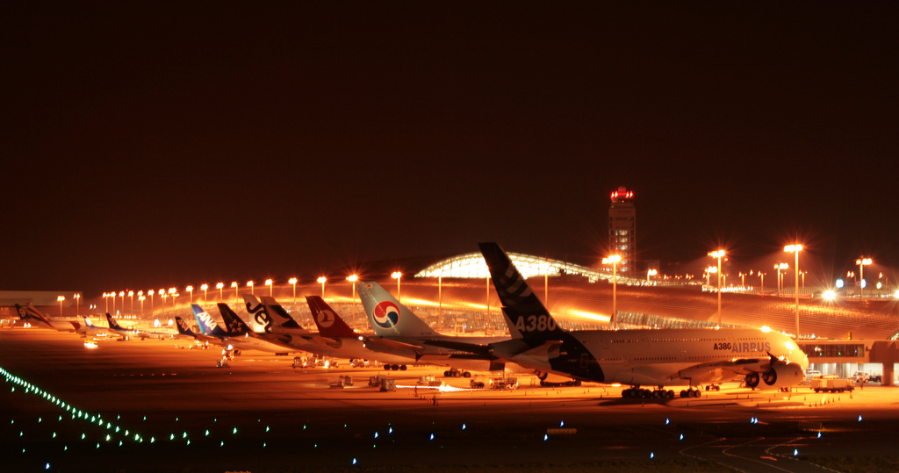
1. Know the Space’s Purpose
Notes:
http://flickr.com/photos/fotopakismo/1654421570/

Slide 8
2
People who are using the Management Console need to talk with each other!
What do they do now?
Most of them use the Installation Console message boards.

Slide 9
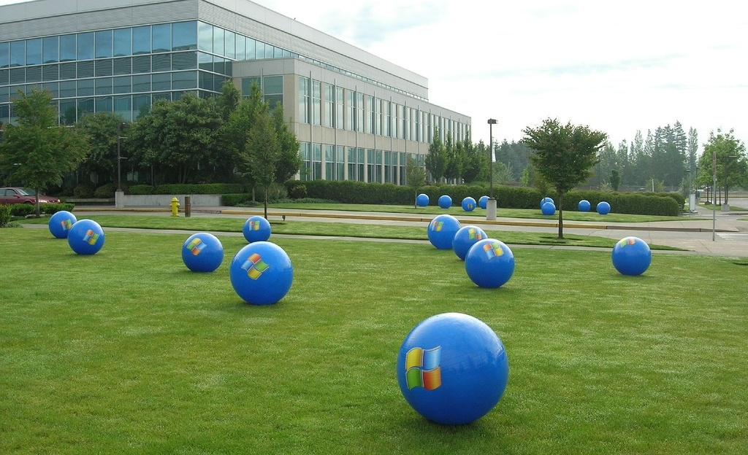
2. Build on Existing & Community Brand
Notes:
“Users don’t care about your internal divisions”

Slide 10
3
Community ROI?
Reach and Impact?
Will the community survive?
Notes:
What tools can I use to measure our return on investment in communities?
How can we gauge reach and impact to current and potential customers?
Is this community going to survive? Is it worth what we pay to maintain it?

Slide 11
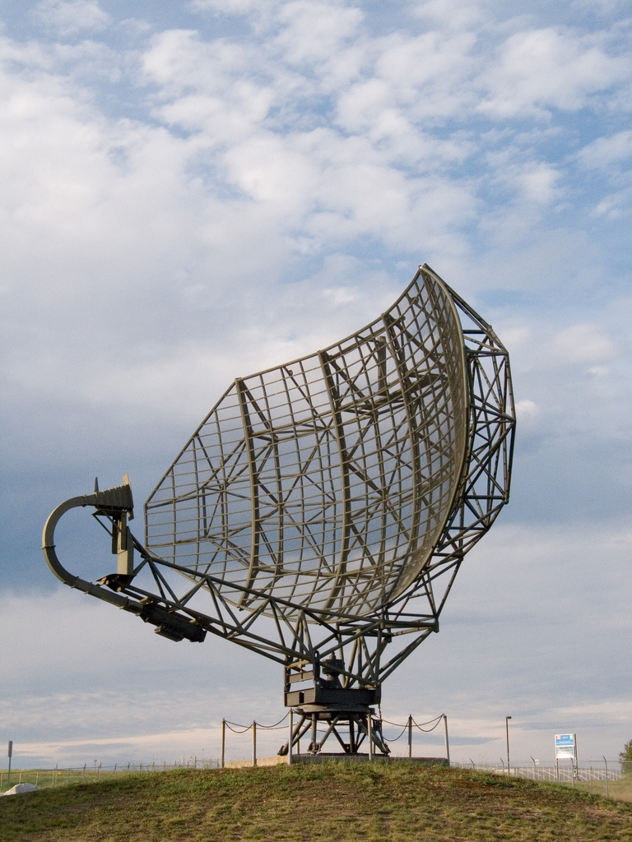
3. Know What the Space is Doing
Notes:
Search
Readership logs
Metadata reports
Author and discussion profiles

Slide 12
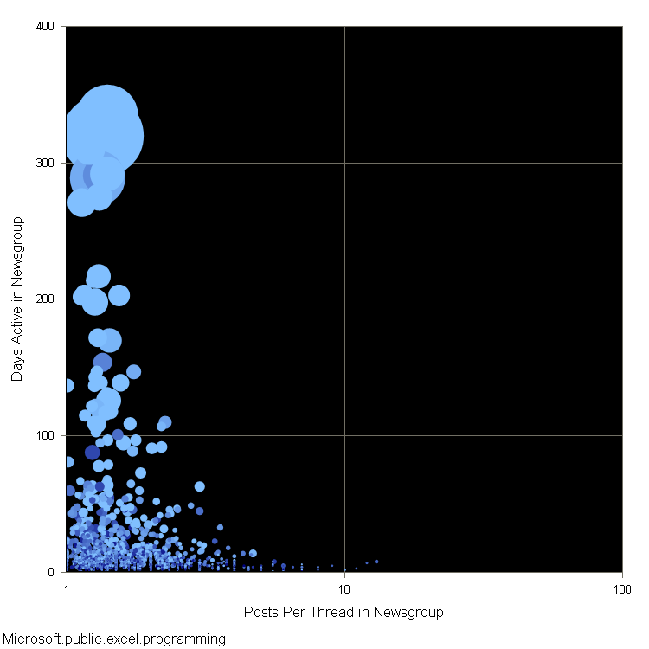
microsoft.public. excel.programming
Notes:
These are images from Usenet Views ( \\msr-halows ). Note that the most active (big bubbles) people have short (left) threads, are active many (top) days.

Slide 13
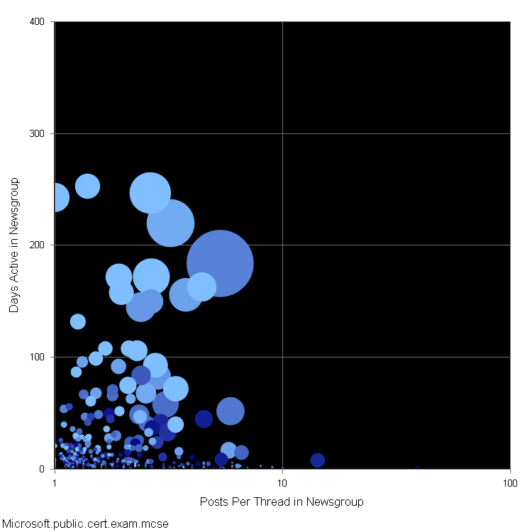
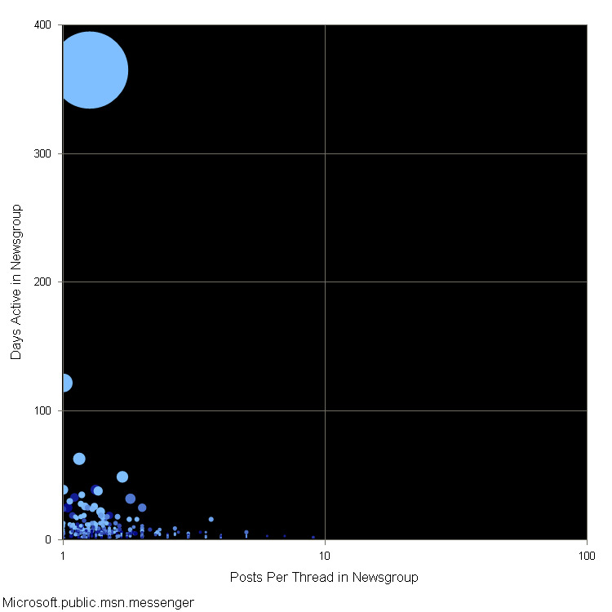
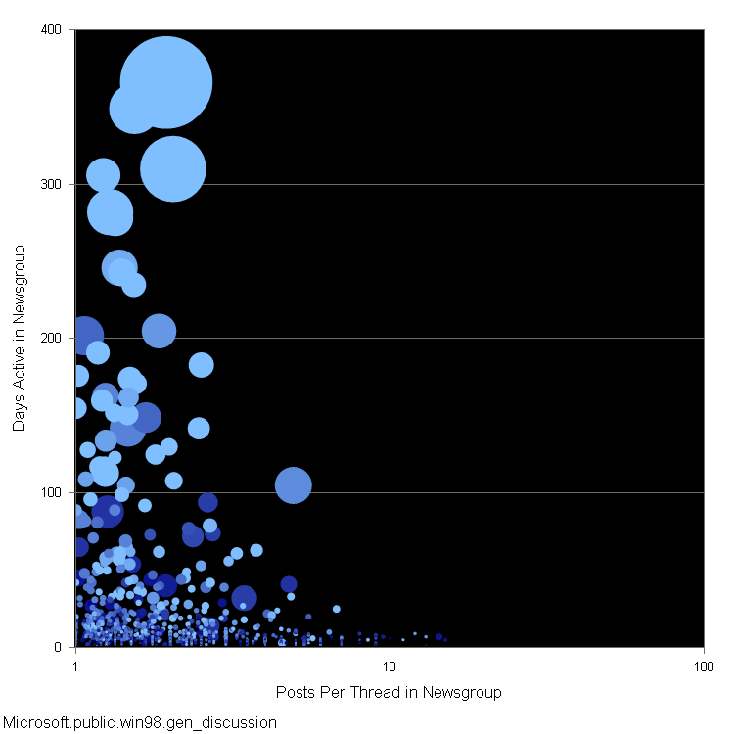
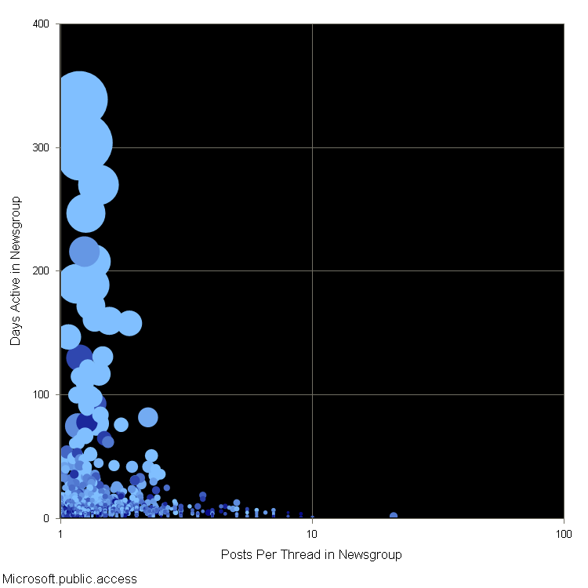
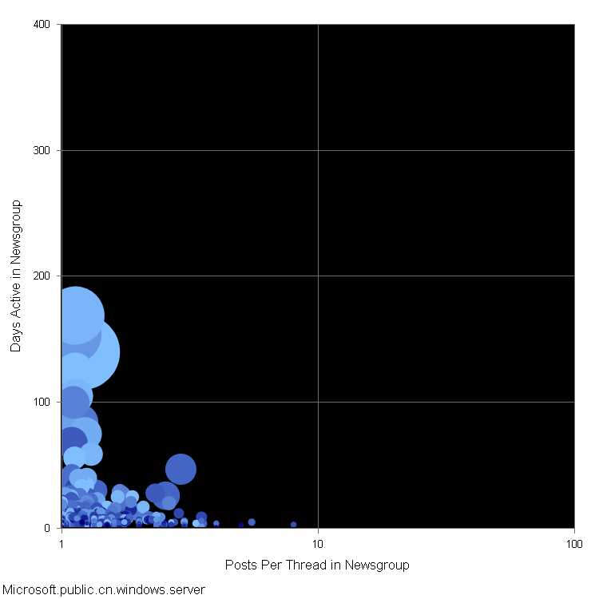
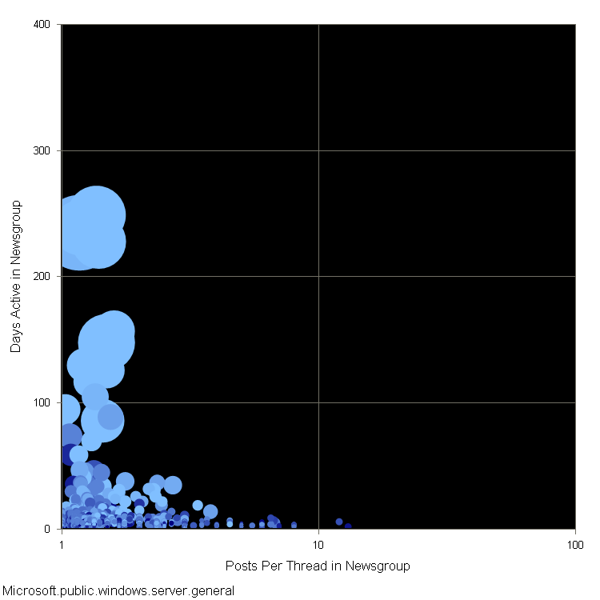
microsoft.public. cert.exam.mcse
microsoft.public. msn.messenger
microsoft.public. win98. gen_discussion
microsoft.public. access
microsoft.public. cn.windows.server
microsoft.public. windows.server. general

Slide 14
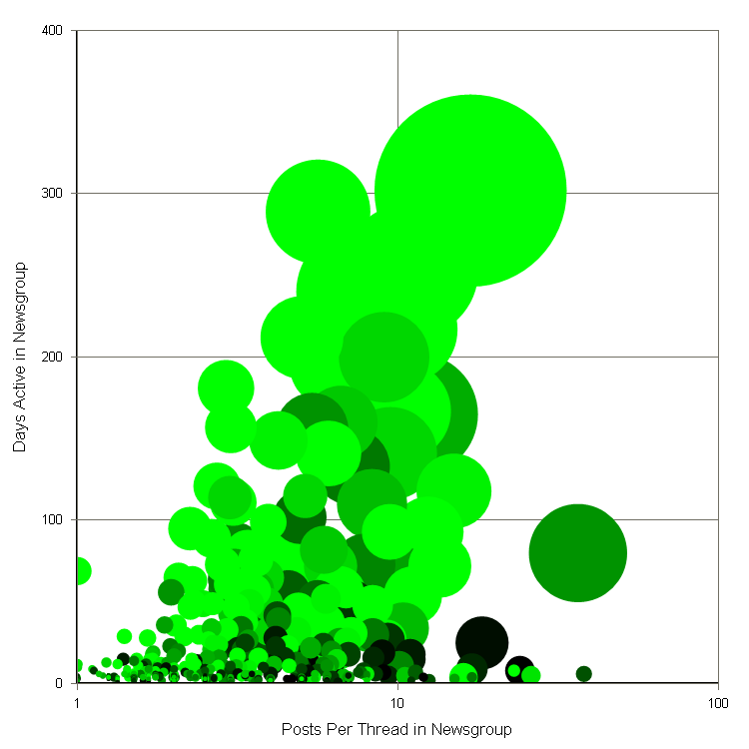
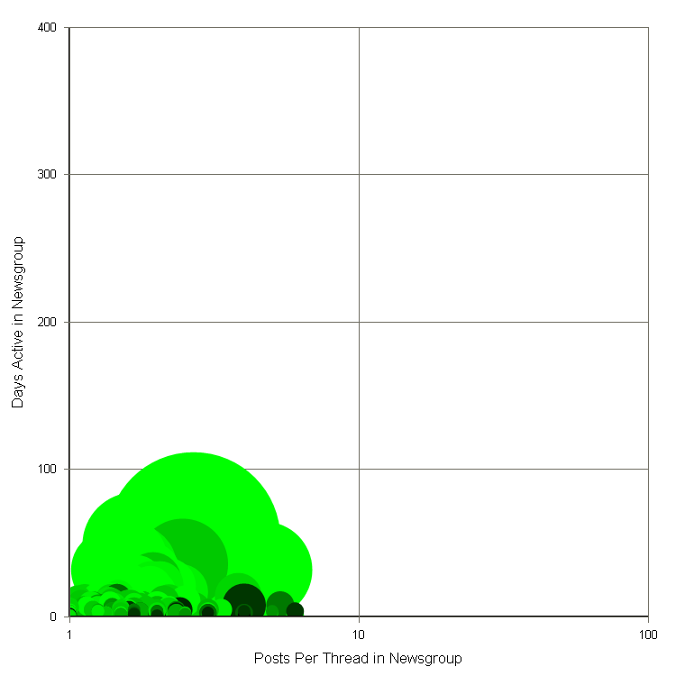
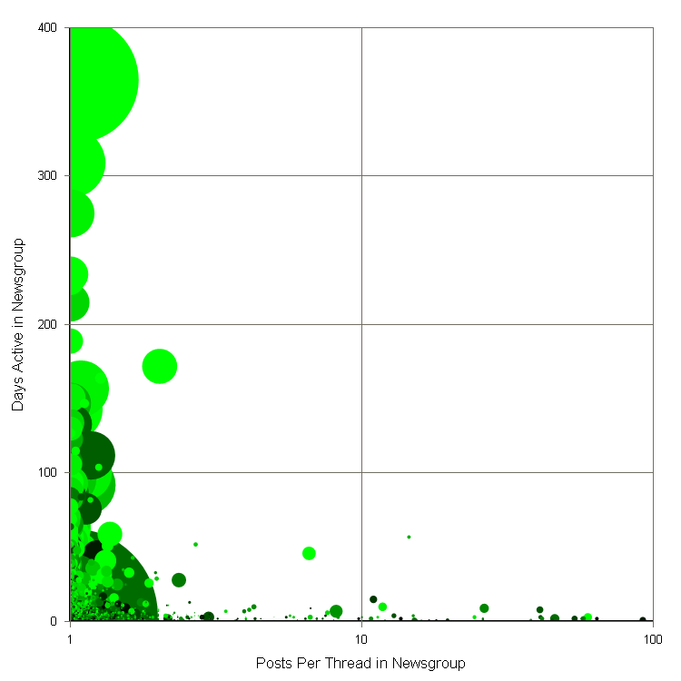
pl.comp.os.advocacy
alt.games.microsoft. flight-sim
alt.binaries.sounds. mp3.complete_cd

Slide 15
4
We‘re getting thousands of page views a day from thousands of IPs, but only a few dozen posts!
What do we do about the free riders?

Slide 16
4. Embrace Leaders; Respect Lurkers

Slide 17
Leaders welcome new people

Slide 18
5
We‘ve put up a top ten list of contributors. The more you add, the better your rank.
Who made it to the top 10 list?
People who added tons of junk!

Slide 19
Notes:
Top ten lists invite gaming. Quantitative systems invite gaming. Slashdot has a karma system, and you run into this.

Slide 20
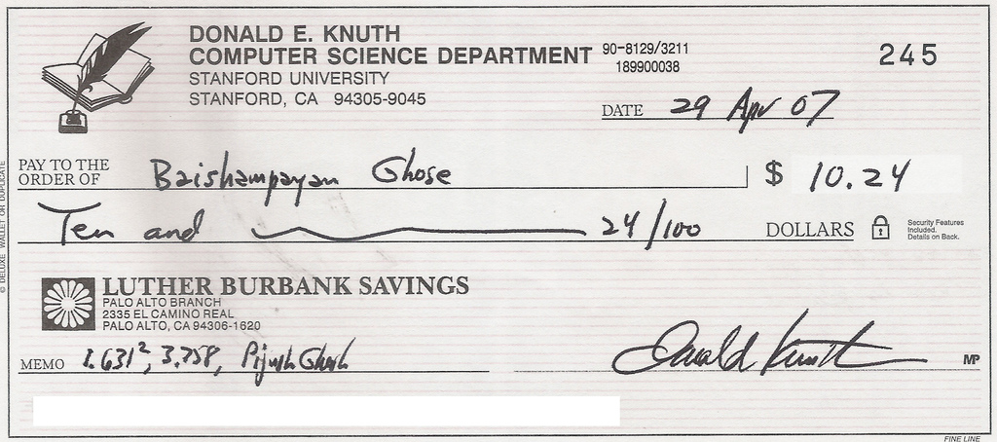
5. Reward Users Individually and Carefully
Notes:
http://flickr.com/photos/ghoseb/502039190/sizes/l/

Slide 22
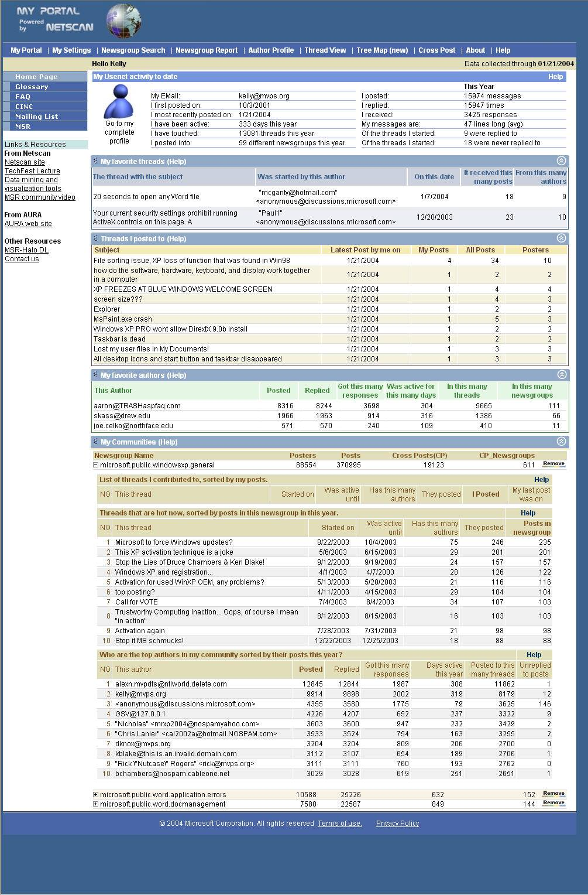

Slide 23
For each post they place, we‘ll let other people rate it.
If they get a negative reputation, we‘ll put that by their name so everyone knows to ignore them.
That way, the bad people won‘t sully our boards.
6

Slide 24
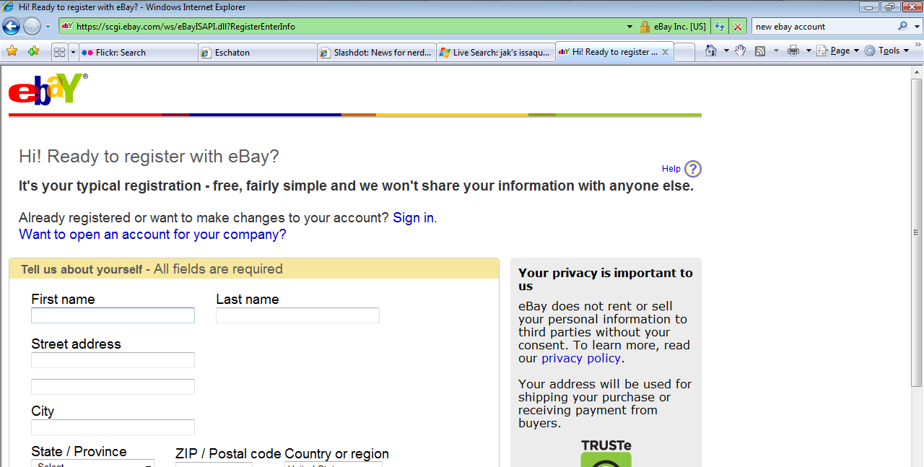
The cost of a new account

Slide 25
6. Use Positive Reputation

Slide 26
We‘d built one message board for each make and model of car on our boards.
No one posted!
Several of our boards have three messages on them.
7
Hello, is anyone there?
Buy Cialias Cheap!
I’m here. Is anyone else?

Slide 27
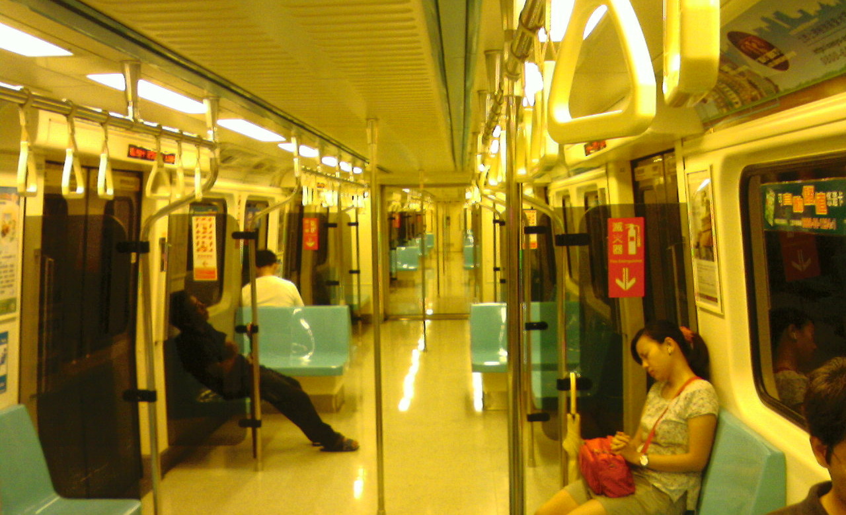
7. Encourage Critical Mass

Slide 28
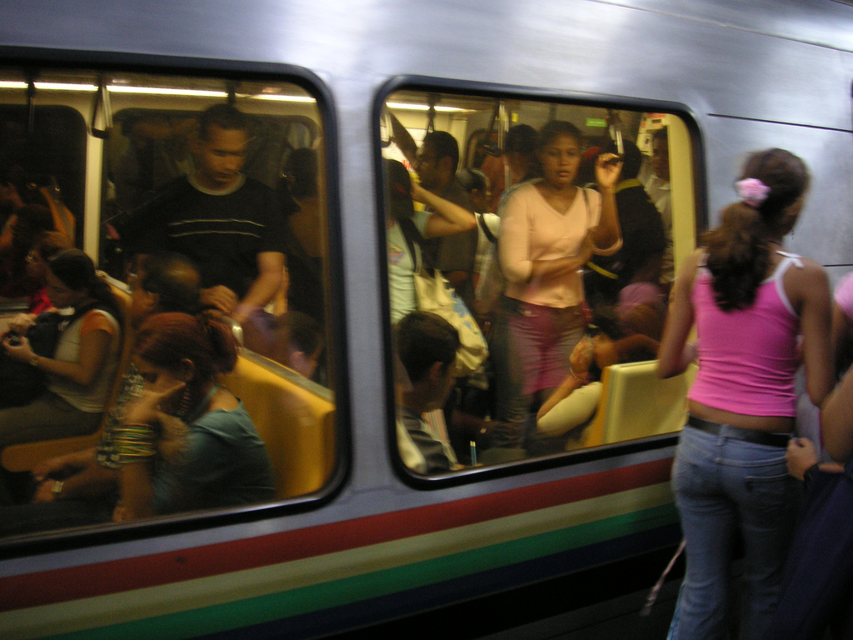
Notes:
http://flickr.com/photos/blmurch/260926511/sizes/l/

Slide 29
8
Let’s create critical mass!
We’ll join these groups—men’s exercise and women’s exercise—into one larger group.
Wait … why are they petitioning us? And leaving?
Notes:
A team had decided to consolidate several groups together in order to help make sure they kept critical mass. ―We‘ll put the fitness discussion groups—male and female—together, to help make sure they have lots to talk about.
They posted notes to the forums, saying that the forum would be merged in two months. The women‘s fitness group sent a petition: they wanted to talk about diets and post-pregnancy issues, and didn‘t think the men could contribute. The men‘s fitness group simply moved their conversation to a different provider, one who was purely dedicated to men‘s fitness issues.

Slide 30
8. Exert Gentle Control
Notes:
They just hang out in your living room. If you change the music or the furniture, they might leave. If shut down the room but tell them to please go over to some other space, some of them will. And some of them will go over to another party entirely. "Hey, let's form a Google Group to discuss this!" They aren't "your" community; they are the community that contributes value to the online space that you work on.

Slide 31
Location and Purpose
Monitor Social Activity
Provide Feedback
Organize and Maintain the Space
Know the space’s purpose
Reward Users
Encourage critical mass
Know what the space is doing
Embrace leaders
Build on existing community
Use positive reputation
Exert gentle control
Notes:
Windows Live Maps (3d)
http://flickr.com/photos/steve-n-leona/242286201/
http://flickr.com/photos/hopkinsii/163936283/

Slide 32
Space Planning for Online Community …let’s talk!
Danyel Fisher, Tammara Combs Turner, and Marc A. Smith
Microsoft Research, Microsoft Live Labs, and Microsoft Internet Services Research Center 1 Microsoft Way Redmond, Washington 98052 {danyelf, tcombs, marc.smith}@microsoft.com
Notes:
Engaged as internal consultants on community
Discussion about how communities are doing
Lots of experience (good/bad/ugly)

