Slide 1
Accurate Max-Margin Training for Structured Output Spaces
Sunita Sarawagi Rahul Gupta
IIT Bombay
http://www.cse.iitb.ac.in/~{sunita,grahul}
TexPoint fonts used in EMF.
Read the TexPoint manual before you delete this box.: AAAAAAAAAAAAA
Notes:
Todo:
Any theoretical handle on generalizability?
Dependency parsing numbers.
Expts with OCR
Compare with CGM

Slide 2
Structured learning
Model
Structured y
Vector: y₁ ,y₂,..,y_{n}
Segmentation
Tree
Alignment
..
x
w=w₁,..,w_{K}
Feature function vector
f(x,y) = f₁(x,y), f₂(x,y),…,f_{K}(x,y),
Score of a prediction y for input x:
s(x,y) = w. f(x,y)
Predict: y* = argmax_{y} s(x,y)
Exploit decomposability of feature functions
f(x,y) = ∑_{d} f (x,y_{d},d)
Notes:
Two differences with standard classification: output is a structure, feature vector defined jointly on x and y.

Slide 3
Training structured models
Given
N input output pairs (x₁ y₁), (x₂ y₂), …, (x_{N} y_{N})
Error of output : E_{i}(y)
Also decomposes over smaller parts: E_{i}(y) = ∑_{c} E_{i,c}(y_{c})
Example: Hamming(y_{i,} y)= ∑_{c} [[y_{i,c} != y_{c}]]
Find w
Small training error
Generalizes to unseen instances
Efficient for structured models

Slide 4
Related work: max-margin training of structured models
Taskar, B. (2004). Learning structured prediction models: A large margin approach. Doctoral dissertation, Stanford University.
Tsochantaridis, I., Joachims, T., Hofmann, T., & Altun, Y. (2005). Large margin methods for structured and interdependent output variables. Journal of Machine Learning Research (JMLR), 6(Sep), 1453–1484.
Several others…

Slide 5
Max-margin formulations
Margin scaling

Slide 6
Max-margin formulations
Margin scaling
Slack scaling
Exponential number of constraints ➔ Use cutting plane

Slide 7
Margin Vs Slack scaling
Margin
Easy inference of most violated constraint for decomposable f and E
Too much importance to y far from margin
Slack
Difficult inference of violated constraint
Zero loss of everything outside margin of 1

Slide 8
Accuracy comparison
Slack scaling up to 25% better than Margin scaling.

Slide 9
Approximating Slack inference
Slack inference: max_{y} s(y)-»/E(y)
Decomposability of E(y) cannot be exploited.
-»/E(y) is concave in E(y)
Variational method to rewrite as linear function

Slide 10
Approximating Slack inference
Now approximate the inference problem as:
Same tractable MAP as in Margin Scaling

Slide 11
Approximating slack inference
Now approximate the inference problem as:
Same tractable MAP as in margin scaling
Convex in ¸➔minimize using line search,
Bounded interval [¸_{l}, ¸_{u}] exists since only want violating y.

Slide 12
Slack Vs ApproxSlack
ApproxSlack gives the accuracy gains of Slack scaling while
requiring same the MAP inference same as Margin scaling.

Slide 13
Limitation of ApproxSlack
Cannot ensure that a violating y will be found even if it exists
No ¸ can ensure that.
Proof:
s(y₁)=-1/2 E(y₁) = 1
s(y₂) = -13/18 E(y₂) = 2
s(y₃) = -5/6 E(y₃) = 3
s(correct) = 0
» = 19/36
y₂ has highest s(y)-»/E(y) and is violating.
No ¸ can score y₂ higher than both y₁ and y₂

Slide 14
Max-margin formulations
Margin scaling
Slack scaling

Slide 15
The pitfalls of a single shared slack variables
Inadequate coverage for decomposable losses
Non-separable: y₂ ₌ [0 0 1]
Separable: y₁ ₌ [0 1 0]
Correct : y₀ ₌ [0 0 0]
s=0
s=-3
Margin/Slack loss = 1.
Since y₂ non-separable from y₀, »=1, Terminate.
Premature since different features may be involved.

Slide 16
A new loss function: PosLearn
Ensure margin at each loss position
Compare with slack scaling.
Notes:
Animate

Slide 17
The pitfalls of a single shared slack variables
Inadequate coverage for decomposable losses
Non-separable: y₂ ₌ [0 0 1]
Separable: y₁ ₌ [0 1 0]
Correct : y₀ ₌ [0 0 0]
s=0
s=-3
Margin/Slack loss = 1.
Since y₂ non-separable from y₀, »=1, Terminate.
Premature since different features may be involved.
PosLearn loss = 2
Will continue to optimize for y₁ even after slack » ₃ becomes 1

Slide 18
Comparing loss functions
PosLearn: same or better than Slack and ApproxSlack

Slide 19
Inference for PosLearn QP
Cutting plane inference
For each position c, find best y that is wrong at c
Small enumerable set
MAP with restriction, easy!
Solve simultaneously for all positions c
Markov models: Max-Marginals
Segmentation models: forward-backward passes
Parse trees

Slide 20
Running time
Margin scaling might take time with less data since good
constraints may not be found early
PosLearn adds more constraints but needs fewer iterations.

Slide 21
Summary
Margin scaling popular due to computational reasons, but slack scaling more accurate
A variational approximation for slack inference
Single slack variable inadequate for structured models where errors are additive
A new loss function that ensures margin at each possible error position of y
Future work: theoretical analysis of generalizability of loss functions for structured models

Slide 22
Questions?

Slide 23
Slack scaling: which constraint?
y^{S} better coordinate ascent direction than y^{T} for the dual
➔faster convergence
Primal
Versus
Original

Slide 24
Is slack scaling the best there is?
Y = Vector y_1,y_2,\ldots y_n
E(y) = sum_i E(y_i)
Two cases:
Y_i s independent
Margin scaling is exactly what we want!
Slack scaling puts too little margin
Y_i s dependent
Margin scaling asks for more margin than needed
Slack scaling better but

Slide 25
Max-margin loss surrogates
Margin Loss
Slack Loss
E_{i}(y)=4

Slide 26
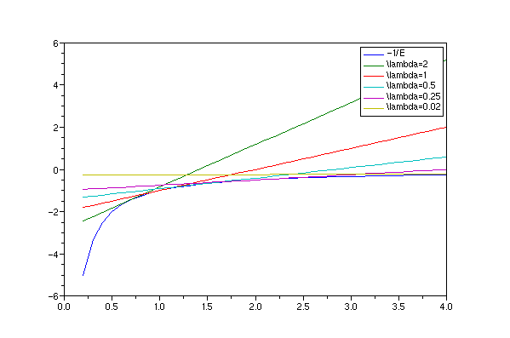
Approximating slack inference
-»/E(y) is concave in E(y)
Variational method to rewrite as linear function
-»/E(y)
E(y)

Slide 27
When is margin scaling bad
 |  | Margin | PosLearn
Address | Edge | 29 | 21.6
 | No Edge | 38 | 36.4
Cora | Edge | 25.1 | 16.6
 | No Edge | 56 | 58.3
ConLL | Edge | 15.3 | 14.9
 | No Edge | 19 | 20.1
F1 Span error
Margin scaling adequate when
No useful edge features: each position independent of each other
PosLearn useful when
Edge features are important ➔ truly structured models
Notes:
ToDo: Redraw better chart.

