Slide 1
Combining Fact and Document Retrieval with Spreading Activation for Semantic Desktop Search
Kinga Schumacher, Michael Sintek and Leo Sauermann
{firstname.surname}@dfki.de
German Research Center for
Artificial Intelligence (DFKI GmbH)

Slide 2
Outline
Semantic Desktop
Semantic Search research areas
Our approach
Evaluation
Future work

Slide 3
The Semantic Desktop
Means for Personal Information Management
RDF, RDFS, identification of resources by URIs
Instead of a document- and application-oriented information management, the Semantic Desktop enables the user to
create own categorization system of projects, persons, topics, events, locations, organizations etc.
integrate all resources (e.g. text-documents, contacts, messages, multimedia) across application borders
collect facts about them
annotate, classify and relate them building the Personal Information Model (PIMO)

Slide 4
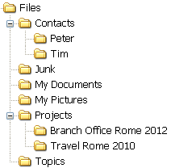
The Semantic Desktop
Supports the user with
Keeping: handling of information storage – concepts are associated with folders
Finding: by navigational search, browsing, filtering, semantic search
ACCESS
Topic
Project
new office
Document
Peter
Tim
invitation
Rome Project
Rome
Who
Where
ACCESS

Slide 5
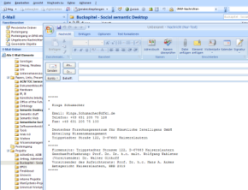
… form the search engine‘s point of view
Information – the knowledge base
Structured and unstructured: facts and documents
native structures (file system, email folders) are mapped to ontological concept
files and other information objects like contacts, calendar entries are mapped to instances
their textual content is indexed
in ontologies, instance base and document-index
Knowledge
base
(PIMO)
Ontology
Instances
Indexing,
semantic tagging, document analysis
Folders,
documents,
desktop
applications

Slide 6
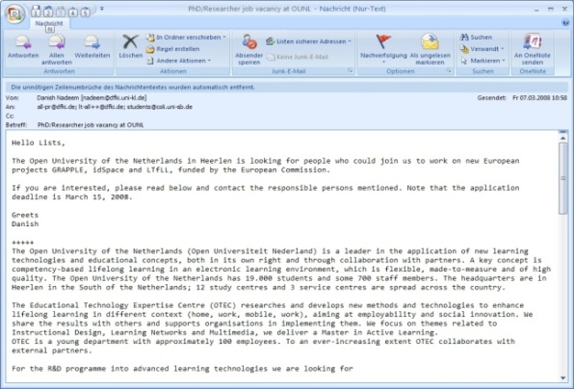
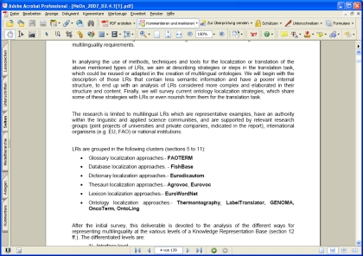
… form the search engine‘s point of view
Human Access
Search for Information: documents and facts
Enable Free-text queries
to keep knowledge overhead away from the user
NLP problems, e.g. syntactic, structural ambiguity
“seminar topics”
“phone number of the KM-Group secretary”
+49 631 205 75 101

Slide 7
Main Semantic Search research areas
Semantic Document Retrieval___
Document retrieval techniques
enhanced through
usage of linguistic information
usage of category systems
graph traversing
Fact Retrieval___________
Fact retrieval through
reasoning
triple(statement)-based algorithms
graph algorithms
combine results
retrieve docu-ments
retrieve facts
triple-based
graph traversing

Slide 8
Architecture
GUI
natural language query
Semantic
Search
fact retrieval
document retrieval
[1]
[2]
[3]
combined approach
Interface
Views, Inference
Knowledge
base
(PIMO)
Ontology
Instances
Indexing,
semantic tagging, document analysis
Folders,
documents,
desktop
applications

Slide 9
Fact Retrieval – Triple-based approach
free text query
Syntactic Matching: query
linguistic information in the knowledge base
n-gram method
phrase matching
Result: set of potential Properties , Instances , Classes
Semantic Matching on the instance base (based on [1])
1st level: create and apply query templates with the matches adjacent terms
2nd level:
iterate over found triples and the syntactic matches of until now semantically unmatched terms and create and apply query templates
stop when: all query terms are included or no further triples can be found
3rd level:
Combine found triples and identify result graphs (coherent subgraphs)
fact retrieval
“perfect
answer”
matched
facts
expanded
query
[1] D.E. Goldschmidt, M. Krishnamoorthy:
Architecting a Search Engine for the Semantic Web.
C&O-2005, Pittsburgh

Slide 10
Fact Retrieval Example
“phone number of the KM-Group secretary”
Property <phone_number>
Instance <KM-Group>
Class <secretary>
<KM-Group><phone_number><?>
<?><phone_number><KM-Group>
[1]
<KM-Group><?><secretary>
[2]
instances:
<SecretaryAD>, …
(no result)
(no result)
get instances
<KM-Group><?><SecretaryAD>
[3]
<KM-Group><unit><SecretaryAD>
[4]
<SecretaryAD><phone_number><?>
<KM-Group><unit><SecretaryAD>
<SecretaryAD><phone_number> „0049 631 205 75 101“
[5]

Slide 11
Fact Retrieval – Triple-based approach
free text query
Ranking
Syntactic Matching: n-gram weights
Semantic Matching:
1st level:
2nd level:
where are included in the triples
3rd level:
fact retrieval
Results
“perfect
answer”
matched
ontological
elements
expanded
query

Slide 12
Semantic Document Retrieval – Graph traversing
expanded query
Expanded query: expanded with the linguistic information about the matched ontological elements
Semantic Document Retrieval
Keyword search on the document index (Lucene)
Apply Spreading Activation:
Activation points: found documents
Activation weights: document weights
Formula:
document retrieval
matched
documents

Slide 13
Combined approach
free text query
fact retrieval
expanded query
document retrieval
weighted activation points, weighted links
instances
properties
matched documents
classes
perfect answer
+
weight
i
j
-
build
activate
3. spread
combine results
search results
merge

Slide 14
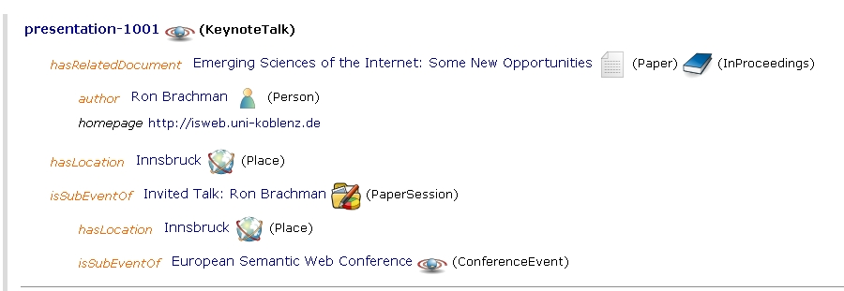
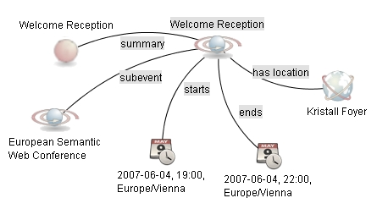
merged result
„perfect answer“

Slide 15
Evaluation
Data and method
Standardized and annotated test data set for semantic desktop missing
Evaluated with the ESWC 2007 knowledge base
Knowledge base extended with some synonyms
Evaluated against the Google Site search on www.eswc2007.org
Set of 11 queries – typical queries of knowledge workers
Average Precision (for details see Proceedings, pp 569-583)
 | Semantic Desktop Search | Google Site Search
Average Precision | 0.9436 | 0.4615

Slide 16
Strengths and Weaknesses
precise results for complex queries
recognition of phrases, synonyms
resolving structural ambiguity
enhanced ranking
useful additional information
Lower precision by unsuitable long queries (if no properties matched: spreading activation propagates to all connected nodes with the same intensity)
Bad performance (30 sec/query)
need of more specific and personalized setup of the semantic network’s link weights
learn from feedback
exploit context

Slide 17
Future Work
Gold Standard for Semantic (Desktop) Search Evaluations (in progress)
Application of named graphs and views (based on the Nepomuk Representation Language NRL)
Advanced GUI with dynamic filters and browsing support

Slide 18
Thank you for your attention!
?
Thanks for the members of the DFKI KM-Group

Slide 19
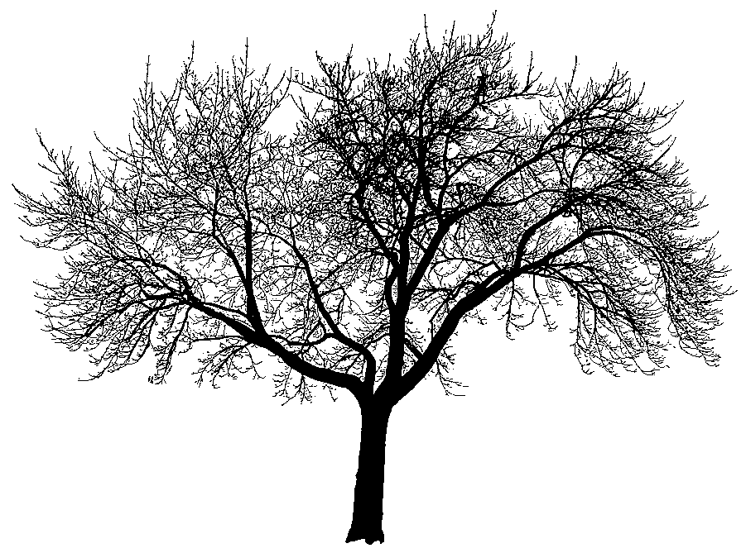
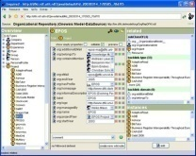
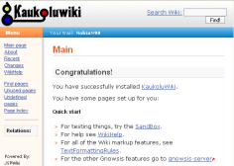
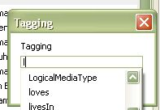
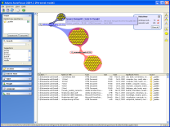
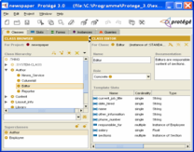
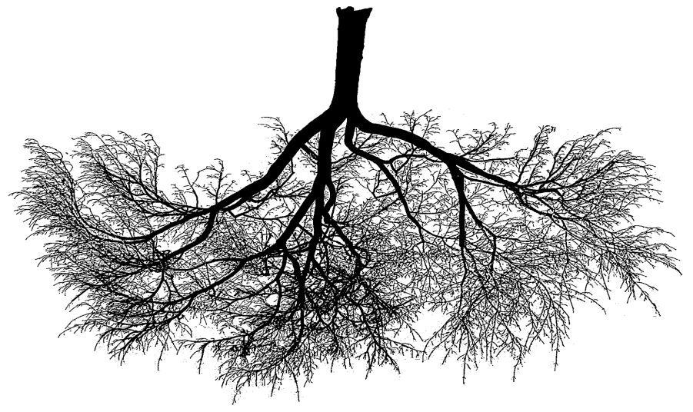
Semantic Desktop Architecture
Semantic Applications
PIMO Editor
Personal Wiki
Application Plugins
Desktop Applications
web interfaces
Domain Ontologies
Gnowsis Server
Sesame2 Repository
Aperture Crawlers
Outlook
Clustering
Ont. Matching
PIMO Store
Outlook
Tagging
GUI invocation
Resource Store
Crawler
Desktop Search
Configuration Store
Files
filesystem
User Context
Service Store
e-mail server
Lucene Index
e-mail

Slide 20
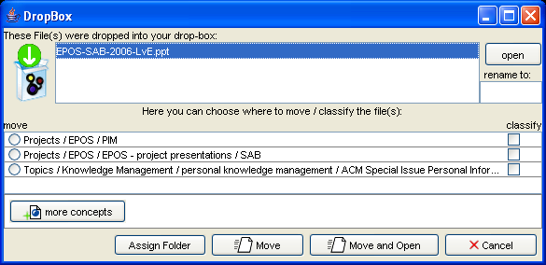
Semantic Desktop Tools
Sidebar
DropBox
Semantic Wiki
Tagging Plugins

Slide 21
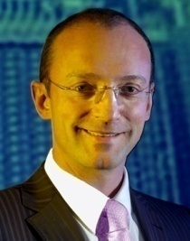
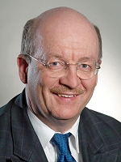
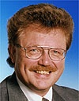
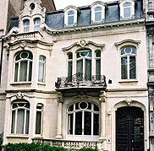
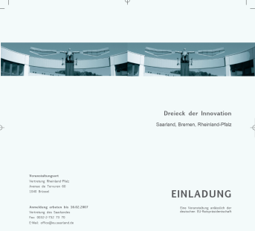
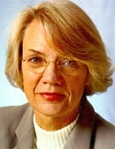
Extract of a PIMO
http://dengel.dfki.de/outlook/contact/0019E1773D6A56
http://www3.dfki.uni-kl.de/agd/dengel/content/index_ger.html
http://www.dfki.de/~wahlster/
has-address
http://www.mbwjk.rlp.de/ministerium/staatssekretaerin-dzwonnek.html
Calender (…)
has-speaker
http://ag47.informatik.uni-bremen.de/eng/team.php
has-speaker
has-speaker
takes-place-on
http://www.karl-rauber.de/
is-hosted-by
has-location
is-hosted-by
is-hosted-by
http://www.landesvertretung.rlp.de/haus_bruessel.html
file:///D:/EigeneDateien/Dokumente/Einladungen/Brüssel.pdf
http://www.landesvertretung.bremen.de/landesv/bevoll/index.html

Slide 22
n-gram matching
decompose a string in a subsequences of n characters
‚basic‘: ‚ba‘, ‚as‘, ‚si‘, ‚ic‘
‚base‘: ‚ba‘, ‚as‘, ‚se‘
map the decomposition to a vector containing the number of occurrences of the n-grams
compute the distance of the vectors
e.g. Dice-Measure d(‘basic’,’base’)= 0.571
 | ba | as | si | ic | se
basic | 1 | 1 | 1 | 1 | 0
base | 1 | 1 | 0 | 0 | 1

