Slide 1
On-line Discovery of Temporal-Difference Networks
Takaki Makino, Toshihisa Takagi
Division of Project Coordination
University of Tokyo

Slide 2
Overview
An algorithm for discovering question network of Temporal-Difference (TD) Networks
For learning predictions in POMDP environments
Similar to discovering core tests in Predictive State Representations
Features:
On-line, incremental discovery
Distributed calculation on network structure

Slide 3
Background: Partially-Observed Markov Decision Process
Partial observation of states from the environment
In this study we consider 1-bit observation case only
Example: 8-state Ring World
In one of 8 states, “1” is observed; for all other states “0” is observed
Agent actions: Left or Right
RL agent needs to distinguish hidden states
The current observation does not identify a state
Nor any finite history of observations
R
R
1
0
R
L
0
L
L
0
R
L
L
R
0
L
L
0
L
R
0
0
R
R

Slide 4
Background: Temporal Difference (TD) Networks (Sutton, 2005)
On-line learning architecture for POMDP, based on Predictive Representation of States (Littman 2002)
Use a set of predicted probabilities for future ob-servations after possible actions to represent states
Apply TD-learning to general predictions
Question network defines prediction targets
Answer network calculates the next state (predictions) from the previous state, action and observation

Slide 5
Background: Structure of TD-Networks (1)
Question Network
Network that represents prediction targets
The set of predictions can identify a state if a sufficient set of questions is given
Observation (observing 1)
L
o
R
y¹
y²
Prediction for observation (If I go left, will I observe 1?)
L
R
L
R
Prediction for prediction (If I go left, will y² be true?) = (If I go left, will I think “If I go left, I will observe 1”?)
y³
y⁴
y⁵
y⁶

Slide 6
Background: Structure of TD-Networks (1)
Question Network
Network that represents prediction targets
The set of predictions can identify a state if a sufficient set of questions is given
R
R
1
0
R
L
0
R
L
0
L
L
0
0
0
R
L
L
R
L
R
L
R
0
L
L
0
1
0
0
0
L
R
0
0
R
R
Predictive Repre- sentation of States

Slide 7
Background: Structure of TD-Networks (1)
Question Network
Network that represents prediction targets
The set of predictions can identify a state if a sufficient set of questions is given
R
R
1
0
R
L
0
R
L
0
L
L
0
0
1
R
L
L
R
L
R
L
R
0
L
L
0
0
0
0
0
L
R
0
0
R
R
Predictive Repre- sentation of States

Slide 8
Background: Structure of TD-Networks (2)
Answer Network
Network that calculates the next prediction as an answer for the question network
Weights are learned through gradient descent
y¹
y¹
y²
y²
y³
y³
y⁴
y⁴
y⁵
y⁵
y⁶
y⁶
y⁷
y⁷
y[t]
Sigmoid function
W
x¹
y¹
Feature Vector
x¹
x²
x³
x⁴
x⁵
x⁶
x⁷
x⁸
x¹
x²
x³
x⁴
x⁵
x⁶
x⁷
x¹⁶
W
x²
y²
x³
σ
y³
x⁴
a^{L}
a^{R}
y¹
y²
y³
y⁴
y⁵
y⁶
y⁷
a[t]
o[t]
y[t-1]
Next state
Connection matrix

Slide 9
Background: Learning State Representation by TD-Networks
Apply Temporal-Difference learning rule to general prediction
Prediction at time t is trained using prediction at time t+1
o[t+1]
y¹
y²
y³
y⁴
y⁵
y⁶
y⁷
y[t+1]
Question Network
TD Learning
y¹
y¹
y²
y²
y³
y³
y⁴
y⁴
y⁵
y⁵
y⁶
y⁶
y⁷
y⁷
y[t]
t
t+1
Answer Network
L
Gradient Descent
0
0
-0.3
x¹
x²
x³
x⁴
x⁵
x⁶
x⁷
x⁸
x¹
x²
x³
x⁴
x⁵
x⁶
x⁷
x¹⁶
0.3
…
0.9
…
Predictive
Represen- tation of States
+0.5
0.4
0.1
a^{L}
a^{R}
y¹
y²
y³
y⁴
y⁵
y⁶
y⁷
…
…
a[t]
o[t]
y[t-1]

Slide 10
Background: Pros and Cons of TD-Networks
Advantage:
On-line learning of predictive representations
Applying TD-Learning to general predictions
Disadvantage:
To represent states correctly, we have to give a question network, tailored for each problem
To solve this problem, we need an automatic discovery algorithm for a sufficient question network

Slide 11
Advantage:
On-line learning of predictive representations
Applying TD-Learning to general predictions
Disadvantage:
To represent states correctly, we have to give a question network, tailored for each problem
To solve this problem, we need an automatic discovery algorithm for a sufficient question network
1
R
0
R
R
L
0
R
L
0
L
L
0
0
1
R
L
L
R
L
R
L
R
0
L
L
0
0
0
0
0
L
R
0
0
R
R
Predictive Repre- sentation of States

Slide 12
Our proposal
L
o
R
An algorithm that incrementally discovers a question network
Start with the minimum question network
Expand a leaf node when the node satisfies the criteria
y¹
y²
L
R
L
R
y³
y⁴
y⁵
y⁶
Expansion Criteria
Additional Components
1. The node is well-known
2. The node is independent
3. The node requires further explanation
a. Dependency Detection Network
b. Moving Average of Errors

Slide 13
Additional Components (1) Dependency Detection Network
Trying to represent a prediction of node y^{i} in terms of observation o and nodes y^{j} ( j < i )
Small error means that the node is dependent
Weights are trained like the answer network
Sigmoid function
o
y¹
d¹
D
y¹
y²
d²
σ
y²
y³
d³
0
y³
Learning target
Network Output
Connection Matrix
Input

Slide 14
Additional Components (2) Average Errors
Calculate moving average of squared errors
For each output node of answer networks and dependency detection networks
d^{SERR} ← ρ₁ d^{SERR} + (1−ρ₁) (y−d)²
d^{LERR} ← ρ₂ d^{LERR} + (1−ρ₂) (y−d)²
y^{LERR} ← ρ₂ y^{LERR} + (1−ρ₂) (z−y)²
( ・ )² : Element-by-element multiplication
0 < ρ₁ < ρ₂ < 1: Time factor parameters
Error of Dependency Detection Network
Short-term error
Long-term error
Error of Answer Network

Slide 15
Expansion Criteria 1: The node is well-known
Confirming that the agent has sufficient experience to learn the node
Prevents unexplored nodes from being expanded
Short-term average error of node i
Long-term average error of node i
Average error of node i’s parent
d_{t}^{SERR i} ≥ d_{t}^{LERR i}
… The error is not in decreasing trend
d_{t}^{LERR i} ≥ d_{t}^{LERR p(i)}
… The error is smaller than its parent’s

Slide 16
Expansion Criteria 2: The node is independent
The node’s prediction cannot be calculated in terms of other, formerly known node values
Independent node = “core tests” in PSR
Assuming that a dependent node never has independent child nodes
The error of Dependency Detection Network
Threshold parameter
d_{t}^{LERR i} ≥ θ₁
… The error is larger than the threshold

Slide 17
Expansion Criteria 3: The node requires further explanation
Choosing the node that has the best descriptive power for the error in the parent’s node
… Prediction error is not smaller than the one
expected from the error of the node’s parent node
Stop expansion when unpredictability is solved
The error of node i in the answer network
Expected error of node i from its parent
Relative probability of visiting node i
Threshold parameter

Slide 18
Comparison to Related Studies
No previous work is known for discovering TD-Network
On-line discovery of PSR core tests (McCracken and Bowling, 2006):
Need to keep a substantially long history
Matrix operation required for calculating linear independency, normalizing probability
Advantage of our work
Distributed calculation on a network structure
No need for keeping history or big matrix algebra

Slide 19
Simulation Experiments
Several POMDP environments
{5,8}-state ring world
Some well-known POMDP with 1-bit observation (Float-Reset, Paint, Tiger, Network)
Actions are selected from a uniform random policy
Parameters are given as follows
ρ₁=0.99, ρ₂=0.999, θ₁= 0.0045, θ₂=0.0005
Learning rate α starts with α=0.1, and after 800,000 steps, α is halved for every 100,000 steps
Compared by mean squared error of the predicted observation for the chosen action from the oracle

Slide 20
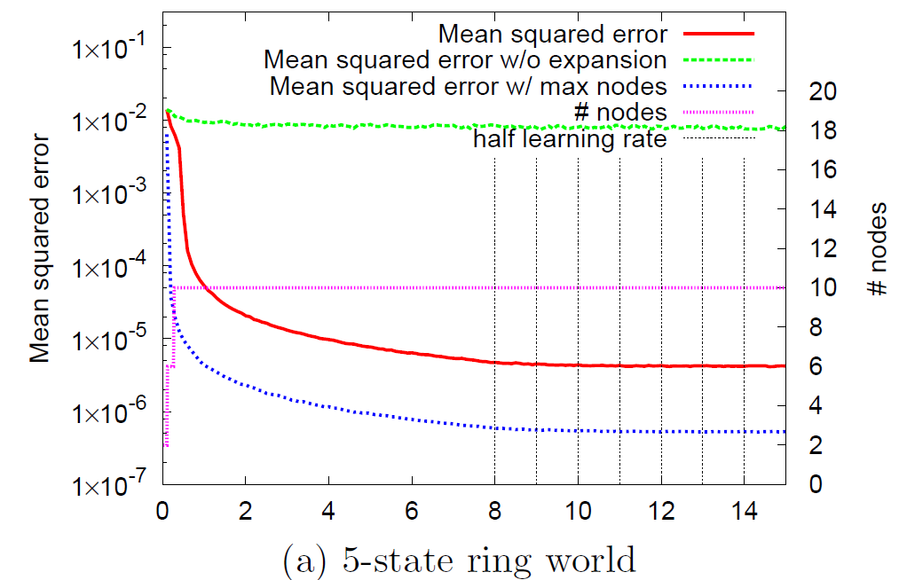
Results (1) 5-state Ring World
Time (×10⁵ steps)

Slide 21
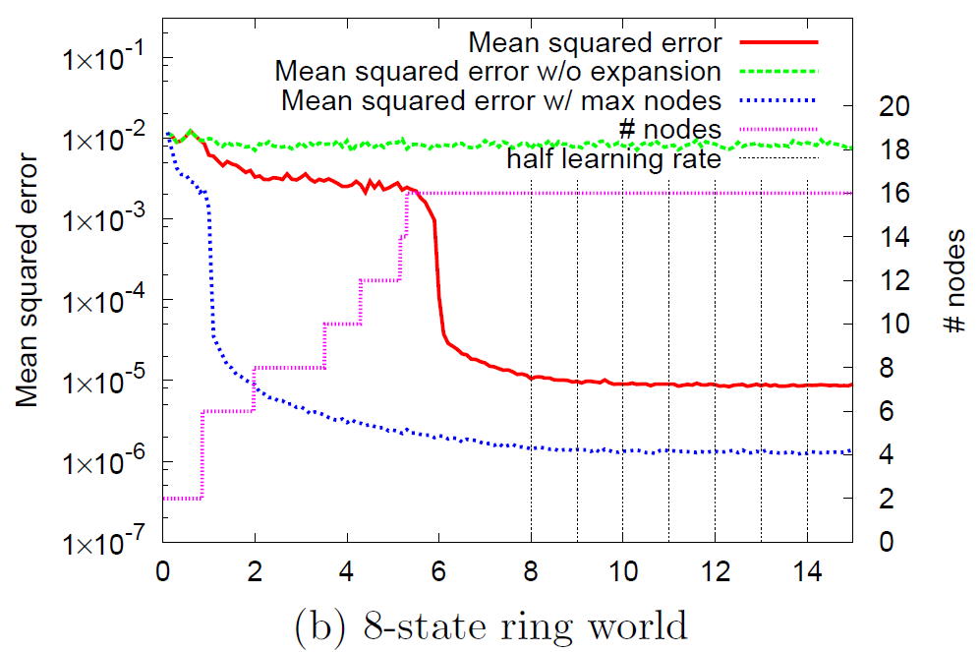
Results (2) 8-state Ring World
Time (×10⁵ steps)

Slide 22
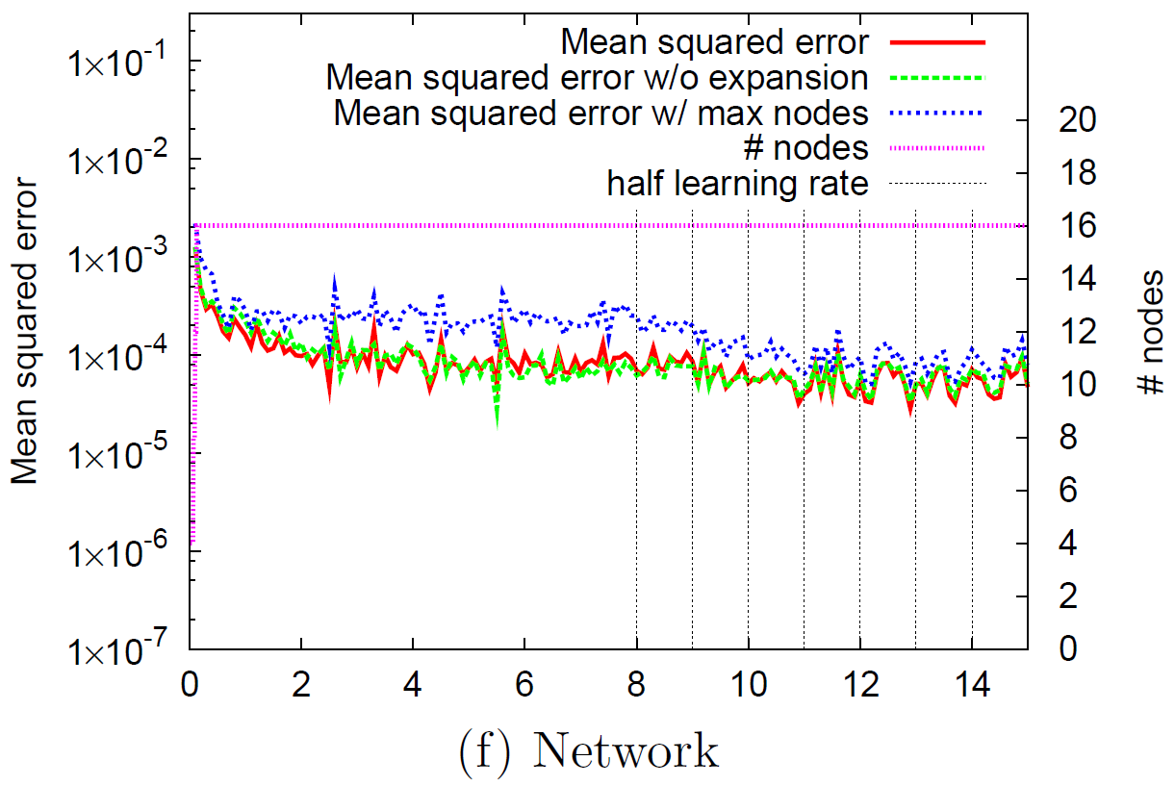
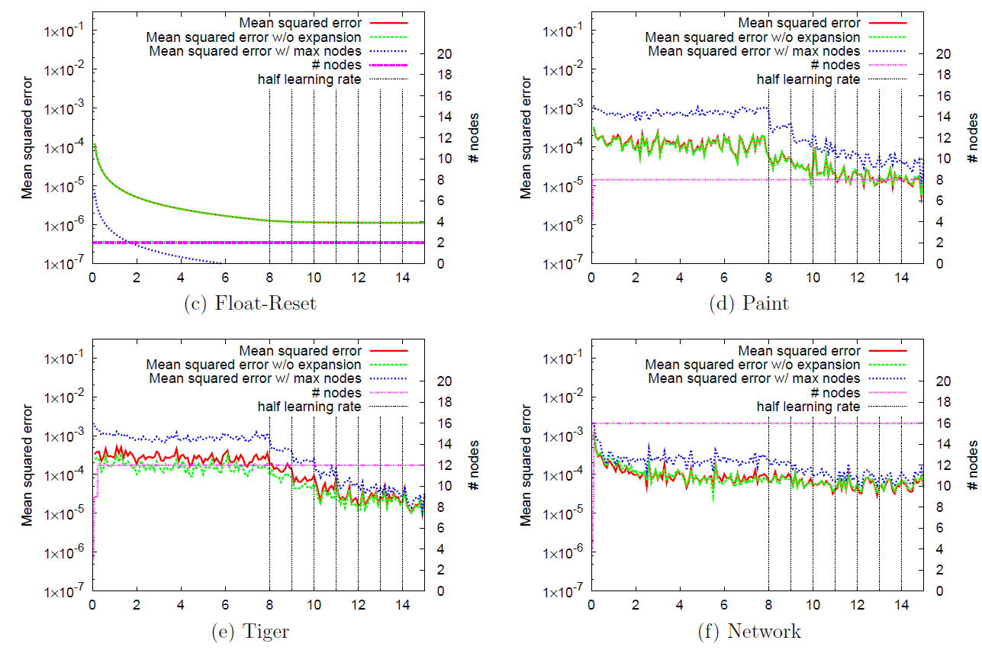
Results (3)
No helpful evaluation from other POMDPs
Initial networks performed just as good as discovered networks
Confirmed that the dis- covery pro- cess stops in probabilistic environments

Slide 23
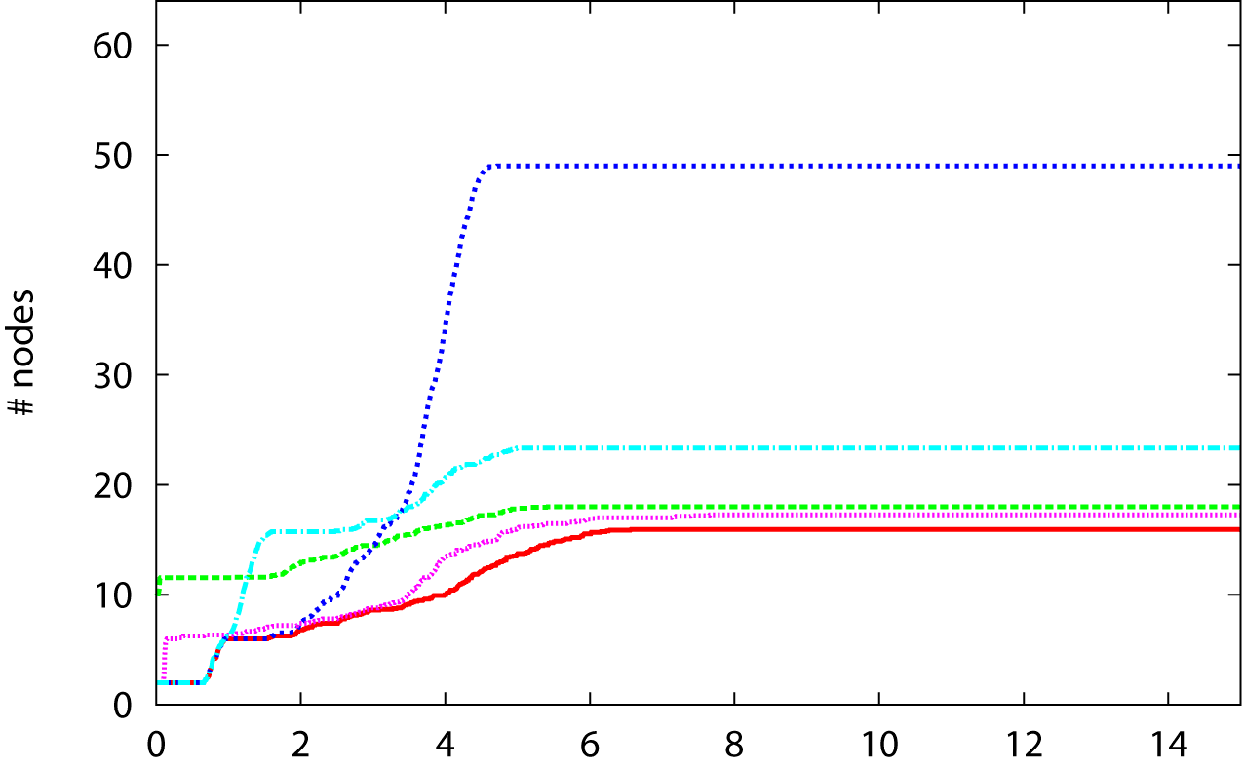
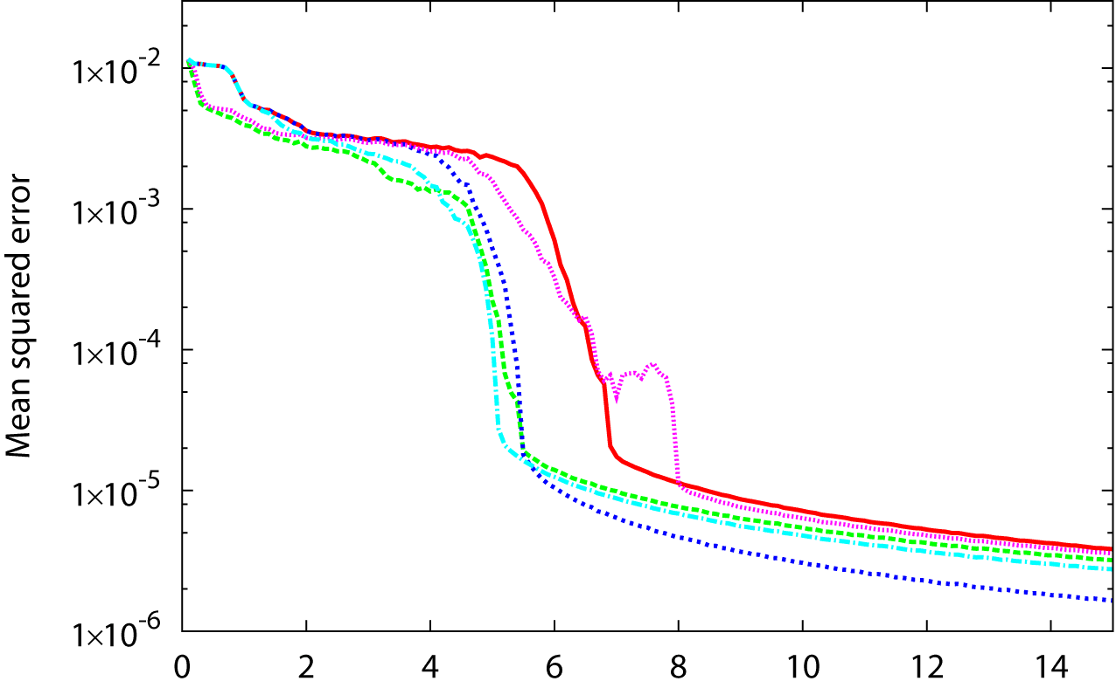
Results (4)
Tests for each criterion disabled (8-State Ring)
With all criteria
W/o “well-known” 1
W/o “well-known” 2
W/o “independence”
W/o “requiring explanation”
# nodes
Least spurious expansions when using all criteria
Learned in any case
Time (×10⁵ steps)
Averaged for 30 trials

Slide 24
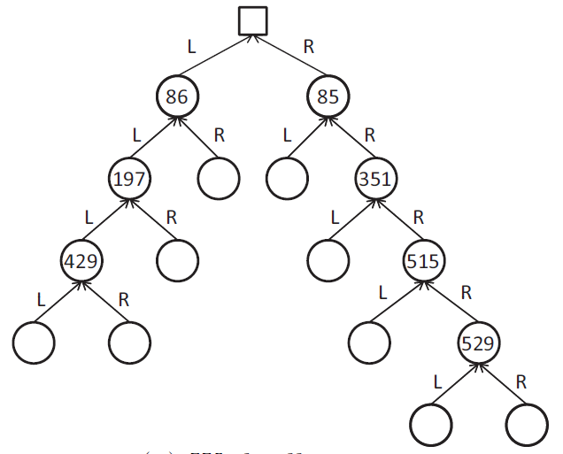
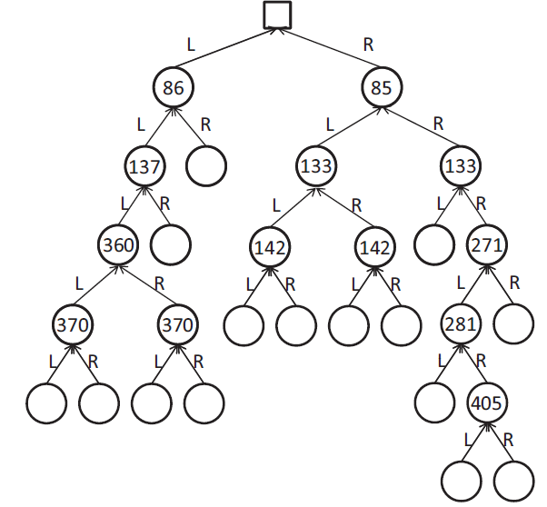
Results (5)
Example of Discovered TD Networks for the 8-state ring world
(a) With all criteria
(b) Without “requiring further explanation”
Numbers denote expanded time (×10³ steps)

Slide 25
Discussion
The algorithm seems to work in small POMDPs
However, no theoretical guarantee is given
Known Limitations:
May fail learning POMDPs with deep dependency
Unavoidable for incremental discovery
Parameter dependency
Trade-off: spurious expansion vs. learning failure
Observation limited to 1 bit
Extension for multi-bit cases seems straightforward, but requires more tests

Slide 26
Summary
We proposed an algorithm for discovering a question network of TD Networks
On-line, incremental discovery
Distributed calculation on the network structure
3 expansion criteria: The node is well-known, independent, requiring further explanation
Uses Dependency Detection Network
Future work
Lifting up limitations, applying to larger problems
More general (non-incremental) discovery by altering the representation of question networks

Slide 28
Background: Learning State Representation with TD-Networks
Apply Temporal-Difference learning rule to general prediction
L
0
R
y¹
y¹
y²
y²
y³
y³
y⁴
y⁴
y⁵
y⁵
y⁶
y⁶
y⁷
y⁷
y[t]
0.3
0.2
L
R
L
R
0.4
0.2
0.1
0.6
x¹
x²
x³
x⁴
x⁵
x⁶
x⁷
x⁸
x¹
x²
x³
x⁴
x⁵
x⁶
x⁷
x¹⁶
0.5
a^{L}
a^{R}
y¹
y²
y³
y⁴
y⁵
y⁶
y⁷
a[t]
o[t]
y[t-1]

Slide 29
Background: Learning State Representation with TD-Networks
Apply Temporal-Difference learning rule to general prediction
t+1
0
0.9
0.1
0.2
0.1
0.2
0.3
0.4
y¹
y¹
y²
y²
y³
y³
y⁴
y⁴
y⁵
y⁵
y⁶
y⁶
y⁷
y⁷
y[t]
L
x¹
x²
x³
x⁴
x⁵
x⁶
x⁷
x⁸
x¹
x²
x³
x⁴
x⁵
x⁶
x⁷
x¹⁶
t
0
0.3
0.2
0.4
0.2
0.1
0.6
0.5
a^{L}
a^{R}
y¹
y²
y³
y⁴
y⁵
y⁶
y⁷
a[t]
o[t]
y[t-1]

Slide 30
Background: Learning State Representation with TD-Networks
Apply Temporal-Difference learning rule to general prediction
y[t+1]: state at t+1 (= prediction for t+2)
0
0.9
0.1
0.2
0.1
0.2
0.3
0.4
L
0
0.9
0.1
0.2
z[t]: teacher for y[t]
(only for predictions conditioned with the action)
0
0.3
0.2
0.4
0.2
0.1
0.6
0.5
y[t]: state at t = prediction for t+1

Slide 31
Background: Learning State Representation with TD-Networks
Apply Temporal-Difference learning rule to general prediction
y[t+1]: state at t+1 (= prediction for t+2)
0
0.9
0.1
0.2
0.1
0.2
0.3
0.4
Actual observation at time t+1
I went left, and now I observe 0
L
0
0.9
0.1
0.2
z[t]: teacher for y[t]
-0.3
Error = -0.3
0
0.3
0.2
0.4
0.2
0.1
0.6
0.5
Prediction at time t
If I go left, I’ll observe 1 with probability 0.3
y[t]: state at t = prediction for t+1

Slide 32
Background: Learning State Representation with TD-Networks
Apply Temporal-Difference learning rule to general prediction
y[t+1]: state at t+1 (= prediction for t+2)
0
0.9
0.1
0.2
0.1
0.2
0.3
0.4
Actual prediction at time t+1
I went left, and now I think “If I go left, I’ll observe 1” with probability 0.9
L
0
0.9
0.1
0.2
z[t]: teacher for y[t]
+0.5
TD Error = +0.5
0
0.3
0.2
0.4
0.2
0.1
0.6
0.5
Prediction at time t
If I go left, I’ll think “If I go left, I’ll observe 1” with probability 0.4
y[t]: state at t = prediction for t+1

Slide 33
Background: Learning State Representation with TD-Networks
Apply Temporal-Difference learning rule to general prediction
t+1
0
0.9
0.1
0.2
0.1
0.2
0.3
0.4
y¹
y¹
y²
y²
y³
y³
y⁴
y⁴
y⁵
y⁵
y⁶
y⁶
y⁷
y⁷
y[t]
t
0
0.3
0.2
0.4
0.2
0.1
0.6
0.5
x¹
x²
x³
x⁴
x⁵
x⁶
x⁷
x⁸
x¹
x²
x³
x⁴
x⁵
x⁶
x⁷
x¹⁶
a^{L}
a^{R}
y¹
y²
y³
y⁴
y⁵
y⁶
y⁷
a[t]
o[t]
y[t-1]

Slide 34
Background: Learning State Representation with TD-Networks
Apply Temporal-Difference learning rule to general prediction
o[t+1]
y¹
y²
y³
y⁴
y⁵
y⁶
y⁷
y[t+1]
Question Network
TD Learning
a^{L}
a^{R}
a[t+1]
y¹
y¹
y²
y²
y³
y³
y⁴
y⁴
y⁵
y⁵
y⁶
y⁶
y⁷
y⁷
y[t]
Answer Network
Gradient Descent
x¹
x²
x³
x⁴
x⁵
x⁶
x⁷
x⁸
x¹
x²
x³
x⁴
x⁵
x⁶
x⁷
x¹⁶
Predictive Representation of States
a^{L}
a^{R}
y¹
y²
y³
y⁴
y⁵
y⁶
y⁷
a[t]
o[t]
y[t-1]

Slide 35
Background: Learning State Representation with TD-Networks
Apply Temporal-Difference learning rule to general prediction
o[t+1]
y¹
y²
y³
y⁴
y⁵
y⁶
y⁷
y[t+1]
Question Network
a^{L}
a^{R}
a[t+1]
y¹
y¹
y²
y²
y³
y³
y⁴
y⁴
y⁵
y⁵
y⁶
y⁶
y⁷
y⁷
y[t]
Answer Network
x¹
x²
x³
x⁴
x⁵
x⁶
x⁷
x⁸
x¹
x²
x³
x⁴
x⁵
x⁶
x⁷
x¹⁶
Predictive Representation of States
a^{L}
a^{R}
y¹
y²
y³
y⁴
y⁵
y⁶
y⁷
a[t]
o[t]
y[t-1]

