Slide 1

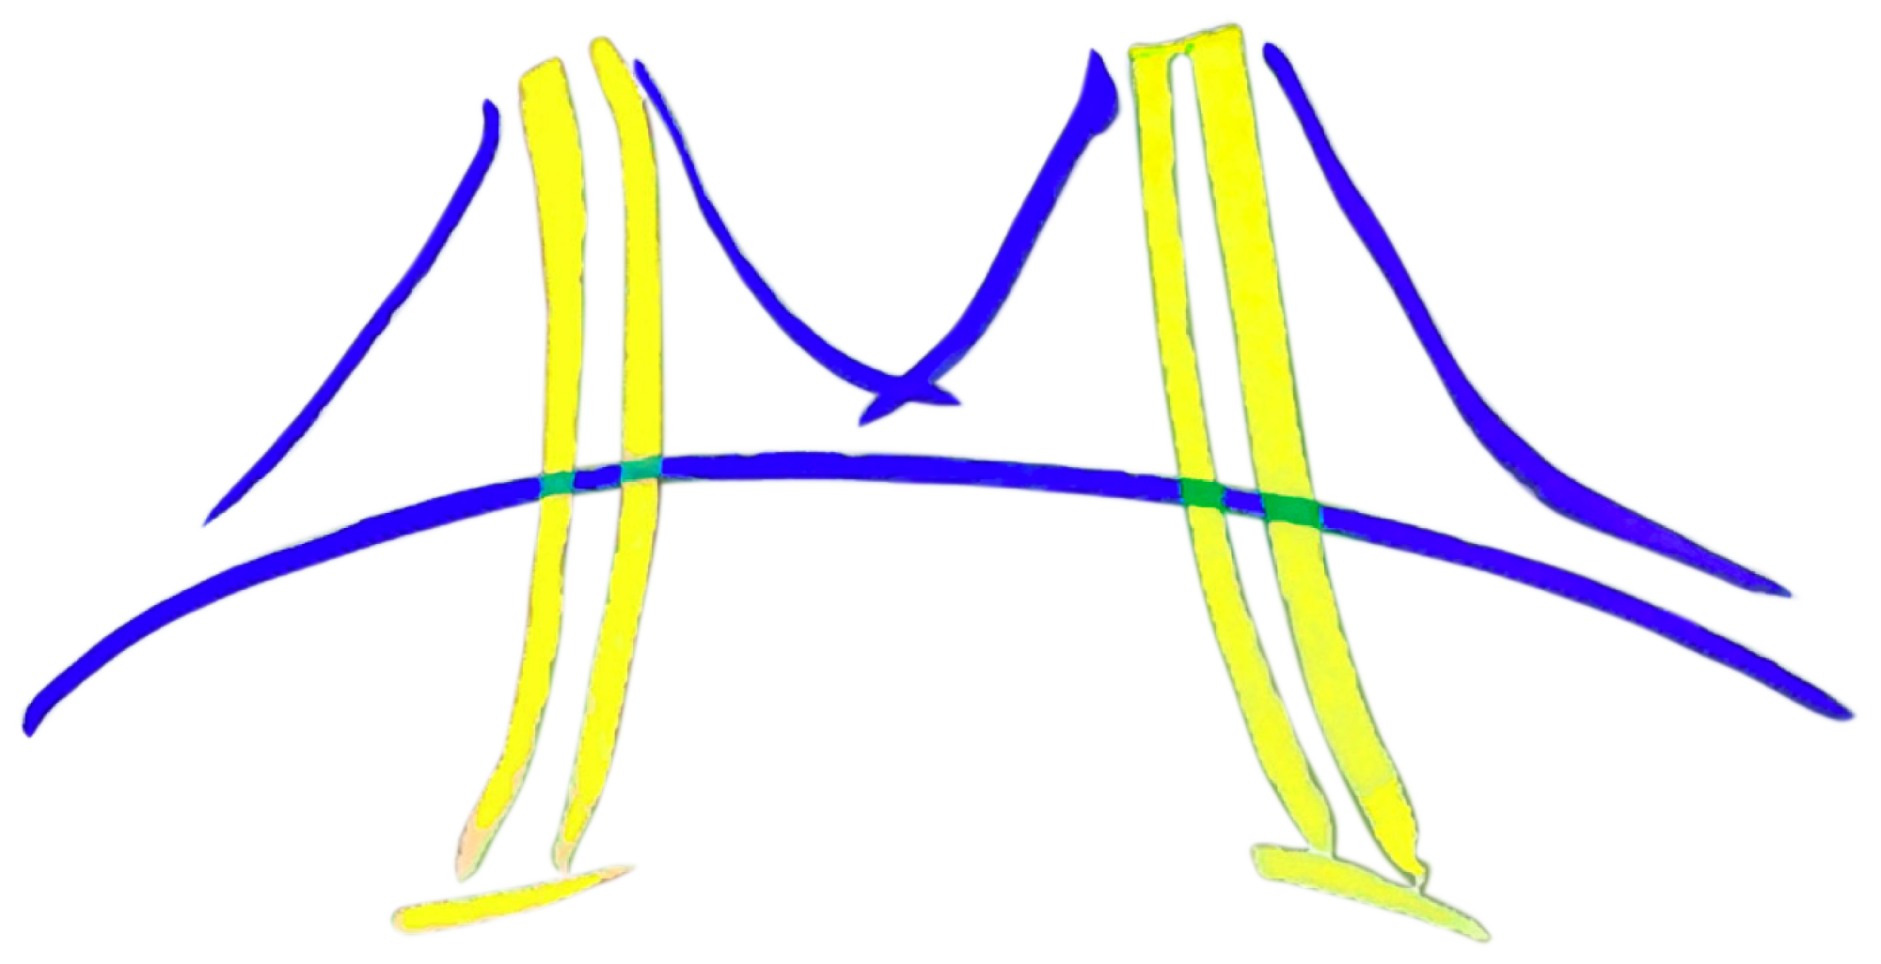
Fast Support Vector Machine Training and Classification on Graphics Processors
Bryan Catanzaro
Narayanan Sundaram
Kurt Keutzer
Parallel Computing Laboratory,
University of California, Berkeley

Slide 2
Outline
Motivation
Graphics Processors
Support Vector Machine Training
  An adaptive 1st and 2nd order working set selection heuristic
Support Vector Machine Classification
Conclusion

Slide 3
Motivation
Kernel-based methods are computationally expensive
  We often have more data than we can afford to process
Future performance will come through parallelism
  Single thread performance increases are tapped out
Highly parallel, general purpose processors are now becoming widely available
  GPUs are at the forefront of this trend
Massive on-chip parallelism can make it easier to parallelize algorithms
  Synchronization is cheaper, easing bottlenecks seen in earlier parallelization efforts

Slide 4
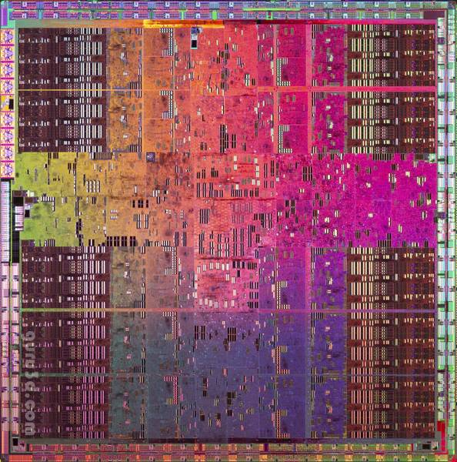
Graphics Processors
Today’s graphics processors have evolved into highly parallel, increasingly general purpose compute engines
Nvidia GPU Specs | 8800GTX | GTX280
Processing Elements | 128 @ 1.35 GHz | 240 @ 1.3 GHz
Resident Threads (max) | 12288 | 30720
SP GFLOPS | 346 | 933
Memory Bandwidth | 86.4 GB/s | 141.7 GB/s
Register File | 0.5 MB | 1.875 MB
Local Store | 256 kB | 480 kB
Memory | 768 MB | 1 GB

Slide 5
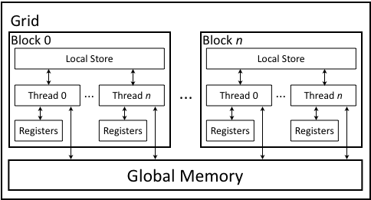
Programming GPUs
Programming is done through CUDA, a small extension to C++
Programmer expresses computations in terms of
  Serial grids
  Parallel blocks (no synchronization or write sharing)
  Parallel threads (arbitrary synchronization, data sharing within a block)
Programmer writes a single thread, designed to be launched in very large numbers (thousands to millions)
0
…
n

Slide 6

SVM Training (C-SVC)
Quadratic Program
Variables:
α: Weight for each training point (determines classifier)
Data:
l: number of training points
y: Label (+/- 1) for each training point
x: training points
Example Kernel Functions:

Slide 7
SMO Algorithm
The Sequential Minimal Optimization algorithm (Platt, 1999) is an iterative solution method for the SVM training problem
At each iteration, it adjusts only 2 of the variables (chosen by heuristic)
  The optimization step is then a trivial one dimensional problem:
Computing full kernel matrix Q not required
Despite name, algorithm can be quite parallel
Computation is dominated by KKT optimality condition updates

Slide 8
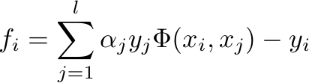
First Order Selection Heuristic
The job of the variable selection heuristic is to choose the 2 variables which will be updated (this is a direction selection)
We use the maximal violating pair first order heuristic & KKT formulation proposed by (Keerthi et al., 2001):
The first order heuristic uses information from the gradient of the functional (similar to steepest ascent)
O(l) complexity for each step

Slide 9
Second Order Heuristic
The first order heuristic can be confused by steep gradients which ultimately lead to marginal improvement of the objective
To overcome this, (Fan et al., 2005) proposed a 2nd order heuristic which selects the variables to maximize the objective F(α)
To keep the heuristic O(l) per step, one variable is chosen as in the first order heuristic
The second is chosen to maximize the objective without regarding the constraints, while still guaranteeing progress towards the constrained optimum
Steep, but shallow
Gentle, but deep

Slide 10




Implementation Sketch
Parallelism is derived from l, the number of training points, as in (Cao et al., 2006)
First order heuristic iteration:
  compute (Map), compute (Reduce)
Second order heuristic iteration:
  compute (Map), compute (Reduce)
  compute (Map), compute (Reduce)
Kernel caching is used to avoid redundant kernel evaluations, as in (Joachims, 1999)
  The cache is managed on the CPU, and kept in GPU memory
Special attention is paid to ensure efficient memory access patterns
  Make memory traffic coherent, use local stores

Slide 11
Adaptive Heuristic
The second order heuristic works very well for some problems, but can be expensive (geomean: 1.8x slower per iteration)
We created an adaptive heuristic which periodically estimates the convergence rate for both heuristics as a function of wall clock time, then chooses the most productive heuristic
The adaptive heuristic
performs close to the
best heuristic on our
test sets
Normalized to 1st order heuristic

Slide 12
Training Results
Training Time (seconds)
Name | #points | #dim
USPS | 7291 | 256
Face | 6977 | 381
Adult | 32561 | 123
Web | 49749 | 300
MNIST | 60000 | 784
Forest | 561012 | 54
5.09
27.6
550
2422
16966
66524
0.576
164
1.32
26.9
483
2023
LibSVM running on Intel Core 2 Duo 2.66 GHz
Our solver running on Nvidia GeForce 8800GTX
Gaussian kernel used for all experiments
9-35x speedup

Slide 13
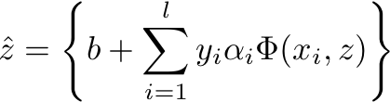
SVM Classification
To classify a point z, evaluate :
For standard kernels, SVM Classification involves comparing all support vectors and all test vectors with a dot product
We take advantage of the common situation when one has multiple data points to classify simultaneously
  In the case where data points are being classified serially, the approach still works, but will not be as fast
We cast the dot products as a Matrix-Matrix multiplication, and then use Map Reduce to finish the classification

Slide 14
Implementation Sketch
CPU optimized code
  Uses dense matrices
  Restructured the computation to use Intel Math Kernel Library BLAS
  Used OpenMP to parallelize the remaining BLAS1 and MapReduce stages.
GPU classifier
  Uses dense matrices
  Uses CUDA BLAS

Slide 15
Classification Results
Classification Time (seconds)
0.77
61
89
107
270
0.23
7.5
15.7
5.2
9.5
0.0096
0.575
0.71
1.06
1.95
CPU optimized version achieves 3-30x speedup
GPU version achieves an additional 5-24x speedup, for a total of 81-138x speedup

Slide 16
Quality of Results
Normalized Support Vector Count
Full System Accuracy
The GPU trainer provides very similar classifiers
The GPU trainer + classifier system provided exactly the same results

Slide 17
Conclusion & Future Work
Massively parallel processors provide useful speedups on SVM training and classification
There are other sources of parallelism in SVM training that we have not exploited:
  Cross validation
  Multi-class
There is much interesting work to be done in finding massively parallel implementations of machine learning algorithms
Code will be available at
http://www.eecs.berkeley.edu/~catanzar/GPUSVM

Slide 18
The end

