Slide 1
Triplet Extraction from Sentences
Lorand Dali lorand.dali@ijs.si
Blaž Fortuna blaz.fortuna@ijs.si
“Jožef Stefan” Institute, Ljubljana
17th of October 2008

Slide 2
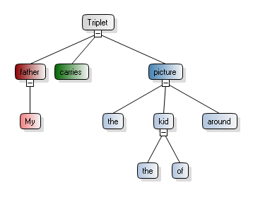
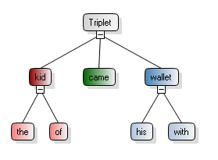
My father carries around the picture of the kid who came with his wallet.

Slide 3
Motivation of Triplet Extraction
Advantages
compact and simple representation of the information contained in a sentence
avoids the complexity of a full parse
contains semantic information
Applications
building the semantic graph of a document
summarization
question answering

Slide 4
Triplet Extraction – 2 Approaches
Extraction from the parse tree of the sentence using heuristic rules
OpenNLP – Treebank Parsetree
Link Parser – Link Grammar (a type of dependency grammar)
Extraction using Machine Learning
Support Vector Machines (SVM) are used
The SVM model is trained on human annotated data

Slide 5
The increase will cover all kinds of wheat including durum and milling wheat.
The
increase
will
cover
all
kinds
of
wheat
including
durum
and
milling
wheat
.
increase
cover
wheat
increase
cover
wheat
durum
wheat
increase
increase
cover
milling
increase
cover
kinds
increase
cover
including
increase
cover
including
increase
cover
durum
SVM
increase
cover
durum
increase
cover
wheat
increase
cover
wheat
increase
cover
kinds
durum
kinds
wheat
durum
kinds
wheat
increase
cover
milling
durum
wheat
increase
. . .
. . .

Slide 6
Merging Triplets
increase
cover
wheat
increase
cover
milling
increase
cover
including
increase
cover
durum
increase
cover
wheat
increase
cover
kinds
Merge triplets with same or adjacent words
increase
cover
kinds wheat including durum milling wheat
Add stopwords
increase
cover
all kinds of wheat including durum and milling wheat

Slide 7
Features of the triplet candidates
Over 300 features depending on:
Sentence
length of sentence, number of words, etc
Candidate
context of Subj, Verb and Obj;
distance between Subj, Verb, Obj
Linkage
number of links, of link types, nr of links from S, V, O
Minipar
depth, diameter, siblings, uncles, cousins, categories, relations
Treebank
depth, diameter, siblings, uncles, cousins, path to root, POS

Slide 8
Evaluation and Testing
Training set = 700 annotated sentences Test set = 100 annotated sentences
Compare the extracted triplets from a sentence to the annotated triplets from that same sentence
Comparison is done according to a similaritry measure ∈ [0, 1] between two triplets
extracted to annotated => precision
annotated to extracted => recall

Slide 9
Triplet Similarity Measure
S
V
O
SubjSim
VerbSim
ObjSim
S’
V’
O’
TrSim = (SubjSim + VerbSim + ObjSim) / 3
TrSim, SubjSim, VerbSim, ObjSim ∈ [0, 1]

Slide 10
String Similarity Measure
The road to success is always under construction
road
success
under
construction
Sim = nMatch / maxLen = 3 / 5 = 0.6
way
success
under
heavy
construction
The way to success is under heavy construction

Slide 11
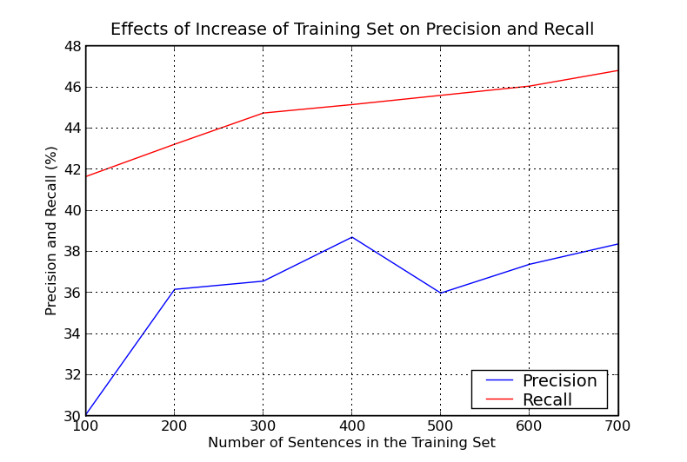

Slide 12
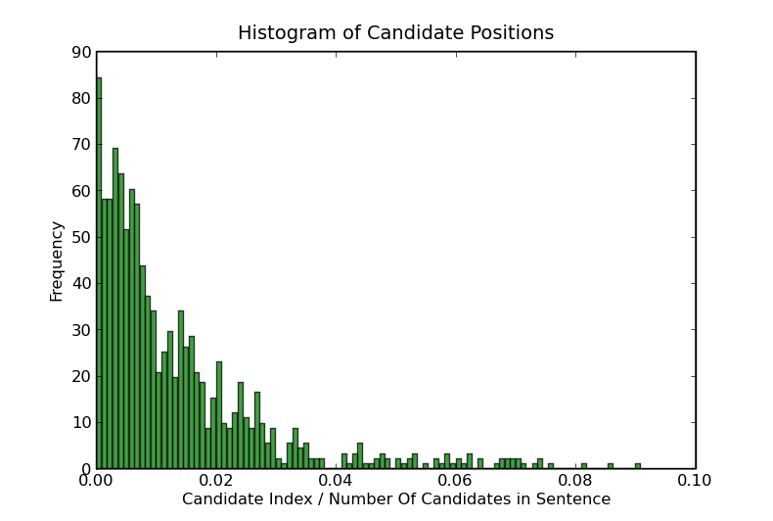
Candidate Position Histogram

Slide 13
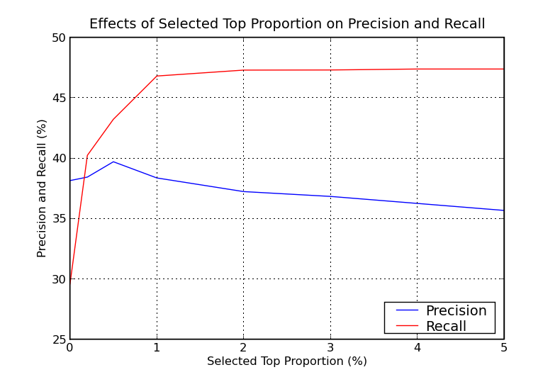

Slide 14
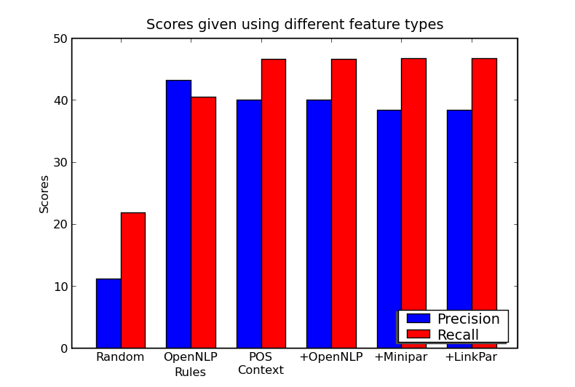

Slide 15
Search the extracted triplets

Slide 16
