Slide 1
The Mountains or the Street Lamp: Search, Research, Research again Chris Burges Microsoft Research October 29, 2008

Slide 2
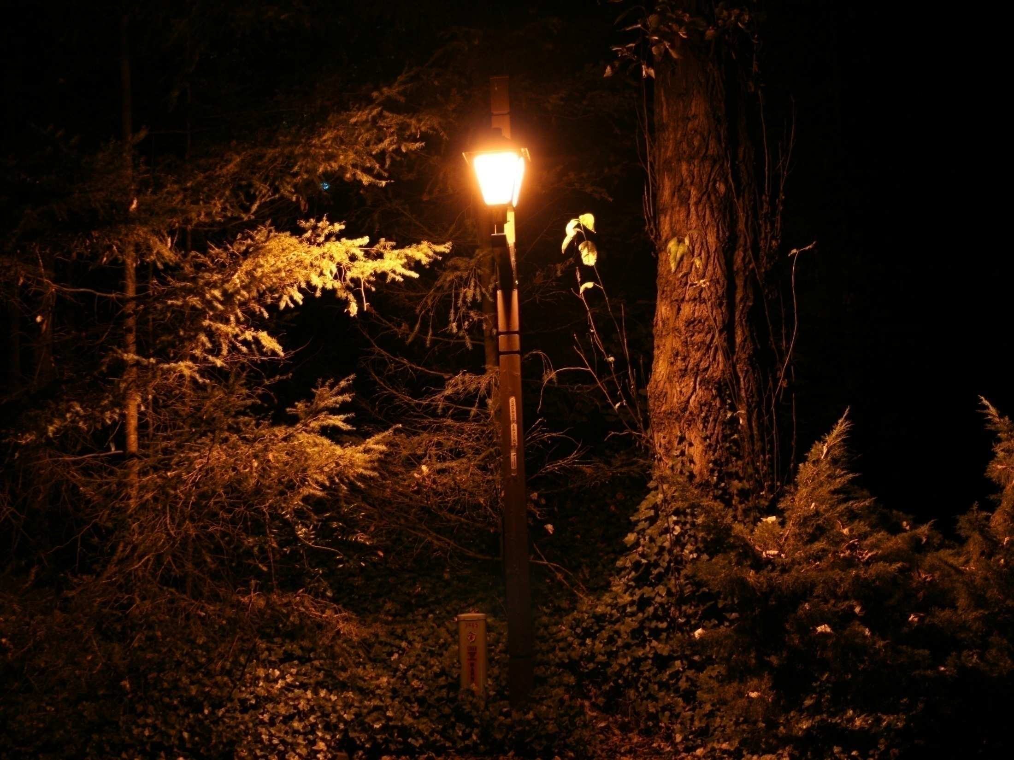

Slide 3
Notes:
General relativity: 45 microseconds per day, about 10 km error per day: Richard Pogge, Ohio State Dept. Astronomy
Eddington, 1919, deflection of starlight by the sun

Slide 4
Contents
Some projects I have worked on
Routing signaling networks for AT&T
Identifying audio in real time
Ranking for web search
Why is biprime factoring hard?

Slide 5
A Research History
1979 -1984 (Brandeis)
Can we detect whether quarks have structure?
Physics of the early universe
1984 -1986 (MIT)
Supersymmetry in anti-deSitter space
Gravitational Aharonov-Bohm effect in Three Dimensions; nonlinear σ models
Buoyant mixtures of cellular-automaton gases
1986 – 1990 (AT&T Bell Labs)
Modeling bit error rates in the AT&T signaling network
Routing the AT&T signaling network
1990 – 2000 (AT&T, Lucent Bell Labs)
Applying convolutional neural nets for Zip code recognition (USPS)
Applying neural nets for handwriting recognition (USPS)
Segmentation of check courtesy amounts + optimal net training (NCR)
Speaker verification with discriminative GMMs (and with SVMs)
Developing Support Vector Machines with V. Vapnik (DARPA)
Notes:
“green” means “positively impacted at least 10 million people”

Slide 6
A Research History, cont.
2000 – present (Microsoft Research)
Image compression with neural nets
Music recognition with Audio Fingerprinting (RARE)
Fast Indexing for Multimedia Identification
Music summarization with RARE
Duplicate audio detection with RARE
Semisupervised learning on graphs
A bit more work on SVMs; convolutional nets for speech detection
Reviews: math for machine learning, dimensional reduction, feature extraction
RankNet: Learning to Rank for Web Search
LambdaRank: IR optimal ranking
Factoring as optimization
Web stuff…

Slide 7
A Research History
1979 -1984 (Brandeis)
Can we detect whether quarks have structure?
Physics of the early universe
1984 -1986 (MIT)
Supersymmetry in anti-deSitter space
Gravitational Aharonov-Bohm effect in Three Dimensions; nonlinear σ models
Buoyant mixtures of cellular-automaton gases
1986 – 1990 (AT&T Bell Labs)
Modeling bit error rates in the AT&T signaling network
Routing the AT&T signaling network
1990 – 2000 (AT&T, Lucent Bell Labs)
Applying convolutional neural nets for Zip code recognition (USPS)
Applying neural nets for handwriting recognition (USPS)
Segmentation of check courtesy amounts + optimal net training (NCR)
Speaker verification with discriminative GMMs (and with SVMs)
Developing Support Vector Machines with V. Vapnik (DARPA)

Slide 8
Routing the AT&T CCS7 Signaling Network
Birmingham, AL
Cleveland, OH
STP
X
STP
4ESS
4ESS
STP
STP
New Orleans, LA
Philadelphia, PA
NCP
80,000 miles of diversity violations found
Solving problem exactly is combinatorically hard
Use modified Djikstra, [# violations, length in violation, length]
Violations reduced to zero (in theory)
Joint work with Terry Cleary

Slide 9
Lessons
Getting the data you need can be tough
Distributed over several databases
Some may not be accessible
Using the data in unexpected ways can reveal errors or missing data
Engaging the Team
“Over the wall” doesn’t work
Must gain credibility, trust, and cycles

Slide 10
A Research History, cont.
2000 – present (Microsoft Research)
Image compression with neural nets
Music recognition with Audio Fingerprinting (RARE)
Fast Indexing for Multimedia Identification
Music summarization with RARE
Duplicate audio detection with RARE
Semisupervised learning on graphs
A bit more work on SVMs
Reviews: math for machine learning, dimensional reduction, feature extraction
RankNet: Learning to Rank for Web Search
LambdaRank: IR optimal ranking
Factoring as optimization
News summarization, web spam detection, convolutional nets for speech detection

Slide 11
Audio Fingerprinting with RARE
Robust Audio Recognition Engine: identify audio (not just music) in stream or in files
Audio Thumbnail Generator
Duplicate Detector
Joint work with J. Platt, J. Goldstein, E. Renshaw

Slide 12
Robust Audio Recognition Engine
6 seconds of audio 64 floats
Compute every 186 ms (or 372)
Compare against database of stored
fingerprints
Confirm with second stored fingerprint
For files, only need to check window
around expected position

Slide 13
Analyze a Stream
Design of the Funnel
Find 64 good projections of
6 seconds of audio
6 sec
6 sec
6 sec of
Song B
good
projection
64 floats / frame
δ₂
δ₁
In Database?
Confirmed?
6 sec of
Song A
0
0
0
1
6 sec of
distorted Song A
If 1, declare match
Good projections maximize δ₂/ δ₁

Slide 14
Build Index
S₃
S₅
Query
N-dim space of features of stored items
S₁
S₂
S₄
R₁
R₅
R₂
R₄
Compute projections into fixed bins
R₃
1
1
0
0
0
1
0
1
0
0
0
0
1
1
0
0
0
0
1
1
Computed and store m-dimensional bit vectors

Slide 15
Retrieval: Trim list by ANDing bit Vectors
At query time
find candidates that overlap bins in all dimensions
Point 1
0
1
1
1
1
1
1
1
0
1
1
0
1
1
1
1
1
0
0
1
1
0
0
1
1
1
0
1
0
0
1
1
0
1
1
0
0
1
0
0
1
1
0
0
1
0
0
0
1
Most examples are excluded from a final linear scan
&
&
&
→
Point N
dim1
dim2
dim3
dim4
For final linear scan:
Compare candidate original spheres against data points

Slide 16
More Lessons
Serendipity can play a major role:
RARE shipped right away
Duplicate detection shipped years later
Audio thumbs not yet shipped
Keep old fires warm

Slide 17
A Research History, cont.
2000 – present (Microsoft Research)
Image compression with neural nets
Music recognition with Audio Fingerprinting (RARE)
Fast Indexing for Multimedia Identification
Music summarization with RARE
Duplicate audio detection with RARE
Semisupervised learning on graphs
A bit more work on SVMs
Reviews: math for machine learning, dimensional reduction, feature extraction
RankNet: Learning to Rank for Web Search
LambdaRank: IR optimal ranking
Factoring as optimization
News summarization, web spam detection, convolutional nets for speech detection

Slide 18
Web Ranking at 60,000 Feet
Given a user’s query, map to category and generate a large list of candidate urls
For each url, compute a feature vector
Features can depend on query, document, aggregated clicks, session data, …
Feed feature vectors into rankers:
Sort the urls by the returned scores
Major collaborators: Qiang Wu, Robert Ragno, Tal Shaked, Live Search Team

Slide 19
There are Many IR Metrics
Precision: Recall:
Average Precision: Compute precision for each positive, average over positions
Mean Average Precision: Average AP over queries
Mean Reciprocal Rank (TREC QA)
Winner Takes All:
Pairwise error and derivatives (‘bpref’)
Fraction pairwise correct = area under ROC curve (fraction true positives vs. fraction false positives)
Notes:
These are all binary costs.

Slide 20
(N)DCG
We’d like a measure for several levels of relevance,
that emphasizes the top ranked items: Normalized
Discounted Cumulative Gain (Jarvelin & Kekalainen,
SIGIR 2000):

Slide 21
Information Retrieval Costs, cont.
All of these costs have the following in common:
They depend only on the labels and the sorted
order of the documents
Viewed as a function of the scores output by some
model, the costs are everywhere either:
Flat (zero gradient)
or
Discontinuous (gradient not defined)
Notes:
Options: find convex approximation; try more direct methods.

Slide 22
RankNet Cost ~ Pairwise Cost

Slide 23
Pairwise Cost Revisited
Pairwise cost fine if appropriate, but:
13 errors
11 errors

Slide 24
LambdaRank
Instead of using a smooth approximation to the cost, and
taking derivatives, write down the derivatives directly.
Then use these derivatives to train a model using
gradient descent, as usual.

Slide 25
More Lessons
The “embedding” model
A great way to understand the problems
Builds trust
Serendipity again
LambdaRank finds empirically optimal models (joint work with Y. Yue, P. Donmez, K. Svore)

Slide 26
A Research History, cont.
2000 – present (Microsoft Research)
Image compression with neural nets
Music recognition with Audio Fingerprinting (RARE)
Fast Indexing for Multimedia Identification
Music summarization with RARE
Duplicate audio detection with RARE
Semisupervised learning on graphs
A bit more work on SVMs
Reviews: math for machine learning, dimensional reduction, feature extraction
RankNet: Learning to Rank for Web Search
LambdaRank: IR optimal ranking
Factoring as optimization
News summarization, web spam detection, convolutional nets for speech detection
Notes:
Blue means No Results!

Slide 27
Factoring Biprimes: A True Mountain
The security of internet commerce (SSL, RSA) rests on a mathematical conjecture, namely, that factoring biprimes is combinatorically hard.
Conjectures aren’t necessarily true. If this conjecture is false, there is no simple backup plan.
The current fastest known factoring method is the general number field sieve. It is exponentially slow:

Slide 28
Circumstantial Evidence That Factoring is Not NP-hard
There are very few known problems that quantum computers could solve exponentially faster than classical computers.
Factoring is one of them: (Shor, 94). The “discrete logarithm” is one more.
Much work since then to find a quantum algorithm that solves an NP complete problem has failed. A quantum computer must use domain knowledge (S. Aaronson, 2008)
Searching a list of solutions is not exponential: (Grover, 96)

Slide 29
Is This The Best We Can Do?
Even exponential complexity, but with better N dependence, would be interesting.

Slide 30
Represent the Problem in Binary

Slide 31
First Trick: Linearization

Slide 32
A Geometrical Problem

Slide 33
Second Trick: Quantization
Reduce feasible region via Linear Programming.

Slide 35
Projections Lose Information
How fast can randomized projections in subspaces find the solution?
Notes:
Projecting along any axis gives no resulting bounds

Slide 36
“True Mountain” Lessons
… likely has swamps, wolves, bears and Interstate 90 between here and there.
Is still fun to see how far you can get.
Keep your daytime job.

Slide 37
Conclusions
Most ‘transfer’ projects were more Mountain than Streetlamp
Industrial research labs are great places to work on projects that
Further the science
Are inspired by pressing problems
Can be tested in the crucible of the marketplace.
Real world constraints can act as a valuable guide in the development of new scientific understanding.
Even industrial research labs will support the occasional crazy project.

Slide 38
Thank You

