Slide 1

Can All Tags be used for Search?
Kerstin Bischoff, Claudiu S. Firan, Wolfgang Nejdl & Raluca Paiu
L3S Research Center/ Leibniz University Hannover

Slide 2
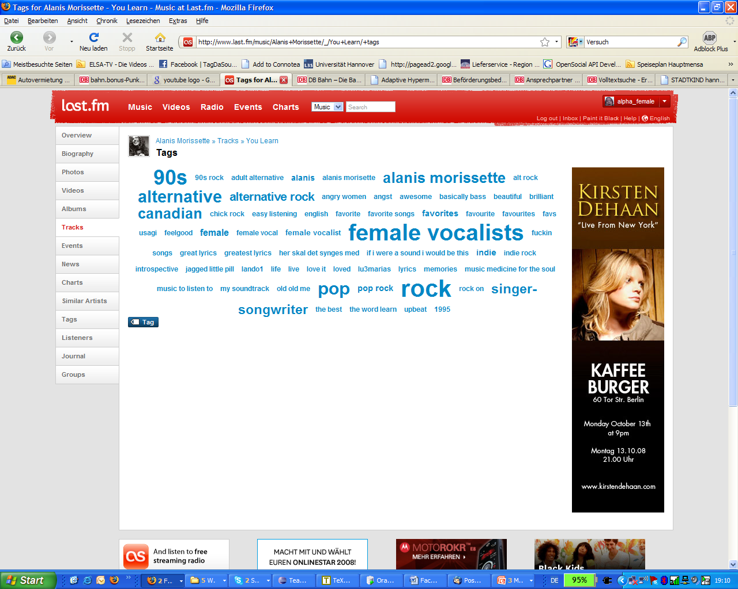
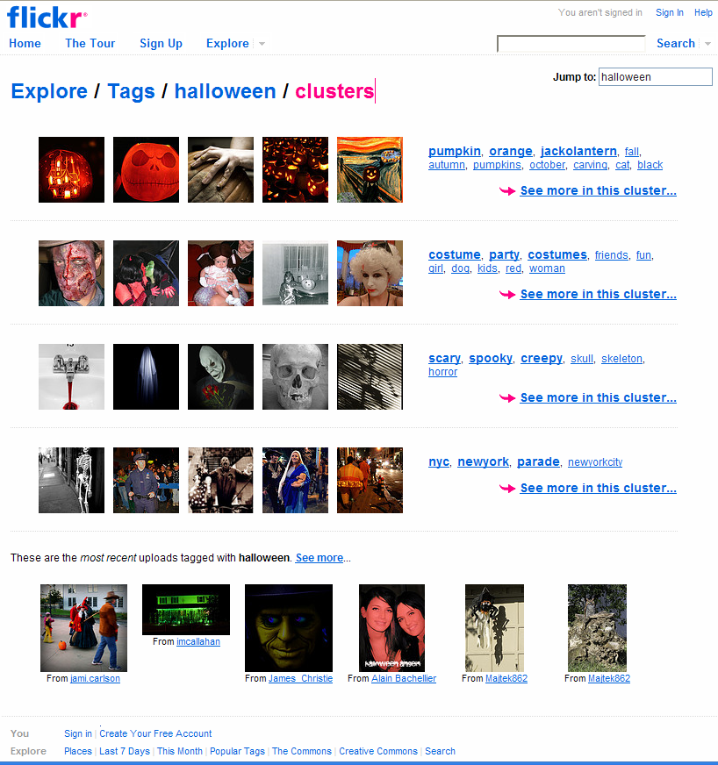

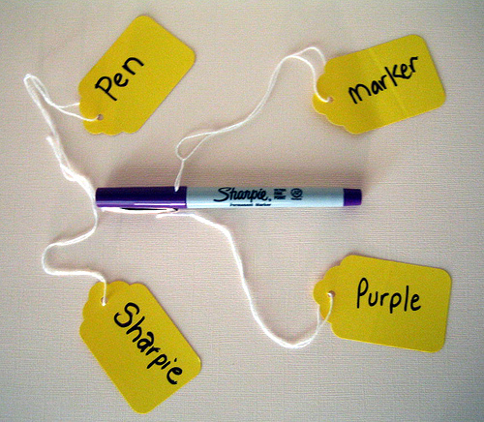


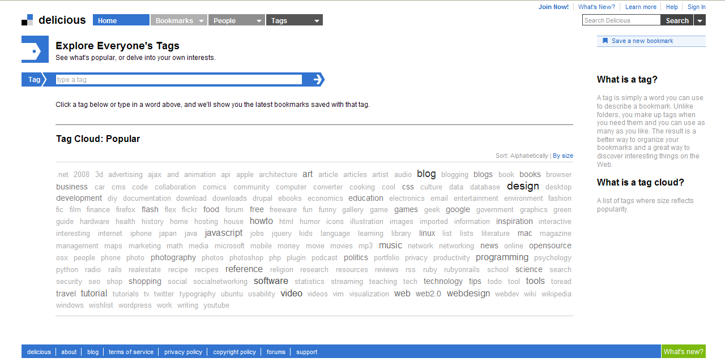







Why research collaborative tagging?
TODO
work
Notes:
- popularity of tagging sites: add freely selectible keywords
- some tagging sites have been acquried by search engine companies: del.icio.us and flickr by Yahoo! And YouTube by Google -> search now systematically extended to these sites (often top results)

Slide 3
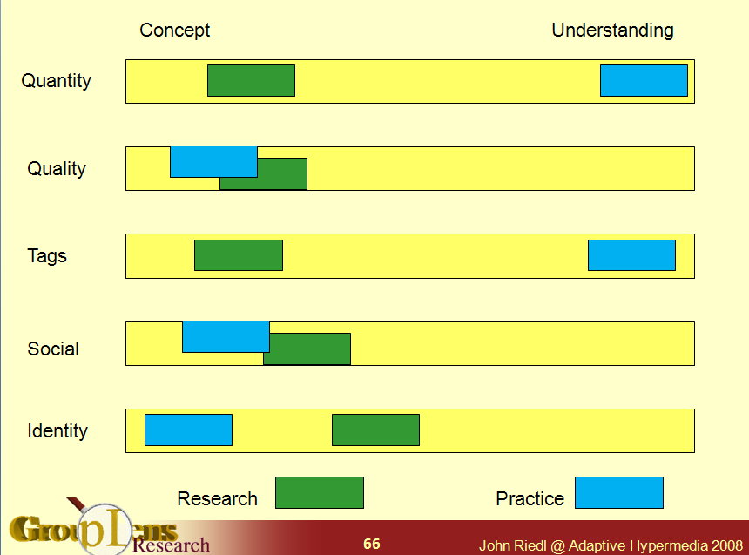
Why research collaborative tagging?
Notes:
- in practice widely used: wisdom of the crowd/collective intelligence users and search engine. But research far behind practice. (John Riedl, keynote at AH2008)
- initial research focused on one site only, or only first qualitative insights
- usefulness in search remains unclear
This paper presents the first evaluation of tagging systems across _multiple_ domains. The authors compare del.icio.us, Last.fm, Flickr, and a crawled set of tags from HTML anchor text. The comparison focuses on reliability, distribution of tag kinds, and relevance. It provides strong evidence that tags are as useful as anchor text for searching, in particular for topic searches. This applies for textual data such as HTML documents, but even more for image or music data which are not searchable by conventional means. In particular, the analysis of the different tag kinds, their distribution, and relevance for search give significant empirical support for the designers of tagging systems which tag kinds to support and promote. As such, the paper contributes significantly to further a more principled and evidence based design for social software.
The main contribution compared to prior work is the study of tagging across multiple domains and the consideration of relevance for search of each tag category. Tag categories have been used before and relevance for search has been studied for tags in general, but neither in combination nor across multiple domains. Both aspects significantly affect the results of the analysis. Of particular interest is that the authors demonstrate that most tagging systems behave very similar to anchor text, a proven method for enhancing relevance of Web search.
This works analyzes the contribution of user tags, as provided by several collaborative tagging systems (de.lic.ious, flickr, last.fm) for search. This is a comprehensive study that provides a broad analysis on the relations between tags and content and on the distributions of tags according to the source they come from. In addition the work describes a study on the connections between user tags to user common queries, and many other aspects related to tag analysis. This is a significant thorough work on the usefulness of tags and is relevant for any tag-based application.
…
It is not completely original, since it is a continuation of previous work.

Slide 4
Tagging sites: Datasets
Last.fm – social music platform:
317,058 tracks with (user generated) metadata (05/2007)
21,177 different (popular) tags with frequencies, users, similar tags
Del.icio.us – bookmarking/tagging the web:
323,294 unique tags associated to 2,507,688 bookmarks (07/2007)
recursive crawl seeding from the start page & start page monitoring
Flickr – photo sharing:
Crawl expanded based on popular tags (01/2004-12/2005)
Here, subset of 100,000 pictures with 32,378 unique tags
Anchor text (AT) – visible, clickable text in a hyperlink:
8,453,043 web pages parsed from Stanford WebBase Crawl (01/2006),
10,348,807 unique AT: 7,902,047 internal; 2,756,377 external
Notes:
Last.fm: personalized radio via CF with similar users - tagging songs, artist, albums,
AT: external and internal Ats (almost no overlap in vocabulary

Slide 5
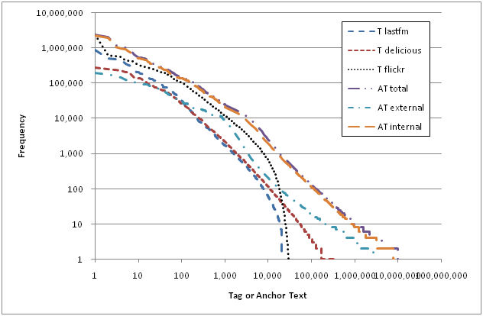
Tag distribution across systems
Power law for
all systems
Notes:
More or less power law for all systems
- sharp drop for Flickr and Last.fm due to crawling procedure focusing on popular tags

Slide 6
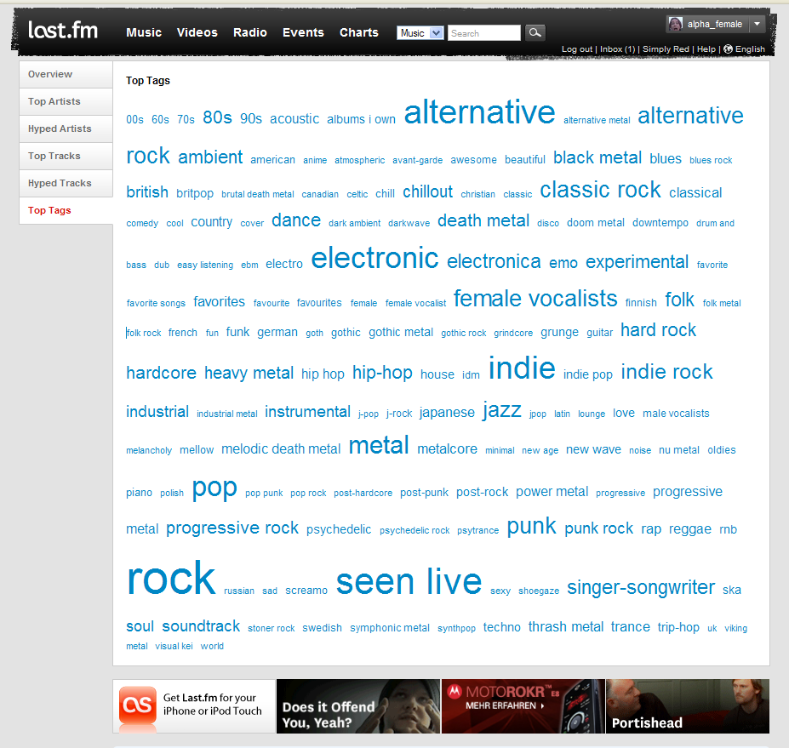
Tags in search
Notes:
- in practice widely used: wisdom of the crowd/collective intelligence users and search engine. But research far behind practice. (John Riedl, keynote at AH2008)
- initial research focused on one site only, or only first qualitative insights
- usefulness in search remains unclear
This paper presents the first evaluation of tagging systems across _multiple_ domains. The authors compare del.icio.us, Last.fm, Flickr, and a crawled set of tags from HTML anchor text. The comparison focuses on reliability, distribution of tag kinds, and relevance. It provides strong evidence that tags are as useful as anchor text for searching, in particular for topic searches. This applies for textual data such as HTML documents, but even more for image or music data which are not searchable by conventional means. In particular, the analysis of the different tag kinds, their distribution, and relevance for search give significant empirical support for the designers of tagging systems which tag kinds to support and promote. As such, the paper contributes significantly to further a more principled and evidence based design for social software.
The main contribution compared to prior work is the study of tagging across multiple domains and the consideration of relevance for search of each tag category. Tag categories have been used before and relevance for search has been studied for tags in general, but neither in combination nor across multiple domains. Both aspects significantly affect the results of the analysis. Of particular interest is that the authors demonstrate that most tagging systems behave very similar to anchor text, a proven method for enhancing relevance of Web search.
This works analyzes the contribution of user tags, as provided by several collaborative tagging systems (de.lic.ious, flickr, last.fm) for search. This is a comprehensive study that provides a broad analysis on the relations between tags and content and on the distributions of tags according to the source they come from. In addition the work describes a study on the connections between user tags to user common queries, and many other aspects related to tag analysis. This is a significant thorough work on the usefulness of tags and is relevant for any tag-based application.
…
It is not completely original, since it is a continuation of previous work.

Slide 7
Tag usage: different kinds of tags
Category | Last.fm | Flickr | Del.icio.us | Anchor text
1. Topic | love | flowers | linux | security
2. Time | 80s | 2005, July | daily | previous years
3. Location | england | toronto | newcastle | nederlands
4. Type | pop, acoustic | portrait | movies, mp3 | pdf, books
5. Author/ Owner | the beatles | wright | alanmoore | musicmoz.org
6. Opinion/ Qualities | great lyrics | scary | annoying | mobile essentials
7. Usage context | workout, lost | vacation | review.later | entertainment
8. Self reference | albums I own | me, 100views | frommyrssfeeds | about us, home
Notes:
Tag classification taxonomy, applicable to different tagging sytems:
- started with existing taxonomies, checking their appropriateness for different resource types
- kept and refined the most fine-grained by Golder&Huberman 2006 adding time and location
- several iterations: refinement – testing by classifying sample tags and computing interrater reliability

Slide 8
Tag type distributions across systems
Manual classification of 300 sample tags per system and for AT
  100 top tags, 100 tags starting at 70% of probability density, 100 tags starting at 90%
Notes:
The 3 sample (percentage) ranks were chosen based on prior findings that suggest that different parts of the power law curve exhibit distinct patterns
Goal: provide descriptive statistics to help formulating appropriate hypotheses based on such relative type frequencies per system
Tag type distributions vary with the system/resource
- > good for search: most tags are not strongly subjective, but pretty factual/verifiable (Topic, Location, Type, Author)
- > just in free-for-all-tagging system and music: Opinions/performance

Slide 9
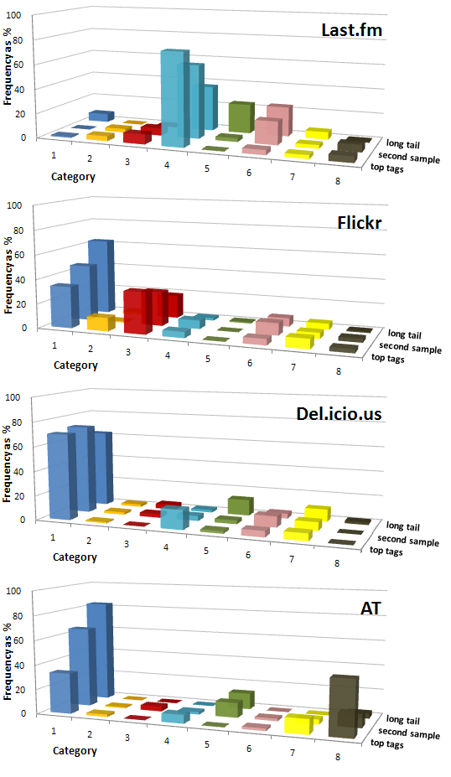
Tag type distributions across samples
Notes:
Last.fm: personalized radio via CF with similar users - tagging songs, artist, albums,

Slide 10
Meta-analysis of tag classes: accuracy
Ambiguity due to homonymy as well as different usage scenarios, fuzzy category boundaries (“Shannon”, “wedding”, “jobSearch”, “CIKM2008”)
Cohen’s Kappa for measuring inter-rater reliability
  75 random tags per system sample were reclassified
  In total κ = 0.71, given a raw agreement of 77%
  (Last.fm κ = 0.74, Flickr κ = 0.69, Del.icio.us κ = 0.46, AT κ = 0.7
  κ = 0.8, when allowing a 2nd class assignment for ambiguous tags
Prominent confusion patterns: always involve the predominant ‘Topic’
(vs. ‘Type’, ‘Author/Owner’, ‘Usage context’)
Notes:
The 3 sample (percentage) ranks were chosen based on prior findings that suggest that different parts of the power law curve exhibit distinct patterns
Goal: provide descriptive statistics to help formulating appropriate hypotheses based on such relative type frequencies per system

Slide 11
Reliability: trust users or experts only?
Tags in music reviews on the web
  Google query [ “artist” “track” music review -lyrics ] for 8,130 random tracks
  73.01% of track tags in web reviews – linear distribution
Tags in AllMusic reviews
  3,600 reviews
  46.14% overlap
  linear distribution
  probably restricted
  vocabulary of experts
Notes:
Google:Text of top 100 Google results extracted
Allmusic-: song or album review
At least 1 tag appears within review for almost all songs -> reliable

Slide 12
Added value or redundancy?
Matching tags and AT to the web page text they annotate
  44.85% of the Del.icio.us tags appear in the page text
  (sample: 20.911 URLs)
  44.7% of external AT and 81.24% internal AT already present in the page (sample 8,614,990 AT)
  For 77,756 URLs in both datasets, text matches between tags and AT
    4.71% with at least one exact match
    42.52% partial match
    Numbers of tags and AT for the same page uncorrelated
Notes:
remarks:
44 % confirms findings by Heymann et al. WSDM 2008
Same characteristic for external AT => should be regarded as a collaborative annotation scheme/system

Slide 13
Added value or redundancy?
Matching tags in track lyrics
  For 77,498 songs, search with tags in lyrics
        Power law distribution:
        3,000 songs have more than 1 tag, 10,000 with 1 tag,
        63,000 no matching tag
        Avg.: 1,54% of tags to be found lyrics
        => theme/topic tags are rare

Slide 14
Query log: Do users search like they tag?
Overlap: queries consisting of tags found in our datasets
  Del.icio.us: 71.22% with at least 1 tag; 30.61% all terms
  Flickr: 64.54% and 12.66% resp.
  Last.fm: 58.43% and 6% resp.
Query
classification
Notes:
Aol, log - MSN Search query Log excerpt planned

Slide 15
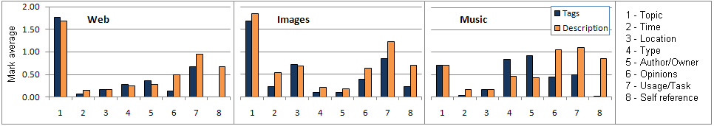
User study*: Independent recall of tag types
30 PhD students had to:
  Recall 2 ‘personal’ songs, 2 pictures, 2 bookmarks
  Describe the item as detailed as possible & give keywords
  Indicates which categories are easily remembered and are thus available in the search process
  * setup adapted from Naaman et al. 2004
1 – Topic
2 – Time
3 – Location
4 – Type
5 – Author/Owner
6 – Opinions
7 – Usage/Task
8 – Self reference
Notes:
Last.fm: personalized radio via CF with similar users - tagging songs, artist, albums,

Slide 16
User study: perceived usefulness of tag types
Rate on 5-point Likert scale:
  The usefulness of the 8 categories for searching own resources
  The usefulness of the 8 categories for searching other peoples’ resources
  How easily each category is remembered
Images
Notes:
Difference between the activities (usefulness, usefulness, remembering) minimal: Pearson r= 0.85 to 0.97

Slide 17
User study: summary
Web
Images
Music
Loc.
Usage
Loc.
Loc.
Usage
Web
Notes:
Last.fm: personalized radio via CF with similar users - tagging songs, artist, albums,

Slide 18
Conclusions
Distributions of tag types depend on resource type and system:
  Del.icio.us/AT: Topic; Flickr: Topic & Location; Last.fm: Type
  Still, for all systems over 60% of tags are factual/verifiable
Most tags are reliable:
  about 73% of tags also occur in online music in reviews (46% resp.)
Tags bring new information:
  Over 50% of the tags are not in a web page’s content
  For music, 98,5 % of tags are new textual information
Tagging and searching behavior show noteworthy differences:
  Underrepresented tag types in tagging: Opinions for Flickr, Usage for Last.fm
Notes:
Last.fm: personalized radio via CF with similar users - tagging songs, artist, albums,

Slide 19




Acknowledgements
This work was partially supported by the PHAROS project
funded by the European Commission (6th FP IST)
We are also very thankful to:
- University of Koblenz/Landau and the Tagora project for the Flickr data
- Knowledge and Data Engineering group at the University of Kassel for
the Del.icio.us dataset
- and you, for your attention

