Slide 1

Practical Guide to Controlled Experiments on the Web:
Listen to your Customers not to the HiPPO
CIKM 2008. Oct 29, 2008
Ronny Kohavi, General Manager
Experimentation Platform, Microsoft
ronnyk@microsoft.com
Joint work with multiple people at the Experimentation Platform team.

Slide 2


Amazon Shopping Cart Recs
Add an item to your shopping cart at a website
  Most sites show the cart
At Amazon, Greg Linden had the idea of showing recommendations based on cart items
Evaluation
  Pro: cross-sell more items (increase average basket size)
  Con: distract people from checking out (reduce conversion)
HiPPO (Highest Paid Person’s Opinion) was: stop the project
Simple experiment was run,
wildly successful
From Greg Linden’s Blog: http://glinden.blogspot.com/2006/04/early-amazon-shopping-cart.html

Slide 3
Agenda
Controlled Experiments in one slide
Examples: you’re the decision maker
Culture, OEC (Overall Evaluation Criterion)
Controlled Experiments: deeper dive
Two key messages to remember
  It is hard to assess the value of ideas.
  Get the data by experimenting because data trumps intuition
  OEC: Make sure the org agrees what you are optimizing

Slide 4
Controlled Experiments
Multiple names to same concept
  A/B tests or Control/Treatment
  Randomized Experimental Design
  Controlled experiments
  Split testing
  Parallel flights
  MVT – Multi-Variable Tests
Concept is trivial
  Randomly split traffic between two versions
    A/Control: usually current live version
    B/Treatment: new idea (or multiple)
  Collect metrics of interest, analyze
  (statistical tests, data mining)

Slide 5
Examples
Three experiments that ran with ExP recently
All had enough users for statistical validity
Game: see how many you get right
  Everyone please stand up
  Three choices are:
    A wins (the difference is statistically significant)
    A and B are approximately the same (no stat sig diff)
    B wins
  If you guess randomly
    1/3 left standing after first question
    1/9 after the second question

Slide 6
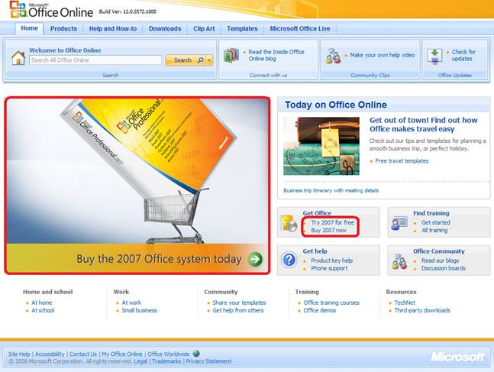
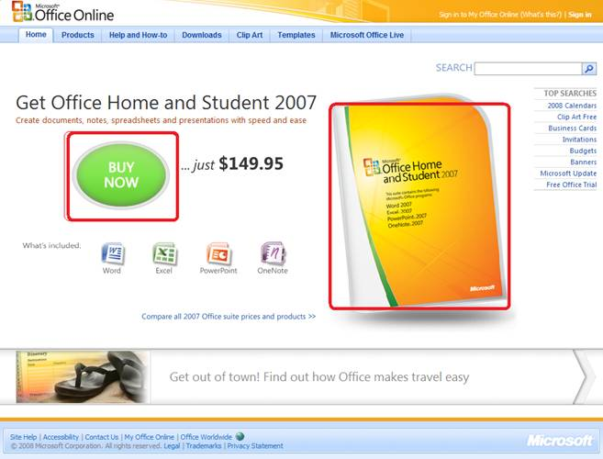
Office Online
Test new design for Office Online homepage
OEC: Clicks on revenue generating links (red below)
A
Raise your right hand if you think A Wins
Raise your left hand if you think B Wins
Don’t raise your hand if you think they’re about the same
B

Slide 7
Office Online
If you did not raise a hand, please sit down
If you raised your left hand, please sit down
B was 64% worse
The Office Online team wrote
  A/B testing is a fundamental and critical Web services… consistent use of A/B testing could save the company millions of dollars

Slide 8


MSN Home Page Search Box
OEC: Clickthrough rate for Search box and popular searches
A
B
Differences: A has taller search box (overall size is the same), has magnifying glass icon, “popular searches”
B has big search button
Raise your right hand if you think A Wins
Raise your left hand if you think B Wins
Don’t raise your hand if they are the about the same

Slide 9
Search Box
If you raised any hand, please sit down
Insight
  Stop debating, it’s easier to get the data

Slide 10
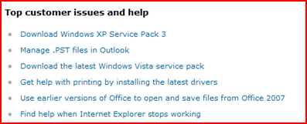
Microsoft Support
Support.microsoft.com shows “top issues”
OEC = click-through rate
A shows top issues
B filters top issues to
OS & Browser used to
visit site (useragent)
Personalization rarely hurts, but does it help?
Raise your right hand if you think B Wins by over 30%
Raise your left hand if you think B Wins by under 30%
Don’t raise your hand if you think they’re about the same

Slide 11
Microsoft Support
If you did not raise a hand, please sit down
If you raised your left hand, please sit down
B was >50% better
  Personalization helps more than people think!

Slide 12
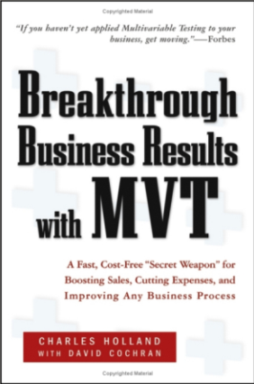
Hard to Assess the Value of Ideas:
Data Trumps Intuition
It is humbling to see how often we are wrong
  Experts are often wrong in many domains
  Doctors did bloodletting for centuries until the 1836 when Pierre Louis ran a controlled experiment (randomized clinical trial)
At Amazon, more than half of the experiments failed to show improvement
  Every new feature was built because someone thought it was a great idea worth implementing (and convinces others)
QualPro tested 150,000 ideas over 22 years
  75 percent of important business decisions and
  business improvement ideas either have no impact on
  performance or actually hurt performance…
Notes:
there is no correlation between what people in the organization think will work and what actually does work

Slide 13
Agenda
Controlled Experiments in one slide
Examples: you’re the decision maker
Culture, OEC (Overall Evaluation Criterion)
Controlled Experiments: deeper dive
Two key messages to remember
  It is hard to assess the value of ideas .
  Get the data by experimenting because data trumps intuition
  OEC: Make sure the org agrees what you are optimizing

Slide 14
The Cultural Challenge
It is difficult to get a man to understand something when his salary depends upon his not understanding it.
-- Upton Sinclair
Why people/orgs avoid controlled experiments
  Some believe it threatens their job as decision makers
  At Microsoft, program managers select the next set of features to develop. Proposing several alternatives and admitting you don’t know which is best is hard
  Editors and designers get paid to select a great design
  Failures of ideas may hurt image and professional standing.
  It’s easier to declare success when the feature launches
  We’ve heard: “we know what to do. It’s in our DNA,” and
  “why don’t we just do the right thing?”

Slide 15
Experimentation Culture
Learn from flat/negative results
  Even if an idea failed to improve the OEC,
  the org learned something. Failing fast is good
  “If you're not prepared to be wrong, you'll never come up with anything original” – Sir Ken Robinson (TED 2006)
  Deploy the positive experiments: only their sum really matters
To innovate, experiment often
  “To have a great idea, have a lot of them” -- Thomas Edison
  If you have to kiss a lot of frogs to find a prince,
  find more frogs and kiss them faster and faster

Slide 16
The OEC
If you remember one thing from this talk, remember this point
OEC = Overall Evaluation Criterion
  Agree early on what you are optimizing
  Getting agreement on the OEC in the org is a huge step forward
  Suggestion: optimize for customer lifetime value, not immediate short-term revenue
  Criterion could be weighted sum of factors, such as
    Time on site (per time period, say week or month)
    Visit frequency
  Report many other metrics for diagnostics, i.e., to understand the why the OEC changed and raise new hypotheses

Slide 17
Agenda
Controlled Experiments in one slide
Examples: you’re the decision maker
Culture, OEC (Overall Evaluation Criterion)
Controlled Experiments: deeper dive
Two key messages to remember
  It is hard to assess the value of ideas .
  Get the data by experimenting because data trumps intuition
  OEC: Make sure the org agrees what you are optimizing

Slide 18
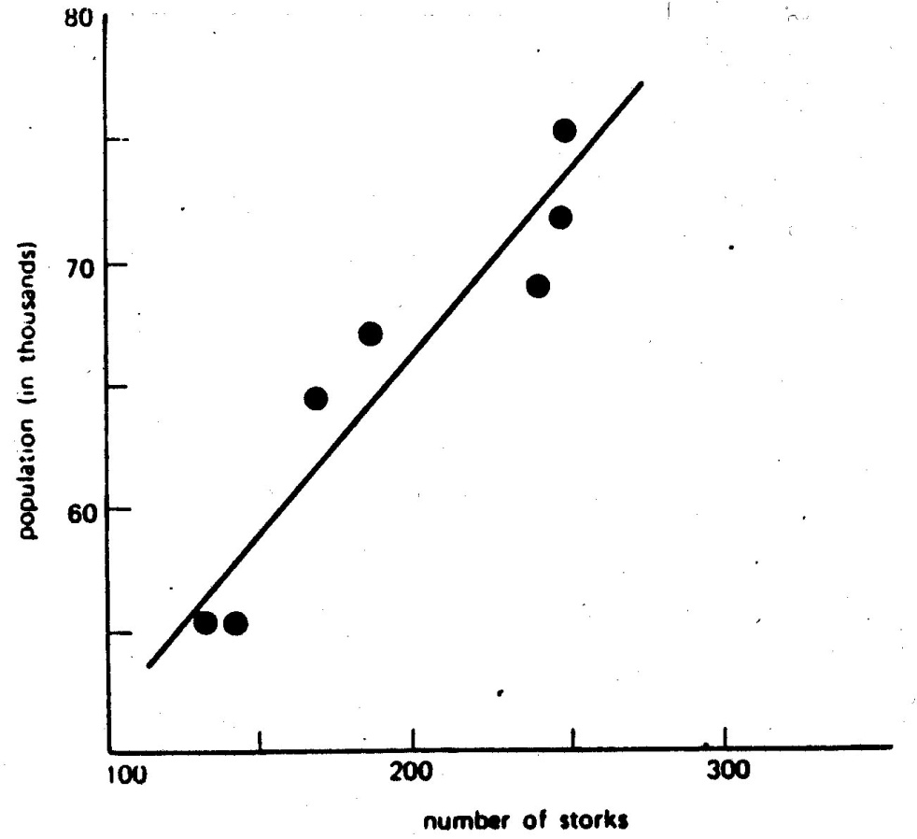
Typical Discovery
With data mining, we find patterns, but most are correlational
Here is one a real example of two highly correlated variables

Slide 19
Correlations are not Necessarily Causal
City of Oldenburg, Germany
X-axis: stork population
Y-axis: human population
What your mother told you about babies when you were three is still not right, despite the strong correlational “evidence”
Example 2:
True statement (but not well known):
  Palm size correlates with your life expectancy
The larger your palm, the less you will live, on average.
Try it out - look at your neighbors and you’ll see who is expected to live longer.
Why?
Women have smaller palms and live 6 years longer on average
Ornitholigische Monatsberichte 1936;44(2)

Slide 20
Advantages of Controlled Experiments
Controlled experiments test for causal relationships, not simply correlations
When the variants run concurrently, only two things could explain a change in metrics:
  The “feature(s)” (A vs. B)
  Random chance
  Everything else happening affects both the variants
  For #2, we conduct statistical tests for significance
The gold standard in science and the only way to prove efficacy of drugs in FDA drug tests

Slide 21
Issues with Controlled Experiments (1 of 2)
If you don't know where you are going, any road will take you there
—Lewis Carroll
Org has to agree on OEC (Overall Evaluation Criterion).
This is hard, but it provides a clear direction and alignment
Quantitative metrics, not always explanations of “why”
  A treatment may lose because page-load time is slower.
  At Amazon, we slowed pages by 100-250msec and lost 1% of revenue
  A treatment may have JavaScript that fails on certain browsers, causing users to abandon.

Slide 22
Issues with Controlled Experiments (2 of 2)
Primacy/newness effect
  Changing navigation in a website may degrade the customer experience (temporarily), even if the new navigation is better
  Evaluation may need to focus on new users, or run for a long period
Multiple experiments
  Even though the methodology shields an experiment from other changes, statistical variance increases making it harder to get significant results.
  There can also be strong interactions (rarer than most people think)
Consistency/contamination
  On the web, assignment is usually cookie-based, but people may use multiple computers, erase cookies, etc. Typically a small issue
Launch events / media announcements sometimes preclude controlled experiments
  The journalists need to be shown the “new” version
Notes:
Good example of primacy: Office 2007 vs. Office 2003

Slide 23
Experimentation Platform Team
Mission: accelerate software innovation through trustworthy experimentation
Build the ExP platform
Change the culture towards more data-driven decisions
Have impact across multiple teams at Microsoft, and
Make platform available externally

Slide 24
Summary
  The less data, the stronger the opinions
It is hard to assess the value of ideas
  Listen to your customers
  Get the data by experimenting because data trumps intuition
  Examples are humbling. More at http://exp-platform.com/cikm.aspx
Replace the HiPPO with an OEC
  Make sure the org agrees what you are optimizing (long term lifetime value)
Compute the statistics carefully
  Power, 95% confidence, ramp-up
  Stats/details described at http://exp-platform.com/hippo_long.aspx
Experiment often
  Triple your experiment rate and you triple your success (and failure) rate. Fail fast & often in order to succeed
  Accelerate innovation by lowering the cost of experimenting

Slide 25

http://exp-platform.com
Accelerating software Innovation through trustworthy experimentation

Slide 26
Extra Slides

Slide 27
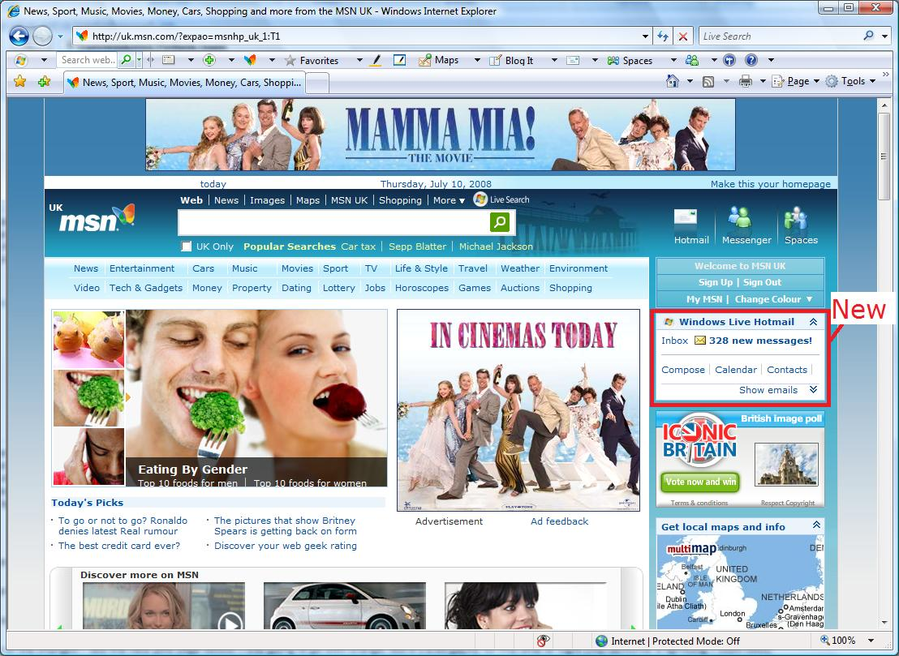
MSN UK Hotmail experiment
Hotmail module on home page

Slide 28
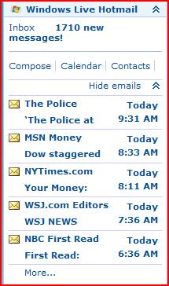
MSN UK Hotmail experiment
A: When user clicks on email
hotmail opens in same window
B: Open hotmail in separate window
Trigger: only users that click in the
module are in experiment
(no diff otherwise)
OEC: clicks on home page (after trigger)
Penalty for users annoyed with new widow (opinionlab feedback)
Raise your right hand if you think A Wins
Raise your left hand if you think B Wins
Don’t raise your hand if they are the about the same

Slide 29
UK Hotmail
If you didn’t raise a hand, please sit down
If you raised your right hand, please sit down
For those in the experiment, clicks on MSN HP increased +8.9%
<0.001% of users in B wrote negative feedback about the new window

Slide 30
Data Trumps Intuition
  The experiment report was sent by the BI/CI team to all multiple teams across the world
  Someone who saw the report wrote
    This report came along at a really good time and was VERY useful.
    I argued this point to my team (open Live services in new window from HP) just some days ago.
    They all turned me down.
    Funny, now they have all changed their minds.

Slide 31
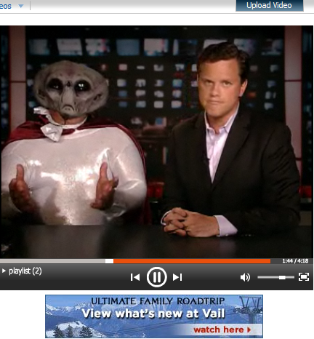

MSN Entertainment and Video Services (EVS)
Determine whether showing the first ad after the first video rather than before it would increase user engagement and loyalty without sacrificing ad revenue
OEC: revenue
Secondary metrics:
  Content starts
  Repeat users
A: Show ad then video
B: Show Video then ad
Raise your right hand if you think A Wins
Raise your left hand if you think B Wins
Don’t raise your hand if about the same

Slide 32
MSN EVS
If you did not raise a hand, please sit down
If you raised your left hand, please sit down
Ad starts =revenue (OEC) for B down 56%
  Content starts per session up 8.5%
  Repeat users up 2%
EVS wrote
  There is a preponderance of opinion driven design…
  The results of the experiment were in some respect counterintuitive.
  They completely changed our feature prioritization. It dispelled long held assumptions about video advertising. Very, very useful.

Slide 33
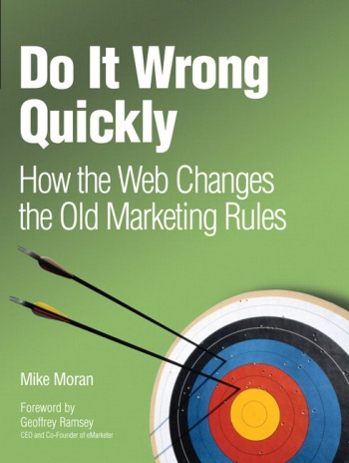

Do It Wrong Quickly
We work on “the plan,” which is
reviewed and approved by execs,
then we execute flawlessly (or do we?)
We’re looking to hit the arrow in the
center—the bulls-eye
But what if we the game is to score the most points, i.e., the sum of arrow scores.
Shooting three arrows may be much
more effective

Slide 34
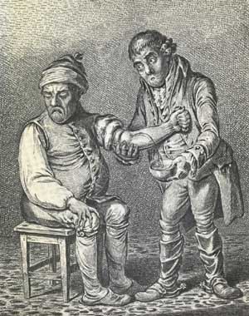
Bloodletting (1 of 2)
For many years, the prevailing
conception of illness was that the sick
were contaminated by some toxin
Opening a vein and letting the sickness
run out – bloodletting.
One British medical text recommended bloodletting for
acne, asthma, cancer, cholera, coma, convulsions, diabetes, epilepsy, gangrene, gout, herpes, indigestion, insanity, jaundice, leprosy, ophthalmia, plague, pneumonia, scurvy, smallpox, stroke, tetanus, tuberculosis, and for some one hundred other diseases
Physicians often reported the simultaneous use of fifty or more leeches on a given patient.
Through the 1830s the French imported about forty million leeches a year for medical purposes
Microsoft Confidential
Notes:
Hebrew: hakazat dam. הקזת דם

Slide 35
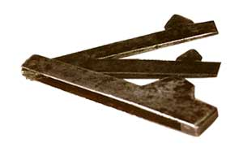
Bloodletting (2 of 2)
Lancet
President George Washington had a
sore throat and doctors extracted 82
ounces of blood over 10 hours (35% of his total blood), causing anemia and hypotension. He died that night.
Pierre Louis did an experiment in 1836 that is now recognized as one of the first clinical trials, or randomized controlled experiment. He treated people with pneumonia either with
  early, aggressive bloodletting, or
  less aggressive measures
At the end of the experiment, Dr. Louis counted the bodies. They were stacked higher over by the bloodletting sink.
Microsoft Confidential
Notes:
I’m telling this horrific story because experts are often wrong about their beliefs. This is one of the central themes: we need to run experiments and make data-driven decisions.

Slide 36
Lesson: Compute Statistical Significance and run A/A Tests
A very common mistake is to declare a winner when the difference could be due to random variations
Always run A/A tests
(similar to an A/B test, but besides splitting the population, there is no difference)
Compute 95% confidence intervals on the metrics to determine if the difference is due to chance or whether it is statistically significant
Increase percentage if you do multiple tests
(e.g., use 99%)
Idea: run an A/A test in concurrent to your A/B test to make sure the overall system doesn’t declare it as significant more than 5% of the time (great QA)

Slide 37
Run Experiments at 50/50%
Novice experimenters run 1% experiments
To detect an effect, you need to expose a certain number of users to the treatment (based on power calculations)
Fastest way to achieve that exposure is to run equal-probability variants (e.g., 50/50% for A/B)
But don’t start an experiment at 50/50% from the beginning: that’s too much risk.
Ramp-up over a short period

Slide 38
Ramp-up and Auto-Abort
Ramp-up
  Start an experiment at 0.1%
  Do some simple analyses to make sure no egregious problems can be detected
  Ramp-up to a larger percentage, and repeat until 50%
Big differences are easy to detect because the min sample size is quadratic in the effect we want to detect
  Detecting 10% difference requires a small sample and serious problems can be detected during ramp-up
  Detecting 0.1% requires a population 100^2 = 10,000 times bigger
Automatically abort the experiment if treatment is significantly worse on OEC or other key metrics (e.g., time to generate page)

Slide 39

Randomization
Good randomization is critical.
It’s unbelievable what mistakes devs will make in favor
of efficiency
Properties of user assignment
  Consistent assignment. User should see the same variant on successive visits
  Independent assignment. Assignment to one experiment should have no effect on assignment to others (e.g., Eric Peterson’s code in his book gets this wrong)
  Monotonic ramp-up. As experiments are ramped-up to larger percentages, users who were exposed to treatments must stay in those treatments (population from control shifts)

