Slide 1



High-Dimensional Descriptor Indexing for Large
Multimedia Databases
Eduardo Valle
Matthieu Cord
Sylvie Philipp-Foliguet
Notes:
Good afternoon. My name is Eduardo and I’ve just finished my Ph.D at the ETIS Labs of the University of Cergy-Pontoise in France. Our team works with content based research, classification and indexing of image and video databases. Today I’ll present our research on the indexing of high-dimensional multimedia descriptors [click]

Slide 2
Image Identification
Find the original
of a document
(and its metadata)
in the absence
of references
Context
Context ?
Notes:
I’ll start with the application which motivated our research in this, which is image identification. // This is also known as copy detection or near-duplicate detection, and allows the retrieval of a document even in the absence of the proper bibliographic references. It’s a common need for every large document repository, and especially for those that deal with visual data... // Visual documents are often reused and embedded in new documents, and in this process the context and the references needed to identify the original are lost []. Obviously, the loss of the context and the metadata deteriorates the user’s ability to interpret the document. Since the context is attached to the identity of the original document, [] recovering the context requires identifying this original

Slide 3
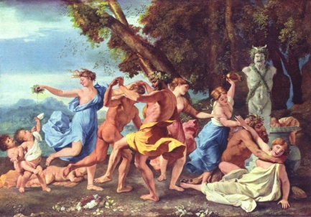

Image Identification
Image retrieval in cultural institutions
  Identification of clippings
  Recovery of accidental document / metadata separation
censored
Query
Original found
Notes:
This task is often performed in cultural institutions, like libraries and archives, where the users arrive with newspapers clippins or photocopies of books, which have very poor identification metadata. Besides those « external » requests there are also idenfitication needs inside those institutions, whenever a document gets accidentally separated from its metadata.

Slide 4
Image Identification
Image retrieval in cultural institutions
  Identification of clippings
  Recovery of accidental document / metadata separation
Copyright violation identification
  Detect unauthorised use
  Link « stolen » images to their originals
C
Notes:
The detection of copyright violation is another application of image identification, and perhaps one of the most sought after. Since many image repositories license their images for a profit, there is the need to detect the unauthorised use of those images.

Slide 5
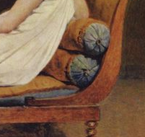

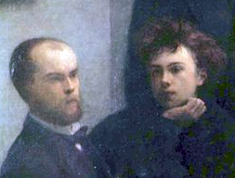
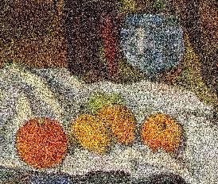
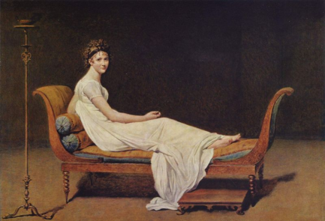
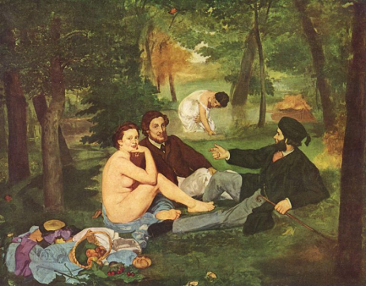
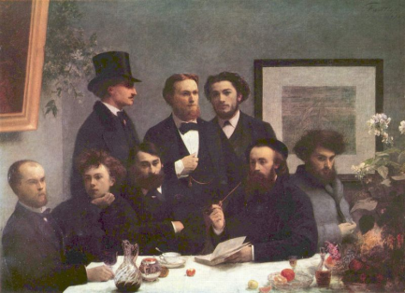
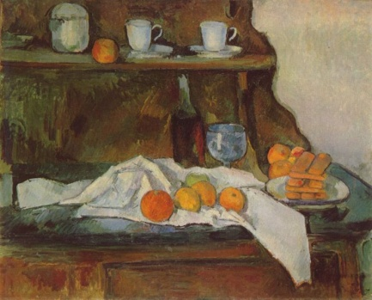
Image Identification
To be robust to (sometimes very strong) transformations
Notes:
Of course, what we are trying to identify are not perfect copies of the original. Our task is more complex because we must be robust to transformations [click], which are very diverse and potentially very strong.

Slide 6
Image Identification Systems
Global descriptors
Local descriptors
SIFT
Notes:
The solution we propose to identify the images is using Content Based Retrieval. Contrarily to other methods, this approach doesn’t need keywords nor watermarks, which can be unavailable or incorrect. Content Based Retrieval uses only the visual information itself. // Because the representation of visual information is semantically poor, content based retrieval uses descriptors to mediate the search. The description of the documents can be either global or local. In the first case, a single descriptor is created for the entire document [click] the typical exemple is the colour histogram. [click]. // In the second case, multiple descriptors are created for different features of the image. [click] The typical example is SIFT [click], which we use on our work, and which works on Points of Interest.

Slide 7
Image Identification Systems
Global descriptors
Local descriptors
SIFT
Notes:
To see the superiority of the local descriptors, imagine what happens in face of a transformation. The global descriptor, if it fails [click] it fails completely. But the local descriptors [click] since they are many, allow for a more robust scheme, since it is probable that at least some of them will survive the transformation.

Slide 8
Database of
Images
Find the PoI of
Each Image
Describe
Each PoI
Index all
Descriptors
...
{ 63, 4, 25, 30, 128, ... }
...
Offline
{ 63, 4, 25, 30, 128, ... }
Query Image
Find the PoI
Describe Each PoI
{ 62, 4, 27, 28, 126, ... }
Descriptor
Matching
Geometric
Consistency
Refined Results
Brute Results
Online
Notes:
So we choose to use local descriptors an this is the detailed architecture of the system. Describing the images consist in finding the Points of Interest and describing each one individually. Then all descriptors are put in one big index. // When the query is presented [click] it is also described in terms of many descriptors. Now we have to create a similarity criterion between the bag of descriptors in the query and the descriptors in the database. To simplify this complex task, we adopt a simple vote count scheme: we match each query descriptor to its most similar descriptors in the database. Each match descriptor, then, gives a vote to the image to which it belongs. We expect that even if many image might receive a couple of votes, only the correct ones will be massively voted. // Compared to global descriptors, this is a very robust architecture, but it presents a performance penalty. We are dealing with a much larger descriptor database, and worse: we have to make a large number of matches to retrieve a single query.

Slide 9
Hypothesis
Large number of descriptors
  Need to accelerate the matching
High dimensional descriptors
  SIFT: 128 dimensions
  Dimensionality not easily reduced: local, non-linear data correlation
Restrictions due to implementation
  Favorise sequential access, avoid random access
Optimise high-dimensional descriptor matching
Notes:
So, to summarize, we are dealing with very large databases, of very high dimensional descriptors. As I mentioned, in our work we use SIFT, which has 128 dimensions. In order to provide precise *and* timely answers, we have to optimise the descriptor matching [click]. To complicate things a little, we have to take into account the technology constraints: for databases so big, we will be using disks, and to use disks we have to minimize random access, because it costs too much.

Slide 10
kNN Search
k nearest neighbours or similarity search
Find, in the data space, the k nearest to the query
Linear search too expensive for large databases
  Cost proportional to the number of entries: O(n)
Indexing to allow accelerating the search
  Logarithmic cost
  (ideally): O(log n)
q
Notes:
The matching of the descriptors is usually performed through an operation named similarity search or k nearest neighbour search. It is a very simple concept: [click] we just want to find, in the space of the data, which points are closer to the query point. // We want to do it faster than by brute-force sequential search, but the problem, is that indexing typically breaks down for high dimensional spaces, because of the infamous “curse of dimensionality”. // So we are forced to accept approximate solutions, but as the dimensionality grows the compromise between precision and speed becomes worse and worse.

Slide 11
Multiple Subindexes
Basic idea
  Reduce the dimensionality of individual subindex
  Aggregate results from sub-index to obtain final answer
Notes:
To conquer that, one idea is to use an structure composed by multiple subindexes. The idea is using several structures of lesser dimensionality, to tame the “curse”.

Slide 12
MEDRANK
a
b = 1
a
b = 2
j
j
h = 1
e
e
d
f = 1
f
d
f
b
b
c
c
i
i
g
g
h
h
a
f
e
g
b
h
c
d
j
i
Notes:
One such algorithm is MEDRANK. It reduces the dimensionality quite dramatically: in fact each sub-index has exactly one dimension. [click] MEDRANK projects the data onto straight lines and uses a vote mechanism to decide which are the nearestneighbours. // The choice of one-dimensional subindexes has an enormous advantage: the data now has a total order, and each individual subindex is simply a sorted list. Because we have so many efficient data structures to deal with sorted lists, this makes implementing the method much easier.

Slide 13
MEDRANK
128D
Notes:
The problem with MEDRANK is that once dimensionality grows too much, it starts to have a lack of correlation between proximity in the one dimensional subindexes and proximity in the entire space. Worse: if the data is quantised [click] I start to have lots of collisions: all data, even those distant from the query, will share exactly the same value with the query in at least one of the dimensions. // Those two effects are enough to ruin MEDRANK’s performance for the high dimensionalities in which we are working.

Slide 14
Space-Filling Curves
a = (1, 1)
b = (2, 1)
c = (3, 3)
d = (5, 5)
e = (6, 2)
f = (6, 5)
g = (6, 6)
a = 2
b = 7
c = 10
d = 34
e = 50
f = 45
g = 40
g
d
f
c
e
a
b
Notes:
We have a difficult situation: we want to have more than one dimension in the sub-indexes, so they can better “capture” the distance between points in the entire space. But when we do so, we of course loose the total order on the point set, which is annoying, because the sorted lists are really convenient to use. // Now, of course we can give the points an arbitrary total order, like an row-first order, but what we really need is the order to be respectfull of the distance. Naturally, it is impossible to do it globally for more than one dimension, but we can do it locally, using some kind of “vicinity-sensitive” ordering. That’s exactly what is provided by the space filling curves. [click] Those fractal curves have the insteresting property of passing trhough every point of a given space, and of, locally, being respectful of the distance.

Slide 15
Space-Filling Curves
Notes:
Well, the problem is that those curves have discontinuities, so we can have perverse situations like we show here. We can’t preserve the distance relationship everywhere in the curve, so at some boundaries, points which are near in the space may come very distant in the curve. And this worsen as dimensionality grows. // All the art of using space-filling curves to do multidimensional indexing is on how to conquer those boundary effects.

Slide 16
Our Proposition: Multicurves
128D
128D
1 ×
8 ×
128D
16D
Notes:
Our proposition is to use multiple curves, but not only that: use curves of lower dimensionality. That way we gain twice: because we have more than one curve, we have a good chance that at least one of them will not put the points we want to retrieve in a discontinuity situation. But also, because of the lower dimensionality, the boundary effects are less severe.

Slide 17
Multicurves
d₁D
(...)
dD
d_{i}D
n_{curves}
(...)
d_{n}D
space of database
subspaces of
subindexes
d₁
d_{i}
d_{ncurves}
Notes:
All that remains is the choice of how many curves and how to share the dimensions among them. In our context of disk-based search, the number of curves must be quite small, since every aditional curve implies at least one additional random access to the data, so it’s reasonable to assume that no more than 8 or 10 curves will be used. // As for the dimension distribution, we use for the moment a simple partitioning, but it would be interesting to figure an optimal way to do it.

Slide 18
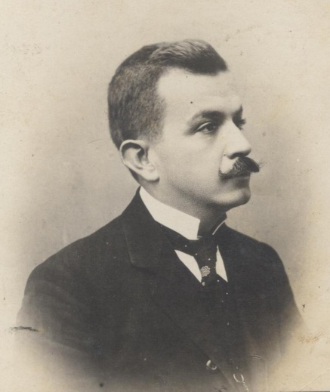
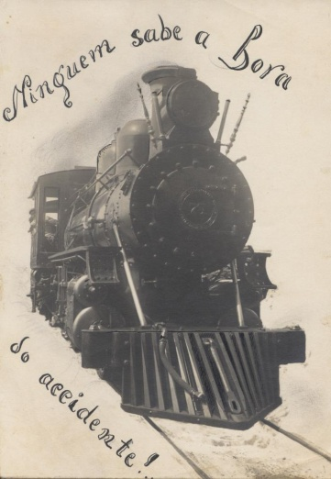
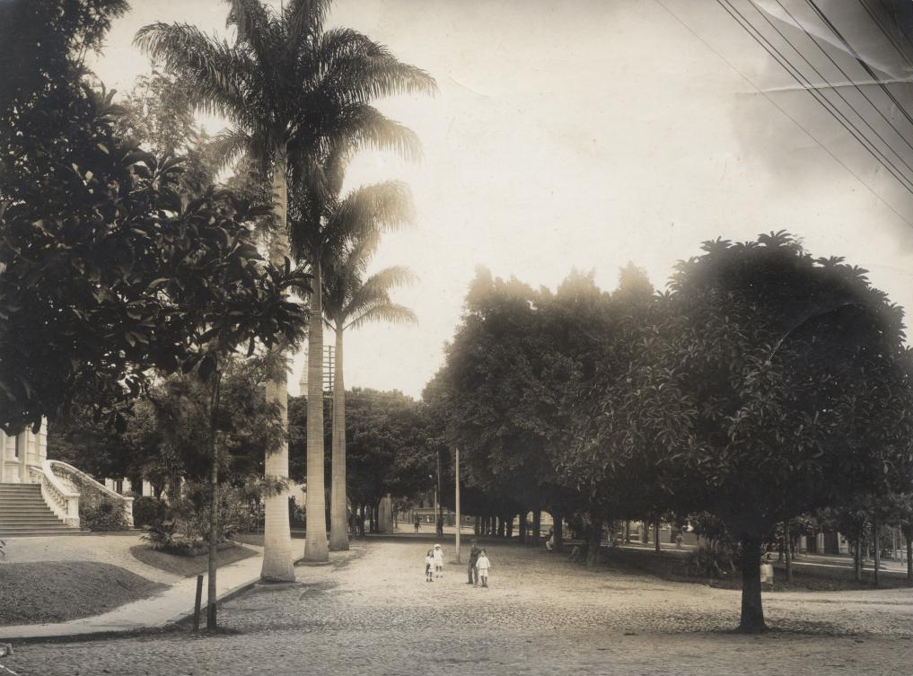
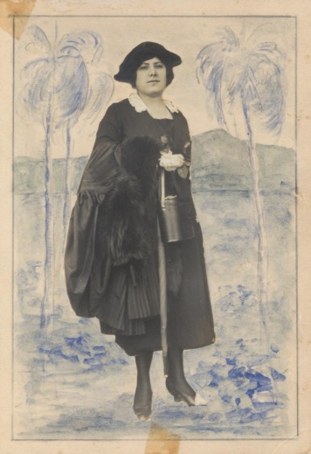
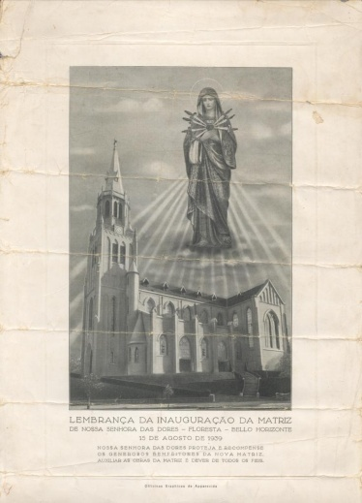
Test Database
APM
  1 500 transformed images from 100 originals
  100 queries: original images
  2 871 300 descriptors
Images from Arquivo Público Mineiro
Notes:
Now for some empirical evalutaion. // Our interested on image identification was strongly motivated by cultural heritage applications, and this is reflected in the databases we used to evaluate the matching. The first one is a database of historical photographs from the State Archives of Minas Gerais. We took a small sample of the database, subjected the image to a variety of transformations and created a database of descriptors.

Slide 19
Comparison with SFC Methods
Notes:
And those are the results for the descriptor matching, showing our method compared with two other state-of-the-art methods, also based on space-filling curves. The method by Liao et al., which also uses multiple curves, but in their case all curves have all the dimensions of the data, and boundary effects are managed by performing translations on the data points. And the method by Mainar-Ruiz et al., which has an interesting approach, using only one curve, and instead creating multiple instances of the data, which are slightly disturbed, to allow them to cross the boundaries. // On the vertical axis we have the precision, here measured by the Mean Average Precision, and on the horizontal axis we have the speed, measured by how many points from the database have to be read. // We varied some parameters for the methods: for multicurves and Liao, the number of curves used, and for Mainar-Ruiz, the number of instances created for each data point. // What we observe is that multicurves has a much better compromise between speed and precision.

Slide 20


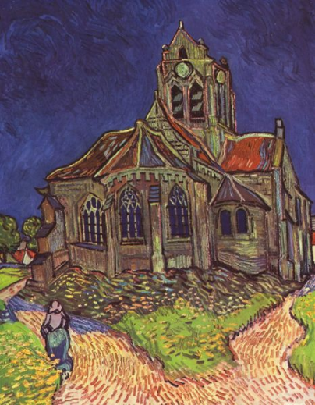

Yorck Test Database
Yorck
  10 459 original images
  100 queries: transformed images
  21 591 483 descriptors
Notes:
We also tested the method on a larger, more realistic database, using the Public Domain Yorck database of paintings.

Slide 21
Comparison with SFC Methods
Notes:
Here the parameter we varied was how many descriptors we examines on each curve (for Mainar-Ruiz we multiplied this by the number of instances, in the interest of fairness). Again, Multicurves has a significantly better compromise.

Slide 22
System Results
Using sequential search
Using multicurves
MAP = 1 (perfect results)
20% of votes lost
MAP = 1 (still perfect)
But speed up of up to 25!
Notes:
Now for an experimento on the system as a whole. // Since the multicurves give an approximate solution, we wanted to see how much its use degrades the ability of the system to make the identification. We noticed that on average, each correctly image lost 20% of its votes, but it turns out to have no effect on the retrieval precision, which is not entirely unexpected, since we have so many descriptors per query. // What is interesting, [click] is that using the multicurves leads to a great speed up on the system.

Slide 23
Conclusion
Good indexing allows using local descriptors, while minimising the performance penalties
Space-filling curves
  Allow to give the points a distance-aware total order
  Suffer from border effects
Multicurves
  Uses multiple moderate-dimensional curves to conquer border effects
  Allows using sorted lists on the subindexes
  Convenient, fast, scalable indexing for multimedia descriptors
Notes:
So to conclude, a good indexing method allows us to profit from the high precision brought by local descriptors, without paying an unacceptable performance penalty. The multicurves provides just that: its moderate dimensional subindexes allow to conquer border effects and have a fast and precise descriptor matching. Besides, the use of the space-filling curves allow to reconcile having multiple dimensions on the subindexes and still using the convenient, sorted-list data structures in the implementation.

Slide 24
High-Dimensional Descriptor Indexing for Large
Multimedia Databases
Eduardo Valle
Matthieu Cord
Sylvie Philipp-Foliguet
Notes:
Thank you.

