Slide 1
An Architecture for Semantic Navigation and Reasoning with Patient Data
Experiences of the Health-e-Child Project
Tamás Hauer
CCCS, Bristol Institute of Technology
ISWC 2008, October 27-30, Karlsruhe, Germany

Slide 2
Credits
University of the West of England
Dmitry Rogulin, Andrew Branson, Jetendr Shamdasani, Tony Solomonides, Richard McClatchey
Siemens Medical & Corporate Technology
Sonja Zillner, Alexey Tsymbal, Martin Huber
The Health-e-Child consortium
http://www.health-e-child.org/

Slide 3
Analyzing a Neuro-oncology Patient Set
ID | Sex | Diagnosis age | Quality of Life | Tumour Site | Histology
... | ... | ... | ... | ... | ...
pat#2456 | M | 5 | 0 (no disease) | Left Cerebral Hemisphere | Astrocytoma
pat#5368 | F | 2 | 3 (relapse) | Left Temporal Lobe | Oligo-dendroglioma
pat#5559 | F | 7 | 3 (relapse) | Hypothalamus | Pilocytic Astrocytoma
... | ... | ... | ... | ... | ...
Use-case:
Neuro-oncologist (pediatrician) has been collecting patient data at a national referral centre for years
Said clinician analyzes the data for finding patterns, trends, correlations
How do various patient characteristics correlate with the tumour site?
What are the most frequent areas of the brain where certain tumours appear?

Slide 4
Outline
Introduction
A Running Example
Reasoning and Visualization Requirements
Medical Ontologies in Play
Logical Theory
Patient Classification via Reasoning
System Architecture
Creation of DL views
Visualization
Patient Data Visualization Using Treemaps
Visual Data Mining - Examples
Conclusions

Slide 5
Introduction
How to support the clinician and researcher in decision making and knowledge discovery?
Acquire, store, manage biomedical information in digitized form
Tools for querying, filtering, classifying, analyzing the information
Tools for presentation, navigation, visualization of just the right information
Challenges:
The processing of information goes beyond that of mathematical/statistical analysis – similarity concepts become important
Decision making is based on a large amount of (implicit) semantics
Medical ontologies formalize semantics explicitly, main usage:
resolving ambiguities – data integration
taxonomies – querying, classification, browsing of knowledge
reasoning ?

Slide 6
Reasoning and Visualization – shopping list
Patient data digitally acquired, managed in database
Integrated data model for managing all information
Distributed database system to include multiple centres.
Domain ontology that governs the stored information
Medical ontology(ies) conceptualizing the background knowledge that can be employed for data analysis
Alignment of the patient information with the background knowledge base(s)
Conformance to an appropriate logical theory for the purpose of automatic reasoning
Architecture and implementation of a system that brings these together
Choice of good visualization paradigm(s) to bring inferred information to the user
Implementation of such visualization component in an integrated system

Slide 7
Visualization Requirements
Key requirement (HeC):
Clearly arranged presentation of similar patients with respect to the complex and heterogeneous patient data
Clinicians and researchers need visual means for comparing and analyzing similarity patterns in 100s of attributes ranging from demographics through image features to proteomic samples
Objectives (HeC):
To discover patterns and dependencies in patient data
Comparison should be supported by browsing facilities over the set of all patient records along relevant features.

Slide 8
Medical Ontologies
Large number of available ontologies – but:
Coverage is incomplete, need multiple ones, need alignment
Few are suitable for reasoning
Typically too large for reasoning purposes – need fragments
These are hard problems on their own – we don’t address them here
We assume that targeted fragments are available and the user can chose them to include in the reasoning process
Examples in this presentation are based on
WHO Classification of tumours (specification translated to OWL-DL)
Brain meronomy as described by the FMA

Slide 9
Our running example
ID | Sex | Diagnosis age | Quality of Life | Tumour Site | Histology
... | ... | ... | ... | ... | ...
pat#2456 | M | 5 | 0 (no disease) | Left Cerebral Hemisphere | Astrocytoma
pat#5368 | F | 2 | 3 (relapse) | Left Temporal Lobe | Oligo-dendroglioma
pat#5559 | F | 7 | 3 (relapse) | Hypothalamus | Pilocytic Astrocytoma
... | ... | ... | ... | ... | ...
Does patient#5368 have a Tumour in the cerebellum?
Which of the patients are similar in that their tumour is in the same region?
Present an overview of patients, classified by their tumour site.
How does the tumour site affect the disease outcome?

Slide 10
Logical Theory
Anatomy:
Tr(regional_part_of) (Transitive)
≥1 regional_part_of ⊑ Anatomical_structure (Domain)
T ⊑ ∀regional_part_of.Anatomical_structure (Range)
Left_temporal_lobe ⊑ Anatomical_structure ⊓ ∃regional_part_of.Left_cerebral_hemisphere
Cerebellum ⊑ Anatomical_structure ⊓ ∃regional_part_of.Metencephalon
Metencephalon ⊑ Anatomical_structure ⊓ ∃regional_part_of.Hindbrain
Hindbrain ⊑ Anatomical_structure ⊓ ∃regional_part_of.Brain
...
Patient T-Box
≥1 hasTumourLocation ⊑ Patient (Domain)
T ⊑ ∀hasTumourLocation.Anatomical_structure (Range)
Patient A-Box:
(Patient ⊓ ∃hasTumourLocation.LeftTemporalLobe)(pat#5368)
...
Queries:
BrainTumourPatient ≡ Patient ⊓ ∃has_tumour_location.(Brain⊔∃regional_part_of.Brain)

Slide 11
Meronomy in FMA induces Patient Taxonomy
X ⊑ ∃regional_part_of.Y
∃hasTumourLocation.(∃regional_part_of.X)⊑
∃hasTumourLocation.(∃regional_part_of.Y)
Queries like CerebellumTumourPatient ≡ Patient ⊓ ∃has_tumour_location.(Cerebrum⊔∃regional_part_of.Cerebrum) create a hierarchical classification over the patient dataset
Visualizing such hierarchy is a goal for the clinician

Slide 12
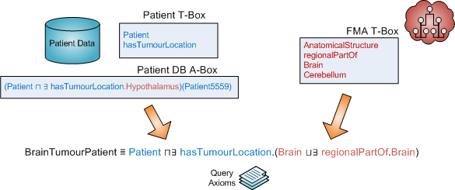
Patient Classification with Reasoning
OWL view of patient records
conforms to domain ontology (“Patient T-Box”)
aligned with external knowledge (“FMA T-Box”)
Merged ontology is queried for inferred knowledge
In our example: The transitive regional_part_of property induces a subsumption hierarchy on (a priori flat) patient data
Query axioms may be used to define patient subclasses

Slide 13
System Architecture
Embedded in HeC SOA
Deployed on HeC grid gateway
Design & Implementation based on OWLAPI (2.2)
Pellet (1.5)
OWL-DL Integrator
generalized OWLOntologyManager
DB-OWL Mapper
creates intermediate (simple flat) views
maps to OWL-DL syntax
Reasoner
T-Box and A-Box reasoning
answers semantic queries, in particular the inferred patient classification
Interpretation/Visualization
Maps the inferred information to the API of the user interface
Merges inferred knowledge with data from the DB that is not part of the reasoning

Slide 14
Creation of DL views
⟨ pat#5368, Left_temporal_lobe , . . . ⟩
⟨ pat#5559, Hypothalamus , . . . ⟩
(Patient ⊓ ∃has_tumour_location.Left_temporal_lobe )(pat#5368)
(Patient ⊓ ∃has_tumour_location.Hypothalamus )(pat#5559)
Need to obtain information in DL syntax
The relational view is mapped to OWL DL A-Box conformant to the patient ontology (recreation of explicit semantics)
Design choices:
DL view: ~DB backend implementation of OWLDataFactory
Transformation implemented as a service component

Slide 15
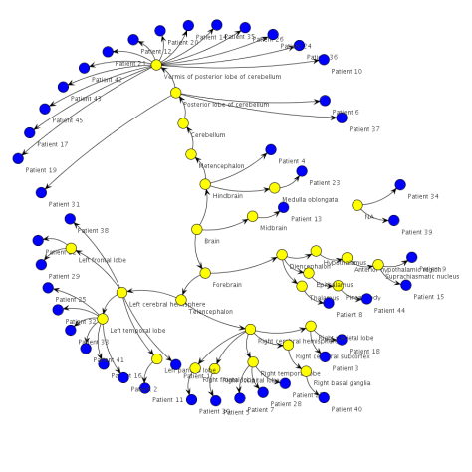
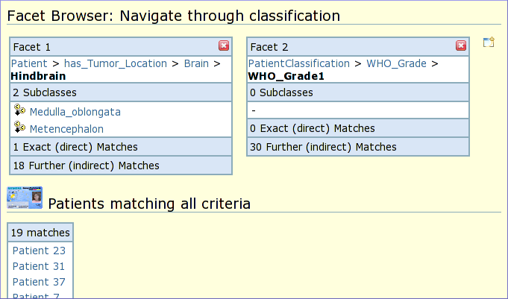
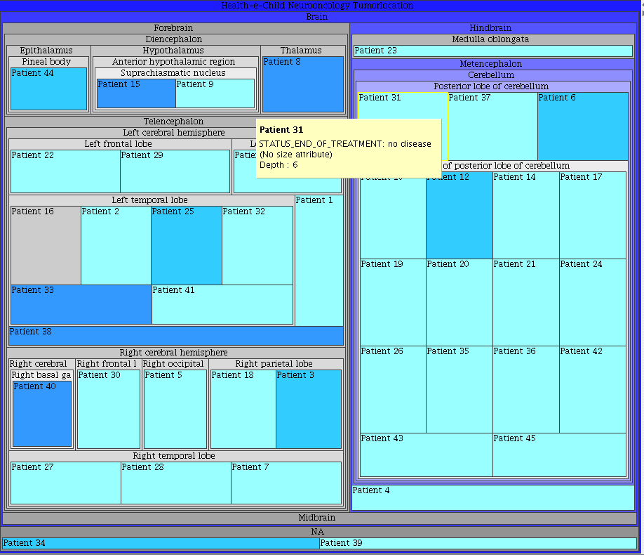
Visualization
Need to incorporate (inferred) semantics into the presentation of the information
Goal: to aid the visualization (discovery) of correlations, similarity with graphical cues in datasets
Of particular interest: visualization of hierarchies
Many results exist on visualization techniques for browsing ontologies, mostly T-Boxes (taxonomies)
Our primary interest is visualization of instance data governed by hierarchical classification

Slide 16
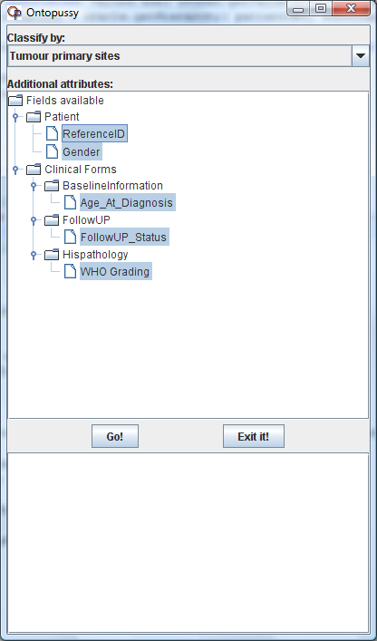
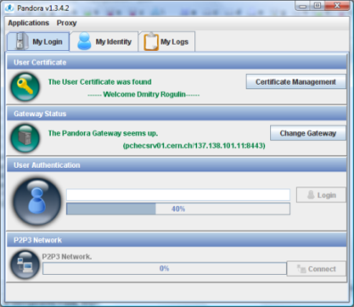
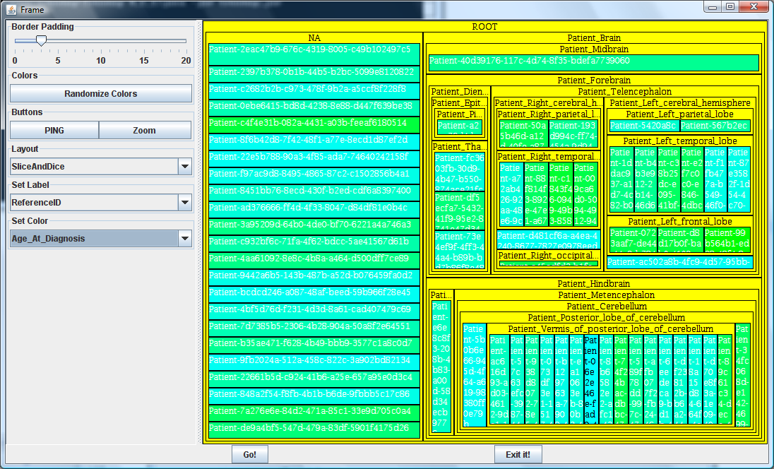
Treemap browser in HeC

Slide 17
Patient Data Visualization using TreeMaps
Space efficiency, uniform information density
Thousands of records may be displayed simultaneously
Three distinguished visual aids: colour, size, hierarchy
Intuitive for visual data mining
Multiple hierarchies are difficult
Navigation is intuitive with some learning curve
Natural display cutoff for large datasets

Slide 18
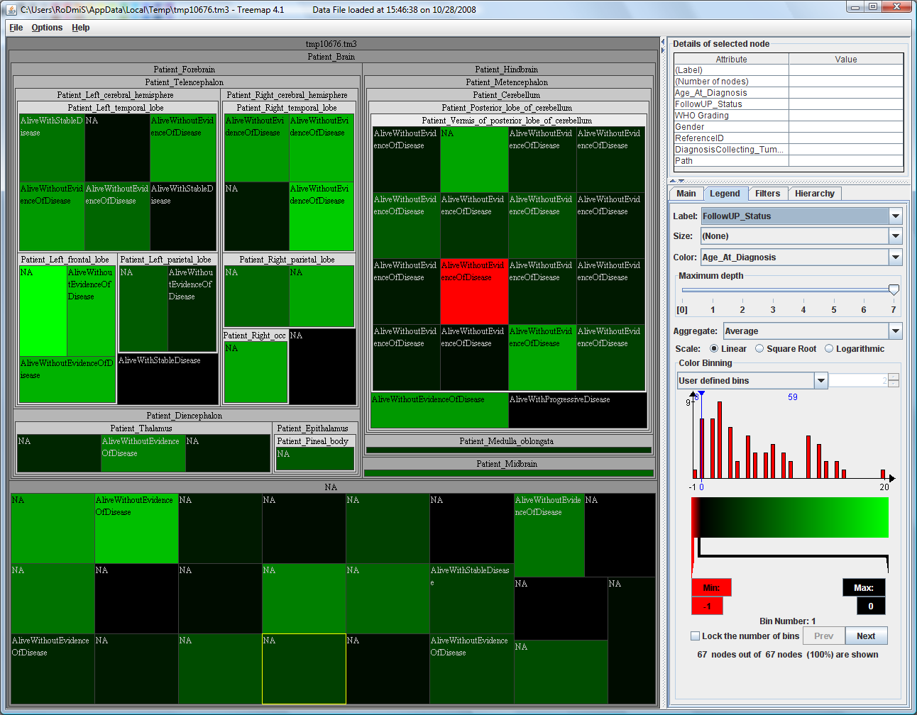
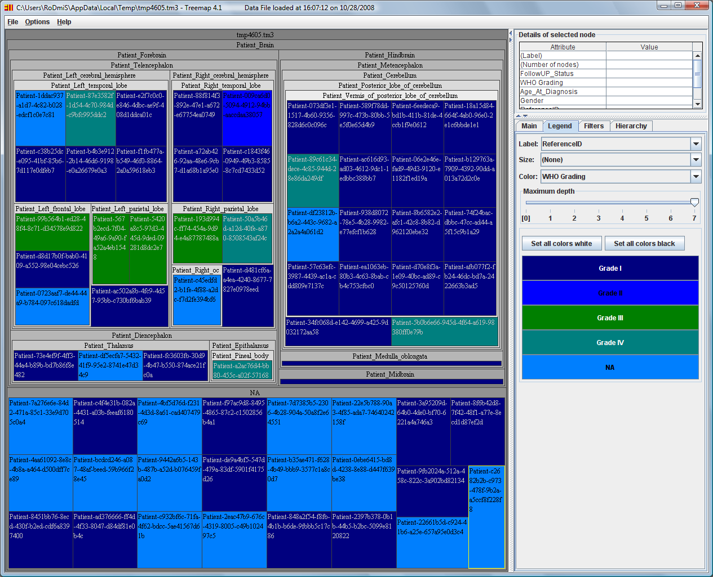
Visual Data Mining

Slide 19
Conclusions
Explicit semantics provides many benefits for medical applications
information integration, classification, browsing
and reasoning
Choice of usable background knowledge is difficult
alignment, DL, scalability
Proposed architecture
database governed by DL domain ontology
alignment with appropriate fragments of DL background KB
DL views of relational data
Reasoner – Patient classification
Visualization
Treemaps work well for visual data mining

