Slide 1

Area-Based Macrotexture Measurements using Stereo Vision
  Gerardo Flintsch
  Center for Sustainable Transportation Infrastructure
  Director
  flintsch@vt.edu
Notes:
NB :
Prepare the slide in one language only!
Preparer la diapositive en une seule langue
Instead of the traffic lights, one can introduce the logo of the organisation
À la place du feu, on peut insérer le logo de l’entreprise.

Slide 2
Overview
Objective
Background
Equipment Development
Results
Conclusions

Slide 3
Acknowledgements
Edgar de Leon & Mohamed Saleh
  Center for Sustainable Transportation Infrastructure, VTTI
Kevin K. McGhee
  Virginia Transportation Research Council
Mark Swanlund
  Federal Highway Administration

Slide 4
Objective
Background
Equipment Development
Results
Conclusions

Slide 5
Objective
To presents a new system that is being developed to measure the texture of a pavement surface using a stereo vision camera
  Uses relatively low cost off-the-shelf components
  Captures images of pavements
  Reconstructs a three dimensional surface map of the pavement surfaces.

Slide 6
Objective
Background
Equipment Development
Results
Conclusions

Slide 7
Background
All pavement surface characteristics relate in some way to the pavement texture.
Adequate, effective, and rapid assessment of pavement texture can be used to support
  Support wet-accident reduction programs
  Help reduce splash and spray conditions, promote lower tire-pavement noise production
  Monitor the quality of the finished traveled surfaces

Slide 8
Background (cont.)
Current approaches have some limitations
“Static” methods such as the sand patch measurements (ASTM E965) and the Circular Track Meter (ASTM E2157) require traffic control and only providing a limited sample of the road texture
High speed laser profilers only measure very thin longitudinal lines and may miss important features adjacent to these lines

Slide 9
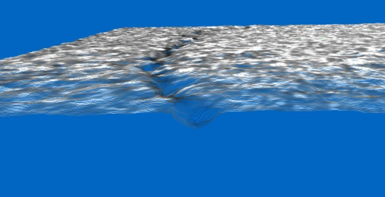
Objective
Background
Equipment Development
Results
Conclusions

Slide 10
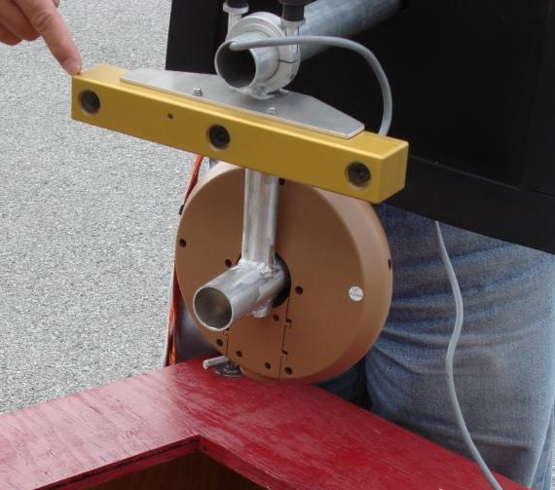
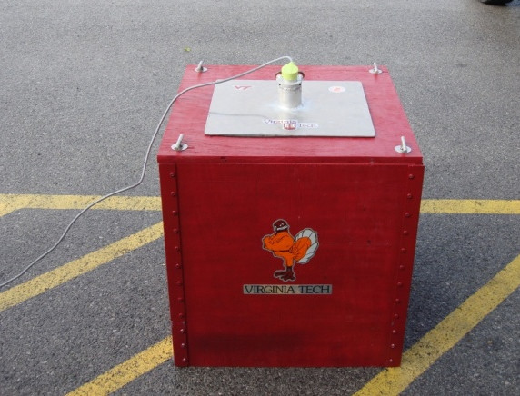
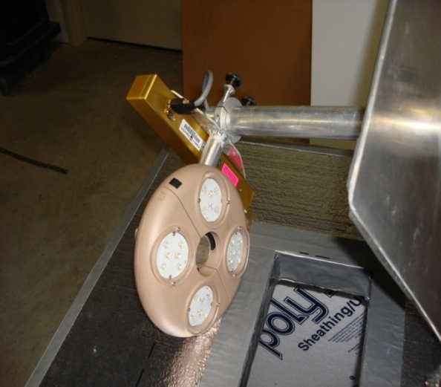
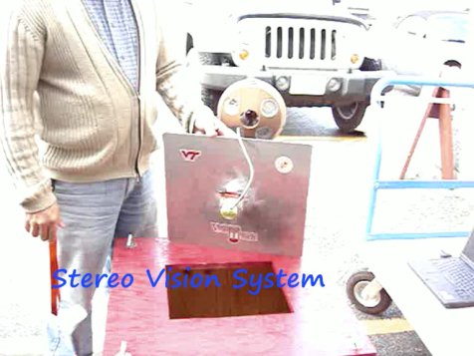
Components
Calibrated stereo vision system
Enclosure box
Lighting System
Laptop Computer
Developed Software

Slide 11

Operation

Slide 12
Algorithm
Set appropriate camera properties
Capture pair of stereo images
Remove lens distortions + rectification to align the epipolar lines
Edge detection (using pre-selected filter masks and coefficients)
Matching using constraints for texture validation, surface size validation and disparity range
Disparity values converted to a grid x, y, and z coordinates = 3-dimensional map
Calculate statistics, such as average depth

Slide 13
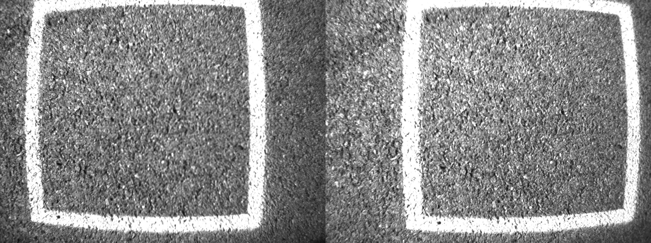
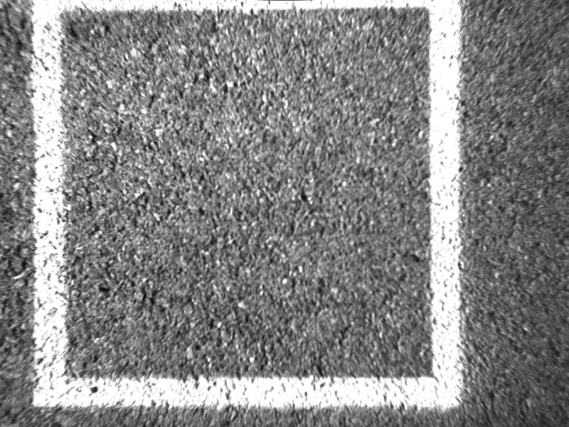
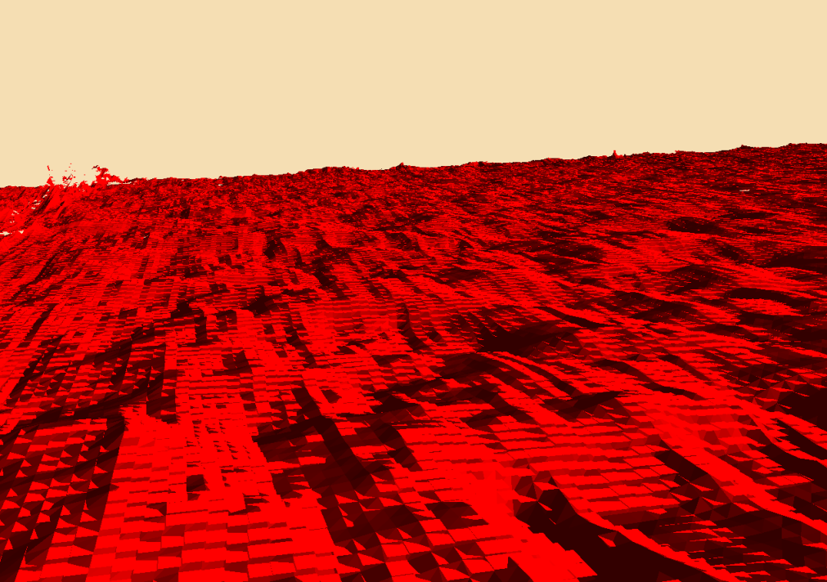
1 pixel ~ 0.25 mm²

Slide 14
Overview
Objective
Background
Equipment Development
Results
Conclusions

Slide 15
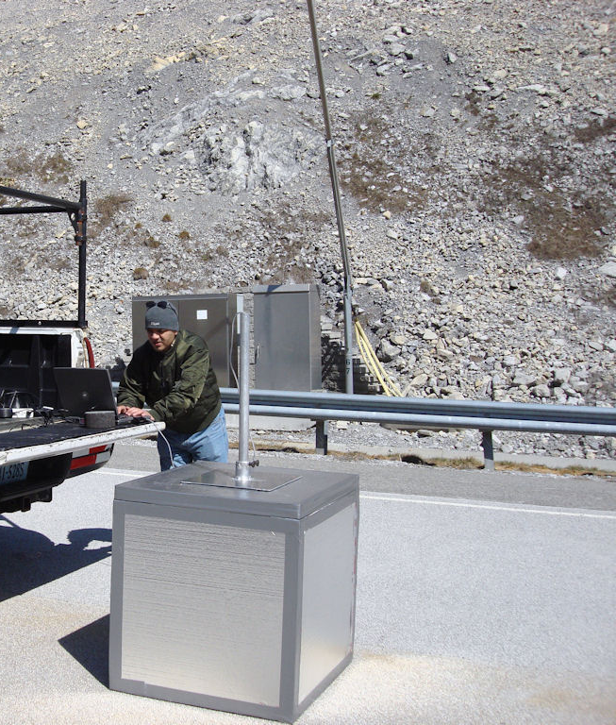
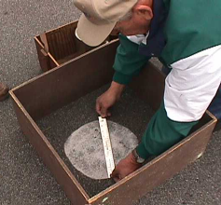
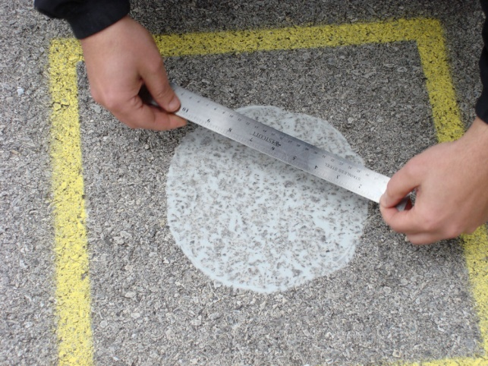
Preliminary Smart Road Comparisons

Slide 16
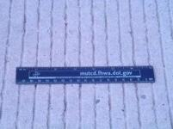
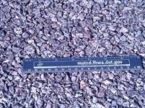
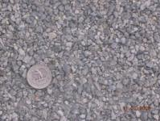
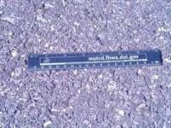
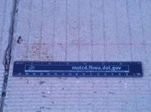
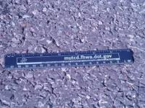
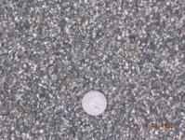
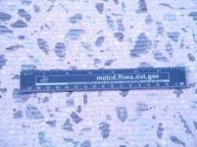
Proof-of-Concept Surfaces Tested
Tined CRCP
OGFC
Cargill SafeLane™
SM 9.5 D SUPERPAVE
JRCP
SMA 9.5 D
VDOT EP5LV
Ground JRCP

Slide 17
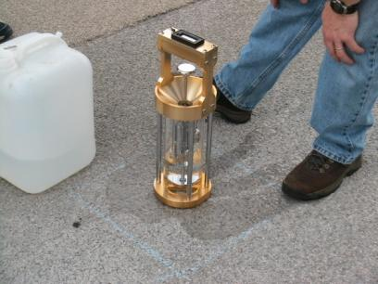
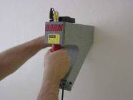
2008 Rodeo Comparisons
2 Circular Track Meter
(ASTM E2157)
  Mean profile depth (MPD)
  Mean texture depth (MTD)
Hydrotimer (ASTM 2380),
Digital Surface Roughness
Meter (DSRM)

Slide 18
Comparisons

Slide 19
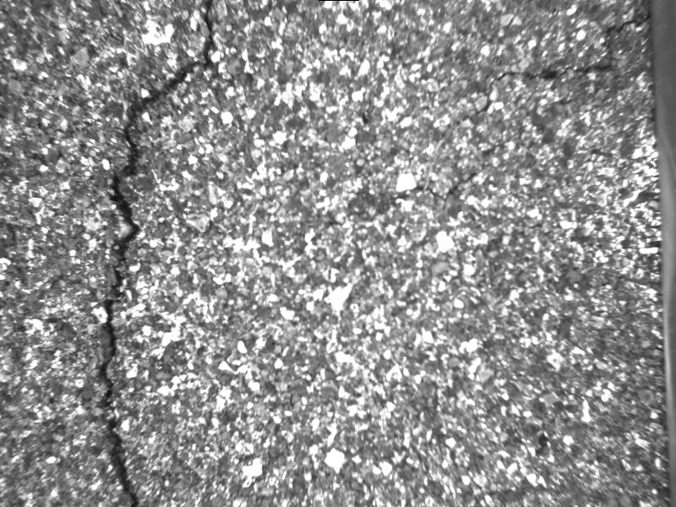
Why do we need area-based approaches?

Slide 20
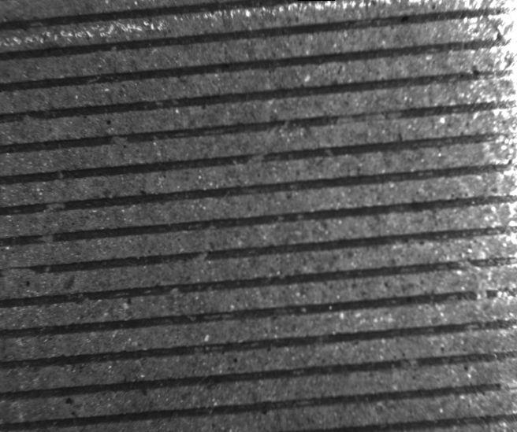
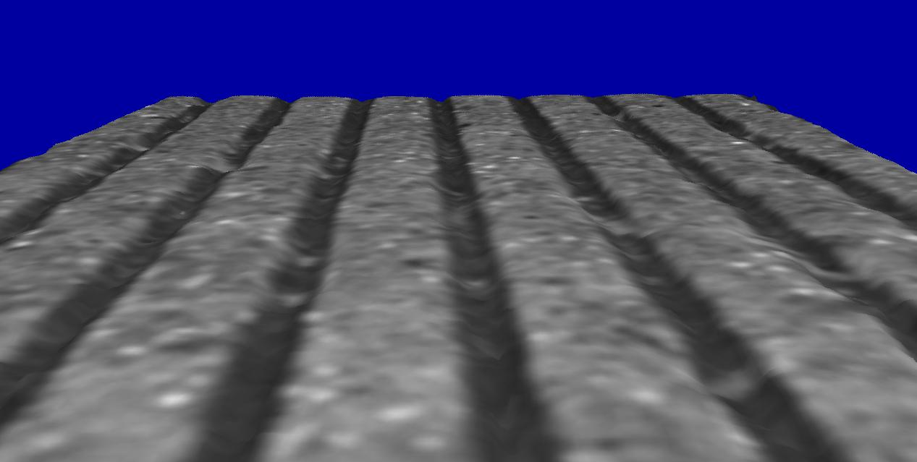
Additional Validation Tests (Wallops)

Slide 21
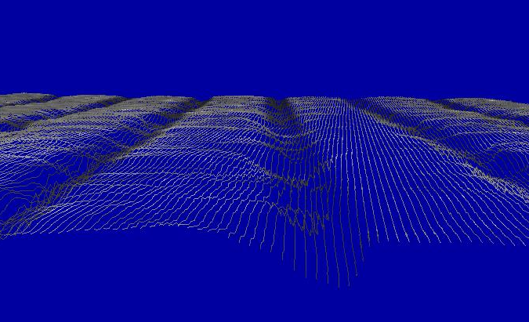
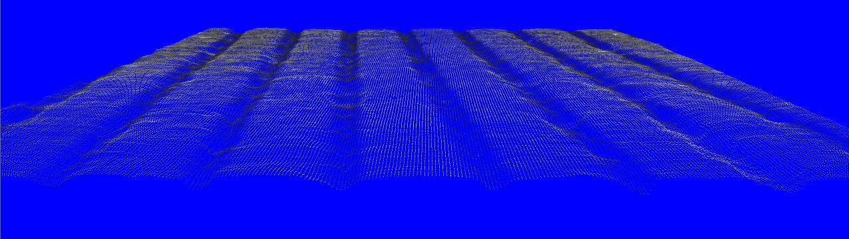
Visualizations
POINTS
MESH

Slide 22
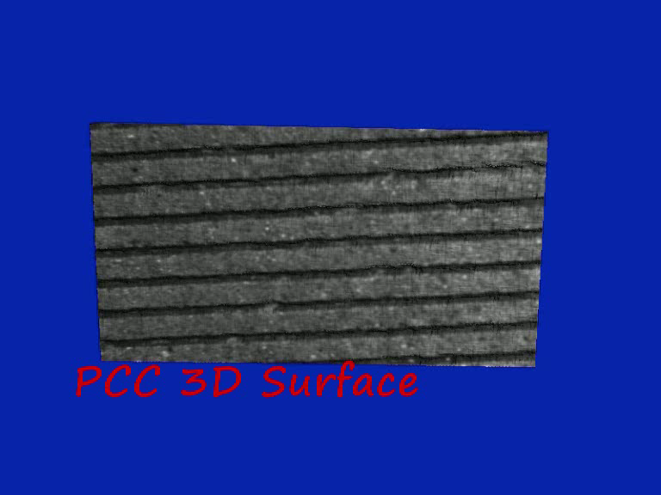

Slide 23
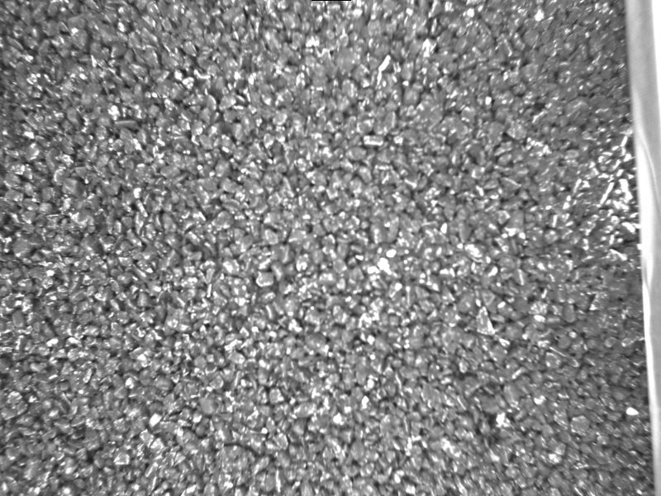
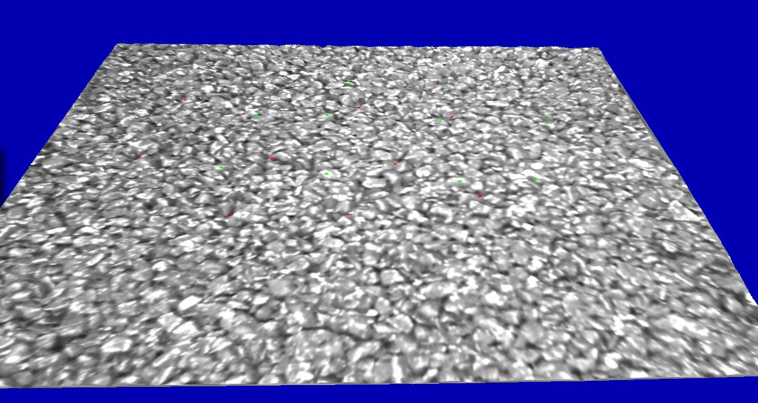
HMA Surface
Rectified Surface
3-D Map

Slide 24
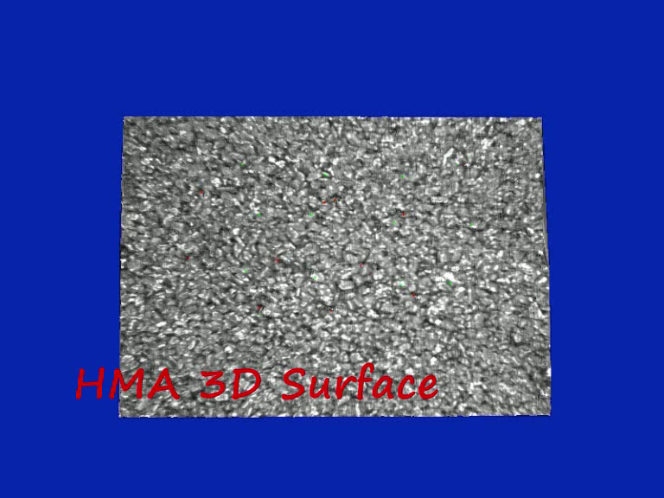

Slide 25
Overview
Objective
Background
Equipment Development
Results
Conclusions

Slide 26
Conclusions
The development of a relatively low-cost pavement surface texture measurement system that can conduct wide-area measurements instead of thin longitudinal lines can provide an accurate characterization of pavement surfaces

Slide 27
Conclusions (cont.)
The stereo-vision-based macrotexture measurement system provides a more accurate (and relevant) methodology for evaluating pavement surface texture than currently available technologies.
  Allows the determination of area surface measurements

Slide 28
Conclusions (cont.)
The results suggest that the development and implementation of area-based macrotexture indicators and measurement techniques will allow a better understanding of the pavement surface properties and more accurate simulations of tire-surface interactions

Slide 29
Acknowledgement (II)
Project sponsored by the Consortium for Pavement Surface Properties.
  Federal Highway Administration (FHWA)
  The Connecticut, Georgia, Mississippi, Pennsylvania, South Carolina, and Virginia Departments of Transportation
  Virginia Tech Transportation Institute (VTTI).
  William Hobbs, Julio Roa, Oscar Gonzalez, and Mario Candia (from CSTI) collaborated with the data collection and processing.

