Slide 1

Evaluation of the International Friction Index Coefficients for Various Devices
  Gerardo Flintsch
  Center for Sustainable Transportation Infrastructure
  Director
  flintsch@vt.edu
Notes:
NB :
Prepare the slide in one language only!
Preparer la diapositive en une seule langue
Instead of the traffic lights, one can introduce the logo of the organisation
À la place du feu, on peut insérer le logo de l’entreprise.

Slide 2
Overview
Objective
Background
Experimental program
Results
Conclusions

Slide 3
Acknowledgements
Oscar Gonzalez & Edgar de Leon
  Center for Sustainable Transportation Infrastructure, VTTI
Kevin K. McGhee
  Virginia Transportation Research Council
Mark Swanlund
  Federal Highway Administration

Slide 4
Objective
Background
Experimental program
Results
Conclusions

Slide 5
Motivation
Different research efforts have studied procedures to harmonize friction measurements
  PIARC Experiment to Compare and Harmonize Texture and Skid Resistance Measurements
  NASA Wallops Friction Workshops Program
  HERMES Experiment

Slide 6
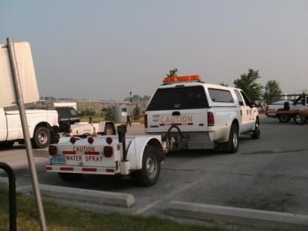
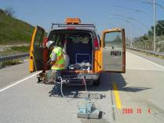
Objective
To compare friction and macrotexture measurement results and determine if the previously adopted models are valid for the devices considered.
  Measurements taken at the Virginia Smart Road in 2008 by the members of the Pavement Surface Properties Consortium.

Slide 7
Objective
Background
Experimental program
Results
Conclusions

Slide 8







Background: Pavement Surface Properties Consortium
Research program focused on enhancing the level of service provided by the roadway transportation system through optimized pavement surface texture characteristics.

Slide 9
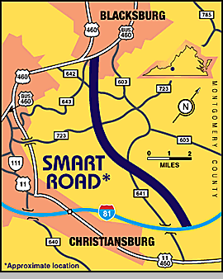

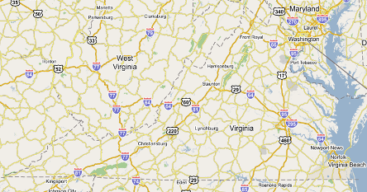
The Virginia Smart Road

Slide 10
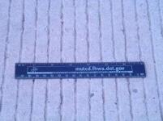
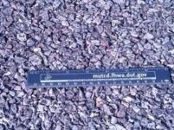
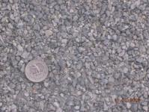
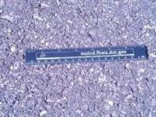
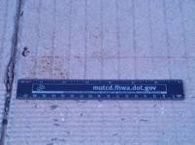
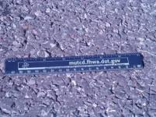
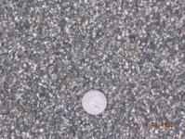
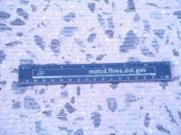
The Virginia Smart Road
Layout
Tined CRCP
OGFC
Cargill SafeLane™
SM 9.5 D SUPERPAVE
JRCP
SMA 9.5 D
VDOT EP5LV
Ground JRCP

Slide 11
Pavement Surface Properties Consortium Current Projects
Annual Equipment Rodeo
Seasonal Monitoring
Evaluation of New Measurement technologies
Evaluation of new “High-friction” pavement technologies
Griptester loan program
Stereo Vision Texture Measuring

Slide 12
Objective
Background
Experimental program
Results
Conclusions

Slide 13
Experimental Program
24 sections
  12 x 2 directions
3 Speeds
5 repetitions @ each speed
2008 Devices:
  2 Locked-wheel trailers
  DFTester
  Griptester
  2 CTMeters
  1 laser profiler w/ macrotexture
  Other …

Slide 14
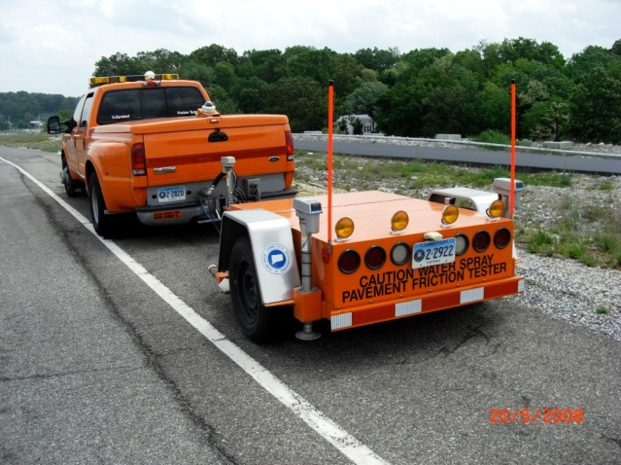
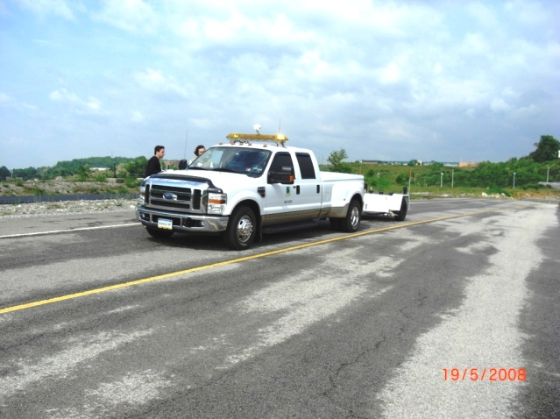
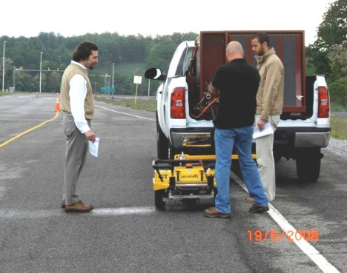
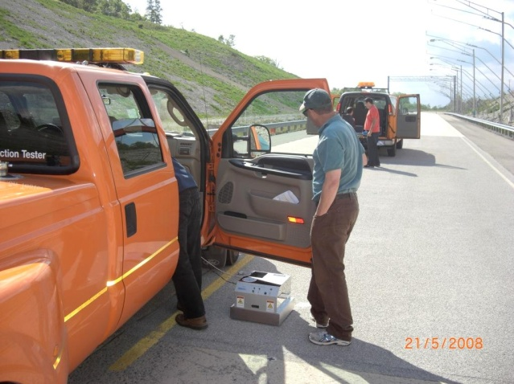
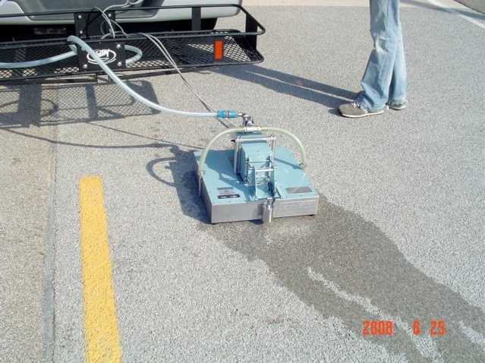
Sample of Equipment Used

Slide 15
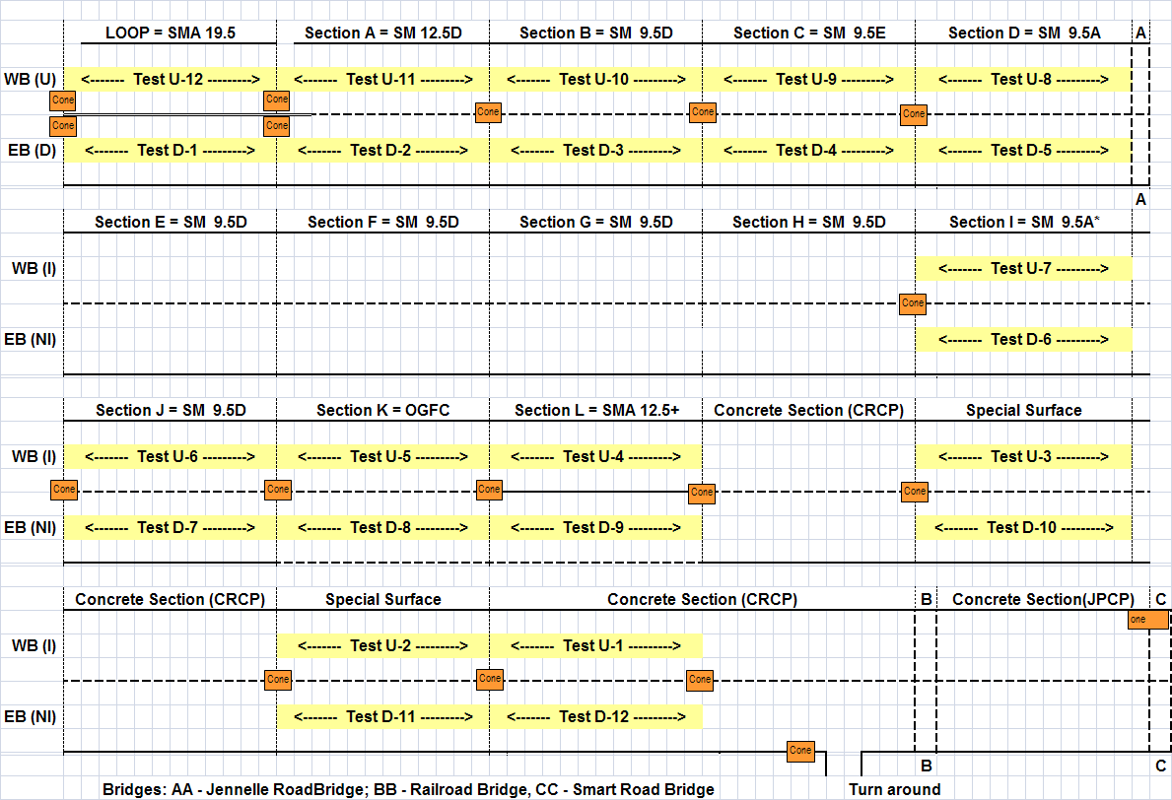

Experimental Section Layout

Slide 16
Objective
Background
Experimental program
Results
Conclusions

Slide 17
Results: Comparison Using Original Coefficients

Slide 18
Revised Coefficients

Slide 19
Adding Macrotexture

Slide 20
Comparison of F60 IFI Coefficients
Friction Unit | Original Coefficients (1) |  |  |  | Revised Coefficients
 | A | B | C | R² | A | B | C | R²
LWS1 | 0.0446 | 0.925 | - | 0.345 | 0.1958 | 0.4599 | - | 0.349
 |  |  |  |  | 0.2030 | 0.2596 | 0.0862 | 0.796
LWS2 | 0.0446 | 0.925 | - | 0.371 | 0.1177 | 0.5542 | - | 0.371
 |  |  |  |  | 0.1401 | 0.3485 | 0.0861 | 0.831
GT | 0.0821 | 0.9104 | - | 0.623 | 0.1459 | 0.6125 | - | 0.623
 |  |  |  |  | 0.2073 | 0.3302 | 0.0608 | 0.785
LWR1 | -0.0228 | 0.6068 | 0.0976 | 0.7831 | 0.1283 | 0.2494 | 0.1188 | 0.7831

Slide 21
“Experimental” Sp

Slide 22
Speed Constant

Slide 23
Comparison of Sp Models
Table 4 -
Devices | Lineal |  |  | Power
 | a | b | R² | a | b | R²
DFT Sp | 122 | 259 | 0.2611 | 378 | 0.300 | 0.2247
LWR1 Sp | 18.3 | 160 | 0.0492 | 136 | -0.211 | 0.0823
LWS1 Sp | 20.0 | 37.1 | 0.2096 | 56.4 | 0.469 | 0.3156
LWS2 Sp | 47.1 | 25.0 | 0.3848 | 70.7 | 0.767 | 0.5609
GT | 48.0 | -2.95 | 0.3342 | 39.4 | 1.168 | 0.4312

Slide 24
Objective
Background
Experimental program
Results
Conclusions

Slide 25
Conclusions
The original PIARC coefficients did not produce harmonious results for the devices and surfaces tested
  ⇒ the original coefficients determined during the PIARC experiment may need to be adjusted for the devices evaluated before the IFI can be implemented in the participating agencies

Slide 26
Conclusions (cont.)
The results also suggest that that there is a better correlation of the speed gradient, Sp, with macrotexture using a power model than with the linear model used on the original IFI equations
  Particularly for the measurements using smooth tires

Slide 27
Conclusions (cont.)
Preliminary revised coefficients for the participating devices are provided based on the results on the sections tested.
However, it is recommended that these values are verified on other surfaces before implementation.

