Slide 1
Adaptive Fourier Domain Inference on the Symmetric Group
Jonathan Huang
NIPS Algebraic Methods Workshop (AML ‘08) 12/11/08
Joint work with Carlos Guestrin,
Xiaoye Jiang, Leonidas Guibas

Slide 2
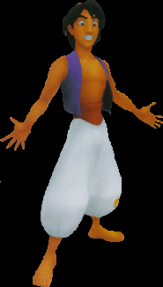
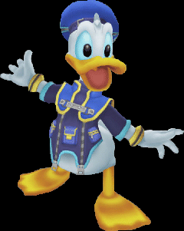
Identity Management [Shin et al., ‘03]
Identity Mixing @Tracks 1,2
Track 1
Track 2
Where is Donald Duck?

Slide 3
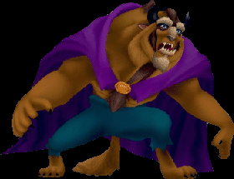
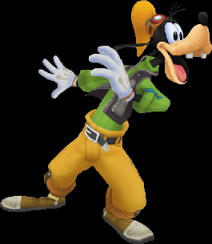
Identity Management
Where is
?
Mixing @Tracks 1,2
Track 1
Mixing @Tracks 1,3
Track 2
Track 3
Track 4
Mixing @Tracks 1,4

Slide 4
Reasoning with Permutations
We model uncertainty in identity management with distributions over permutations
Identities
[1 3 2 4] means:
“Alice is at Track 1,
and Bob is at Track 3,
and Cathy is at Track 2,
and David is at Track 4
with probability 1/10”
A B C D | P(σ)
1 2 3 4 | 0
2 1 3 4 | 0
1 3 2 4 | 1/10
3 1 2 4 | 0
2 3 1 4 | 1/20
3 2 1 4 | 1/5
1 2 4 3 | 0
2 1 4 3 | 0
A B C D | P(σ)
1 2 3 4 | 0
2 1 3 4 | 0
1 3 2 4 | 1/10
3 1 2 4 | 0
2 3 1 4 | 1/20
3 2 1 4 | 1/5
1 2 4 3 | 0
2 1 4 3 | 0
Track Permutations
Probability of each
track permutation

Slide 5
Storage Complexity
There are n! permutations!
Graphical models not effective due to mutual exclusivity constraints (“Alice and Bob cannot both be at Track 1 simultaneously”)
One such constraint for each pair of identities
n | n! | Memory required to store n! doubles
9 | 362,880 | 3 megabytes
12 | 4.8x10⁸ | 9.5 terabyes
15 | 1.31x10¹² | 1729 petabytes (!!)
x 1,800,000

Slide 6
1st order summaries
An idea: For each (identity j, track i) pair, store marginal probability that j maps to i
Identities
“David is at Track 4 with
probability:
=1/10+1/20+1/5=7/20”
A B C D | P(σ)
1 2 3 4 | 0
2 1 3 4 | 0
1 3 2 4 | 1/10
3 1 2 4 | 0
2 3 1 4 | 1/20
3 2 1 4 | 1/5
1 2 4 3 | 0
2 1 4 3 | 0
A B C D | P(σ)
1 2 3 4 | 0
2 1 3 4 | 0
1 3 2 4 | 1/10
3 1 2 4 | 0
2 3 1 4 | 1/20
3 2 1 4 | 1/5
1 2 4 3 | 0
2 1 4 3 | 0
Track Permutations

Slide 7
1st order summaries
Summarize a distribution using a matrix of 1st order marginals
Requires storing only n² numbers!
Example:
“Bob is at Track 2
with zero probability”
3/10
0
1/2
1/5
1
1/5
1/2
3/10
0
2
Tracks
3/10
1/5
1/10
9/20
3
1/5
3/10
3/20
7/20
“Cathy is at Track 3
with probability 1/20”
4
A
B
C
D
Identities

Slide 8
The problem with 1st order
What 1st order summaries can capture:
P(Alice is at Track 1) = 3/5
P(Bob is at Track 2) = 1/2
Now suppose:
Tracks 1 and 2 are close,
Alice and Bob are not next to each other
P({Alice,Bob} occupy Tracks {1,2}) = 0
1st order summaries cannot capture
higher order dependencies!

Slide 9
2nd order summaries
Idea #2: store marginal probabilities that ordered pairs of identities (k,l) map to pairs of tracks (i,j)
Identities
A B C D | P(σ)
1 2 3 4 | 0
2 1 3 4 | 0
1 3 2 4 | 1/10
3 1 2 4 | 0
2 3 1 4 | 1/20
3 2 1 4 | 1/5
1 2 4 3 | 0
2 1 4 3 | 0
A B C D | P(σ)
1 2 3 4 | 0
2 1 3 4 | 0
1 3 2 4 | 1/10
3 1 2 4 | 0
2 3 1 4 | 1/20
3 2 1 4 | 1/5
1 2 4 3 | 0
2 1 4 3 | 0
“Cathy is Track 3
and
David is in Track 4
with zero probability”
Track Permutations

Slide 10
2nd order summaries
Can also store summaries for ordered pairs:
2nd order summary requires O(n⁴) storage
Identities
(A,B)
(B,A)
(A,C)
(C,A)
1/6
1/12
1/8
1/12
“Bob is at Track 1
and
Alice is at Track 3
with probability 1/12”
(1,2)
1/12
1/6
1/12
1/8
(2,1)
Tracks
1/12
1/12
1/8
1/24
(1,3)
(3,1)
1/12
1/12
1/24
1/8

Slide 11
Et cetera…
And so forth… we can define:
3rd-order marginals
4th-order marginals
…
n^{th}-order marginals
(which recovers the original distribution but requires n! numbers)
By the way, the 0th-order marginal is the normalization constant (which equals 1)
Fundamental Trade-off: can capture higher-order dependencies at the cost of storing more numbers

Slide 12
The Fourier interpretation
Marginal summaries are connected to Fourier analysis!
Used for multi-object tracking [Kondor et al, ’07]
Simple marginals are “low-frequency”: intuitively,
1st order marginals are the lowest frequency responses (except for DC component)
2nd order marginals contain higher frequencies than 1st order marginals
3rd order marginals contain still higher frequency information
Note that higher-order marginals can contain lower-order information

Slide 13
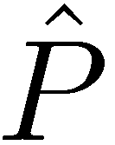
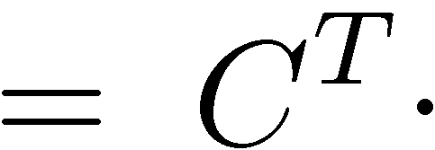
Fourier coefficient matrices
Fourier coefficients on permutations are given as a collection of square matrices ordered by “frequency”:
Marginals are constructed by conjugating Fourier coefficient matrices by a (pre-computed) constant matrix:
0th order
1st order
2nd order
n^{th} order
First two Fourier matrices
1st-order marginals
Notes:
Point to zeroth order coeff, then say that first order can be constructed by first two blocks, second order can be constructed by first 3 blocks… nth order can be constructed by all blocks

Slide 14
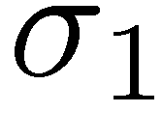
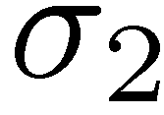
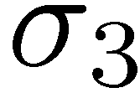
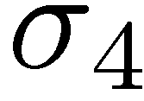
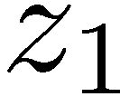
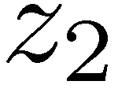
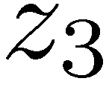
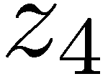
Hidden Markov Model Inference
Mixing model – “e.g., Tracks 2 and 3
swapped identities with probability ½”
Latent permutations
Identity observations
Observation model – “e.g.,
see green blob at Track 3”
Problem statement: For each timestep, find posterior marginals conditioned on all past observations
Need to rewrite all inference operations completely in the Fourier domain

Slide 15
Hidden Markov model inference
Two basic inference operations for HMMs:
How can we do these operations without enumerating all n! permutations?
(Prediction/Rollup)
(Conditioning)

Slide 16
Random walk transition model
We assume that σ_{t+1} is generated by the rule:
Draw τ∼ Q(τ)
Set σ_{t+1} = τ⋅σ_{t}
For example, Q([2 1 3 4])=½ means that Tracks 1 and 2 swapped identities with probability ½
Mixing Model
Track 1
Track 2
Track 3
Track 4

Slide 17
Prediction/Rollup
Inputs:
Prior distribution P(σ_{t})
Mixing Model Q(τ)
Prediction/Rollup can be written as a convolution:
Convolution (Q*P_{t})!

Slide 18
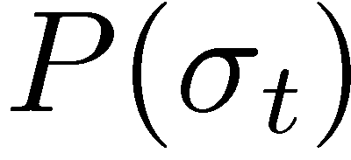
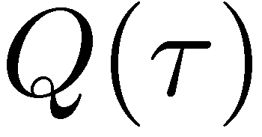
Fourier Domain Prediction/Rollup
Convolutions are pointwise products in the Fourier domain:
prior distribution
Prediction/Rollup does not increase
the representation complexity!
mixing model

Slide 19
Hidden Markov model inference
Two basic inference operations for HMMs:
How can we do these operations without enumerating all n! permutations?
(Prediction/Rollup)
(Conditioning)

Slide 20
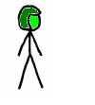
Conditioning
Bayes rule is a pointwise product of the likelihood function and prior distribution:
Example likelihood function:
P(z=green | σ(Alice)=Track 1) = 9/10
(“Prob. we see green at Track 1 given Alice is at Track 1 is 9/10”)
Posterior
Likelihood
Prior
Track 1

Slide 21
Conditioning
Conditioning increases the representation complexity!
Example: Suppose we start with 1st order marginals of the prior distribution:
P(Alice is at Track 1 or Track 2)=.9
P(Bob is at Track 1 or Track 2)=.9
…
Then we make a 1st order observation:
“Cathy is at Track 1 or Track 2 with probability 1”
(This means that Alice and Bob cannot both be at Tracks 1 and 2!)
P({Alice,Bob} occupy Tracks {1,2})=0
Need to store 2nd-order
probabilities after
conditioning!

Slide 22
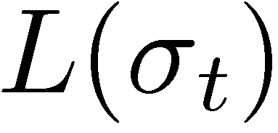
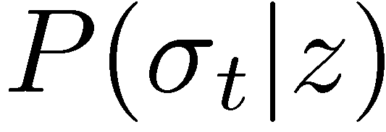
Kronecker Conditioning
Pointwise products correspond to convolution in the Fourier domain [Willsky, ‘78]
(except with Kronecker Products in our case)
Our algorithm handles any prior and any likelihood, generalizing the previous FFT-based conditioning method [Kondor et al., ‘07]
Conditioning can increase
representation complexity!
prior
likelihood
posterior

Slide 23
Dealing with bandlimiting errors
Consecutive conditioning steps can propagate errors,
(sometimes causing approximate marginals to be negative!)
Our Solution: Project to relaxed Marginal Polytope (space of Fourier coefficients corresponding to nonnegative marginal probabilities)
Projection can be formulated as a Quadratic Program in the Fourier domain
Marginal Polytope

Slide 24
Tracking with a camera network
Camera Network data:
8 cameras, multi-view, occlusion effects
11 individuals in lab
Identity observations obtained from color histograms
Mixing events declared when people walk close to each other
Omniscient tracker
60
50
40
Better
% Tracks correctly Identified
30
20
10
0
time-independent classification
w/o Projection
with Projection

Slide 25
Scaling
For fixed representation depth, Fourier domain inference is polytime:
But complexity can still be bad…
4
Exact inference
Better
3
Running time in seconds
2
Can we exploit some other kind of structure
in practice??
3rd order
1
2nd order
1st order
0
4
5
6
7
8
n
Representation Depth | # of Fourier coefficients
1st order | O(n²)
2nd order | O(n⁴)
3rd order | O(n⁶)
4th order | O(n⁸)
Notes:
Need more of a story here – an impetus for looking at independence

Slide 26
Adaptive Identity Management
In practice, it is often sufficient to reason over smaller subgroups of people independently
Groups join when tracks from two groups mix
Groups split when an observation allows us to reason over smaller groups independently
Idea: adaptively factor problem into
subgroups allowing for higher order
representations for smaller subgroups
“This is Bob”
(and Bob was originally in the Blue group)

Slide 27
Problems
If the joint distribution h factors as a product of distributions f and g:
Distribution over tracks {1,…,p}
Distribution over tracks {p+1,…,n}
(Join problem) What are the Fourier coefficients of the joint h given the Fourier coefficients of factors f and g?
(Split problem) What are the Fourier coefficients of factors f and g given the Fourier coefficients of the joint h?

Slide 28
First-order Independence
Let f be a distribution on permutations of {1,…,p}, and g be a distribution on permutations of {p+1,…,n}
Join problem for 1st-order marginals:
Given 1st-order marginals of f and g, what does the matrix of 1st-order marginals of h look like?
“Cathy is at Track 4
with probability 1/20”
1st-order marginals
“Cathy is at Track 10
with zero probability”
f
h
g
zeroes

Slide 29
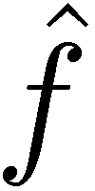
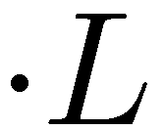
Joining
Joining for higher-order coefficients gives similar block-diagonal structure
Also get Kronecker product structure for each block

Slide 30
Joining
Coefficients of the joint related to coefficients of the factors by:
Block multiplicities equivalent to Littlewood-Richardson coefficients
#P-hard to compute in general, but (very) tractable for low-order decompositions
Complexity: same as prediction/rollup step for the joint distribution (with known block multiplicities)

Slide 31
Problems
If the joint distribution h factors as a product of distributions f and g:
Distribution over tracks {1,…,p}
Distribution over tracks {p+1,…,n}
(Join problem) What are the Fourier coefficients of the joint h given the Fourier coefficients of factors f and g?
(Split problem) What are the Fourier coefficients of factors f and g given the Fourier coefficients of the joint h?

Slide 32
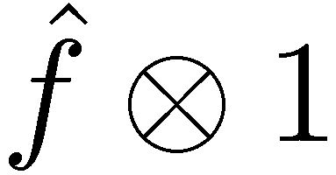
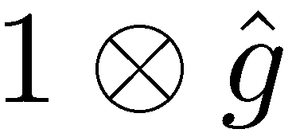
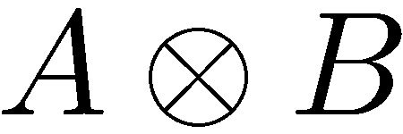
Splitting
We would like to “invert” the Join process:
Consider recovering 2nd Fourier block
Our approach: search for blocks of the form: or
Need to recover A, B from – only possible to do up to scaling factor
Theorem: these blocks always exist! (and are efficient to find)
Notes:
Let’s consider recovering second block. It appears twice in this matrix. In the second case, we need to factor a kronecker product, which in general is only possible up to scale

Slide 33
Marginal Preservation
Now we know how to join/split given the Fourier transform of the input distribution
Problem: In practice, never have entire set of Fourier coefficients!
Marginal preservation guarantee:
Conversely, we get a similar guarantee for splitting
(Usually get some higher order information too)
Theorem: Given m^{th}-order marginals for independent factors, then we exactly recover m^{th}-order marginals for the joint distribution.

Slide 34
Detecting Independence
To adaptively split large distributions, need to be able to detect independent subsets.
Recall what first-order independence looks like:
Can use (bi)clustering* on matrix of marginals to discover an appropriate ordering!
* (Need balance constraint forcing square blocks)
In practice, get unordered
identities, tracks…
matrix of marginals with appropriate
ordering on identities and tracks
Notes:
Before doing this, summarize what we’ve done so far. So far, we’ve tackled joining, splitting, and approximation issues that arise. The last problem that remains is detecting independent subsets (like structure learning)

Slide 35
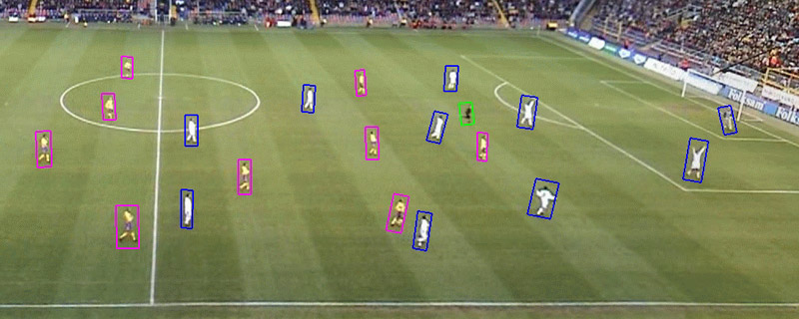
First-order independence
First-order condition is insufficient:
“Alice guards Bob”
Tracking yellow and white teams independently ignores the fact that Alice and Bob are always next to each other!
“Alice is in yellow team”
“Bob is in white team”

Slide 36
Handling Near-Independence
We only detect at first-order, but:
We can measure departure from independence at higher orders
And even when higher order independence does not hold, we have the following result:
(we get a marginal distribution for white team and a marginal distribution for yellow team)
When first-order independence does not hold, we obtain approximate marginals.
Theorem: If first-order independence holds, we always obtain exact marginals of each subset of tracks.
Notes:
So clearly first order independence is not the same as being independent at higher orders. But even if we only detect independence at a first-order level using biclustering, what we can do is to measure the degree of independence of

Slide 37
Experiments - Accuracy
nonadaptive
1
0.8
0.6
label accuracy
better
0.4
0.2
adaptive
0
0
0.05
0.1
0.15
0.2
0.25
0.3
ratio of observations
dataset from [Khan et al. 2006]

Slide 38
Experiments – Running time
nonadaptive
2000
1500
nonadaptive
adaptive
1500
1000
better
Running time (seconds)
elapsed time per run (seconds)
1000
adaptive
500
500
0
0
0
0.1
0.2
0.3
20
40
60
80
100
ratio of observations
Number of ants

Slide 39
Conclusion
Presented an intuitive, principled representation for distributions on permutations with
Fourier-analytic interpretations, and
Tuneable approximation quality
Formulated general and efficient inference operations directly in the Fourier domain (prediction/rollup, conditioning, join, split)
Addressed approximation and scalability issues
Applied algorithms successfully on simulated and real data
Opens significant, new research opportunities in AI/ML
Some ideas generalize to other finite groups

Slide 40
Thanks Thanks Thakns Thaksn Thasnk Thaskn Thnask Thnksa …
Jonathan Huang
NIPS Algebraic Methods Workshop (AML ‘08) 12/11/08

Slide 41
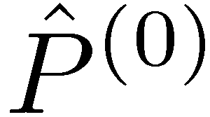
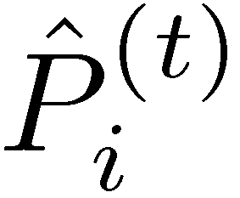
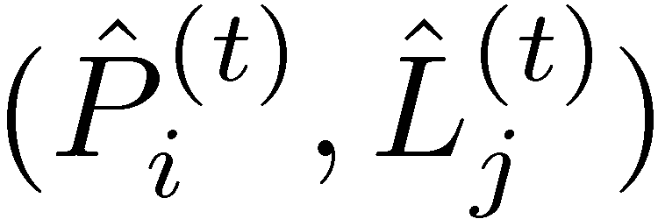
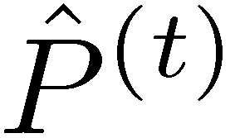
Algorithm Summary
Initialize prior Fourier coefficient matrices
For each timestep t = 1,2,…,T
Prediction/Rollup:
For all coefficient matrices
Conditioning
For all pairs of coefficient matrices
Compute and reproject to the orthogonal Fourier basis
Drop high frequency coefficients of
Project to relaxed Marginal polytope using a Quadratic program
Return marginal probabilities for all timesteps
Input: Fourier coefficients of mixing and observation models

Slide 42
Mixing and Observation Models
Fourier-theoretic framework can handle a variety of probabilistic models
But… need to be able to efficiently compute Fourier coefficients for mixing/observation models...
Useful family of function “primitives”:
Can efficiently Fourier transform the indicator function of subgroups of the form :
Fourier coefficient matrices of S_{k}-indicators are diagonal, with all nonzero entries equal to k!
Notes:
Our framework not only handles these single track observations, but it handles a variety of very general probabilistic models (since, conceptually, any function has a Fourier transform). The catch is that we need to be able to compute low-order coefficients efficiently. What we know how to do at this point is to compute the transform of indicator functions of the following form. We know such and such about such functions and we view these indicators as a useful primitive for constructing more complicated models.

Slide 43
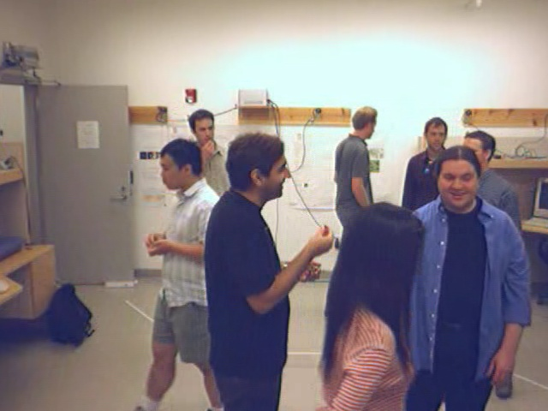
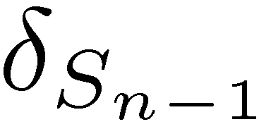
1st order observation model for tracking
Blob for Track j
If Identity i is on Track j, prob. z_{j} is Gaussian with mean = appearance
Color histogram z_{j}
appearance model for Identity i
Color histogram identity i
If we make one such observation per track, P(z|σ) is proportional to and can be represented exactly by 1^{st-}order Fourier parameters
Notes:
43

Slide 44
S_{k}-Indicator Primitives
Most mixing/observation models can be written as (sparse) linear combinations of S_{k}-indicators!
Associated subgroup of the S_{n}
Indicator function of of S_{k}xS_{n-k} is
the convolution of indicators
of S_{k} and S_{n-k}
Mixing Models
Pairwise | S₂ | “Tracks 1 and 2 swapped identities”
k-subset | S_{k} | “Confusion at tracks {1,2,3,4,5}”
Mixing Models
Pairwise | S₂ | “Tracks 1 and 2 swapped identities”
k-subset | S_{k} | “Confusion at tracks {1,2,3,4,5}”
Mixing Models
Pairwise | S₂ | “Tracks 1 and 2 swapped identities”
k-subset | S_{k} | “Confusion at tracks {1,2,3,4,5}”
Observation Models
Singletrack | S_{n-1} | “Alice is at track 2”
Multitrack | S_{n-k} | “Alice is at track 2, Bob is at track 3”
Bluetooth | S_{k}xS_{n-k} | “Red team is at tracks {1,3,5,6,8,9}”
Pairwise ranking | S_{n-2} | “Apples are better than oranges”
Observation Models
Singletrack | S_{n-1} | “Alice is at track 2”
Multitrack | S_{n-k} | “Alice is at track 2, Bob is at track 3”
Bluetooth | S_{k}xS_{n-k} | “Red team is at tracks {1,3,5,6,8,9}”
Pairwise ranking | S_{n-2} | “Apples are better than oranges”
Observation Models
Singletrack | S_{n-1} | “Alice is at track 2”
Multitrack | S_{n-k} | “Alice is at track 2, Bob is at track 3”
Bluetooth | S_{k}xS_{n-k} | “Red team is at tracks {1,3,5,6,8,9}”
Pairwise ranking | S_{n-2} | “Apples are better than oranges”

Slide 45
Generalized Independence
Observation: We care:
more about interactions between first and second place, and
less about interactions between first and last place.
Independence allows us to capture something like this, but full independence is not appropriate for ranking:
Generalized Independence: Can we exploit some kind of alternative structure?
1st-order marginals
1st place
“Guava is ranked 5th
with zero probability”
2nd place
Ranks
“Guava is ranked 6th
with some probability”
Objects
(apples,bananas,coconuts…)

Slide 46
Rank Independence
Candidate idea: Instead of factoring into independent distributions over ranks, factor into distributions over relative ranks
Example:
σ = [7 3 2 6 5 4 8 1 9]
¿ = [1 2 3 4]
Candidate idea: Instead of factoring into independent distributions over ranks, factor into distributions over relative ranks
Example:
σ = [7 3 2 6 5 4 8 1 9]
¿ = [1 2 3 4]
Relative ranking of ¿ in σ:
Definition:
Define (1,…,p) and (p+1,…n) to be rank independent if:

Slide 47
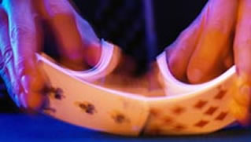
Rank Independence
Rank independence is a strict generalization of independence
The joint distribution h can also be written as a convolution:
Some connections to Radon transforms…
Rank independence:
Does rank independence hold in real ranked data?
Can we exploit it for fast inference?
Are there conditional generalizations of rank independence?
(think of shuffling two independent permutations together)

Slide 48
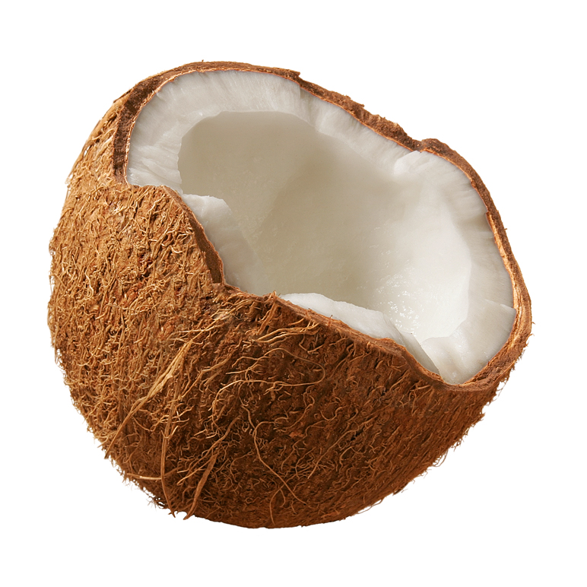
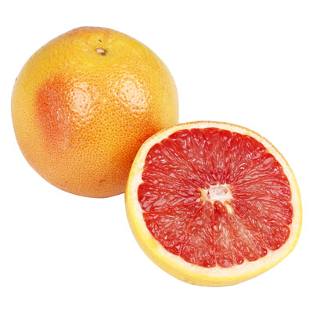
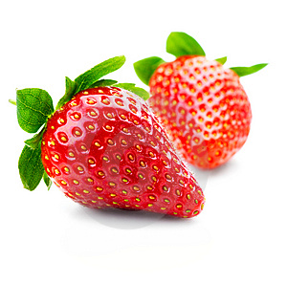
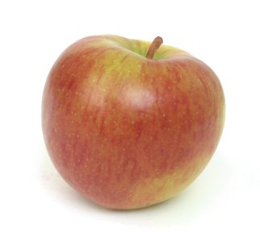
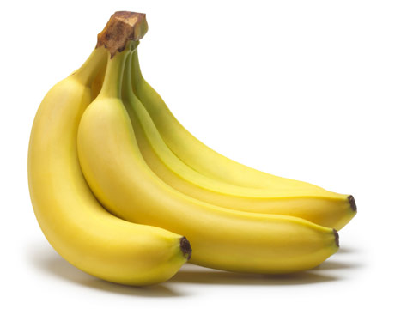
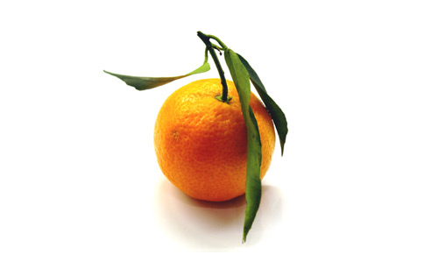
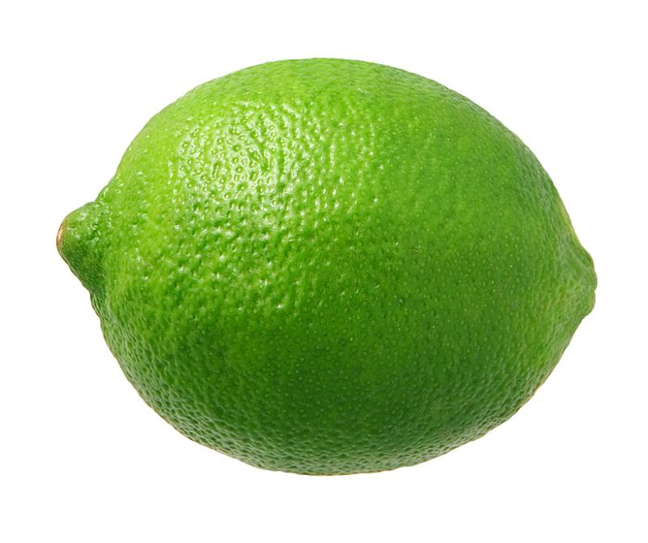
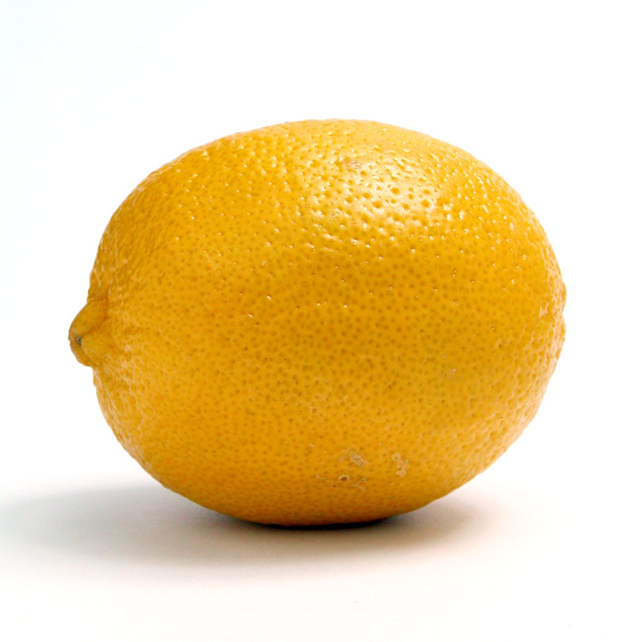
Generalization to unseen objects
Consider a distribution P over user preference rankings on fruits:
How can we modify P to include a never-before encountered object?
What if we know that the new object is a citrus fruit?
Citrus fruits
Generalization to unseen objects:
Allow for objects to be associated with side information (features)
Allow for observation models to depend on features

Slide 49
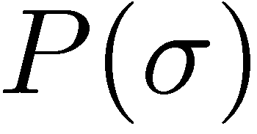
Optimization
Is MAP inference easier given a bandlimited function?
Optimizing a 0th-order (constant) function is trivial…
Optimizing a 1st-order function is reduces to bipartite matching and can be done in polynomial time…
Unfortunately:
Optimization: Can we formulate Fourier domain optimization algorithms that work well in practice?
permutations
Theorem: Any instance of the traveling salesman problem can be reduced to optimizing a second-order function on permutations in polynomial time.

