Slide 1
Graphical Multi-Task Learning
Dan Sheldon
Cornell University
NIPS SISO Workshop
12/12/2008
Notes:
Thanks. The title of my talk is graphical multi-task learning.

Slide 2
Multi-Task Learning (MTL)
Separate but related learning tasks --- solve them jointly to achieve better performance
E.g., in document collection, learn classifiers to predict category, relevance to query 1, query 2, etc.
Neural nets [Caruana 1997]
Shared hidden layers
Generative models / Hierarchical Bayes
Shared hyper-parameters
Notes:
I’ll start with a quick review of multi-task learning. The general idea is that, when you’re presented with a bunch of predictions tasks which you believe to be related, that, rather than learning a model for each task in isolation, you can achieve better performance by somehow coupling the learning processes to allow information to be shared among tasks.
For example, in neural networks you can combine many tasks into one network with multiple outputs: then training data for each task affects the hidden layers, and if tasks are truly related, you can better learn features in the hidden layers to help all tasks.
In a generative setting, it’s common to have generative models; each model is itself generated according to a single task-generation process. During inference, the shared hyperparameters allow for information passing between tasks.

Slide 3
Task Relationships
Most previous work: pool of related tasks
This work: leverage known structural information
Graph structure on tasks
Discriminative setting
Regularized kernel methods
Notes:
Most previous work on multi-task learning makes no a priori distinction among task relationships --- there is simply a pool of related tasks.
In this work I’ll present methods to leverage known structural information about the task relationships, in the form of a graph. These methods work in a discriminative setting, with any regularized kernel method.

Slide 4
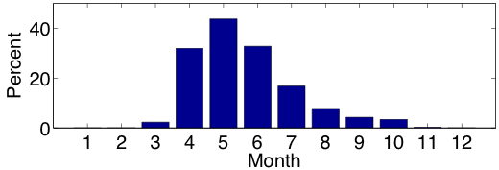
Motivating Application
Predict presence/absence of Tree Swallow (migratory bird) at locations in NY.
Observations:
x_{i} – date, time, location, habitat, etc.
y_{i} – saw a Tree Swallow?
Significant change throughout the year
How to model?
Percent positive observations by month
Notes:
Let me motivate this further with an example in species distribution modeling. This is the application that motivated this work, and for which I’ll present experimental results later.
The problem is predicting the presence of absence of tree swallows at locations in NY. The training data consists of observations consisting of feature vectors xi describing the date, time, location and other information about the observation such as habitat and climate variables, and labels yi indicating whether the observer saw a Tree Swallow or not. We would then like to make predictions for unobserved locations and times.
Since tree swallows are migratory birds that leave NY for the winter, this is a seasonally changing prediction task, as illustrated by this chart showing the percentage of positive observations by month.
The question is, how do we want to model this problem? It’s a straightforward classification setup, but we’re concerned with modeling the heterogeneity between months.

Slide 5
Separate Tasks?
Jan
Feb
Mar
Dec
….
Split training examples by month and train 12 separate models
OK if lots of training data
Notes:
If we really want to explicitly model heterogeneity, one option is to split the training examples by month and learn 12 separate classifiers. This will probably work well if there is lots of training data but in a data poor environment you are really challenging your learning algorithms by dividing the amount of training data, perhaps providing only a few examples per month, when you don’t really believe that these tasks are completely unrelated.

Slide 6
Single Task?
Jan, Feb, Mar,
… ,
Dec
Use all training examples to learn a single classifier
Include date as a feature to learn about month-to-month heterogeneity
Notes:
At the other extreme, another natural option is to pool all the training data and learn a single classifier, and include the date as a feature to allow your algorithm to learn about seasonal changes.

Slide 7
Symmetric MTL?
Jan
Feb
Mar
Dec
….
Ignores known problem structure
January is very weakly related to July
Notes:
You might try to apply multi-task learning to explicitly allow heterogeneity while sharing information among months. But symmetric multi-task methods discard knowledge of the problem structure. Clearly, January is much more closely related to February than to July.

Slide 8
Graphical MTL
Jan
Feb
Mar
Dec
….
Use a priori knowledge about structure of relationships, in the form of a graph.
Notes:
In Graphical Multi-Task learning, we can leverage the known graph structure (in this case, a cycle) representing task relationships.

Slide 9
Marketing in Social Network
Alice
Bob
Symmetric Task Relationships.
Alice
Bob
Prefer to leverage network structure!
(known a priori)
Notes:
A traditional approach in marketing is to use a hierarchical bayesian model to connect these units, allowing information sharing among them. However, this treats all tasks relationships symmetrically, and in this case, we really do have direct knowledge of the social network structure relating individuals, and would definitely like to use this in our learning. That’s what we can do with Graphical Multi-Task learning.

Slide 10
Idea
Use regularization to penalize differences between tasks that are directly connected
Penalize by squared difference || f_{t} – f_{t-1} ||²
f₁
f₂
f₃
f₁₂
….

Slide 11
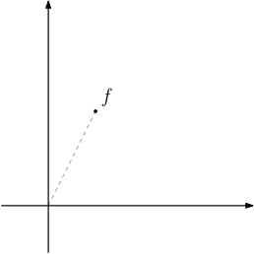
Illustration
Regularized learning: Trade off empirical risk vs. complexity.
Penalize squared
distance from origin.

Slide 12
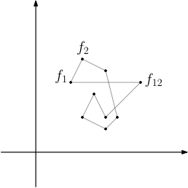
Illustration
Graphical MTL: Trade off empirical risk vs. task differences.
Penalize sum of
squared edge lengths.
[Evgeniou, Micchelli and Pontil JMLR 2006]

Slide 13
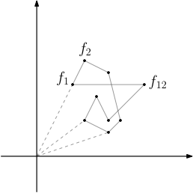
Illustration
Note: translation invariant.
Also add edges to origin.
Task-specific regularization.
Multi-Task regularization.
Empirical Risk

Slide 14
Related Work
Multi-Task learning: lots!
Caruana 1997, Baxter 2000, Ben-David and Schuller 2003, Ando and Zhang 2004
Multi-Task Kernels: Evgeniou, Michelli, Pontil 2006
General framework
Focus on linear, symmetrical case (all experiments)
Propose graph regularization, nonlinear kernels
Task Networks: Kato, Kashima, Sugiyama, Asai, 2007
Second order cone programming
Notes:
By now you have a feel for what I’m going to do. Before I describe the method, let me mention some related work.
There has been lots and lots of work on multi-task learning, but these two papers depart from the typical model of symmetric task relationships. The first paper has a somewhat similar formulation to what I’ll propose, and they present a sophisticated learning to solve SVMs connected by task networks. One of the advantages of what I’ll propose is actually in its simplicity --- when all is said and done it can be easily implemented in any kernel methods.
Our work will build very heavily on the second paper by Evgeniou Michelli and Pontil. We will use their multi-task kernel framework. They actually propose the graphical method that we will explore, but it is not explored in depth and all of their experiments actually use symmetric relationships. We’ll make several important extensions to their work that really allow the method to work:

Slide 15
This Work
Build on Evgeniou, Micchelli and Pontil
Main contribution: Practical development of graphical multi-task kernels, focused on nonlinear case.
Task-specific regularization
New treatment of non-linear kernels
Application

Slide 16
Technical Insights
Base kernel:
Key technical insight: Can reduce this problem to a single-task problem by learning one function f(x,t) and modifying the kernel:
Multi-task
kernel
Task
kernel
Base
kernel

Slide 17
Technical Insights
Base kernel:
Construct task kernel K from graph Laplacian L.
Multi-task kernel:

Slide 18
Proof Sketch
Define task-specific function as function that supplies task ID: .
Claim: . Hence task-specific functions are comparable via inner products. (Relies on product kernel)
Claim: is a weighted sum of inner products between task-specific functions: .
Graph Laplacian gives the desired weights:

Slide 19
One more thing…
Normalize task kernel to have unit diagonal
Reason:
Preserve scaling of K when choosing α
All entries in [0,1]

Slide 20
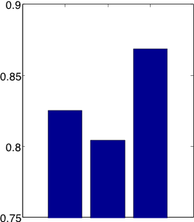
Results
AUC
Bird prediction task
> 5% improvement
Details:
SVM with RBF kernels
G = cycle
Grid search for C and γ
α = 2⁻⁸ (robust to many choices)
Pooled
Separate
Multitask
Notes:
Previous results: .8136 (pooled), ,8047 (individ

Slide 21
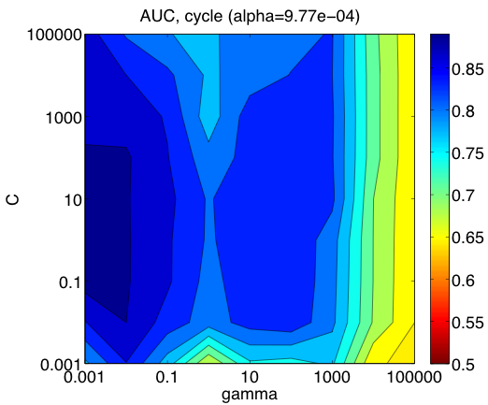
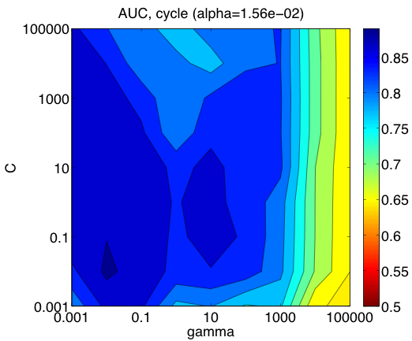
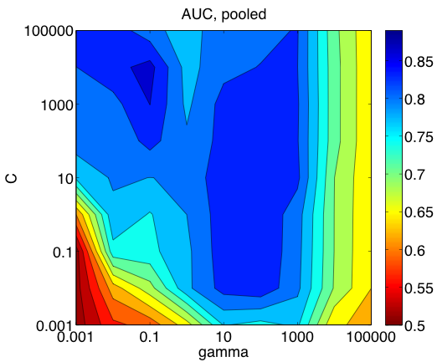
Sensitivity to C and gamma
Pooled
α = 2⁻¹⁰
α = 2⁻⁶

Slide 22
Extensions
Learn edge weights: detect periods of stability vs. change.
Applications:
Social networks
Bird problem: Spatial regions. Many species.
Faster training using graph structure.
Percent positive observations by month

Slide 23
Thanks!

