Slide 1
Partially Observed Maximum Entropy Discrimination Markov Networks
Jun Zhu
Dept. of Comp. Sci. & Tech., Tsinghua University
Machine Learning Dept., Carnegie Mellon University
Joint work with Eric P. Xing and Bo Zhang

Slide 2
Outline
Introduction
Structured Prediction
Max-margin Markov Networks
Max-Entropy Discrimination Markov Networks (MaxEnDNet)
Basic Theorems
Partially Observed MaxEnDNet
Experimental Results
Summary

Slide 3
Classification
Inputs:
a set of training samples , where
and
Outputs:
a predictive function :
Examples ( ):
Logistic Regression
Max-likelihood estimation
Support Vector Machine (SVM)
Max-margin learning

Slide 4
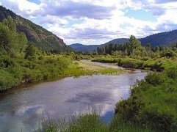
Structured Prediction
Inputs:
a set of training samples: , where
Examples:
Part-of-speech (POS) Tagging:
Image segmentation
Outputs:
a predictive function :
“Do you want fries with that?” -> <verb pron verb noun prep pron>

Slide 5
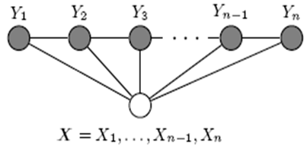
Structured Prediction Models
Conditional Random Fields (CRFs) (Lafferty et al., 2001)
Based on Logistic Regression
Max-likelihood estimation (point-estimate)
Max-margin Markov Networks (M³Ns) (Taskar et al., 2003)
Based on SVM
Max-margin learning ( point-estimate)
Markov properties are encoded in the feature functions

Slide 6
Between MLE and max-margin learning
Likelihood-based estimation
Probabilistic (joint/conditional likelihood model)
Easy to perform Bayesian learning, and consider prior knowledge, missing data
Max-margin learning
Non-probabilistic (concentrate on input-output mapping)
Not obvious how to perform Bayesian learning or consider prior, and missing data
Sound theoretical guarantee with limited samples
Maximum Entropy Discrimination (MED) (Jaakkola, et al., 1999)
A Bayesian learning approach
The optimization problem (binary classification)
Notes:
Basically, it performs Bayesian learning. It has a lot of nice propertities and subsumes SVM as a special case.

Slide 7
MaxEnt Discrimination Markov networks
MaxEnt Discrimination Markov Networks (MaxEnDNet):
Generalized maximum entropy or regularized KL-divergence
Subspace of distributions defined with expected margin constraints
Bayesian-style Prediction
Notes:
If we don’t have any data, we subjectively choose a prior p_0.

Slide 8
Solution to MaxEnDNet
Theorem 1 (Solution to MaxEnDNet):
Posterior Distribution:
Dual Optimization Problem:
Convex conjugate (closed proper convex )
Def:
Ex:

Slide 9
Reduction to M³Ns
Theorem 2 (Reduction of MaxEnDNet to M³Ns):
Assume
Posterior distribution:
Dual optimization:
Predictive rule:
Thus, MaxEnDNet subsumes M³Ns and admits all the merits of max-margin learning
Furthermore, MaxEnDNet has at least three advantages …

Slide 10
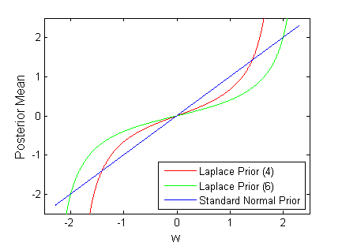
Three Advantages
PAC-Bayesian prediction error guarantee
Introduce regularization effects, such as sparsity bias
Laplace prior => Posterior shrinkage effects (Laplace M^3N, ICML’08)
An elegant approach to incorporate latent variables and structures
Partially observed MaxEnDNet

Slide 11
Motivating Example
Web data extraction
Goal: Name, Image, Price, Description, etc.
Given Data Record
{Head}
{Info Block}
{Tail}
Hierarchical model
Advantages:
Computational efficiency
Long-range dependency
Joint extraction
{Note}
{Repeat block}
{Note}
{image}
{name, price}
{image}
{name, price}
{name}
{price}
{desc}
{name}
{price}

Slide 12
Learn hierarchical model with latent variables
Can we learn a hierarchical model from partially labeled data?
Yes!
Partially observed CRFs for object recognition (NIPS’04)
Dynamic Hierarchical MRFs for web data extraction (ICML’07)
How about max-margin learning?
Yes!
Easy with MaxEnDNet

Slide 13
Partially observed MaxEnDNet
augmented with hidden variables
Def of PoMEN:
Prediction:

Slide 14
Alternating Minimization Alg.
Factorization assumption:
Alternating minimization:
Step 1: keep fixed, optimize over
Step 2: keep fixed, optimize over
Normal prior
M^3N problem (QP)
Laplace prior
Laplace M^3N problem (VB)
Equivalently reduced to a NLP with
a polynomial number of constraints

Slide 15
Experimental Results
Web data extraction:
Name, Image, Price, Description
Methods:
Hierarchical CRFs, Hierarchical M^3N
PoMEN, Partially observed HCRFs
Pages from 37 templates
Training: 185 (5/per template) pages, or 1585 data records
Testing: 370 (10/per template) pages, or 3391 data records
Record-level Evaluation
Leaf nodes are labeled
Page-level Evaluation
Supervision Level 1:
Leaf nodes and data record nodes are labeled
Supervision Level 2:
Level 1 + the nodes above data record nodes

Slide 16
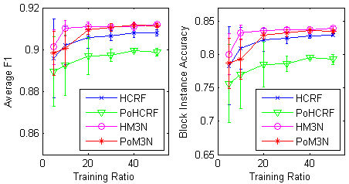
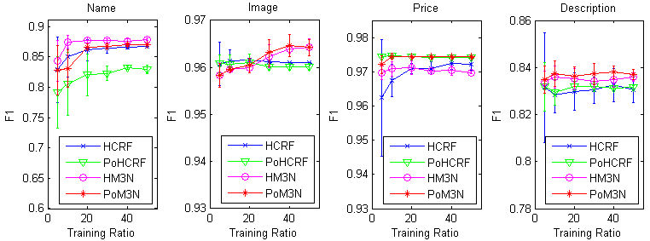
Record-Level Evaluations
Overall performance:
Avg F1:
avg F1 over all attributes
Block instance accuracy:
% of records whose Name, Image, and Price are correct
Attribute performance:

Slide 17
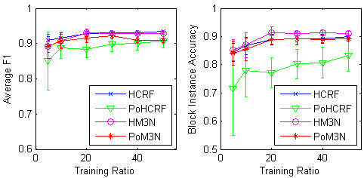
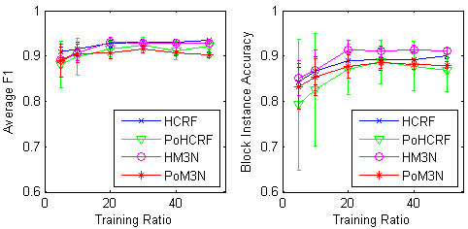
Page-Level Evaluations
Supervision Level 1:
Leaf nodes and data record nodes are labeled
Supervision Level 2:
Level 1 + the nodes above data record nodes

Slide 18
Summary
MaxEnt Discrimination Markov Networks (MaxEnDNet)
PAC-Bayesian performance guarantee
Sparsity regularization effects
Incorporating latent variables and structures
Experimental results show the advantages of max-margin learning over likelihood methods with latent variables

Slide 19
Margin-based Learning Paradigms

