Slide 1
Measuring the Similarity between Implicit Semantic Relations using Web Search Engines
Danushka Bollegala, Yutaka Matsuo, Mitsuru Ishizuka
Web Search and Data Mining (WSDM) Conference 2009
Barcelona, Spain.
Notes:
I am Danushka from the univ. of tokyo and I will be presenting the paper titled ….. This is a collaborative work with Yutaka Matsuo and Mitsuru Ishizuka who are also from the univ. of tokyo.

Slide 2
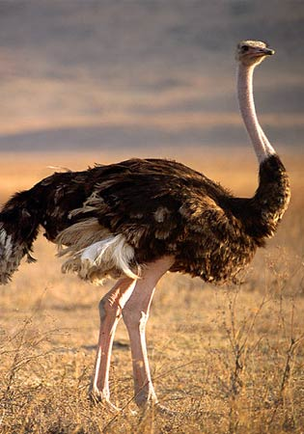
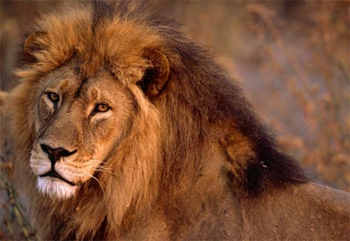
Attributional vs. Relational Similarity
Attributional Similarity:
Correspondence between attributes of two words/entities
e.g. automobile vs. car
Relational Similarity:
Correspondence between relations between word/entity pairs
e.g. (Ostrich, Bird) vs. (Lion, Cat)
X Is a large Y
(word, language) vs. (note, music)
Y is composed using X
Notes:
The goal of this work is to design a similarity measure. However, before we go deep, lets briefly think about various similarities that we encounter. Very broadly speaking, similarity can be categorized into two classes, attributional vs relational. Attributional similarity is the correspondance between attributes of two objects. For example, both car and automobile has tyres, wheels, used for the same purpose, which is to travel, so there is quite a high degree of attributional similarity between these terms. On the other hand we have relational similarity, which is the correspondence between relations that hold between words. For example, think of a lion and an ostrich. Obviously, they don’t have much attributes in common. However, if we think of the word-pairs ostrich to bird vs. lion to cat, then we see that the relation X is a large Y holds for both these word-pairs. In other words, ostrich is a large bird, whereas, lion is a large cat (in fact the largest in this case). Another example would be word to language as to note to music. In this case, languages are written using words whereas music is written using notes. Analogical word-pairs such as these show a high degree of relational similarity. The goal of our work is to create a relational similarity measure from the web.

Slide 3
Applications of Relational Similarity
Recognizing Analogies (Turney ACL 2006)
(traffic, road) vs. (water, pipe)
Recognizing Metaphors
All the world’s a stage, And all the men and women merely players; They have their exists and their entrances; (Shakespeare, As You Like it)
Relational Web Search (Caferella et al. WWW 2006)
Given a relation R, find entity-pairs (X,Y) that has R.
Example: query: (Google, You Tube)
Results: (Yahoo, Inktomi), (Microsoft, FAST), (Adobe Systems, Macromedia),…
X flows in Y
Notes:
Lets first quickly look at various applications that can potentially benefit from a relational similarity measure. In NLP community there has been considerable amount of work carried out to detect and extract analogies from a large text corpus. For example, word-analogies such as traffic to road vs. water to pipe is such an analogy where the relation X flows in Y holds between the two words in each word-pair. Going one step deeper, to recognize sentence level metaphors one could use a relational similarity measure. Here, men and women are metaphorically related to actors. Detecting such metaphors automatically is a challenging task. Another interesting application is relational web search, where you want to search for entity-pairs between which a given relation R holds. For example, you would search for two company names between which an acquisition relation hold and would expect the search engine to return all such company pairs. If you limit the relation to one of hypernumy, synonymy etc then you can list up words that are similar to a given word. In theory, one can define attributional similarity using relational similarity but not vice versa. Therefore, relational similarity is a more general concept than attributional similarity. If you know the relations that hold between words then it can help greatly when you do word sense disambiguation. For example, the ambiguous word plant can mean a tree or a factory. Popularly used contextual hypothesis will not help to disambiguate plant using the word food, because trees can be considered as food for animals at the same time food can be created at plants. However, if we know the relations for and at, then we can disambiguate the plant in these two cases.

Slide 4
Analogy making in AI
Structure Mapping Theory (SMT) (Genter, Cognitive Science ’83)
Analogy is a mapping of knowledge from one domain (the base) into another (the target) which conveys that a system of relations known to hold in the base also holds in the target.
Mapping rules: M:b_{i}→t_{i}
Attributes of objects are dropped
RED(b_{i}) RED(t_{i})
Certain relations between objects in the base are mapped to the target
REVOLVES(EARTH,SUN) → REVOLVES(ELECTRON,NEUCLEUS)
systematicity principle: base predicate that belongs to a mappable system of mutually constraining interconnected relations is more likely to be mapped to the target domain.
CAUSE[PUSH(b_{i},b_{j}), COLLIDE(b_{j},b_{k})] → CAUSE[PUSH(t_{i},t_{j}), COLLIDE(t_{j},t_{k})]
Notes:
In AI, much work into analogy creation and identification went in during 1980’s mainly due to the structure mapping theory proposed by Genter. The ability to identify analogies has seen as a central ability of being intelligent. In SMT, an analogy is defined as a mapping between two domains. SMT engine proposes an algorithm to find this mapping that operates over a knowledge base described using predicate logic. Attributes such as colors are dropped during the mapping process and only relations are mapped. Systematicity principle governs which relations are mapped. For example, an electron that revolves around a nucleus is considered to be analogous to planets revolving around sun in Rutherford’s theory. Here, the attributes of electrons or planets are not mapped. Only the factor that one revolves around another in both base and target domains is mapped during the process. However, one major drawback of SMT is that it requires knowledge to be presented in clean logical forms to operate, which we do not find on the natural language texts.

Slide 5
Measuring Relational Similarity between Entities
How to measure the similarity between relations?
E.g. (Google,YouTube) vs. (Microsoft, Powerset)
E.g. (Einstein, Physics) vs. (Gauss, Mathematics)
Problems that must be solved
How to explicitly state the relation between two entities?
How to extract the multiple relations between two entities?
Extract lexical patterns from contexts where the two entities co-occur
A single semantic relation can be expressed by multiple patterns.
E.g. “ACQUISITION”: X acquires Y, Y is bought by X
Cluster the semantically related lexical patterns into separate clusters.
Semantic Relations might not be independent.
E.g. IS-A and HAS. Ostrich is a bird, Ostrich has feathers
Measure the correlation between various semantic relations
Mahalanobis Distance vs. Euclidian Distance

Slide 6
Proposed Method
Retrieving Web snippets using a searching engine
Approximating the local context
Extracting lexical patterns from snippets
Explicitly stating the semantic relations
Clustering the extracted patterns
Identifying the semantically related patterns
Computing the inter-cluster correlation
Find the relatedness between clusters
Computing Mahalanobis distance
Measuring relational similarity as a non-Euclidean distance

Slide 7
Pattern Extraction
We use prefix-span, a sequential pattern mining algorithm, to extract patterns that describe various relations, from text snippets returned by a web search engine.
query = lion * * * * * * * cat
snippet =
patterns =
Prefix span algorithm is used to extract patterns:
Efficient
Considers gaps
Extracted patterns can be noisy:
misspellings, ungrammatical sentences, fragmented snippets
.. lion, a large heavy-built social cat of open rocky areas in Africa ..
X, a large Y / X a large Y / X a Y / X a large Y of
Notes:
We use seven asterisks to form a conjunctive query and retrieve snippets that contain the two words within a window of 7 words. We then replace the two words with variables X and Y and extract all subsequences that contain both X and Y. We use prefixspan algorithm to efficiently extract such subsequences as lexical patterns from snippets. For example from this snippet we extract patterns… However, not all extracted subsequences can be considered as good patterns because snippets usually contain misspellings as well as ill-formed and fragmented sentences.

Slide 8
Clustering the Lexical Patterns
We have ca. 150,000 patterns that occur more than twice in the corpus that express various semantic relations
However, a single semantic relation is expressed by more than one lexical patterns
How to identify the patterns that express a particular semantic relation?
Distributional Hypothesis (Harris 1957)
Patterns that are equally distributed among word-pairs are semantically similar
We can cluster the patterns according to their distribution in word-pairs
Pair-wise comparison is computationally expensive!!!

Slide 9
Distribution of patterns in word-pairs
Pattern | Pattern | Similarity
X buys Y | X acquires Y | 0.853133
X buys Y | Y ceo X | 0.000297
X buys Y | Y chief executive X | 0.000183
X acquires Y | Y ceo X | 0
X acquires Y | Y chief executive X | 0
Y ceo X | Y chief executive X | 0.969827

Slide 10
Greedy Sequential Clustering
Sort the patterns according to their total frequency in all word-pairs
Select the next pattern:
Measure the similarity between each of the existing clusters and the pattern
If the similarity with the most similar cluster is greater than a threshold θ, then add to that cluster, otherwise form a new cluster with this pattern.
Repeat until all patterns are clustered.
We view each cluster as a vector of word-pair frequencies and compute the cosine similarity between the centroid vector and the pattern.
Properties of the clustering algorithm
Scales linearly with the number of patterns O(n)
More general clusters are formed ahead of the more specific clusters
Only one parameter to be adjusted (clustering threshold θ)
No need to specify the number of clusters
Does not requite pair-wise comparisons, which are computationally costly
A greedy clustering algorithm

Slide 11
Computing Relational Similarity
The formed clusters might not be independent because,
Semantic relations can be mutually dependent
E.g. IS-A relation and HAS-A relation
The Greedy Sequential Clustering algorithm might split a semantic relation into multiple clusters
Euclidean distance cannot reflect the correlation between clusters
We use Mahalanobis distance to measure the relational similarity.
Mahalanobis distance between two vectors x and y is defined by, where A is the covariance matrix.
In this work, we set A to the inter-cluster correlation matrix
(x-y)^{t} A⁻¹ (x-y)

Slide 12
Experiments
Dataset
We created a dataset that has 100 entity-pairs covering five relation types. (20X5 = 100)
ACQUIRER-ACQUIREE (e.g. [Google, YouTube])
PERSON-BIRTHPLACE (e.g. [Charlie Chaplin, London])
CEO-COMPANY (e.g. [Eric Schmidt, Google])
COMPANY-HEADQUARTERS (e.g. [Microsoft, Redmond])
PERSON-FIELD (e.g. [Einstein, Physics])
ca. 100,000 snippets are downloaded for each relation type

Slide 13
Relation Classification
We use the proposed relational similarity measure to classify entity-pairs according to the semantic relations between them.
We use k-nearest neighbor classification (k=10)
Evaluation measures

Slide 14
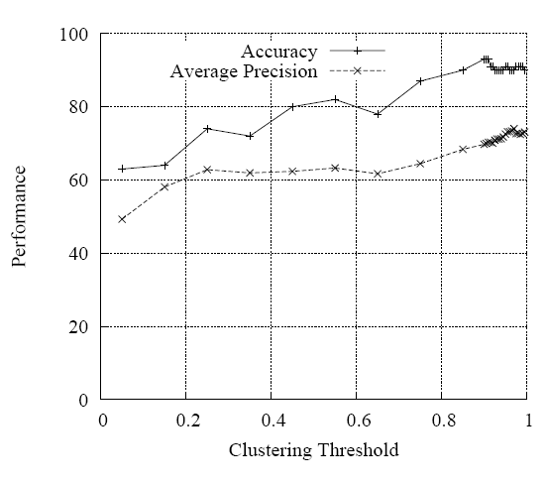
Classification Performance

Slide 15
Pattern Clusters
Comparison with baselines and previous work
VSM: Vector Space Model (cosine similarity between pattern frequency vectors)
LRA: Latent Relational Analysis (Turney ‘06 ACL, Based on LSA)
EUC: Inner Product (Euclidean distance between cluster vectors)
PROP: Mahalanobis distance between entity-pairs (PROPOSED METHOD)

Slide 16
Results - Average Precision
Relation | VSM | LRA | EUC | PROP
ACQUIRER-ACQUIREE | 92.7 | 92.24 | 91.47 | 94.15
COMPANY-HEADQARTERS | 84.55 | 82.54 | 79.86 | 86.53
PERSON-FIELD | 44.70 | 43.96 | 51.95 | 57.15
CEO-COMPANY | 95.82 | 96.12 | 90.58 | 95.78
PERSON-BIRTHPLACE | 27.47 | 27.95 | 33.43 | 36.48
OVERALL | 68.96 | 68.56 | 69.46 | 74.03

Slide 17
Conclusions
Distributional similarity is useful to identify semantically similar lexical patterns
Clustering lexical patterns prior to measuring similarity improves performance
Greedy sequential clustering algorithm efficiently produces pattern clusters for common semantic relations
Mahalanobis distance outperforms Euclidean distance when measuring similarity between semantic relations

Slide 18
Thank You
Contact: Danushka Bollegala
danushka@mi.ci.i.u-tokyo.ac.jp
http://www.miv.t.u-tokyo.ac.jp/danushka
The University of Tokyo, Japan.

