Slide 1
Finding Text Reuse on the Web
Center for Intelligent Information Retrieval,
University of Massachusetts, Amherst
Michael Bendersky, W. Bruce Croft
WSDM 2009, Barcelona, Spain

Slide 2
Outline
Finding Text Reuse on the Web
Ranking Text Reuse Instances
Building an event timeline
Building an event link graph
Correlations between text reuse representations

Slide 3
What is Text Reuse?
Includes a large scope of text transformations
Addition/Deletion of original text parts
Reformulations
Partial Rewrites
Applications
Plagiarism detection
Information analysis for corporate and intelligence applications
“Fact-checker” for Web users
Similarity Spectrum
Using Web Search Engines to find documents containing Text Reuse
Detecting Text Reuse Statements

Slide 4
Text Reuse on the Web
So far techniques for text reuse were tested on relatively homogeneous collections
Newswire collections (Clough et al.‘02, Metzler et. al ’05)
Blogs (Seo and Croft ‘08)
Our goal is to detect text reuse on the web
Quality of content varies
Sources vary: electronic newspapers, blogs, Wikipedia…
Too big to pre-process

Slide 5
Similarity Spectrum
Near Duplicates
Text Reuse
Topical Similarity

Slide 6
Example
The North Korean government has vehemently denied any hand in counterfeiting and has vowed to resist pressure from the US over the matter
Late in the week, the North Korean government vehemently denied any hand in counterfeiting and vowed to resist pressure from the US over the matter
Near Duplicates
Text Reuse
Topical Similarity

Slide 7
Example
The North Korean government has vehemently denied any hand in counterfeiting and has vowed to resist pressure from the US over the matter
North Korea has been using all the immunities and technical abilities that “only governments have” to counterfeit United States currency, Mr. Asher said
Near Duplicates
Text Reuse
Topical Similarity

Slide 8
Example
The North Korean government has vehemently denied any hand in counterfeiting and has vowed to resist pressure from the US over the matter
Near Duplicates
Text Reuse
Topical Similarity
In one commentary carried by the state-run Korean Central News Agency on Saturday, The Associated Press reported, Pyongyang declared that it “does not allow such things as bad treatment of the people, counterfeiting and drug trafficking”

Slide 9
Related Work
Duplicate Documents
(Brin et al. ‘95, Broder et al. 97,
Henzinger ‘06)
Duplicate Text Fragments
(Bernstein & Zobel, ’04,
Fetterly et al. ’05, Kolak & Schilit ‘08)
Sentence/Passage Retrieval
(Murdoch & Croft, ‘05 Balasubramanian et al. ’07)
Near Duplicates
Text Reuse
Topical Similarity
Reuse Detection in News
(Clough et al. ‘02, Metzler et. al ’05)
Reuse Detection in Blogs
(Seo and Croft, ‘08)

Slide 10
What we often have

Slide 11
Jordanian security officials on Sunday announced the arrest of an Iraqi woman … a fourth bomber in the Amman hotel attacks and they broadcast a taped confession showing her wearing a translucent suicide explosive belt …
AMMAN, Jordan, Nov. 13 -- She twirled, almost like a model showing off the latest fashion, her waist a thick belt of translucent tape with crude red wires attached
http://www.washingtonpost.com/
Looking nervous and wringing her hands, Sajida Mubarak Atrous al-Rishawi, 35, described how she failed to blow herself up during a wedding reception at the Radisson SAS hotel on Wednesday night…
http://www.santafenewmexican.com/news/
Al-Rishawi, 35, from the Anbar provincial capital of Ramadi and the sister of al-Qaeda in Iraq leader Abu Musab al-Zarqawi's slain lieutenant … was arrested Sunday.
http://www.usatoday.com/news/world/
What we want

Slide 12
Finding Text Reuse on the Web
Document Retrieval
Sentence Segmentation
Ranked List
Sentence Retrieval
Presentation
Timeline
Link Graph

Slide 13
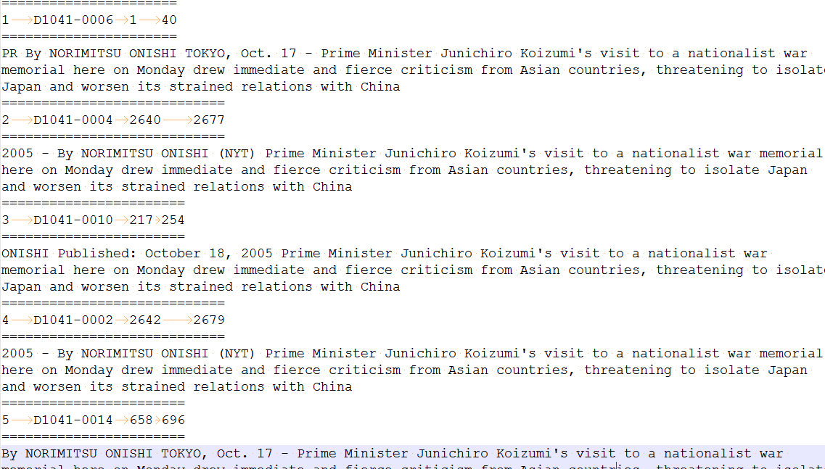
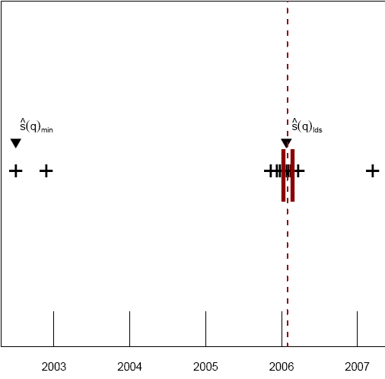
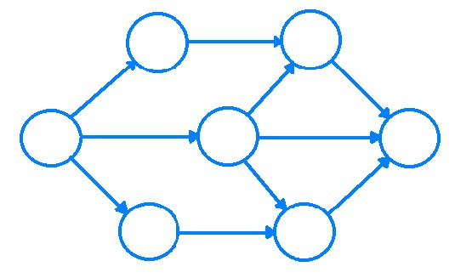
Presentation Modules: Ranked List
Initial Document Retrieval
Sentence Retrieval
Experimental Results
Ranked List
Presentation
Timeline
Link Graph

Slide 14
Some notation
T – set of dated topical or factual statements
Related to a news topic
Sentence or paragraph long
D – set of retrieved documents
E.g., using web search API
R – ranked list of sentences from D
Candidates for containing text reuse

Slide 15
Initial Document Retrieval
Use a public web search API
(http://developer.yahoo.com/search/)
Allows to examine the utility of text reuse in a real-world scenario
We can either
Issue statements from T as unquoted queries
May result in a query drift
Issue statements from T as quoted queries
Only allows exact matches – not flexible enough
In either case, maximum of 100 results per query is allowed

Slide 16
Iterative Chunking
A process to increase the size of D by gradual query relaxation
Extract “chunks” (noun phrases, named entities)
Weigh chunks by # retrieved results
Sort chunks by decreasing weight
To increase coverage, remove the lowest weighted chunk
Iterate

Slide 17
“The Senate confirmed Roberts as Chief Justice in late September”
D
Concept extraction and weighting
Concepts | “Senate” | “Roberts” | “Chief Justice” | “late September”
Weights | 368,000,000 | 234,000,000 | 26,300,000 | 8,670,000
“Senate” + “Roberts” + “Chief Justice” + “late September”
D
“Senate” + “Roberts” + “Chief Justice”
D
“Senate” + “Roberts”
D

Slide 18
Sentence Segmentation
Strip the non-content parts of the documents
javascript
anchor text
html markup
Applying MX Terminator (Reynar and Ratnaparkhi, 1997)
Standard max-entropy sentence segmentation tool
Trained on news corpora
Threshold the maximum sentence length
Wait, isn’t the web noisy?
ads, page menus, boilerplate text
In practice, segmentation errors did not have a significant impact on retrieval performance

Slide 19
Sentence Retrieval
Two standard bag-of-words models work well in practice
Query Likelihood
Mixture Model

Slide 20
Setup
T - 50 query statements
D – ~400 documents per query, after iterative chunking process.
Document-Level Retrieval
Scored a document by the number of chunked queries that retrieved the document
10 top retrieved documents are judged per query/method
Sentence-Level Retrieval
Can we do better than document-level retrieval?
10 top retrieved sentences are judged per query/method

Slide 21
Iterative Chunking
 | Document – Level Retrieval
Rel. Grade | Category | Unquoted Query | Iterative Chunking
3 | (Near) Duplicates | 29% | 19%
2 | Text Reuse | 39% | 42%
1 | Topical Similarity | 15% | 19%
0 | Non-Relevant | 17% | 29%
 | Total Judged | 373 | 500
 | NDCG@10 | 0.441 | 0.464

Slide 22
Sentence Retrieval
 | Document – Level (Baseline) |  | Sentence – Level
Rel. Grade | Category | Iterative Chunking | Query Likelihood |  | Mixture Model | Δ over baseline
3 | (Near) Duplicates | 19% | 31% |  | 30% | +11%
2 | Text Reuse | 42% | 54% |  | 58% | +16%
1 | Topical Similarity | 19% | 13% |  | 10% | - 9%
0 | Non-Relevant | 29% | 2% |  | 2% | -27%
 | Total Judged | 373 | 500 | 500
 | NDCG@10 | 0.464 | 0.629* | 0.633* |  | +17%

Slide 23
Presentation Modules: Timeline
Timeline Construction
Source Date Detection
Date Assignment Policies
Ranked List
Presentation
Timeline
Link Graph

Slide 24
Sometimes a ranked list is not enough

Slide 25
Constructing a Timeline
Timeline visualization are valuable for tracking information and event flow
Time “landmarks” help event recollection (Ringel et al. ‘03)
Allow to detect the “original story” (Metzler et al. ’05)
Allow to follow the story development
(Swan & Jensen ‘00; Mei & Zhai ‘05)
Allow to easily detect outliers

Slide 26
Constructing a Timeline [Cont.]
Constructing a timeline can be straightforward if
Precision and Recall of Event Detection is 100%
Each event can be assigned an exact date
Neither hold in a realistic web setting
Web page dating is unreliable
E.g., Last-Modified header
Events and web page date often do not correspond

Slide 27
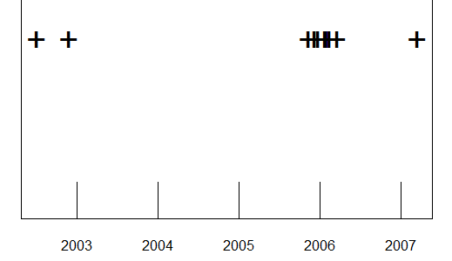
Source Date Detection
Given a set of dated statements R on a timeline
Earliest Date
Longest Dense Sequence

Slide 28
Date Assignment
What if the statements in R are not dated?
Last-Modified Header
Use the HTTP header of the page
Earliest-in-Context
The earliest date appearing in the document
Closest-in-Context
The closest date in the document to the statement

Slide 29
Evaluation
Measure the estimation error (in days)
How does Err vary as a function of
Size of R
Estimator type
Date assignment policy

Slide 30
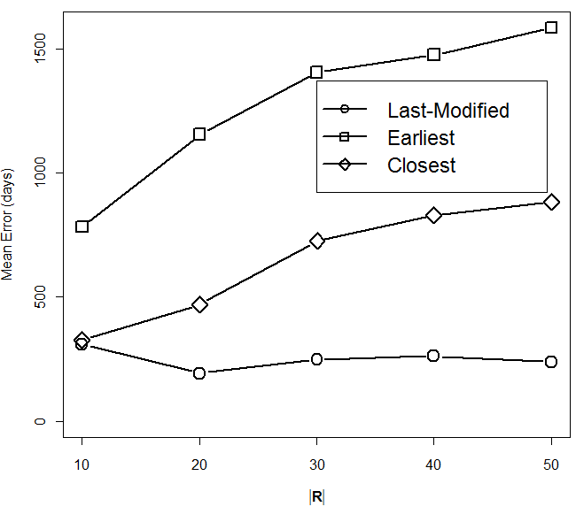
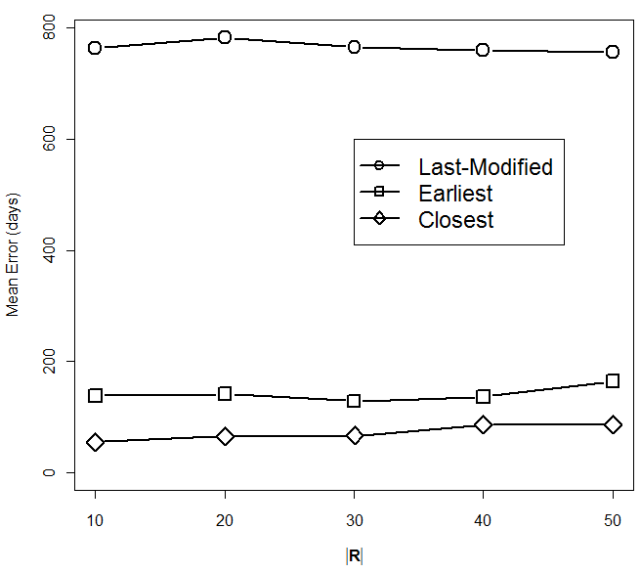

Slide 31
Best Parameter Settings
Parameters | Mean | Median | σ
MIN/Last-Modified |R| = 20 | 192.7 | 46.5 | 265.7
LDS/Earliest-in-Context |R| = 30 | 127.7 | 9.0 | 349.3
LDS/Closest-in-Context |R| = 10 | 54.1 | 5.5 | 125.2

Slide 32
Presentation Modules: Link Graph
Link Graph Construction
Hub & Authority Domains
Ranked List
Presentation
Timeline
Link Graph

Slide 33
HITs Paradigm for Text Reuse
Link graph shows explicit connections between text reuse sources
In a traditional setting, all information sources can be equally trusted
This assumption no longer holds on the web
We’ll leverage the link graph structure to determine
Authorities - contain complete and reliable information
Hubs - quote reliable sources

Slide 34
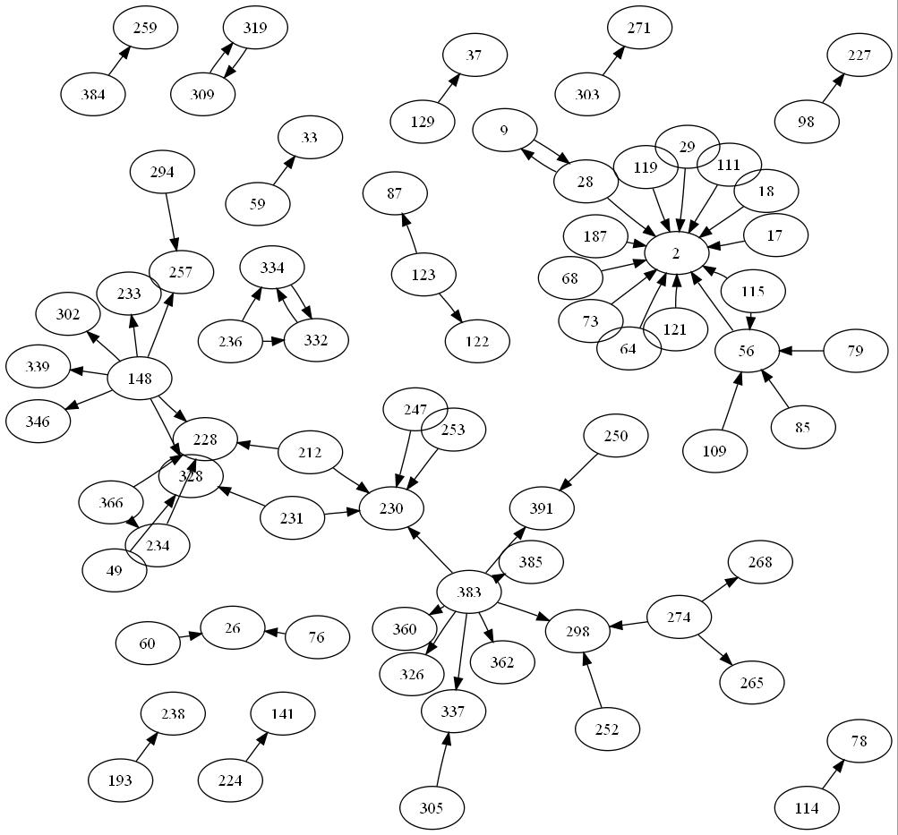
whitehouse.gov
“President Discusses Hurricane Relief in Address to the Nation”
Buzzflash.com
“Tired Of Being Lied To? Modern History You Can't Afford to Ignore”
A
H
President Bush has spoken of creating greater federal authority during natural disasters

Slide 35
Most Frequent Authority and Hub Domains
Rank | Authorities | Hubs
1 | en.wikipedia.org | nytimes.com
2 | cnn.com | answers.com
3 | washingtonpost.com | news.bbc.co.uk
4 | nytimes.com | washingtonpost.com
5 | news.bbc.co.uk | pbs.org
6 | whitehouse.gov | sourcewatch.org
7 | usatoday.com | usatoday.com
8 | cbsnews.com | salon.com
…
18 | time.com | globalpolicy.org
19 | boston.com | news.yahoo.com
20 | un.org | america.gov

Slide 36
Presentation Modules: Correlations
Ranked List
Presentation
Timeline
Link Graph

Slide 37
Query Performance Prediction
How do different presentation modules correlate?
Can we leverage this correlation?
For example, to detect poorly performing queries?

Slide 38
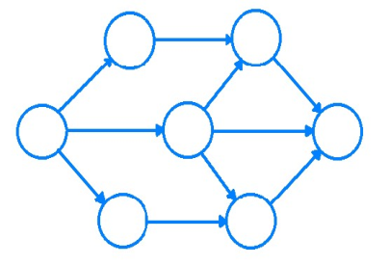
Query Performance Prediction [Cont.]
Hypothesis I
Hypothesis II
It is hard to detect source dates for poorly performing queries
Results for poorly performing queries will have sparse link graphs

Slide 39
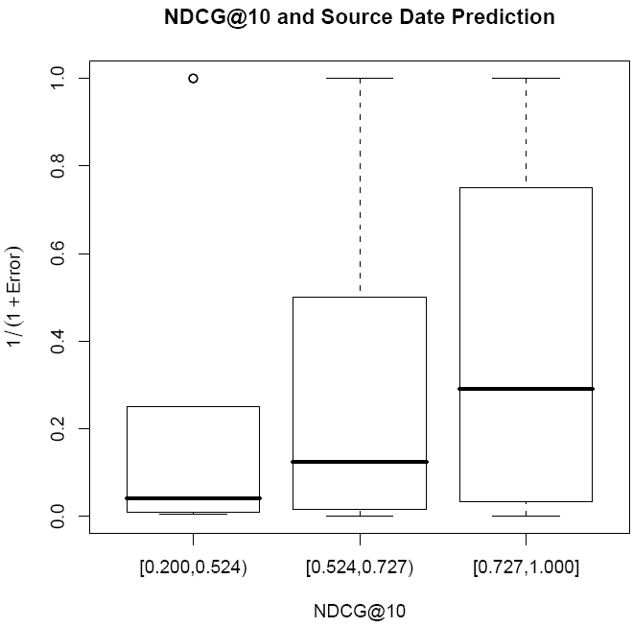
Hypothesis I
“It is hard to detect source dates for poorly performing queries”
Poorly Performing Queries
Topical Similarities and Text Reuse Found

Slide 40
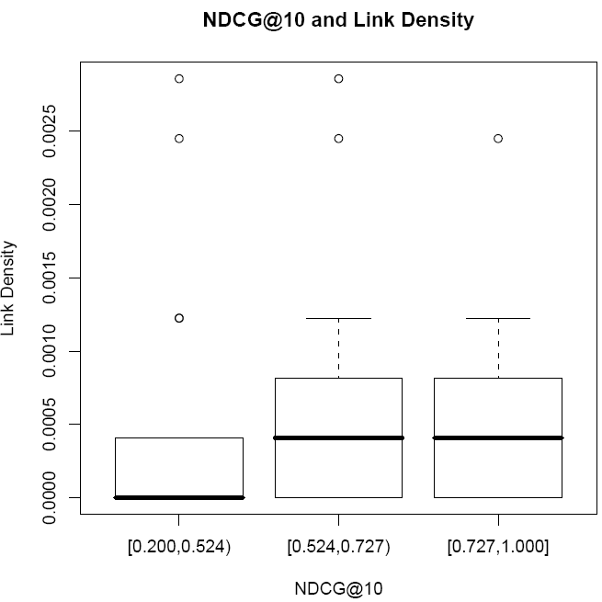
Hypothesis II
“Results for poorly performing queries will have sparse link graphs”
Poorly Performing Queries
Topical Similarities and Text Reuse Found

Slide 41
Conclusions
We investigated how feasible it is to find text reuse on the web
The results are encouraging
Simple sentence retrieval techniques work reasonably well, given a sufficient initial pool of retrieved documents.
Properties of the web allow to investigate other form of results presentation such as timeline or link graph
Different presentations tend to be correlated

Slide 42
Future Work
Build a prototype text reuse detection system for the web
Conduct more user studies
More experiments with current/new presentation modules

Slide 43
Thank You!

