Slide 1
Mining User Web Search Activity with Layered Bayesian Networks or How to Capture a Click in its Context
B. Piwowarski¹, G. Dupret², R. Jones²
¹ University of Glasgow, UK (work done while in Yahoo!)
² Yahoo! Labs

Slide 2
Web search logs
A lot of a simple information:
Time stamp
Temporary user id
Query
Clicked URLs
A (non) click is an implicit feedback
Most of the time, this information is exploited at a click level

Slide 3
Motivations
Many queries occur once or twice:
Within a 2 months log, 73% of distinct queries (30% of the total query volume), were issued a single time
How can we benefit from that data?
User click models should take into account the context surrounding any user action in order to interpret them

Slide 4
Query chains, logical sessions, sessions, …
It is a set of user actions related to a single query intent
Sessions are high level goals amenable to:
Measure user satisfaction
Provide a wide enough context to interpret a click
Build query recommendation systems
… but sessions are complex objects
This work is an attempt to build a model at a chain level

Slide 5
Outline

Slide 6
I. Building query chains
From single events to chains

Slide 7
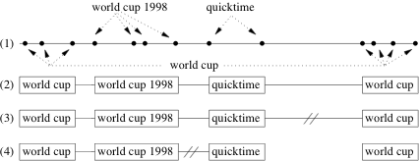
Overall process
Grouping atomic sessions
Time threshold
Similarity threshold

Slide 8
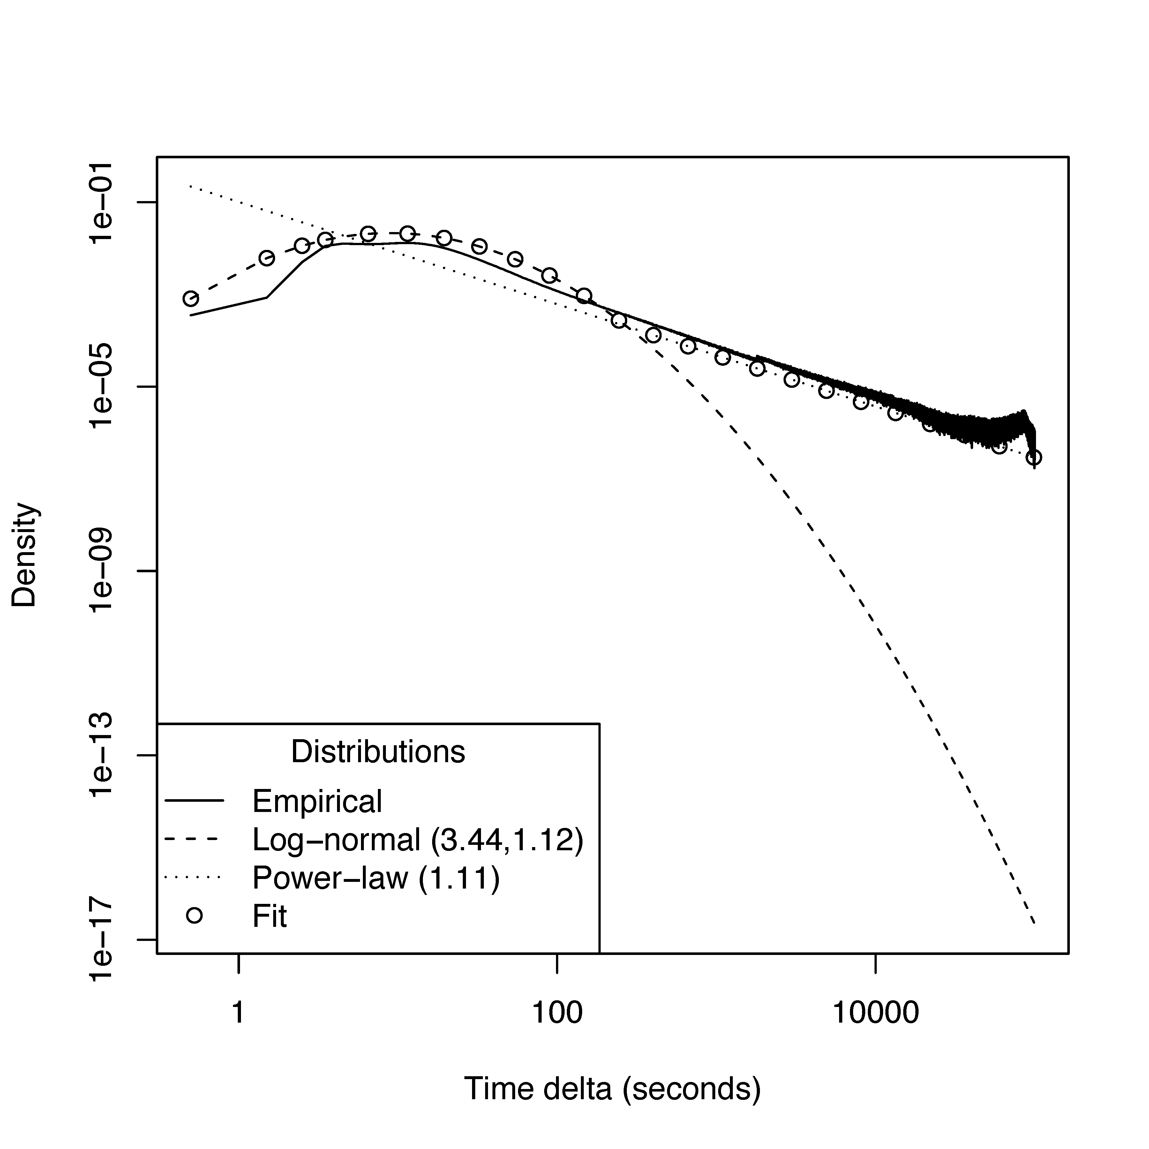
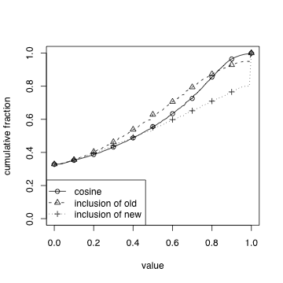
Thresholds
Kept in same chain
Kept in same chain
Time difference
Similarity threshold

Slide 9
Query chains: (some) other approaches
Heuristics:
Time delta of 5… to 120 minutes
Machine learning approaches [1,2], with features:
Time delta between two interactions
Added and/or deleted terms
Clicked document content [3]
Optimisation problem [4]
[1] S. Ozmutlu. Automatic new topic identification using multiple linear regression. IPM 42(4)
[2] R. Jones and K. Klinkner. Beyond the session timeout: Automatic hierarchical segmentation of search topics in query log (CIKM 2008)
[3] X. Shen et al. Implicit user modeling for personalized search (CIKM 2005)
[4] P. Boldi et al. The Query-ﬂow Graph: Model and Applications (CIKM 2008)

Slide 10
II. A model for query chains
A Bayesian Network approach

Slide 11
A model for chains
[1] “Test - Operate - Test - Exit” framework (Miller, 1960)

Slide 12
A model for chains
Chains exhibit a structure (chain, query, page, click) which is both natural and constrained
The model should explain what we observe (# of searches, time, relevance, etc.) in the logs
The model should use latent variables as we want:
To gain insight into the user behaviour
To do cluster subset of user actions
Related works:
Search trails [1]
Next user action [2]
Click models [3, 4]
[1] R. W. White and S. M. Drucker. Investigating behavioral variability in web search. WWW 2007.
[2] Downey et al. Models of Searching and Browsing: Languages, Studies, and Application (IJCAI 2007)
[3] Dupret and Piwowarski (SIGIR 2008)
[4] Guo et al. Efficient Multiple-Clicks Models in Web Search (WSDM 2009)

Slide 13
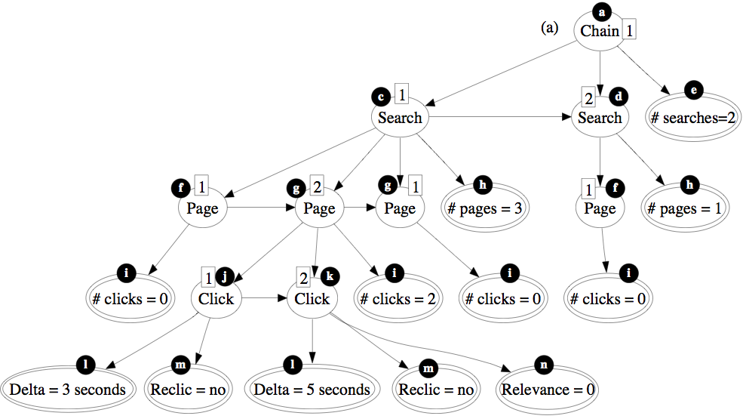
Layered Bayesian Network

Slide 14
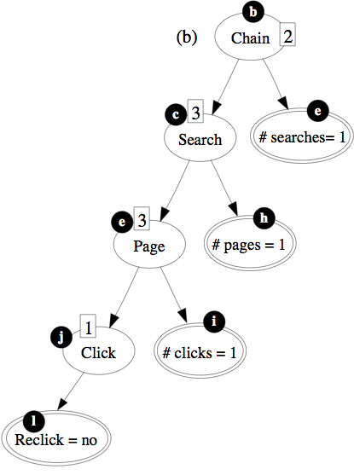
Layered Bayesian Network

Slide 15
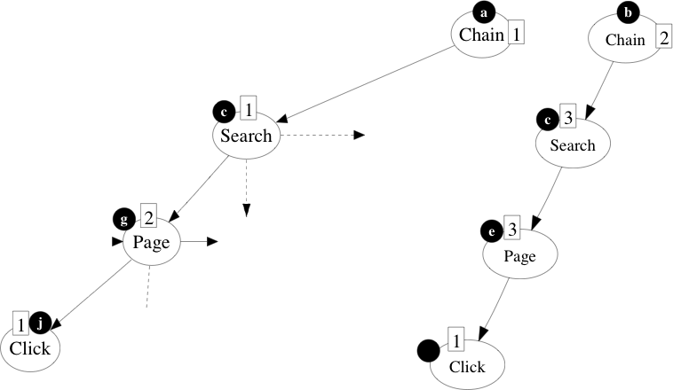
Layered Bayesian Network

Slide 16
Parameters
Chain
is chain-specific

Slide 17
Parameters
Chain
Search
Search
(Same for page level & click level)

Slide 18
Parameters
Search
Delta=Δ

Slide 19
The model
Learnt with the EM algorithm (19M of UK chains with editorial judgments)
Various configuration (# of states for chain, search, page and action): 5-5-5-5, 10-10-10-10, 5-5-5-20
500 EM iterations (likelihood is stabilized for those values, but more tests are needed)

Slide 20
The model: analysis
It is possible to compute expected values of certain quantities given a state, e.g.
One different search type: 7 to 11 clicks (compared to 1) and 4 to 7 pages (compared to 1), 600 seconds time span (compared to the range 40-90)
Query length (which is not an input variable)
Constant for a chain (around 2.1 )
2.1 to 3.1 for search states
Time ranges from 71 to 187 seconds for Chain states which is of interest since all the other values remain approximately stable

Slide 21
III. Validating the model
Prediction of relevance

Slide 22
Predicting relevance
Most models attempt at estimating:
Document attractiveness [3]
Document attractiveness preferences [2]
Relevance with logistic regression [1]
All these methods need more than one instance of one query
Estimating non relevance is hard when considering clicked documents:
UK Data (3% of “judged” clicks in our sample are not relevant, 34% when aggregated)
[1] B. Carterette and R. Jones. Evaluating search engines by modeling the relationship between relevance and clicks. In NIPS 2007.
[2] F. Radlinski and T. Joachims. Query chains: learning to rank from implicit feedback. ACM SIGKDD 2005.
[3] G. Dupret and B. Piwowarski. User behavior and search engine query logs: a generative model to predict clickthrough rate. SIGIR 2008.

Slide 23
The BN gives the context of a click
Chain
Probability (Chain state=… / observations) = (0.2, 0.4, 0.01, 0.39, 0)
Search
Probability (Search state=… / observations) = (0.1, 0.42, …)
Page
Probability (Page state=… / observations) = (0.25, 0.2, …)
Click
Probability (Click state=… / observations) = (0.02, 0.5, …)
Relevance
Probability ([not] Relevant / observations) = (0.4, 0.5)

Slide 24
Features for one click
For each clicked document, we compute a set of features:
(BN) Chain/Page/Action/Relevance state distribution
(BN) Maximum likelihood configuration, likelihood
Word confidence values (averaged for the query)
Time and position related features
This is associated with a relevance judgment from an editor and used for learning
Notes:
Ambiguity (not last): term belongs to a search followed by another
Usefulness (last_empty)
Misspell (max. of occurrence of another term)

Slide 25
Learning with Gradient Boosted Trees
We use a Machine Learning approach to predict relevance, Gradient boosted trees (Friedman 2001), with a tree depth of 4 (8 for non BN-based model)
We used each time disjoint train (BN + GBT training) and test sets
We have two sets of sessions S1 and S2 (20 million chains) and two set of queries + relevance judgment J1 and J2 (around 3600 queries, but 1000 queries only found in the logs)
Process (repeated 4 times), e.g.
learn the BN parameters on S1+J1,
extract the BN features and learn the GBT with S1+J1
Extract the BN features and predict relevance assessments of J2 with sessions of S2

Slide 26
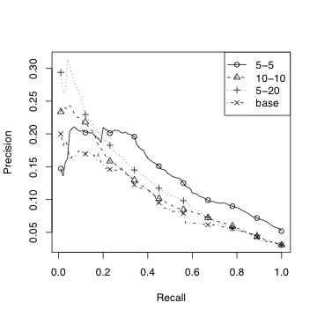
Results

Slide 27
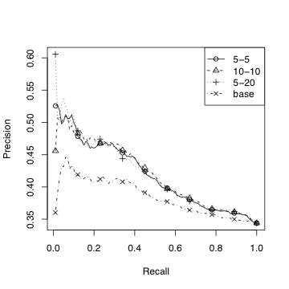
Results (aggregated)

Slide 28
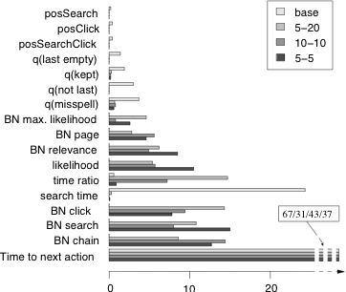
Results (feature importance)

Slide 29
Conclusions
Key points:
Extend the click information with a representation of the context in which this click happen
This context is useful in deciding whether the document clicked was relevant to the user
There is a lot of room for improvement
Applications:
Document relevance
User satisfaction
Query sampling (knowing user satisfaction, try to find classes of «difficult» of queries)
Unsolved issues:
Documents that are “seen” but not clicked
Limits of the evaluation (editorial judgements vs subjective relevance, bias of the query set)

