Slide 1
WSCD09
Workshop on Web
Search Click Data 2009
Survey and evaluation of query intent detection methods
David J. Brenes, Daniel Gayo Avello, Kilian Pérez-González
Notes:
http://www.flickr.com/photos/bcnbits/468186933/

Slide 2
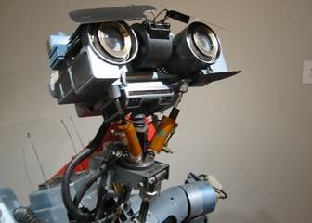

Slide 3
phenoxyphenyl
entertainment tonight
jewish christmas
mortgage calculator
eoc phi
famington, new mexico
"oneida indian nation"
"oneida, ny" and "employment"
sim city 4 cheats
benihana of novi
total body kc
ferenc molnar
cucumber shampoo molton brown
who likes grinding in wow?
solitude utah ski
nick nilsson training in orlando
homunculi tattoo
"robert louis stevenson"+quotes
ww ii military installations south carolina
bogen 3016
sch 1830v samsung
www.brookdaleliving.com
air temperature gauge
old calvary church
steelers playoff game

Slide 4
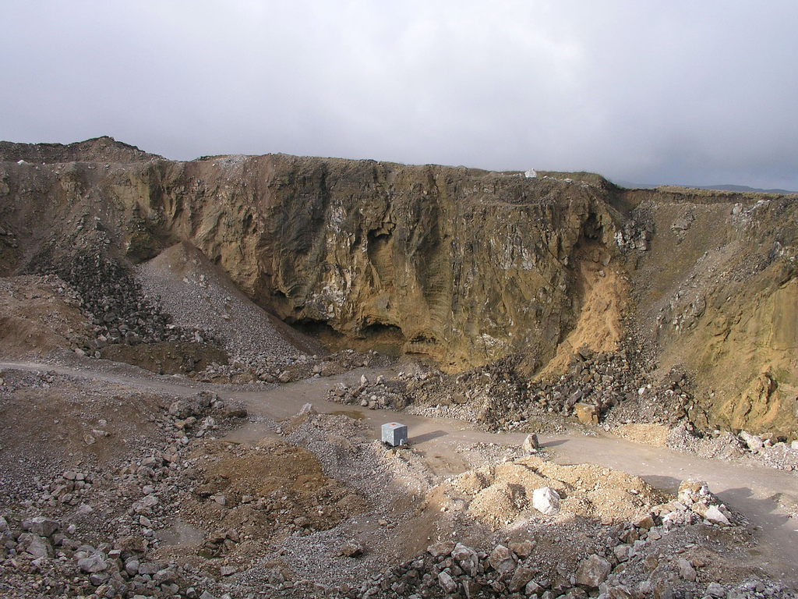
Notes:
http://www.flickr.com/photos/earthwatcher/528601379/

Slide 5
a query log (pretty raw, huh?)
one query (still raw)
Notes:
http://www.flickr.com/photos/earthwatcher/528601379/

Slide 6
Notes:
http://www.flickr.com/photos/nidriel/210680853
http://www.flickr.com/photos/kankan/53973269/
http://www.flickr.com/photos/paranoide0/123300127/
http://www.flickr.com/photos/barjack/183619841/

Slide 7
apple
Notes:
http://www.flickr.com/photos/nidriel/210680853
http://www.flickr.com/photos/kankan/53973269/
http://www.flickr.com/photos/paranoide0/123300127/
http://www.flickr.com/photos/barjack/183619841/

Slide 8
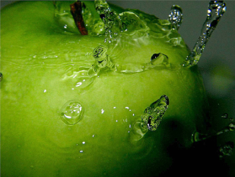
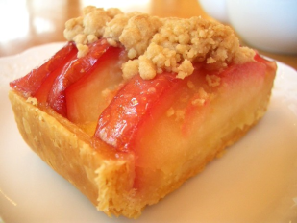
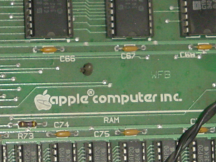
apple
Notes:
http://www.flickr.com/photos/nidriel/210680853
http://www.flickr.com/photos/kankan/53973269/
http://www.flickr.com/photos/paranoide0/123300127/
http://www.flickr.com/photos/barjack/183619841/

Slide 9
reading the user’s mind. i.e. inferring query intent.
Notes:
http://www.flickr.com/photos/remolinos/2885859004/

Slide 10
Intent is just one of the queries dimensions.

Slide 11
st. thomas bed and breakfast

Slide 12
intent (transactional?)
st. thomas bed and breakfast

Slide 13
intent (transactional?)
st. thomas bed and breakfast
topic (shopping/travel/lodging?)

Slide 14
intent (transactional?)
st. thomas bed and breakfast
topic (shopping/travel/lodging?)
geographical location (Virgin Islands?)

Slide 15
Intent is just one of the queries dimensions.
query topic
geographical location
commercial/product/job seeking
...
human vs ‘robot’ queries

Slide 16
KDD Cup 2005 LogCLEF 2009
WSCD’09

Slide 17
query topic classification
KDD Cup 2005 LogCLEF 2009
WSCD’09
log analysis and geographic query identification
user goals humans vs robots topic analysis of queries etc.

Slide 18
However…
Topic and Intent are the classical ones
and we are mainly interested in query intent detection.

Slide 19
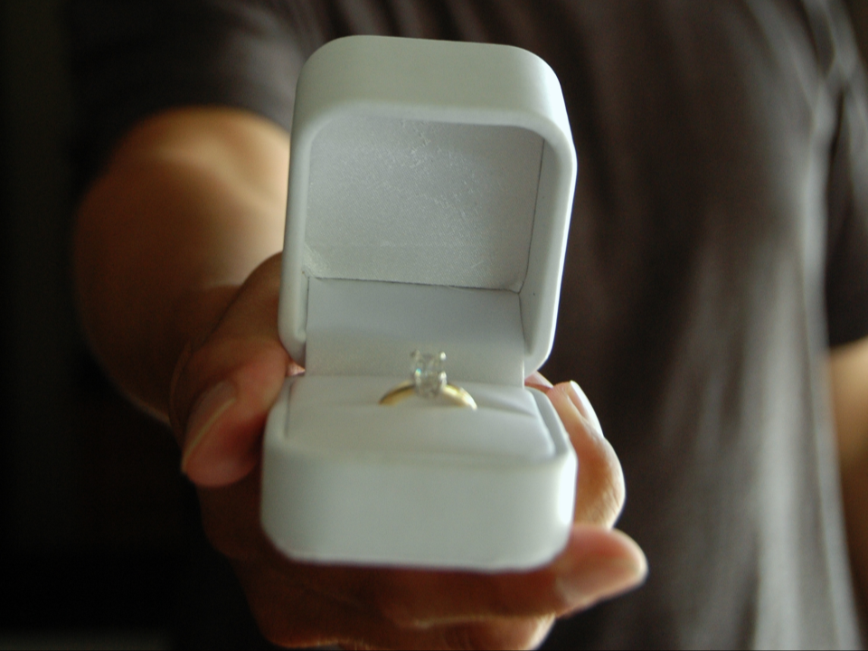
Our proposal for the WSCD’09
Notes:
http://www.flickr.com/photos/billselak/728806350/

Slide 20
“To replicate most of the techniques to perform automatic query intent detection in addition to study the feasibility of a pooling strategy à-la-TREC to evaluate the different techniques.”
“We hope to anticipate some of the benefits and difficulties from a hypothetical bakeoff on broad query classification.”
Notes:
http://www.flickr.com/photos/billselak/728806350/

Slide 21
Query intent
Informational. The intent is to acquire some information assumed to be present on one or more web pages.
Navigational. The immediate intent is to reach a particular site.
Transactional. The intent is to perform some web-mediated activity.
Andrei Z. Broder
Notes:
http://flickr.com/photos/sigir2007/879635810/

Slide 22
Query intent
Informational. The intent is to acquire some information assumed to be present on one or more web pages.
Navigational. The immediate intent is to reach a particular site.
Transactional. The intent is to perform some web-mediated activity.
difficult to distinguish...
Andrei Z. Broder
Notes:
http://flickr.com/photos/sigir2007/879635810/

Slide 23
Query intent
Navigational Transactional
Informational
symptoms separation anxiety dogs
should snow dogs wear booties
what is addison's diseases for dogs
yellowpages
the huns yellow pages.com

Slide 24
Query intent
Navigational Transactional
Informational
symptoms separation anxiety dogs
should snow dogs wear booties
what is addison's diseases for dogs
yellowpages
the huns yellow pages.com
find the ‘right’ website
find the ‘right’ answer
telling apart informational from navigational/transactional queries matters.

Slide 25
Query intent detection methods replicated
Lee et al. 2005, click-through data + document collection, ad hoc thresholds
Liu et al. 2006, click-through data, ad hoc evidences
Jansen et al. 2008, rule-based
Brenes and Gayo 2008, click-through data, ad hoc evidences
these were just the evaluated methods.
those requiring training and/or external corpora were left for future research.

Slide 26
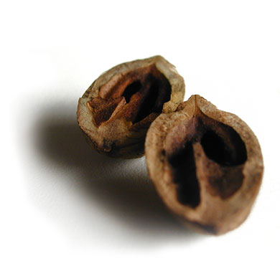
Query intent detection methods replicated
Lee et al. 2005
Click distribution (from clickthrough-data) and anchor-link distribution (from document collection)
Flat distributions ➔ informational queries
Skewed distributions ➔ navigational/transactional
Additionally, average number of clicks per query
Notes:
http://www.flickr.com/photos/twinsparc/8653608/

Slide 27
Query intent detection methods replicated
Liu et al. 2006
n Clicks Satisfied (nCS) number of sessions where the user clicked, at most, n results (n=2)
top n Results Satisfied (nRS) number of sessions where the user clicked, at most, the top n results (n=5)
Additionally, click distribution (Lee et al. 2005)
Notes:
http://www.flickr.com/photos/twinsparc/8653608/

Slide 28
Query intent detection methods replicated
Jansen et al. 2008
Navigational queries:
Contain names of companies, businesses, organizations or people
Contain domain suffixes
They have less than three terms
Most of the data obtained from Freebase http://www.freebase.com
Notes:
http://www.flickr.com/photos/twinsparc/8653608/

Slide 29
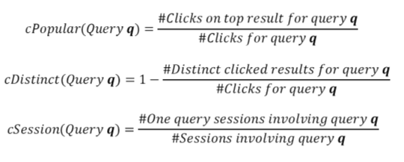
Query intent detection methods replicated
Brenes and Gayo 2008
Weight of the most popular result (cPopular)
Number of distinct visited results (cDistinct)
Navigational queries tend to appear issolated (cSession)
Notes:
http://www.flickr.com/photos/twinsparc/8653608/

Slide 30
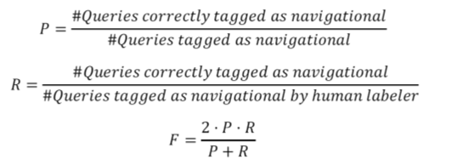
Proposed evaluation method
Precision, recall and F-measure
6,624 queries (1‰) were manually tagged
10 judges plus the authors
Each judge tagged 1,000 queries (aprox.)
Third judge polished inconsistencies
Notes:
http://www.flickr.com/photos/redjar/136165399/

Slide 31
What about the pooling strategy?
Unfeasible :(
81% actual navigational queries appear in the pool
Most of the queries flagged as navigational 80% of the queries (5 million) to be manually evaluated
Notes:
http://www.flickr.com/photos/redjar/136165399/

Slide 32
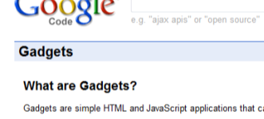
But the sample was pretty “small”…
Sure. Bigger samples!
Dolores Labs Blog: a must read!
Notes:
http://www.flickr.com/photos/redjar/136165399/

Slide 33
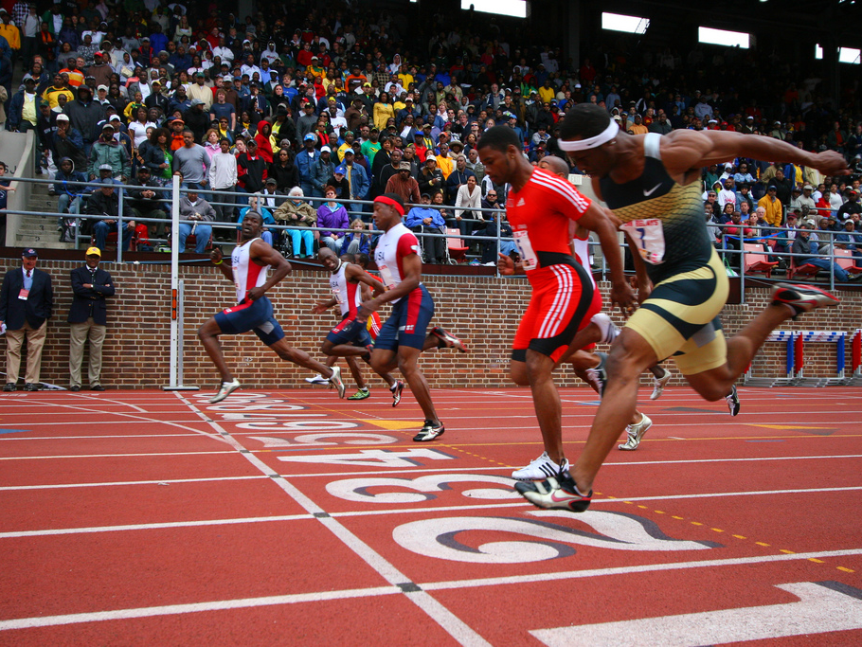
And what
about the results?
Notes:
http://www.flickr.com/photos/alvin_/2457832920/

Slide 34
Best achievers
Liu et al. nCS (0.378), nRS (0.398)
Brenes and Gayo cPopular (0.374)
Jansen et al. heuristic rules (0.360)
Promising features
nRS
using domains and website names
Monte Carlo simulation (?)

Slide 35
Best achievers
Liu et al. nCS (0.378), nRS (0.398)
Brenes and Gayo cPopular (0.374)
Jansen et al. heuristic rules (0.360)
Promising features
nRS
using domains and website names
Monte Carlo simulation (?)
users behaviour
external knowledge
filling the gap

Slide 36
Conclusions and Future work
Feasible evaluation methodology
Pooling evaluation is unfeasible
Larger tagged samples are needed
Further refinement to improve performance
Notes:
http://www.flickr.com/photos/wolfgangstaudt/2174481713/

Slide 37
Uhh… Questions?
Notes:
http://www.flickr.com/photos/kitsu/404092967/

