Slide 1
Information Arbitrage Across
Multi-Lingual Wikipedia
Eytan Adar, Michael Skinner*, and Daniel Weld
University of Washington, CSE
*Google Inc.
WSDM’09

Slide 2

English (22%)
2.5M articles
250+ other languages
8.8M articles
1M
100K
10K
# Articles (Log Scale)
1K
100
10
1
11.4M Articles
Languages by Rank
Wikipedia Oct’08

Slide 3
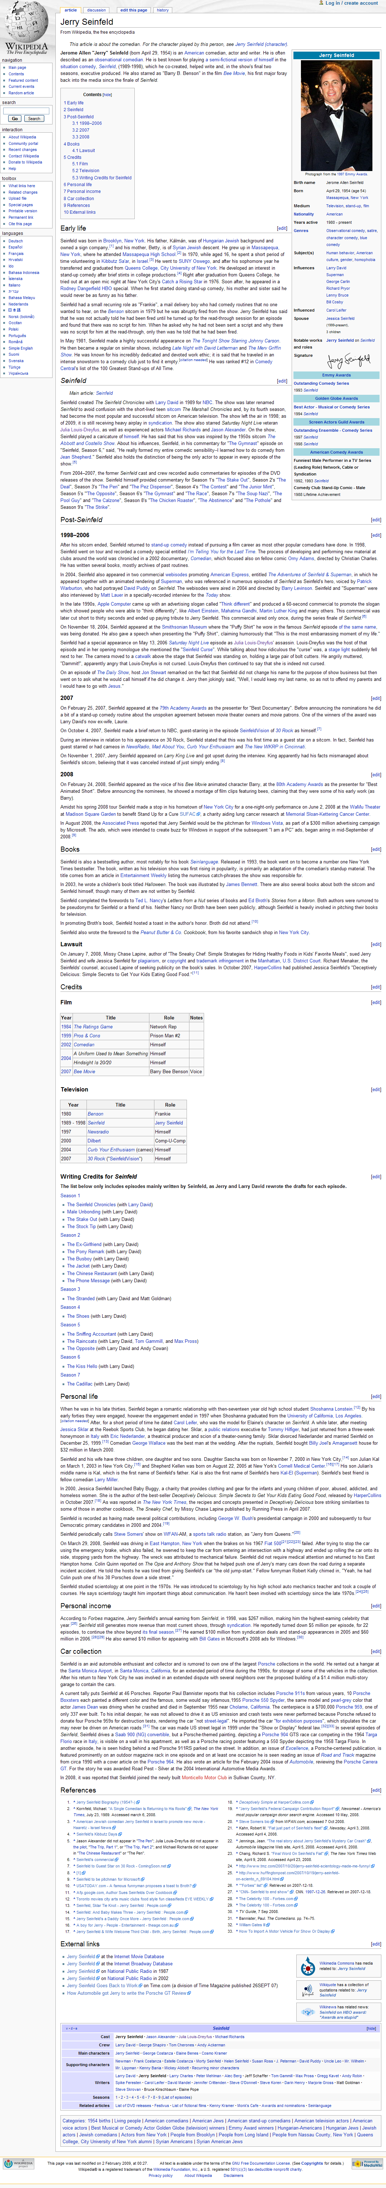
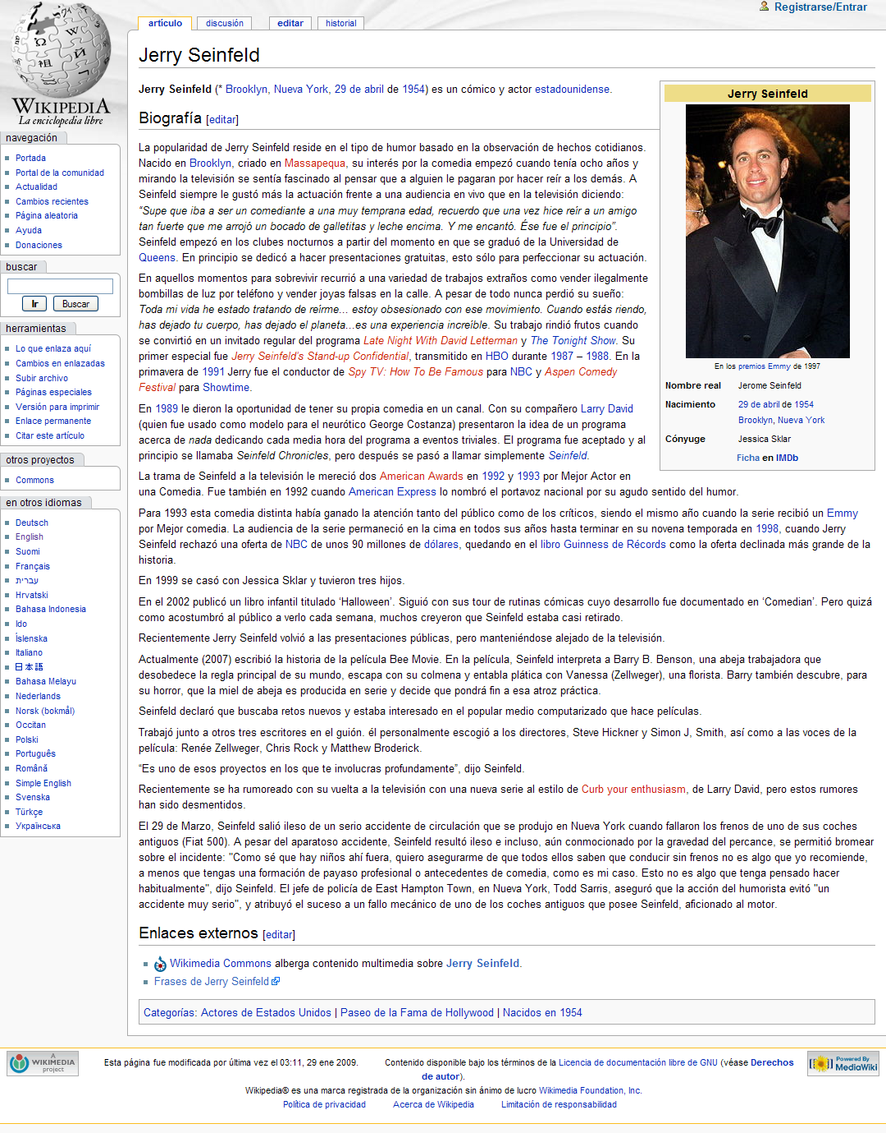
Jerry Seinfeld
English
Spanish

Slide 4
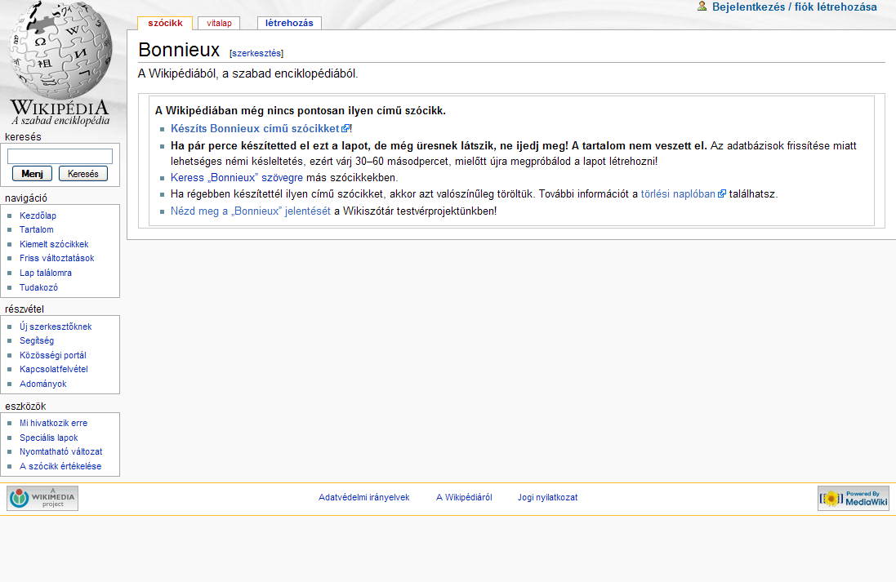
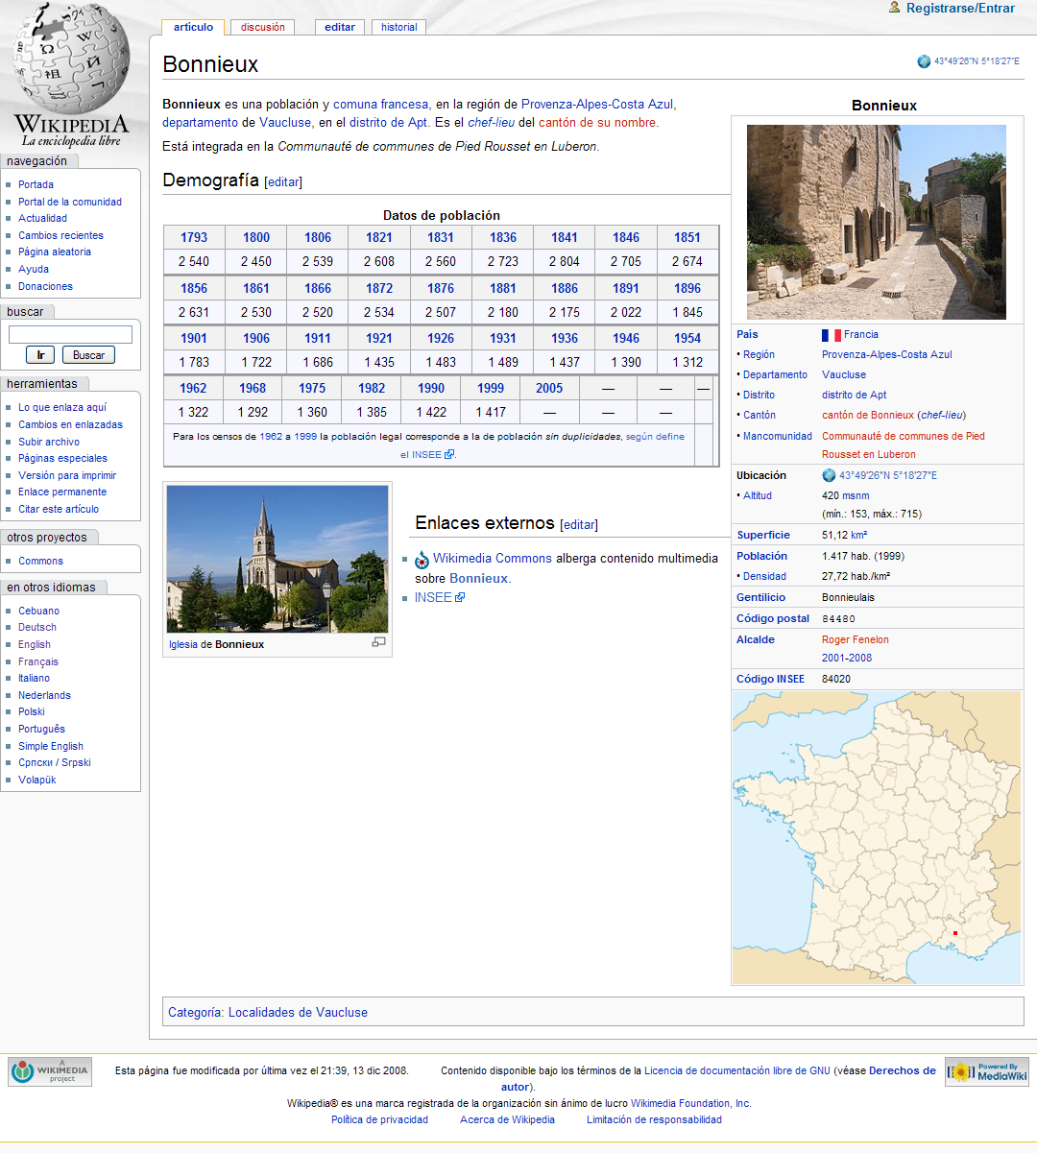
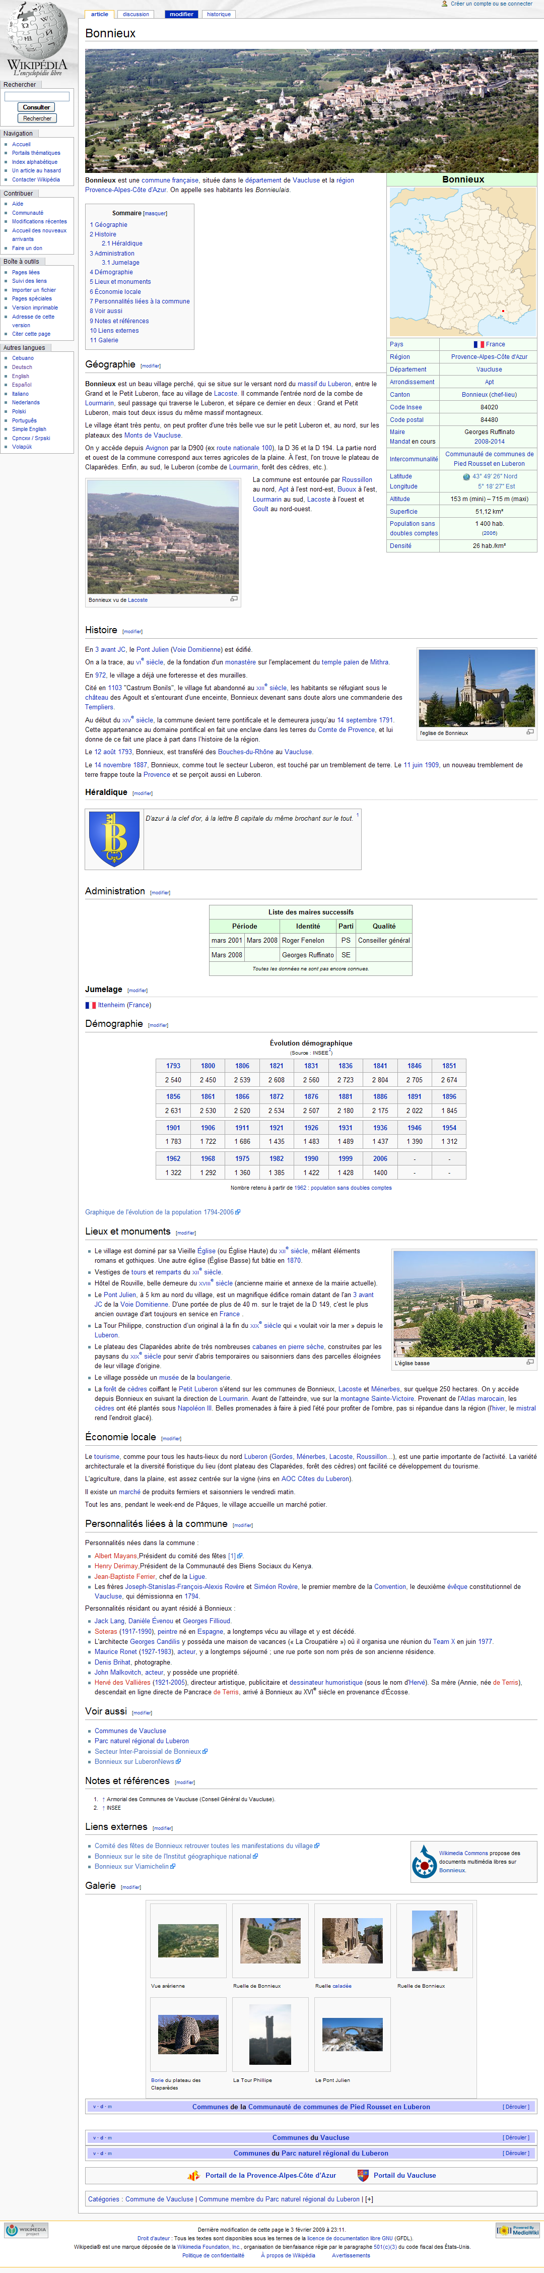
Bonnieux
Spanish
French
Hungarian

Slide 5
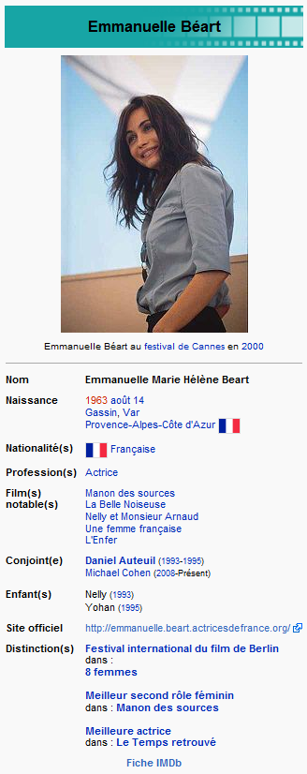
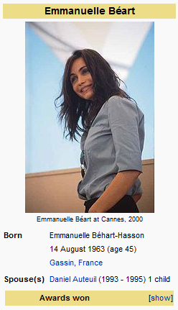
The idea
The problem
French
Many more details
2 children
New husband
time
visit
English

Slide 6
The Idea
Spouse = Jessica Seinfeld = Cónyuge
Spouse = Cónyuge
Spouse = Katie Holmes
Cónyuge = ?
Spouse = Katie Holmes
Cónyuge = Katie Holmes

Slide 7
Talk outline
The Data
Ziggurat
  Page alignment
  Infobox Key Alignment
  Infobox completion
Evaluation
Future Work

Slide 8
Talk outline
The Data
Ziggurat
  Page alignment
  Infobox Key Alignment
  Infobox completion
Evaluation
Future Work

Slide 9
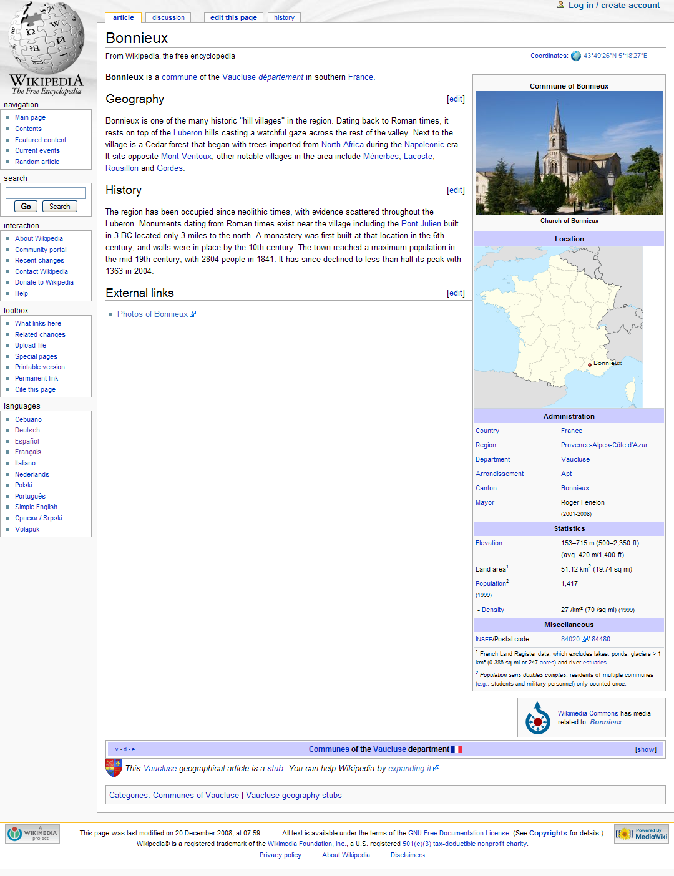
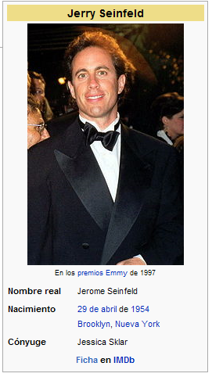
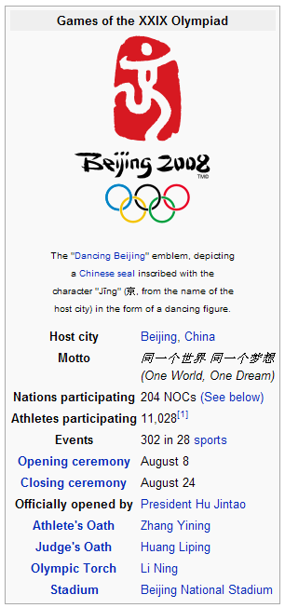
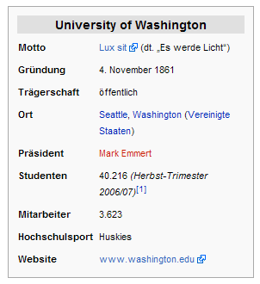
Infoboxes

Slide 10
The Data
Raw Wikipedia from January ’08
  English, German, French, Spanish
Articles are in Wikitext
  Adhoc combination of text/HTML/Wiki markup
Dbpedia (http://dbpedia.org)
  Preprocessed infoboxes
Some cleanup on our part
  12.8M, 2.1M, 1.5M, and 880k key/value pairs

Slide 11
values
keys
Class = Olympics Infobox
Class = Hochschule (College)

Slide 12
Talk outline
The Data
Ziggurat
  Page alignment
  Infobox Key Alignment
  Infobox completion
Evaluation
Future Work

Slide 13
Talk outline
The Data
Ziggurat
  Page alignment
  Infobox Key Alignment
  Infobox completion
Evaluation
Future Work

Slide 14

The Ziggurat System
Ziggurat
Page Alignment
English Wikipedia
French Wikipedia

Slide 15


The Ziggurat System
Ziggurat
Page Alignment
Infobox Key Alignment
p(spouse = conjoint) = .9
p(spouse = cónyuge) = .87
p(birthplace = geburtsort) = .893
p(name = nom) = 1
p(parents=nom) = .681
p(children = hijos) = .857
…
English Wikipedia
French Wikipedia

Slide 16

The Ziggurat System
Ziggurat
Page Alignment
Infobox Key Alignment
Infobox Completion
German
p(spouse = conjoint) = .9
p(spouse = cónyuge) = .87
p(birthplace = geburtsort) = .893
p(name = nom) = 1
p(parents=nom) = .681
p(children = hijos) = .857
…
French
Spanish
English

Slide 17

Page Alignment
English
Eiffel Tower
French
Tour Eiffel
Spanish
German
Cluster ID: 12443933039
Page Alignment
Infobox Key Alignment
Infobox Completion

Slide 18
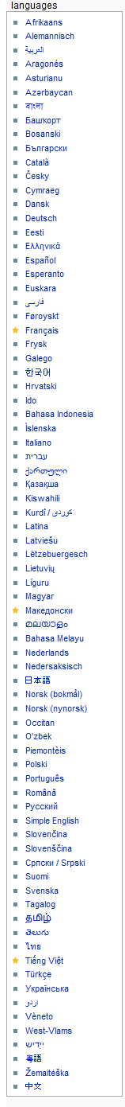

Page Alignment
Page Alignment
Infobox Key Alignment
Infobox Completion

Slide 19
English
349170
French
358426
146143
217947
380802
222096
208049
225147
385128
142433
Spanish
135830
German
129613
Page Alignment
Infobox Key Alignment
Infobox Completion

Slide 20
Page Alignment
Compute weakly connected components
Not perfect solution
  Some topics split among multiple pages
  Future work to recombine
Cluster
Instances
# articles in original cluster
Page Alignment
Infobox Key Alignment
Infobox Completion

Slide 21
Infobox Key Alignment
Ziggurat
Page Alignment
Infobox Key Alignment
Infobox Completion
p(country/name = pays/nom) = .9
name = France = France = nom
name = Canada = Canada = nom
United States of America = États-Unis d'Amérique
Page Alignment
Infobox Key Alignment
Infobox Completion

Slide 22
Deciding on Equality
Tom Cruise ≟ Cruise, Thomas
États-Unis d'Amérique ≟ United States of America
12000,00 ≟ 12,000.00
12 Km ≟ 7.45 miles
Pingtung ≟ Taiwan
raisin≟ raisin
Solution: build a single classifier that decides on equality
Page Alignment
Infobox Key Alignment
Infobox Completion

Slide 23
Infobox Key Alignment
Ziggurat
Page Alignment
Infobox Key Alignment
Infobox Completion
Single Instance Classifier
Probability Estimation
Page Alignment
Infobox Key Alignment
Infobox Completion

Slide 24
Classifier Features
Word features
Correlation Features
Translation Features
Equality features
Word features
N-gram features
Cluster ID Features
Language Features
Single Instance Classifier
(are two values equal?)
Page Alignment
Infobox Key Alignment
Infobox Completion

Slide 25
Classifier Features
Word features
Correlation Features
Translation Features
Equality features
Word features
N-gram features
Cluster ID Features
Language Features
Single Instance Classifier
(are two values equal?)
Page Alignment
Infobox Key Alignment
Infobox Completion

Slide 26
Word Features
Simple example
  Transform phrase into bag of words
    The Great Gatsby = {gatsby,great,the} = Great Gatsby, The
  Compare through Dice coefficient
    2 * | X ⋂ Y | / (|X| + |Y|)
  More words in common, more likely to be equal
Page Alignment
Infobox Key Alignment
Infobox Completion

Slide 27
Translation features
Using PanDictionary
  sense disambiguated pan-lingual dictionary
Translate each term in bag to (all possible) translations in target language
  {public,university} = {publique, ouvert, universelle,…,université, académie, collège,…}
Count overlap to target
  {publique université}
Page Alignment
Infobox Key Alignment
Infobox Completion

Slide 28
Correlation Features
Pays/Superficie Totale = 12 Km²
Country/Area = 4.6332 Miles²
Hack: Hard code all transformations
Better: Learn conversions
We know that Pays infoboxes are frequently paired with Country infoboxes
Test all pairs of keys with numerical values
Page Alignment
Infobox Key Alignment
Infobox Completion

Slide 29
Correlation Features
250
Some highly correlating data is wrong (but generally right match has highest correlation)
200
y = 0.3765x + 8.7485
R² = 0.9077
150
Pays/Superficie Totale
100
50
0
0
Country/Area
200
400
600
Page Alignment
Infobox Key Alignment
Infobox Completion

Slide 30
Classifier Features
Word features
Correlation Features
Translation Features
Equality features
Word features
N-gram features
Cluster ID Features
Language Features
Single Instance Classifier
(are two values equal?)
Training data
Page Alignment
Infobox Key Alignment
Infobox Completion

Slide 31
Generating Training Data
Self-supervised learning
Use things that are very likely correct to generate more training data
  Likely correct = many instances of exact phrase equality
Page Alignment
Infobox Key Alignment
Infobox Completion

Slide 32
Generating Training Data
    Country/Capital= Paris= Pays/Capitale
    Country/Capital = Tel Aviv= Pays/Capitale
    Country/Capital= Madrid= Pays/Capitale
    …
    Country/Capital = Pays/Capitale
    68 times
    Higher Likelihood
    Country/currencyCode= Pays/codeMonnaie
    45 times
    Lower Likelihood
    …
    Country/latD= Pays/populationRang
    1 time
    Country/commonName= Pays/plusGrandeVille
    1 time
Page Alignment
Infobox Key Alignment
Infobox Completion

Slide 33
confident that country/name = pays/nom
Key | Value
name | Italy
…
Key | Value
nom | italie
Eau(%) | 16,9
…
+
20k
Page Alignment
Infobox Key Alignment
Infobox Completion

Slide 34
confident that country/name = pays/nom
Key | Value
name | Italy
…
Key | Value
nom | italie
Eau(%) | 16,9
…
40k
–
Page Alignment
Infobox Key Alignment
Infobox Completion

Slide 35
Classifier Features
Word features
Correlation Features
Translation Features
Equality features
Word features
N-gram features
Cluster ID Features
Language Features
  Additive logistic regression
Single Instance Classifier
(are two values equal?)
{0,1}
Nom,États-Unis d'Amérique,
Name,United States of America
Page Alignment
Infobox Key Alignment
Infobox Completion

Slide 36
Infobox Key Alignment
Ziggurat
Page Alignment
Infobox Key Alignment
Infobox Completion
Single Instance Classifier
Probability Estimation
Page Alignment
Infobox Key Alignment
Infobox Completion

Slide 37
Probabilities
Can do better by considering multiple instances
  Generate up to 100 instances of each possible pairing
  Run classifier to find “equal” pairs
  score = number equal / number of tested (100)
Page Alignment
Infobox Key Alignment
Infobox Completion

Slide 38
Infobox Completion
Ziggurat
Page Alignment
Infobox Key Alignment
Infobox Completion
Choosing Potential Keys
Fill in Missing Values

Slide 39
Choosing Potential Keys
No new attributes
Page Alignment
Infobox Key Alignment
Infobox Completion

Slide 40
Choosing Potential Keys
Key | Value
Name
Spouse
Occupation
…
Tom Cruise
Katie Holmes
Actor
Page Alignment
Infobox Key Alignment
Infobox Completion

Slide 41
Choosing Potential Keys
No new attributes
New attributes based on commonly occurring keys
  E.g., “person” frequently has name, spouse, occupation, etc.
Page Alignment
Infobox Key Alignment
Infobox Completion

Slide 42
Choosing Potential Keys
Key | Value
Name
Tom Cruise
Spouse
Occupation
…
Page Alignment
Infobox Key Alignment
Infobox Completion

Slide 43
Choosing Potential Keys
No new attributes
New attributes based on commonly occurring keys
  E.g., “person” frequently has name, spouse, occupation, etc.
New infobox & attributes based on commonly occurring infobox pairings
  No infobox for Tom Cruise in English, but persondaten box in German, etc.
Page Alignment
Infobox Key Alignment
Infobox Completion

Slide 44
Choosing Potential Keys
Key
Person
Personne
Name
Spouse
French
Tom Cruise
English
Tom Cruise
Actor
Acteur
Awards
Page Alignment
Infobox Key Alignment
Infobox Completion

Slide 45
Filling Missing Values
Simple: for each target attribute, pick the source attribute with the highest pair-wise score
  e.g., name usually maps to nom
  Can fail when one source attribute is a really strong match for many targets
Less simple: If you assume a one-to-one mapping, can use known algorithms for maximum weight matching
Page Alignment
Infobox Key Alignment
Infobox Completion

Slide 46
Talk outline
The Data
Ziggurat
  Page alignment
  Infobox Key Alignment
  Infobox completion
Evaluation
Future Work

Slide 47
Talk outline
The Data
Ziggurat
  Page alignment
  Infobox Key Alignment
  Infobox completion
Evaluation
Future Work

Slide 48
Classifier Precision
Ziggurat
Page Alignment
Infobox Key Alignment
Infobox Completion
90.7%
Single Instance Classifier
Probability Estimation
90.6%
(without translation features)

Slide 49
Classifier Precision
Ziggurat
Page Alignment
Infobox Key Alignment
Infobox Completion
Produces a score & matches have different plausibilities
Single Instance Classifier
Probability Estimation
name = nom? (p = 1)
name = nom de naissance? (p = .8)
caption = nom? (p = .6)

Slide 50
Classifier Precision
285 pairs with a broad range of p
4 independent graders
  0 = no match
  1 = possible (but not ideal) match
  2 = perfect match

Slide 51
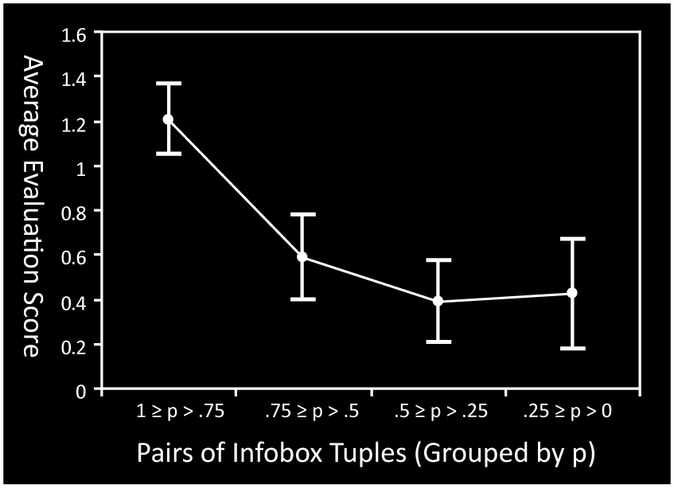
Classifier Precision
Threshold set at p > .75 (high tester scores)

Slide 52
Classifier Precision
285 pairs with a broad range of p
4 independent graders
  0 = no match
  1 = possible (but not ideal) match
  2 = perfect match
Another 200 pairs, with p > .75
  86% precision

Slide 53
Ziggurat Recall
Look at how big an infobox is on average
  How many entries are completed?
Look at how big an infobox can get
  how many entries can be completed? (99%tile)
“Max”
“Size”
We added
Current avg.
Infobox Classes (CDF)

Slide 54
English
Most developed articles

Slide 55
German
Narrow gains
Infobox vocabulary fairly constrained (personendaten)
Editing restricted

Slide 56
French

Slide 57
Spanish
Least # of articles, most to gain

Slide 58
Generating Infoboxes
Not one to one
  Many possible outcomes
  personendaten → actor, athlete, politician, etc.
Test by throwing out infobox and regenerating using other languages
  E.g., Drop Tom Cruise’s actor infobox
  German (80.7% precision)
  English is hard (45.7% precision)
    Not necessarily wrong! (Actor vs. Film_Actor)
Does newly created infobox contain the fields?
  71.8% precision

Slide 59
Talk outline
The Data
Ziggurat
  Page alignment
  Infobox Key Alignment
  Infobox completion
Evaluation
Future Work

Slide 60
Talk outline
The Data
Ziggurat
  Page alignment
  Infobox Key Alignment
  Infobox completion
Evaluation
Future Work

Slide 61
Future work
Language voting
  Currently we take the best value
Joint inference
  Align all languages at the same time
Non-western languages
  Can we still be “dictionary free?”
Translating values
  Deal with situations in which we need to translate the text (can’t rely on links and titles)
Linked editing

Slide 62
Summary
Work on Wikipedia content is diverse and unequal
  Expertise and interests are localized
Work in one language can be leveraged to help others
Ziggurat
  Accurately learns and performs mapping operations between languages

Slide 63
Thanks! Merci! ¡Gracias! Danke!
Oren Etzioni & The Turing Center
NSF, ARCS
?

