Slide 1
Cross-Language Query Classification
using Web Search for Exogenous Knowledge
Xuerui Wang, Andrei Broder, Evgeniy Gabrilovich,
Vanja Josifovski, Bo Pang
Yahoo! Research

Slide 2
Motivation: Query Classification
Web query classification an essential task in understanding user intent
Blue Lithium
Heavy Water
ex560lu
Several applications:
Advertising [Broder et al SIGIR2007, CIKM2008]
Web search
High granularity

Slide 3
The Other Web
Non-English Web growing at a fast pace:
210M Chinese Internet users, compared to 218M in the US (2008)
Potential for growth much larger than in the English speaking countries
Fragmented markets
Most of the available language processing resources in English:
ODP
KDD Cup 2005
Our previous work: 6K node taxonomy for query classification
Building taxonomies from scratch for all non-English languages?
Key issue: training set

Slide 4
Reuse of English Taxonomies
In many cases a large portion of the taxonomy can be reused
Products
Services
Entertainment (partially) …
Translate the labels manually; training set (queries) automatically
How to classify a foreign web query into an English taxonomy?
Most MT tools are targeted for larger text fragments
4
Notes:
Other uses: bilingual user advertising

Slide 5
Cross-Language Query Classification using MT
Straw man
Directly translate non-English queries into English
Classify the translated queries
Baseline
Send translated queries to an English search engine
Vote based on search results
Our method (Jasper system)
Web search in the query’s original language: resolving cultural references
Machine translation on search results: better MT for longer text spans
Class prediction via majority voting: robust against incorrect MT or text classification
Perform the imprecise MT on lower density information: pages

Slide 6
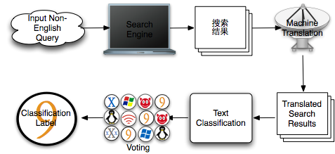
Jasper in a Nutshell
6

Slide 7
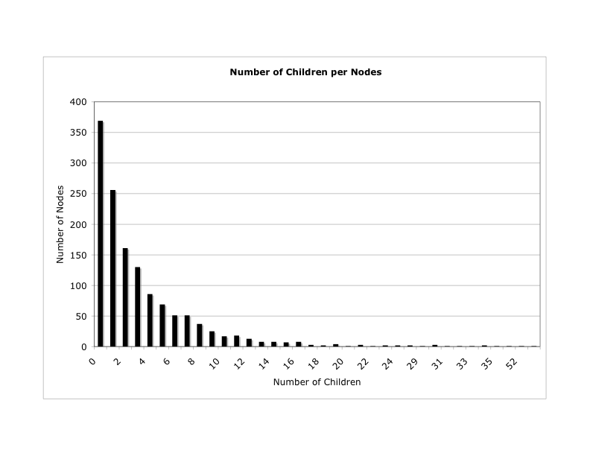
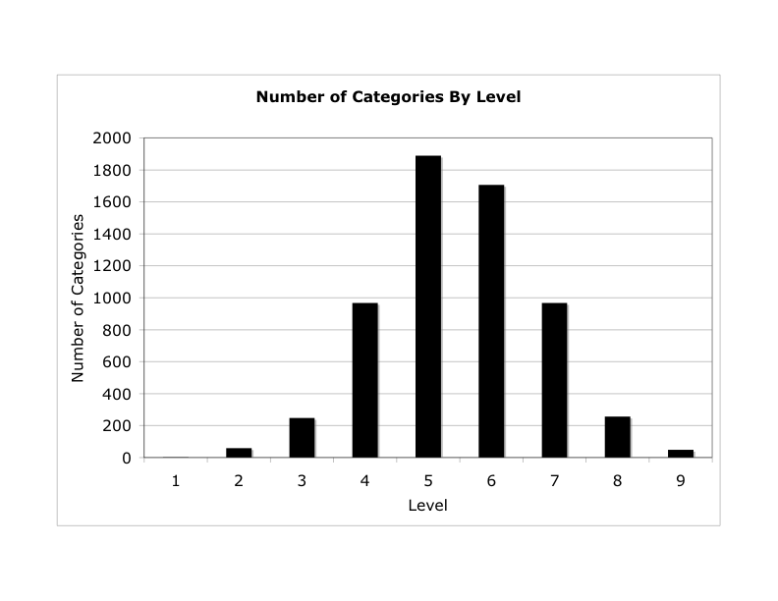
Our Taxonomy
Over 6,000 topical nodes
Populated with ~150 queries per node
Bid phrases of ads
Editorially selected
Commercial interest mostly
Notes:
Mention the ad connection to explain why the taxonomy is populated with bid phrases

Slide 8
Detour: Building a Document Classifier
Start with a taxonomy populated with queries
Produce documents that correspond to these queries
Evaluate the queries in a search engine and collect the results and use these as a training set for SVM, logistic regression, etc.
Produce meta documents from the taxonomy queries, use these as centroids of a nearest neighbor classifier
The second approach yielded better results
Notes:
Mention the ad connection to explain why the taxonomy is populated with bid phrases

Slide 9
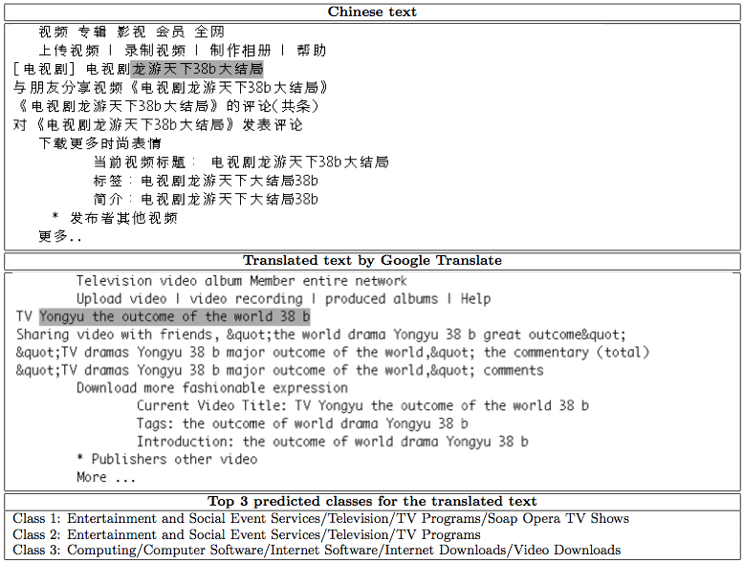
Classification of MT Web Pages

Slide 10
Back to Query Classification
Use 32 search result pages
Machine translation systems:
Google Translate,
Babel Fish,
Per-word dictionary lookup
Votes from individual search results and predict top classes
Human editors judge each prediction as correct or incorrect

Slide 11
Data Sets
Stratified sampling:
Divide query log into ten deciles by query frequency (in log scale)
Randomly sample the same number of queries from each decile.
C200: 200 queries from a large-scale Chinese query log (20 per decile)
C1000: 1000 queries from the same Chinese query log (100 per decile)
R100: 100 queries from a large-scale Russian query log (10 per decile)
11

Slide 12
Experimental Results on C200 (I)
Two editors independently judge each prediction as correct or incorrect
Logical AND/OR of two editors’ judgments
One-tail paired t-test (p-value < 0.05)
“*”: Jasper > Baseline
“+”: GoogleTranslate > Babelfish
“◊”: Babelfish > Dictionary
Notes:
binary judgments

Slide 13
Experimental Results on C200 (II)
With the same machine translation system, Jasper consistently and significantly outperforms the baseline (denoted by *)
This improvement holds regardless of the MT system used.

Slide 14
Experimental Results on C200 (III)
Quality of MT system impacts the performance of both Jasper and the baseline.
GoogleTranslate is significantly (denoted by +) better than Babelfish, and Babelfish in turn significantly (denoted by ◊) better than Dictionary lookup.
Worst performance of Jasper (with Dictionary) is still better than the best baseline (with GoogleTranslate)
Even with a simple bilingual dictionary, Jasper gives decent performance.

Slide 15
Experimental Results on C200 (IV)
Without search results, translating queries using GoogleTranslate, the performance is much worse (last column)
Conclusions are the same whether we use logical OR or logical AND to combine two editorial judgments, i.e., they are not affected by how strict the editorial judgment is.

Slide 16
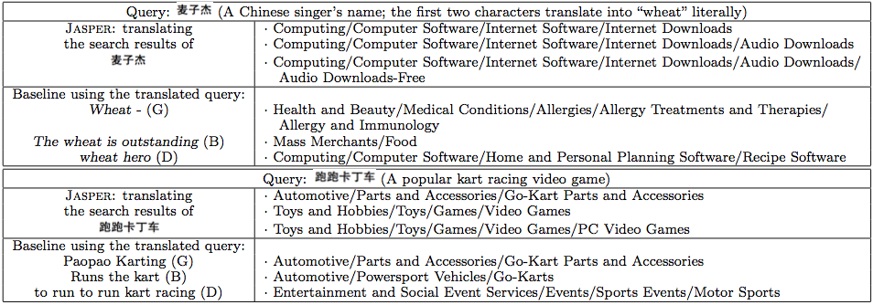
Selected Examples
GoogleTranslate (G), Babelfish (B), and Dictionary (D)

Slide 17
Experimental Results on C1000 and R100
“*”: Jasper > Baseline “+”: GoogleTranslate > Babelfish
Conclusions are the same for both Chinese and Russian.
Better results for Russian due to better translation (language similarity).

Slide 18
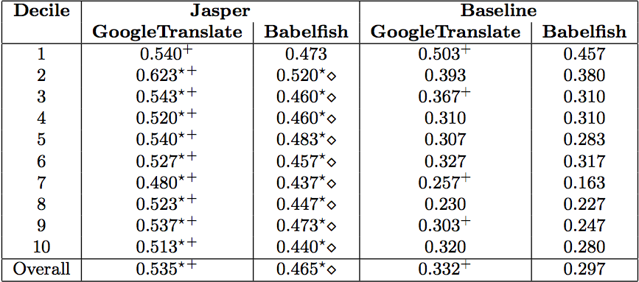
Stratified Analysis of Query Frequency
Jasper is more robust than Basline to query frequency
Superiority of Jasper holds across decile
Very frequent queries are easy to translate by any MT system

Slide 19
Other Experiments (what did not work)
Combining Jasper and baseline, taking advantage of evidence at both sides, hurts the performance.
Combing different MT systems does not work
- Macro-combination of votes of translated results
- Micro-combination of translated results directly

Slide 20
Conclusions
A method for low-cost bootstrap of query classification in foreign languages.
A good start for small markets
Blind relevance feedback in the query’s native language significantly reduces the impact of erroneous MT.
Perform MT on a lower information density area.
For two foreign languages Jasper outperforms the baseline regardless of MT system.
Performance consistent across query frequencies

Slide 21
Thank you! Vanja Josifovski http://research.yahoo.com/vanja_josifovski

