Slide 1
Efficient Multiple-Click Models in Web Search
Fan Guo¹, Chao Liu² and Yi-Min Wang² 1 Carnegie Mellon University
2 Microsoft Research
Feb 11, 2009

Slide 2
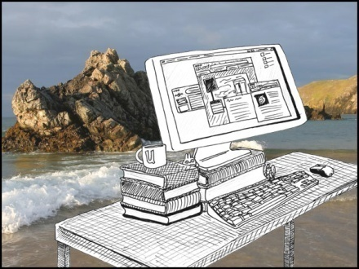
Overview
Web Search Activity
Search Engine Presentation
User Interaction Logs
Models for Leveraging User Feedbacks
Notes:
Here we focus on click logs
http://www.untyped.com/images/weblog.jpg

Slide 3
Overview
Web Search Activity
Logging
Search Engine Presentation
User Interaction Logs
Models for Leveraging User Feedbacks
Notes:
Logging: extract features and log them

Slide 4
User Implicit Feedbacks
A very rich set of candidate features
(Agichtein et al., SIGIR’06)

Slide 5
User Implicit Feedbacks
Practical consideration
Recording effort (how much tweaking?)
Noise elimination (e.g., dwelling time?)
Would the answer change after scaling up to 10x? 100x?

Slide 6
Click Logs
Query term
cmu
Document URL
www.cmu.edu
Position/Rank
1
Clicked or Not
Yes
Query term
cmu
Document URL
www.cmu.edu
Position/Rank
1
Clicked or Not
Yes
Query term
cmu
Document URL
www.cmu.edu
Position/Rank
1
Clicked or Not
Yes
Query term
cmu
Document URL
www.ri.cmu.edu
Position/Rank
10
Clicked or Not
No

Slide 7
Click Logs
Query term
cmu
Document URL
www.cmu.edu
Position/Rank
1
Clicked or Not
Yes
Time stamp
01/19/2009, 4:00:01pm
Session ID
...
User ID
...
Query term
cmu
Document URL
www.cmu.edu
Position/Rank
1
Clicked or Not
Yes
Query term
cmu
Document URL
www.cmu.edu
Position/Rank
1
Clicked or Not
Yes
Query term
cmu
Document URL
www.ri.cmu.edu
Position/Rank
M = 10
Clicked or Not
No

Slide 8
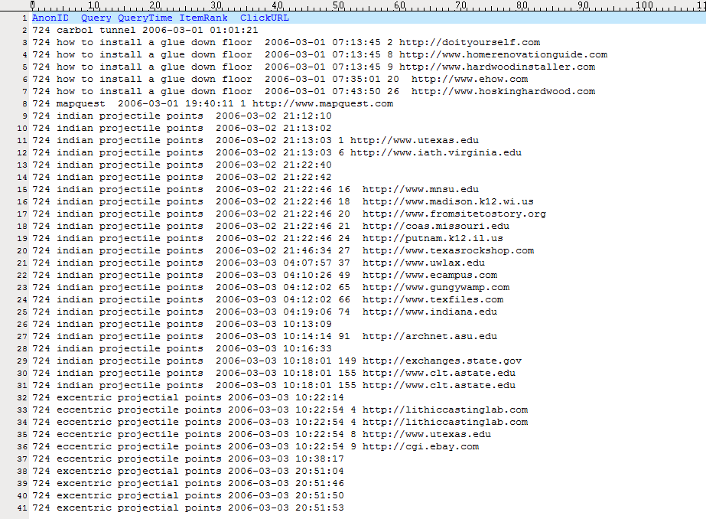
A Snapshot
Notes:
From the AOL release, plain text, would be a database for TB data

Slide 9
Overview
Web Search Activity
Search Engine Presentation
User Interaction Logs
Models for Leveraging User Feedbacks
Cleanup
Notes:
Query normalization; fraud click elimination

Slide 10
Overview
Modeling
Web Search Activity
Search Engine Presentation
User Interaction Logs
Models for Leveraging User Feedbacks

Slide 11
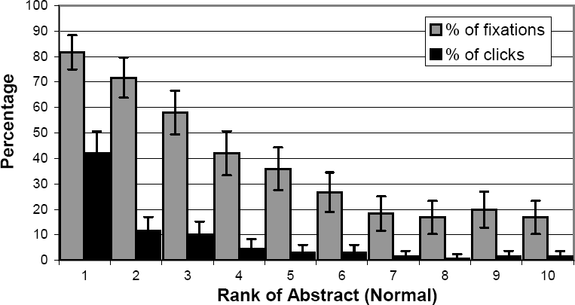
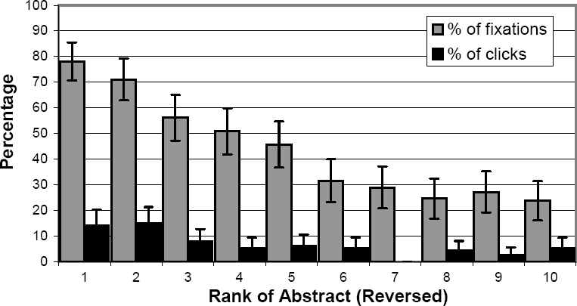
Clicks are biased
Images are copied from (Joachims et al., 2007) in ACM TOIS

Slide 12
Examination Hypothesis
A web document must be examined before clicked.
Relevance is defined as the conditional probability of click upon examination.
P(Click) = P(Examination) * Relevance, formulated in (Richardson et al., WWW’07)
Notes:
given E_i, C_i is independent of past examination and clicks

Slide 13
Most Simple Click Model
Variable Definition
E_{i}: binary r.v. for examination on position i;
C_{i}: binary r.v. for click on position i;
r_{di}: relevance for document d_{i} on position i.

Slide 14
Most Simple Click Model
Independent Click Model
P(E_{i} = 1) = 1
P(C_{i}=1) = r_{di}
Therefore we have

Slide 15
Cascade Hypothesis
Proposed in (Craswell et al., WSDM’08)
Strict Linear order of examination and click
E_{i} = 0 => E_{i+1} = 0
Cascade Model

Slide 16
Cascade Model
Modeling the first click (Craswell et al., WSDM’08)
P(C_{i}=1|E_{i}=0) = 0, P(C_{i}=1|E_{i}=1) = r_{di}
P(E₁=1) =1, P(E_{i+1}=1|E_{i}=0) = 0
P(E_{i+1}=1|E_{i}=1, C_{i}=0) = 1
P(E_{i+1}=1|E_{i}=1, C_{i}=1) = ?
examination hypothesis
cascade hypothesis
modeling a single click

Slide 17
Dependent Click Model
Modeling multiple clicks
P(C_{i}=1|E_{i}=0) = 0, P(C_{i}=1|E_{i}=1) = r_{di}
P(E₁=1) =1, P(E_{i+1}=1|E_{i}=0) = 0
P(E_{i+1}=1|E_{i}=1, C_{i}=0) = 1
P(E_{i+1}=1|E_{i}=1, C_{i}=1) = λ_{i}
examination hypothesis
cascade hypothesis
modeling 1+ click(s)

Slide 18
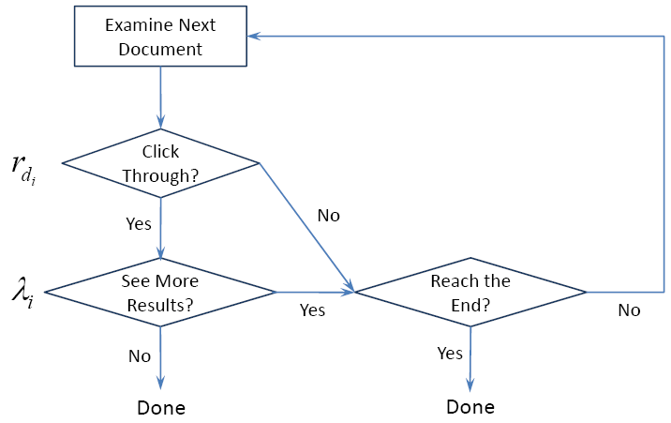
Dependent Click Model
λ_{i} (1 ≤ i < 10) are global user behavior parameters.
The full picture

Slide 19
DCM Algorithms
Two sets of unknown values for estimation
Query-specific: document relevance r
Global: user behavior parameter λ
Approximate Maximum-Likelihood Learning
Maximizing a lower bound of log-likelihood
Would be exact if the chain length is infinite
Notes:
Drop the (less probable) case that user looks over the last clicked position without any click (examination depth)

Slide 20
DCM Algorithms
Estimation Formulae
empirical CTR measured before last clicked position
empirical probability of “clicked-but-not-last”
Notes:
Note that in general, relevance (relevance) depends on user behavior parameters (lambda)

Slide 21
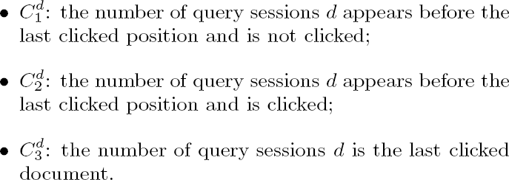
DCM Implementation
Keep 3 counts for each query-document pair
Then
Notes:
Least effort: 2 counts for each q-U pair and 2(M-1) global counts

Slide 22
Overview
Web Search Activity
Search Engine Presentation
User Interaction Logs
Models for Leveraging User Feedbacks
Application
Notes:
applications

Slide 23
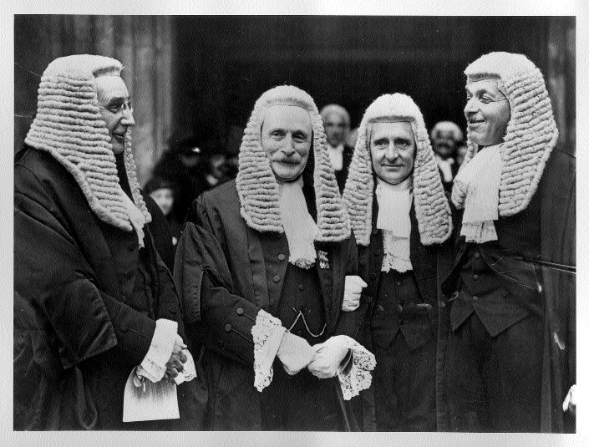
Click Model Applications
User-Perceived Relevance
A good candidate feature for ranking, but…
As input for existing ranking algorithms
v.s. human judgment
Notes:
Should be careful if it is the sole feature
http://weblogs.newsday.com/news/local/longisland/politics/blog/judges.jpg

Slide 24
Click Model Applications
Search Engline Evaluation
Summary of the overall user experience
Expected clickthrough rate
Browsing Behavior Statistics
Application in Sponsored Search
Building block for auction/pricing mechanism
(Kempe and Mahdian, WINE 2008) (Aggarwal et al., WINE 2008)
(Guo et al., WSCD’09)

Slide 25
Notes:
http://www.jemstar.com/myjeremy/download_files/experiment_1280x960wallpape.jpg

Slide 26
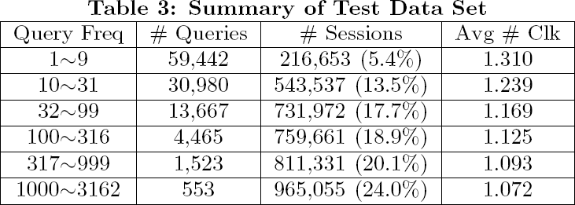
Click Data Set
Collected in 2 weeks in July 2008.
Discard query sessions with no clicks.
178 most frequent queries removed.

Slide 27
Click Data Set
After preprocessing:
110,630 distinct queries
4.8M/4.0M query sessions in the training/test set
Training Time: ~7 min

Slide 28
Evaluation Criteria
Test Data Log-likelihood
Given the document impression in the test set
Compute the chance to recover the entire click vector
Averaged over different query sessions

Slide 29
Test Data Log-Likelihood
ICM: -1.401, DCM: -1.327 (26.5% chance)
Notes:
Smoothing helps

Slide 30
Evaluation Criteria
Predicting First/Last Clicks
Given the document impression in the test set
Draw 100 click vector samples (with 1+ clicks)
Compute the corresponding RMS error

Slide 31
First/Last Clicked Position

Slide 32
Examination/Click Distribution

Slide 33
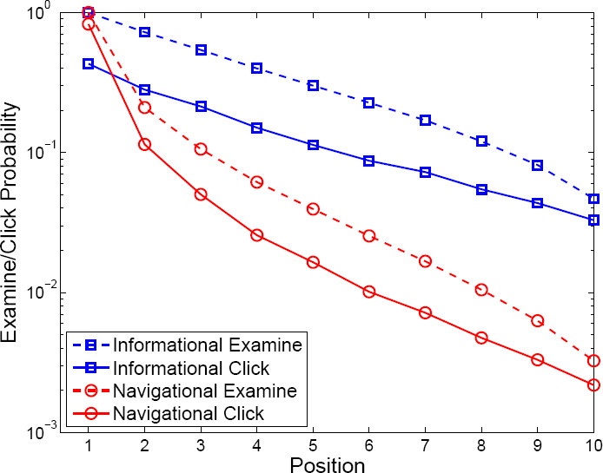
Difference by User Goals
From (Guo et al., WSCD’09)on a different data set

Slide 34
An Alternative
User Browsing Model (Dupret et al., SIGIR’08)
Examine probability depends on
Preceding clicked position
Distance to preceding clicked position
Comparing with DCM:
Allow jump in examination (no longer strictly linear)
Parameter set is an order of magnitude larger
More expensive algorithms (iterative, EM-like)

Slide 35
Conclusion
Click Models:
A principled way of integrating user click data
All current models are based on examination hypothesis
Should be scalable and incremental
DCM:
built upon cascade model, for multiple-clicks
introduce a set of position-dependent to characterize the examine-next probability
provides a fast, simple, yet effective solution
Notes:
Active area: two www papers

Slide 36
Open Problems
Trade-off in effectiveness/efficiency
Evaluation (test bed and test metric)
Click-model relevance v.s. human-judged relevance
Click model for universal search?

Slide 37
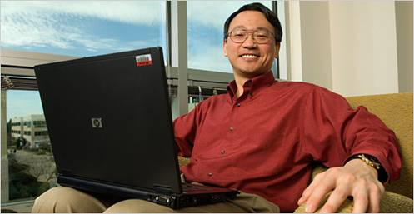
Acknowledgement
Chao Liu Yi-Min Wang
Ethan Tu Li-Wei He Nick Craswell
Notes:
Co-authors and Microsoft friends
http://research.microsoft.com/en-us/groups/sqcil/

Slide 38
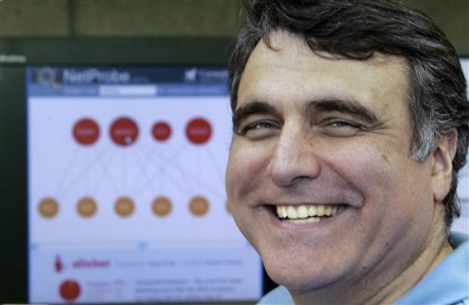
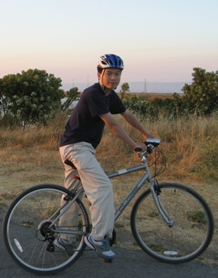
Acknowledgement
Christos Faloutsos Lei Li

Slide 39
Thank you!
Notes:
Related work…

