Slide 1
Analysis of Long Queries in a Large Scale Search Log
Center for Intelligent Information Retrieval,
University of Massachusetts, Amherst
Michael Bendersky, W. Bruce Croft
WSCD 2009, Barcelona, Spain

Slide 2
Outline
Introducing the Long Queries
Types of Long Queries
Click Analysis
Improving Retrieval with Long Queries
Evaluating Retrieval
The analysis in this talk is based on RFP 2006 dataset (MSN Search Query Log excerpt)

Slide 3
Why Long Queries?
Natural for some applications
Q&A
Enterprise/Scholar search
May be the best way of expressing complex information needs
Perhaps selecting keywords is what is difficult for people ( e.g., SearchCloud.net )
Queries become longer when refined
(Lau and Horvitz ‘99)
Length correlates with specificity
(Phan et al. ‘07)
Might become more widespread when search moves “out of the box”
e.g., speech recognition, search in context

Slide 4
Retrieval with Long Queries
Current evidence that retrieval with long queries is not as effective as with short ones
TREC descriptions (Bendersky & Croft ‘08)
Search in Q&A archives (Xue & Croft ‘08)
We study the performance of the long queries from the search logs
Identifying the problems
Discussing potential solutions
Building test collections

Slide 5
Length Analysis
Expected Query Length = 2.4
~15M queries
Most queries are short
For 90.3% of the queries
len(q) < 5
For 99.9% of the queries
4 < len(q) <13
99.9%

Slide 6
Short Queries
Long Queries
90.3 %
9.6%

Slide 7
Query Types
Short Queries
All assigned to a class SH
Long Queries
Questions (QE)
Operators (OP)
Composite (CO)
Non-Composite
Noun Phrases (NC_NO)
Verb Phrases (NC_VE)

Slide 8
Questions (QE)
Questions are queries that begin with one of the words from the set:
{what, who, where, when, why, how, which, whom, whose, whether, did, do, does, am, are, is, will, have, has}
Examples ^{(*)}
What is the source of ozone?
how to feed meat chickens to prevent leg problems
do grover cleveland have kids
^{(*)} Spelling and punctuation of the original queries is preserved.

Slide 9
Operators (OP)
Operators are defined as queries that contain (at least)
One of the Boolean operators {AND,OR,NOT}
One of the phrase operators {+, “}
One of the special web-search operators {contains:, filetype:, inanchor:, inbody:, intitle:,ip:, language:, loc:, location:, prefer:, site:, feed:, has-feed:, url:}
Examples ^{(*)}
bristol, pa AND senior center
"buffalo china " pine cone"
site:dev.pipestone.com ((Good For A Laugh))
^{(*)} Spelling and punctuation of the original queries is preserved.

Slide 10
Composite(CO)
Composite are queries that can be represented as a non-trivial composition of short queries in the search log.
Non-Trivial - segmentation that includes at least one segment of len(q) > 1
Examples ^{(*)}
[us postal service] [zip codes]
[good morning america] [abc news]
[university of new mexico] [map]
^{(*)} Spelling and punctuation of the original queries is preserved.

Slide 11
Noun Phrases (NC_CO)
Noun Phrase queries that cannot be represented as a non-trivial segmentation
Examples ^{(*)}
child care for lowincome families in california
Hp pavilion 503n sound drive
lessons about children in the bible
^{(*)} Spelling and punctuation of the original queries is preserved.

Slide 12
Verb Phrases (NC_VE)
Verb Phrase queries that cannot be represented as a non-trivial segmentation
Contain at least one verb, based on a POS tagger output
Examples ^{(*)}
detect a leak in the pool
teller caught embezzling after bank audit
eye hard to open upon waking in the morinig
^{(*)} Spelling and punctuation of the original queries is preserved.

Slide 13
Query Distribution by Type
Total Queries: 14,921,286
Long Queries: 1,423,663
Type | Count | % of Long
Questions (QE) | 106,587 | 7.5
Operators (OP) | 78,331 | 5.5
Composite (CO) | 910,103 | 64
Noun Phrases (NC_NO) | 209,906 | 14.7
Verb Phrases (NC_VE) | 118,736 | 8.3

Slide 14
Click Analysis
How do long queries
Affect user behavior?
Affect the search engine retrieval performance?
We’ll examine 3 basic click-based measures (Radlinsky et al. ‘08)
Mean Reciprocal Rank – MeanRR(q)
Max Reciprocal Rank – MaxRR(q)
Abandonment Rate – AbRate(q)

Slide 15
Clicks and Query Length
31% Decrease
11% Decrease
Mean Reciprocal Rank

Slide 16
Clicks and Query Length
21% Decrease
9% Decrease
Max Reciprocal Rank

Slide 17
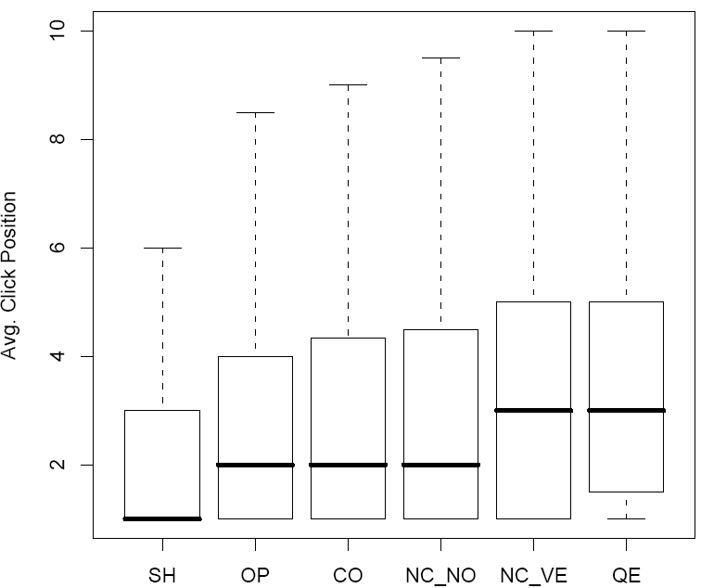
Clicks and Query Type
Random sample
10,000 queries per type

Slide 18
Measures by Query Type
Statistically Significant Difference in MeanRR between the groups based on a two-tailed t-test (p < 0.05)
Type | length | MeanRR | MaxRR | AbRate
SH | 1.99 | 0.73 | 0.77 | 0.40
CO | 5.67 | 0.59 | 0.67 | 0.41
OP | 6.05 | 0.58 | 0.67 | 0.58
NC_NO | 5.77 | 0.58 | 0.67 | 0.61
NC_VE | 6.35 | 0.53 | 0.62 | 0.59
QE | 6.75 | 0.51 | 0.61 | 0.51

Slide 19
Clicks and Query Frequency
Long queries are less frequent than the short ones
Can query performance be explained by frequency alone? (Downey et al. ‘08)
Control the frequency variable by examining tail queries
Queries that appear exactly once in the search log

Slide 20
Clicks and Query Length for Tail Queries
30% / 20% Decrease
Drop in Reciprocal Ranks cannot be explained by query frequency alone

Slide 21
Improving Long Queries
Survey of promising techniques for improving long queries
Query Reduction
Query Expansion
Query Reformulation
Term & Concept Weighting
Query Segmentation
Ideal: Evaluate these techniques in tandem on a single test bed
TREC Collection
Search Logs

Slide 22
Query Reduction
Eliminating the redundancy in the query
Define Argentine and Britain international relations → “britain argentina”
Some interactive methods were found to work well (Kumaran & Allan ‘07)
However, automatic query reduction is error-prone
In fact, query reduction can be viewed as a special case of term-weighting

Slide 23
Query Expansion
A well known IR technique
A challenge is that long queries may produce unsatisfactory initial results
yielding unhelpful terms for query expansion.
An interaction with the user may help (Kumaran & Allan ‘07)

Slide 24
Query Reformulation
Broad definition that covers
Query suggestions
Adding synonyms or contextual terms
Abbreviation resolution
Spelling corrections
Can be viewed as mapping U → S
U – User vocabulary
S – System vocabulary
(Marchionini & White ‘07)
Recent work shows that query logs are helpful for building such mappings
(Jones et al. ’06, Wei et al. ’08, Wang & Zhai ’08, … )

Slide 25
Term & Concept Weighting
Some terms/concepts are more important than others
Especially when the queries are long
Recent work seems to affirm this intuition
Term – Based Smoothing (Mei et al. ‘07)
Concept weighting (Bendersky & Croft ‘08)
Learning Term Weights (Lease et al. ‘09)
Interesting to reaffirm these findings on user queries from query logs
Less structure
Less redundancy

Slide 26
Query Segmentation
Creation of atomic concepts
[us postal service] [zip codes]
Can be done with reasonable accuracy
With supervision
(Guo et. al ‘08, Bergsma & Wang ’07)
Or with a big enough training corpus
(Tan & Feng ‘07)
But can it improve retrieval vs. using simple n-gram segments?
(Metzler & Croft ‘05)

Slide 27
Retrieval Evaluation
Search Log
Contains queries
Contains click data
GOV2 test collection
Crawl of .gov domain
Largest publicly available TREC web collection
Pick a set of query strings such that each query string in the set
Occurs more than once in the search log
Is associated with at least one click on the URL in GOV2 collection

Slide 28
Creating Relevance Judgments
Resulting set contains
13,890 queries
Long queries - 8.5% of the set
# Clicks per query
Short queries ~ 2 clicks per query
Long queries ~ 1 click per query
Due to the sparseness of the data
Treat each click as an absolute relevance judgment
Compare systems by their performance on click data vs. absolute relevance judgments

Slide 29
Short Queries Performance
Statistically Significant Difference in MeanRR between the groups based on a two-tailed Wilcoxon test (p < 0.05)
 | 150 TREC titles |  | 700 Log Queries
 | p@5 | MAP | p@5 | MAP
QL-NM | 35.44 | 20.04 | 3.11 | 6.03
QL-NS | 57.32 | 29.68 | 3.69 | 7.09
QL | 56.64 | 29.56 | 3.77 | 7.14
SDM | 62.01 | 32.40 | 4.40 | 8.01
QL – Query Likelihood model (Ponte & Croft ‘98)
QL-NM – Query Likelihood model w/o smoothing
QL-NS – Query Likelihood model w/o stopword removal
SDM – Sequential Dependency Model (Metzler & Croft ‘05)

Slide 30
Long Queries Performance
Query Type | Method | p@5 | % Clk – Ret
CO (# qry: 920) | QL | 3.04 | 59.1
 | SDM | 3.22 | 63.5
NC_CO (# qry: 97) | QL | 6.60 | 76.92
 | SDM | 5.77 | 80.77
NC_VE (# qry: 67) | QL | 6.87 | 97.01
 | SDM | 7.76 | 97.01
QE (# qry: 88) | QL | 4.09 | 77.42
 | SDM | 4.32 | 77.42

Slide 31
Conclusions
We examined the effects of query length on query performance in the search logs
We proposed a simple taxonomy for different types of long queries in the search logs
We proposed a simple method to combine existing test collections and search logs for retrieval evaluation

