Slide 1
The World Wide Web and the Wealth of Nations: Does IT Matter? Inaugural Lecture, March 18, 2009
Prof. Dr. Martin Hepp
Professur für Allgemeine BWL, insbesondere E-Business
http://www.unibw.de/ebusiness/

Slide 2
Part I: Specialization, Coordination, and Wealth

Slide 3
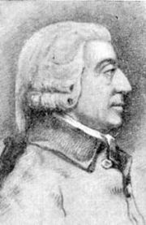
1. Division of Labor and Specialization Gains
Adam Smith: The Wealth of Nations, 1776

Slide 4
2. Exchange and Coordination
search – select – negotiate – set-up contract – exchange – supervise - enforce

Slide 5
3. Transaction Costs: “Coordination Is No Free Lunch”
Ronald H. Coase
The Nature of The Firm (1937)
Oliver E. Williamson
The Economics of Organization: The Transaction Cost Approach (1981)

Slide 6
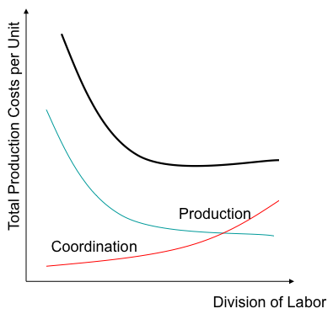
4. Our Ability to Economize on the Cost of Coordination Constrains Our Ability to Specialize

Slide 7
5. Macroeconomic Impact of Transaction Costs
> 50 % of the US GDP (1970)
John Joseph Wallis and Douglas C. North: Measuring the Transaction Sector in the American Economy, 1870 – 1970
(1986)

Slide 8
6. Some Drivers of Transaction Costs
Uncertainty
Opportunism
Specificity
Low Transaction Frequency
Williamson (1981)

Slide 9
Part II: Selected Functions of Enterprises in Markets

Slide 10
1. Inter-temporal Transformation
Supply Side
time
Demand Side

Slide 11
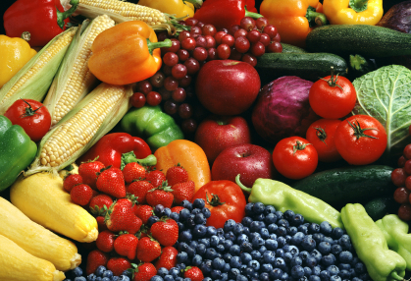
2. Volume Transformation
Supply Side
Demand Side

Slide 12
3. Risk Transformation
Typical Examples: Insurance, Lottery, Financial Markets ☹

Slide 13
4. Coordination and Production

Slide 14
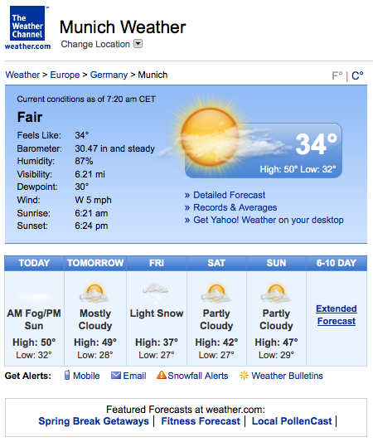
5. Imperfect Information and Uncertainty

Slide 15
6. … Under Uncertainty
… things may go wrong!

Slide 16
7. It’s All About Information
Acquisition / Elicitation
Processing

Slide 17
8. Information Overload Is a Myth
Processing

Slide 18
9. Category Systems…
Fruits
Apples
Food
DangerousAnimals
Lions

Slide 19
9. … Are Essential for Efficient Information Processing …
Food
Appropriate Actions:
What Can / Should I Do?
DangerousAnimals

Slide 20
9. … For Humans and Computers Alike!

Slide 21
Part III: The Economics of Automation

Slide 22
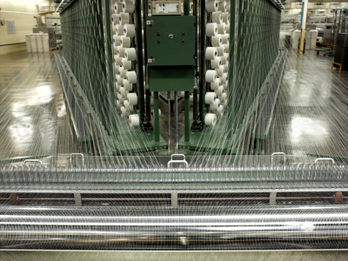
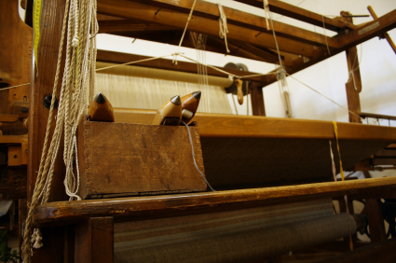
1. Man Has Tried For Ages ...

Slide 23
2. When Is Automation Efficient?
Cost of Human Labor (100%)
T = Training time
E = Execution time per task
W = Wage per hour
F = Frequency
Cost = W*(T+E*F)
Cost of a Machine (100%)
C = Construction of the machine
B = Building the machine
M = Materials for building the machine
O = Operating costs per piece
F = Frequency
Cost = C+B+M+O*F

Slide 24
3. Computer Information Systems
Cost of a Machine (100%)
C = Construction of the machine
B = Building the machine
M = Materials for building the machine
O = Operating costs per piece
F = Frequency
Cost = C+B+M+O*F

Slide 25
4. Software Reuse
Notes:
This means that Reuse is key.

Slide 26
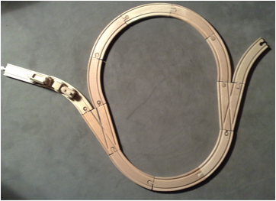
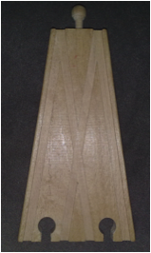
5. Reuse and the Toy Train: Small or Large Building Blocks

Slide 27
6. (Simplified) Economics of Reuse

Slide 28
Part IV: Information Technology and the World Wide Web

Slide 29
1. The Nature of Information Processing in the Machine
Input
Data
Output
Data
Processing
Algorithm

Slide 30
2. Category Systems in the Mind and in the Machine
Algorithms are suited only for objects of a predefined category.
More subtle operations require a more subtle category system.

Slide 31
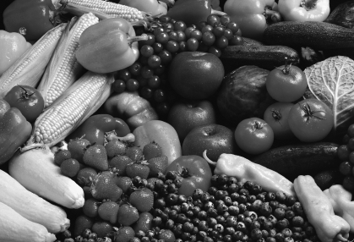
2. Category Systems in the Mind and in the Machine
Highlight all red fruits in the picture!
No notion of color, red, red objects!

Slide 32
3. The World Wide Web
Around 1990, …

Slide 33
… this guy ...

Slide 34
Sir Tim Berners-Lee
http://www.w3.org/People/Berners-Lee/

Slide 35
… had a great idea...

Slide 36
3. The World Wide Web, Essentially:
Turn References in Documents from Road Signs into Roads
Click!

Slide 37
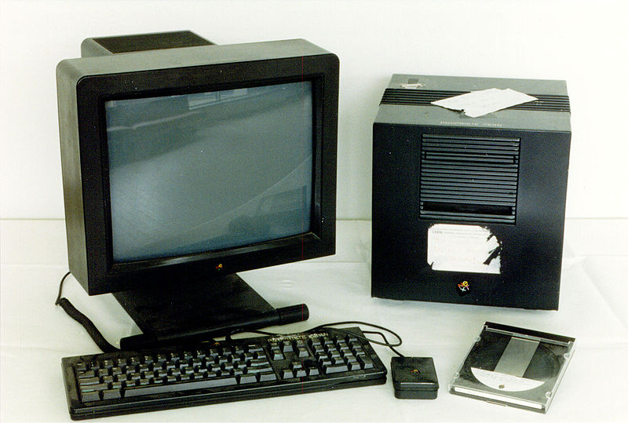
First Web Server

Slide 38
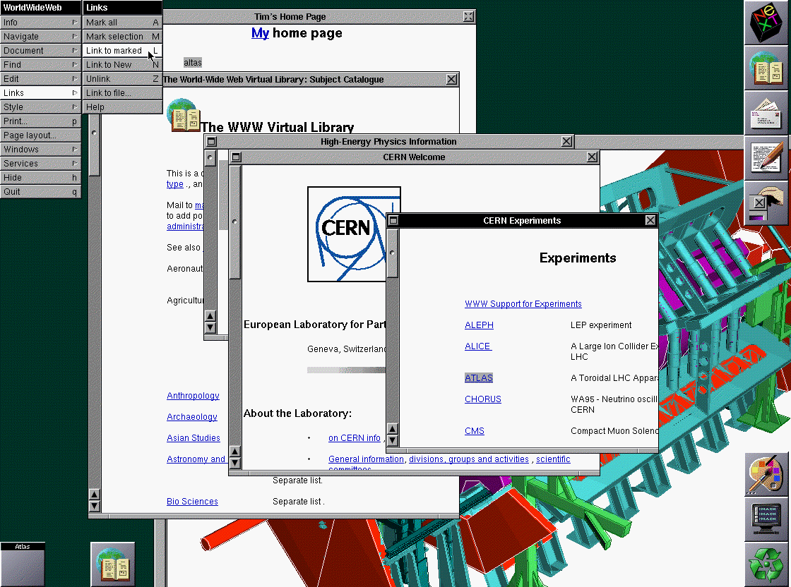
First Browser
http://www.w3.org/History/1994/WWW/Journals/CACM/screensnap2_24c.gif

Slide 39
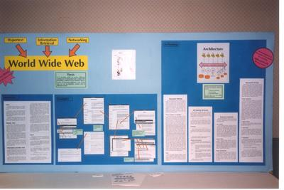
Hypertext '91 Conference in San Antonio, Texas (USA)
http://www.w3.org/2004/Talks/w3c10-HowItAllStarted/?n=16

Slide 40
4. The Web Fosters The Particular
Oh! So do I!
I collect xyz!

Slide 41
Part V: Where Are We Heading?

Slide 42
Recap: Specificity How much you loose when you can‘t use a good for what it was designed.

Slide 43
1. Growth in Specificity
Reason # 1: Division of Labor

Slide 44
The Range of Production on the Level of the Overall Economy
N = Number of Commodities
c = Number of Components per Level of Division of Labor
x = Depth of the Division of Labor

Slide 45
1. Growth in Specificity
Reason # 2: Technical Advancement and Innovation

Slide 46
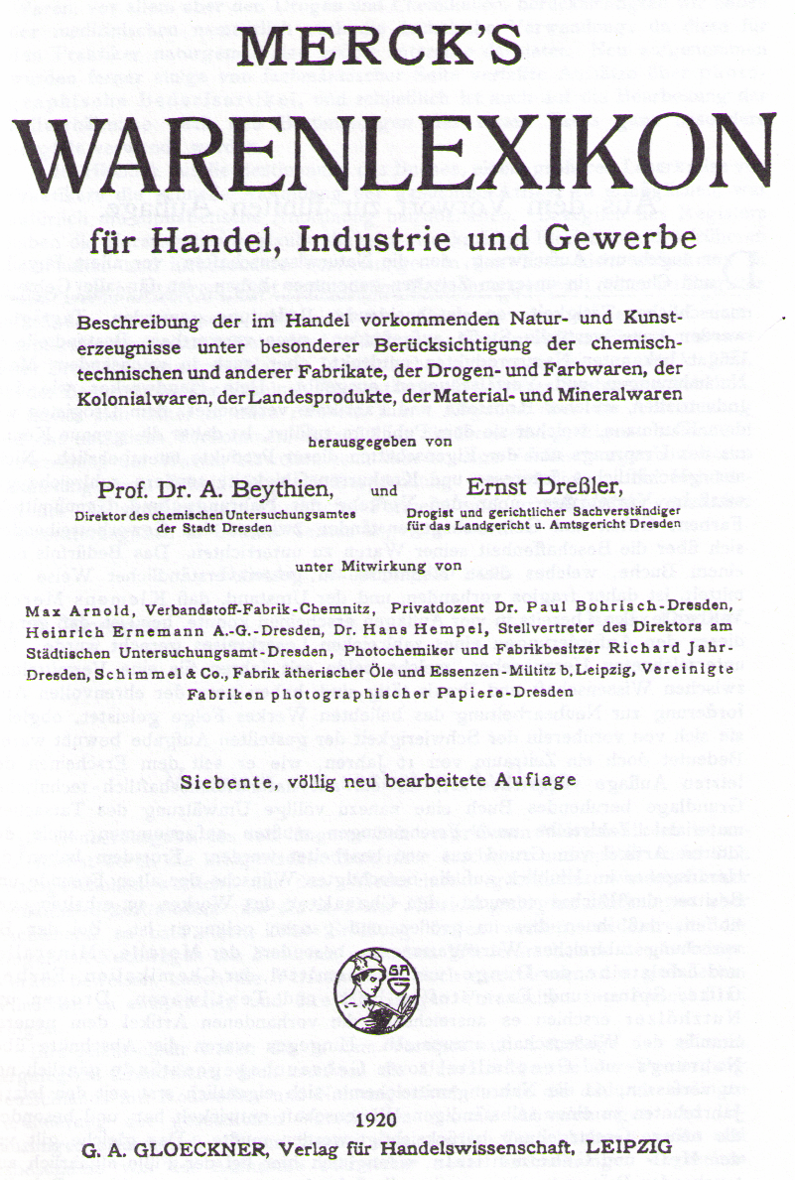
1920: 5168 Types of Goods

Slide 47
1. Growth in Specificity
Reason # 3: Logistics
Temporal Constraints etc.

Slide 48
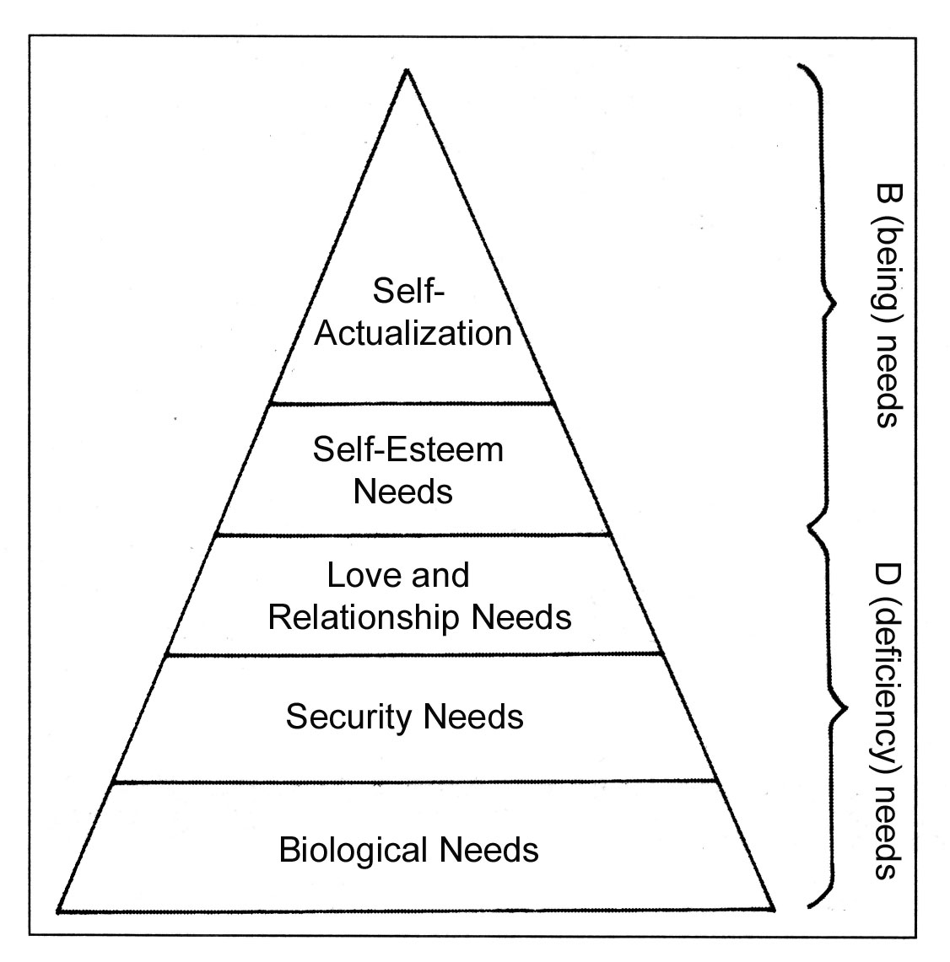
1. Growth in Specificity
Reason # 4: Wealth
Abraham H. Maslow (1908-1970)
A Theory of Human Motivation (1943)

Slide 49
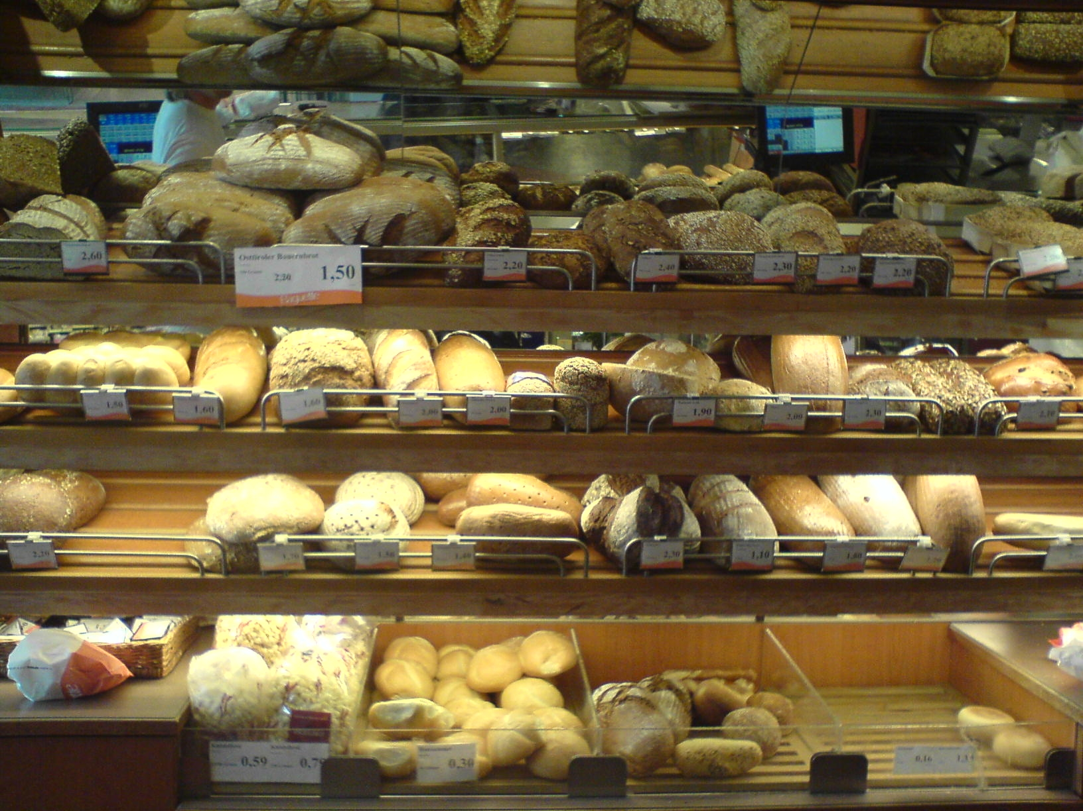
Examples

Slide 50
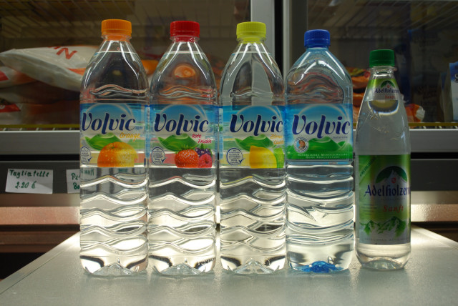
Examples

Slide 51
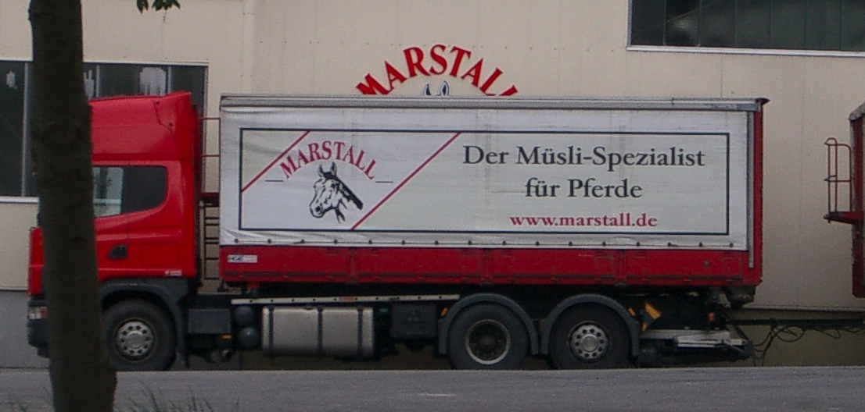
Examples

Slide 52
2. Specificity and Uncertainty
Higher risk under imperfect information

Slide 53
3. Specificity Creates Long-Tail Effects

Slide 54
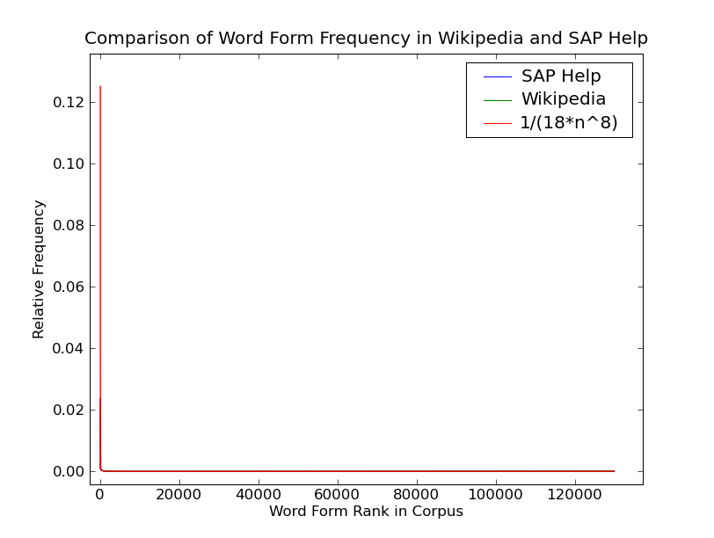
5. Conceptual Specificity Induces Symbolic Specificity

Slide 55
6. Increased Specificity of Data Structures

Slide 56
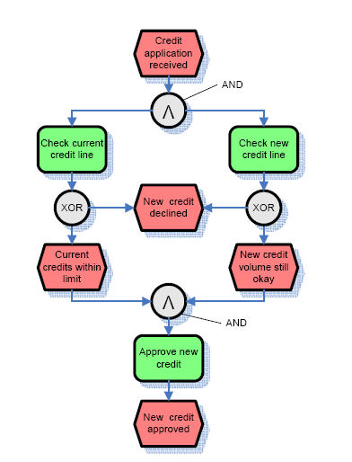
7. Increased Specificity of Processes

Slide 57
Long-tail Effects in the Processes Landscape
ad hoc processes
Only frequently executed processes can currently be automated
© IBM, 2006

Slide 58
8. The Money is on the Long Tail
Diversification

Slide 59
Part VI: Does IT Matter?

Slide 60
Recap: We Must Master Specificity
...and it‘s growing

Slide 61
1. Computers May Help…
…but...

Slide 62
2. Has ICT Lowered the Cost of Coordination?
Not uniformly, quite some counter-evidence.
Cordella (2006), Carr (2003)

Slide 63
3. The Productivity Paradox
No significant correlation between IT budget and productivity nor profitability.
But you are looking at the wrong variable, my friend....

Slide 64
4. Could ICT Lower the Cost of Coordination?
Cost of a Machine (100%)
C = Construction of the machine
B = Building the machine
M = Materials for building the machine
O = Operating costs per piece
F = Frequency
Cost = C+B+M+O*F

Slide 65
6. Search: Yellow Pages vs. Google
Lower search costs per search than ever before in history.

Slide 66
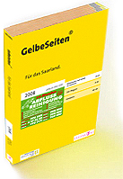
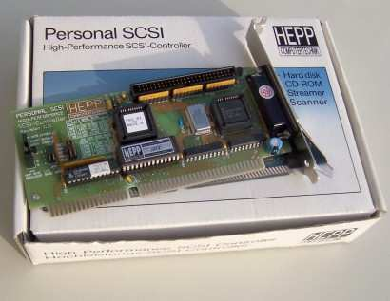
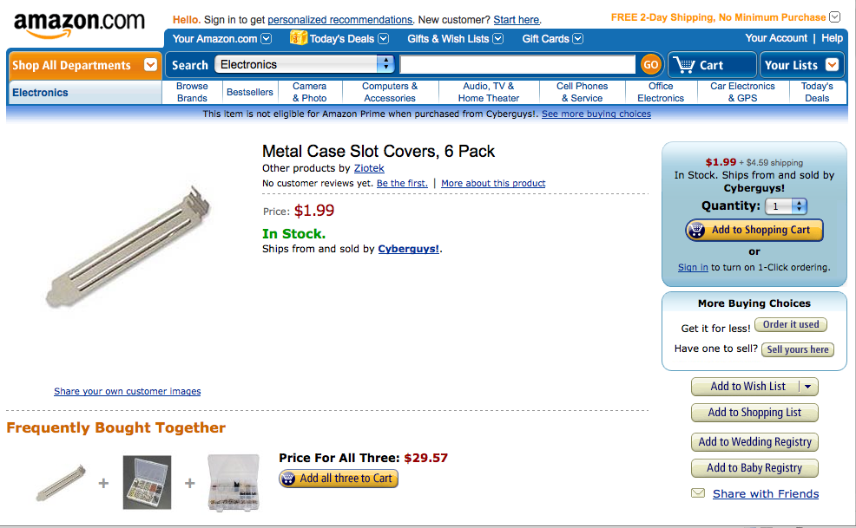
Hepp Computertechnik, ca. 1992

Slide 67
7. But: Google Still Insufficient on the Long Tail of Search
Now endorsed by Yahoo!

Slide 68
Part VII: Can IT Be A Commodity?

Slide 69
1. Carr’s Claims

Slide 70
2. What is a Commodity?
...something ... which is supplied without qualitative differentiation across a market.
(Okay, that‘s Wikipedia only)

Slide 71
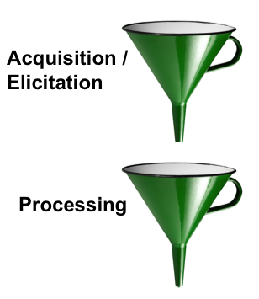
3. But: IT Determines the Sensory and Cognitive Performance of Enterprises
Web Mining
Airline Yield Management Systems
Etc.

Slide 72
4. Component Reuse is Not Equivalent to Turning IT into a Commodity!

Slide 73
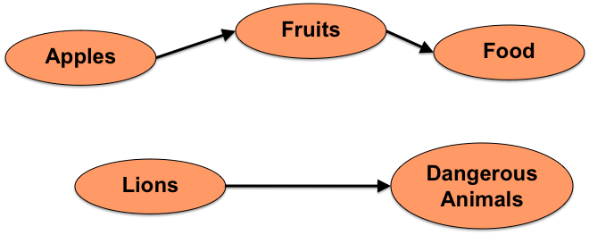
5. IT Must Represent the Category Structures of Human Reality
...also on the long tail (otherwise, no algorithmic solution)

Slide 74
6. Computer Information Systems Show Massive Economies of Scale
How many times can we run the same code?

Slide 75
7. The World Wide Web Allows Reuse Even on the Long Tail

Slide 76
Part VIII: Conclusion

Slide 77
Epilogue

Slide 78
Thank you.
http://www.unibw.de/ebusiness/

