Slide 1
Matchbox
Large Scale Online Bayesian Recommendations
David Stern, Thore Graepel, Ralf Herbrich
Online Services and Advertising Group
MSR Cambridge

Slide 2
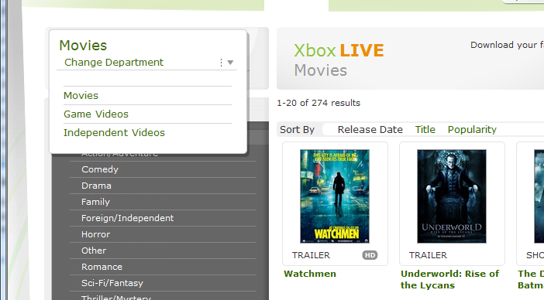

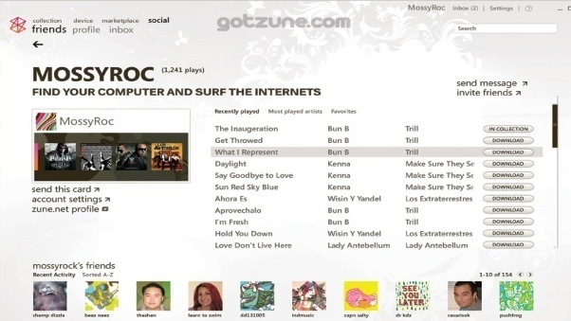
Overview
Motivation.
Message Passing on Factor Graphs.
Matchbox model.
Feedback models.
Accuracy.
Recommendation Speed.

Slide 3
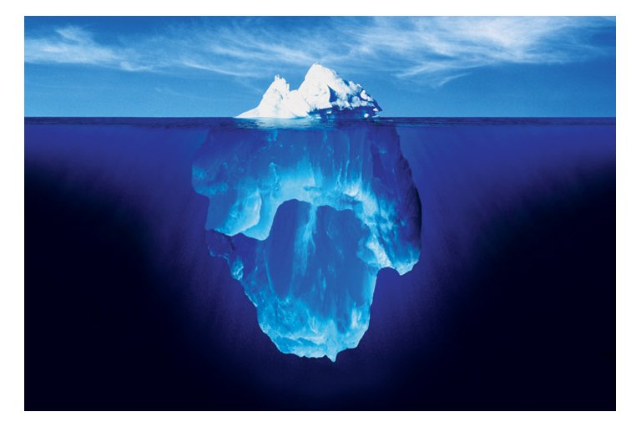

Slide 4

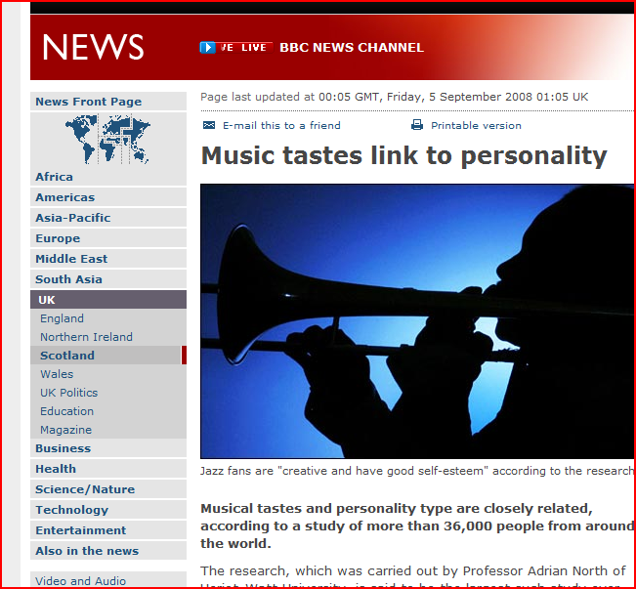
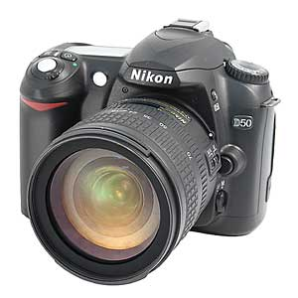

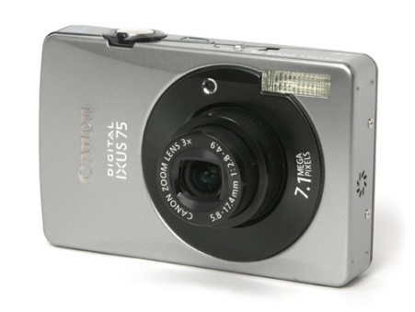

Large scale personal recommendations
User
Item

Slide 5
Collaborative Filtering
Items
1
2
3
4
5
6
Metadata?
A
B
Users
C
D
?
?
?

Slide 6

Goals
Large Scale Personal Recommendations:
  Products.
  Services.
  People.
Leverage user and item metadata.
Flexible feedback:
  Ratings.
  Clicks.
Incremental Training.

Slide 7
factor graphs

Slide 8
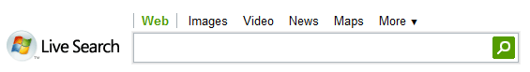
factor graphs

Slide 9
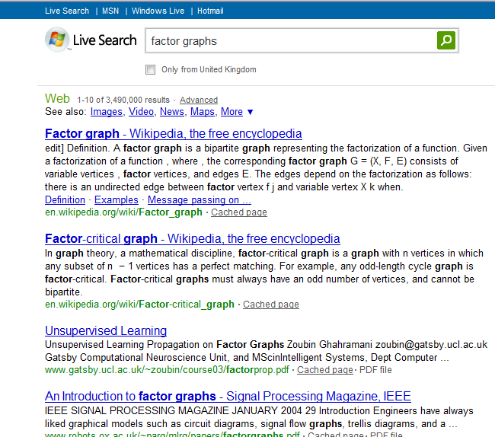

Slide 10
Factor Graphs / Trees
Definition: Graphical representation of product structure of a function (Wiberg, 1996)
  Nodes: = Factors = Variables
  Edges: Dependencies of factors on variables.
Question:
  What are the marginals of the function (all but one variable are summed out)?

Slide 11
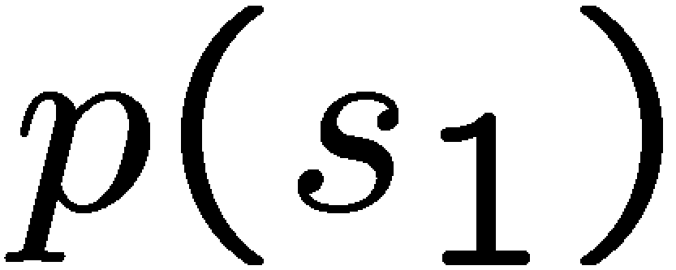
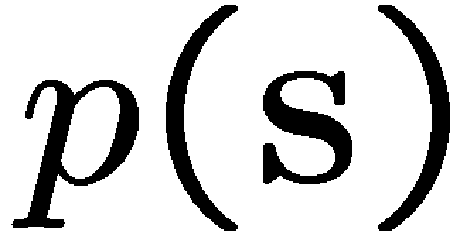
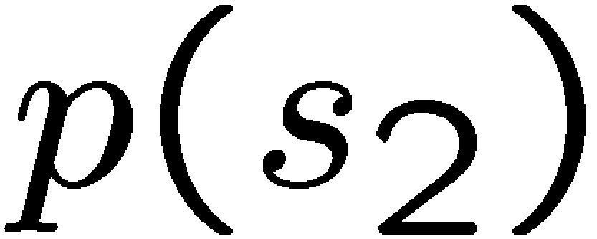
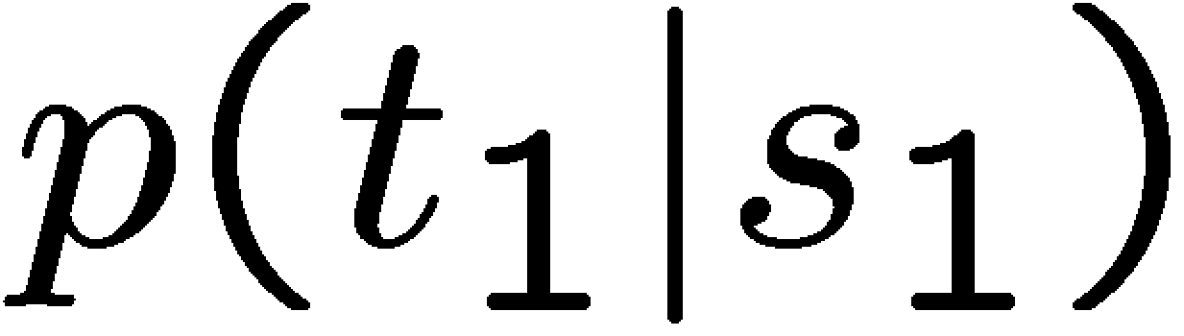
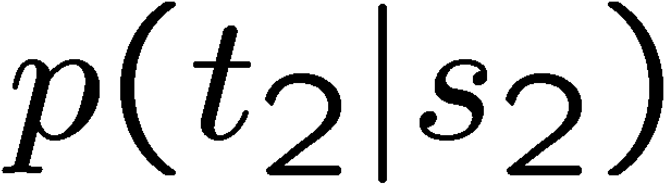
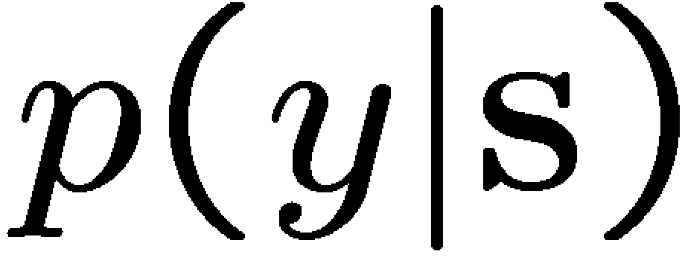
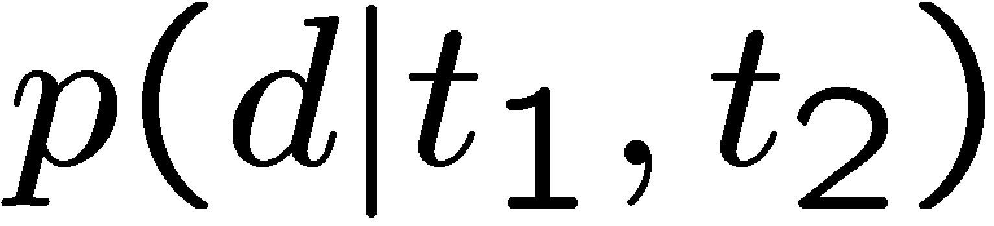
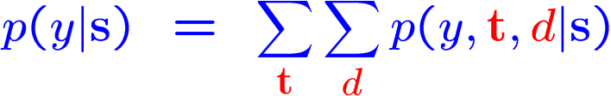
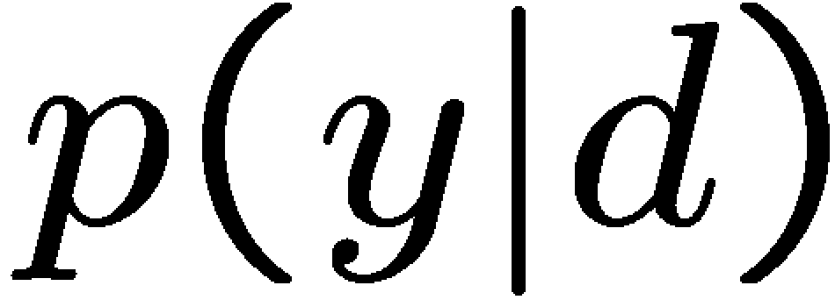
Factor Graphs and Inference
Bayes’ law
Factorising prior
Factorising likelihood
Sum out latent variables
Message Passing
s₁
s
s₂
Factor graphs reveal computational structure based on statistical dependencies
Messages are results of partial computations
Computations are localised
Infer.Net is a .Net library for (approximate) message passing built at MSRC
t₁
t₂
d
y

Slide 12





Gaussian Message Passing
*
=
-5
0
5
-5
0
5
-5
0
5
≈
?
*
=
-5
0
5
-5
0
5
-5
0
5

Slide 13
the model

Slide 14
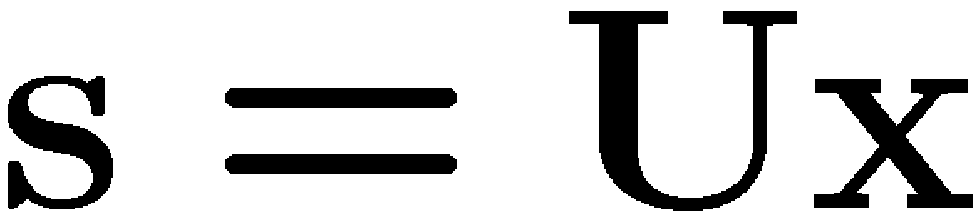
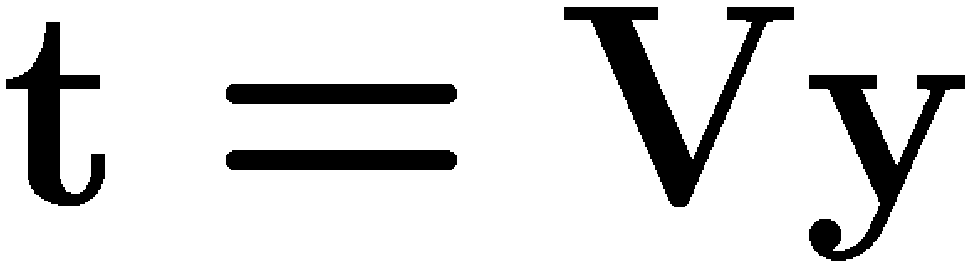
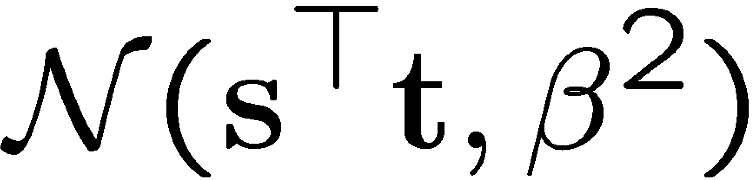
Matchbox With Metadata
User Metadata
Item Metadata
ID=234
Male
British
Camera
SLR
u₀₁
u₁₁
u₂₁
User
v₁₁
v₂₁
Item
+
s₁
t₁
+
User ‘trait’ 1
u₀₂
u₁₂
u₂₂
v₁₂
v₂₂
+
s₂
t₂
+
User ‘trait’ 2
Rating potential ~
*
r

Slide 15
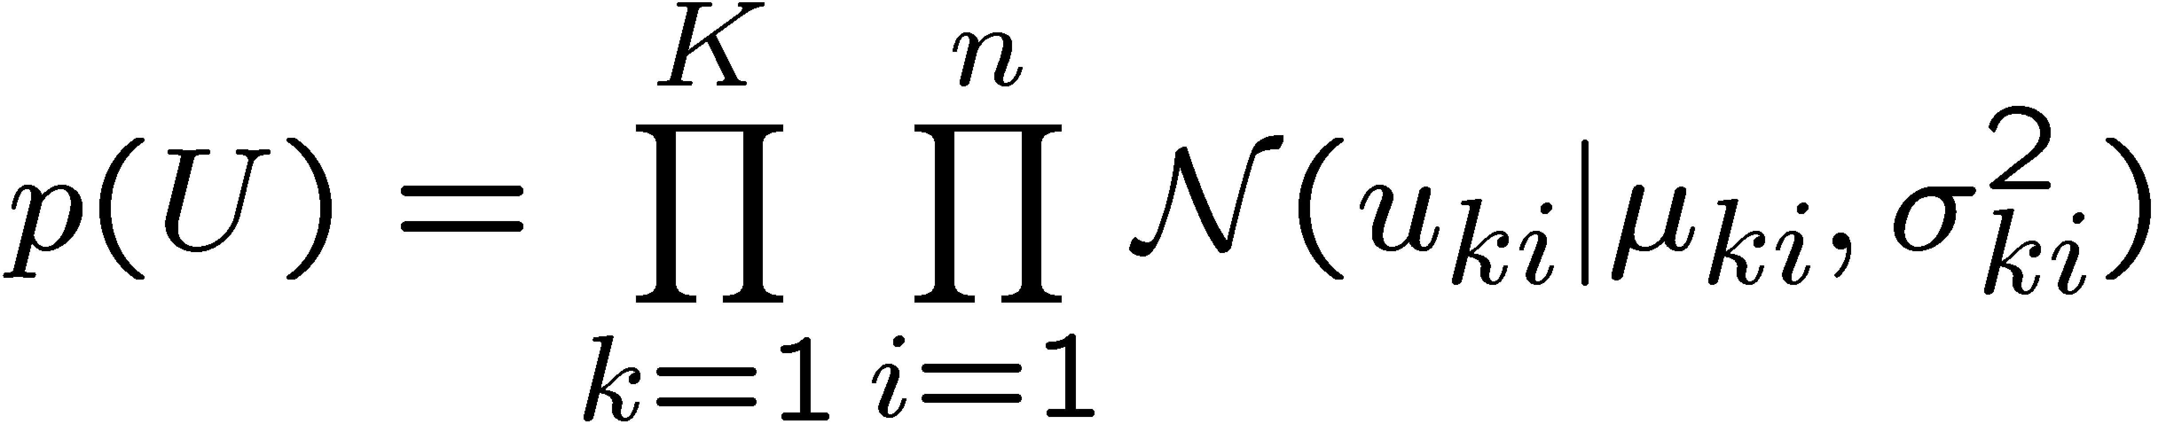
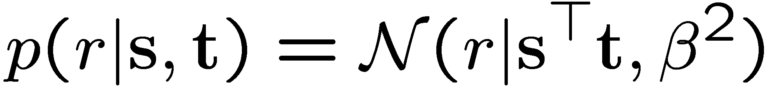

Matchbox With Metadata
User Metadata
Item Metadata
Male
British
Camera
SLR
u₁₁
u₂₁
User
v₁₁
v₂₁
Item
+
s₁
t₁
+
User ‘trait’ 1
u₁₂
u₂₂
v₁₂
v₂₂
+
s₂
t₂
+
User ‘trait’ 2
*
Incremental Training:
Assumed-Density Filtering
r

Slide 16
User/Item Trait Space
User-User, Item-Item similarity measure.
Solves Cold Start Problem
Single Pass
Flexible Feedback
Parallelisable by two methods
  Implicit
  Explicit
‘Preference Cone’ for user 145035

Slide 17
Incremental Training with ADF
Items
1
2
3
4
5
6
A
B
Users
C
D

Slide 18
feedback models

Slide 19
Feedback Models
r
q
=3
>0

Slide 20
Feedback Models
r
q
>
>
<
<
t₀
t₁
t₂
t₃

Slide 21
accuracy

Slide 22
Performance and Accuracy
Netflix Data
100 million ratings
17,700 movies / 400,000 users
Parallelisation with locking:
8 cores ➔ 4x faster
User / movie metadata
3,900 movies / 6,040 users
1 million ratings
MovieLens Data

Slide 23
MovieLens – 1,000,000 ratings
6040 users
3900 movies
User ID
Movie ID
User Job
Other | Lawyer
Academic | Programmer
Artist | Retired
Admin | Sales
Student | Scientist
Customer Service | Self-Employed
Health Care | Technician
Managerial | Craftsman
Farmer | Unemployed
Homemaker | Writer
User Age
<18
18-25
25-34
35-44
45-49
50-55
>55
Movie Genre
Action | Horror
Adventure | Musical
Animation | Mystery
Children’s | Romance
Comedy | Thriller
Crime | Sci-Fi
Documentary | War
Drama | Western
Fantasy | Film Noir
User Gender
Male
Female

Slide 24
MovieLens
Training Time: 5 Minutes

Slide 25
Netflix – 100,000,000 ratings
17770 Movies, 400,000 Users.
Training Time 2 hours (8 cores: 4X speedup).
14,000 ratings per second.
Number Trait Dimensions | RMSE
Cinematch | 0.9514
2 | 0.941
5 | 0.930
10 | 0.924
20 | 0.916
30 | 0.914

Slide 26
Training In Parallel

Slide 27


Parallel Message Passing
s₁
s₂
s₃
s₄
s₅
s₆
 | Shared Memory (Locking) | Distributed Memory (Cloning)
Pro | No variable duplication in memory No approximation error | Infinite scalability Works across machine boundaries Avoids conflicts in dense models
Con | Needs shared memory Frequent locking in dense models | Variable duplication in memory Small approximation error
=
=
=
=
=
=
=
=
=
=
=
=
y₁
y₂
y₃
y₄
y₅
s₁
s₂
s₃
s₄
s₅
s₆
s₁
s₂
s₃
s₄
s₅
s₆
y₁
y₂
y₃
y₄
y₅

Slide 28
recommendation speed

Slide 29
Prediction Speed
Goal:
find N items with highest predicted rating.
Challenge:
potentially have to consider all items.
Two approaches to make this faster:
  Locality Sensitive Hashing
  KD Trees
No Locality Sensitive Hash for inner product?
Approximate KD trees best so far.

Slide 30
Approximate KD Trees
Approximate KD Trees.
Best-First Search.
Limit Number of Buckets to Search.
Non-Optimised F# code: 100ns per item.
Work in progress...
0.25s Budget
Can Recommend 2,500,000 Items

Slide 31
KD Trees
ABCD
D
A
AB
CD
A
B
C
D
max A > max B
max D > max C
max AB > max DC
C
B

Slide 32
Approximation: limit buckets considered.

Slide 33
Approximate KD Trees

Slide 34
conclusions

Slide 35
Conclusions
Integration of Collaborative Filtering with Content information.
Fast, incremental training.
Users and items compared in the same space.
Flexible feedback model.
Bayesian probabilistic approach.

