Slide 1
Triplify – Linked Data Publication from Relational Databases
Sören Auer, Sebastian Dietzold, Jens Lehmann, Sebastian Hellmann, David Aumueller
AKSW, Institut für Informatik

Slide 2
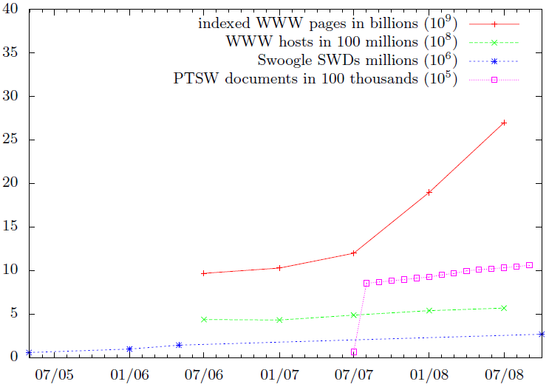
Growth of the Semantic Data Web
Still outpaced by the traditional Web ☹

Slide 3
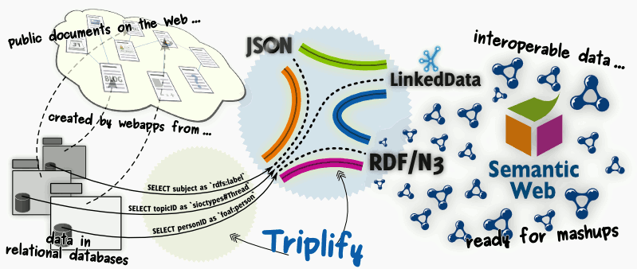
Triplify Big Picture

Slide 4
Triplify Motivation
Project | Area | Downloads
phpBB | discussion forum | 235480
Gallery | photo gallery | 166005
XOOPS | CMS | 115807
Coppermine | photo gallery | 113854
Typo3 | CMS | 63641
Liferay Portal | Portal | 39615
eGroupWare | group ware | 33865
Alfresco | CMS | 31914
e107 | CMS | 19996
Lifetype | Blogging | 16730
Plone | CMS | 13993
Compiere | ERP + CRM | 13718
WebCalendar | Calendar | 12832
Nucleus | Blogging | 12739
Tikiwiki | Wiki | 6368
overcome the chicken-and-egg dilemma of missing semantic representations and search facilities on the Web
Triplify leverages relational representations behind existing Web applications:
often open-source, deployed hundred thousand times
structure and semantics encoded in relational database schemes (behind Web apps) is not accessible to Web search engines, mashups etc.
Monthly Web application downloads at Sourceforge

Slide 5
Overview
Web Browser
Keyword-based Search Engines
Semantic-based Search Engines
HTML pages
RDF triple-based descriptions (Linked Data, RDF, JSON)
Webserver
Triplify
Endpoint registry
Web Application
Triplify script
Configuration repository
Relational Database

Slide 6
Solution overview
SQL is the industry standard language for relational transformations
Extend SQL with a few syntactic constructs opaque to the SQL query processor
Map URL patterns to sets of SQL query patterns
For a concrete URL request, replace placeholders in the query patterns, execute the query
Transform resulting relations into various RDF serializations (multiple view to class approach)

Slide 7
Triplify Solution: SQL-SELECT queries map relational data to RDF
Triplify Configuration:
number of SQL queries selecting information, which should be made publicly available.
Special SQL query result structure required (in order to convert results into RDF:
first column must contain identifiers for generating instance URIs (i.e. the primary key of DB table)
column names are used to generate property URIs, renaming columns allows to reuse properties from existing vocabularies such as Dublin Core, FOAF, SIOC
e.g. SELECT id, name AS 'foaf:name' FROM users
individual cells contain data values or references to other instances (eventually constitute the objects of resulting triples)

Slide 8
Example: Wordpress Blog Posts
Associate the URL path fragment 'post‘ with a number of SQL patterns:
http://blog.aksw.org/triplify/post/(xxx)
SELECT id, post_author AS 'sioc:has_creator->user', post_title AS 'dc:title', post_content AS 'sioc:content', post_date AS 'dcterms:modified^^xsd:dateTime‘, post_modified AS 'dcterms:created^^xsd:dateTime'
FROM posts
WHERE post_status='publish‘ (AND id=xxx)
SELECT post_id id, tag_label AS 'tag:taggedWithTag‘
FROM post2tag INNER JOIN tag ON(post2tag.tag_id=tag.tag_id)
(WHERE id=xxx)
SELECT post_id id, category_id AS 'belongsToCategory->category‘
FROM post2cat
(WHERE id=xxx)
Object property
1
Datatype property
2
3

Slide 9
RDF Conversion
http://blog.aksw.org/triplify/post/1
1
id | post_author | post_title | post_content | post_date | post_modified
1 | 5 | New DBpedia release | Today we released … | 200810201635 | 200810201635
2
id | tag:taggedWithTag
1 | DBpedia
1 | Release
..
3
id | belogsToCategory
1 | 34
…
http://blog.aksw.org/triplify/post/1 sioc:has_creator http://blog.aksw.org/triplify/user/5
http://blog.aksw.org/triplify/post/1 dc:title “New DBpedia release”
http://blog.aksw.org/triplify/post/1 sioc:content “Today we released …”
http://blog.aksw.org/triplify/post/1 dcterms:modified “20081020T1635”^^xsd:dateTime http://blog.aksw.org/triplify/post/1 dcterms:created “20081020T1635”^^xsd:dateTime
http://blog.aksw.org/triplify/post/1 tag:taggedWithTag “DBpedia”
http://blog.aksw.org/triplify/post/1 tag:taggedWithTag “Release”
http://blog.aksw.org/triplify/post/1 belongsToCategory http://blog.aksw.org/triplify/category/34

Slide 10
Triplify Implementation: Simplicity
Expose semantics as simple as possible
No (new) mapping languages – easy to learn
Few lines of code – easy to plug-in
Simple, reusable configurations
Available for most popular Web app languages
PHP (ready), Ruby/Python under development
Works with most popular Web app DBs
MySQL (extensively tested), PHP-PDO DBs (SQLite, Oracle, DB2, MS SQL, PostgreSQL etc.) should work, not needed for Virtuoso ☺
Triplify exposes RDF/Ntriples, LinkedData and RDF/JSON

Slide 11
Example Config
<?php include('../wp-config.php'); $triplify['namespaces']=array( 'vocabulary'=>'http://triplify.org/vocabulary/Wordpress/', 'foaf'=>'http://xmlns.com/foaf/0.1/', … ); $triplify['queries']=array( 'post'=>array( "SELECT id,post_author 'sioc:has_creator->user',post_date 'dcterms:created',post_title 'dc:title', post_content 'sioc:content', post_modified 'dcterms:modified‘ FROM {$table_prefix}posts WHERE post_status='publish'", "SELECT post_id id,tag_id 'tag:taggedWithTag' FROM {$table_prefix}post2tag", "SELECT post_id id,category_id 'belongsToCategory' FROM {$table_prefix}post2cat", ), 'tag'=>"SELECT tag_ID id,tag 'tag:tagName' FROM {$table_prefix}tags", 'category'=>"SELECT cat_ID id,cat_name 'skos:prefLabel',category_parent 'skos:narrower' FROM {$table_prefix}categories", 'user'=>array( "SELECT id,user_login 'foaf:accountName',SHA(CONCAT('mailto:',user_email)) 'foaf:mbox_sha1sum', user_url 'foaf:homepage',display_name 'foaf:name' FROM {$table_prefix}users", "SELECT user_id id,meta_value 'foaf:firstName' FROM {$table_prefix}usermeta WHERE meta_key='first_name'", "SELECT user_id id,meta_value 'foaf:family_name' FROM {$table_prefix}usermeta WHERE meta_key='last_name'", ), 'comment'=>"SELECT comment_ID id,comment_post_id 'sioc:reply_of',comment_author AS 'foaf:name', SHA(CONCAT('mailto:',comment_author_email)) 'foaf:mbox_sha1sum', comment_author_url 'foaf:homepage',
comment_date AS 'dcterms:created', comment_content 'sioc:content',comment_karma,comment_type FROM {$table_prefix}comments WHERE comment_approved='1'", ); $triplify['objectProperties']=array( 'sioc:has_creator'=>'user', 'tag:taggedWithTag'=>'tag', 'belongsToCategory'=>'category‘,'skos:narrower'=>'category','sioc:reply_of'=>'post'); $triplify['classMap']=array('user'=>'foaf:person', 'post'=>'sioc:Post', 'tag'=>'tag:Tag', 'category'=>'skos:Concept'); $triplify['TTL']=0; // Caching $triplify['db']=new PDO('mysql:host='.DB_HOST.';dbname='.DB_NAME,DB_USER,DB_PASSWORD);
?>

Slide 12
Configuration repository
Triplify configurations are shared at: http://Triplify.org
Existing configurations for OpenConf, Wordpress, WackoWiki, Drupal, OJS, Joomla, osCommerce, Gallery, phpBB, OMDB …

Slide 13
Triplify Endpoint Registry
Simple REST endpoint registry: http://triplify.org/Registry/?url=%rdf_source_URL%
Itself available as Linked Data endpoint
Enables building of mashups, vertical search and other applications using information from many sources – product search, blog search etc.

Slide 14
Triplify Temporal Extension
Problem: How do next generation search engines know something changed on the Data Web?
Different solutions:
Try to crawl always everything: currently deployed on the Web
Ping a central update notification service: PingTheSemanticWeb.com – will probably not scale if the Data Web gets really deployed
Each linked data endpoint publishes an update log: Triplify Update Logs

Slide 15
Triplify Temporal Extension
special update path and vocabulary
http://example.com/Triplify/update
http://example.com/Triplify/update/2007 rdf:type update:UpdateCollection .
http://example.com/Triplify/update/2008 rdf:type update:UpdateCollection .
http://example.com/Triplify/update/2008
http://example.com/Triplify/update/2008/Jan rdf:type update:UpdateCollection .
http://example.com/Triplify/update/2008/Feb rdf:type update:UpdateCollection .
Nesting continues until we finally reach an URL, which exposes all updates performed in a certain second in time…
http://example.com/Triplify/update/2008/Jan/01/17/58/06
http://example.com/Triplify/update/2008/Jan/01/17/58/06/user123
update:updatedResource http://example.com/Triplify/users/JohnDoe ;
update:updatedAt "20080101T17:58:06"^<xsd:dateTime> ;
update:updatedBy http://example.com/Triplify/users/JohnDoe .

Slide 16
LOD Update log generation
Updates have to be logged in the DB
Update log queries have to expose a date as first column:
$triplify['queries']=array(
…
'update'=>"SELECT p.changed AS id,
p.id AS 'update:updatedResource->project‘
FROM project p",
);

Slide 17
Triplify Spatial Extension: Linked Open Geo Data
Spatial data is crucial for the Data Web in order to interlink geographically linked resources.
Open Street Map project (OSM) collects, organizes and publishes geo data the wiki way:
80.000 OSM users collected data about 22M km ways (roads, highways etc.) on earth, 25T km are added daily
OSM contains a vast amount points-of-interest descriptions e.g. shops, amenities, sports venues, businesses, touristic and historic sights.
Goal: publish OSM geo data, interlink it with other data sources and provide efficient means for browsing and authoring:
Open Street Map data extraction works on the basis of OSM database dumps, a bi-directional live integration of OSM and our Linked Geo Data browser and editor is currently in the works.
Triplify spatial data publishing, the Triplify script for publishing linked data from relational databases is extended for publishing geo data, in particular with regard to the retrieval of information about geographical areas.
LinkedGeo Data browser and editor is a facet-based browser for geo content, which uses an OLAP inspired hypercube for quickly retrieving aggregated information about any user selected area on earth.

Slide 18
Triplify Spatial Extension
How to publish geo-data using Triplify?
http://linkedgeodata.org/near/48.213056,16.359722/1000/amenity=Hotel
http://linkedgeodata.org/node/212331
http://linkedgeodata.org/node/944523
http://linkedgeodata.org/node/234091
http://linkedgeodata.org/way/56719
node/150760824 amenity "pub";
created_by "JOSM";
distance "5995";
name "La friolera";
geo#lat "40.4474";
geo#long "-3.7173".
Lon
Lat
Radius
Attribute
Value

Slide 19
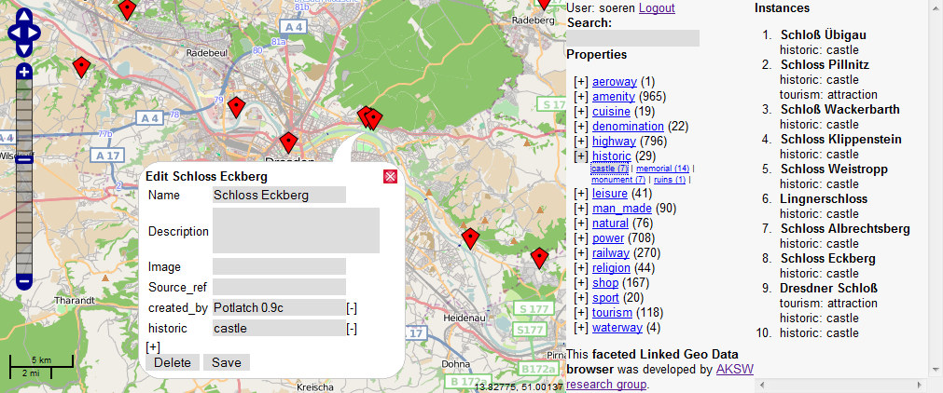
Faceted Linked-Geo-Data Browser

Slide 20
RDB2RDF tool comparison
Tool | Triplify | D2RQ | Virtuoso RDF Views
Technology | Scripting languages (PHP) | Java | Whole middleware solution
SPARQL endpoint | - | X | X
Mapping language | SQL | RDF based | RDF based
Mapping generation | Manual | Semi-automatic | Manual
Scalability | Medium-high (but no SPARQL) | Medium | High
More at: http://esw.w3.org/topic/Rdb2RdfXG/StateOfTheArt

Slide 21
Conclusion
Triplify supports the “long tail” of deployed Web applications
Publishing RDF and Linked Data is simple
Support for temporal and spatial data dimensions
LOD Update Logs enable differential crawling
Linkedgeodata.org provides spatial identifiers for most parts of the world
More comprehensive solutions are (still) required for SPARQL support

Slide 22
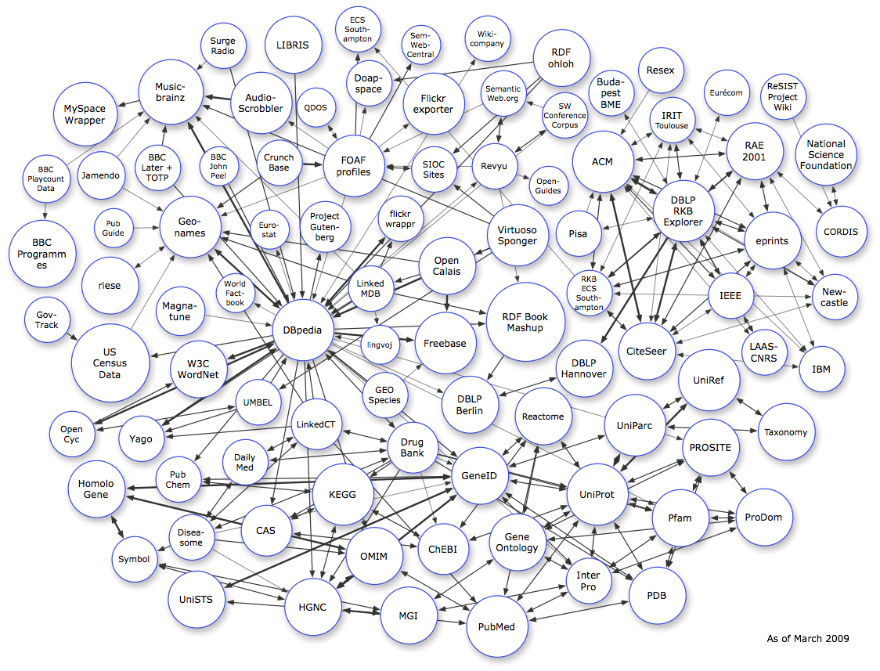
Should it be a Cloud or the Sky?

Slide 23
Thanks!
Sören Auer
auer@informatik.uni-leipzig.de
Research group Agile Knowledge Engineering & Semantic Web (AKSW): http://aksw.org
http://Triplify.org
http://DBpedia.org
http://OntoWiki.net
http://OpenResearch.org
http://aksw.org/projects/xOperator
DL-Learner.org
Cofundos.org

