Slide 1


Enterprise COllaboration & INteroperability
Enterprise Collaboration Services
Patrick Sitek –
Bremen Institute for Production and Logistics
at the University of Bremen
May, 5th Budapest

Slide 2
Workshop Agenda
Enterprise Collaboration Services - Concept
Enterprise Collaboration Services - Detail
What’s new in COIN EC Baselines
Questions & Answers
2

Slide 3
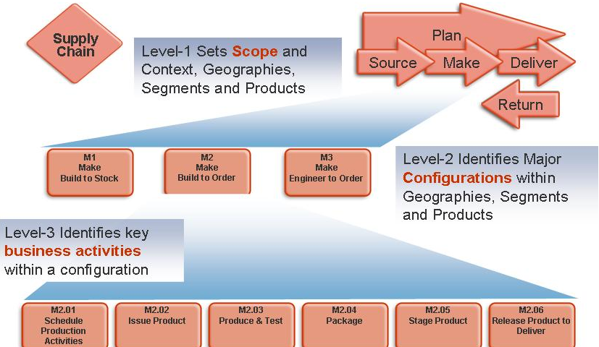
Understanding Enterprise Collaboration
OEM determines the SC competencies and network structure
  Aligned by construction
  OEM generates BOs for the SC
  Top-down modeling, structuring and planning
  Full scale competencies visibility
  Centralised enactment & management
Service Center as a competencies collector
Manual Alignment process
Crawlers to discover market BOs
Top-down modelling, structuring and planning
Negotiation for scheduling
Centralised enactment & management
  Specific BE competencies
  Intelligent Alignment process (Agents)
  BO Miners to discover internally-generated BOs
  Participative and collaborative structuring, modeling and planning
  P2P enactment & management
3

Slide 4
Enterprise Collaboration Baseline Concept –
Business Perspective
 | Enterprise Collaboration Preparation | Enterprise Collaboration Formation | Enterprise Collaboration Management & Operation | Enterprise Collaboration Dissolution
Competencies Management Baseline Services | Service for Maintaining Competencies | Service for matching Competencies with Business Opportunity | Service for Tracking Capacities | Service for Maintaining Knowledge and Training
Business Opportunities Management Baseline Services | Service for Identifying Business Opportunities |  | Service for Tracing Progress | Service for Customer Support
 | Basic Services for Human Interaction
4

Slide 5
Existing EC tools and systems
Category | Software | Number of Tools | Tool Name
Web application | Tomcat | 10 | Virtual Breeding Environment Management (VMBS), Professional Virtual Community (PVC) Management and Governance, PVC Rewarding Tool, Requirement Identification Service (refQuest), E4 (Extended Enterprise Management in Enlarged Europe) Platform, Supported Indicator Definition (SID), Collaboration Opportunity Characterization (COC) Plan, Virtual Organization (VO) Model Repository, Partner Selection (PS), VO Formation
 | Apache Web server | 2 | Collaboration Opportunity (CO) Finder, Customer Support Service (DISCO)
 | Microsoft IIS | 4 | PVC Management and Governance, Planned, Mediated, and Ad-hoc Collaborations
Web service | Axis | 2 | Communication Service Set, Activity Management
Database | MySQL | 9 | PVC Management and Governance, PVC Rewarding Tool, Planned, Mediated, and Ad-hoc Collaborations, Communication Service Set, Activity Management, refQuest, DISCO
 | PostgreSQL | 5 | VBMS, E4 Platform, CO Finder, COC-Plan, VO Formation
Programming Language | Java | 10 | VBMS, PVC Rewarding Tool, Communication Service Set, Activity Management, refQuest, SID, COC-Plan, VO Model Repository, PS, VO Formation
 | C# | 5 | PVC Management and Governance, Planned, Mediated, and Ad-hoc Collaborations, E4 Platform
 | PHP | 2 | CO Finder, DISCO
5

Slide 6
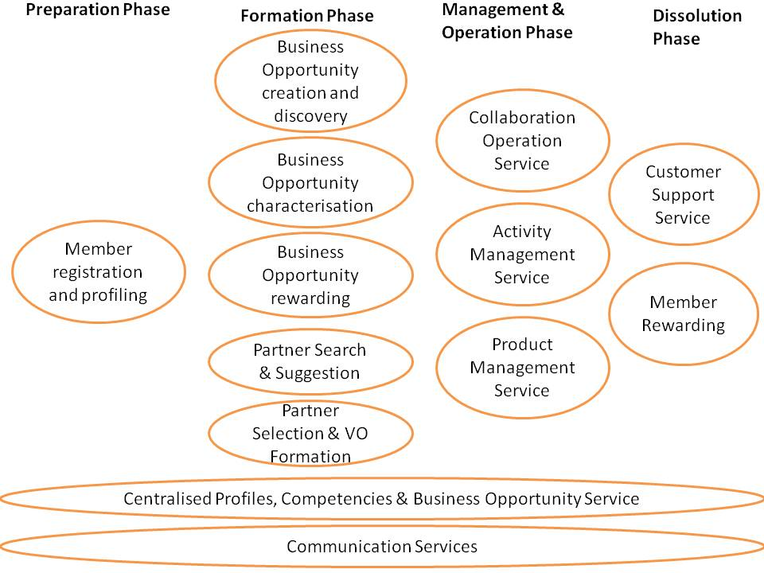
Enterprise Collaboration Baseline Services –
Prototype Details (GUI)
core set of services and tools
each ellipse represents a business service that is supported by a group of software tools and services

Slide 7
Member registration
Details
Alignment with EC | Member Registration Tool is offered in the Preparation Phase of an Enterprise Collaboration to organizations and individuals in order to register in the network.
Functionality | Member Registration Tool process requires the following steps: 1. Membership applicant creates a new account. 2. Membership applicant chooses whether to register as an organization or a professional individual 3. Membership applicant submits member data and evidence data. 4. Membership administrator is informed about a new applicant. 5. Membership administrator evaluates organization/individual and evidence data of the new applicant and might inquire additional information. 6. Membership administrator accepts or rejects the application. 7. On a successful application the Membership applicant becomes a member and can access information other members.
Licensing | Creative Commons 3.0 non-commercial license (http://creativecommons.org/licenses/by-nc/3.0/de/deed.en).
Contact Person | Simone Stegel, BIBA, stl@biba.uni-bremen.de
Notes:
Orally explain what VCOR is

Slide 8
Member profiling
Details
Alignment with EC | Preparation phase: the Company Manager sets up his company profile (workflows that are going to be used, definition of processes and performance data, contributed products or services, assignment of workflows to products)
Functionality | Partner Profiling requires the following proceeding: 1. Registration as Administrator / Network Manager. See all profiles available in the network b) See all network members offering specific components/ services. See details about single components and process performance of specific supplier as well as uploaded documents regarding the offer. c) See and configure all running Enterprise Collaborations 2. Or registration as Network Member. 3. Logged in as a Network Member: a) Add components/ services and upload documents about component b) Define processes needed (VCOR™) c) Define key performance indicators for each process (VCOR™) d) See all components and referring details offered from network member e) Change the details, upload new documents, and configure performance data of existing components f) See all Enterprise Collaborations the user is involved in
Licensing | Partner Profiling tool is based on Java technologies and is released adopting OSS GNU General Public License v2 license (http://www.gnu.org/licenses/gpl-2.0.html).
Contact Person | Simone Stegel, BIBA, stl@biba.uni-bremen.de
Notes:
Orally explain what VCOR is

Slide 9
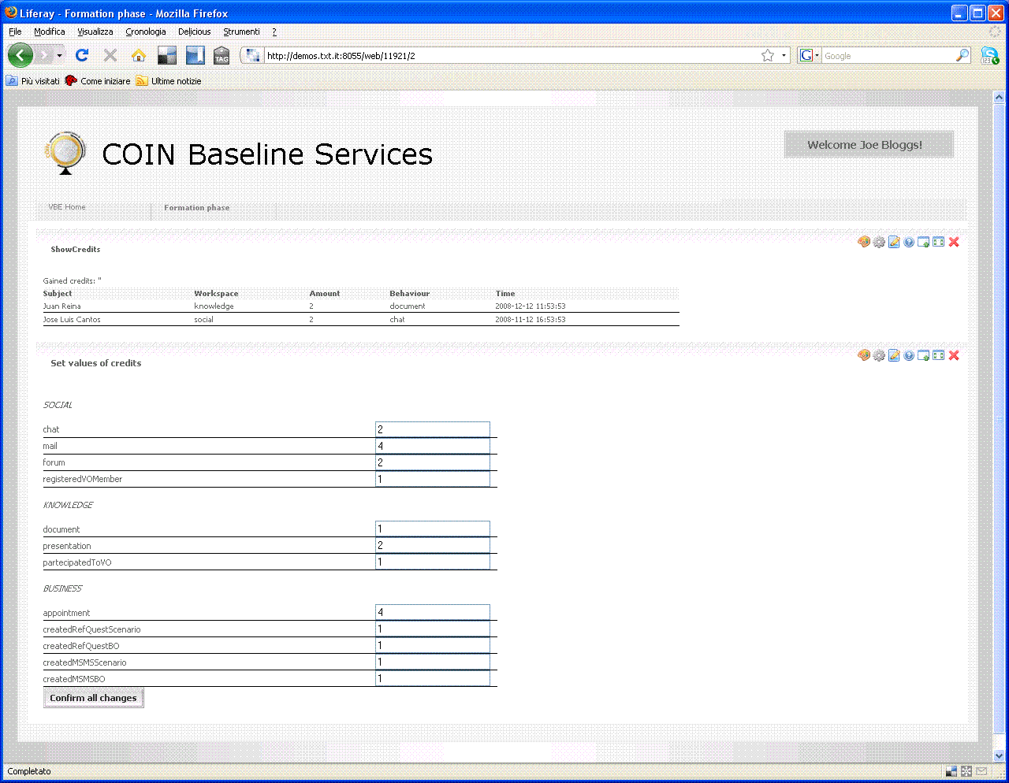
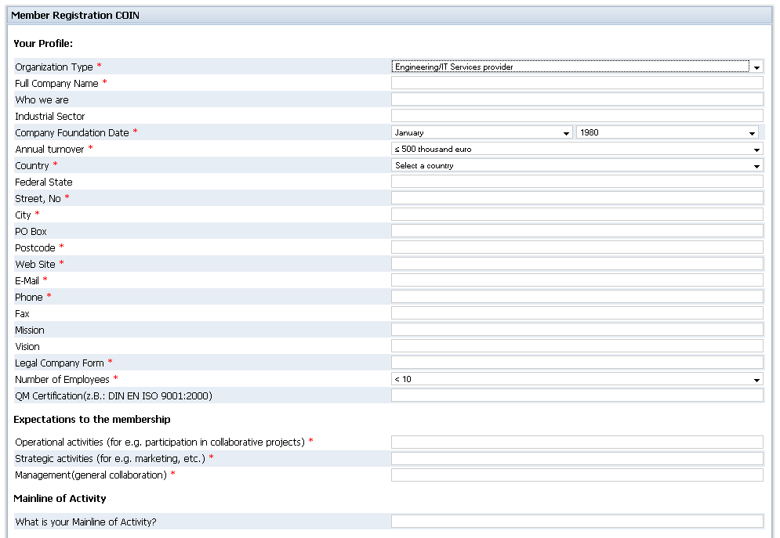
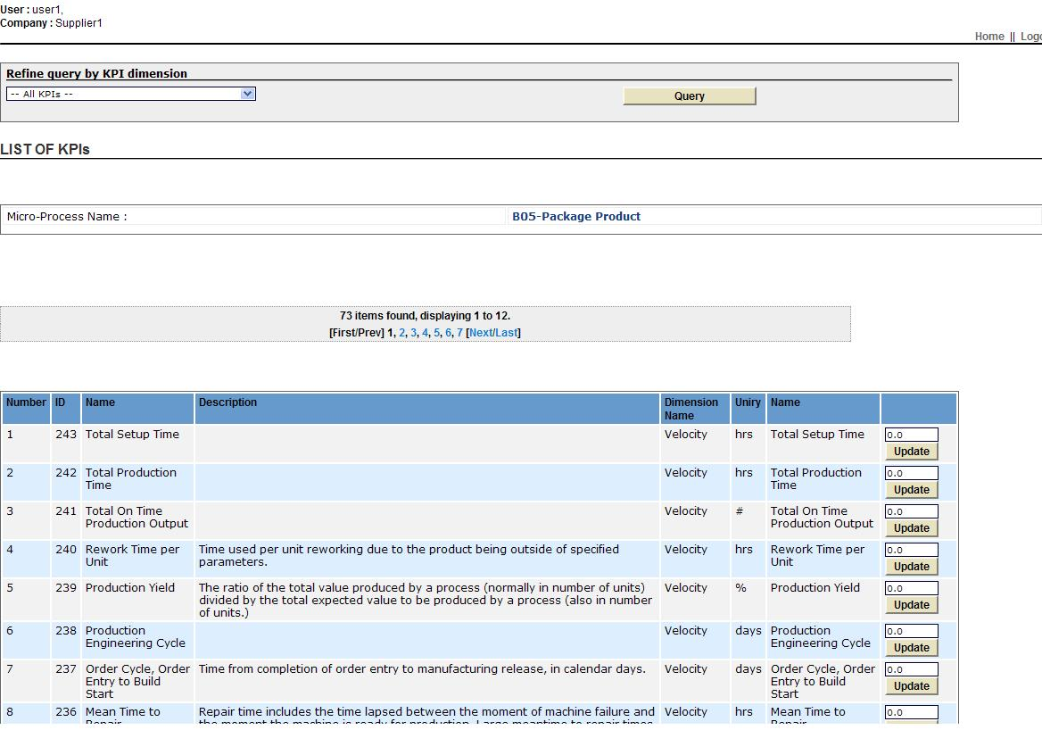
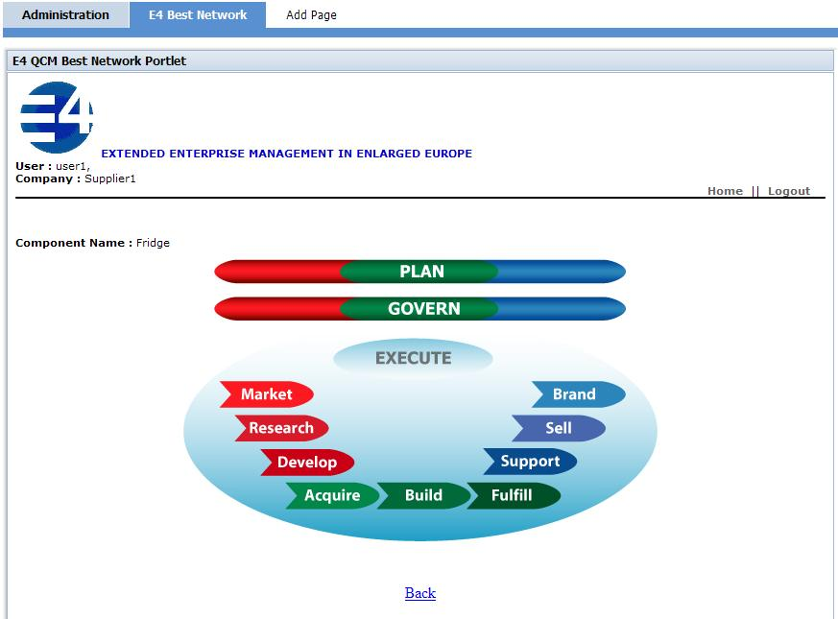
Member registration and profiling
Management of member information
and member performance profiling
(processes, VCOR KPIs)
For both individuals and organizations.
Notes:
Orally explain what VCOR is

Slide 10
Enterprise Collaboration Baseline Services –
Prototype Details
core set of services and tools
each ellipse represents a business service that is supported by a group of software tools and services

Slide 11
Business Opportunity creation
Details
Alignment with EC | RefQuest is a serious game for the Business Opportunity Creation option, allows the implementation of different ideation processes due to the separation of gaming engine and game content. Actions and events keep the ideation process innovative. This Business Opportunity Creation tool supports the creative ideation process between network members at an early stage in the collaboration phase.
Functionality | The BO Creation game requires the following proceeding: 1. Login as a player. 2. Choose a perspective. 3. Individual idea generation 4. Common idea generation 5. Idea presentation 6. Idea assessment 7. Complete idea generation.
Licensing | The BO Creation tool is developed and completely owned by BIBA Business Opportunity Creation (refQuest) on BIBA server at http://www.games.biba.uni-bremen.de
Contact Person | Simone Stegel (stl@biba.uni-bremen.de)

Slide 12
Business Opportunity discovery
Details
Alignment with EC | The necessity of this tool comes from the necessity of the broker to find in a short time the right BO. The large amount of data available in the web do this research very complex and time consuming. This tool can leverage the broker from these issues presenting in an automatic way the list of suitable BOs. The Business Opportunity Discovery Service is a web application looking for CfT (calls for tenders) published in internet web sites. Application output data are exported to other services to give the possibility to manage discovered BOs. Data are stored into Business Opportunity Model by “Business Opportunity Service” web services.
Licensing | The license is to be determined.
Contact Person | Drago Trebeznik, JSI, drago.trebeznik@ijs.si
Notes:
Orally explain what VCOR is

Slide 13
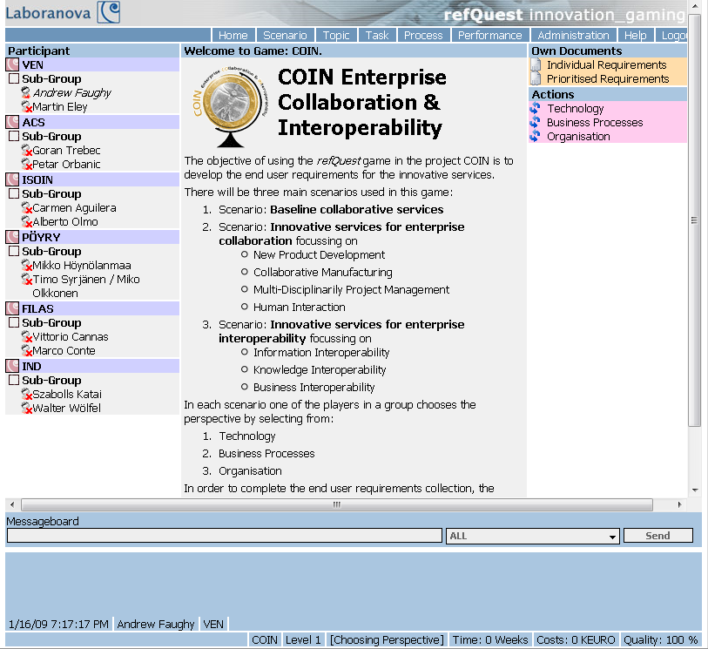
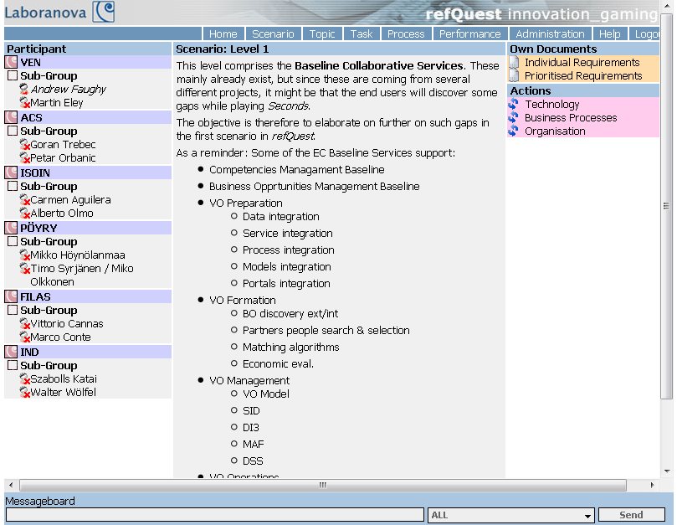
Business Opportunity creation and discovery
Software tools and services:
Business Opportunity Discovery Service
Business Opportunity Creation Tool
Notes:
Orally speak about exogenous and endogenous BOs, and that ECOLEAD did not support the latter BOs, but LABORANOVA did

Slide 14
Enterprise Collaboration Baseline Services –
Prototype Details
core set of services and tools
each ellipse represents a business service that is supported by a group of software tools and services

Slide 15
Business Opportunity rewarding
Details
Alignment with EC | The Business Opportunity Rewarding Tool is offered to motivate parties interested in an enterprise collaboration in contributing business opportunities. The Business Opportunity Rewarding tool developed as a Java portlet runs within the COIN Baseline EC Portal and accesses the COIN Centralized Profiles, Competencies and Business Opportunity Service.
Functionality | The Business Opportunity Rewarding tool requires the following proceeding: 1. Administrator created a list of incentives. 2. Member uploads BO idea. 3. Administrator is informed about a new item. 4. Administrator evaluates the item and enters a score. 5. Member accesses the incentives list and can select an incentive.
Licensing | Creative Commons 3.0 non-commercial license (http://creativecommons.org/licenses/by-nc/3.0/de/deed.en)
Contact Person | Simone Stegel, BIBA, stl@biba.uni-bremen.de
Notes:
Orally explain what VCOR is

Slide 16
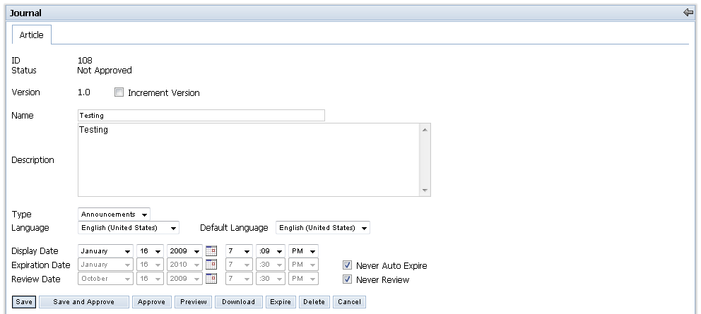
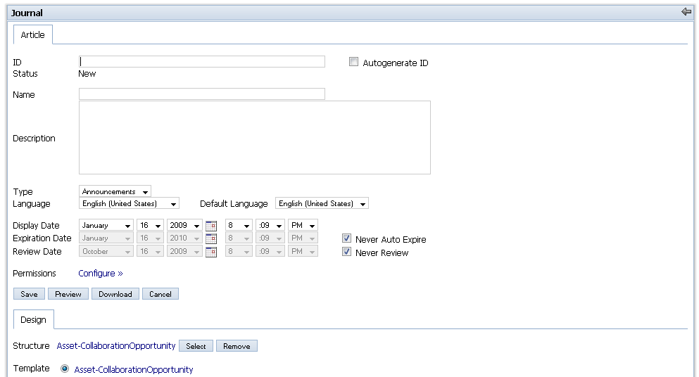
Business Opportunity rewarding
Software tools and services:
- Business Opportunity Rewarding Tool
Reward organisations creating new business opportunities for the cluster
Score is defined and maintained for each member of the enterprise collaboration

Slide 17
Enterprise Collaboration Baseline Services –
Prototype Details
core set of services and tools
each ellipse represents a business service that is supported by a group of software tools and services

Slide 18
Business Opportunity characterisation
Details
Alignment with EC | BO Characterization tool allows a user to make BO decomposition, identify needed competencies and make a rough planning of the EC. The BO decomposition is done in terms of products to be manufactured as well as Bill of Material and/or activities to be performed as well as Work Breakdown Structure.
Functionality | The “WBS service” provides the creation of a complete Work Breakdown Structure (WBS) getting in input in a BOM with activities (tasks) to be performed to create the related item. The service allows the creation of the WBS by the usage of different algorithms such: • As Soon As Possible (ASAP) • Al Late As Possible (ALAP) • minimum usage of resources The output of the computation is returned to the caller by an XML file
Licensing | All third party software components and libraries are released under Apache Licence or Sun licence.
Contact Person | Michele Sesana, TXT, michele.sesana@txt.it
Notes:
Orally explain what VCOR is

Slide 19
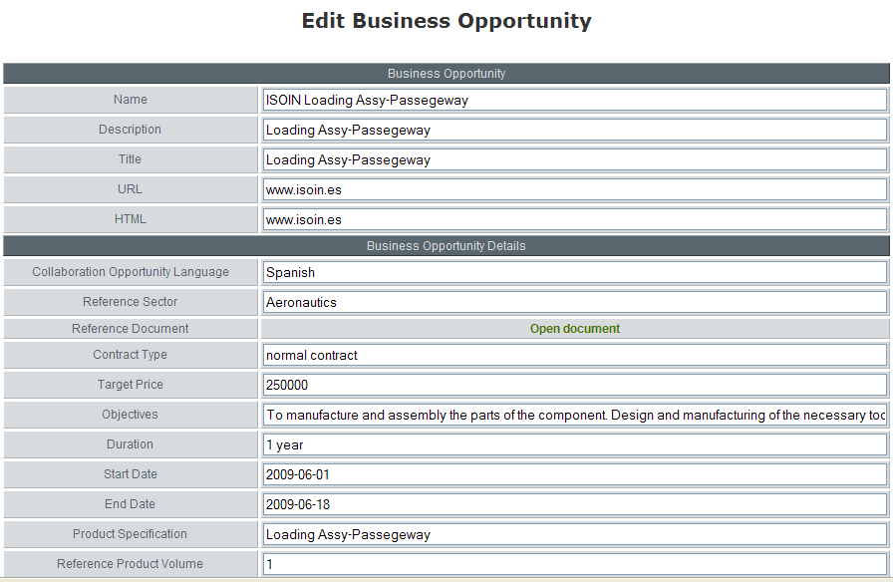
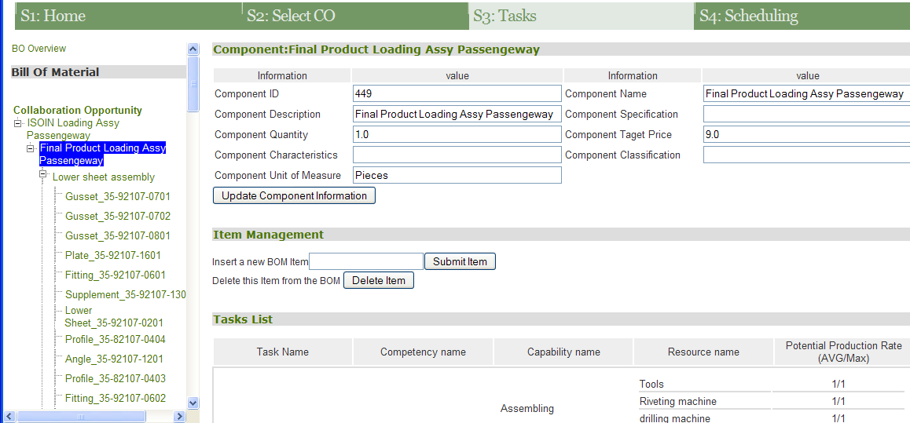
Business Opportunity characterisation
Software tools and services:
- Business Opportunity Characterization Service and Tool for Manufacturing
Characterization of a Business Opportunity in terms of BOM (Bill Of Material) definition, BOM item information tasks and required competencies to perform them. BO formalization in a structure (WBS).
Notes:
Is it just for manufacturing?

Slide 20
Enterprise Collaboration Baseline Services –
Prototype Details
core set of services and tools
each ellipse represents a business service that is supported by a group of software tools and services

Slide 21
Partner Search & Suggestion
Details
Alignment with EC | The purpose of partners search (PS) tool is to assist the broker in the selection of the most suitable members for a EC regarding the requirements of a given and characterized business opportunity (BO). The output of the PS tool is a list of potential EC configurations including an associated expected performance for each possible configuration with respect to the applied performance criteria.
Functionality | Main functionalities: - Import: Read import data about tasks and required competencies from the Business Opportunity Model. - Search: The partner search will look for the potential partners that have the required competences / processes as well as resource availability to be part of the new EC. - Generation and Analysis of suggested EC: presents not only the best arrangements but also additional information regarding special characteristics of each partner
Licensing | Has to be determined.
Contact Person | The service has been created in a past project by VTT, for WP4.1 purposes has been adapted and integrated by TXT, contact person is Michele Sesana (michele.sesana@txt.it)
Notes:
Orally explain what VCOR is

Slide 22
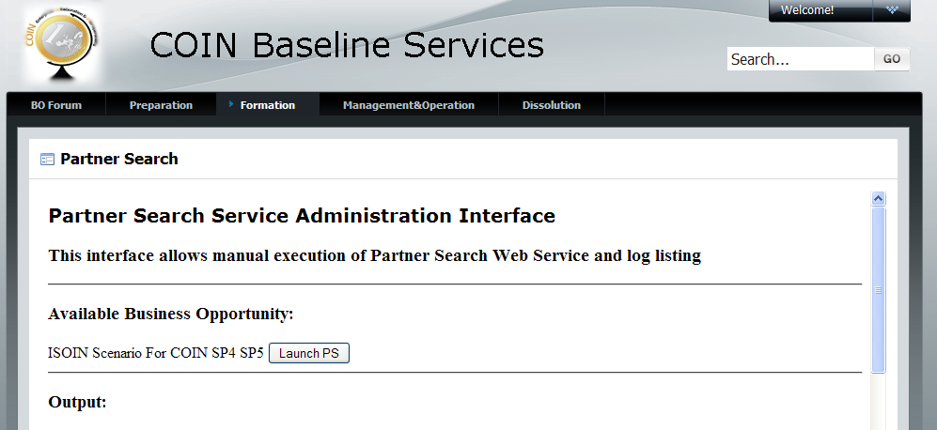
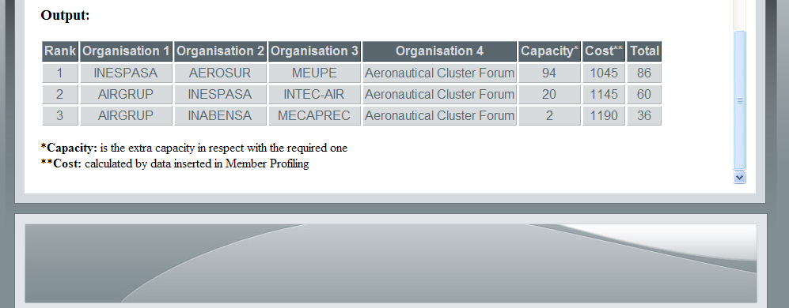
Partner Search & Suggestion
Software tools and services:
- Partner Search Service
Search for relevant partners (from the cluster member pool)
Web service implementing and executing search algorithms
The service suggests the most suitable members for an Enterprise Collaboration regarding the requirements of a given business opportunity (BO)

Slide 23
Enterprise Collaboration Baseline Services –
Prototype Details
core set of services and tools
each ellipse represents a business service that is supported by a group of software tools and services

Slide 24
Partner Selection & EC Formation
Details
Alignment with EC | Creating a new EC and selecting the appropriate partners. The Partner Selection and EC Formation tool manages information about ECs during the Formation phase. It provides mechanisms for storing information on created ECs in the data-structure as well as structuring, storing, and providing inheritance information to the formation process. The innovation lies in the combination of organizations and individual profiles representing a highly dynamic collaborative network.
Functionality | The Partner Selection and EC Formation tool requires the following steps: 1. Administrator can create a new EC. 2. Administrator can choose partners according to a list retrieved from Partner Search & Suggestion or choosing other partners distinguishing organizations and individuals. 3. Administrator can edit information about each EC and can edit EC documents. 4. Member can access information on each EC. 5. All running and terminated ECs are displayed.
Licensing | Creative Commons 3.0 non-commercial license(http://creativecommons.org/licenses/by-nc/3.0/de/deed.en).
Contact Person | Simone Stegel, BIBA, stl@biba.uni-bremen.de
Notes:
Orally explain what VCOR is

Slide 25
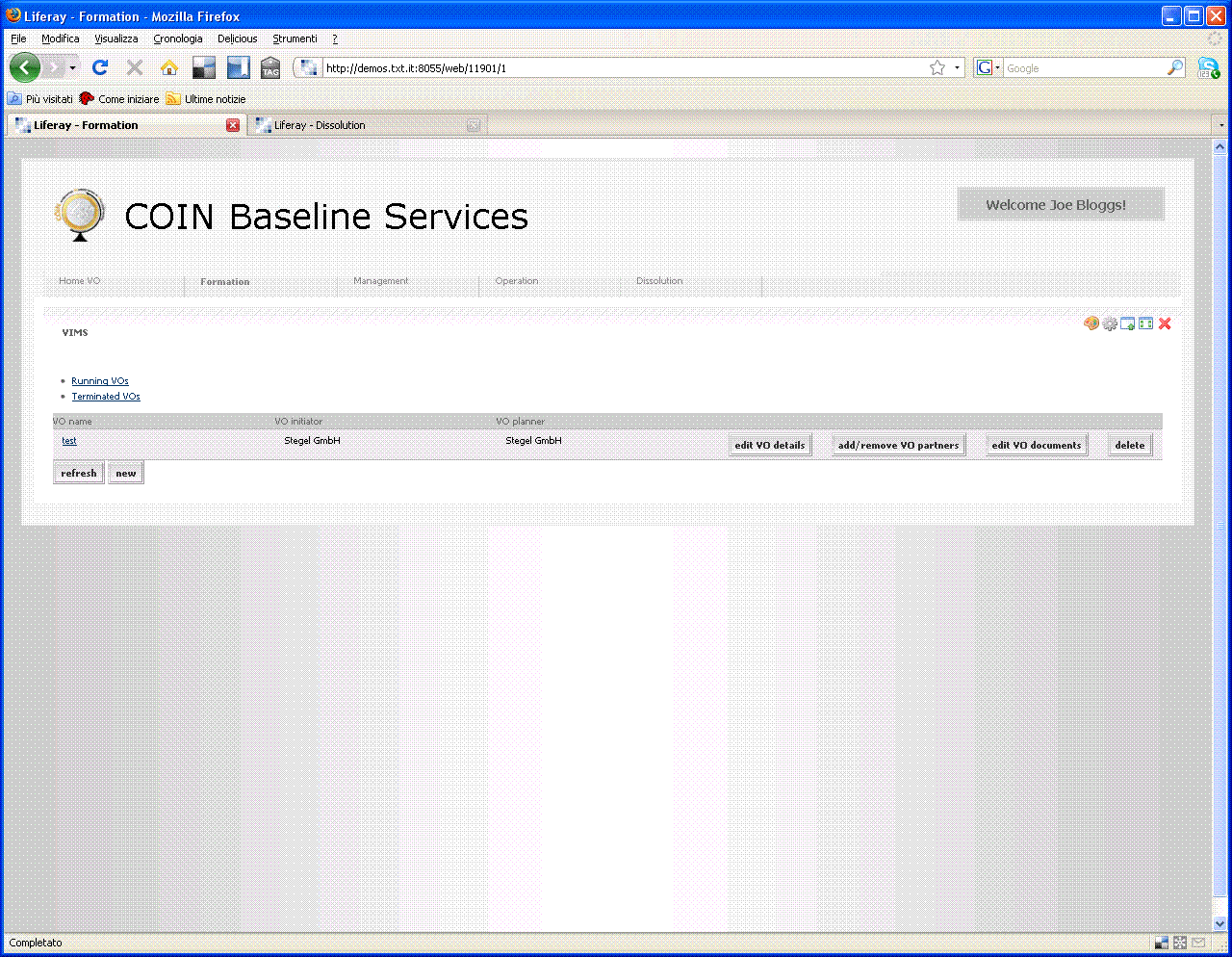
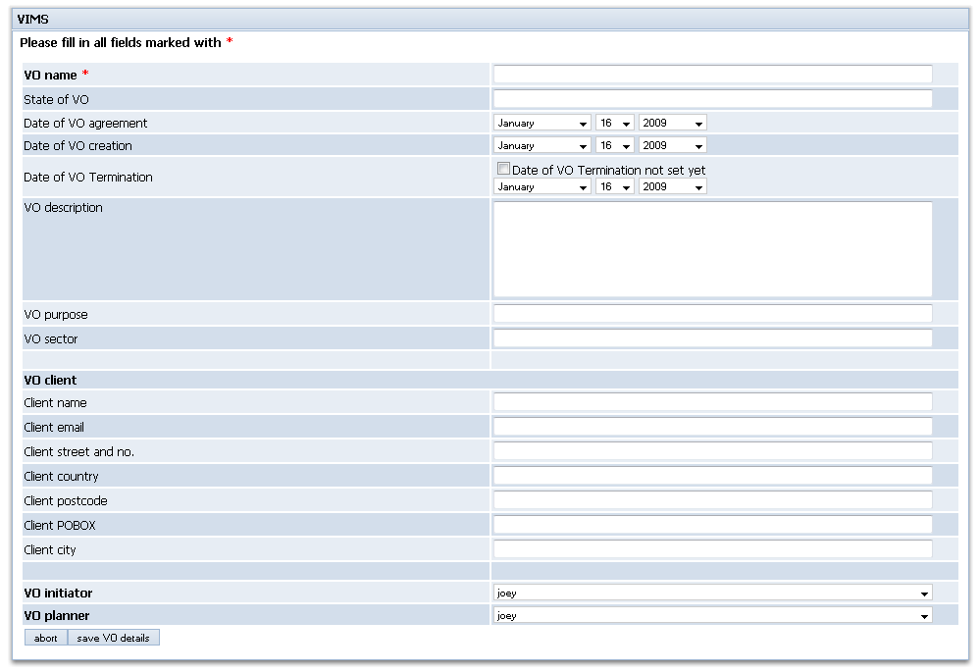
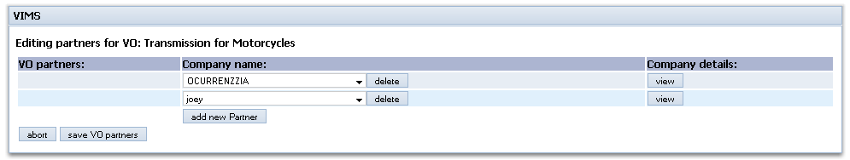
Partner Selection & EC Formation
Software tools and services:
Partner Selection Tool
VO Formation Tool
Mechanisms for storing information on created ECs
- Structuring, storing and providing inheritance information to the EC formation process.

Slide 26
Enterprise Collaboration Baseline Services –
Prototype Details
core set of services and tools
each ellipse represents a business service that is supported by a group of software tools and services

Slide 27
Activity Management Service
Details
Alignment with EC | The Activity Service is a Web service offers support for dynamically managing activities of users and teams. The Activity Service supports the creation and management of activities of people within a collaboration scenario. For the COIN baseline scenario the Activity Service is used to support the execution of tasks in the operational phase. Once the activities are created, they are managed and tracked by the Mediated Collaboration Service. To read the tasks of a particular BO and convert them to activities a conversion service provided by TUV can be used.
Functionality | - representing structures to organize and link - tasks to perform - participants of these tasks - resources and artefacts to use or to produce - creating/editing/delegating/deleting activities - activities can be managed ad-hoc, without the need for a predefined workflow
Licensing | The license is to be determined. The Activity Service is currently not released for public use, but a running instance is managed and provided by TUV.
Contact Person | Hong-Linh Truong, TUV, truong@infosys.tuwien.ac.at
Notes:
Orally explain what VCOR is

Slide 28
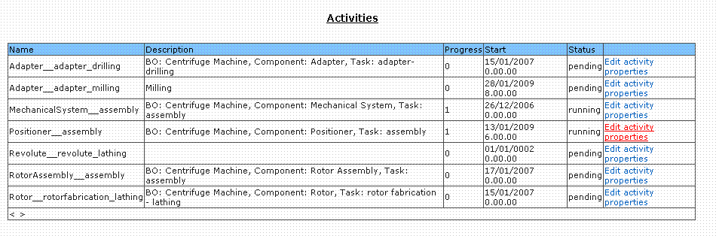
Activity Management Service
Software tools and services:
- Activity Service
- Creation and management of activities of people within an EC
Information about responsible and involved users, time constraints, and applicable resources
Records any changes to activity structures during runtime
Allows to analyze deviations from planned collaborations

Slide 29
Enterprise Collaboration Baseline Services –
Prototype Details
core set of services and tools
each ellipse represents a business service that is supported by a group of software tools and services

Slide 30
Collaboration Operation Service
Details
Alignment with EC | The Collaboration Operation tool is a problem-solving environment, based on a process of collecting and evaluating contributions from the activity members by the activity leader, who is the problem responsible.
Functionality | The moderator is also the responsible for compiling the solution form, taking into account the experts suggestions, deciding which contributions shall be included in the solution and, at closing time, who participate in the activity. Contributions can be evaluated, accepted or rejected by activity leader, downloaded by other members, and in the end of the activity the leader can summarize all suitable contributions and upload the final result.
Licensing | Has to be determined.
Contact Person | Lidia Garavaglia, TXT, lidia.garavaglia@txt.it
Notes:
Orally explain what VCOR is

Slide 31
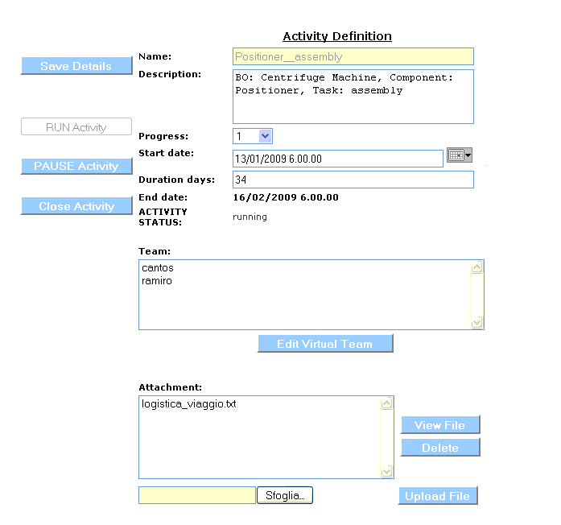
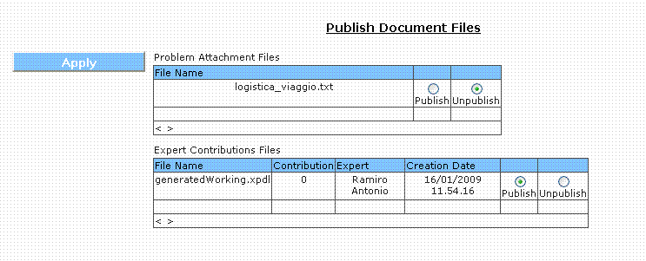
Collaboration Operation Service
Software tools and services:
- Collaboration Operation Tool
- Problem-solving service
Collecting and evaluating
contributions from activity
management service
Compile solution forms, taking
into account the experts
suggestions, deciding which
contributions shall be included in
the solution
Sent information to responsible
people

Slide 32
Enterprise Collaboration Baseline Services –
Prototype Details
core set of services and tools
each ellipse represents a business service that is supported by a group of software tools and services

Slide 33
Product Management Service
Details
Alignment with EC | The Product Management Service is designed for the operational phase of the EC. The Product Management Service consists of many web services, based on DISCO project.
Functionality | It enables product developers to share documentation of their products and assemblies, and structure their complex products in catalogues, categories and different configurations.
Licensing | The Product Management Service is published under GNU Lesser General Public License. For more information about GNU LGPL please visit http://www.opensource.org/licenses/lgpl-3.0.html
Contact Person | Alberto Olmo, ISOIN, aolmo@isoin.net
Notes:
Orally explain what VCOR is

Slide 34
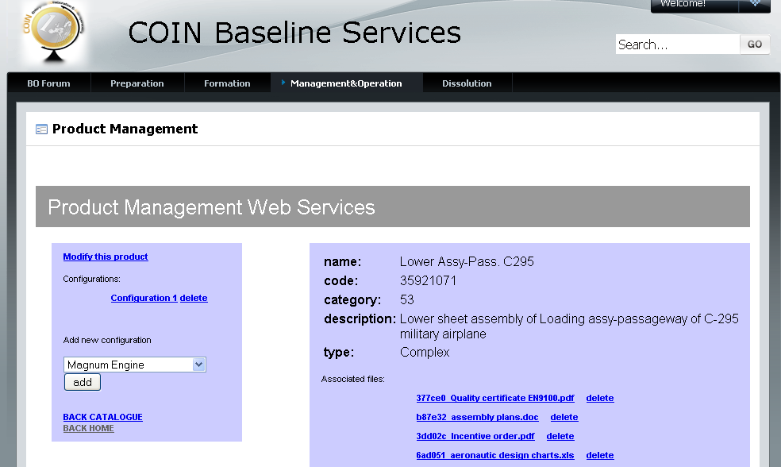
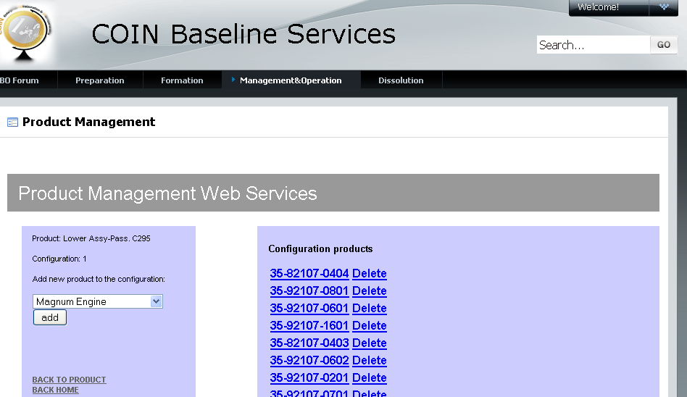
Product Management Service
Software tools and services:
- Product Management Service and Tool
Share documentation of products and assemblies
Structure complex products in catalogues, categories and different configurations

Slide 35
Enterprise Collaboration Baseline Services –
Prototype Details
core set of services and tools
each ellipse represents a business service that is supported by a group of software tools and services

Slide 36
Customer Support Service
Details
Alignment with EC | The Customer Support Service is designed for the dissolution phase of EC. The Customer Support Service consists of many web services, based on DISCO project.
Functionality | It enables end customers to access the information of products and assets resultant from the EC project, with a structured classification in catalogues, categories and different configurations of the complex product.
Licensing | The Customer Support Service is published under GNU Lesser General Public License. For more information about GNU LGPL please visit http://www.opensource.org/licenses/lgpl-3.0.html
Contact Person | Alberto Olmo, ISOIN, aolmo@isoin.net
Notes:
Orally explain what VCOR is

Slide 37
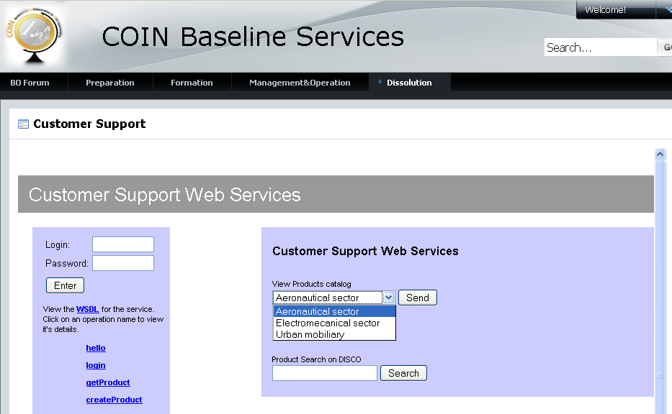
Customer Support Service
Software tools and services:
- Customer Support Service and Tool
- Access information of products and assets resultant from the EC project
- Structured classification in catalogues, categories and different configurations of the complex product

Slide 38
Enterprise Collaboration Baseline Services –
Prototype Details
core set of services and tools
each ellipse represents a business service that is supported by a group of software tools and services

Slide 39
Member Rewarding
Details
Alignment with EC | Credits are a performance indicator, their function is represent and monitor individuals’ activities in terms of participation in each of the workspaces, so that every members of an EC and especially administrator can check their behavior and compare it to the expected one.
Functionality | To do that the first feature exposed is available to the administrator that, using AdminCreditsService tool, decides how many credits are due to every action executed by the users. Another feature gave to the administrator is the possibility to visualize credits related to individuals in order to understand their behaviors. The main functionalities of the tool is the automatic assignment of credits to the individuals by their performed actions in one or more workspaces (stored in the database), through information coming from external tools using this functionality exposed by SetCreditsService.
Licensing | Has to be determined.
Contact Person | Lidia Garavaglia, TXT, lidia.garavaglia@txt.it
Notes:
Orally explain what VCOR is

Slide 40
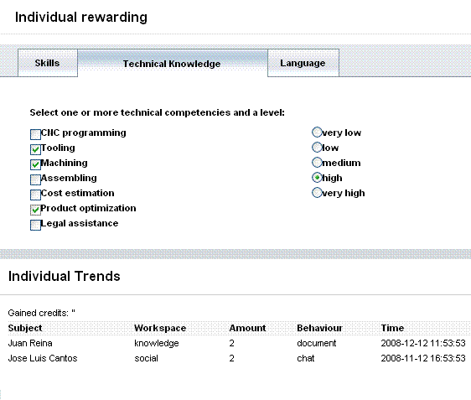
Member Rewarding
Software tools and services:
Individual Credit Management Tool
Individual Rewarding Tool
Members can be rewarded
for their skills and technical
competencies
Gained credits as
performance indicators for
participated activities in the
portal can be seen

Slide 41
Enterprise Collaboration Baseline Services –
Prototype Details
core set of services and tools
each ellipse represents a business service that is supported by a group of software tools and services

Slide 42
Communication Services
Details
Alignment with EC | Human collaboration within EC is a major goal. One preliminary for strong collaboration is communication which is performed by using several different technologies, like e-mail, instant messaging, chats and Voice calls via Skype. TUV provides different single Web services which offer these functionalities.
Functionality | The CommunicationPortlet provides a GUI for using the Email Service, Instant Messaging Service, and SkypeWeb Service. It enables the end-user directly to utilize these communication facilities and demonstrates their features, which are: - Sending an e-mail notification - To one recipient, to a list of recipients - Sending an IM notification - To one recipient, to a list of recipients - Creating a chat room and invite other users - Utilize SkypeWeb features, such as - Starting a conference call, Starting a text chat, Sending Files via Skype These functionalities realize Ad-Hoc collaboration features, which enable direct and synchronous communication between specific activity members.
Licensing | The license is LGPL v3.The third party software components and libraries included in the current release are using diverse open source licenses.
Contact Person | Hong-Linh Truong, TUV, truong@infosys.tuwien.ac.at
Notes:
Orally explain what VCOR is

Slide 43
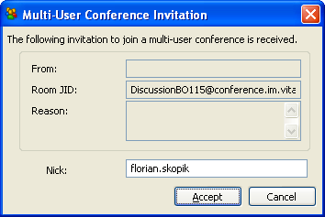
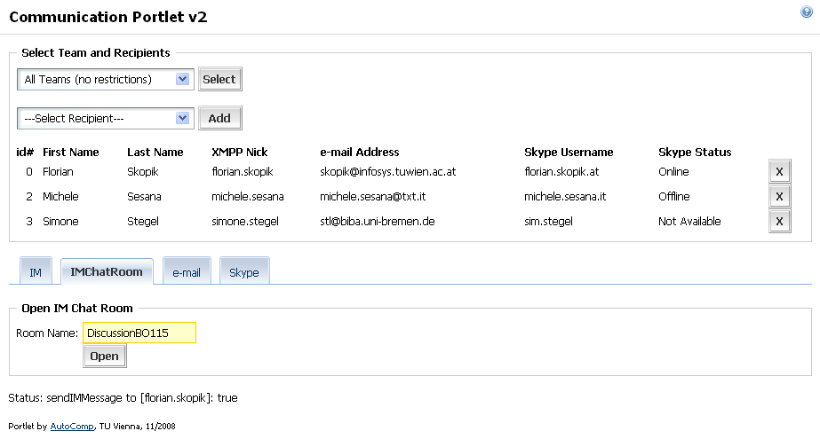
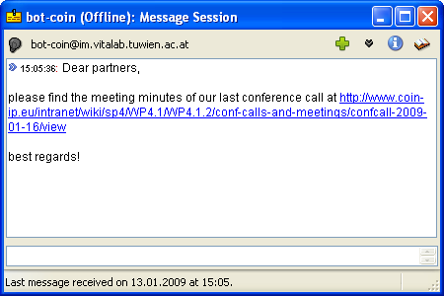
Communication Services
Software tools and services:
Email Service,
Instant Messaging Service,
Skype Web Service,
Notification Service,
Communication Portlet
Communication between humans through e-mail, instant messaging and voice chat
Utilize the communication services directly
Services can be used by other services/tools to
distribute relevant information
Notify about important events in all collaboration
phases

Slide 44
Enterprise Collaboration Baseline Services –
Prototype Details
core set of services and tools
each ellipse represents a business service that is supported by a group of software tools and services

Slide 45
Business Opportunity Service - Details
Alignment with EC | The Business Opportunity Service is a java enterprise application exposing a web service . The purpose of this service is to give an easy high level interface to manage data about the Business Opportunity which means that any tool will save and add part of the Business Opportunity model during the execution of its activities.
Functionality | The current version of the service is a web service allowing access to the BO Model triggering the low level functionalities exposed by “COIN Data Level Business Opportunity Access Service”. This service features are: Create a new BO - Edit BO data - Delete a BO - Find a specific BO - Get a list of BO comply with some parameters - Define the status of the BO and the related tool that is allowed to access to related data
Licensing | Has to be determined.
Contact Person | Michele Sesana, TXT, michele.sesana@txt.it
Notes:
Orally explain what VCOR is

Slide 46
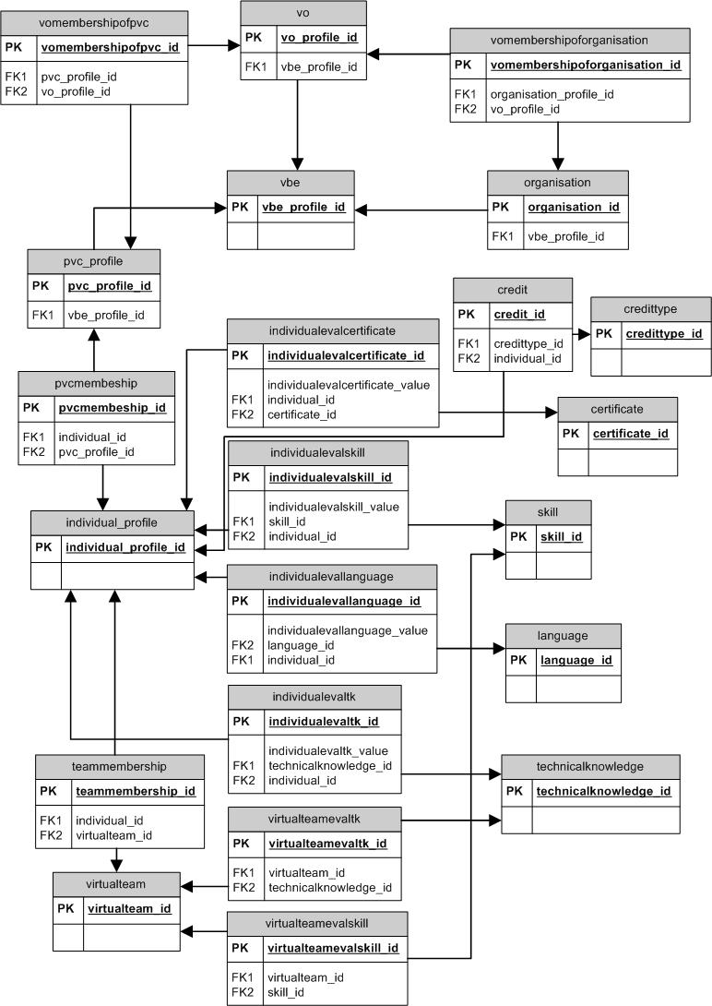
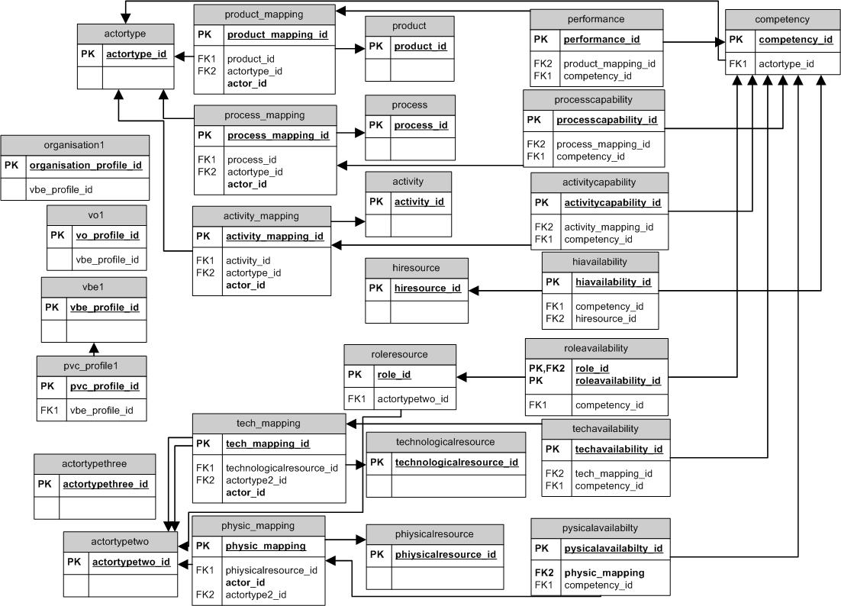
Service to Access the Profiles, Competencies and Business Opportunity Common Repository
Software tools and services:
Profiles, Competencies, Business Opportunities models and database,
Access to the common Profiles and Competencies Service,
Business Opportunity Access Service
Support of business opportunity information, individual credits, profiling,
human interaction information
Manages the core data model schema which is used by all baseline tools
and services.
All tools and services can save/retrieve
required data from different, but common,
models without any concern of who
inserted these data, what is the data
structure of the other modules and who
will use the saved data
Notes:
Not clear the last sentence aboutr SaaS

Slide 47
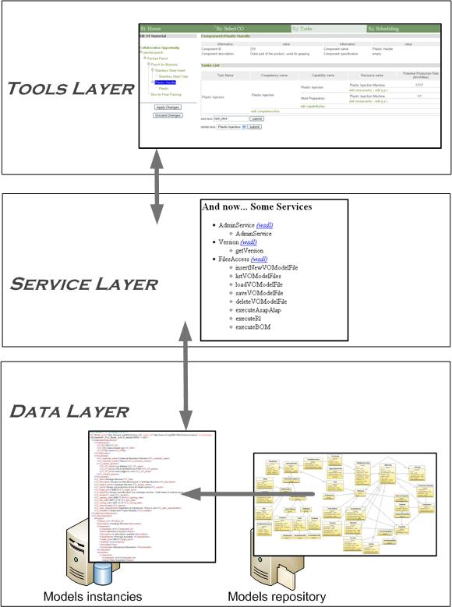
What‘s new in COIN EC Baselines?
- Common Data and Models Base with 59 implemented entities
Former software has been decoupled in three levels, separating business logic, presentation layer and data
Business logic has been encapsulated into reusable web-services
Data exchanged by applications are now managed by a common database and private data of application stay on legacy databases
- Harmonisation of Networks of individuals (PVCs) and Enterprises

Slide 48



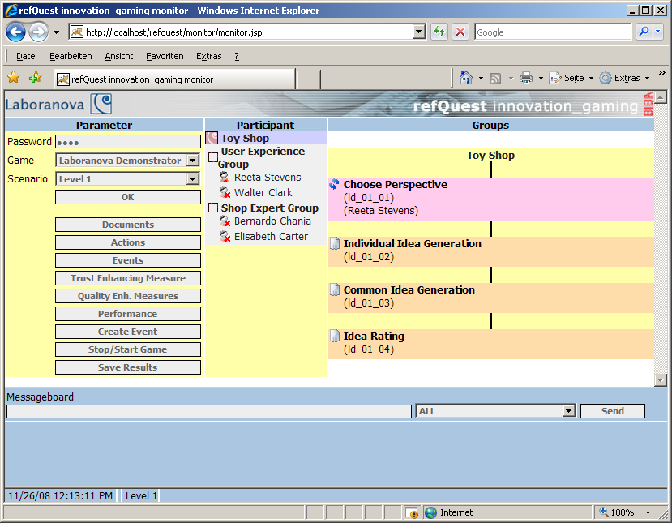
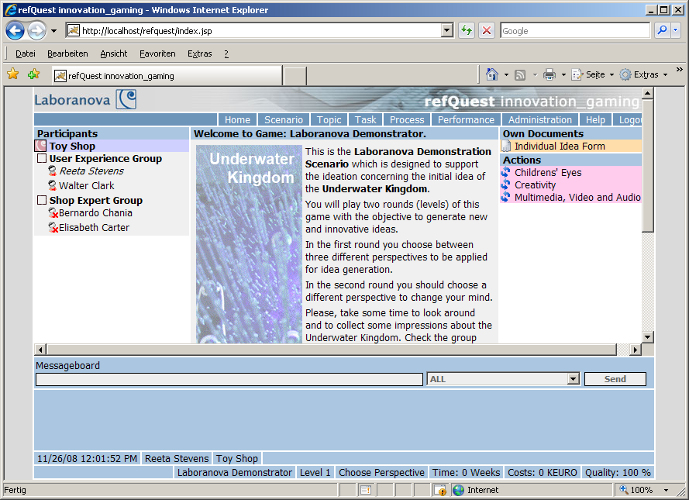


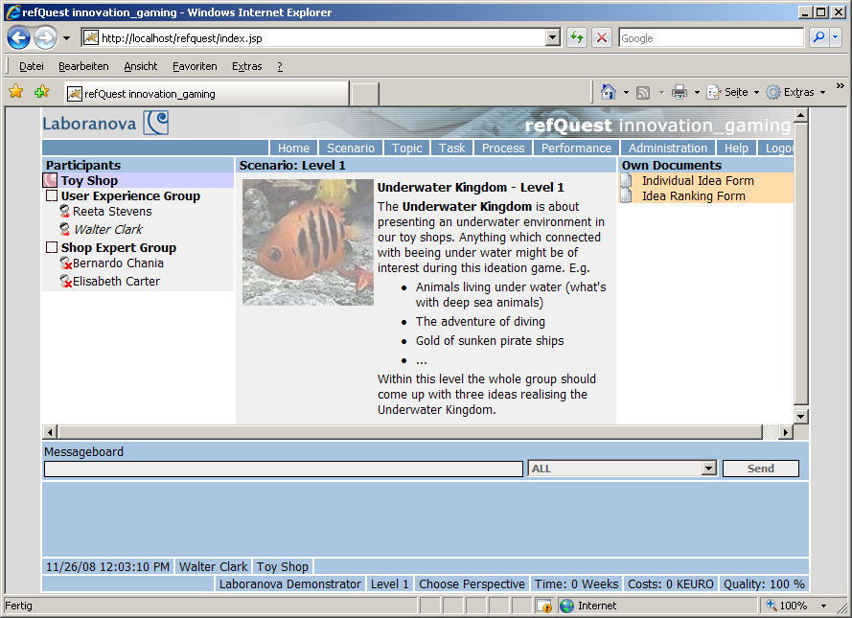
What‘s new in COIN EC Baselines?
Creating Business Opportunities
Jesus Racero
Simon Vazquez
Juan Reina
Simon Vazquez uses the Monitor as Facilitator Interface.
The players log into the game using a standard Web Browser.
Ignacio Eguía
Antonio Ramiro

Slide 49
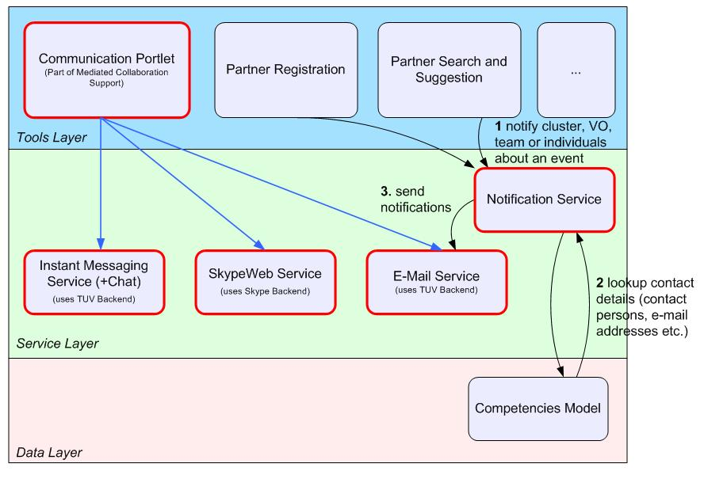
What‘s new in COIN EC Baselines?
Human Interaction Communication Services

Slide 50
Thank you for your attention
Patrick Sitek
BIBA – Bremen Institute for Production and Logistics GmbH
IKAP - Collaborative Business in Enterprise networks
Hochschulring 20
D-28359 Bremen
Germany
phone: +49 (0)421-218 5591
fax: +49 (0)421-218 5610
mailto: sit@biba.uni-bremen.de
http://www.biba.uni-bremen.de

