Slide 1
Seeking and Offering Expertise across Categories: A Sustainable Mechanism Works for Baidu Knows
Jiang Yang, Xiao Wei
University of Michigan
Notes:
Good morning everyone, Eric has given a wonderful talk on news feed of facebook, here we are discussing another type of online community, Question&Answer sites. Our topic is ……, this work is done by Jiang Yang and me I am Xiao Wei, we are from school of information @...
To our knowledge, this is a first published study on Baidu Knows
We observed several interesting user behavior patterns.
BaiduKnows seems to be a successful QA site, Hopefully this paper can help to introduce it as a good instance of social media to study

Slide 2
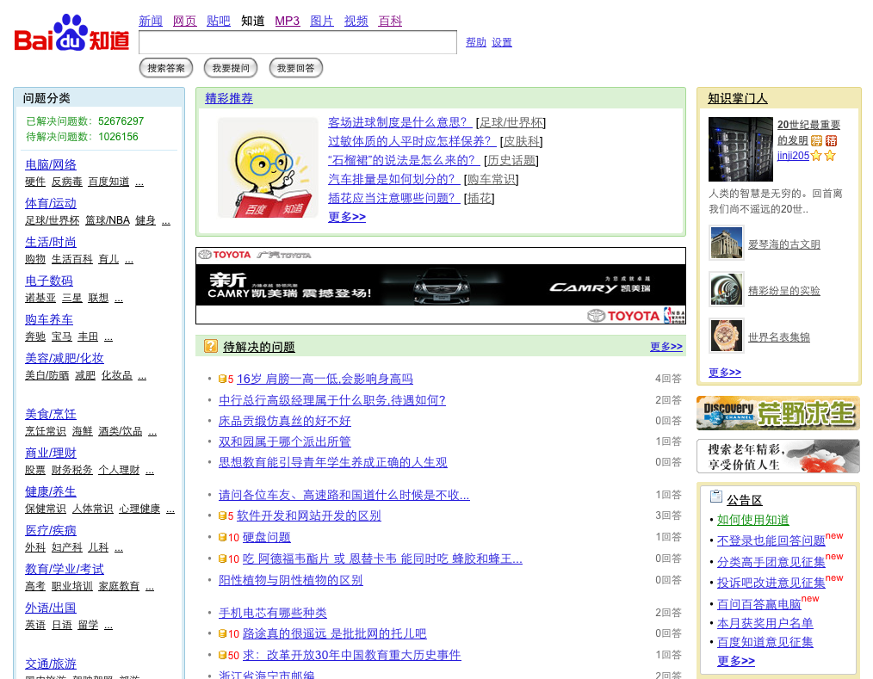
Notes:
BaiduKnows is a Chinese Q&A website. This is the front page of Baidu Knows,
At first, there is a encouraging notice on top-left corner shows instant updating of total number of solved questions and opening questions in current moment.
And the left column shows, as many other QA sites, Baidu Knows also categorizes questions into main categories and sub categories.
The middle part of the page is a recommended list of topics and newly posted questions, through which the users could quickly access to the these questions.
The right side of the page Baidu Knows community features which promotes contributors.

Slide 3
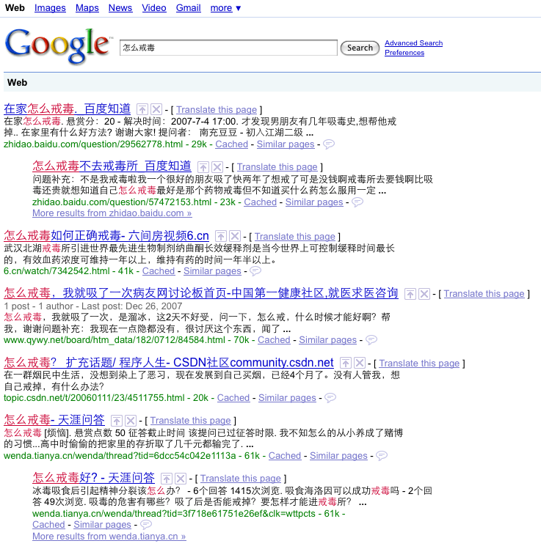
Baidu Knows: Largest Chinese Q&A site
How to swear off drugs
Growing extremely fast
more than 80 million questions have been asked in 4 years
Huge user population
users are connected with many other Baidu services
2,667,518 unique users participated in the period of the data, within half year
Knowledge repository as online resource
How to swear off drugs in home-Baidu Knows
How to swear off drugs without going to rehabilitation center-Baidu Knows
Notes:
Just as Baidu Search is is largest search engine in China, Baidu Knows also became the largest Chinese QA site. It was launched by Baidu since the middle of 2005, and had more than 90 million questions have been asked so far. More than half successfully got solved.
Baidu Knows also garnered huge Chinese user population. Within the period of time of our observation, there were close to 3 million unique registered users.
As the result of great growth of this kind of QA community, user contributed content become more and more important. For example, as one typed “how to swear off drugs” on Google in Chinese, the first two answers are both from Baidu Knows and they provide a likely perfect DIY tutorial of swearing off drugs.

Slide 4
Baidu Knows: comparing to peers
 | Yahoo! Answers | Baidu Knows
Start date | Dec., 2005 | Jun., 2005
Incentives for asking | Pay a flat rate of virtual points to ask | Earn a flat rate of points, but pay for extra award
Incentives for answering | Flat rate of virtual points | Flat rate of virtual points +extra flexible rate
Honor system | Aggregated points Levels according to points | Aggregated points Levels according to points 5 tracks of honor titles
Popularity: # questions answered everyday | 39,299 | 43,300
Notes:
BaiduKnows is often compared to Yahoo!Answer inEnglish. They share some similar design features such like they both use a virtual points system as incentives and From this number at the bottom we can see they both are very popular sites.
But BaiduKnows has some difference from Yahoo!Answer:
At the first askers on BaiduKnows could offer an extra amount of points for the questions, that the best answerer would win, but on Yahoo!Answer the rates are flat. Flexible points make BaiduKnows more like a market system.
Second, user pay points to ask on Yahoo but Baidu users get points by asking questions
At last, they both use aggregated points to upgrade the level, but BaiduKnows have tracks of honor titles
We will talk about the details

Slide 5
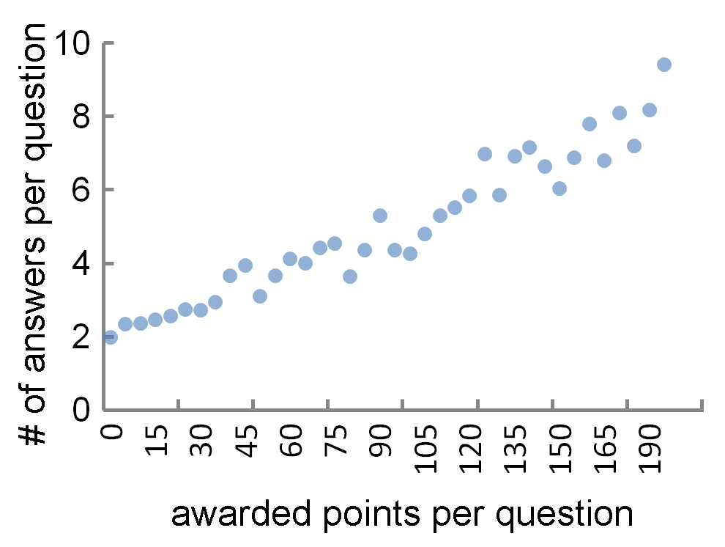
Another similar Q&A site, but
Points! Points! Points!
Flexible amount of extra points set for best answerer
More points buy more answers (R = 0.26, p<0.0001)
People are incentivized to answer more in order to ask—address lack of repository on online community
Building sense of community
Honor-title system
business titles (e.g., from trainee to CEO)
traditional Chinese imperial examination titles
magical titles (see Harry Porter)
knight-errant titles (Chinese Kongfu)
traditional Chinese military titles
Personal profile connected with people’s activities on other Baidu services
Instant online chatting
Feedback to answerers
Explicitly promote contributors
Notes:
BaiduKnows is all about the points
Consistent with all-pay auction model’s prediction and lab experiment result, on Baidu Knows, higher point award would induce more participation. And as shown in the figure, on average, the return rate in terms of number of answers has a constant margin rate when people offered higher amount of points.
On the other hand, Baidu Knows emphasis on building the sense of community. In particular, it has a honor title system that provides 5 virtual career tracks such like business military tracks.….users can make success on these tracks, …For example, on one track, there are 18 different titles according a user’s point level, on military track, one user can be titled as private at the beginning and could become a Marshall later on.
This helps baiduKnows to build a sense of community along with other features like online chatting or feedback from asker to answerer

Slide 6
Data & General Statistics
Full history of Q&A during Dec, 2007~May, 2008
9,300,000 questions were asked
5,210,163 were resolved
56% questions of total asked questions
Some were deleted (e.g. too politically sensitive ☺, Most them just did not get answer
2,667,518 unique users have participated in the site
3.3 answers for each answered question
Yahoo! Answers: 7.3
Possible reasons:
1. Yahoo! encourages answering rather than asking
2. No market system would obtain more answers per question than market system (Gary Hsieh & Scott Counts, 2009)
Open question: how much the extra point can leverage people’s participation from the questions they would answer without payment to those they are less likely to answer
Notes:
Our dataset is crawled full history of questions and answers for almost a half year from baiduKnows. There were more than 9 million questions asked, 56% questions were solved.
There are almost 3 million users have participated in asking or answering or both activities. On average, each answered question, obtained 3.3 answers, which is significantly lower than Yahoo! Answers
This is just a preliminary comparison between these 2 sites. There are maybe two reasons account for this, the first one is:
As mentioned before, Yahoo! ‘s design encourage answering rather than asking, people need to pay points in order to ask; while on Baidu, one can even earn a bit points for asking.
On the other hand, as Hsieh and Counts found in their experiment that no market system can obtain more contribution than market system, we suspect somehow flexible point incentive can play the role as money.
Next, We are going to talking about our major findings

Slide 7
People pay differently for different questions
Categorical difference
Price
Related to popularity of the category: R=0.46, p<0.05
Related to first question ratio within the category: R=0.47, p<0.05
Price ~ Popularity + first question ratio, R² =0.63, p<0.05
Implications
Deficiency of the information from alternative resources
Might be the trigger for people start using the site
Notes:
First we take a look at how people offer different price for the best answers.
There is significant categorical difference across categories, as we can see here people like to pay more points in music, computer, and medicine and pay less in knowledge about brands, science, and food.
The average price of per question is positively correlated to the popularity of the category and the first question ratio, popularity is the total number of questions in one category and the first question ratio is the defined number of users’ first question divided by total number of questions in one category.
And combine popularity and first question together, we can achieve a bit higher prediction on the price, the regression implies that the price, or say the value as perceived by users, indicate a deficiency of the information from other alternative resources, and those questions, are often the trigger for people start using the site.

Slide 8
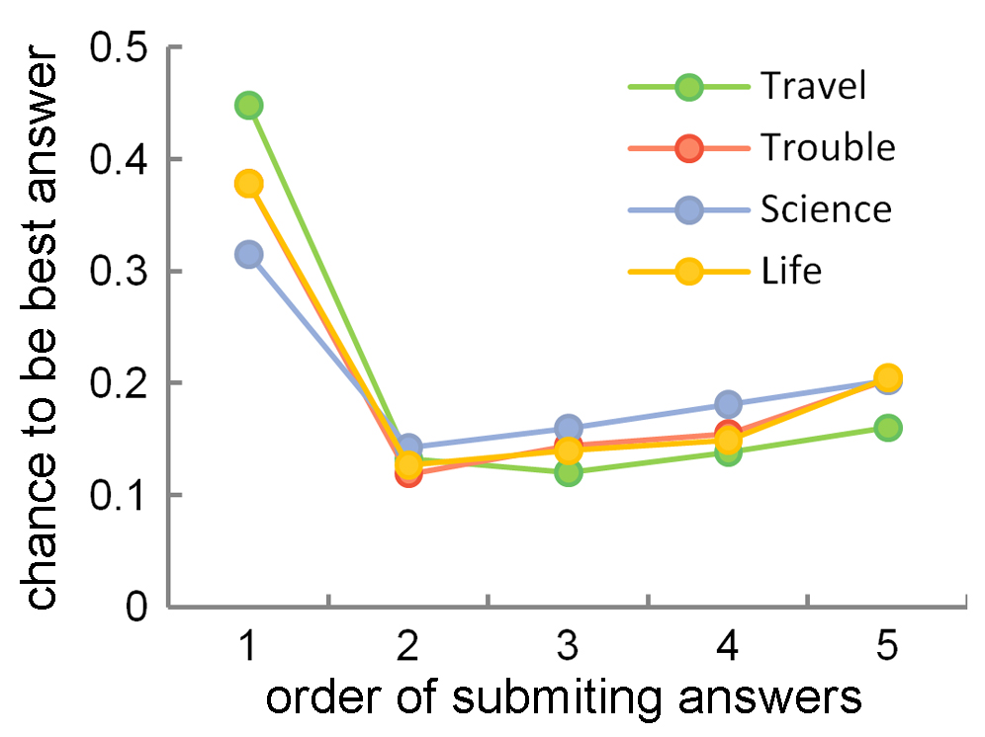
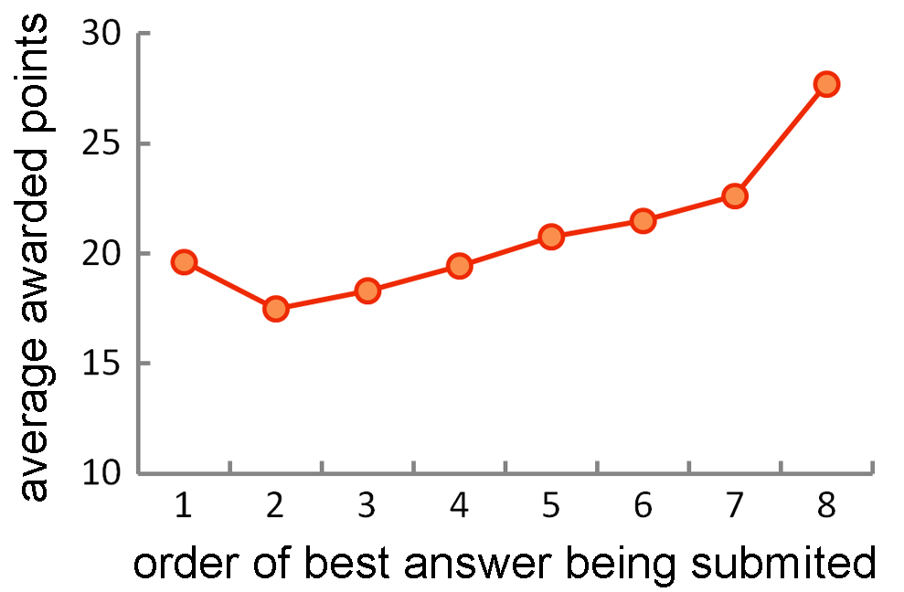
Selecting best answer to help cheap questions?
Order difference
Best answer selection in terms of chronological order:
According to human rating of sample questions, the order of answers doesn’t matter
In Naver in Korea, later answers has higher probability to be chosen
But, this differs according to price
When askers select later answer, the average price is also higher (e.g., all questions got 8 answers)
When askers offer fewer points, they tend to reward prompt answers; otherwise, they might consider answer’s quality more
Implications
Another way of incentive?
Interesting for further study
Notes:
Interestingly we also found correlation between price and the pattern of user selecting best answers.
From this figure we can see this part is consistent with Naver in Korea, in which later answers has higher probability to be chosen. However in this part we can see that the first answer has the highest probability, while according to our human rating result, the time order of answering doesn’t matter.
Furthermore this differs with the change of the price. From this figure we can see ….. This implies that When asker don’t want to offer points, they award prompt answers to provide another way of incentive.

Slide 9
Reinforcement cycle: encourage continuing
Notes:
A good QA site want to encourage users keep answering questions. Here we investigate how people’s answer activity experience relates to many other participation patterns, thus forming a reinforcement cycle to encourage people to continue answering on BaiduKnows

Slide 10
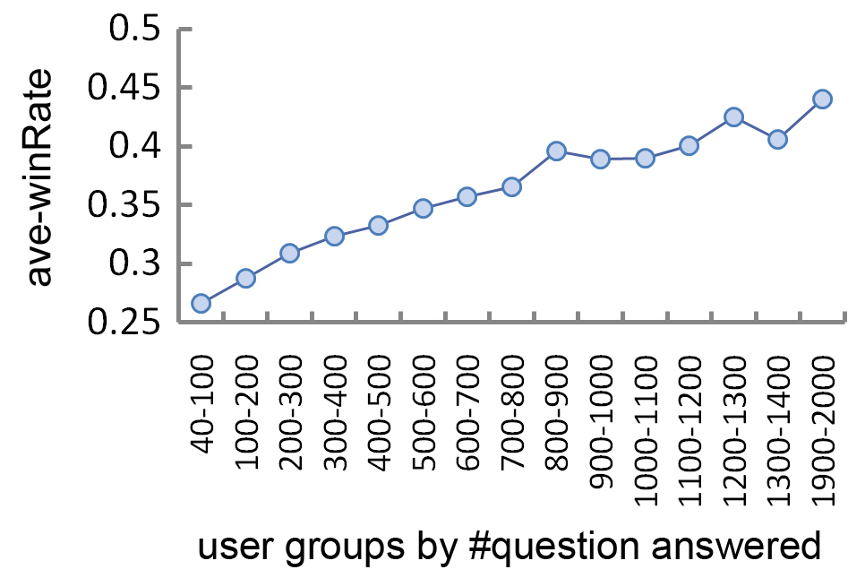
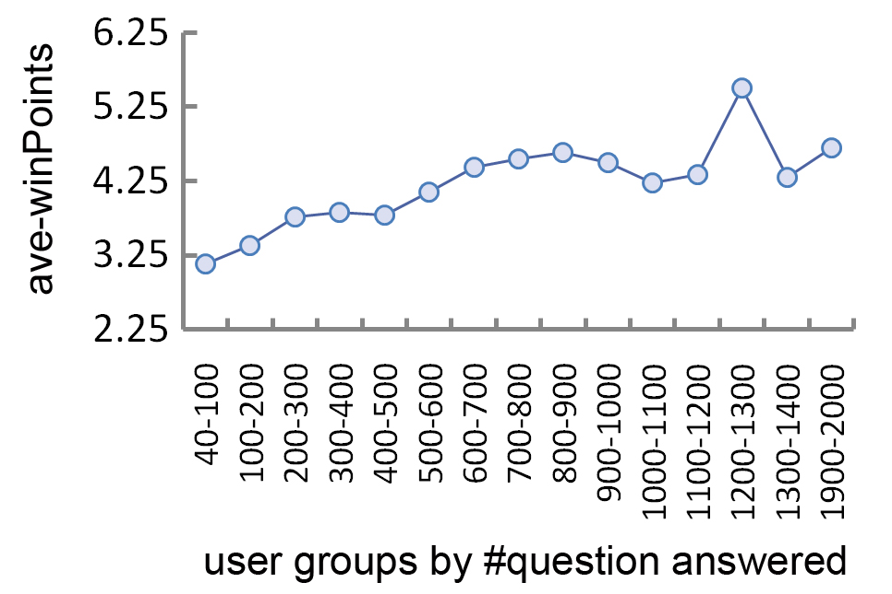
Reinforcement: more active, better performance In terms of winRate, R=0.16, p<0.0001 winPoints, R=0.06, p<0.0001 Guru score, R=0.10, p<0.0001
Notes:
At the first There is significant correlation between answerer’s activity level and different kinds of performance measures, for example, win rate, defined by the best answer ratio in all submitted answers, and winPoints, defined by the average point one can earn in answering a question, and Guru score, which uses observed win number minus the expected win number .
The two graphs show answerers’ performance in winRate and ave. winPoint measures, by grouped people of different activity experience for example in this group, user answered more than…, we can see that the mean of each group’s performance is growing nearly consistently when users have more activities.
This pattern indicated the positive connection between activity level and performance. so far we could only guess that the reason is: when people perform better on the site and thus earn more points, they are more likely to be encouraged to participate more and stay longer.

Slide 11
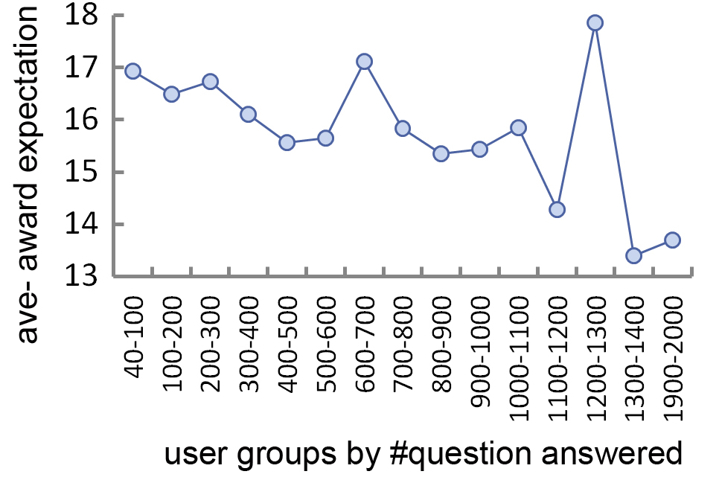
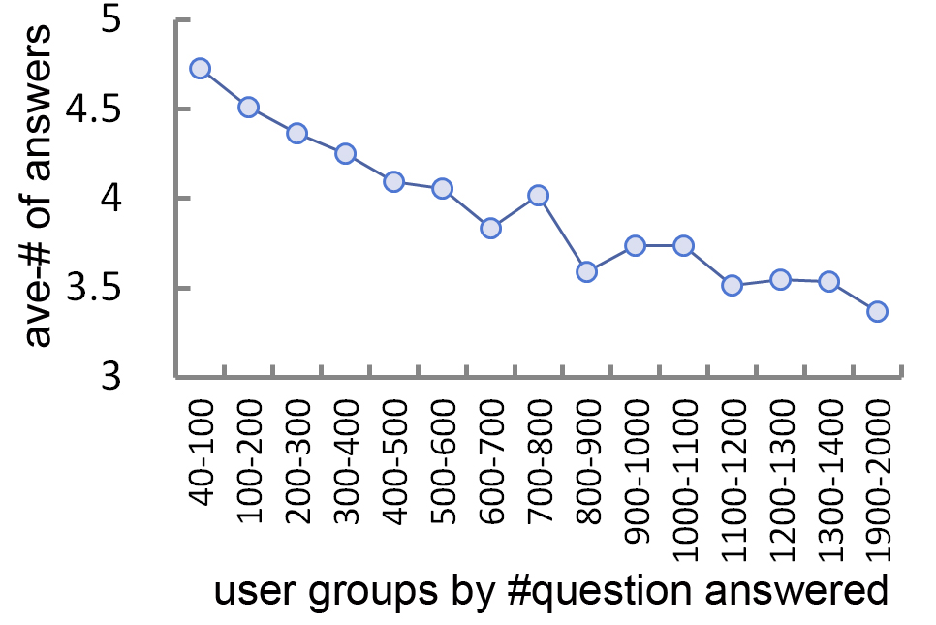
Reinforcement: more active, taking better strategy In terms of choosing cheap questions, R=0.02, p<0.0001 thus less competition, R=0.09, p<0.0001
Notes:
We found that more active answerers seemed to know and take better strategies to participate in the site. For example, choosing less expensive questions would be a good strategy to avoid many competitors as we mentioned more expensive questions get more answers.
We can see another clue that more active answerers choose questions that have fewer answers.
This result echoes with our analysis on taskcn.com on which people are submitting real solutions to specific tasks to earn real money. We found that higher performance users tend to adopt better strategies like they would be able to discover less popular tasks to enhance winning probability and they would submit solutions later. Therefore, we cannot assume higher performance represents higher expertise level, but we would be sure that the better strategies they employ can considerably contribute to their performance

Slide 12
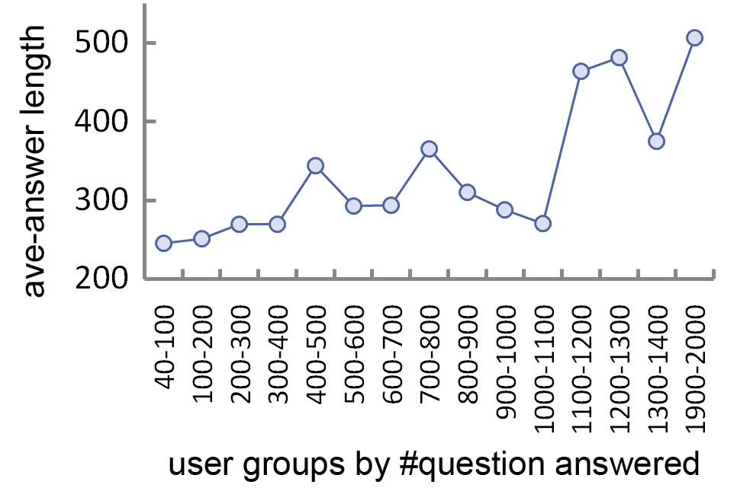
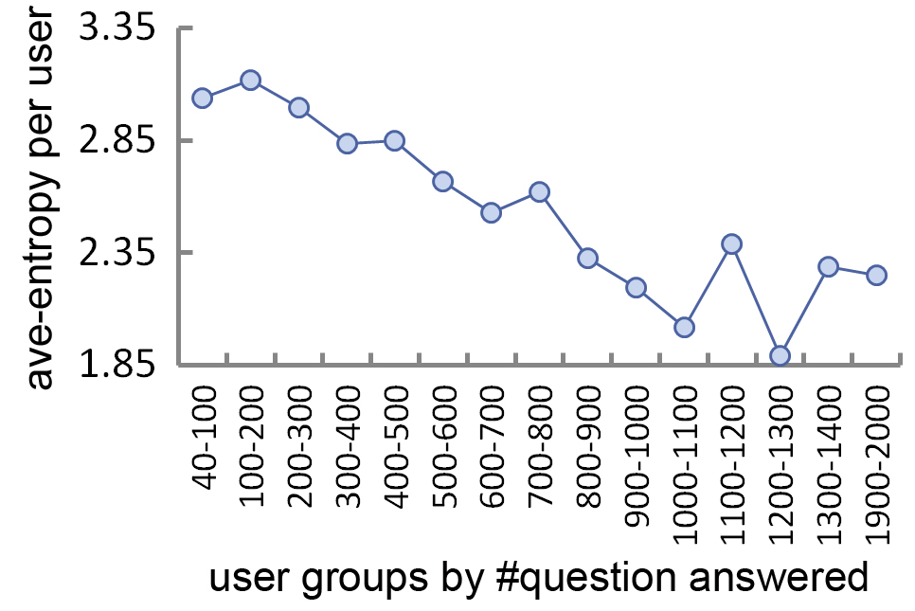
Reinforcement: more active, taking better strategy In terms of inputting more efforts, R=0.06, p<0.0001 being more focused, R=-0.04, p<0.0001 with Entropy
Notes:
We also observed more active answerers are working harder and being more focused. In terms of working hard, we can use the thread length of the answer to see how much effort they put, and in terms of focus, we measure entropy base on the frequency that users answered across main categories and subcategories.
We can see more active answerers works harder and are more focused.

Slide 13
Reinforcement cycle: encourage continuing
Notes:
Based on above knowledge, we could infer the interrelationship among these several users answering patterns, they are all positively correlated together and they can potentially reinforce one another. When people putting more effort and be more focused, and take better strategies to select questions to answer, they would enhance the chance to win significantly; thus they can achieve better performance.
And in turn, better performance would encourage people to continue, in particular, continue practicing their strategies and improve. They could also, by participating more then gain more experience, and have more time to learn strategy and change their behavior accordingly. These improvements can further enhance the chance to win again, as a cycle process.
We think this would be a good pattern of user’s behavior in terms of participating in site. We may take this into evaluating a site: to what degree a site can offer and form this kind of positive reinforce loops.

Slide 14
Predicting answerers’ performance
Choosing higher price
Competitiveness of questions
Answer length
Focus across categories
(+)
(-)
(+)
(+)
Prediction power slightly increases for more experienced answerers:
100~200 questions: R²=0.54
500~1000 questions: R²=0.60
Notes:
Using these pattern measures we can predict answerer’s performance in terms of winning rate. We found users’ self selection on higher priced questions, and less competitive questions can contribute positively to their winning rate,
And their personal answering patterns like writing longer answers and being more focused in categories would also enhance the chance of winning. All these four can account for more than half of the variance, and we found across several user groups of different activity levels, the prediction power would slightly increases.

Slide 15
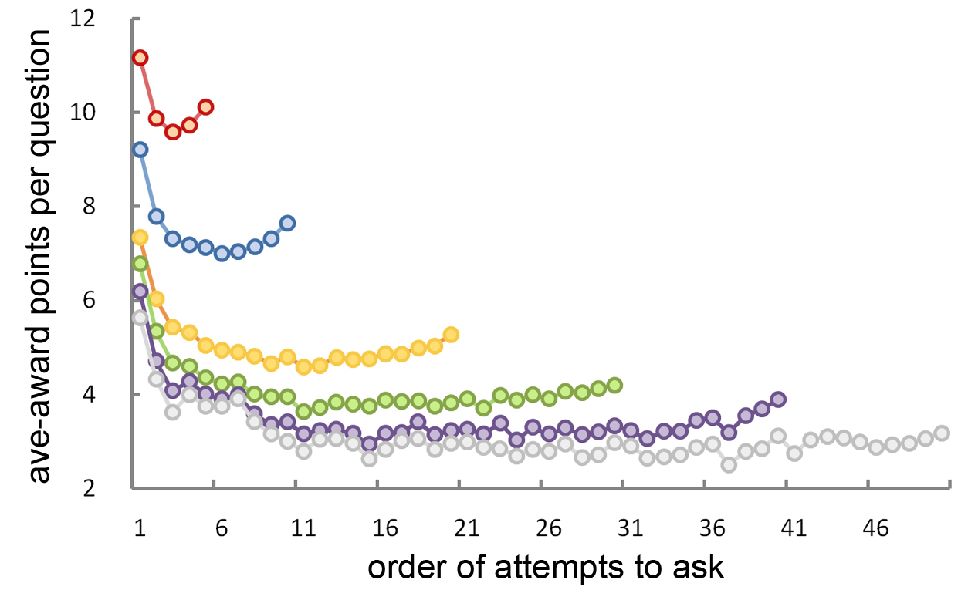
Askers: learn how to better ask
Asking pattern:
Initial quick adjustment
First question is more important?
Realized the pricing norm on the site?
Less frequent askers pay higher than frequent askers
Single question asker stopped asking NOT because got less answers (actually significantly more!)
Implication: different expectations & incentives across askers
Notes:
Above section is about answerers, on the asker’s end, we also observed how askers adjust behaviors over time.
At the first, this graph shows different activity groups changed the amount of points they offered per question in time order.
Clearly, there are two patterns show up here:
First, …
We also see that asker who stopped after asked only one questions actually get more answers.
Thus all of these indicate that different askers have different expectations and incentives.

Slide 16
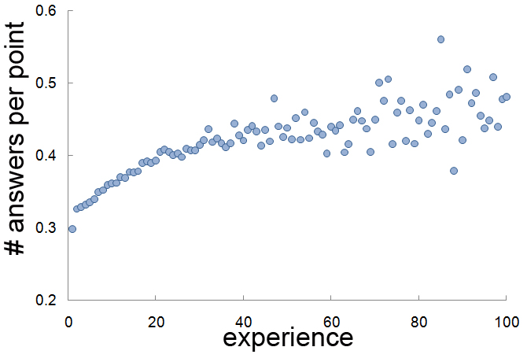
Askers: learn how to better ask
Slight trend: experienced askers get more answers with per point they spend to ask
Notes:
In addition, in stead of offering less points than the initial questions, askers actually can slightly improve their performance: as shown here, when they ask more questions, the return rate per point increases.

Slide 17
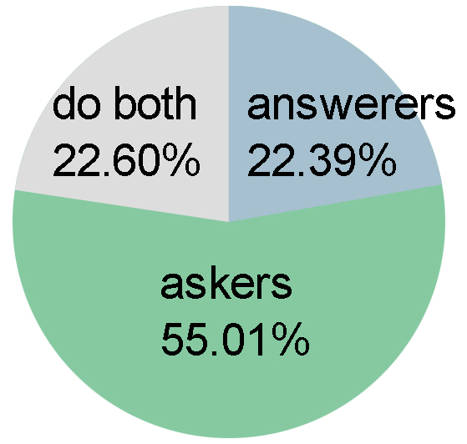
Notes:
Next let’s take a look at users on BaiduKnows from another angle.
In our observation period, we find that users can be discerned as 3 groups in terms of their activity patterns, we have more than half users who only ask questions, we have answerers who only answer and, we have a group of users who both ask and answer, we call them do-both users.

Slide 18
Do both users: core of contribution
Much more active:
Asked almost half of the total questions
Average asked: 4.1 questions, compared to 1.88 of pure askers
Average answered: 15.3 questions, compared to 9.2 of pure answerers
More generous:
Offering higher award: 12.3 per question versus 11.6 on average in general
Sharing the same pattern as normal asker, but paying higher each time
But they are not necessarily experts:
Fall below pure answerers in terms of winRate
Answers are shorter
Choosing less competitive questions
They are incentivized:
Ask more -> answer more (R=0.26, p<0.0001)
Earn more -> spend more (R=0.19, p<0.0001)
Notes:
Do-both Users form the core of contribution of the site. Here are some features of this group of users:
They are much more active in terms of both asking and answering than other users, and they account for almost half of the total questions
They are also the most generous group of people, they offer higher award for each question they asked
However, although they answered more questions than other peers, they are not necessarily more expert than others. In stead, they fall below the group who only answered in terms of winning rate. In fact, they provide shorter answers and they also choose less competitive questions to enhance winning chance with less efforts.
They spend points as they earn points. The correlation shows between the number of questions they asked as well as answered; similarly, there is correlation between the points one earned and the points one spent.
From this analysis, we can interpret that this significant portion of users, are actually incentivized to answer more to earn points in order to be able to ask and successfully get answers. And this group of users are driven by the incentive design, to become the most important contributors of the site.

Slide 19
Seeking & offering across categories
Notes:
As we learned significant users both ask and answer on Baidu Knows, we would like to go a bit further on how they actually asked and answered.
The fundamental assumption of Q&A site is people can draw upon diverse expertise through weak ties. We assume each participants has some expertise in some fields but they may need some other expertise in other fields.
Then we would like to know whether this happens and how the point system can drive people to form these exchange cycles. Here we also had some preliminary exploration on Baidu Knows and it shows people intensively sharing knowledge and expertise across categories, which signals a healthy online QA community

Slide 20
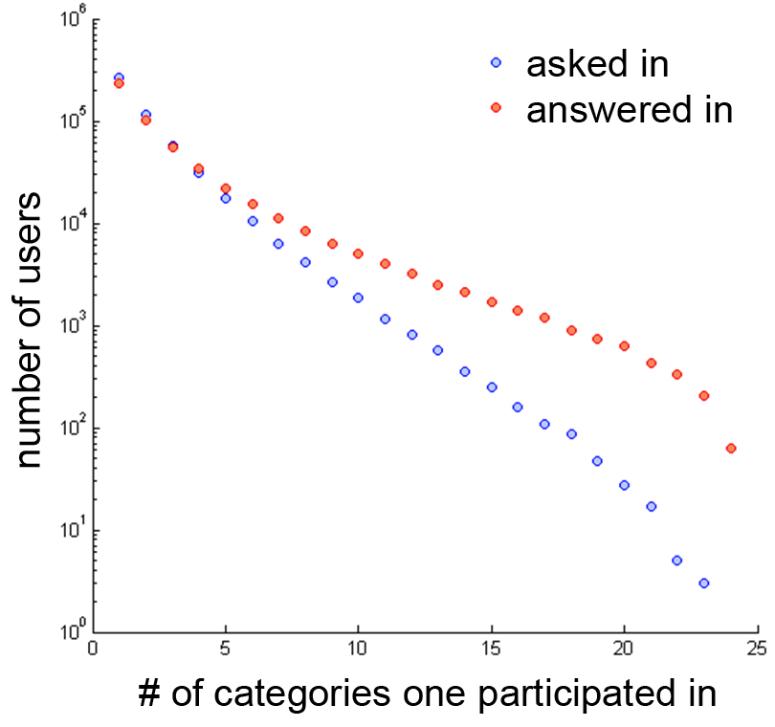
Across category activities forms the community
Bowtie structure:
Within each meta-category, LSCC ranging from 0.005% to 7.7%
Over the site, LSCC: 16%, close to smaller-scaled tech community (Java Forum, in Zhang et all. 2007)
DoBoth users contribute to connecting people in the network:
Answered in 2.9 categories on average
Asked in 2.1 categories on average
Notes:
First, we looked at the distribution of the number of categories people have asked or answered in.
From the plot we can see that many people do ask and answer in different categories. And usually people answered in more categories than categories they asked in. On average, they answered in 2.9 categories and asked in 2.1 categories.
This would because this group of users often answered more questions than asked. And we may assume one needs to answers more in order to get enough points to ask, as people can not win all of the question.
In addition, we used Bowtie analysis to see how users are interlinked through ask-reply interactions. We found within any main category, the largest connected component is rather small, and they vary from 0 to 8%.
However, across the whole site, the connected component became much larger, as 16%, which is even more connected than a smaller-scaled online java forum studied by Zhang. This particularly indicates how users’ cross category behaviors has significantly contribute to the overall connectedness of the site.

Slide 21
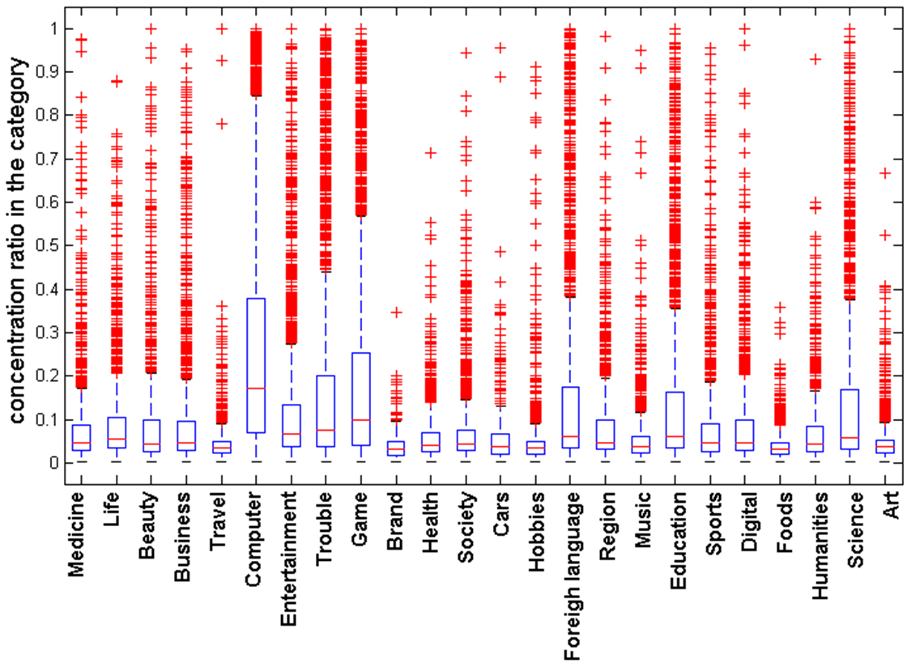
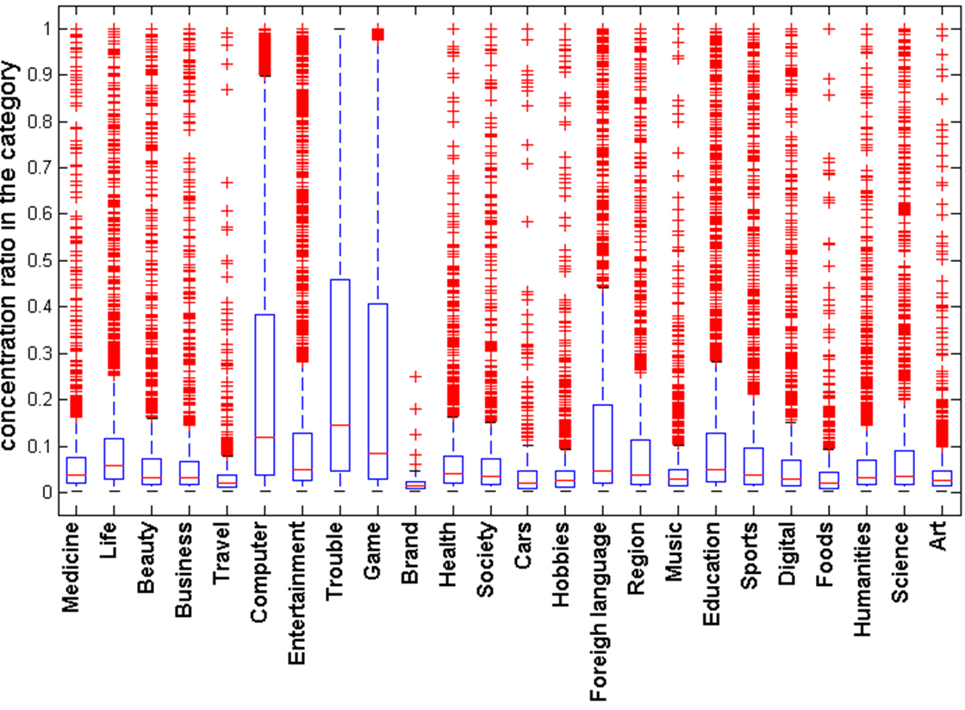
Category Concentration
Asking Answering
Notes:
We use a concentration measure to see how concentrate users are in different categories. It is calculated by the number of questions one user asked or answered in a category versus total number of questions she asked or answered. We could see that across categories, the distributions of concentration are different. For example, people are more concentrated in computer, game, and discussion about troubles, while less likely to stay in travel and food for long. Please note that it is not necessarily related to population or question price. For example, people stay in travel shortly, but they like to offer higher price on answers.
In addition, not surprisingly, people are more concentrated in answering than in asking. Especially in some categories like health, various people may just stop by and ask questions that concern them, while answerers in health would be very focused.
This is just a preliminary lens of viewing the pattern of how people seek and offer knowledge and expertise, but we can based on this to infer how users are distributed in the knowledge space in terms of both interest and expertise. In future work, we would like to continue on this to discover the mystery.

Slide 22
Conclusion & further questions
A sustainable mechanism is working on Baidu Knows:
People can allocate more points for more important questions
Answerers are incentivized by points, thus expertise can be better allocated to more important questions
A reinforcement cycle forms: people input more, rewarded more, gain more experience, better performance
People seeking & offering expertise across categories: as using and earning points
Further questions:
Side effect of point system?
How the community features on Baidu Knows makes it different?
What determines the value of questions?
Dynamics of expertise exchanging & how to evaluate the mechanism?
And more… …
Notes:
In conclusion, we find that

Slide 23
Some literature
Internet scaled knowledge sharing:
Adamic, L. A., Zhang, J., Bakshy, E., & Ackerman, M. S. 2008. Everyone knows something: Examining knowledge sharing on Yahoo Answers, Proceedings of the 17th international conference on World Wide Web. Beijing.
Harper, F. M., Daphne, R., Sheizaf, R., & Joseph, A. K. 2008. Predictors of answer quality in online Q&A sites. Proceeding of the twenty-sixth annual SIGCHI conference on Human factors in computing systems.
Harper, F.M., D. Moy, and J.A. Konstan. Facts or Friends? Distinguishing Informational and Conversational Questions in Social Q&A Sites. in CHI. 2009. Boston, MA, USA.
Marlow, C., et al. HT06, Tagging Paper, Taxonomy, Flickr, Academic Article, ToRead. in the Seventeenth Conference on Hypertext and Hypermedia. 2006.
Gary Hsieh, Scott Counts: mimir: a market-based real-time question and answer service. CHI 2009: 769-778
Incentives & user behavior
Yan Chen, F. Maxwell Harper, Joseph A. Konstan, Sherry Xin Li: Social Comparisons and Contributions to Online Communities: A Field Experiment on MovieLens. Computational Social Systems and the Internet 2007
Nam, K., Adamic, L. A., & Ackerman, M. S. 2009. Questions in, Knowledge iN? A Study of Naver's Question Answering Community, the twenty-seventh annual SIGCHI conference on Human factors in computing systems. Boston: ACM.
Yang, J., Adamic, L. A., & Ackerman, M. S. 2008. Crowdsourcing and Knowledge Sharing: Strategic User Behavior on Taskcn. Proceedings of the 8th ACM conference on Electronic commerce.
Notes:
Here is some literatures but not all.

Slide 24
Thanks:
Lada Adamic
Mark Ackerman
And all of you here now ☺
Contact us
Jiang Yang, yangjian@umich.edu
Xiao Wei, xiaowei@umich.edu

