Slide 1
Applied Temporal RDF: Efficient Temporal Querying using SPARQL
Jonas Tappolet and Abraham Bernstein ESWC 2009

Slide 2
Motivation
Usually, data is not valid forever!
isA
Human
Albert_Einstein
dayOfBirth
March 14th 1879
dayOfDeath
April 18th 1955

Slide 3
Motivation
Usually, data is not valid forever!
Munich
residedIn
residency
Albert_Einstein
residencyEnd
residencyStart
1896
location
Munich
1880

Slide 4
Motivation
Time as part of the data model (literals)
Versioned Graphs
Time as dimension (Gutierrez et al., 2005)
Reification
Named Graphs
1879 - 1955
isA
Human
Albert_Einstein
1880 - 1896
residedIn
Munich

Slide 5
The Format
Graphset
&G1 owltime:hasBeginning 2005 .
&G1 owltime:hasEnd 2009 .
&G2 owltime:hasBeginning 2006 .
G2 owltime:hasEnd NOW .
&G1 owltime:intervalOverlaps &G2 .
…
Default Graph
&G1
&G2
&G3

Slide 6
Temporal RDF Graph Algorithm Insert
Retrieve validity information of triple
Check whether interval is already present
If not, create new named graph (assign URI)
insert meta data
Insert triple into appropriate named graph

Slide 7
Temporal RDF Graph Algorithm Update
Retrieve validity information of triple
Try to find triple in graphset
If found, remove triple from named graph
If named graph empty now, remove named graph
Check whether new interval is already present
If not, create new named graph (assign URI)
insert meta data
Insert triple into appropriate named graph

Slide 8
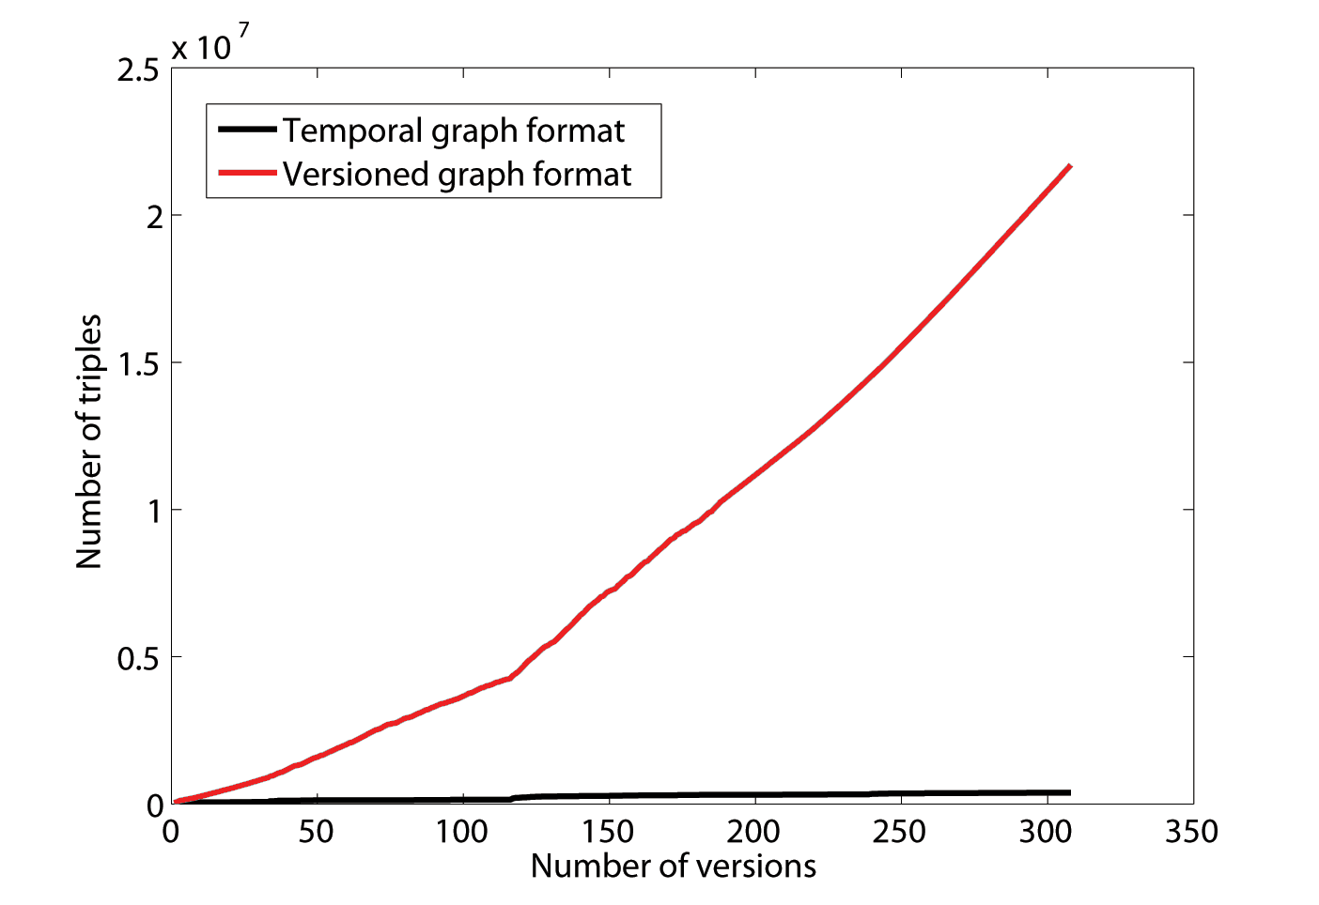
Datasets for Evaluation
Data Source | Time Model | Data Period | # Triples | # Intervals
EvoOnt* | Versioned graphs | 2001 - 2007 | 22 millions | 2505
Swiss Parliamentarians** | Encoded in data model | 1848 - 2008 | 50’000 | 38’182
* EvoOnt: Software history of an Eclipse Subproject (306 versions)
** Parliamentarians: Swiss Parliamentarians with date of birth and death as well as start and end years of their service periods.

Slide 9
Queries
No extensions to existing syntax and format made: out-of-the-box SPARQL
Two types of queries: timepoint and temporal queries
τ-SPARQL syntax simplifies understanding and composing of queries

Slide 10
Timepoint Queries
Example in classic SPARQL and τ-SPARQL
SELECT ?person ?councilName
WHERE{
GRAPH ?g {
?person gov:memberOf ?councilName .
} .
?g time:hasBeginning ?start .
?start time:inInteger ?s .
FILTER(?s <= 1995 || ?s = 'NOW') .
?g time:hasEnd ?end .
?end time:inInteger ?e .
FILTER(?e >= 1995 || ?e = 'EVER') .
}
SELECT ?person ?councilName
FROM TIMEPOINT 1995 WHERE{
?person gov:memberOf ?councilName .
}
KB can be preprocessed! Run query pattern only against intervals that are valid in the asked timepoint

Slide 11
KeyTree Index
Derived from Time Index [Elmasri 1988]
Variable Key distance
Similar to mpeg compression: Key Frames and Deltas
i2, i6
+
i5
i1
i1, i4, i6
i2, i6
i5, i6
i6
i6
i1
i2
i3
i4
i5
i6
time

Slide 12
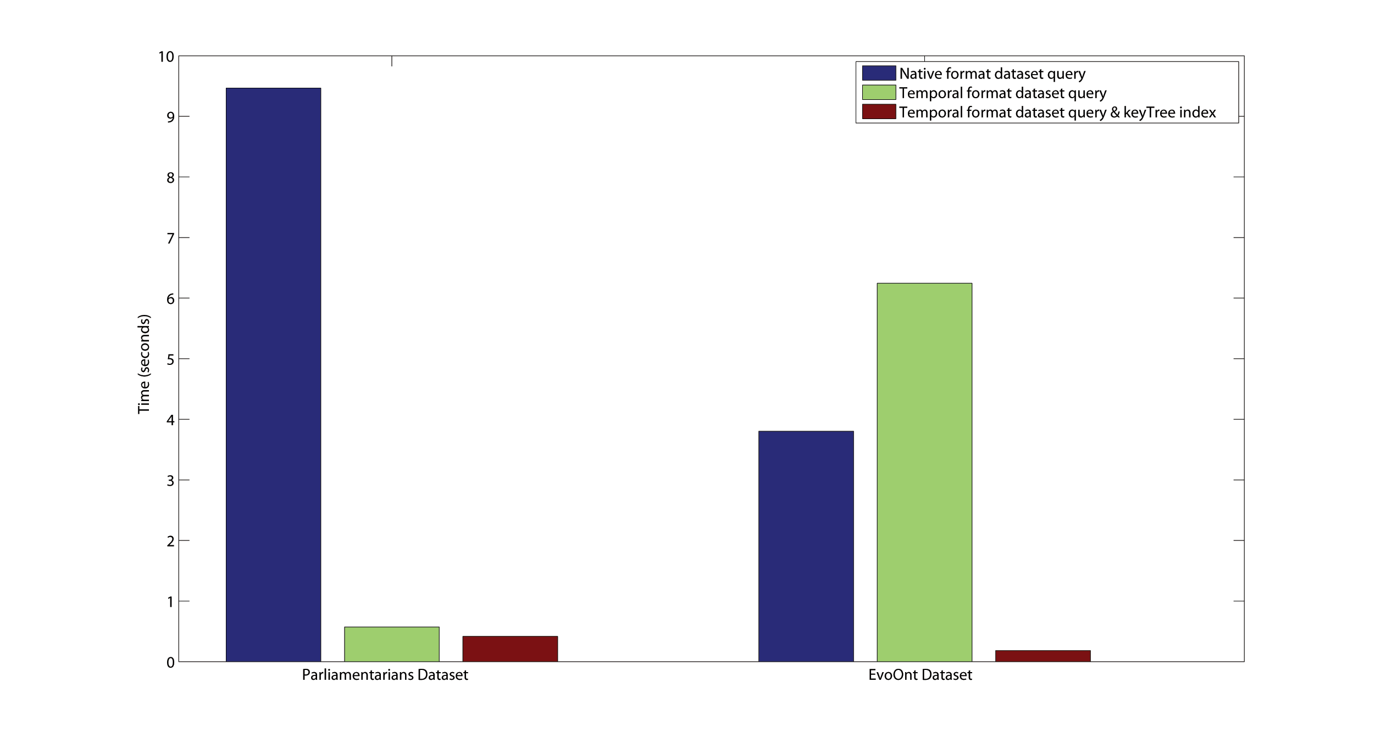
Timepoint Query Evaluation
Native format query
Temporal format query Temporal format query & keyTree Index
Parliamentarians Dataset
EvoOnt Dataset
Execution time of queries to retrieve all triples in a specific timepoint (multiple runs, averaged)

Slide 13
Temporal Queries
Query Rewriting:
Quad Patterns [?b, ?e] ?s ?p ?o .
Rewritten to:
GRAPH ?g{ ?s ?p ?o. }
?g owltime:hasBeginning ?b .
?g owltime:hasEnd ?e .
Bound to the graph URI
Bound to the interval’s end time
Bound to the interval’s start time

Slide 14
Temporal Queries – Interval Relations
[?b, ?d] ?person hasName ‘Albert Einstein’ .
[?birth, ?death] ?other a Person .
[?b, ?d] owltime:intervalOverlaps [?birth, ?death]
Rewritten to:
GRAPH ?g1{ ?person hasName ‘Albert Einstein’. }
GRAPH ?g2{?other a Person.}
?g1 owltime:intervalOverlaps ?g2 .
?g1 owltime:hasBeginning ?b .
…
People that lived during Albert Einstein’s lifetime

Slide 15
Temporal Query Evaluation
Versioned Graph (EvoOnt) approach not suitable for temporal queries!

Slide 16
Conclusions
Temporal graphs using out-of-the-box Semantic Web tools
The temporal format can vastly reduce the # of triples by removing redundancies
τ-SPARQL syntax facilitates query writing and can be mapped to standard SPARQL
The temporal format can increase the expressivity of a dataset

Slide 17
Discussion

Slide 18
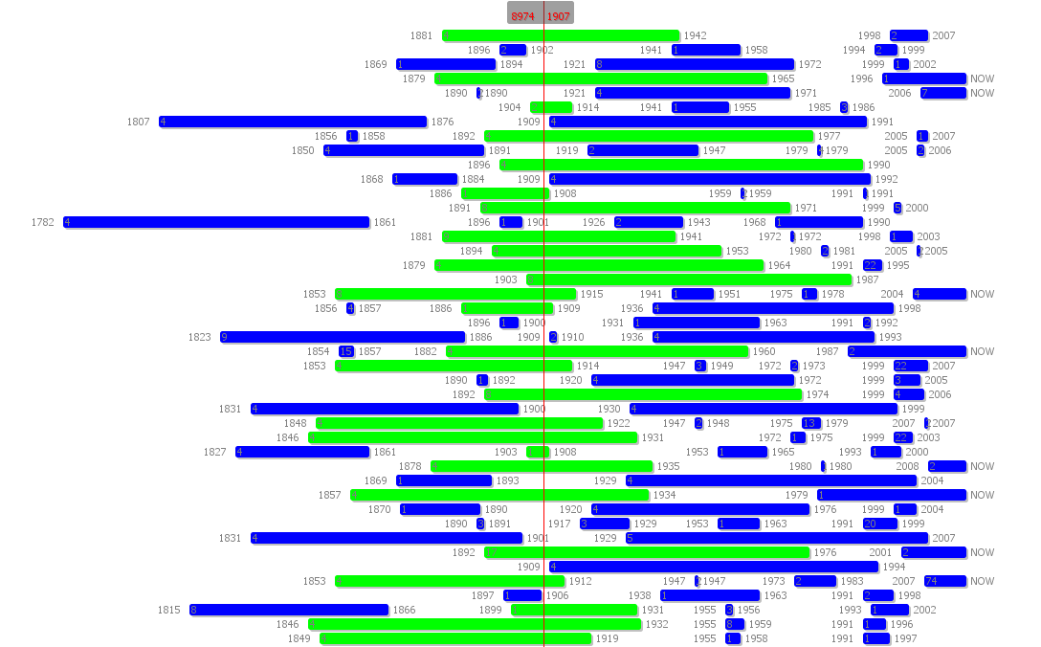
Interval Visualization

Slide 19
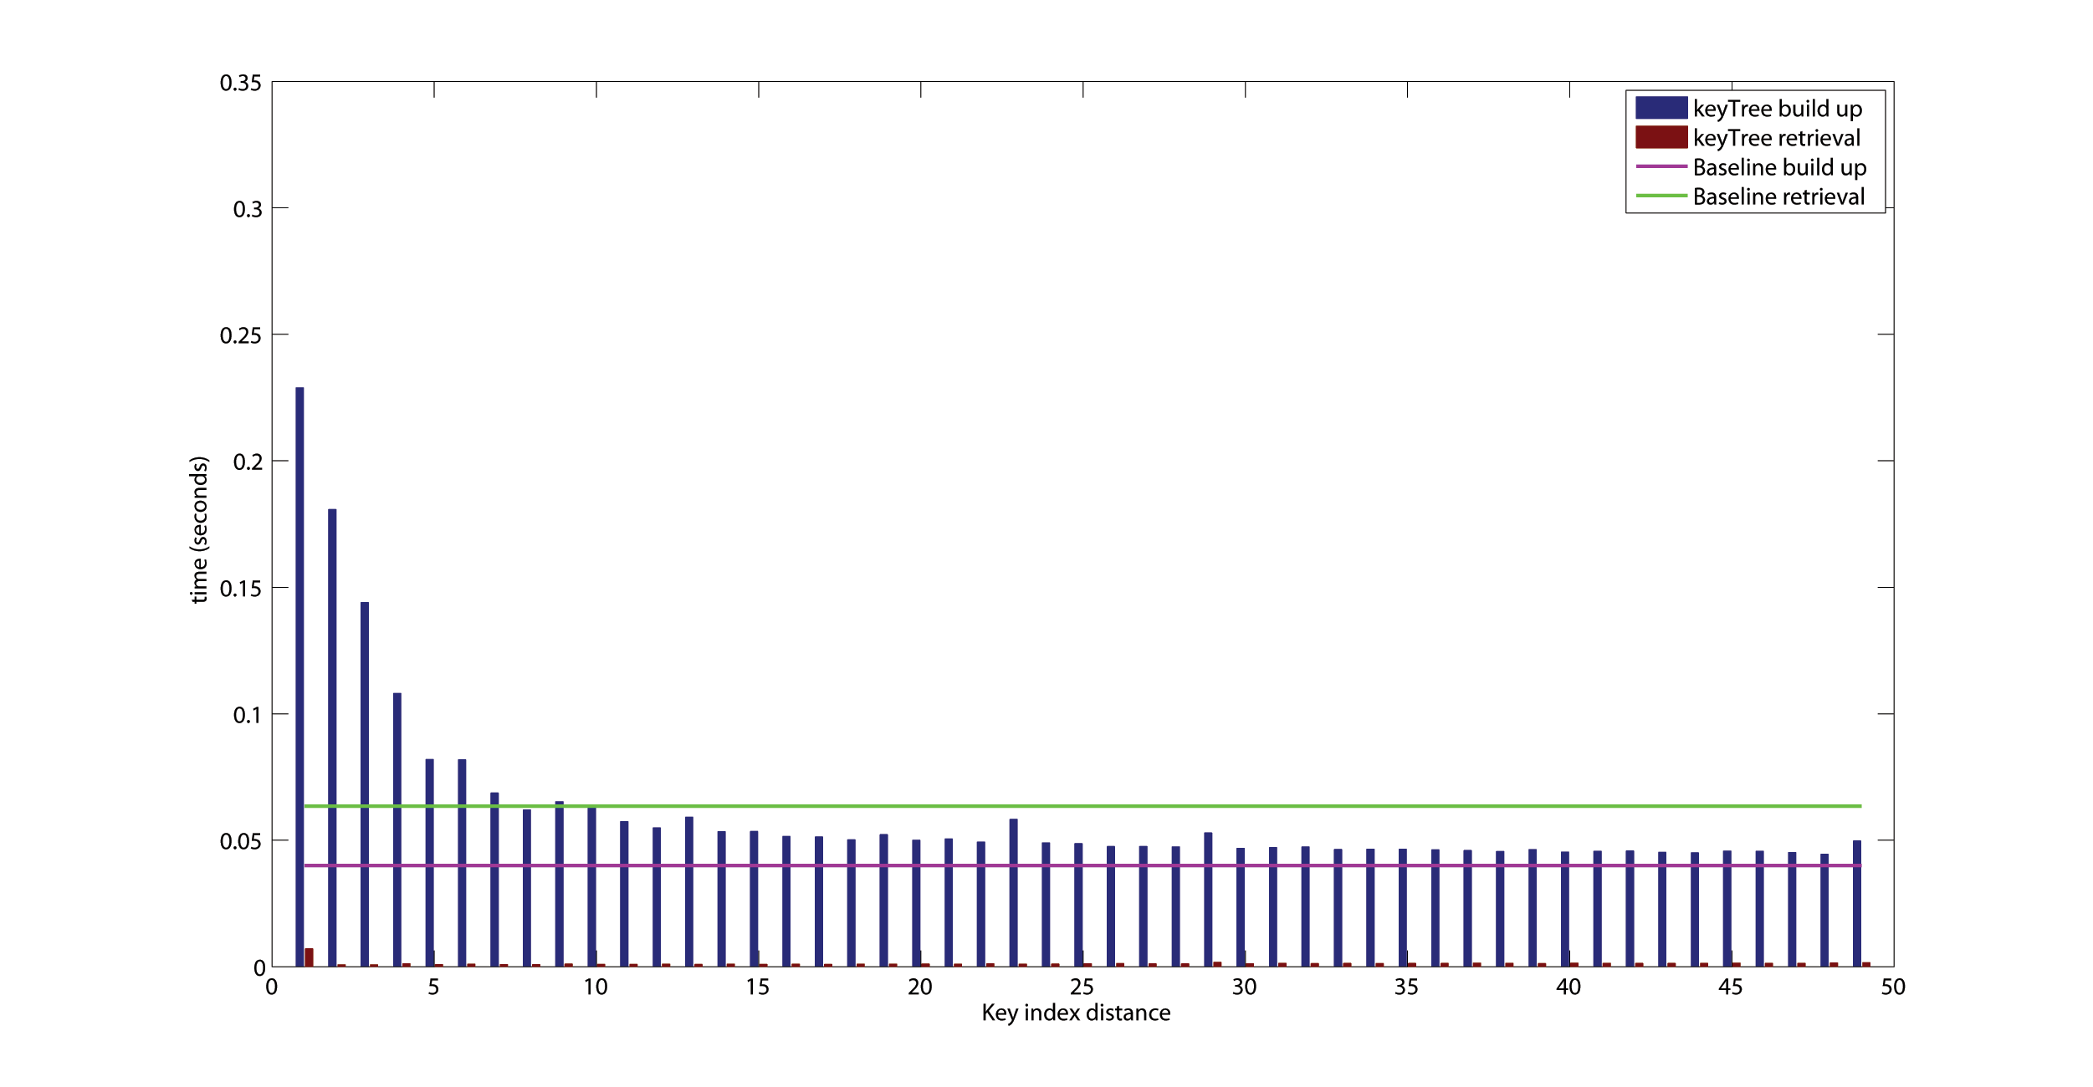
keyTree Index Evaluation (EvoOnt)

Slide 20
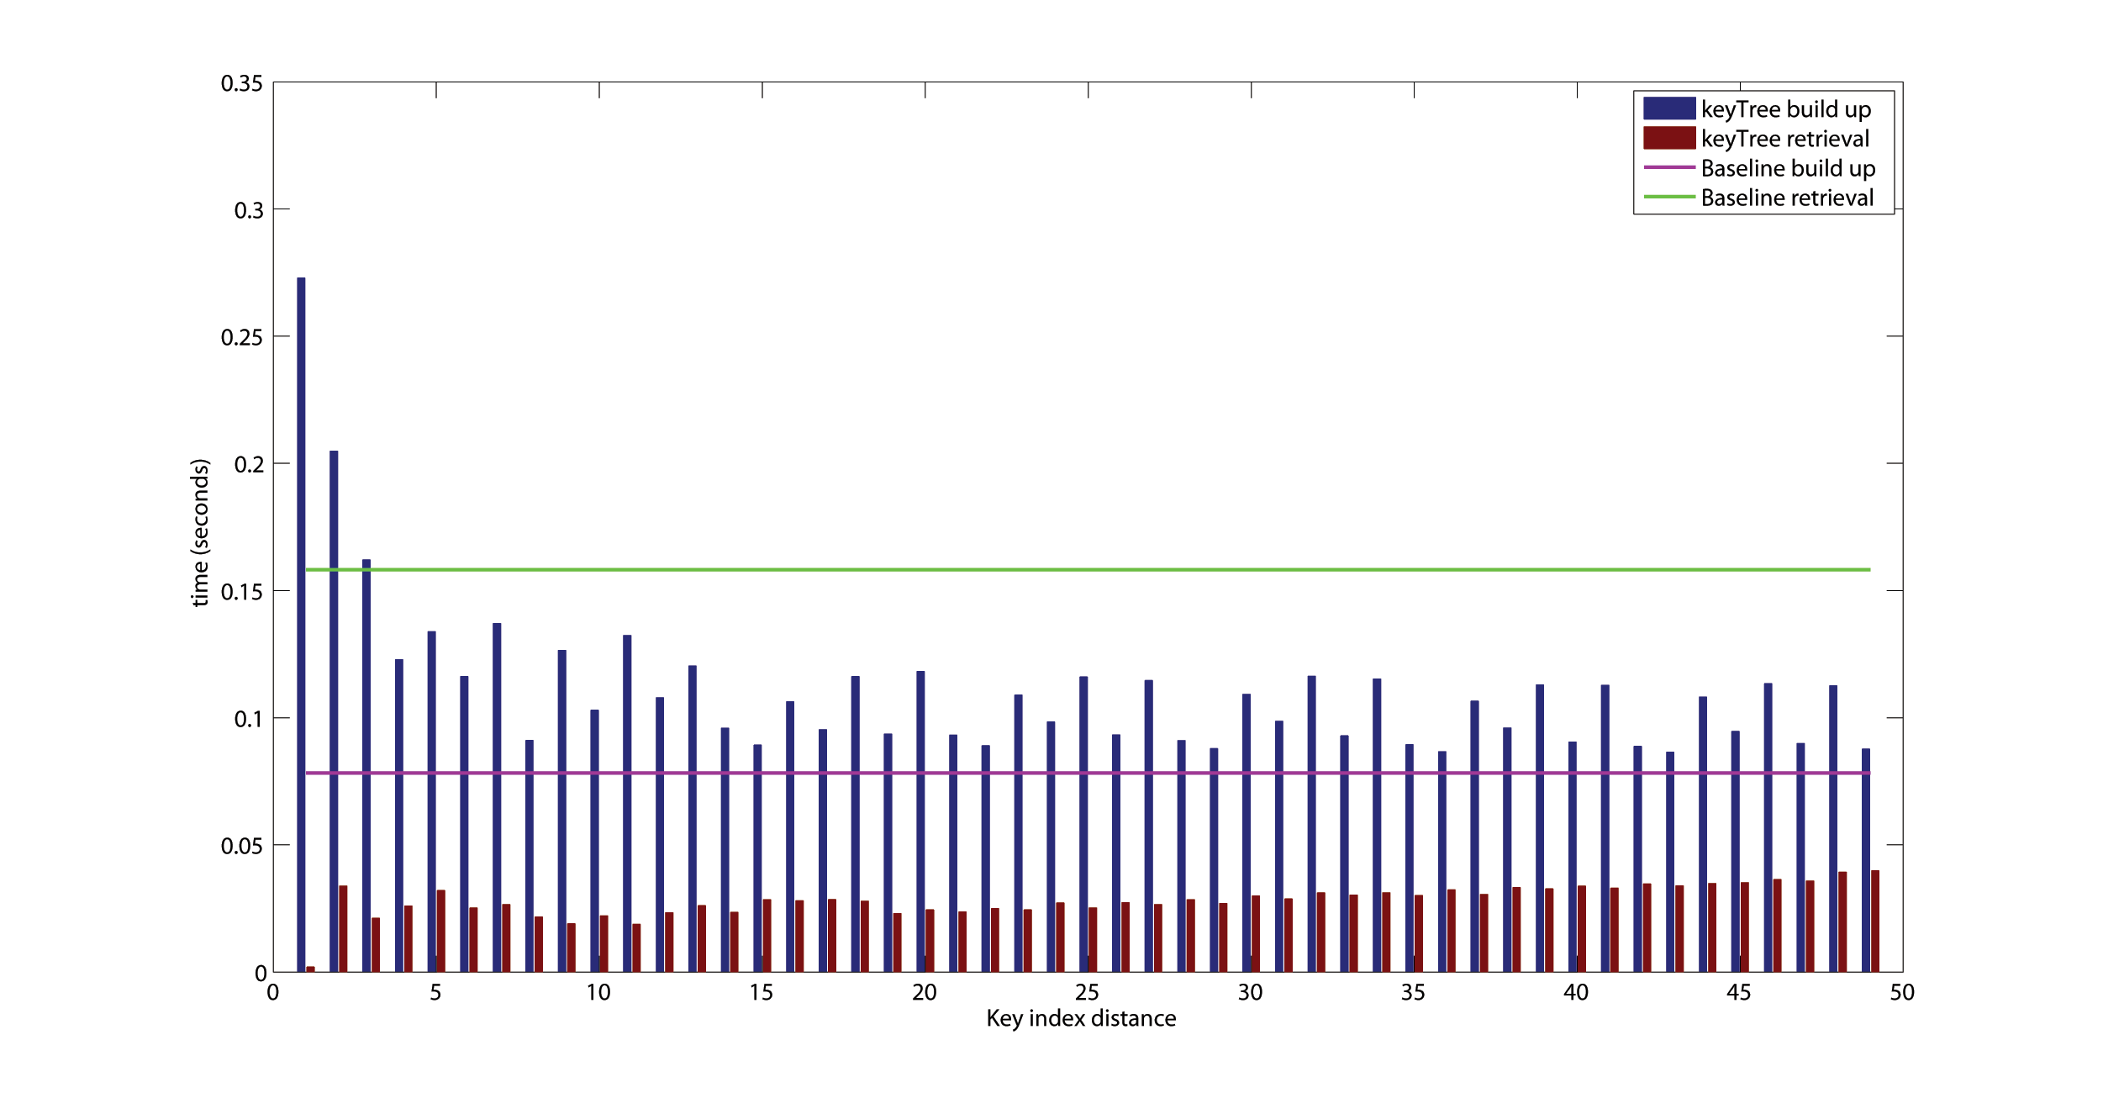
keyTree Evaluation

