Slide 1
Bayesian Clustering for Email Campaign Detection
Peter Haider & Tobias Scheffer
University of Potsdam

Slide 2
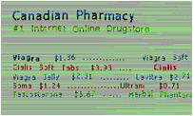
Email Campaign Detection
$salutation, This is $firstname $lastname. Our $organisation confirms you $acceptance for a $volume loan for a $payment.
$drug1 $price1 $drug2 $quantity $price2 .
Probabilistic
templates
Generated
examples
Hello, This is Terry Hagan.
Our company confirms you are legible for a $250.000 loan for a $380.00/month.
Dear Mr/Mrs, This is Brenda Dunn.
Our office confirms you can get a $228.000 loan for a $371.00 per month payment.
Dear friend,
nothing
specific
whatsoever.

Slide 3
Email Campaign Detection
Hello, This is Terry Hagan.
Our company confirms you are legible for a $250.000 loan for a $380.00/month.
Hello, This is Terry Hagan.
Our company confirms you are legible for a $250.000 loan for a $380.00/month.
Dear friend,
nothing
specific
whatsoever.
Set of objects
Cluster according to
their sources
?
Joint likelihood: integrate out parameters
$salutation, This is $firstname $lastname. Our $organisation confirms you $acceptance for a $volume loan for a $payment.
Hello, This is Terry Hagan.
Our company confirms you are legible for a $250.000 loan for a $380.00/month.
?
$drug1 $price1 $drug2 $quantity $price2 .
Hello, This is Terry Hagan.
Our company confirms you are legible for a $250.000 loan for a $380.00/month.
Dear friend,
nothing
specific
whatsoever.

Slide 4
Spam Filtering
Incoming emails
Hello, This is Terry Hagan.
Our company confirms you are legible for a $250.000 loan for a $380.00/month.
Dear friend,
nothing
specific
whatsoever.
Hello, This is Terry Hagan.
Our company confirms you are legible for a $250.000 loan for a $380.00/month.
Clustered emails in spam trap
Inbox: filter according to threshold on conditional likelihood
Hello, This is Terry Hagan.
Our company confirms you are legible for a $250.000 loan for a $380.00/month.
Hello, This is Terry Hagan.
Our company confirms you are legible for a $250.000 loan for a $380.00/month.

Slide 5
Problem Setting
Unknown number of sources with hidden parameters.
Set of objects, generated from several sources.
Goal: Find most likely clustering of objects according to their source.
$salutation, This is $firstname $lastname. Our $organisation confirms you $acceptance for a $volume loan for a $payment.
$drug1 $price1 $drug2 $quantity $price2 .
Hello, This is Terry Hagan.
Our company confirms you are legible for a $250.000 loan for a $380.00/month.
Hello, This is Terry Hagan.
Our company confirms you are legible for a $250.000 loan for a $380.00/month.
Dear friend,
nothing
specific
whatsoever.
Hello, This is Terry Hagan.
Our company confirms you are legible for a $250.000 loan for a $380.00/month.
Hello, This is Terry Hagan.
Our company confirms you are legible for a $250.000 loan for a $380.00/month.
Dear friend,
nothing
specific
whatsoever.

Slide 6
Outline
Review: Closed-form solution for Bayesian clustering with independent binary features.
Feature transformation that allows arbitrary dependencies in input space.
Optimization problem and algorithm for learning feature transformation.
Case study: Filtering spams through campaign detection.

Slide 7
Bayesian Clustering with Independent Binary Features
Factorize likelihood and prior over dimensions.
Analytical forms of joint likelihood and predictive probability.
Hello, This is Terry Hagan.
Our company confirms you are legible for a $250.000 loan for a $380.00/month.
$salutation, This is $firstname $lastname. Our $organisation confirms you $acceptance for a $volume loan for a $payment.
Hello, This is Terry Hagan.
Our company confirms you are legible for a $250.000 loan for a $380.00/month.
Hello, This is Terry Hagan.
Our company confirms you are legible for a $250.000 loan for a $380.00/month.

Slide 8
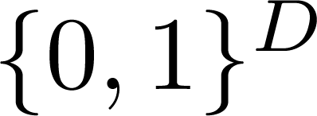
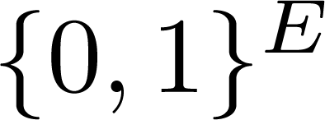
Feature Transformation
Independence assumption inappropriate.
Transform features into different space, where dimensions are (more or less) independent.

Slide 9
How Do We Get ?
Approximate true predictive distribution.
Ensure that approximation is suitable as probability distribution.

Slide 10
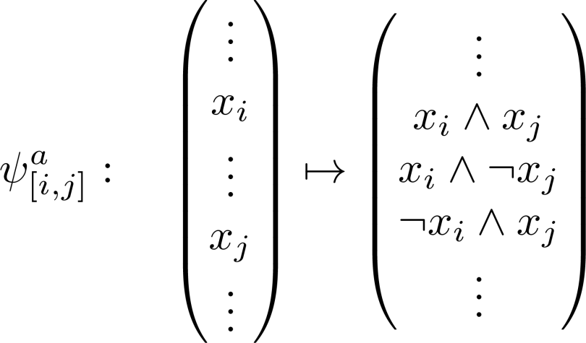
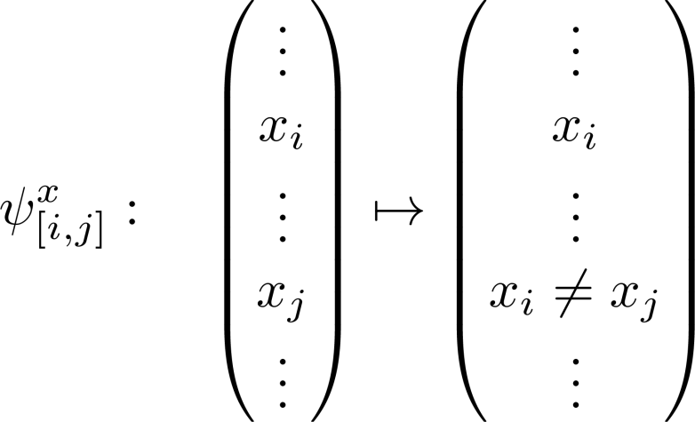
What Does Look Like?
Construct from elementary Boolean operations.
Search space: all concatenations
Includes all possible binary transformations.
Injective, sparsity preserving.

Slide 11
How To Find The Optimal ?
Minimize expected Kullback-Leibler divergence between true and approximated predictive distribution:
Approximate expectation by sum over empirical sample S:
Optimization problem:

Slide 12
Feature Transformation: Algorithm
Non-convex optimization problem → greedy procedure.
Algorithm:
Start with identity transformation
Repeat
Until convergence.

Slide 13
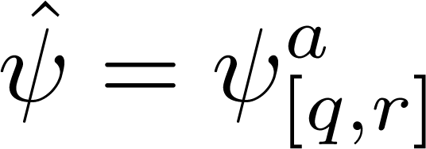
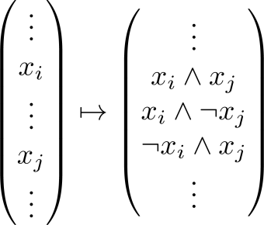
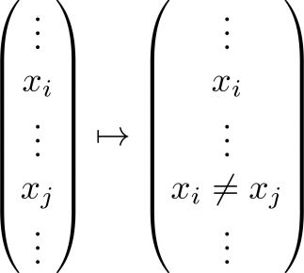
Feature Transformation: Example

Slide 14
Sequential Bayesian Clustering
Hello, This is Terry Hagan.
Our company confirms you are legible for a $250.000 loan for a $380.00/month.
Hello, This is Terry Hagan.
Our company confirms you are legible for a $250.000 loan for a $380.00/month.
Dear friend,
nothing
specific
whatsoever.
Cluster according to
their sources
Each step: most likely cluster

Slide 15
Case Study: Email Campaign Detection
Generally: no ground truth for unsupervised clustering.
Natural evaluation criterion for email campaign detection: contribution to accurate filtering of spam.
Spam trap stream:
window of 5,000 most recent spams
total: 69,625
sequential clustering of window.
Test stream:
mixture of
62,662 spams
36914 non-spams
Decision criterion:

Slide 16
Setting 1: Non-Spams from Test Distribution Available
Non-spams for training: 10,000 emails from same distribution as test non-spams.
Optimistic setting, since in practice test distribution differs from training distribution.
Compare:
Bayesian Clustering | Bayesian Clustering | Support Vector Machine
Feature Transformation trained on 10,000 non-spams | No Feature Transformation | Train on 10,000 non-spams and window of 5,000 most recent trapped spams

Slide 17
Results
Tune hyperparameters for maximum number of true positives at zero false positives.
Increase of true positive rate with Bayesian clustering with feature transformation over SVM.

Slide 18
Setting 2: No Non-Spams from Test Distribution Available
No non-spams for training.
Evaluate performance on entirely unknown non-spams.
Compare:
Bayesian Clustering | Bayesian Clustering | One-class SVM
Feature Transformation trained on 10,000 spams | No Feature Transformation | Train on window of 5,000 most recent trapped spams

Slide 19
Results
Tune hyperparameters for maximum number of true positives at zero false positives.
Sevenfold increase of true positive rate with Bayesian clustering with feature transformation over SVM.

Slide 20
Conclusions
Derived closed-form solution for Bayesian clustering, allowing arbitrary dependencies in input space.
Optimization problem for learning feature transformation as set of Boolean functions, that minimizes approximation error.
Spam filtering case study showed vast improvements over SVM in absence of non-spam training examples from the test distribution.

