Slide 1
Large-scale Deep Unsupervised Learning using Graphics Processors
Rajat Raina
Anand Madhavan
Andrew Y. Ng
Stanford University

Slide 2
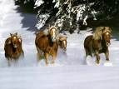
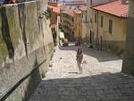
Learning from unlabeled data
Classify
vs.
car
motorcycle
Input space
Learn higher-level representation
Deep Belief Networks
Sparse Coding
Unlabeled examples
Higher-level representation
Large-scale Deep Unsupervised Learning Rajat Raina, Anand Madhavan, Andrew Y. Ng

Slide 3
The promise of unsupervised learning
Use large amounts of unlabeled data to learn
complex/deep models, possibly with many parameters.
Large-scale Deep Unsupervised Learning Rajat Raina, Anand Madhavan, Andrew Y. Ng

Slide 4
Some recent work on DBNs
(Similar situation for sparse coding.)
Published Source | Domain | Number of free parameters
Hinton et al. | Handwritten digits | 1.6 million
Hinton & Salakhutdinov | Face images | 3 million
Salakhutdinov & Hinton | Information retrieval | 2.6 million
Ranzato & Szummer | Text documents | 3.6 million
Our DBN model over images |  | 100 million
Large-scale Deep Unsupervised Learning Rajat Raina, Anand Madhavan, Andrew Y. Ng

Slide 5
Large-scale learning [Banko & Brill, 2001]
Large-scale Deep Unsupervised Learning Rajat Raina, Anand Madhavan, Andrew Y. Ng

Slide 6
Large-scale unsupervised learning
Current models: 1000s of input dimensions, 1000s of hidden units. 10⁶ parameters.
Our desired model: 10⁸ parameters
Large-scale Deep Unsupervised Learning Rajat Raina, Anand Madhavan, Andrew Y. Ng

Slide 7
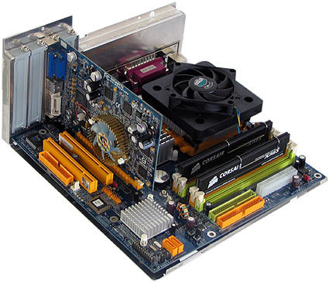
Graphics Processors
CPU
RAM
Graphics Card (GPU)
Motherboard
Large-scale Deep Unsupervised Learning Rajat Raina, Anand Madhavan, Andrew Y. Ng

Slide 8
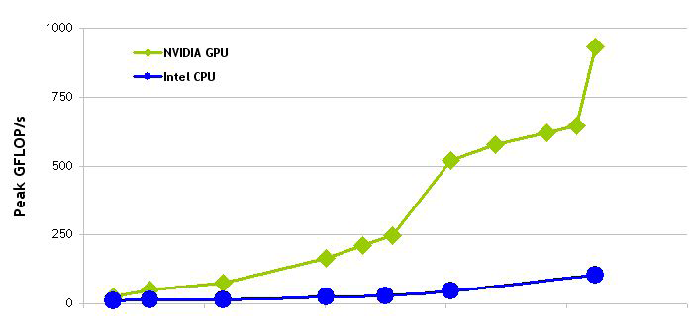
Why graphics processors?
1000
750
500
250
0
NVIDIA GPU
Peak Gflops
(billion ops / sec)
Intel CPU
2003 2004 2005 2006 2007 2008
(Source: NVIDIA CUDA Programming Guide)
Large-scale Deep Unsupervised Learning Rajat Raina, Anand Madhavan, Andrew Y. Ng

Slide 9
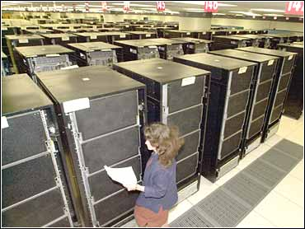
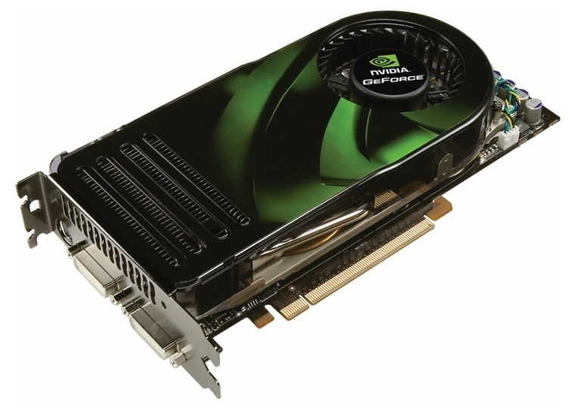
Why graphics processors?
IBM ASCI White Supercomputer
Cost: $110 million
Space: 2 basketball courts
13 graphics cards
Large-scale Deep Unsupervised Learning Rajat Raina, Anand Madhavan, Andrew Y. Ng

Slide 10
GPU Schematic
30 MPs
MP
MP
…
MP
Shared Memory
(16K)
Shared Memory
(16K)
Shared Memory
(16K)
1000GB/s
SP
SP
SP
SP
SP
SP
SP
SP
SP
SP
SP
SP
SP
SP
SP
SP
SP
SP
SP
SP
…
SP
SP
SP
SP
Registers
Registers
100 GB/s
(coalesced)
Registers
Global Memory (~1GB)
Slow transfer from RAM
RAM
(Note: Some additional features not displayed.)

Slide 11
GPU Programming
MP
MP
MP
Shared Memory
Shared Memory
Shared Memory
Two-level parallelism
Split task into blocks, blocks into threads.
Access to global memory (not RAM).
Restrictions on memory access patterns.
Main bottleneck:
Getting data into GPU memory, and accessing it in efficient ways.
NVIDIA CUDA
High-level routines to allocate/copy GPU memory.
Good GPU matrix libraries that suffice for many machine learning tasks.
SP
SP
SP
SP
SP
SP
SP
SP
SP
SP
SP
SP
SP
SP
SP
SP
SP
SP
SP
SP
SP
SP
SP
SP
Global Memory (~1GB)
RAM
Large-scale Deep Unsupervised Learning Rajat Raina, Anand Madhavan, Andrew Y. Ng

Slide 12
Unsupervised learning on GPUs
Initialize parameters in global memory.
while convergence criterion is not satisfied
Periodically transfer a large number of unlabeled examples into global memory.
Pick a few of the unlabeled examples at a time, and compute the updates in parallel using the GPU's two-level parallelism (blocks and threads) or GPU matrix libraries.
end
Transfer learnt parameters from global memory.
Large-scale Deep Unsupervised Learning Rajat Raina, Anand Madhavan, Andrew Y. Ng

Slide 13
Deep Belief Networks
Learning Large DBNs using Graphics Processors Rajat Raina, Andrew Y. Ng

Slide 14
Restricted Boltzmann Machine (RBM)
. . .
h₁
h₂
h
. . .
v
v₁
v₂
v₃
Contrastive divergence learning via conditional distributions:
Large-scale Deep Unsupervised Learning Rajat Raina, Anand Madhavan, Andrew Y. Ng

Slide 15
Experimental setup
Single graphics card: Nvidia GTX 280
1GB on-board memory, 240 cores.
Current price: US $250.
CPU:
Two cores, each @3.16GHz.

Slide 16
Learning Large RBMs
Dual-core CPU
2 weeks
1 week
35 hours
72x faster
1 day
Learning time for 10 million examples
(log scale)
8 hours
2 hours
GPU
5 hours
1 hour
½ hour
1 18 36 45
Millions of parameters
Large-scale Deep Unsupervised Learning Rajat Raina, Anand Madhavan, Andrew Y. Ng

Slide 17
Overlapping patches DBN
Hidden Units_{A}
. . . . . .
Hidden Units_{B}
W_{A}, b_{A}, c_{A}
W_{B}, b_{B}, c_{B}
Patch A
Patch B
Input image
Large-scale Deep Unsupervised Learning Rajat Raina, Anand Madhavan, Andrew Y. Ng

Slide 18
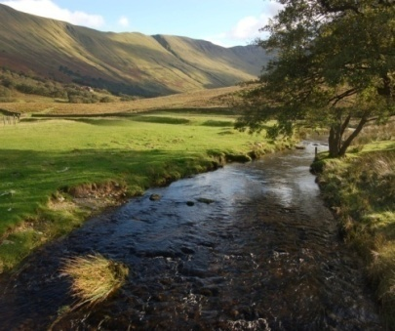
Overlapping patches DBN example
110 million parameters.
…
…
. .
…
8192
units
15680
units
2048
units
32768 units
(128 units per 24x24 patch)
20736 units (144x144)
All layers can be learnt in about 1 day on a GPU.
Large-scale Deep Unsupervised Learning Rajat Raina, Anand Madhavan, Andrew Y. Ng

Slide 19
Sparse Coding
Large-scale Deep Unsupervised Learning Rajat Raina, Anand Madhavan, Andrew Y. Ng

Slide 20
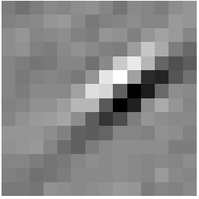
Sparse coding
Basis vectors b
Given unlabeled data x^{(i)}, obtain b by solving:
Alternating minimization
Keep a fixed, find optimal b.
Keep b fixed, find optimal a.
Input
= 0.8 * + 0.3 * + 0.5 *
x = 0.8 * b₈₇ + 0.3 * b₃₇₆ + 0.5 * b₄₁₁
Activations a
Large-scale Deep Unsupervised Learning Rajat Raina, Anand Madhavan, Andrew Y. Ng

Slide 21
Parallel Sparse Coding
Alternating minimization
Keep a fixed, find optimal b. Easy on GPU (projected grad descent).
Keep b fixed, find optimal a. Not as straightforward.
Need to parallelize:
Large-scale Deep Unsupervised Learning Rajat Raina, Anand Madhavan, Andrew Y. Ng

Slide 22
Parallel Sparse Coding
Easy to optimize for one coordinate (keeping the others fixed).
(Friedman et al., 2007)
One iteration of our algorithm:
Descent direction
Large-scale Deep Unsupervised Learning Rajat Raina, Anand Madhavan, Andrew Y. Ng

Slide 23
Sparse coding with 10⁶ parameters
19 days
Dual-core CPU
Learning time (days) with 10 million examples
15x faster
GPU
1 day 6 hours
3% nonzero 10% nonzero
Sparsity
Large-scale Deep Unsupervised Learning Rajat Raina, Anand Madhavan, Andrew Y. Ng

Slide 24
Summary
Large-scale unsupervised learning.
Ten-times more data might transform an OK algorithm into a good algorithm.
Working at smaller-scale risks confounding the effects of the model itself, with the effect of scale.
GPUs are a powerful tool for machine learning.
Easy to program (no low-level programming).
Especially useful for stochastic learning methods.
Learning algorithms for DBNs and sparse coding can be an order-of-magnitude faster.
Large-scale Deep Unsupervised Learning Rajat Raina, Anand Madhavan, Andrew Y. Ng

Slide 25
THE END

Slide 26
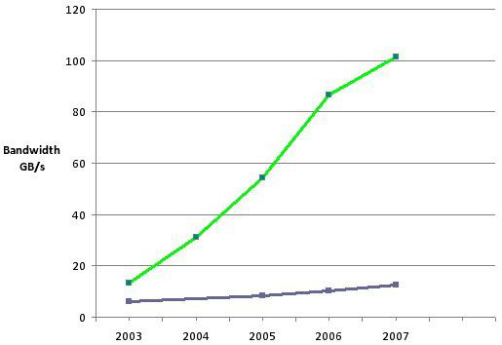
Why graphics processors?
120
100
80
60
40
20
0
NVIDIA GPU
Bandwidth from memory to processor
(GB/s)
Intel CPU
2003 2004 2005 2006 2007
(Source: NVIDIA CUDA Programming Guide)
Large-scale Deep Unsupervised Learning Rajat Raina, Anand Madhavan, Andrew Y. Ng
Notes:
In modern computing, sometimes the bottleneck is getting data into the processor from the memory.

Slide 27
GPU Programming: A=A+B
__global__ void vecAdd(float* A, float* B){
int my = threadIdx.x + blockIdx.x * 128;
A[my]=A[my]+B[my];
}
int main(int argc, char** argv){
float A[SIZE], B[SIZE];
float* d_A, * d_B;
cudaMalloc((void**)&d_A,SIZE_BYTES); cudaMalloc((void**)&d_B,SIZE_BYTES);
cudaMemcpy(d_A,A,SIZE_BYTES,cudaMemcpyHostToDevice);
cudaMemcpy(d_B,B,SIZE_BYTES,cudaMemcpyHostToDevice);
vecAdd<<<32,128>>>(d_A,d_B);
cudaThreadSynchronize();
cudaMemcpy(A,d_A,SIZE_BYTES,cudaMemcpyDeviceToHost);
}
GPU
CPU
(Adapted from http://www.cs.technion.ac.il/~marks/docs/LinuxClubGPGPU.pdf)
Notes:
http://www.cs.technion.ac.il/~marks/docs/LinuxClubGPGPU.pdf

