Slide 1
  Supervised learning from multiple experts
  Whom to trust when everyone lies a bit
  Vikas C Raykar
  Siemens Healthcare USA
  26th International Conference on Machine Learning
  June 16 2009
  Co-authors
  Shipeng Yu, Anna Jerebko, Charles Florin, Gerardo Hermosillo Valadez, Luca Bogoni
  CAD and Knowledge Solutions (IKM CKS), Siemens Healthcare, Malvern, PA USA
  Linda H. Zhao
  Department of Statistics, University of Pennsylvania, Philadelphia, PA USA
  Linda Moy
  Department of Radiology, New York University School of Medicine, New York, NY USA
TexPoint fonts used in EMF.
Read the TexPoint manual before you delete this box.: AAAAAAAAAA

Slide 2
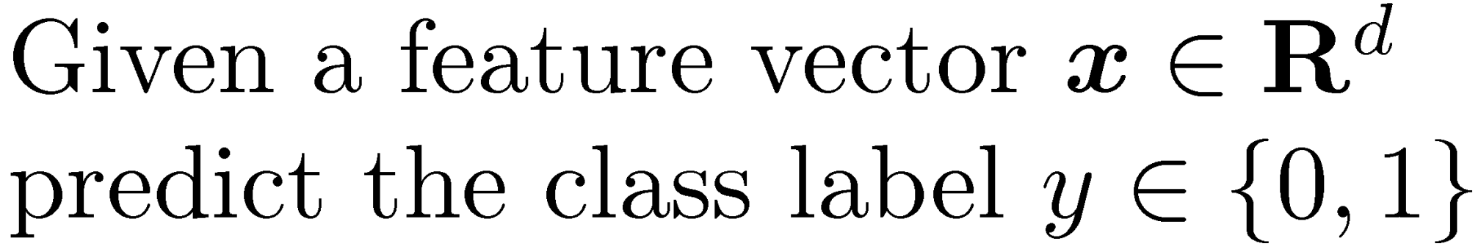
Binary classification

Slide 3
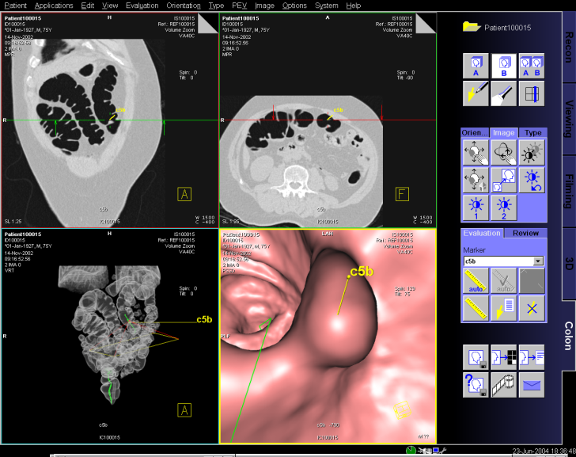
Computer-aided diagnosis (CAD) colorectal cancer
Predict whether a region on a CT scan is cancer (1) or not (0)
Notes:
From a classification perspective, given a region on a medical image like a CT scan we have to predict whether it is cancer or not.
For a given region a set of features is usually computed.

Slide 4
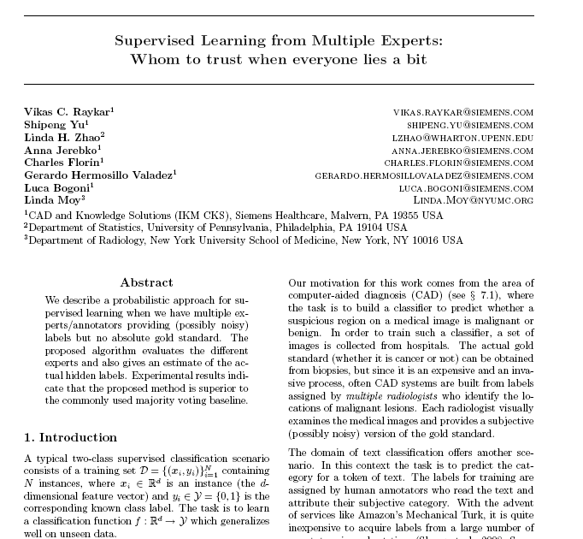
Text classification
Predict whether a token of text belongs to a particular category(1) or not (0)

Slide 5




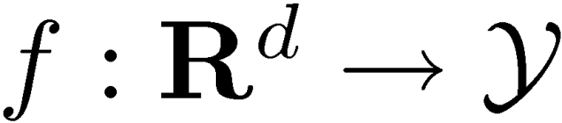



Supervised binary classification
Instance | Label
 | 1
 | 0
 | 0
 | 1
. | .
. | .
 | 1
Learn a classification function
which generalizes well on unseen data.

Slide 6

Objective ground truth gold standard
How do we obtain the labels for training ?
Is it cancer or not?
Getting the actual golden ground truth can be
  Expensive
  Tedious
  Invasive
  Potentially dangerous
  Could be impossible
Golden ground truth can be obtained only by a biopsy of the tissue
Notes:
Sometimes even a biopsy cannot confirm whether it is cancer or not.

Slide 7
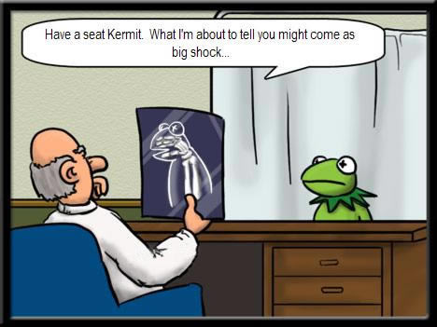
Subjective ground truth
Is it cancer or not?
Getting objective truth is hard.
So we use opinion from an expert (radiologist)
She/he visually examines the image and provides a subjective version of the truth.
Notes:
For some tasks all we can hope to get is subjective ground truth.

Slide 8
Subjective ground truth from multiple experts
An expert provides a his/her version of the truth.
Error prone.
Use multiple experts who label the same example.

Slide 9
Annotation from multiple experts
Each radiologist is asked to annotate whether a lesion is malignant (1) or not (0).
Lesion ID | Radiologist 1 | Radiologist 2 | Radiologist 3 | Radiologist 4 | Truth Unknown
12 | 0 | 0 | 0 | 0 | x
32 | 0 | 1 | 0 | 0 | x
10 | 1 | 1 | 1 | 1 | x
11 | 0 | 0 | 1 | 1 | x
24 | 0 | 1 | 1 | 1 | x
23 | 0 | 0 | 1 | 0 | x
40 | 0 | 1 | 1 | 0 | x
In practice there is a substantial amount of disagreement.
We have no knowledge of the actual golden ground truth.
Getting absolute ground truth (e.g. biopsy) can be expensive.

Slide 10
We are interested in
Building a model which can predict malignancy.
How do you evaluate your classifier ?
How do you train the classifier ?
How do you evaluate the experts ?
Can we estimate the actual ground truth?
ID | R1 | R2 | R3 | R4 | Truth
12 | 0 | 0 | 0 | 0 | x
32 | 0 | 1 | 0 | 0 | x
10 | 1 | 1 | 1 | 1 | x
11 | 0 | 0 | 1 | 1 | x
24 | 0 | 1 | 1 | 1 | x
23 | 0 | 0 | 1 | 0 | x
40 | 0 | 1 | 1 | 0 | x
Estimate of Truth
0
0
1
1
1
0
0
Prediction
1
0
1
0
1
0
1

Slide 11
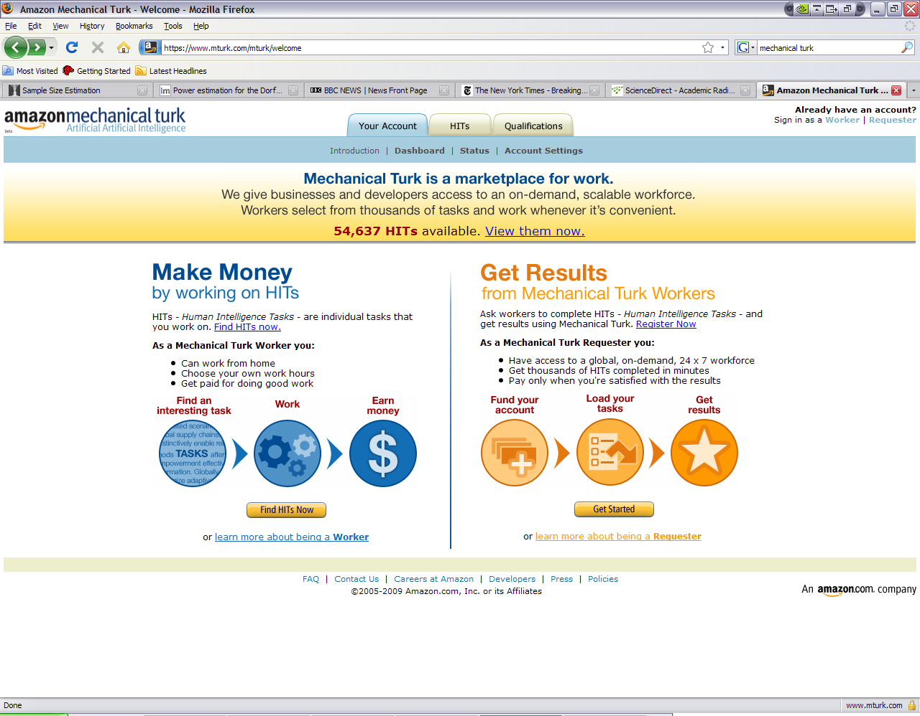
Crowd sourcing marketplaces
Possibly thousands of annotators.
Some are genuine experts.
Most of novices.
Some may be even malicious
Without the GT how do we know?

Slide 12
Plan of the talk
Multiple experts
  Objective ground truth is hard to obtain
  Subjective labels from multiple annotators/experts
  How do we train/test a classifier/annotator?
Majority voting
Proposed EM algorithm
Experiments
Extensions

Slide 13
Majority Voting
Use this to
train and test
models.
Use the label on which most of them agree as an estimate of the truth.
ID | R1 | R2 | R3 | R4 | Truth | Majority Voting
12 | 0 | 0 | 0 | 0 | x | 0
32 | 0 | 1 | 0 | 0 | x | 0
10 | 1 | 1 | 1 | 1 | x | 1
11 | 0 | 0 | 1 | 1 | x | ?
24 | 0 | 1 | 1 | 1 | x | 1
23 | 0 | 0 | 1 | 0 | x | 0
40 | 0 | 1 | 1 | 0 | x | ?
Pr [label=1]
0.00
0.25
1.00
0.50
0.75
0.25
0.50
? When there is no clear majority use a super-expert to adjudicate the labels.

Slide 14
What’s wrong with majority voting ?
The problem is that it is just a majority.
Assumes all experts are equally good.
What if majority of them are bad and only one annotator is good?
Breast MR example | R1 | R2 | R3 | Label from biopsy | Majority Voting
10 | 1 | 1 | 0 | 0 | 1
22 | 1 | 1 | 0 | 0 | 1
FIX : Give more importance to the expert you trust ?
PROBLEM : How do we know which expert is good? For that we need
the actual ground truth ? Chicken-and-egg problem

Slide 15
Plan of the talk
Multiple experts
  Objective ground truth is hard to obtain
  Subjective labels from multiple annotators/experts
  How do we train/test a classifier/annotator?
Majority voting
  Uses the majority vote as an estimate of the truth
  Problem: Considers all experts as equally good
Proposed algorithm
Experiments
Extensions

Slide 16
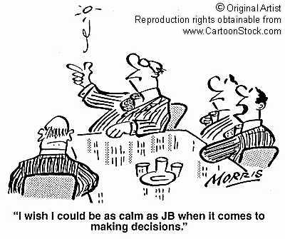
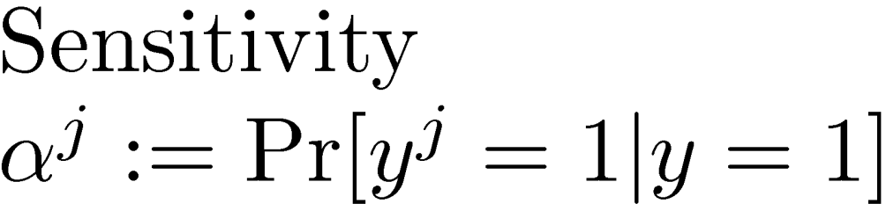
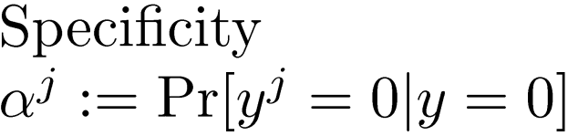
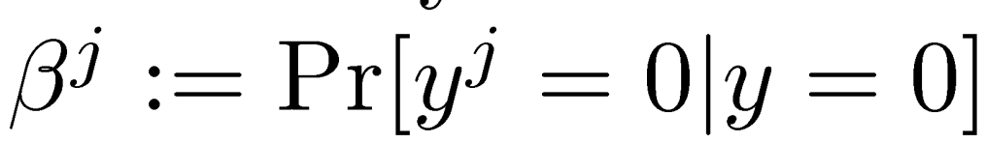
How to judge an expert/annotator ?
A radiologist with two coins
Label assigned by expert j
True Label

Slide 17
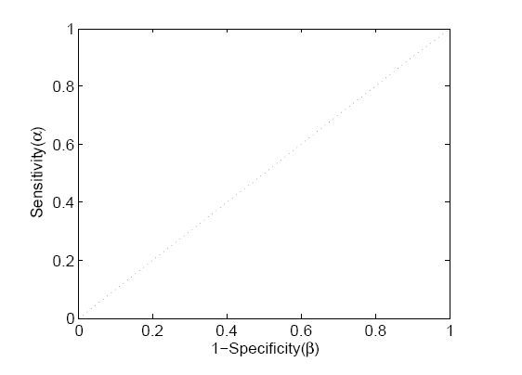
How to judge an annotator ?
Gold Standard
Luminary
Dumb expert
Novice
Dart throwing monkey
Good experts have high sensitivity and high specificity.
Evil

Slide 18
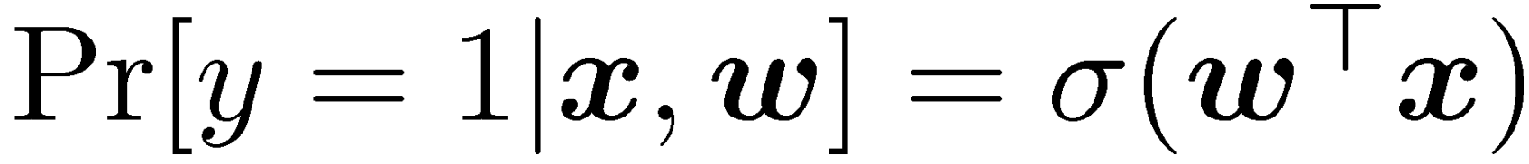
Classification model
Linear classifier
Logistic Regression
Instance/feature vector
Weight vector

Slide 19
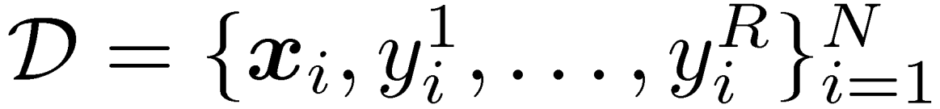
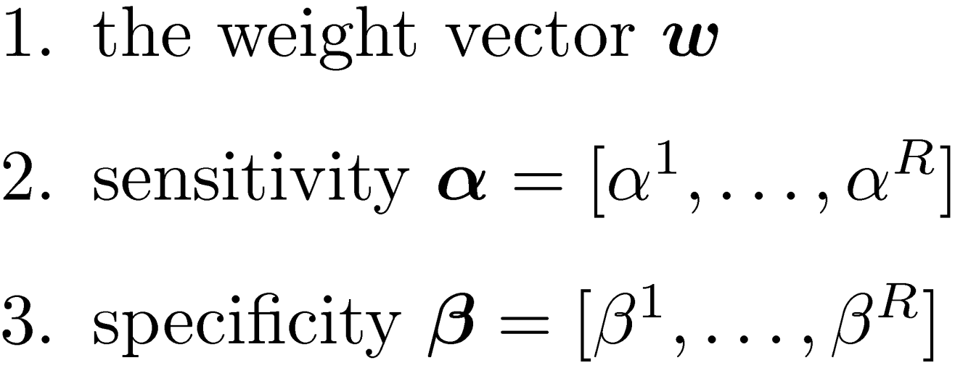



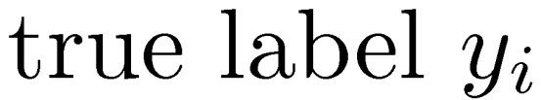
Problem statement
Input Given N examples with annotations from R experts
Output
Missing

Slide 20
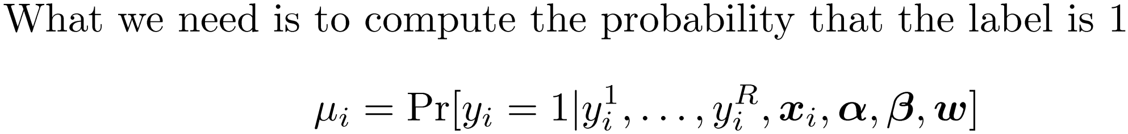
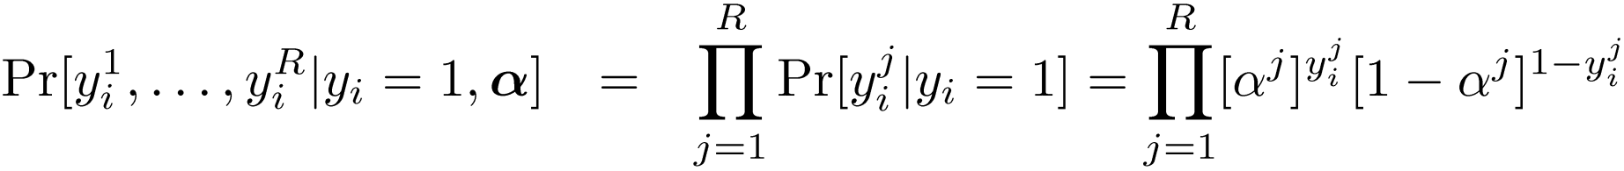
Step 1: How to find the missing label ?
Bayes Rule
Classification model
Likelihood
Conditional on the true label we assume the radiologists make their decisions independently.

Slide 21
Step 1: How to find the missing label ?
So if someone provided me with the true sensitivity and specificity for each
radiologist (and also the classifier) I could give you the true label as
Why is this useful ? We really do not know the sensitivity, specificity, or the classifier.

Slide 22

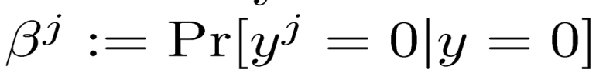
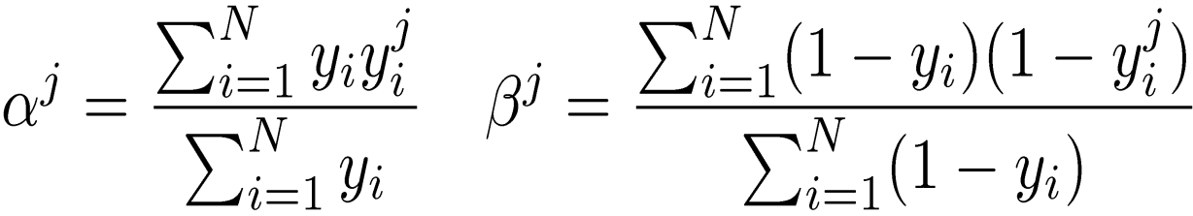
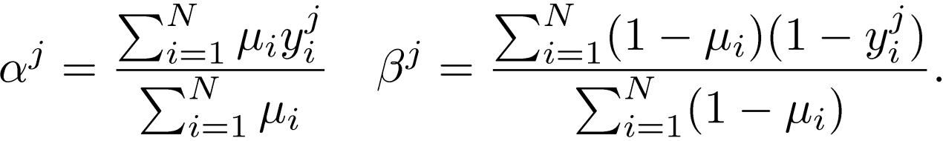
Step 2: If we knew the actual label …
We can compute the sensitivity and specificity of each radiologist.
Instead of a hard label (0 or 1)
If I had a soft label (probability that the label is 1)
Sensitivity and specificity with soft labels

Slide 23
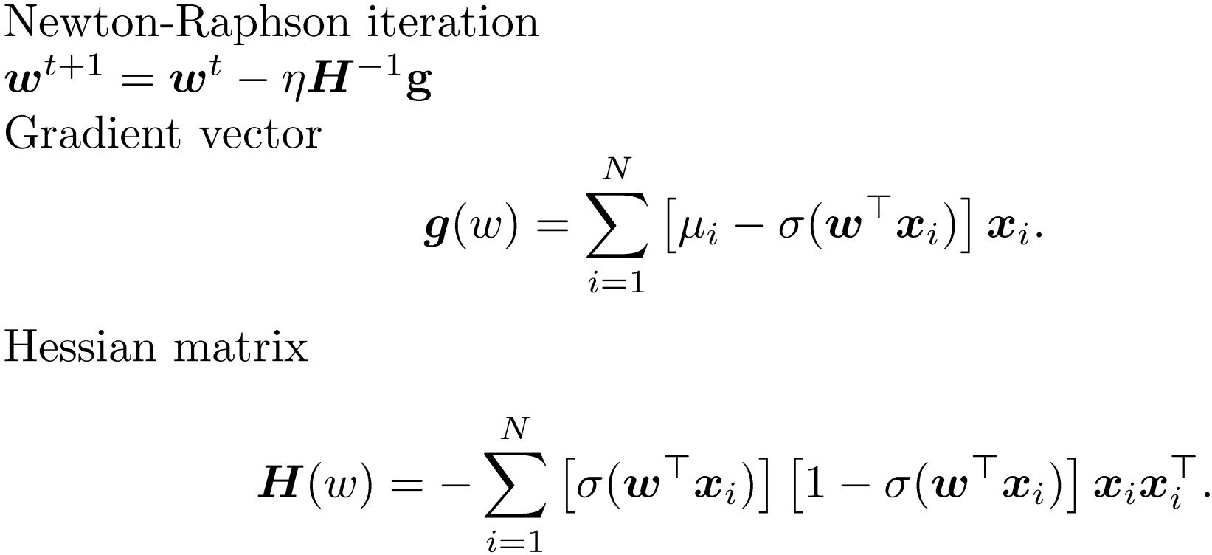
Step 2: If we knew the actual label
We could always learn a classifier.
Logistic regression with probabilistic supervision
Soft label

Slide 24
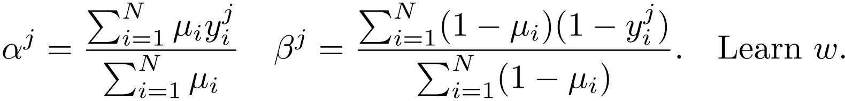
The chicken-and-egg problem
If I knew the true label I can learn a classifier /estimate how good each expert is
Iterate till convergence
Initialize using majority-voting
If I knew how good each expert is I can estimate the true label

Slide 25
The final EM algorithm
Bayesian approach
Prior on the experts
See the paper
M-step
The algorithm can be rigorously derived by writing the likelihood.
We can find the maximum-likelihood (ML) estimate for the parameters.
The log-likelihood can be maximized using an EM algorithm
The actual labels are the missing data for EM algorithm.
Missing labels
See paper
E-step

Slide 26
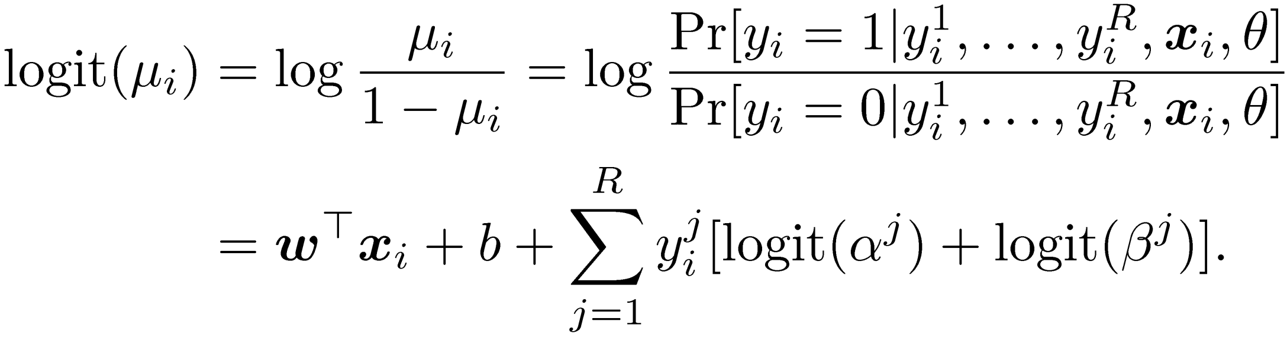
One insight

Slide 27
Plan of the talk
Multiple experts
  Objective ground truth is hard to obtain
  Subjective labels from multiple annotators/experts
  How do we train/test a classifier/annotator?
Majority voting
  Uses the majority vote as consensus
  Problem: Considers all experts as equally good
Proposed algorithm
  Iteratively estimates the expert performance, the classifier, and the actual ground truth.
  Principled probabilistic formulation
Experiments
Extensions

Slide 28
Datasets
Hard to get datasets with both gold standard and multiple experts
Domain | Gold standard | Number of annotators | Number of features | Number of positives | Number of negatives
Digital Mammography | Available (Biopsy) | Simulated | 27 | 497 | 1618
Breast MRI
Textual Entailment
How good is the classifier ?
How well can you estimate the annotator performance?
How well can you estimate the actual ground truth ?
Proposed EM algorithm
Majority Voting

Slide 29
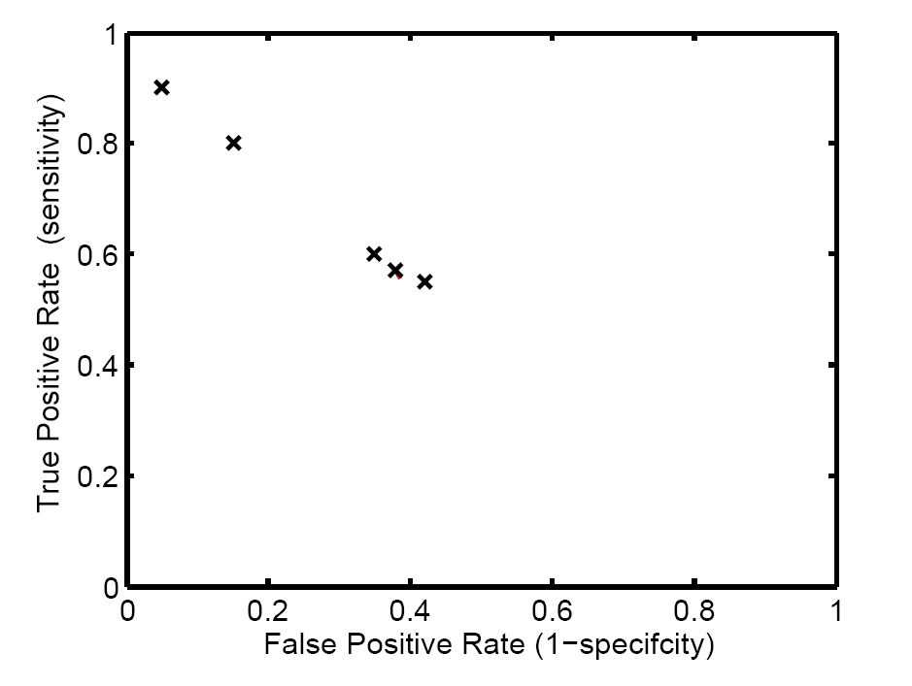
Mammography dataset 5 simulated radiologists
Gold standard
2 experts
3 novices

Slide 30
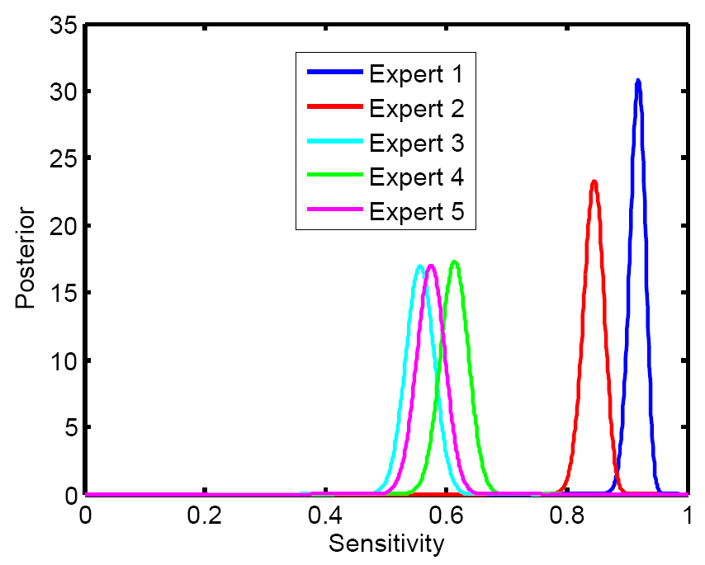
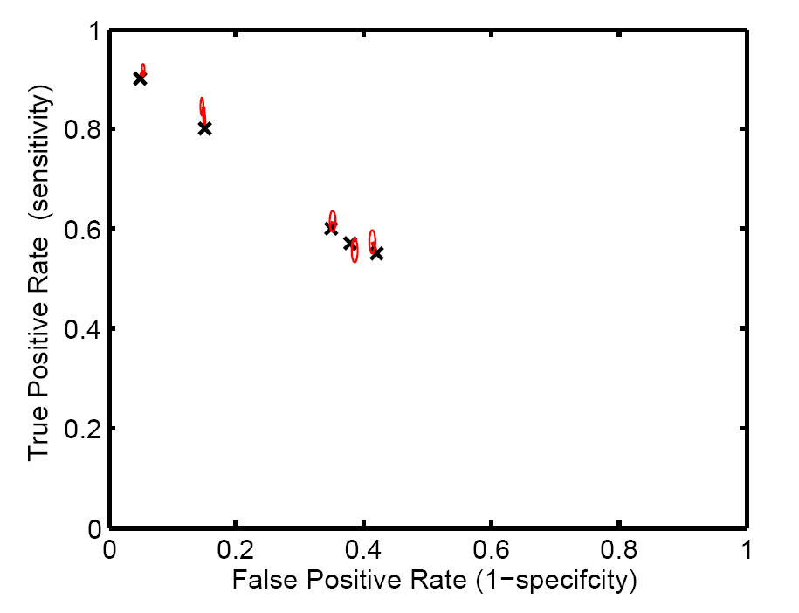
Estimated sensitivity and specificity Proposed algorithm

Slide 31
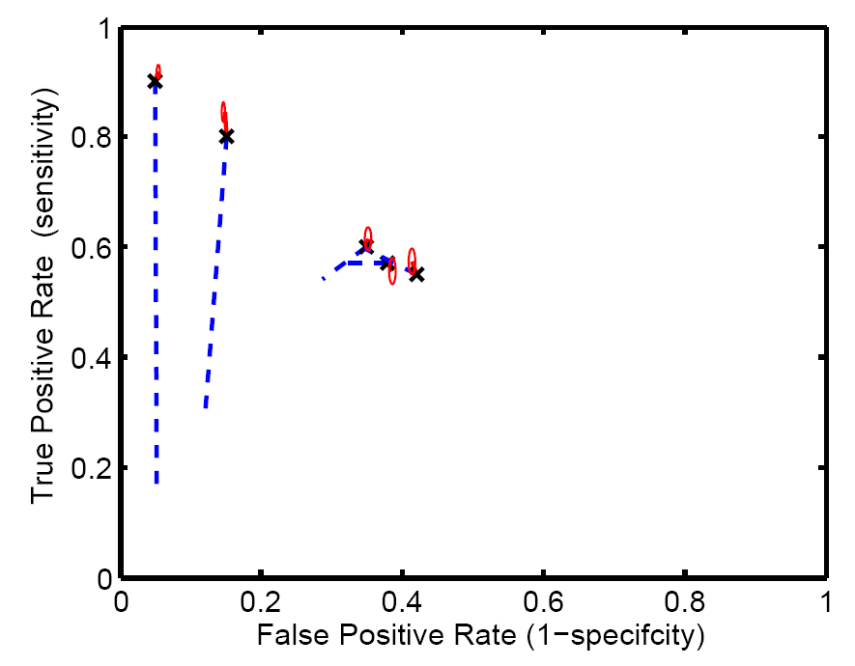
Estimated sensitivity and specificity Majority voting

Slide 32
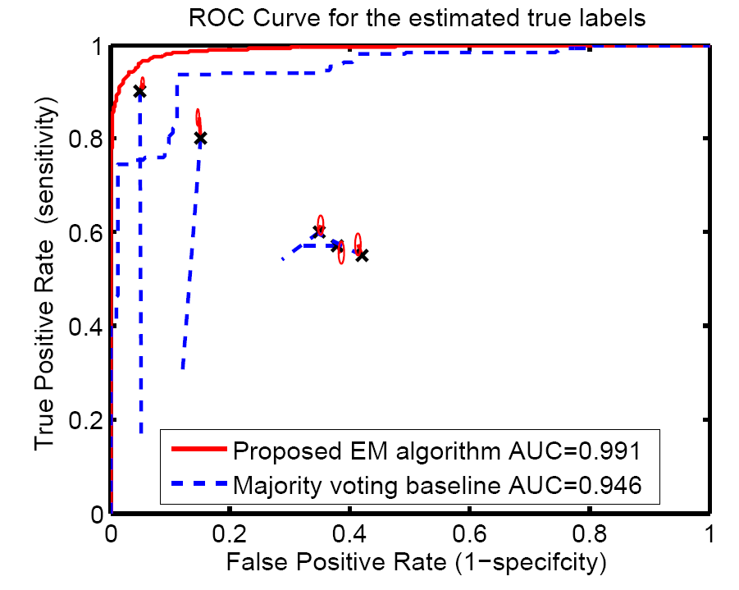
ROC for the estimated Ground Truth
3.0% higher

Slide 33
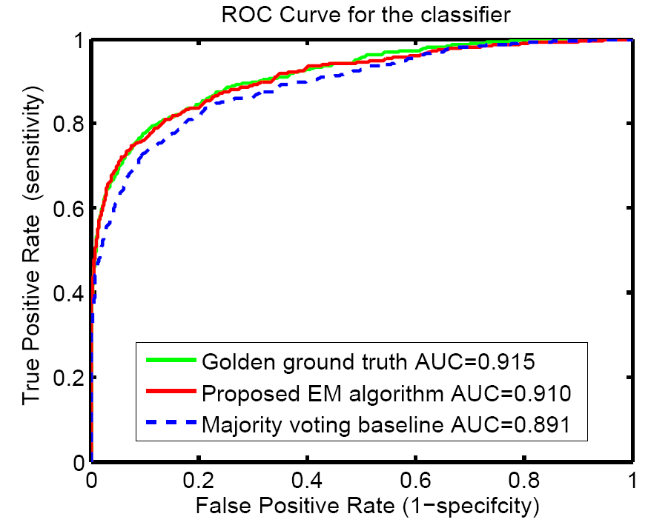
ROC for the learnt classifier
3.5% higher

Slide 34
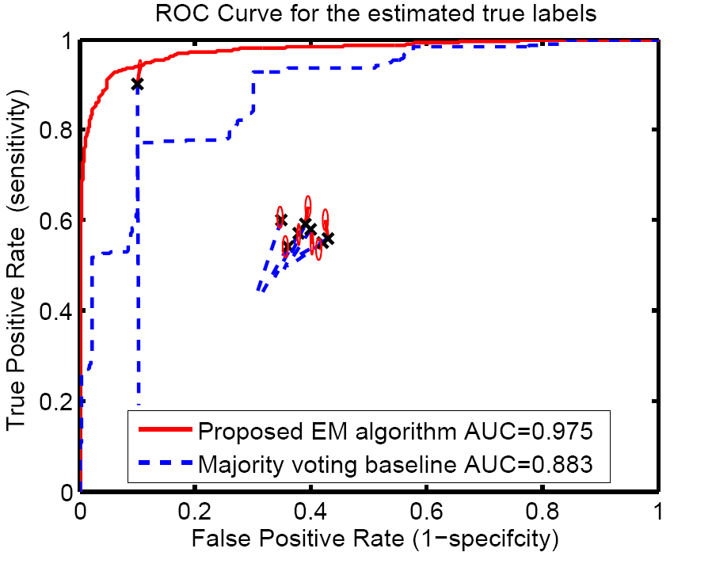
We need just one good expert

Slide 35
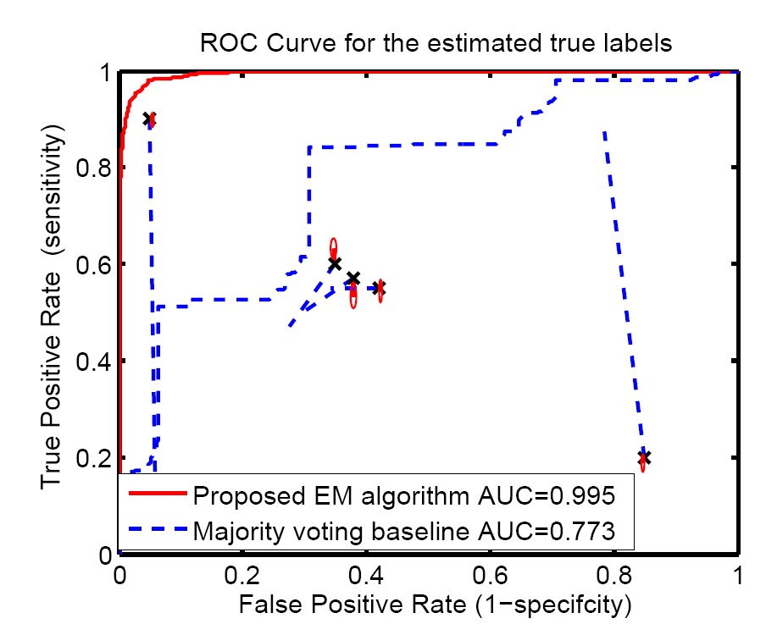
Malicious expert

Slide 36
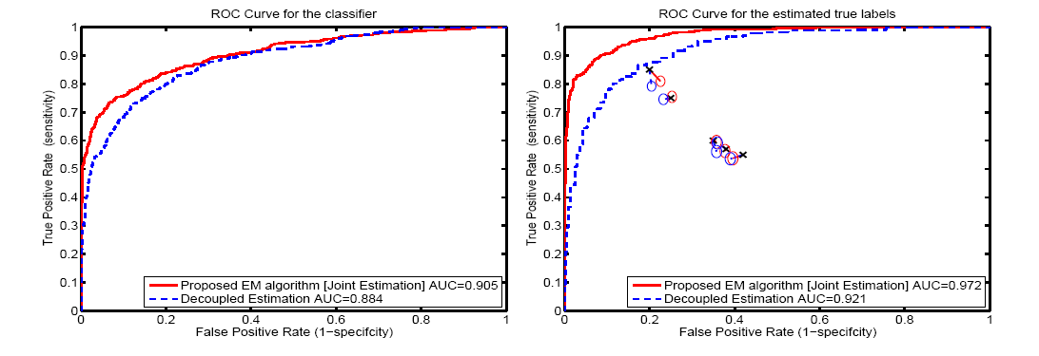
Benefits of joint estimation
Features help to get a better ground truth

Slide 37
Datasets
Domain | Gold standard | Number of annotators | Number of features | Number of positives | Number of negatives
Digital Mammography | Available (Biopsy) | Simulated | 27 | 497 | 1618
Breast MRI | Available (Biopsy) | 4 radiologists | 8 | 28 | 47
Textual Entailment

Slide 38
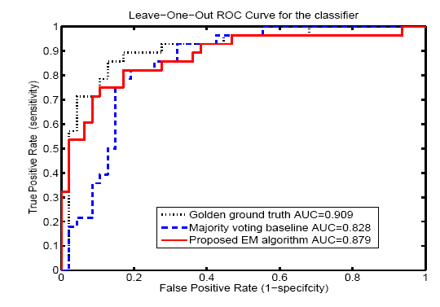
Breast MRI results

Slide 39
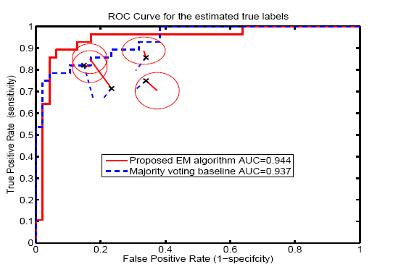
Breast MRI results

Slide 40
Datasets
Domain | Gold standard | Number of annotators | Number of features | Number of positives | Number of negatives
Digital Mammography | Available (Biopsy) | Simulated | 27 | 497 | 1618
Breast MRI | Available (Biopsy) | 4 radiologists | 8 | 28 | 47
Textual Entailment [Snow et al. 2008] | Available | 164 readers | No features | 800 tasks [94 % data missing]
Two CAD datasets
Digital Mammography
Breast MRI

Slide 41
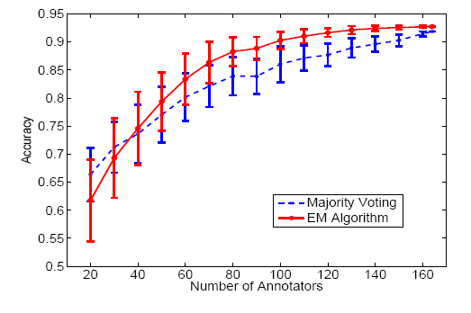
RTE results

Slide 42
Plan of the talk
Multiple experts
  Objective ground truth is hard to obtain
  Subjective labels from multiple annotators/experts
  How do we train/test a classifier/annotator?
Majority voting
  Uses the majority vote as consensus
  Problem: Considers all experts as equally good
Proposed algorithm
  Iteratively estimates the expert performance, the classifier, and the actual ground truth.
  Principled probabilistic formulation
Experiments
  Better than majority voting
  especially if the real experts are a minority
Extensions
  Categorical, ordinal, continuous

Slide 43
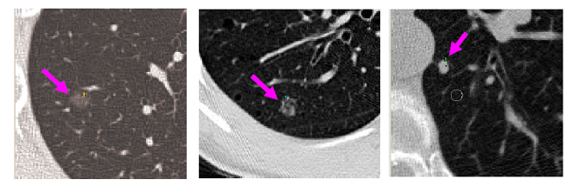
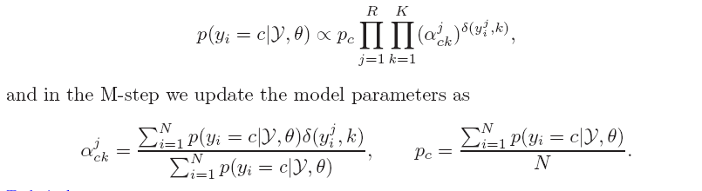
Categorical Annotations
Each radiologist is asked to annotate the type of nodule in the lung.
GGN - Ground glass opacity
PSN - Part solid nodule
SN - Solid nodule
Nodule ID | Radiologist 1 | Radiologist 2 | Radiologist 3 | Radiologist 4 | Truth
12 | GGN | GGN | PSN | PSN | x
32 | GGN | PSN | GGN | PSN | x
10 | SN | SN | SN | SN | x

Slide 44

Ordinal Annotations
Each radiologist is asked to annotate the BIRADS category of a lesion.
Nodule ID | Radiologist 1 | Radiologist 2 | Radiologist 3 | Radiologist 4 | Truth
12 | 1 | 2 | 2 | 2 | x
32 | 2 | 2 | 3 | 4 | x
10 | 4 | 5 | 5 | 5 | x
BIRADS>1 | 1 | 2 | 3 | 4
12 | 0 | 1 | 1 | 1
32 | 1 | 1 | 1 | 1
10 | 1 | 1 | 1 | 1
BIRADS>2 | 1 | 2 | 3 | 4
12 | 0 | 0 | 0 | 0
32 | 0 | 0 | 1 | 1
10 | 1 | 1 | 1 | 1
BIRADS>3 | 1 | 2 | 3 | 4
12 | 0 | 0 | 0 | 0
32 | 0 | 0 | 0 | 1
10 | 1 | 1 | 1 | 1
BIRADS>4 | 1 | 2 | 3 | 4
12 | 0 | 0 | 0 | 0
32 | 0 | 0 | 0 | 0
10 | 0 | 1 | 1 | 1

Slide 45
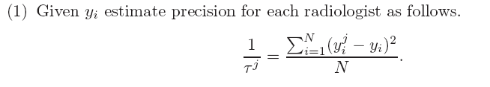
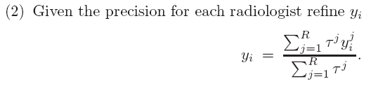
Continuous Annotations
Each radiologist is asked to measure the diameter of a lesion.
Nodule ID | Radiologist 1 | Radiologist 2 | Radiologist 3 | Radiologist 4 | Truth
12 | 8 | 11 | 14 | 12 | x
32 | 11 | 9.5 | 9.6 | 9 | x
10 | 33 | 76 | 71 | 45 | x
Can we do better than averaging ?

Slide 46
Plan of the talk
Multiple experts
  Objective ground truth is hard to obtain
  Subjective labels from multiple annotators/experts
  How do we train/test a classifier/annotator?
Majority voting
  Uses the majority vote as consensus
  Problem: Considers all experts as equally good
Proposed algorithm
  Iteratively estimates the expert performance, the classifier, and the actual ground truth.
  Principled probabilistic formulation
Experiments
  Better than majority voting
  especially if the real experts are a minority
Extensions
  Categorical, ordinal, continuous
46

Slide 47
Future work
Two assumptions:
Expert performance does not depend on the instance.
Experts make their decision independently.

Slide 48
Related work
Dawid, A. P., & Skeene, A. M. (1979). Maximum likelihood estimation of observed error-rates using the EM algorithm. Applied Statistics, 28, 20-28.
Hui, S. L., & Zhou, X. H. (1998). Evaluation of diagnostic tests without a gold standard. Statistical Methods in Medical Research, 7, 354-370
Smyth, P., Fayyad, U., Burl, M., Perona, P., & Baldi, P. (1995). Inferring ground truth from subjective labelling of venus images. In Advances in neural information processing systems 7, 1085-1092.
Sheng, V. S., Provost, F., & Ipeirotis, P. G. (2008). Get another label? Improving data quality and data mining using multiple, noisy labelers. Proceedings
of the 14th ACM SIGKDD International Conference on Knowledge Discovery and Data Mining (pp. 614-622).
Snow, R., O'Connor, B., Jurafsky, D., & Ng, A. (2008). Cheap and Fast - But is it Good? Evaluating Non-Expert Annotations for Natural Language Tasks. Proceedings of the Conference on Empirical Methods in Natural Language Processing (pp. 254-263).
Sorokin, A., & Forsyth, D. (2008). Utility data annotation with Amazon Mechanical Turk. Proceedings of the First IEEE Workshop on Internet Vision at CVPR 08 (pp. 1-8).

Slide 49
Thank You ! | Questions ?

