Slide 1
ICML 2009
Blockwise Coordinate Descent Procedures for the
Multi-task Lasso
with Applications to Neural Semantic Basis Discovery
Han Liu, Mark Palatucci, Jian Zhang
Carnegie Mellon University
Purdue University
June 16, 2009
TexPoint fonts used in EMF: AAAAAAAAAAAA
Notes:
Thank you. I’m going to present some work with Han Liu and Jian Zhang

Slide 2
Overview
Sparsity and Multi-task Lasso
Review Lasso and Multi-task Lasso (MTL)
Discuss a new technique for solving MTL that is very fast and highly scalable
Cognitive Neuroscience
Goal: Want to predict the brain’s neural activity in response to some stimulus
Show how we can use MTL to learn good features for prediction
Notes:
This talk is divided into two main parts..In the first part of the talk I’m going to discuss “sparsity and regularization” – in particular I’m going to review the Lasso..one of the most popular sparse models…then I’m going to talk about a multi-task version that’s useful if you have related tasks. I’m going to discuss a new state-of-the-art way to solve it.
In the second part, I’m going talk about a cognitive neuroscience problem – where our goal is to build a computational model to predict the brain’s neural activity. I’ll show how to formulate the problem as a multi-task Lasso – and how the model can learn useful features and build a good predictor.

Slide 3
Sparse Models
Output Prediction
Model
Relevant Features
Features:
Notes:
Ok – let’s do a quick review of sparse models. Say we have a bunch of features – we want to input into a model, and the model outputs some prediction. But only a few features are relevant to the task – and we’d like a model to _automatically_ discover which features are good, and ignore the rest.

Slide 4
Sparsity through Regularization
Model: Loss Function + Penalty Term
Squared Loss
Sum of Absolute Weights
Lasso
Notes:
So there are a few models that have this property – but one of the most popular ways to achieve a sparse model is to use regularization. I’m sure everyone remembers what regularization is – we have some sort of loss function..and then a penalty on the model complexity. For example, we have a squared loss – y is response and x, is some design matrix of features, the betas are weights to learn – this is just simple regression. And now we have a penalty on the sum of absolute values of the weights. This model is called the lasso – and it was discovered this type of penalty induces sparsity – and has become quite popular in the last 10 years.

Slide 5
Joint Sparsity of Related Tasks
Output Prediction-2
Output Prediction
Output Prediction-3
Model
Model
Model
Relevant Features
Notes:
Ok – so imagine now that I have several tasks – all with a potentially different set features – but you might believe the tasks are related somehow – and one belief might be that they share a common set of features – even if those features have different values for different tasks. The goal might be to build a model that could somehow “learn” the relevant features that are common to all tasks.

Slide 6
Joint Sparsity: Shared Features
Output Prediction-2
Output Prediction
Output Prediction-3
Model
Relevant Features
Shared Features:
Notes:
As a special case of this – you could imagine that all tasks share the same design matrix – and this was a problem called the “Simultaneous Lasso” proposed by Turlach 2004.
So let’s see how can use regularization to promote joint sparsity across tasks.

Slide 7
Lasso Model
Multi-Task Lasso Model
Sum over K tasks
a.k.a Sum of sup-norm
Notes:
Here we have original Lasso – model – squared loss plus penalty – and now we have what Jian Zhang called in his thesis work – the multi-task lasso.
We see that it’s very similar – except we sum error across tasks. And now the norm becomes a matrix norm called L1-Linf..Its worth mentioning that this matrix norm isn’t the only penalty to encourage sparsity – others have proposed L1L2 – and fully understanding the difference between the two is an interesting question for future work. But this is the one we focus on here – and it has the nice property that when K=1 we just get the original single task lasso.
Zhang 2008 – allows different design matrix
K = 1, reduces to single-task Lasso
Mention L1L2

Slide 8
Lasso Penalty
Learns sparse solution: most elements zero, only relevant features non-zero
Multi-Task Lasso Penalty
Tasks
Learns row-sparse solution: most rows zero, some rows have non-zero elements in each column
Features
Notes:
Let’s get some intuition about what these norms are doing..with lasso we learn a sparse solution – most elements are zero. Only relevant non-zero..
With Multi-task – we get a row-sparse solution – we’re learning a matrix of coeff..and we want most rows to be zero..and a few rows to have non-zero elements – but each task can have its own weight for that feature.

Slide 9
Solving the Lasso and Multi-task Lasso
Lasso:
LARS, Interior Point, Primal/Dual, Gradient Projection, Coordinate Descent
Multi-task Lasso
Interior Point (Turlach et al. 2004)
Gradient Projection (Quattoni et al. 2009)
Coordinate Descent (this work 2009)
Notes:
Ok – so we have these two objectives..How do we solve them? Lots of ways for single-task lasso..we’ll talk about the best way in a minute..
For multi-task – interior point ..– some work from Quattoni
and you all are lucky – because last year there weren’t really any scalable ways to solve this – and now you’ll have two..

Slide 10
What’s the best method?
Single-task Lasso:
Coordinate Descent
Friedman, Hastie, Tibshirani (2008)
Wu, Lange (2008)
Duchi, Shalev-Shwartz, Singer, and Chandra (2008)
Notes:
On many metrics – speed, ease of implementation, scalability – coordinate descent seems to be the best..but allow the method is very old – only recent work has showed empirically how good it is..So in some sense it’s like the Susan Boyle of optimization algorithms – old, unsophisticated, and no one knew how good it was until very recently.
Originally proposed by Fu (1998) but abandoned
Theory from Tseng (2001) showed would not get stuck for Lasso objective
Empirical results from Friedman, Hastie, Wu show competitive and faster than
LARS and interior point methods
Many other tricks make coordinate descent highly efficient: warm start,
covariance pre-computation, update schedule

Slide 11
Coordinate Descent
Why is coordinate descent so good for the Lasso?
Each iteration can be computed using a closed-form soft-thresholding operator
If solution vector is truly sparse, it can avoid updating irrelevant parameters through a simple check
Many computational tricks – warm start, covariance pre-computing, adaptive/greedy updates
Can we develop a coordinate descent procedure for the Multi-task Lasso that has a similar closed-form update for each iteration?
Notes:
Talk about 1st point then coord descent
3rd point – not going into details – but the basic idea is the often you want to solve the objective for many different values of the penalty – the lambda..and a lot of the computation can be reused..So there is a big win here if you’re planning to computing many values of the lambda – such as when you’re doing cross validation.
Originally proposed by Fu (1998) but abandoned
Theory from Tseng (2001) showed would not get stuck for Lasso objective
Empirical results from Friedman, Hastie, Wu show competitive and faster than
LARS and interior point methods
Many other tricks make coordinate descent highly efficient: warm start,
covariance pre-computation, update schedule

Slide 12
Coordinate Descent for Multi-task Lasso
Yes we can!
Lasso:
Multi-task Lasso:
Main result: Can generalize soft-thresholding to multiple tasks using a Winsorization operator
Notes:
Hard to derive because of subdifferential conditions for the infinity norm…
M – linear in tasks – can reuse for each task

Slide 13
Take Out Points from Part I
Can efficiently solve the multi-task Lasso using a closed-form Winsorization operator that’s easy-to-implement
This leads to a Coordinate Descent method that can take advantage of all the usual computational tricks

Slide 14
Overview
Sparsity and Multi-task Lasso
Review Lasso and Multi-task Lasso (MTL)
Discuss a new technique for solving MTL that is very fast and highly scalable
Cognitive Neuroscience
Goal: Want to predict the brain’s neural activity in response to some stimulus
Show how we can use MTL to learn good features for prediction
Notes:
This talk is divided into two main parts..The first thing I’m going to talk about is “sparsity and regularization” – why sparse models are
Important and I’m going to review the Lasso – one of the most popular sparse models. I’m then going to discuss the multi-task Lasso – which is useful if you have related tasks…and then show you a fast way to solve it.
In the second part, I’m going talk about a cognitive neuroscience problem – where our goal is to build a model to predict the brain’s neural activity. Show MTL useful for learning good features.

Slide 15
Neural Activity Prediction
Mitchell et al. (2008)
Predicted activity
Model
eat | taste | ride, …
“apple”
0.836, 0.346, 0.000, …
“airplane”
0.01, 0.001, 0.8500, …

Slide 16
Neural Activity Prediction
Can we train a model to automatically discover a good set of semantic features?
Notes:
Rather than using 25 text co-occurrences, can we learn to automatically discover a set of semantic features

Slide 17
Neural Activity Prediction
Each “task” is the neural activity of a voxel
This is a multi-task Lasso problem!
Model
Large number of possible features
“apple”
Notes:
The response variables are the neural activity
The features are text co-occurences

Slide 18
Evaluation
Data
Response: Collected fMRI images of neural activity for 60 words (5 examples from 12 categories)

Slide 19
Data – fMRI Examples
Categories 60 Exemplars
BODY PARTS |  | leg | arm | eye | foot | hand
FURNITURE |  | chair | table | bed | desk | dresser
VEHICLES |  | car | airplane | train | truck | bicycle
ANIMALS |  | horse | dog | bear | cow | cat
KITCHEN UTENSILS |  | glass | knife | bottle | cup | spoon
TOOLS |  | chisel | hammer | screwdriver | pliers | saw
BUILDINGS |  | apartment | barn | house | church | igloo
PART OF A BUILDING |  | window | door | chimney | closet | arch
CLOTHING |  | coat | dress | shirt | skirt | pants
INSECTS |  | fly | ant | bee | butterfly | beetle
VEGETABLES |  | lettuce | tomato | carrot | corn | celery
MAN MADE OBJECTS |  | refrigerator | key | telephone | watch | bell
Notes:
We trained our original model using 25 sensory/motor words chosen based on psychological literature

Slide 20
Evaluation
Data
Response: Collected fMRI images of neural activity for 60 words (5 examples from 12 categories)
Design: Each word represented as co-occurrence vector with 5,000 most frequent words in English

Slide 21
Evaluation
Experiment
Train model using 58 of 60 word stimuli (leave-two-out-cross-validation)
Run Multi-task Lasso to select features from co-occurrences with 5,000 most frequent words
Use those features in same linear model in Mitchell et al. (2008)
Apply to predict activation for 2 held-out-words
Label 2 held-out-words using cosine similarity with prediction
Repeat for all (60 choose 2) = 1,770 iterations

Slide 22
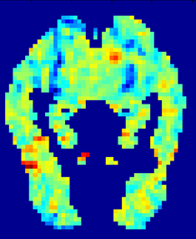
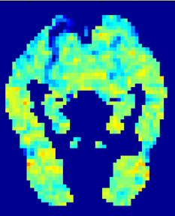
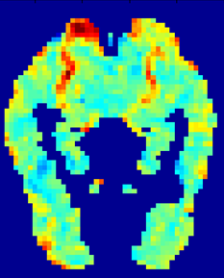
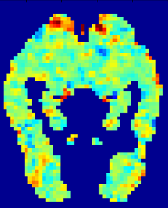
Predicted:
Observed:
fMRI activation
“celery”
high
average
“airplane”
below average
Predicted and observed fMRI images for “celery” and “airplane” after training on 58 other words. [Mitchell et al. 08]
Notes:
22
In our dataset we collected fMRI data for 60 words total. Here is the result of training on 58 words and predicting the left out two.

Slide 23
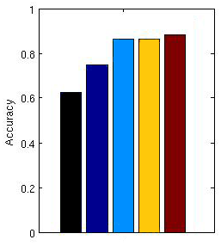
Results
Learned features using Multi-task Lasso (set size of 25, 140, 350 features)
Handcrafted 25 features
from domain experts
Random 25 features
(words)

Slide 24
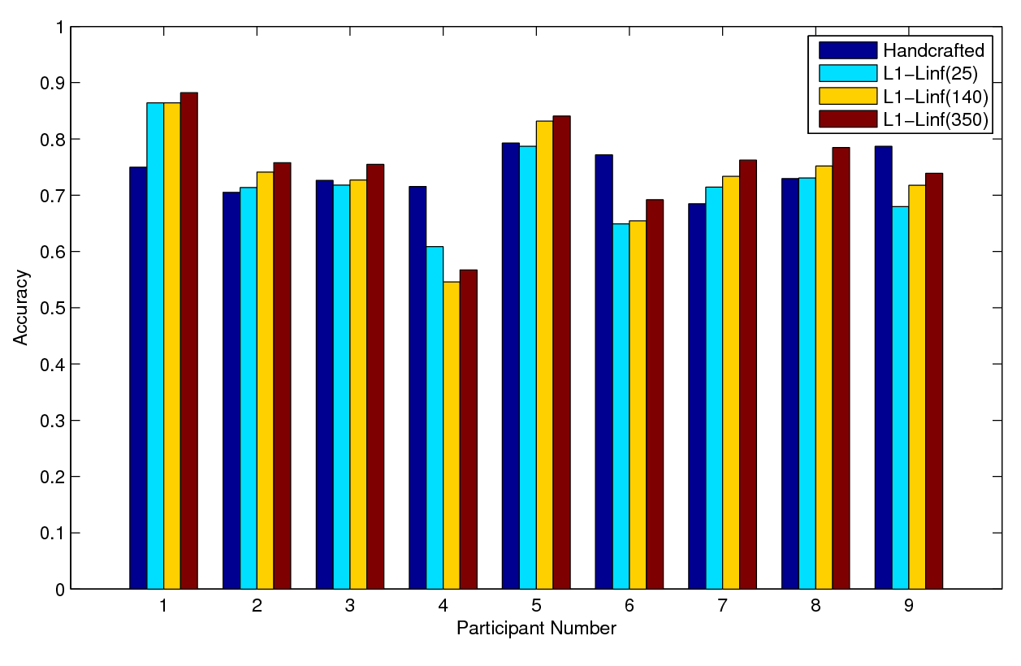
Results
Notes:
Add random
In majority of subjects – we beat the handcrafted features..That’s with no assumptions about neuro-science.
But model can also do poorly if subject noisy

Slide 25
Interpreting the Model
25 Top Features (Words) Selected by Multi-task Lasso
Tools | Car | Dog | Wine | Pottery
Model | Station | Bedroom | Breakfast | Cup
Mad | Rentals | Fishing | Cake | Tip
Arms | Walk | Cleaning | Cheese | Gay
Right | White | Front | Contents | Result
Notes:
Contrary evidence tthat verbs are best..
Had tools
Had bodyparts
Vehicles
Foods
Kitchen items

Slide 26
Interpreting the Model
How does a feature contribute to observed neural activation?
Notes:
We trained our original model using 25 sensory/motor words chosen based on psychological literature

Slide 27
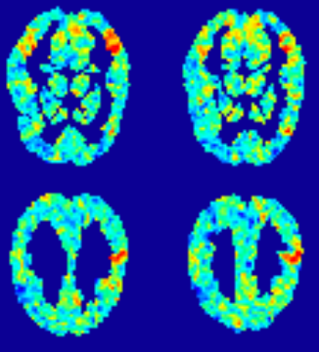
Interpreting the Model
Analyzing the weights learned for the “Tools” feature:
Superior temporal sulcus believed associated with perception of biological motion
Postcentral gyrus believed associated with pre-motor planning
Notes:
We trained our original model using 25 sensory/motor words chosen based on psychological literature

Slide 28
Take Out Points: Multi-task Lasso
Can learn common features of related tasks
Scalable to thousands of features and tasks found with our coordinate descent procedure.
Can build interpretable models useful for natural science applications
Can learn features for neural prediction that perform better than handcrafted features on majority of fMRI subjects
See Liu, Palatucci, and Zhang 2009:
Blockwise Coordinate Descent Procedures for the Multi-task Lasso

Slide 29
ICML 2009
Thanks to:
Tom Mitchell
W.M. Keck Foundation
National Science Foundation
Intel Research
Google
TexPoint fonts used in EMF: AAAAAAAAAAA

