Slide 1
On Primal and Dual Sparsity of Markov Networks
Jun Zhu*†, and Eric P. Xing†
*Department of Computer Science & Technology, Tsinghua University
†School of Computer Science, Carnegie Mellon University
ICML 2009 @ Montreal, Canada
6/12/2009
1

Slide 2
Outline
Problem Formulation
Theoretical Connections
Algorithmic Connections
Experimental Results
Conclusion

Slide 3
Structured Prediction
Learning inputs:
  a set of training samples: , where
  Examples:
    OCR
Learning outputs:
  a predictive function :
b
r
a
c
e
Notes:
Relaxes the iid assumption of classification

Slide 4
Regularized Empirical Risk Minimization
True data distribution:
Risk:
  is a non-negative loss function, e.g., Hamming loss
Empirical Risk :
Regularized Empirical Risk
  is a regularizor; is the regularization parameter

Slide 5
Max-Margin Markov Networks (M³N)
-norm M³N (Taskar et al., 2003):
  Base discriminative function:
    The linear form:
  Prediction Rule:
  Margin:
  Structured hinge loss (an upper bound of empirical risk):
  An equivalent formulation:
-norm M³N:

Slide 6
Sparsity Interpretation
Equivalent formulation ( )
Projection
Primal Sparsity:
  Only a few input features have non-zero weights in the original model
Pseudo-primal Sparsity:
  Only a few input features have large weights in the original model
Dual Sparsity:
    Only a few lagrange multipliers are non-zero
Example: (linear max-margin Markov networks)
  Complementary Slackness Condition:

Slide 7
Laplace Max-Margin Markov Networks
MaxEnDNet – an average model (Zhu et al., 2008)
  Base discriminative function:
  Effective discriminative function:
  Predictive rule:
  Margin:
  Expected structured hinge loss:
  Learning problem
Laplace max-margin Markov network is the Laplace MaxEnDNet
  MaxEnDNet with the prior being a Laplace distribution

Slide 8

Adaptive Max-Margin Markov Networks
a
Intuition from the scale-mixture interpretation of Laplace distribution
First-order moment matching constraint.

Slide 9
Entropic Regularizer:
  Strict positive:
  Monotonically increasing:
  Approaching the 1-norm:

Slide 10
Graphic illustration

Slide 11
Algorithmic Connections
a
a
a
a
EM-style Alg.
Variational Bayesian Alg.

Slide 12
Relationship Summary

Slide 13
Synthetic Data Sets
Datasets with 30 correlated relevant features + 70 i.i.d irrelevant features
  We generate 10 datasets, each having 1000 samples. True labels are assigned via a Gibbs sampler.

Slide 14
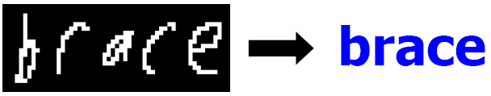
OCR Data Sets
Task:

Slide 15
Algorithm Comparison
Error rates and training time (CPU-seconds)
  Projected sub-gradient
  Cutting-plane
  EM-algorithm

Slide 16
Web Data Extraction
Task:
  identify Name, Image, Price, and Description of product items
Data: 1585 training records; 3391 testing records
Evaluation Criteria:
  Average F1:
    the average of F1 values of all the attributes
  Block instance accuracy:
    the percentage of records whose Name, Image, and Price are all correct

Slide 17
Summary
Relationships among the sparse max-margin MNs
Simultaneously (pseudo-) primal and dual sparsity benefit the structured prediction models

Slide 18
Solution to MaxEnDNet
Theorem 1 (Solution to MaxEnDNet):
    Posterior Distribution:
    Dual Optimization Problem:
Convex conjugate (closed proper convex )
  Def:
  Ex:

Slide 19
Reduction to M³Ns
Theorem 2 (Reduction of MaxEnDNet to M³Ns):
  Assume
    Posterior distribution:
    Dual optimization:
    Predictive rule:
Thus, MaxEnDNet subsumes M³Ns and admits all the merits of max-margin learning
Furthermore, MaxEnDNet has at least three advantages …

Slide 20
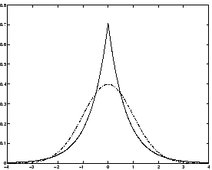
Laplace M³Ns (LapM³N)
The prior in MaxEntNet can be designed to introduce useful regularizatioin effects, such as sparsity bias
Normal prior is not so good for sparse data …
Instead, we use the Laplace prior …
  hierarchical representation (scale mixture)

Slide 21
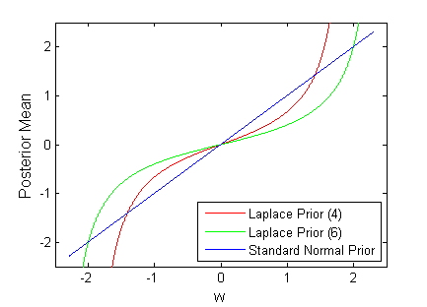
Posterior shrinkage effect in LapM³N
Exact integration in LapM³N
Alternatively,
Similar calculation for M³Ns (A standard normal prior)
A functional transformation

Slide 22
Variational Bayesian Learning
Exact dual function is hard to optimize
Use the hierarchical representation, we get:
We optimize an upper bound:
Why is it easier?
  Alternating minimization leads to nicer optimization problems
Keep fixed | Keep fixed
- The effective prior is normal | - Closed form solution of and its expectation
An M³N optimization problem!
Closed-form solution!

Slide 23
Three variants of Max-margin MNs
Regularized Structured Hinge Loss Minimization:
Special Instantiations:

Slide 24
Thanks!
Reference:

