Slide 1
Identifying Personal Stories in Millions of Weblog Entries
Andrew S. Gordon and Reid Swanson
Institute for Creative Technologies, University of Southern California | ICWSM-09
The projects or efforts depicted were or are sponsored by the U.S. Army Research, Development, and Engineering Command (RDECOM),and/or the US Army Research Institute. The content or information presented does not necessarily reflect the position or the policy of the Government, and no official endorsement should be inferred.

Slide 2
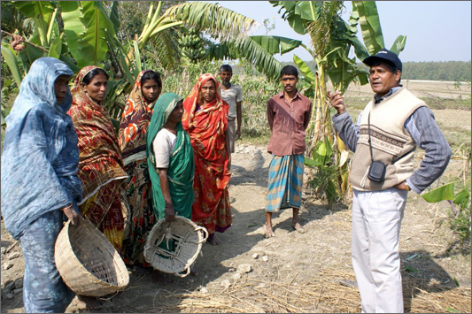
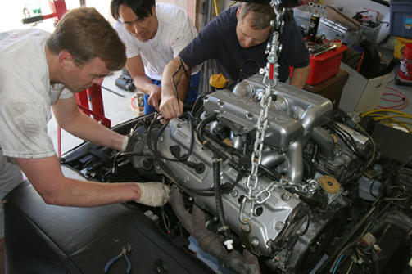
Storytelling in daily life

Slide 3
Storytelling in Internet weblogs
“my life and experience” is the #1 topic of people’s weblogs
Pew Internet & American Life Project, 2006
900,000 new weblog posts each day
Technorati.com State of the Blogosphere 2008
Millions of stories of everyday human experience
Between 4.8% and 17% of weblog entries are personal stories
Another day at school, at the office, or on the road
The occasional amazing occurrence
... I arrived at 5pm on Monday evening and quickly made my way to the hotel. My electric razor is now in the hands of whoever took it out of my checked suitcase, but the joke is on them because I left the plug at home so they might get about a weeks worth of shaves out of it, not to mention the whole voltage difference. I was able to purchase a disposable razor at an "Auto Service”. These are little convenient stores mostly run by Koreans down in Paraguay. ...

Slide 4
Definition
Personal stories in weblogs: Textual discourse that describes a specific series of causally related events in the past, spanning a period of time of minutes, hours, or days, where the author or a close associate is among the participants.

Slide 5
Weblog stories as data
Anecdotal evidence, on a massive scale
Creative Double Bind (Langellier & Peterson, ST in EL, 2004)
[...] only by being insincere in making up a “good telling” can a sincere or “good story be told. At the same time, a good or “tellable” story is one that is about an experience – something out of the ordinary – in which the sincerity of the storyteller is established through the ordinariness of the telling rather than the extraordinary events of the story.
A rich source of data, of three inseparable parts
Events in the world
Perceptions of those events
Narration of those perceptions
Need for comprehensive corpora
To conduct quantitative analyses of storytelling in everyday life
To investigate the relationship between events, perception, and narration
To build applications that exploit these relationships

Slide 6
Our previous work
Gathering stories from audio speech
(Gordon, Ganesan, K-KCAP 2005)
Commercial speech recognition, Naïve Bayes text classification
Poor results: 39.6% precision, 25.3% recall
Good results on transcriptions: 53.0% precision, 62.9% recall, F-score .575
Gathering stories from weblog text
(Gordon, Cao, Swanson, K-CAP 2007)
Support vector machines, Sentence delimiting, Gaussian smoothing
Good results: 46.4% precision, 60.6% recall, F-score .509
Building large story corpora
(Gordon, Cao, Swanson, K-CAP 2007)
Analyzed the weblogs of 390 thousand people over 373 days
Results: 4.5 million story fragments, 66.5 million sentences, 1.06 billion words
Not comprehensive, Fragmented, Unclear distribution requirements

Slide 7
Opportunity: The ICWSM-09 Dataset Challenge
training data
New
Story
Classifier
comprehensive story corpus

Slide 8
Annotation of the training data
Label entries as primarily story or non-story
Easier to do when looking at the HTML rendering than the raw XML
Identified entries in Aug/01 folder of tiergroup-1 still on the web (18%)
1st attempt: Amazon Mechanical Turk
$ 0.01 for 5 annotations (story / non-story)
Foiled by bots, Spent days allotting micropayments
2nd attempt: Do it ourselves
1 annotator
5002 weblog entries
240 (4.8%) labeled as personal stories
No inter-rater agreement study
Assumed to be Kappa=0.68 (Gordon & Ganesan, 2005)

Slide 9
Development of story classifier
Confidence-weighted linear classifier (Dredze et al., ML 2008)
Similar to the perceptron (Rosenblatt, Psych Rev 65, 1958)
Competitive with other learning algorithms, but fast to train and apply
Java port of Google Code Project, Online Learning Library (Okanohara, 2008)
Word-level features
Only text that appears in the <description> field
Best results obtained using unigram features and part-of-speech tags
Unigram frequency features performed as well
Evaluation
Separate development and test sets (750 / 4252)
10-fold cross validation on test set
Precision = 66%, recall = 48%, F-score = 0.55
Truncated <description> evaluation
Test on only first 250 characters: Precision = 47%, recall = 3%, F-score = 0.06

Slide 10
Top weighted features
Story Features | Non-Story Features
went sent took back i had evening down comments friend was art got did headed | will 1 / years blog has team many can are love being use before :

Slide 11
Application to the full dataset
Targeted English entries, identified by <dc:lang> field
Included entries with fewer than 250 characters, but flagged them separately
960,098 entries labeled as personal stories
937,994 entries with more than 250 characters
Second precision evaluation
Sampled 300 entries classified as personal stories from the entire dataset
47 no longer existed on the web
191 / 253 entries were hand-annotated as stories (75% precision)
Within the standard deviation (13%) of cross-validation results (66% precision)

Slide 12
Where stories are told
source | stories | percent
livejournal.com | 543682 | 57.9%
wordpress.com | 124468 | 13.3%
blogspot.com | 57226 | 6.1%
typepad.com | 36300 | 3.9%
vox.com | 23744 | 2.5%
top 5 | 785420 | 83.7%

Slide 13
In which Spinn3r.com tiergroup stories are told

Slide 14
When stories are told

Slide 15
Opportunities
Quantitative social science
Comprehensive corpus of storytelling in everyday life
Content is about life, not just Internet life
Innovative applications of large-scale story collections
Say Anything: Collaborative open-domain interactive storytelling (ICWSM-09)
StoryUpgrade: Activity-based story retrieval (ICWSM-08)
Distributed as an index to the ICWSM Spinn3r.com corpus
1 tiergroup-1/Aug/01/part-1.xml 502 83 2.1521754 +
2 tiergroup-1/Aug/01/part-1.xml 14535 66 2.3929944 +
3 tiergroup-1/Aug/01/part-1.xml 17500 68 5.0078306 +
4 tiergroup-1/Aug/01/part-1.xml 24730 87 0.83582455 +
5 tiergroup-1/Aug/01/part-1.xml 27742 77 0.23305145 +
...
Get your copy today (gordon@ict.usc.edu)

Slide 16
Thanks!

