Slide 1
UTA-NM: Explaining Stated Preferences with Additive Least Non-Monotonic Utility Functions
Tomáš Kliegr
Department of Information and Knowledge Engineering, University of Economics, Prague, Czech Republic

Slide 2
Outline
Introduction to the UTA method
Not well known in Preference Learning community (according to one of the reviewers)
Motivation for the non-monotonic extension
Illustrative Example
Limitations and further work

Slide 3
Example
g₁ looks, g₂ wittiness, g₃ sport attitude
Alternatives a₁… a₅
The DM preferences:
Why?
Stated Preference
1.
2.
3.
4.
5.
Name | Look | Wittiness | Sport
John | 4 | 2 | 1
Ashley | 2 | 1 | 2
Peter | 3 | 3 | 3
Martin | 2 | 4 | 4
Stan | 2 | 4 | 5
Legend: 1(Low) … 5 (High)

Slide 4
UTA Method
UTA Method is a linear-programming method for disaggregation-aggregation analysis of preferences (Siskos 85).
Input for the method are implicit preferences in the form of the order of alternatives. E.g. a₁ > a₂ ~ a₃ > a₄ > a₅
Alternatives are described by a set of criteria g₁,…,g_{n}
The utility from an alternative is given by the sum of utilities from the criteria:
u(John) = u_{looks}(4) + u_{wittines}(2) + u_{sport}(1)
Name | Look | Wittiness | Sport
John | 4 | 2 | 1

Slide 5
Partial Utility Function
The value at breakpoints of partial utility function is given by the sum of marginal utilities
Partial utility functions in traditional UTA methods are monotonic
UTA finds values of marginal utility variables that generate the most similar ranking to the reference ranking
u_{look}(a)
w_{i}³
u_{looks}(John) = u_{looks}(4)
= w₁¹ +w₁²+w₁³
w_{i}²
w_{i}¹
g₁⁰
g₁¹
g₁²
g₁³

Slide 6
Infering marginal utilities from the ranking
Introduce two errors σ⁺ and σ⁻ for each alternative
Susbtract utilities of consecutive alternatives:
Objective function minimizes the sum of errors σ⁺ and σ⁻
A1: u(John) = w₁¹ +w₁² ⁺ w₁³ +w₂¹ A2: u(Ashley) = w₁¹ +w₃¹
Since Rank(John) = 1 and Rank(Ashley)=2 then
d(A1,A2) = w₁² + w₁³ +w₂¹ + w₃¹ + σ₁⁺ + σ₁⁻ + σ₂⁺ - σ₂⁻ > δ, δ = 0.05
d(A1,A2) = w₁² + w₁³ + w₂¹ + w₃¹ > δ, δ = 0.05
Other constraints may prevent this hard constraint to hold
Errors σ⁺ and σ⁻ allow UTA to find imperfect solutions

Slide 7
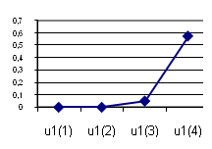
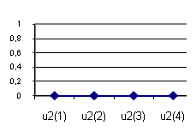
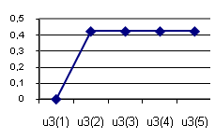
Example
Pref | Name | Look | Wittiness | Sport
1 | John | 4 | 2 | 1
2 | Ashley | 2 | 1 | 2
3 | Peter | 3 | 3 | 3
4 | Martin | 2 | 4 | 4
5 | Stan | 2 | 4 | 5
Explanation for stated order
a₁ a₂ a₃ a₄ a₅
Looks
Wittiness
Attitude to sport
By applying the model back to data we get:
a₁ a₂ a₃ ~ a₄ ~ a₅
The discovered solution does not fully comply with the stated order of the alternatives

Slide 8
Motivation for non-monotonic UTA
In the example, a fully fitting model was not found because the preferences of the DM were actually non-monotonic in criterion „g3: Sport“
UTA assumes monotonic preferences
The only non monotonic UTA algorithm (Despotis, Zopounidis 93) has following limitations
The exact utility function shape need to be known beforehand
There is maximum one change of shape per utility function
Proposed fully non-monotonic version: UTA-NM

Slide 9
UTA - NM
Inspired by UTA
Relaxes the monotonicity assumption (by allowing negative marginal utility)
Problem: solutions have many changes of shape in partial utility functions
overfitting
not interpretable
UTA - NM simultaneously minimizes the sum of errors σ⁺ and σ⁻ and the complexity of the model expressed by the number of changes in shape of partial utility functions.
Challenge: Keep the problem linear

Slide 10
First approach: non-linear model, non-linear methods
It is simple to count the number of changes in the shape if we can use nonlinear funcions such as if or abs.
The work on linearized UTA-NM was preceded by experiments with non-linear methods
Branch&Bound/GRG Solver
Interval Global Solver
Genetic algorithms
Optimal solution not found, or took too long (IGS)
Best result Branch&Bound/GRG Solver initialized with UTA Star

Slide 11
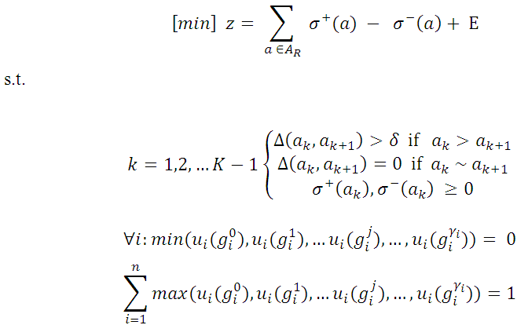
LP program outline

Slide 12
Utility calculation

Slide 13
Normalization
UTA
UTA NM
More details in the paper

Slide 14
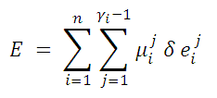
Penalization
The value of the objective function is increased for each point in which the partial utility function changes its shape
The change of shape is detected from signs of marginal utilities and and is saved to binary variable
is nearest previous non-zero marginal utility
Penalization element:
sign (w_{i}^{l}) | sign (w_{i}^{l}+1) | e_{ij}
-1 | -1 | 0
-1 | 0 | 0
-1 | +1 | 1
0 | -1 | 0
0 | 0 | 0
0 | +1 | 0
1 | -1 | 1
+1 | 0 | 0
+1 | +1 | 0
u_{i}(a)
w_{i}²
w_{i}⁵
g_{i}⁰
g_{i}¹
g_{i}²
g_{i}³
g_{i}⁴
g_{i}⁵
g_{i}⁶

Slide 15
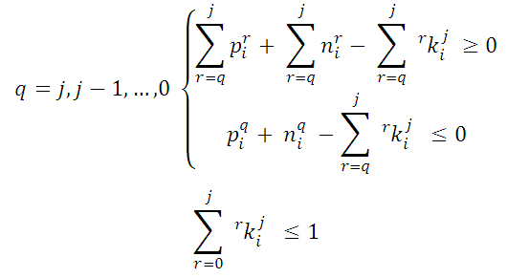
Locating the nearest previous nonzero w_{i}^{l}
For g_{i}⁴ (j=4) we search the nearest previous nonzero marginal utility w_{i}^{l}.
sign(w_{i}) | p_{i}^{r} | y_{i}^{r}
+ | 1 | 0
- | 0 | 1
0 | 0 | 0
Sign of marginal utility variable is expressed by the binary variables p_{i}^{r}, y_{i}^{r} .
q
p_{i}^{q}
y_{i}^{q}
k_{i}^{q}
j=4
4
0
0
0
0
3
0
0
0
0
2
1
0
1
1
1
1
0
0
1
0
1
0
0
1
u_{i}(a)
w_{i}²
w_{i}³
w_{i}⁴
w_{i}¹
w_{i}⁵
w_{i}⁰
g_{i}⁰
g_{i}¹
g_{i}²
g_{i}³
g_{i}⁴
g_{i}⁵
g_{i}⁶
Variable ^{r}k_{i}^{q} is set to 1 only iff w_{i}^{q} is the nearest previous nonzero utility to g_{i}^{j}

Slide 16
Example
Partner selection
Explicit preferences :
the DM prefers middle value of sport endorsement
Software used:
Frontline Premium Solver (Commercial solver)
LP Solve (Open source solver)
Visual UTA 1.0 (Academic UTA Star implementation)

Slide 17
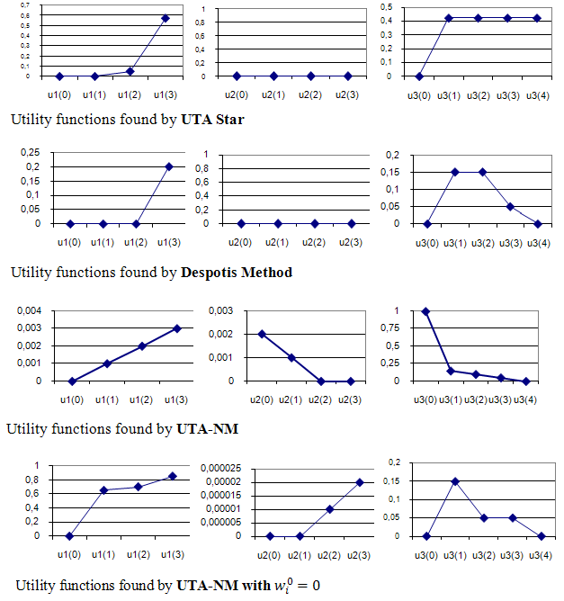
Information supplied
Higher values are better
In all criteria
Higher values are better in u1 and u2, maximum of u3 is in u3(3)
None
The worst value (nonexclusive) is at the first breakpoint

Slide 18
Experimental results
Model found with UTA-NM was the only one to fully match the stated order (Pearson coefficient equal to 1)
The deviation from the explicitly expressed preferences is also small
Performace-wise, UTA-NM was slowest with 40/20 seconds (LPSolve on T1/ RiskSolver on T2) compared to less than 1 sec for other methods.
Method | Final rank | Error sum | Pearson Coefficient | Local Extremes | Explicit preferences
DM | a1>a2>a3>a4>a5 | NA | NA | NA | NA
UTA Star | a1>a2~a3~a4~a5 | 0,15 | 0,73 | 0 | no
Despotis | a1>a2~a3~a4>a5 | 0,1 | 0,96 | 1 | yes/NA
NM T1 | a1>a2>a3>a4>a5 | 0 | 1 | 0 | No
NM T2 | a1>a2>a3>a4>a5 | 0 | 1 | 1 | Partially

Slide 19
Conclusion
UTA Star was generalized to work with non-monotonic preferences
If there is a monotonic solution fully complaint with stated preferences exists, UTA-NM outputs it
UTA-NM has means to prevent overfitting
Expert can input prior knowledge about the shape of the utility functions, these are used to weight contribution of changes in shape to the objective f.
Resulting problem is linear and convex and hence processable with standard LP solvers
Further work needs to focus on performance optimisations

Slide 20
Direction of further research
The method is general but suffers from severe performance issues
Even for very small toy problems tens of binary variables
Real-world problems computationally infeasible
Linearization with less binary variables
Simplification (1 change of shape within criterion)
Run as many Despotis UTA as there are positions in which the change of shape may occur

