Slide 1

Informal Knowledge Processes
The Long Tail of Business Processes
Marcel Tilly, EMIC
2009-09-05, Bled
Summer School

Slide 2
Name: Marcel Tilly

Slide 3
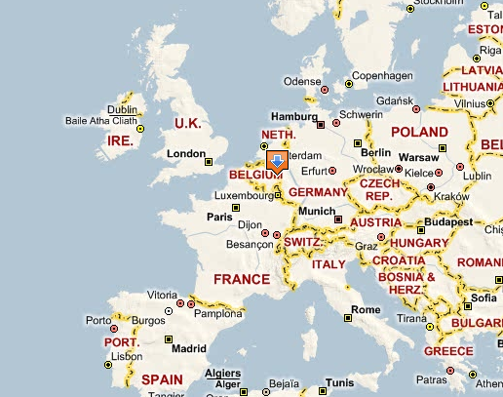
European Microsoft Innovation Center

Slide 4
EMIC

Slide 5
EMIC != MSR

Slide 6
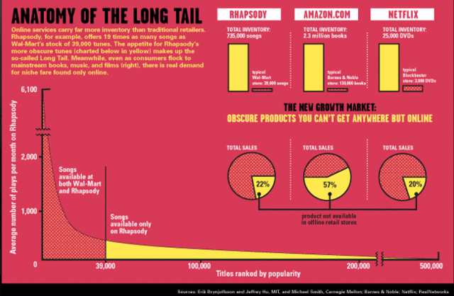

Slide 7
Agenda
Knowledge Worker
Business Processes and Informal Knowledge Processes
  Motivations
  Definitions
Framework for Knowledge Processes
Metrics for optimisation of Knowledge Process efficiencies
Security and Privacy Aspects in Knowledge Processes

Slide 8
I’m a Knowledge Worker!

Slide 9
EXERCISE – before we start
Discuss with your neighbor the term
“Knowledge worker”!
2 min.

Slide 10
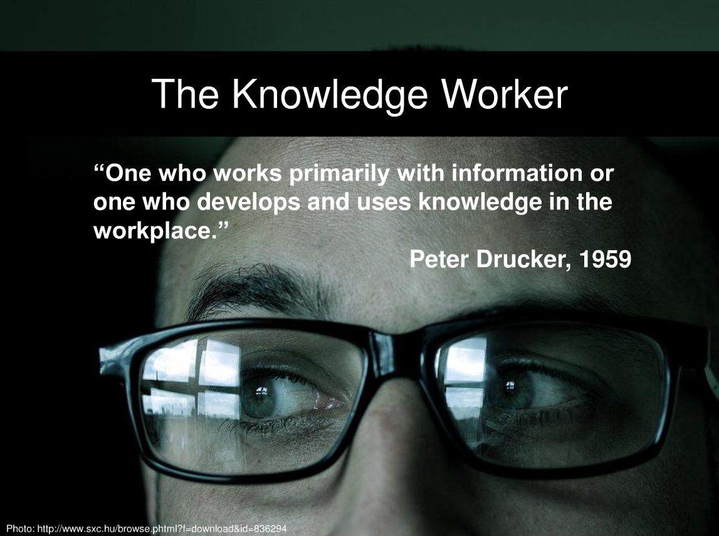

Slide 11
Knowledge Worker Revisited
Thomas Davenport has defined knowledge workers as people who “think for a living” and discusses who they are, what they do, and how their number is growing [2005].
  For our purposes we accept as a given that, for an increasing proportion of people in the world economy, work is to a large extent mental rather than physical.
  To significantly increase economic productivity it is necessary, therefore, to increase the productivity of this knowledge-based and knowledge-driven work.

Slide 12
ACTIVE’s Knowledge Worker
A knowledge worker is a specialist or an expert dedicated to a specific knowledge intensive work domain within an enterprise.
He principally uses his experience, skill, and current working context to understand summaries and create new knowledge from exiting pieces of work.
Knowledge workers bring ingenuity and inventiveness along with intuitive dissension making in their daily work as well as for the team.
Related tasks and workers benefit in terms of learning, modifying and enhancing their workflows.

Slide 13
The typical situation of a Knowledge Worker
What’s happening?
How to share
Where to look?
When to act?
Who knows what?
Anything new?
Who and what can I trust?

Slide 14
EXCERCISE
Discuss with your neighbor the term
“informal knowledge process”!
2 min.

Slide 15


The Long Tail …
Complex Business Processes
  High repetition rate
  Mature
  Involve defined roles
  Enterprise driven
Informal Processes*
  Scope - user or small team
  Repetition rate is low
  Depend on skill, experience, and judgement of the knowledge worker
Repetition
SAP, Dyamics, ARIS …
Capturing and supporting
non-formalized processes
UAM, NEPOMUK, SmartDesktop
Supported by enterprise applications
Formalized processes
Not supported by enterprise applications
Non-formalized processes
Processes
* aka Artful Processes, Knowledge Processes

Slide 16


Rules of Business…
People, empowerment, collaboration, …
The basis of the operation is the structure of the activities
Knowledge-based
The basis of the operation is the knowledge of individuals.
Structured-based
Procedures, control, compliance…
* taken from http://www.thecontenteconomy.com/2009/04/slides-from-our-enterprise-20-seminar.html

Slide 17
Where is the knowlegde?
Formalized
Non-Formalized
Number of repetitions
Use of knowledge
Ability of formalisation

Slide 18
Workflow is a finite set of sequential/ parallel activities triggered by events.*
*taken from: Computer/Supported Coorperative Work, Uwe m. Borghoff and Johann H. Schlichter, Springer, 2000

Slide 19
Business Process is a collection of sequential/ parallel activities necessary for processing of economically relevant objects.*
*taken from: Computer/Supported Coorperative Work, Uwe m. Borghoff and Johann H. Schlichter, Springer, 2000

Slide 20
Informal Knowledge Process is a collection of loosely defined and ramified activities (actions) necessary for processing of user relevant data.

Slide 21
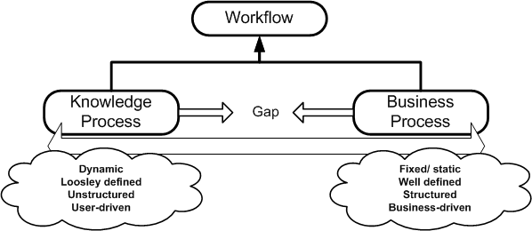
Workflows, Business Processes, Informal Knowledge Process
Workflow is a finite set of sequential/ parallel activities triggered by events.*
Business Process is a collection of sequential/ parallel activities necessary for processing of economically relevant objects.*
Informal Knowledge Process is a collection of loosely defined and ramified activities (actions) necessary for processing of user relevant data.
 | Business Process | Informal Knowledge Process
Goal | Business-goal driven | User-goal driven
Scope | Enterprise | Individual
Structure | Static | Ramified
Description | Formal | Informal
Guided | Externally Coordinated | Ad-hoc/ Spontaneous
Analyzed | Monitored, Analyzed, Optimized | Not Monitored, Emerging
*taken from: Computer/Supported Coorperative Work, Uwe m. Borghoff and Johann H. Schlichter, Springer, 2000

Slide 22
Business Processes & KPs
Business Processes trigger KPs (BPC)
KPs can trigger BPs (KP2)
KPs can connect business processes (KPA-KPB)
KP1
KP2
BP1
BP2
BP3
KPA
KPB
Business Process
BPA
BPB
BPC
Knowledge Process
KP…

Slide 23
Evolving Knowledge Processes
KPs can transform to business processes over time when they become stable and static/ mature
There are KPs without a business process context
  Example:
    Start-ups usually do not have well-defined business process. Knowledge worker just executing knowledge processes
t

Slide 24
Definition
A Knowledge Process (KP) is…
  loosely defined and structural ramified collection of actions.
  not fully defined in terms of structure and the order of action are at its point of initiation
  in which actions require a decision by an actor about the follow-up action.
  in which the actor uses his knowledge and the context to decide for the successor action.
  in which decisions have to been taken during execution time over the process development path and lead to emerging structural ramification constituted by admissible alternatives.
  in which dynamic ramification is the one of the key features.

Slide 25
KP over time
  A knowledge process is a collection of actions (ramified, non-structure at the beginning)
  Actor makes a decision influenced by a driver about a follow-up action out of the admissible actions
  The driver is derived from the state of the context and the environment (situation)
  A follow-up action could trigger another knowledge process

Slide 26
KP-Example: Prepare Presentation
KP#1
(Bob)
A1
Go to url
A2
Identify
information
A3
Copy information
A4
Open Powerpoint
A5
Paste
information
A6
Talk to another person
A7
Save
presentation
KP#2
(Alice)
A1
Go to url
A4
Open Powerpoint
A2
Identify
information
A3
Copy information
A5
Paste
information
A6
Talk to another person
A7
Save
presentation
KP#3
(Bob)
A1
Go to url
A6
Talk to another person
A2
Identify
information
A3
Copy information
A4
Open Powerpoint
A5
Paste
information
A7
Save
presentation
with pre/post
conditions
Knowledge Process:
  Collection of actions
    Ramified
    non-structured
    with constraints
  KP = [a1,a2,a3,a4,a5,a6,a7]
A3
Copy information
A5
Paste
information
A1
Go to url
A2
Identify
information
A4
Open Powerpoint
A7
Save
presentation
A6
Talk to another person
A1
Go to url
triggers
System Event
A2
Identify
information
triggers
non-system Event
A6
Talk to another person
Triggers another
KP

Slide 27
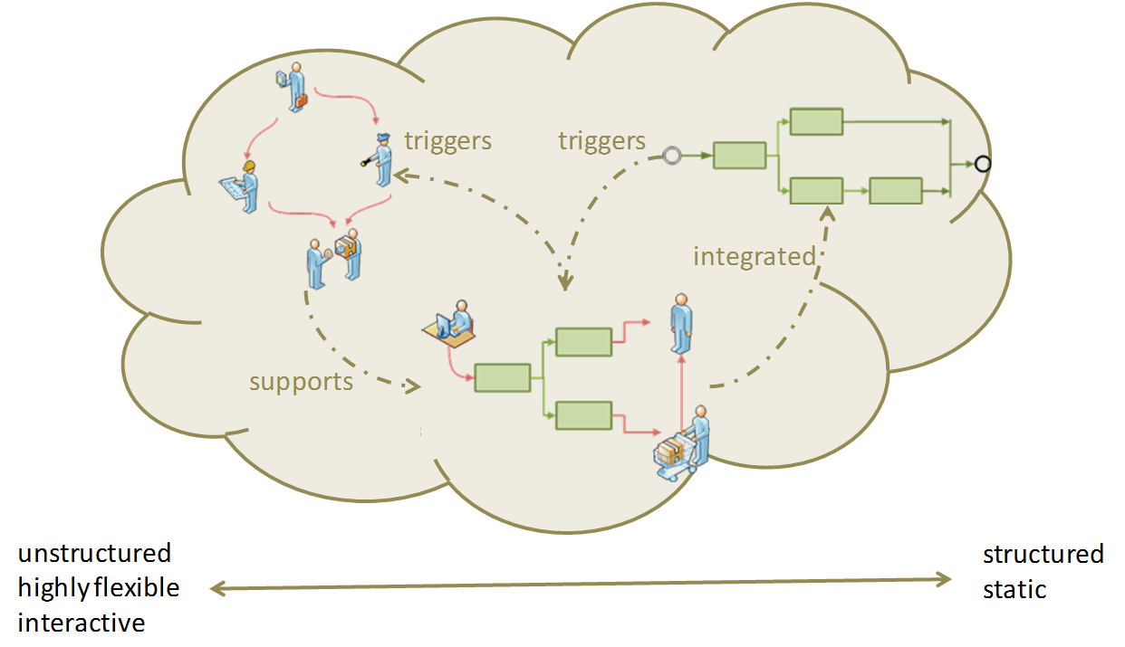
Motivation
Besides formal processes within the enterprise there are several informal processes
  Writing a proposal, scheduling a meeting, preparing a bid …
Use of formal process systems is reserved for enterprise level, not on user level
  Common workflow modelling tools are considered as too complex
Need for a …
  → lightweight
  knowledge worker-driven
  context-aware
  support of informal process
  … solution!

Slide 28
Knowledge Processes in ACTIVE
In ACTIVE we will support knowledge processes with innovative application systems by transforming informal knowledge processes into more formalized knowledge processes.
The developed "formalized knowledge processes" will support knowledge workers in their daily business.
The worker still remains the driver of this process.
The ACTIVE Knowledge Work is going to analyse the informal knowledge processes and tries to identify recurring sequences and patterns within a process of a single person or a team so that tacit knowledge becomes explicit as a result of knowledge process actions
Enhance knowledge workers‘ effectiveness and efficiency

Slide 29
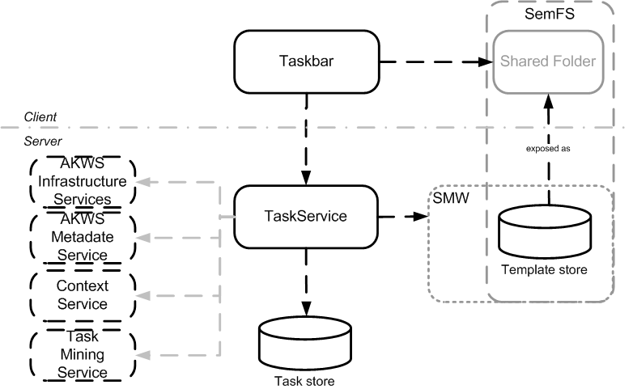
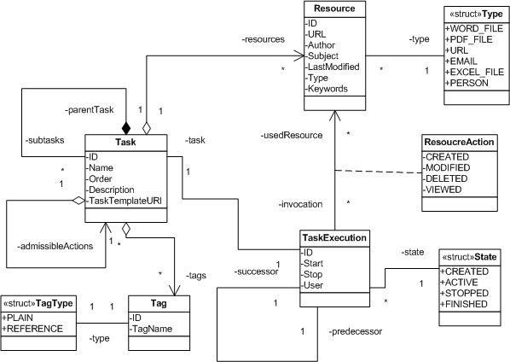
TaskService/TaskBar Integration
Provides methods to store tasks and associate resources
Provides methods to structure and restructure tasks lists during runtime (user-driven)
  lightweight and top-down approach
Logs task executions for mining and prediction
0.66
a3
a1
a2
0.33
a4
a1
a2
a3
a1
a2
a3
a1
a2
a4
a1
a2
a1
a1
a2
a2
a3
a3
a4
t

Slide 30
Task Management as a Web Service
Task[] GetTasks(); | Returns all top level tasks (knowledge process traces) of a specific user from the store
Task[] GetSubTasks(string TaskId); | Returns the next level of tasks for a given parent task from store
string CreateTask(Task NewTask); | Creates a new task (knowledge process trace) as a top level task
string AddTask(string TaskId, Task SubTask); | Adds a sub task to a given parent task
void DeleteTask(string TaskId); | Deletes a task
void UpdateTask(Task Task); | Updates a task; it is important that the ID of the task exists in the store
string AddResourceToTask(string TaskId, Resource Resource); | Adds a resource (file, URL, person) to a task
void RemoveResource(string ResourceId); | Removes a resource from the store
void UpdateResource(Resource Resource); | Updates a resource in the store; it is manadtory that the resource ID exists
string AddTaskInnvocation(string TaskId, TaskExecution NewTaskExecution); | Adds TaskExecution data to a task
void UpdateTaskInnvocation(TaskExecution TaskInnvocation); | Updates TaskExecution data; it is important that the ID of the TaskExecution exists in the store
void RemoveTag(string TaskId, string TagId); | Removes a tag from a task
String AddTag(string TaskId, Tag NewTag); | Associate a task with a tag

Slide 31

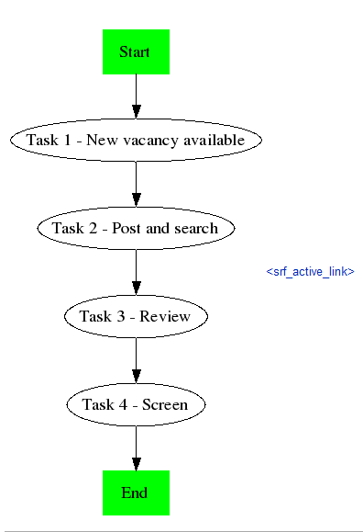

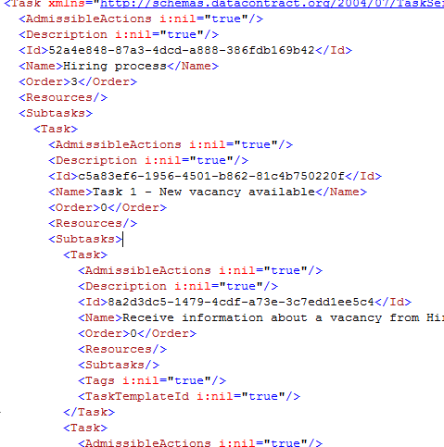
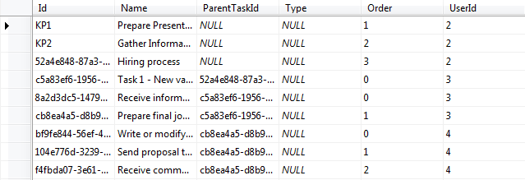
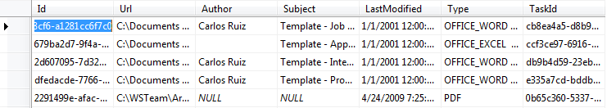
Task Execution (top-down)
<external>
Aperture
Taskbar
Extract Content
<external>
OpenCalais
Extract Tags
KP Templates and Resources
SemFS
Wizard
KP Templates and Resources
Local FS
<WP1>
SMW
TaskService
Logging
TaskService Store
Tasks
Resources

Slide 32
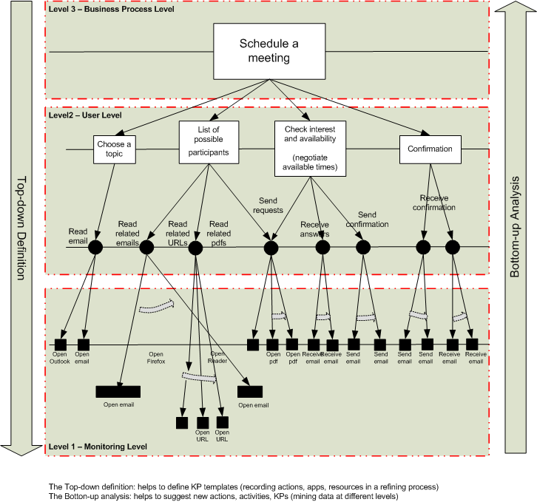
KProcess Execution Level
Schedule a meeting
0.66
a3
a1
a2
0.33
a4
Users
a1
a2
a3
a1
a2
a3
a1
a2
a4
a1
a2
a3
d1=d3
d=diff(C-e)
d1
d2
d3
d4
d5
d6
d7
P2,P3
P2,P3
e1
e2
e3
e4
e5
e6
e7
P1
P4
Events
e1
e2
e3
e4
e5
e6
e7
Context
C1
C2
C3
P1,P2,P3
P2,P3,P4

Slide 33
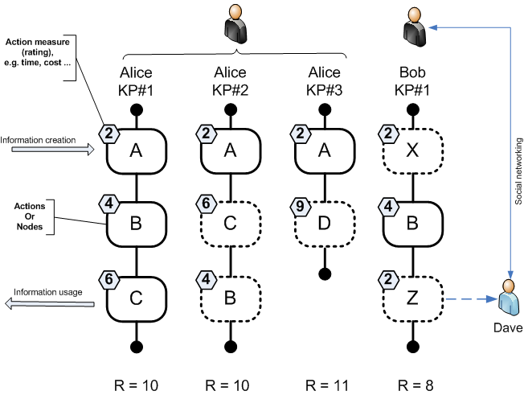



Metrics and Measures for KPs
  Measures
  Size S
    S(G) = count (N)
  Dependability D
    D(G)= count(N_{in})+ count(N_{out})
  Diversity V
  Separability Y
  Structural Complexity SC
  Performance, external costs
User-dependable values
  Skill Value Vector
  Feasibility
Subjective values
  Quality of the result
  Satisfaction with the process

Slide 34
‚Inter‘ – action Matters
How do other use resources/ information?
  Actions, Skills, Experiences
Discover and share Knowledge processes
  Organisation /Social Network
What is the context?
  Business Process, Knowledge Process
People
Conversations
Content
Data

Slide 35
Hot-dog theory
A
F
T
S
G
H
O
I
Knowledge workspace
Enterprise
Inter-prise
Active nodes
Dumb nodes
External nodes
- Active node are specialists that define the process dynamics and can only have an interface to the Enterprise knowledge portals
Dumb nodes are non specialists and are information/data pushers and these roles may be incorporated into the enterprise information systems
- External node are specialists in a sub-process level and therefore should be considered while designing the enterprise information systems

Slide 36
Hot-dog theory
A
F
T
S
G
H
O
I
Knowledge workspace
Enterprise
Inter-prise
Active nodes
Dumb nodes
External nodes
- Active node are specialists that define the process dynamics and can only have an interface to the Enterprise knowledge portals
Dumb nodes are non specialists and are information/data pushers and these roles may be incorporated into the enterprise information systems
- External node are specialists in a sub-process level and therefore should be considered while designing the enterprise information systems

Slide 37
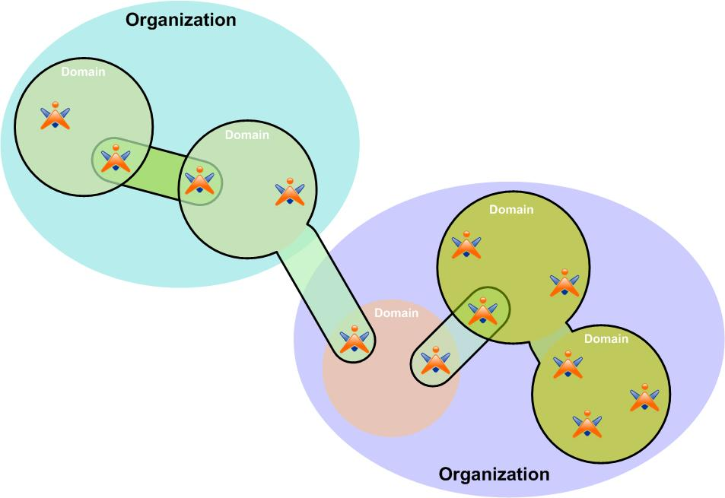
Security-aware Knowledge Processes
Knowledge Processes are defined, used and shared across different administrative groups and domains.
      → Key for enhancing the value of a corporation.
      → Social interactions: virtual boundaries
Security framework:
      powerful,
      flexible,
      semantically rich,
      automate as much as possible
Dependent environment
Principle environment

Slide 38
Security-aware Knowledge Processes
Provide mechanisms to handle security and privacy issues for Knowledge Processes across different domains and organizations
      Semantic security policies and annotations: pose constraints on system’s behaviour and to dynamically control and automate the system options.
      Grid technologies: virtual organization as a transparent approach for enabling distributed applications from multiple administrative domains, with and security requirements
      Trust management: how trust is managed based on their previous user’s interactions in modern open and decentralized systems.

Slide 39
Summary
Informal Knowledge Processes are the norm in certain industries
  Not supported by enterprise applications
Proposed a semi-automated approach
  Combination of Top-down and Bottom-up
  No ‘Auto-Magic’: Magic does not work!
Approach to quantify and evaluate Knowledge Processes
  Make them comparable and reusable
  Support ‘refactoring’ for optimisation
Security and Privacy is important

Slide 40
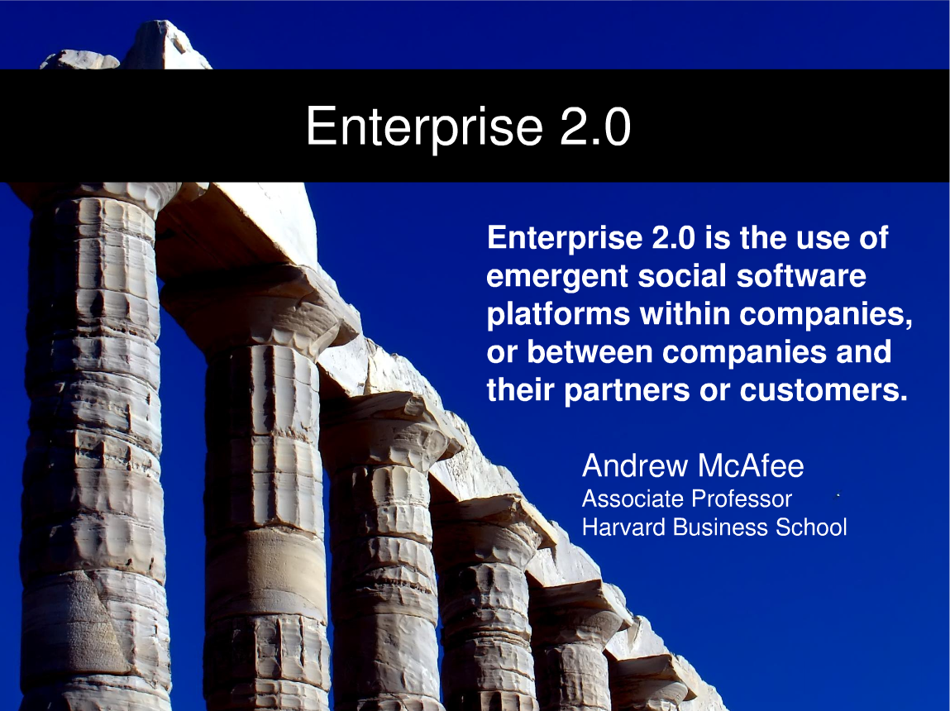

Slide 41
References
Some slides I took from http://www.thecontenteconomy.com/2009/04/slides-from-our-enterprise-20-seminar.html
The “Long Tail” slide is taken from http://ldc.upenn.edu/myl/llog/LongTail.gif
Many Thanks!

Slide 42
Q&A

