Slide 1
Introduction to the ACTIVE Knowledge Workspace SDK
Igor Dolinsek (HERMES SoftLab)
ACTIVE Summer School
September 5t 2009, Bled, Slovenia

Slide 2
Agenda
Introduction to the ACTIVE knowledge workspace
Workspace software architecture
Online demonstration of basic Workspace features
Overview of ACTIVE Software Developer Kit
ACTIVated application - example

Slide 3
Introduction to the ACTIVE knowledge workspace (1)
Partners: HSL, BT, JSI ,EMIC ,iSoco
Goal: Create a software environment for the knowledge worker consisting of an integrated set of context-aware knowledge management tools.
Integrate tools developed in WP1-WP3 and extend off-the-shelf tools like MS Office suite to benefit from ACTIVE technology.

Slide 4
Introduction to the ACTIVE knowledge workspace (2)
How do knowledge workers perform they work and share their knowledge?
Workspace concepts to improve this:
Working contexts
Info resources
Tasks
Transform off-the-shelf tools to fit into the Workspace = ACTIVation

Slide 5
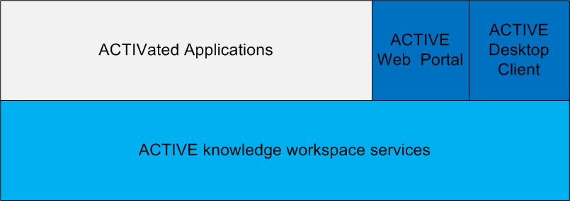
Workspace software architecture (1)

Slide 6
Workspace software architecture (2)
Generic applications
Specialised applications
ACTIVE web portal
ACTIVE taskbar
Metadata
Service
Task
Service
Context
Service
Metadata recommender service
TaskMining Service
ContextMining Service
Workspace infrastructure services

Slide 7
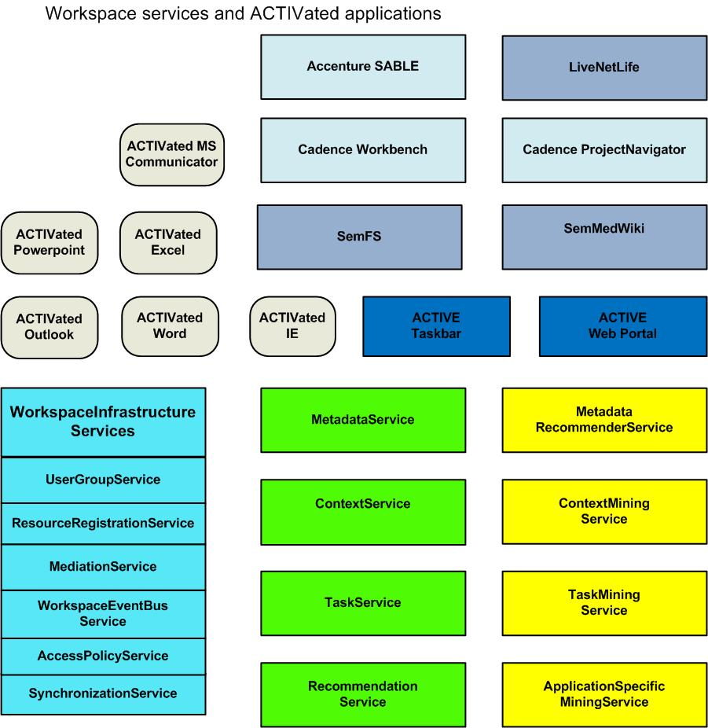
Workspace software architecture (3)

Slide 8
Workspace software architecture (4)
Inter-service communication
Web services (WSDL/SOAP & RESTful )
Apache ActiveMQ Event bus: messaging & publish/subscribe: XML schema

Slide 9
Online demonstration of basic Workspace features
Demo version of Workspace at:
http://hope.ijs.si:3000/login
Username: guest, password:guest
Demo limitations
Workspace download for research purposes: under consideration

Slide 10
Overview of ACTIVE Software Developer Kit
WSDLs for Web services
XML schemas for event messages
C# APIs useful for ACTIVated applications
C# APIs for Task Service
Ruby APIs for Infrastructure services
Online SDK documentation

Slide 11
Overview of ACTIVE Software Developer Kit (2)
Three levels of ACTIVated applications
Basic level: activity monitoring
Intermediate level: context filtering and context switch support
Advanced level: process support built into the application’s GUI.

