Slide 1
A professional messaging utility for distributing relevant information within enterprise in real-time.

Slide 2
Agenda
Project and Team
Market Overview of Microblogging
Key-Features of Lizzon
Classification of Enterprise Tools
Notes:
Short introduction of team, which cannot be here

Slide 3
About the Project
Initiated by FIR and Microsoft
Addressed to students of RWTH
In context of ACTIVE SummerSchool
Discussion group on Web2.0
Idea on enterprise communication tool
Independent project group formed

Slide 4
Team Lizzon
Felix Jordan Project Leader | Golo Meißner Business Analysist | Julian Krenge Software Architect
Notes:
Studies: industrial engineers

Slide 5
Agenda
Project and Team
Market Overview of Microblogging
Key-Features of Lizzon
Classification of Enterprise Tools

Slide 6
Gartner‘s Hype Cycle for Emerging Technologies
Visibility
Microblogging in 200
8
9
→ Mainstream adoption in 2 – 5 years
Time
Technology
Trigger
Peak of
Inflated
Expectations
Trough of
Disillusionment
Slope of
Enlightment
Plateau of
Productivity
Notes:
Explain phases of Lifecycle
Development of Microblogging
Tech Trigger: Human Augmentation, Quantum computing
Peak: Cloud Computing, E-book readers
Trough: Public virtual worlds, Phone payment
Enlightment: Wikis, SOA

Slide 7
Microblogging Platforms
Social microblogging:
Established software vendors: Enterprise Social Messaging Experiment (SAP), OraTweet (Oracle), BlueTwit (IBM)
Dedicated microblogging provider: Yammer, SocialCast, Socialtext Signals, HeadMix, Co-op
Open source microblogging: Laconica, Jisko
Twitter, Identica
Notes:
…and many more
Yammer (and SocialCast) lead market
Identica based on Laconica

Slide 8
Agenda
Project and Team
Market Overview of Microblogging
Key-Features of Lizzon
Classification of Enterprise Tools

Slide 9
Features
 | Yammer | SocialCast | ESME | Twitter | Laconica
Own server
Web interface
Attachments
Shortener Service
Groups
Tagging
Orga charts
Notes:
Attachments: Duplicate file
Shortener Service: No info about destination
Tagging: (SocialCast: categorisation: unconvenient)

Slide 10
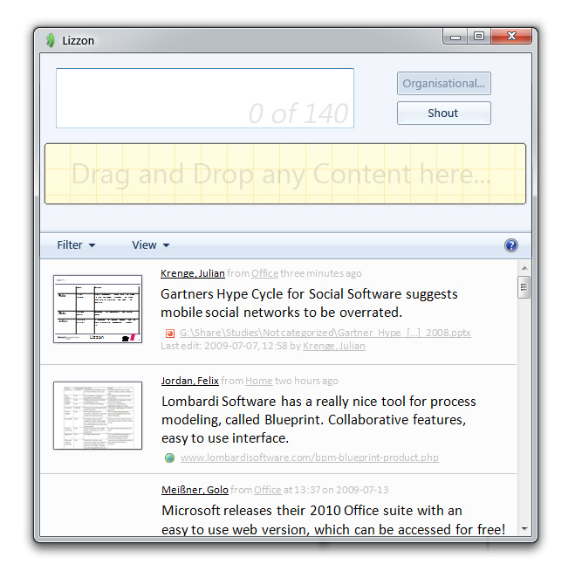
Principles
Sharing knowledge fast and easily
Accessing knowledge directly
User-friendly interface
Notes:
Explain interface:
Input: Text, Tags, nothing
Drag and Drop: Anything
Keep at minimum

Slide 11
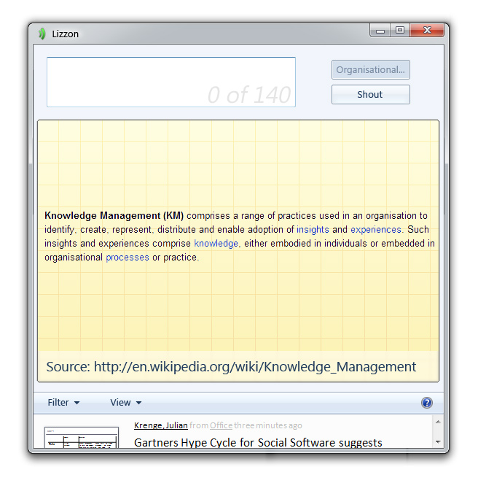
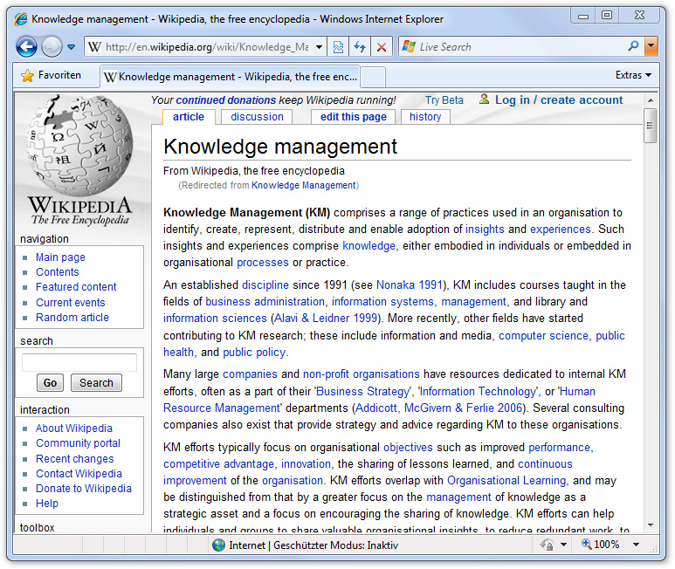
Key-Features
Advanced Resource Publishing
Drag and Drop any content
Preview of content
Automatic detection of source
Notes:
Explain source-detection

Slide 12
Key-Features
Generic Tagging
knowledge
Gather tags from content and source
Define tags for users by their profile
Information input
Behaviour within Lizzon
micro-
blogging
soft-
ware
Lizzon
communicate
tag
enterprise
content
information
Notes:
Get tags from input, extract or source

Slide 13
Key-Features
Knowledge Map
Shouting on this topic
Listening to this topic
Favourising shouts of this topic
Shows all employees expertise on any topic
Enables direct identification of specialists
Listening to this topic
Shouting on this topic
Listening to this topic
No relation at all
Notes:
Merge topics to create overall knowledge map

Slide 14
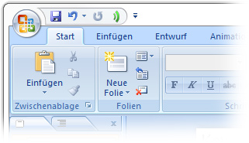
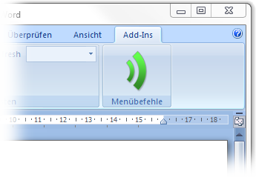
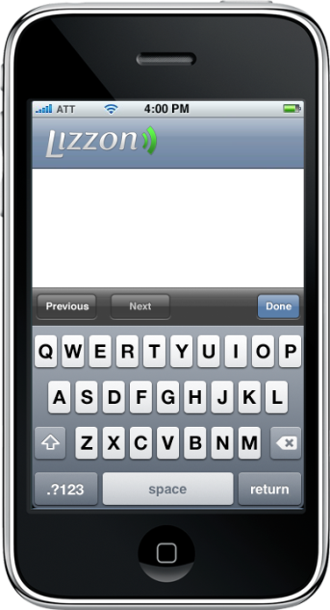
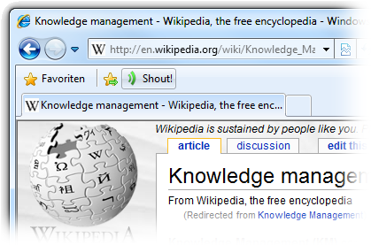
Key-Features
Integrate with existing tools
Desktop-Software, Bookmarklet, Office-plugin
Applications for mobile devices
Web interface

Slide 15
Features
 | Lizzon | Yammer | SocialCast | ESME | Twitter | Laconica
Own server
Web interface
Office Plugins
Attachments
Shortener Service
Source detection
Groups
Tagging
Generic Tagging
Orga charts
Knowledge Map
Notes:
Groups are useless
Orga Charts

Slide 16
What can you do?
Knowledge Worker
Stay up to date on your topics
See state of the art on certain topic
Identify specialists within enterprise
Sharpen your profile as a specialist
Management
Identify assets of knowledge workers
Notes:
Why should KWs participate?

Slide 17
Agenda
Project and Team
Market Overview of Microblogging
Key-Features of Lizzon
Classification of Enterprise Tools
Notes:
Classification to make presentation round

Slide 18
Classification of enterprise tools
ERP, CRM
BluePrint, ProWim
ActionBase,
BlueKiwi, Lizzon
Standardised
Flow
Diagram
Dynamic
Flow
Diagram
Best Practices & Service Patterns
Standardised
Flow Diagram
Dynamic
Flow Diagram
Events and
Actions
formal
semi-formal
informal
Number of repetitions
Use of knowledge
Ability of formalisation
Notes:
Cover only left part of long tail

Slide 19
Thank you for Lizzon-ing.

Slide 20
Why not groups? – Status quo
Any Group
Topic

Slide 21
Why not groups? – Avoid detour
Any Group
Topic

Slide 22
Why not groups? – Subtopics
Topic
Sub-topic

Slide 23
How Hierarchies Work
Enterprise
Project

