Slide 1
Multiple Target Localisation at over 100 FPS
Simon Taylor
Tom Drummond
Department of Engineering
University of Cambridge, UK
This work was supported by The Boeing Company

Slide 2
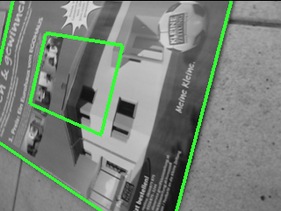
Problem: Fast Localisation
Known Target
Camera Image
Localised Target

Slide 3
Local Feature Methods
Interest Region Detection
Region Matching
Descriptors
Classifiers
SIFT
Randomised Trees
MOPS
GLOH
Ferns
Notes:
Factor out common image transformations (translation, rotation, scale, affine...)
Match query regions to database ones
...despite appearance differences which remain after region detection

Slide 4
Quantised Patches
Sparsely sampled 8 x 8 rectangular patch
Quantised relative to μ and σ of samples
Original Image Patch
Quantised
Image Patch
Sparse Sampling

Slide 5
Training Set
Artificially warped views of entire target from different viewpoints
Grouped into “viewpoint bins”
Scale Bin 4
Scale Bin 8
Viewpoint Centre
Warped Views
Viewpoint Centre
“Reference Frame”
Warped Views

Slide 6
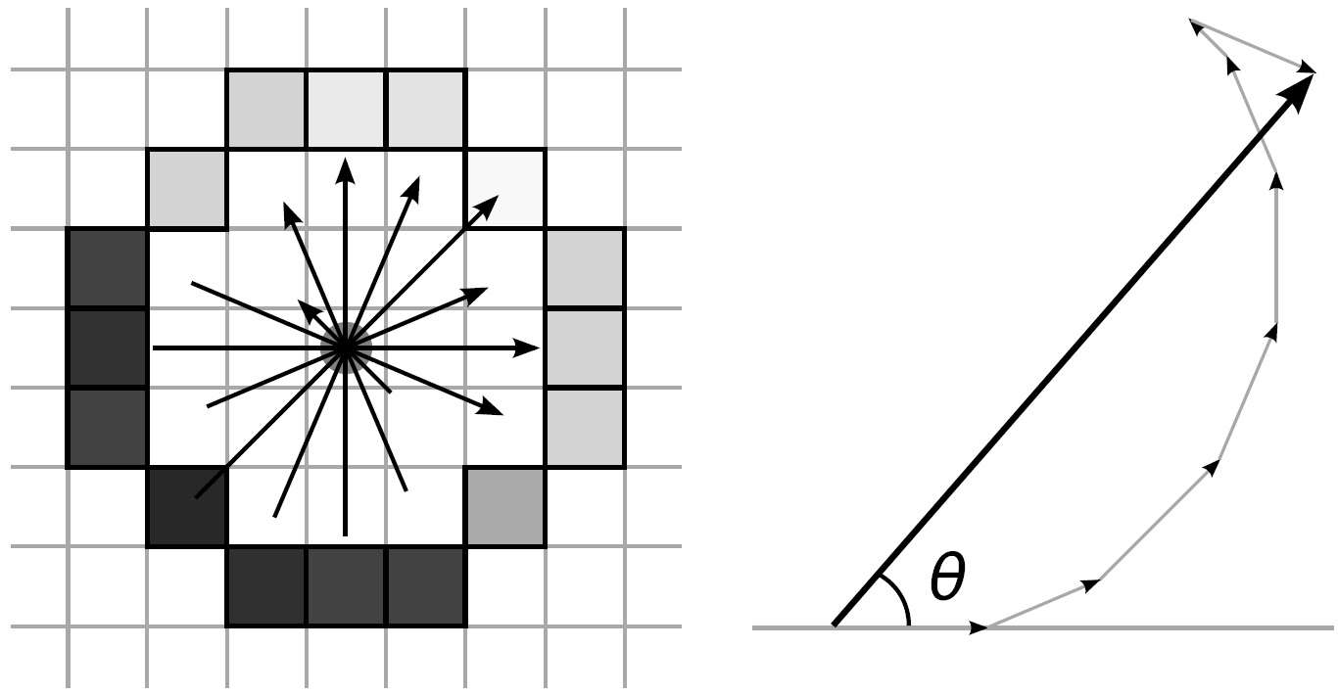
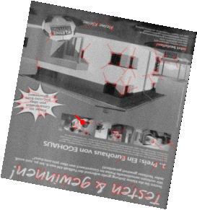
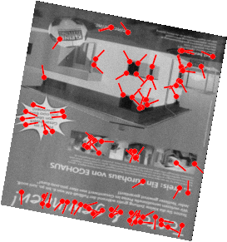
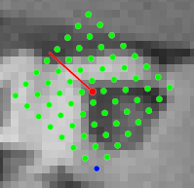
Extracting Subfeatures
FAST-9 Interest Points
Orientation Estimation→
Rotate Sampling Grid
Bilinear Sampling
Quantisation
Notes:
Show interest points detected in 3 images (r, g, b)
Show one with the quantised patch

Slide 7
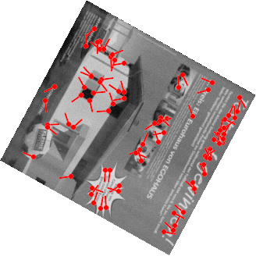
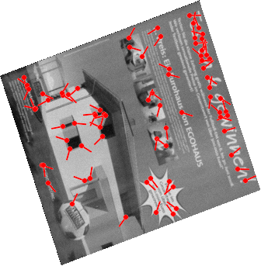
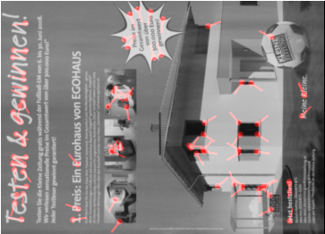
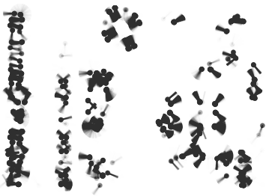
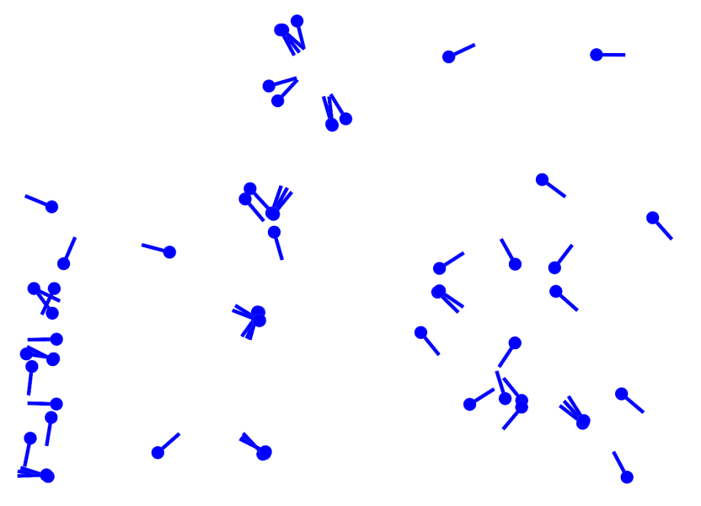
Clustering Subfeatures
Known warp
Select most
repeatable
Notes:
Warp previous images into reference frame
Show 2 demo clusters

Slide 8
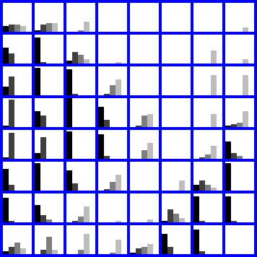
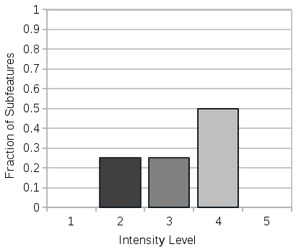
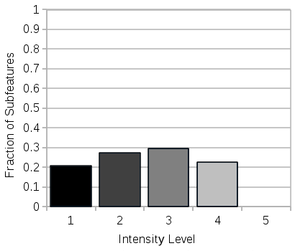
Histogrammed Intensity Patches
Histogram of intensity for each sample
... 1081 subfeatures in total

Slide 9
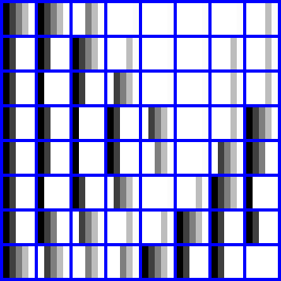
Binary Representation
Histogram values quantised to 1-bit
40 bytes per feature model
00001 00001 11000 11110

Slide 10
Dissimilarity Score
Count of pixels in “rare” bins for a feature
Matching Patch
00010 00010 00001 00001 … - Patch
00001 00001 11000 11110 … - HIP
00000 00000 00000 00000 … - ANDed
Bitcount(ANDed) = 0+
Non-matching Patch
10000 10000 10000 10000 … - Patch
00001 00001 11000 11110 … - HIP
00000 00000 10000 10000 … - ANDed
Bitcount(ANDed) = 2+
00001 00001 11000 11110

Slide 11
Binary Tree Lookup
Exploits similarity between HIPs to avoid exhaustive search
010100011
011010100
011010100
011010100
010010100
011010101
010100011
011010101
010100011
110010100
110010100
001100010
000100010
001100010
001100010

Slide 12
Viewpoint Consistency
Hough transform on target ID, scale, rotation
Check vector between matches is reasonable

Slide 13
Comparison with Wagner et al. 2008
Ad Book Cars Map Panorama Photo Vienna
Wagner et al. 2008 tested on 7 sequences
Total frame time around
5ms on average
Around 96% of frames
localised successfully

Slide 14
Comparison with Wagner et al. 2008
Over 4x faster
More robust
Memory usage 5-10 times lower

Slide 15
Multiple Target Localisation

Slide 16
Multiple Target Localisation
Under 7.5ms with all 7 targets in database
Small robustness penalty from
Additional matching targets
Indexing

Slide 17
Conclusions
Classification-based matching can provide robust and fast localisation
HIPs provide a memory and computationally efficient model for features
Training phase can limit the impact of fast but inaccurate region detection approaches
Tree-based lookup allows exact classification results without exhaustive comparison

