Slide 1
3D-Assisted Facial Texture Super-Resolution
Pouria Mortazavian, Josef Kittler, William Christmas
Centre for Vision, Speech and Signal Processing
University of Surrey
p.mortazavian@surrey.ac.uk
10 September 2009

Slide 2
Super-Resolution:
Given a number of low-resolution observations from the same scene/object, estimate a high resolution image of that scene/object.

Slide 3
Super-Resolution:
Given a number of low-resolution observations from the same scene/object, estimate a high resolution image of that scene/object.
Reconstruction-based
Example-based
Object-specific

Slide 4
Maximum aposteriori estimation:

Slide 5
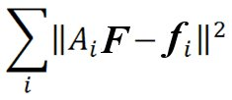
Generative Model :
Maximum aposteriori estimation:
Likelihood:
SR constraint: The HR image, when appropriately warped and down-sampled should yield the LR input images.
f_{i} = A_{i} . F + η_{i}
A : Warp, Blur, Down Sampling
η : Pixel noise
- log
~
A₂
A₃
A₁
A₄
L₁
L₂
L₃
L₄

Slide 6
Face Hallucination:
[Baker and Kanade, PAMI 2002]
Likelihood
- log
~
Prior:
Gradient Prediction
- log

Slide 7
Face Hallucination:
[Baker and Kanade, PAMI 2002]

Slide 8
3D Morphable Model:
A 3D Morphable face model represents each face by a set of model coefficients, and generates new, natural-looking faces from any novel set of coefficients.
3D structure of a known face is captured in shape and texture vectors

Slide 9
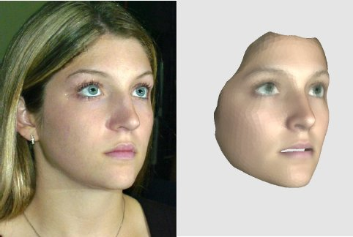
Fitting the 3DMM to 2D Images:
Model parameters (α, β, ρ) are optimized using a MAP estimator such that the appearance of the model matches that of the 2D image.
Image taken from J.R. Tena Rodr´ıguez’s PhD thesis: “3D Face Modelling for 2D+3D Face Recognition”

Slide 10
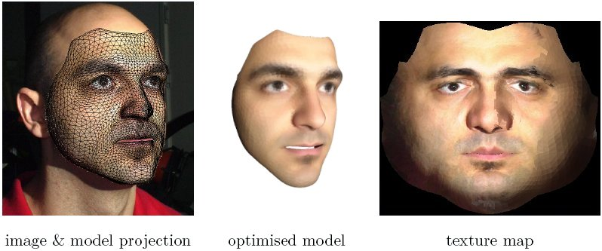
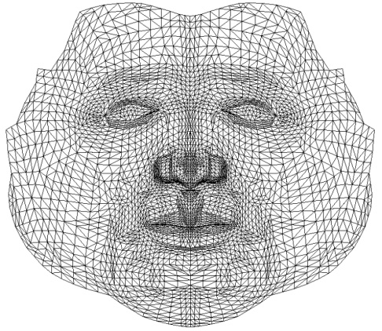
Texture Extraction:
Once the model is fitted on a 2D image, we can extract the texture from the input image and map to a pre-defined, shape- and pose- normalized coordinate frame:
Image taken from J.R. Tena Rodr´ıguez’s PhD thesis: “3D Face Modelling for 2D+3D Face Recognition”

Slide 11
3D-Assisted SR:

Slide 12
3D-Assisted SR:
Texture SR
Model Fitting

Slide 13
3D-Assisted SR:
Texture SR
Model Fitting
Assuming μ and ρ have a dense distribution which peaks at their optimal
value (obtained by model fitting), the above simplifies to:

Slide 14
3D-Assisted SR:
let:
Assuming t has all information available in f :

Slide 15
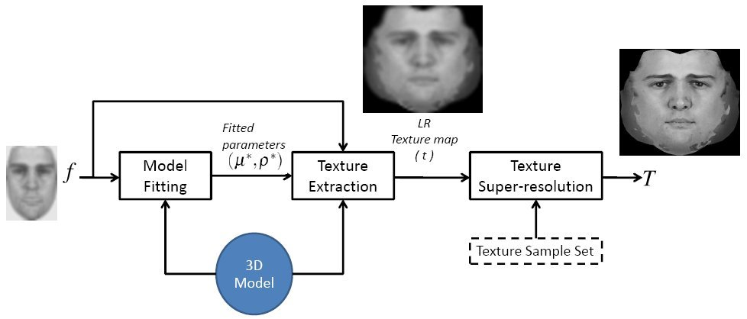
3D-Assisted SR:

Slide 16
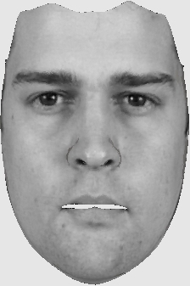
3D-Assisted SR:

Slide 17
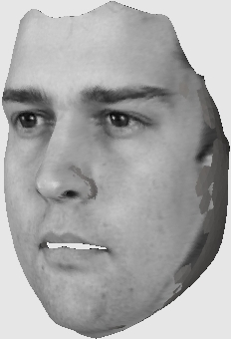
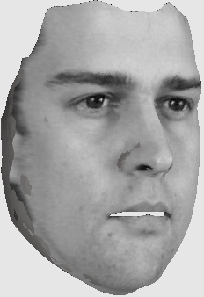
3D-Assisted SR:

Slide 18
Likelihood:

Slide 19
Likelihood:
Prior:
Gradient Prediction:

Slide 20
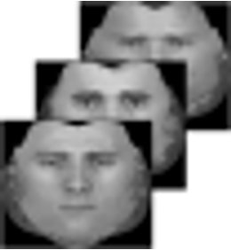
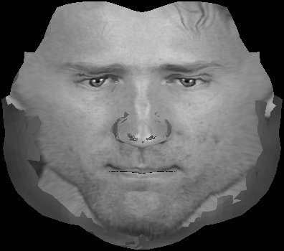
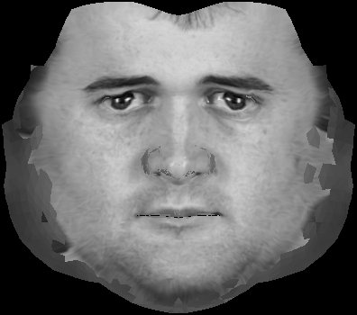
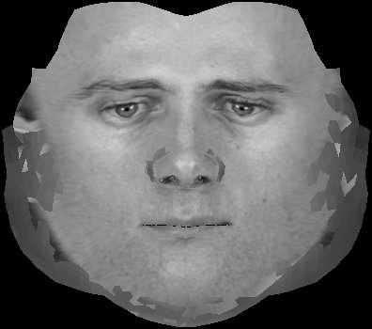
Likelihood:
Prior:
Gradient Prediction:

Slide 21
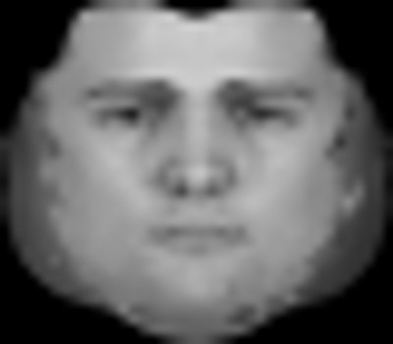
Likelihood:
Prior:
Gradient Prediction:

Slide 22
Likelihood:
Prior:
Gradient Prediction:

Slide 23
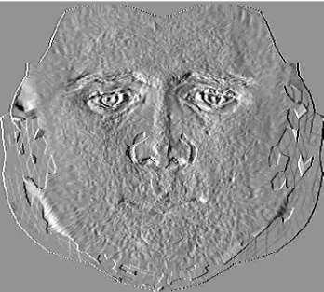
Likelihood:
Prior:
Gradient Prediction:

Slide 24
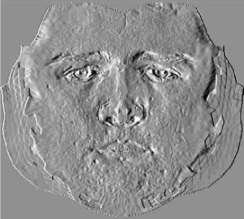
Likelihood:
Prior:
Gradient Prediction:

Slide 25
Likelihood:
Prior:
Gradient Prediction:

Slide 26
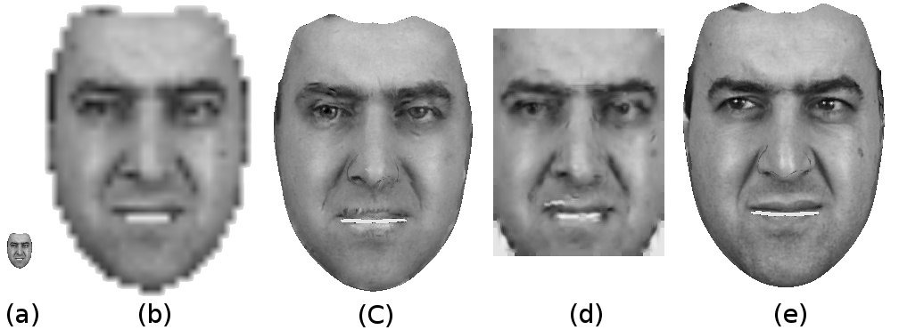
Results:

Slide 27
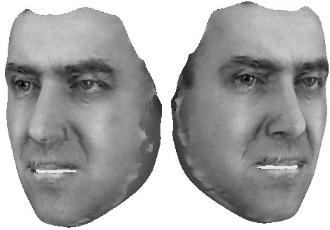
Results:

Slide 28
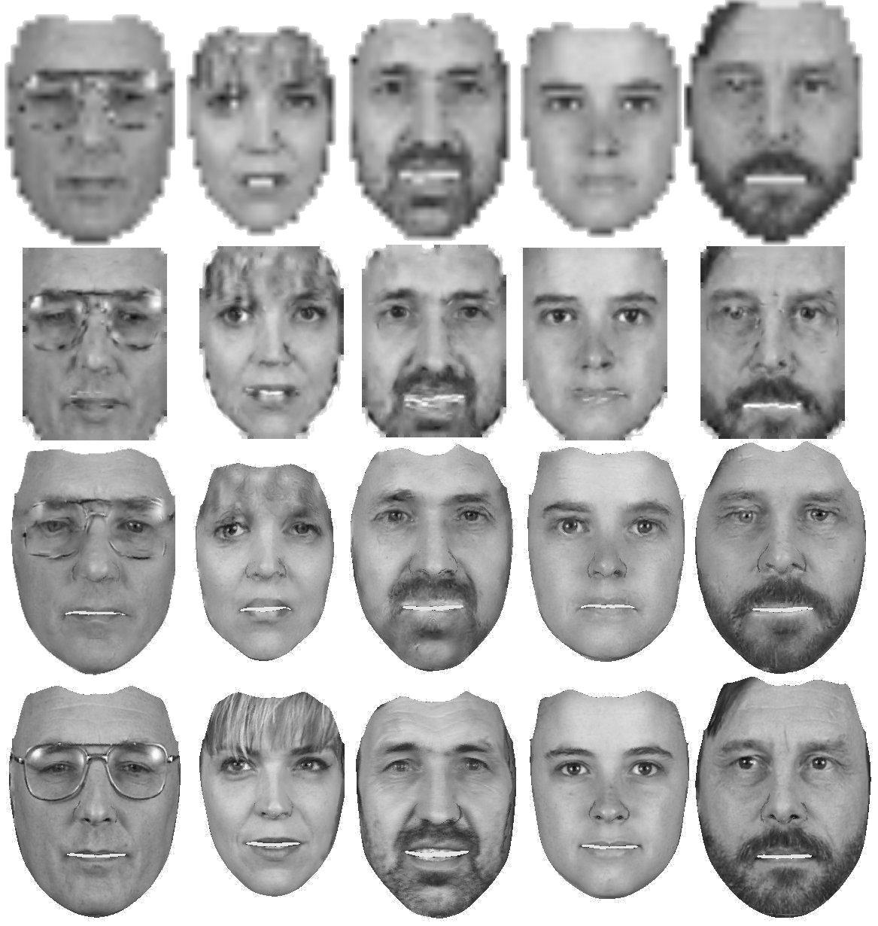
Results:

Slide 29
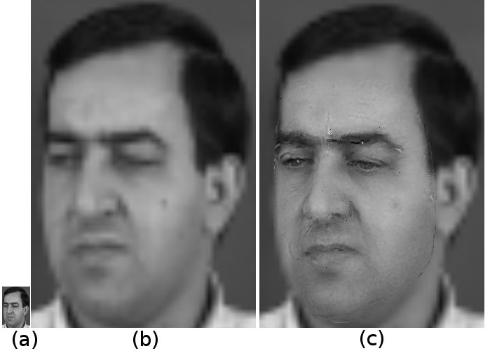
Results:

Slide 30
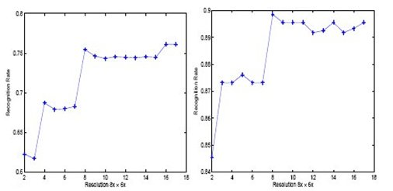
Results (Face Recognition):
Resolution of the input image can affect recognition performance
PCA
LDA
* J. Wang, C. Zhang, H. Shum, ” FACE IMAGE RESOLUTION VERSUS FACE RECOGNITION PERFORMANCE BASED ON TWO GLOBAL METHODS“, Proceedings of Asia Conference on Computer Vision (ACCV’04)

Slide 31
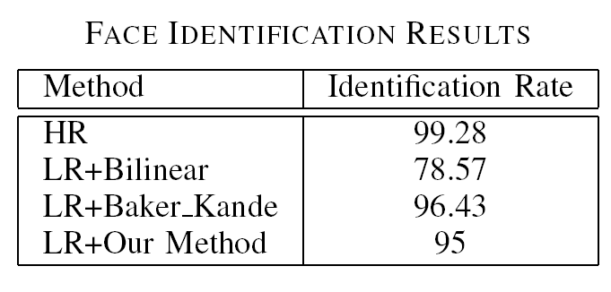
Results (Face Recognition):
Resolution of the input image can affect recognition performance
PCA
LDA
* J. Wang, C. Zhang, H. Shum, ” FACE IMAGE RESOLUTION VERSUS FACE RECOGNITION PERFORMANCE BASED ON TWO GLOBAL METHODS“, Proceedings of Asia Conference on Computer Vision (ACCV’04)
XM2VTS
LBP histograms + LDA
Normalized Correlation
3 samples for training and 3 for test

Slide 32
Conclusions:
Our framework can deal with pose-independent face super-resolution.
The results obtained are visually comparable to Face Hallucination in the image domain.
The proposed method can provide additional information for face recognition.
Model fitting on low-resolution images is not ideal and can degrade the results. However, its effect is not detrimental to the final result.

Slide 33
Thank You

