Slide 1
What Stops Social Epidemics?
Greg Ver Steeg
Rumi Ghosh & Kristina Lerman
USC Information Sciences Institute
Notes:
Intro/coll.

Slide 2
Information, viruses, etc. spread from
node to node on a network
Infected
Not Infected
Transmissibility, λ
= Probability to infect your neighbor
Notes:
We’re talking about spreading processes on networks.
In general, we have a directed network, and we start with some infected node
1 – the seed node is able to infect his neighbors. Each neighbor is infected with probability lambda, transmissibility
2 – these nodes in turn can infect their neighbors
Call it info cascade

Slide 3
What is an epidemic? We observe many cascades that:
Grow quickly initially
But remain too small for standard (viral) epidemic models
Information cascades differ:
Response to repeated exposure is important on Digg (and Twitter)
Drastically alters predictions about size of epidemics
Notes:
First, I want to present this puzzle
Found at least one part of this puzzle is that standard epidemic models are designed for disease spread, but information spread operates very differently, In particular, with respect to repeat exposure. This drastically alters predictions about epidemic size.

Slide 4
What is an epidemic?
On an infinite graph, an epidemic is any process that spreads to a fraction of all the nodes
1
Fraction of nodes infected
Epidemic threshold
predicted for many
cascade models
0
Transmissibility, λ
Notes:
One of the fundamental results in networks research
How do things look on a real network?

Slide 5
Social news:
Users submit or vote for (infected by) news stories
Social network
Users follow ‘friends’ to see
Stories friends submit
Stories friends vote for
Trending stories
Digg promotes most popular stories to its Top News page

Slide 6
Distribution of cascade size on ------
#nodes ∼300k
Most cascades less than 1% of total network size!
A small fraction is still a fraction, though, right?
Notes:
We looked at cascades on Digg, a social news network.
On Digg, the seed node submits a news story, his friends on the social network can see this and choose to vote for the story, i.e. they are infected. Their friends can then see the story and vote, etc.
We looked at cascades for many stories over a month long period in 2009
Although the network of active users had 300k nodes, fewer than 1% participated in most cascades.

Slide 7
Why are these cascades so small?
Standard model of epidemic growth
(Heterogenous mean field theory, SIR model, same degree distribution as Digg)
Most cascades fall in this range
λ, Transmissibility
Transmissibility of almost all Digg stories fall within width of this line?!
Notes:
Standard epidemic model, how should cascade sizes look as a function of lambda?
First, we should have a threshold, predicted by several models.
Now, look at cascade sizes, what does this tell us about transmissibility of our stories. (!)

Slide 8
Maybe graph structure is responsible?
← Mean field prediction (same degree dist.)
← Simulated cascades on a random graph with same degree dist.
Simulated cascades on the observed Digg graph
epidemic threshold
transmissibility λ
clustering reduces epidemic threshold and cascade size,
but not enough!
Notes:
First explanation might be graph structure. Mean field neglects rich cluster structure and finite graph effects. In this graph, we changed back from a log-log to see these small differences.
We simulated cascades on graphs to see how structure affected cascade size.
Finite, random graph, same dd. Slightly reduces cascade sizes. On a finite graph, unavoidable loops and clustering.
On Digg graph, there is even more structure. Reduces threshold, smaller cascades.
And yet, still doesn’t jibe with our observed cascade sizes…
kL:
We also observe the existence of a threshold of transmissibility both in case of random and actual graph, below which the cascades die out. Clustering leads to the lowering of this threshold. We observe that clustering does limit the size of the cascades with the cascade sizes on the random graph being bigger than in the actual digg graph with the same transmissibility.
The golden line shows the expected size of cascades
Using the heterogeneous mean field (HMF) theory which predicts the cascade size taking the log tail degree distribution into account in the limit of large graphs . For the random graph, the epidemic threshold and the cascade sizes are very close to what is predicted by the heterogeneous mean field theory on epidemic spread, shown by the golden line
Because the randomized graph is still finite, some clustering inevitably occurs (it
has a clustering coefficient of about 0.02), decreasing the cascade size from the HMF
prediction.

Slide 9
What about the spreading mechanism?
Infected
Not Infected
?
Independent
Cascade Model implicit in many epidemic models
Notes:
If not structure, maybe the spreading mechanism has some effect?
Very simple mechanism, but not without choices
We have to decide what to do about repeat exposure. Is this a big effect?

Slide 10
How important are repeat exposures?
More than half exposed to a story more than once!
Notes:
On this graph we have the probability of having exactly n friends voting. It’s on a log-log plot with a longish tail. Significant probability of having 10 friends voting. More than half are exposed more than once.
Clearly, repeat exposures are important. So how do people respond?

Slide 11
How do people respond to repeated exposure?
Not much.
We have similar results for
Twitter -------
Also noted by Romero, et al, WWW 2011
Notes:
The answer is not much. If we look at the probability to vote on a story given that n friends have voted one it, you see that having 30 friends voting doesn’t make you significantly more likely to vote than if you have 1 friend voting. In the ICM, for example, if the probability after one friend voting is lambda, there is an independent probability lambda for each subsequent friend voting.
We’ve also noticed a deviation from ICM for our data on Twitter, and a similar observation has been reported. But, now the important question; what is the effect of this observation?

Slide 12
Big consequences for epidemic growth
Most people are exposed to a story more than once
Repeated exposures have little effect
Growth of epidemics is severely curtailed (especially compared to Ind. Cascade Model)

Slide 13
Weak response to repeated exposure
Take effect of repeat exposure into account:
Actual Digg cascades
Result of simulations
Epidemic threshold unchanged
λ*
λ*, Transmissibility
Notes:
Back to our graph of cascade size as a function of transmissibility.
Now, we simulate cascades again, only taking into account the graph structure and fact that repeated exposure doesn’t increase prob vote
Predicts threshold
And match cascade size perfectly, orders of magnitude smaller than viral epidemic predictions. That’s really nice, essentially a zero parameter fit. But we can explain more than just cascade size.

Slide 14
Also explains dynamics
Number of new people exposed to a story (who don’t vote on it)
Number of new people exposed to a story (who do vote)
Notes:
Let’s compare the simulated cascades and Digg cascades again, but this time we’ll look at each point in the story, after the i-th person has voted.
The question is, how many new fans are reached by the i-th voter. The top lines are new fans who don’t end up voting, the bottom, ones who do.
Note the y-axis is a log scale, this is dropping very quickly! There’s no need to take decay of novelty into account, here we have a decay of fresh faces!

Slide 15
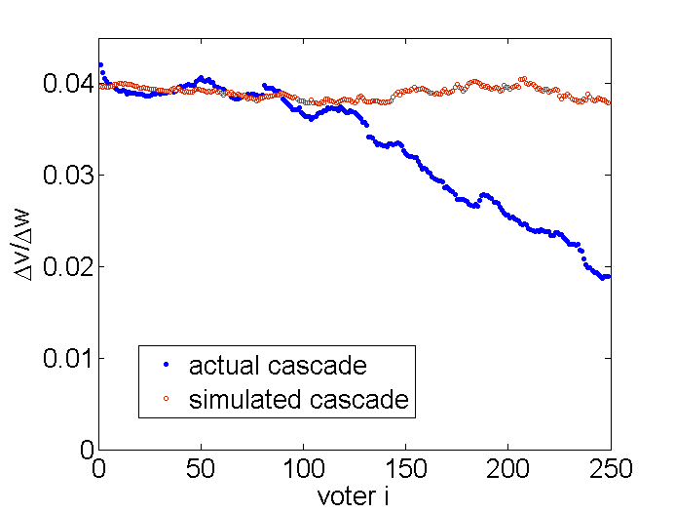
Transmissibility: the percentage of new people exposed who end up infected/voting
Approximate time of story promotion to front page
Notes:
In fact, transmissibility needs to be redefined based on our model. Only freshly exposed people are likely vote, so we should look at the fraction of freshly

Slide 16
Structure + Behavior
Accurate
model
of behavior
Independent
cascade
model
Accurate
model
of behavior
Notes:
One last theme I’d like to drive home: in this case it was important to take
Structure AND behavior into account.

Slide 17
Summary
Information spread ≠ Disease spread
Big consequences for epidemics
Repeat exposures are important on Digg and Twitter
On Digg, people don’t respond to repeat exposure
Drastically reduces size of epidemics
Data available! http://www.isi.edu/~lerman/downloads/digg2009.html

Slide 18
Decay of novelty

Slide 19
Weak response to repeated exposure
Standard model of epidemic growth
(Heterogenous mean field theory, SIR model, same degree distribution as Digg)
λ*
Notes:
Fine tuning of transmissibility

Slide 20
What is an epidemic on a finite graph?
Infected
Not Infected
We would call this an epidemic, right?
And now?
Epidemics saturate the graph
Notes:
Put in different

Slide 21
What is an epidemic on a finite graph?
Same number of red dots
Epidemics saturate the graph
Notes:
Put in different

Slide 22
Sub-epidemic cascade size
Reproductive number, R₀ is the average number of new spreaders reached by each spreader.
R₀ < 1 ⇒ No Epidemic
Average number of friends
Transmissibility

Slide 23
Transmissibility of almost all Digg stories fall within width of this line?!
Notes:
Independent of Graph size
Small epidemic on a finite graph?
Range of stories for digg

Slide 24
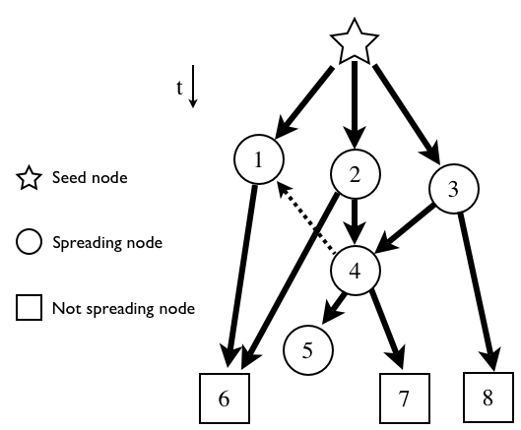
Saturation on a real graph
Notes:
Multiple incoming arrows

